Slide 1
Update from the Joint CEOS-CGMS Working Group on Climate Agenda item 4.5
Jeff Privette, NOAA
Wenying Su, NASA
39th CEOS SIT
10 April 2024
Tokyo, Japan

Slide 2
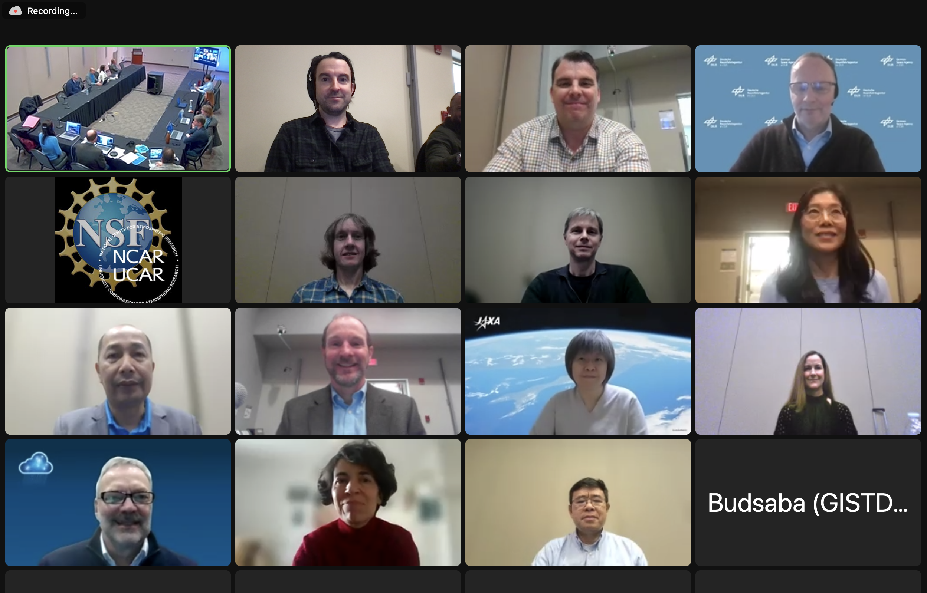
Recent Major Events and Activities
Delivered CEOS-CGMS Statement for SBSTA at COP-28 to CSA
WGClimate-20 hosted by NOAA-Boulder (March)
Top 2024 Priorities (all in CEOS Work Plan)
Conduct remaining work on Space Agency Response to GCOS Implementation Plan (IP)
Complete Gap Analysis Report (v3/4.1)
Update Coordinated Action Plan
Update, restructure and rename ECV Inventory
Submit journal manuscript on climate records definitions
Nominate Vice-Chair: Vincent-Henri Peuch (ECMWF)

Slide 3
Warm Welcome to New Members
GISTA (Geo-Informatics & Space Technology Development Agency), Thailand
Pakorn Petchprayoon
Budsaba Uamkasem
Kanjana Koedkurang
SANSA (South African National Space Agency), South Africa
Lerato Shikwambana
Nale Mudau
USGS (U.S. Geological Survey), United States
Kimberly Casey
Kelly Bruno
George Xian
UKSA (U.K. Space Agency), Britain
Gareth Thomas

Slide 4
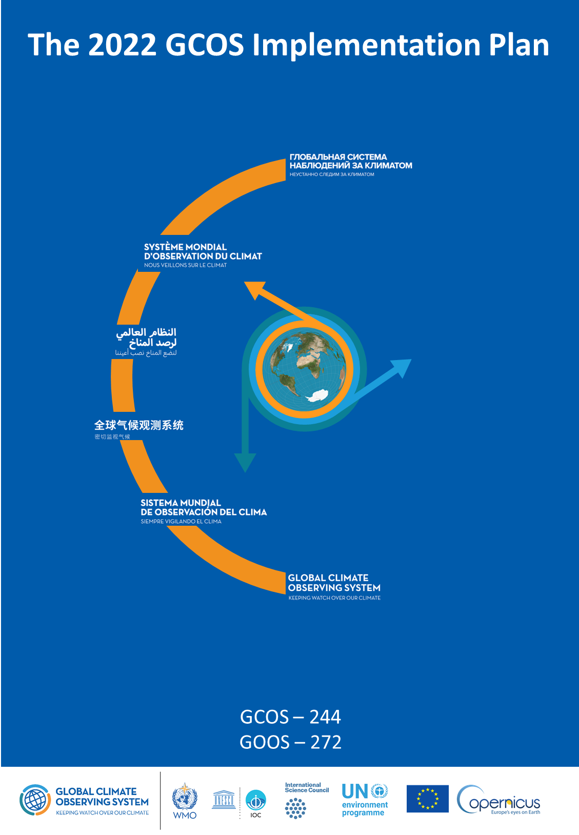
1. Agency Response to GCOS IP (2022)
Purpose
Describes needs/gaps in Global Climate Observing System
Produced every 5-6 years
2022: GCOS provided 16 Actions, each with multiple Activities
WGClimate addressing with a two-phase response
Completed 21 Activities in 2023 (more straightforward)
Addressing similar number in 2024 (more complex)
Submission to CEOS and CGMS Principals: mid-2025

Slide 5
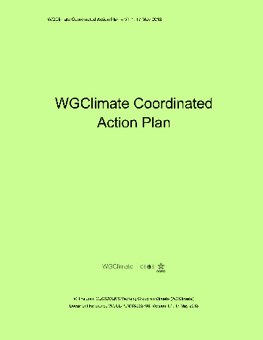
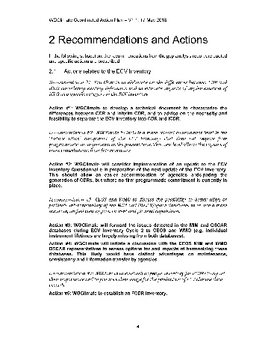
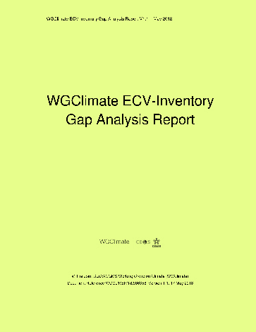
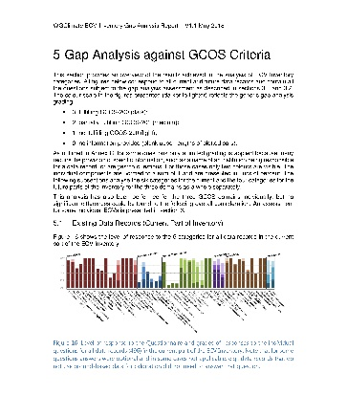
2-3. Core Documents Update: Context
ECV Inventory
WGClimate
Climate Experts
Improved CDRs
Gap Analysis
Data producers
Improved observing system
Coordinated Action Plan
WGClimate
CEOS / CGMS

Slide 6
2-3. Core Documents Update: Context
ECV Inventory
WGClimate
Climate Experts
Improved CDRs
Gap Analysis
Data producers
Improved observing system
Coordinated Action Plan
WGClimate
CEOS / CGMS

Slide 7
2-3. Core Documents Update: Schedule
Merged Gap Analysis Report
Assigned updates due mid-April
Out for review on April 30
Seek endorsement by June
Coordinated Action Plan
Assigned updates due mid-April
Out for review on April 30
Seek endorsement by June
Aligning with inputs to Space Agency Response to GCOS IP
2024 effectively a COVID-era clean-up and catch-up

Slide 8
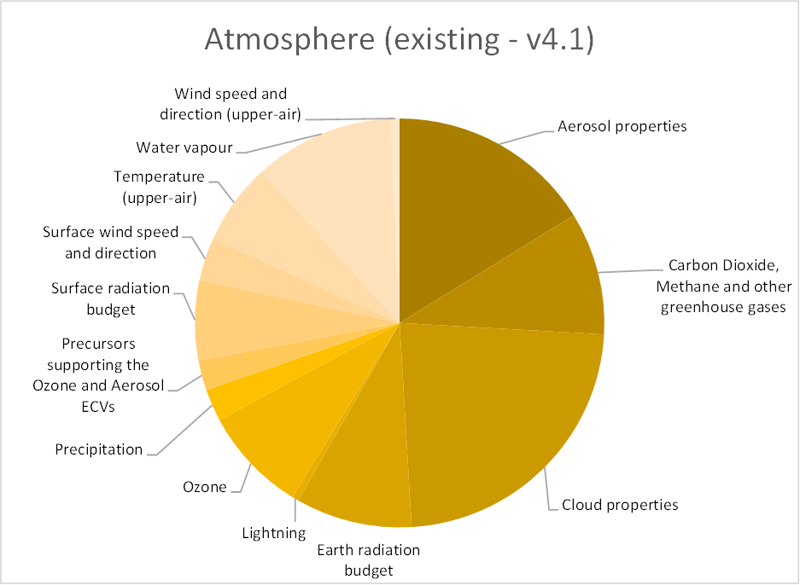
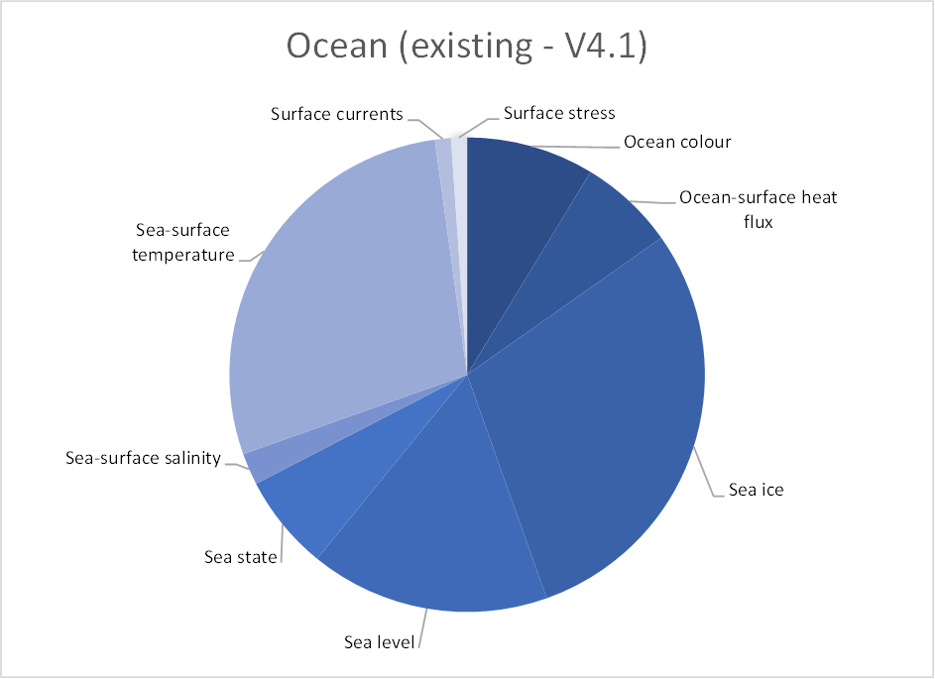
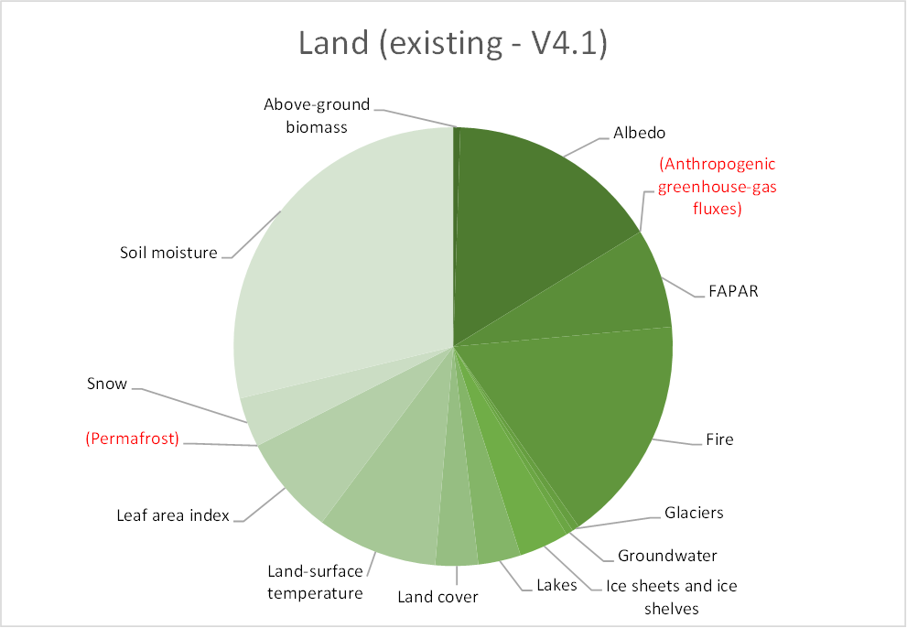
4. Evolution of ECV Inventory
Purpose
One-of-a-kind international compendium of metadata for known CDRs
Tool developed to ensure future space observation architecture will be adequate for CDR generation requirements
Growing use as authoritative CDR library for end-users, researchers, developers
History
V2.0: October 2017
V3.0: August 2020
V4.0: October 2021
V4.1: November 2022
V5.0: ~December 2024
- 45 previously-submitted records
V6.0: ~December 2025
- Simpler structure, processes, name
EUMETSAT initiated new 5-year support contract (starts April 2024)

Slide 9
5. Climate Records Definitions
Goal: General, robust, anticipatory of evolving technologies
e.g., indices, reanalysis-derived CDRs, GPSRO, gravimetry, ML/AI, in situ
Near-final definitions briefed to CEOS Plenary in November 2023
Manuscript in development for peer-reviewed journal article in late 2024

Slide 10
6. Next WGClimate Vice-Chair
Issued Call for Nominations on 16 January 2024
New Vice-Chair assumes duties at the CEOS 2024 Plenary
Current Vice Chair rotates to Chair for 2-year term, then next rotation
For WGClimate's Terms of Reference
Chair alternately drawn from meteorological and non-meteorological agencies
Wenying Su, the current Vice Chair, is from a non-meteorological agency (NASA)
🡪 Next Vice-Chair must be from a meteorological agency
One nomination received: Vincent-Henri Peuch (ECMWF)
Next steps: Submit to CGMS and CEOS Plenaries for approval

Slide 11
6. Nomination of Vincent-Henri Peuch (ECMWF)
Joined ECMWF in 2011. Led initiation and implementation of Copernicus Services at ECMWF. Founding Director of the Copernicus Atmosphere Monitoring Service for 10 years.
Current member of ECMWF Directorate as Director for engagement with the European Union and Head of ECMWF Bonn (190 staff) -- the centre of gravity for ECMWF EU activities including Copernicus and Destination Earth.
30-years experience in atmospheric composition modelling, composition-climate interactions and data assimilation of observations of atmospheric constituents (>105 publications, h-index: 48).
Active in international scientific and steering bodies including WMO’s Global Atmospheric Watch and Global Greenhouse Gas Watch Study Group (co-chair) and ESA’s Advisory Committee for Earth Observation and Climate Science Advisory Board.
ECMWF representative to CEOS-CGMS Joint Working Group on Climate and ECMWF’s CEOS contact since 2022. Contributes to Greenhouse Gas aspects, Space Agencies response to GCOS IP and provides liaison with relevant ECMWF/C3S/CAMS/DestinE activities: reanalyses, link to policy stakeholders, data stores, use cases…

Slide 12
Review of Near-term Activities
CGMS Working Group II meeting (April)
Submission to Merged Gap Analysis Report to Principals (June)
Submission to Coordinated Action Plan to Principals (June)
CGMS Plenary (June)
Draft Statement for SBSTA/COP-29 (July-August)
Off-label activities (not in Work Plan)
Exploring process and options for a COP Side Event
Dialog with SCO on gathering satellite needs for local/regional scale climate adaption projects

Slide 13
WGClimate-20 Takeaways on SIT-39 Agenda Items
Item 4.4 –Global Stocktake 1 and 2
WGClimate is an appropriate CEOS standing body to
Conduct the GST1 lessons-learned analysis (independence from GHG TT)
Develop a strategic plan for GST2 leveraging GST1 lessons-learned
Note: IPCC report had great impact, other not much. For GST2, next major IPCC report might not be available
Item 4.6 – Proposed Task Force on CEOS climate policy impacts; Prep for SIT TW and Plenary
Should involve CGMS (Note WGClimate reports to CEOS and CGMS Plenaries)
WGClimate TOR (quotes)
In the context of the UN Framework Convention on Climate Change (UNFCCC) and other international coordination mechanisms, [WGClimate] will:
Ensure a plan is put in place for the development of a joint CEOS/CGMS response, which has broad consultation across the community, and provides the basis for future planning and priority setting by space agencies in response to climate information needs.
WGClimate proposes to develop plan over 2024-2025

Slide 14
Side note: NOAA Support to LSI-VC
NOAA Agency Announcement
Xiwu 'Jerry' Zhan to support LSI-VC and AFOLU
VIIRS, MODIS Land Cover/Change Products, AMSR-E Land, Surface modeling and assimilation, soil moisture
Former LSI-VC member Kevin Gallo retired

Slide 15
Thank you
jeff.privette@noaa.gov

Slide 16
Backups

Slide 17
16 Actions in the Space Agency Supplement
Most Actions have multiple Activities
Space agencies play minor role in 3 additional Actions
Space agencies collaborate with others on 2 additional Actions

Slide 18
Near-final/Working CDR Definitions
Near-final CDR definitions
A Climate Data Record (CDR) is a consistently-processed and uncertainty-quantified time series of earth system data or information, located in time and space, of sufficient length and quality to be useful in climate-related applications.
Subtype: A Fundamental CDR (FCDR) is a CDR of at-sensor observations.
An Interim CDR (ICDR) is a consistently-processed and uncertainty-quantified time series of earth system data or information, located in time and space, generated by a baselined CDR system modified to enable lower latency production.
Caveats and clarifications
• “Earth system data or information” is an observation or a derived/modeled earth-system variable (measurable or not, e.g., it could be synthesized like "potential temperature" or an index like LAI)
• “Consistently-processed” means generated with a processing system designed to minimize output discontinuities and changes in the algorithmic approach over the period of record.
• “Sufficient” length and quality values vary with use and application. There are no fixed thresholds. A CDR must be fit-for-purpose.
• The definitions are not all mutually-exclusive, and more than one can apply to a given time series (e.g., an ICDR can become a CDR of typically lower quality than baselined CDR).

