Slide 1
SIT-39 2024
Space-based Earth Observation Community’s Role in the Policy Process
Giacomo Grassi,
Joana Melo
European Commission
Agenda Item #4.3b
SIT-39 2024, Tokyo, Japan
10th - 11th April 2024

Slide 2
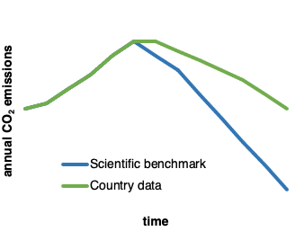
How the Paris Agreement works
Global Stocktake
historical ← → projected
GAP
National GHG data and pledges
Models’ benchmark

Slide 3
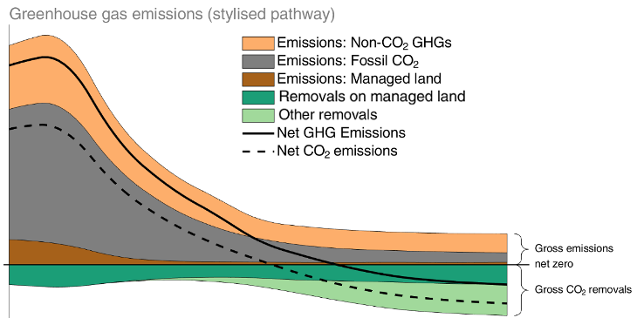
Land use & forests matter: do we know enough?
The relative importance of land CO₂ sink will increase
with time: are we confident on data?

Slide 4
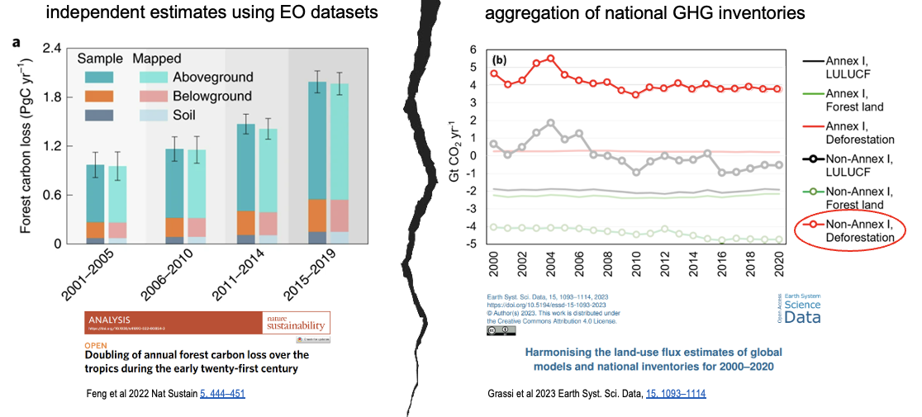
Have deforestation emissions increased or decreased during 2000-2020?
Increased
Decreased
Remained stable
Not sure

Slide 5
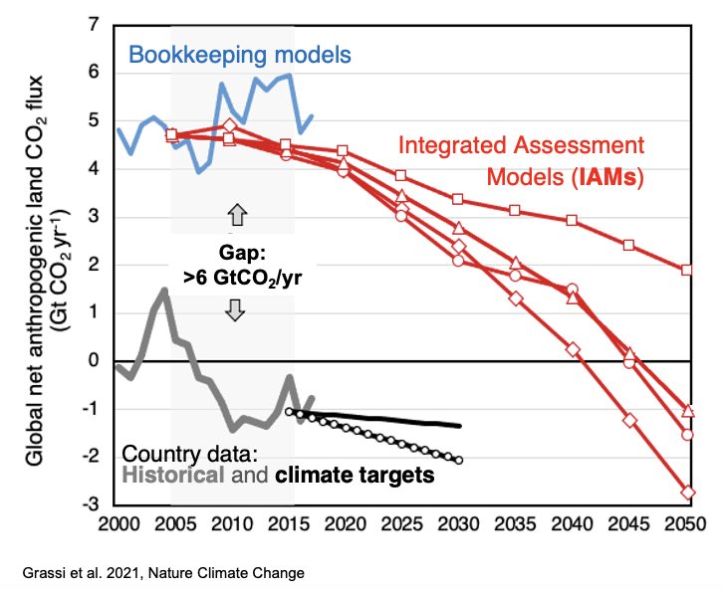
Is land use (LULUCF) globally a source or a sink of emissions?
A source
A sink
Close to equilibrium
Not sure
This large gap is confusing policy makers:
Why do we have this gap?
Can we trust country LULUCF data?
How to reconcile the difference?

Slide 6
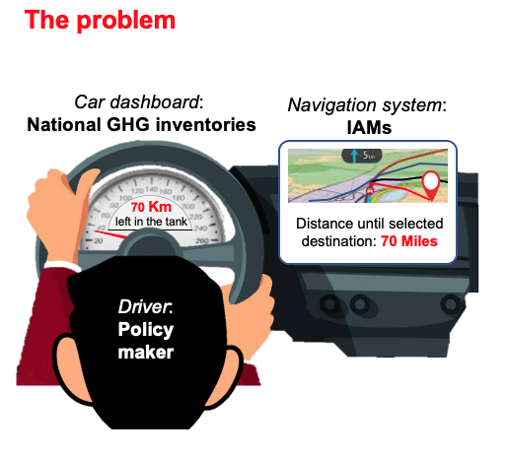
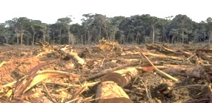
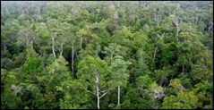
How to reconcile the difference?
Navigation system:
Global models
Fossil fuel emissions
$\sim$88%
Atmosphere ($\sim$45%)
Oceans
($\sim$25%)
LULUCF in global models
Land use change
emissions ($\sim$12%)
Land
(forests)
($\sim$30%)
LULUCF in national inventories
Approach to reconcile the gap: add the CO₂ sink considered ‘natural’ by 16 DGVMs and ‘anthropogenic’ by countries to the anthropogenic forest flux by 3 bookkeeping models
Notes:
People are in the map

Slide 7
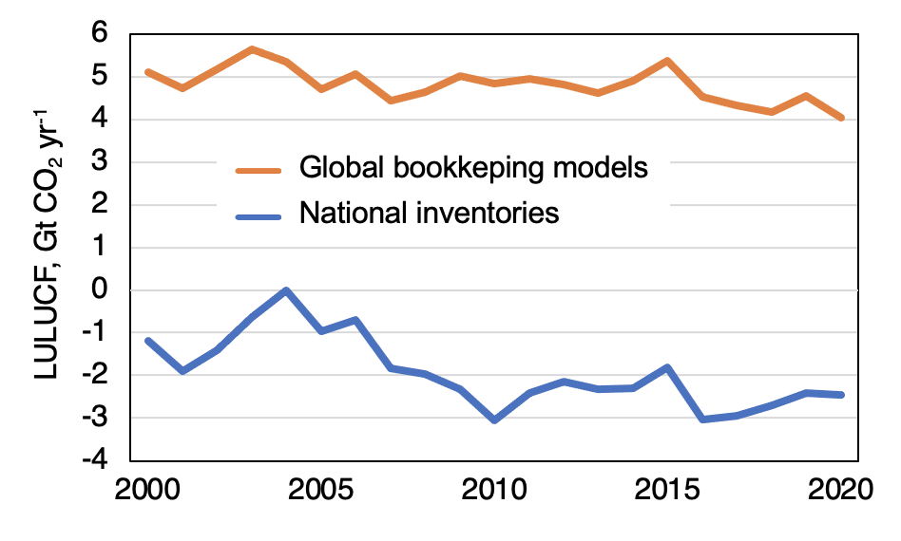
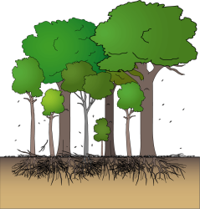
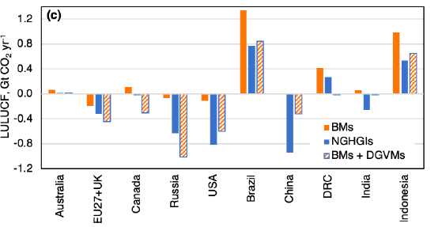
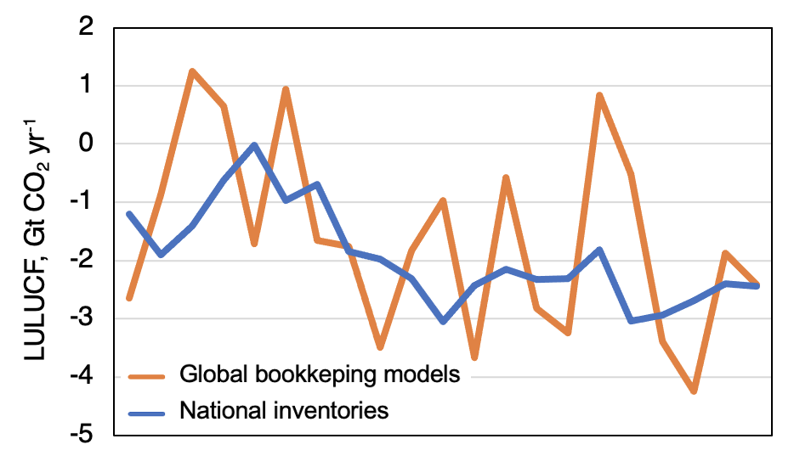
Does it work to reconcile historical data?
No, that’s anthropogenic
before reconciliation
That’s natural
6.7 GtCO₂
Blueprint for comparing anthropogenic land-use fluxes at country level
after reconciliation
Now we understand better each other!
+ DGVMs
Grassi et al. 2023, ESSD

Slide 8
Issue well ackowledged
IPCC AR6 SPM Synthesis report (2023): “Global databases make different choices about which emissions and removals occurring on land are considered anthropogenic. Most countries report their anthropogenic land CO2 fluxes including fluxes due to human-caused environmental change (e.g., CO2 fertilisation) on ‘managed’ land in their national GHG inventories. Using emissions estimates based on these inventories, the remaining carbon budgets must be correspondingly reduced.”
UNFCCC’s synthesis report for the Global Stocktake (2023): “Adjustments should be made where any comparison between LULUCF data reported by countries and the global emission estimates of the IPCC is attempted.”

Slide 9
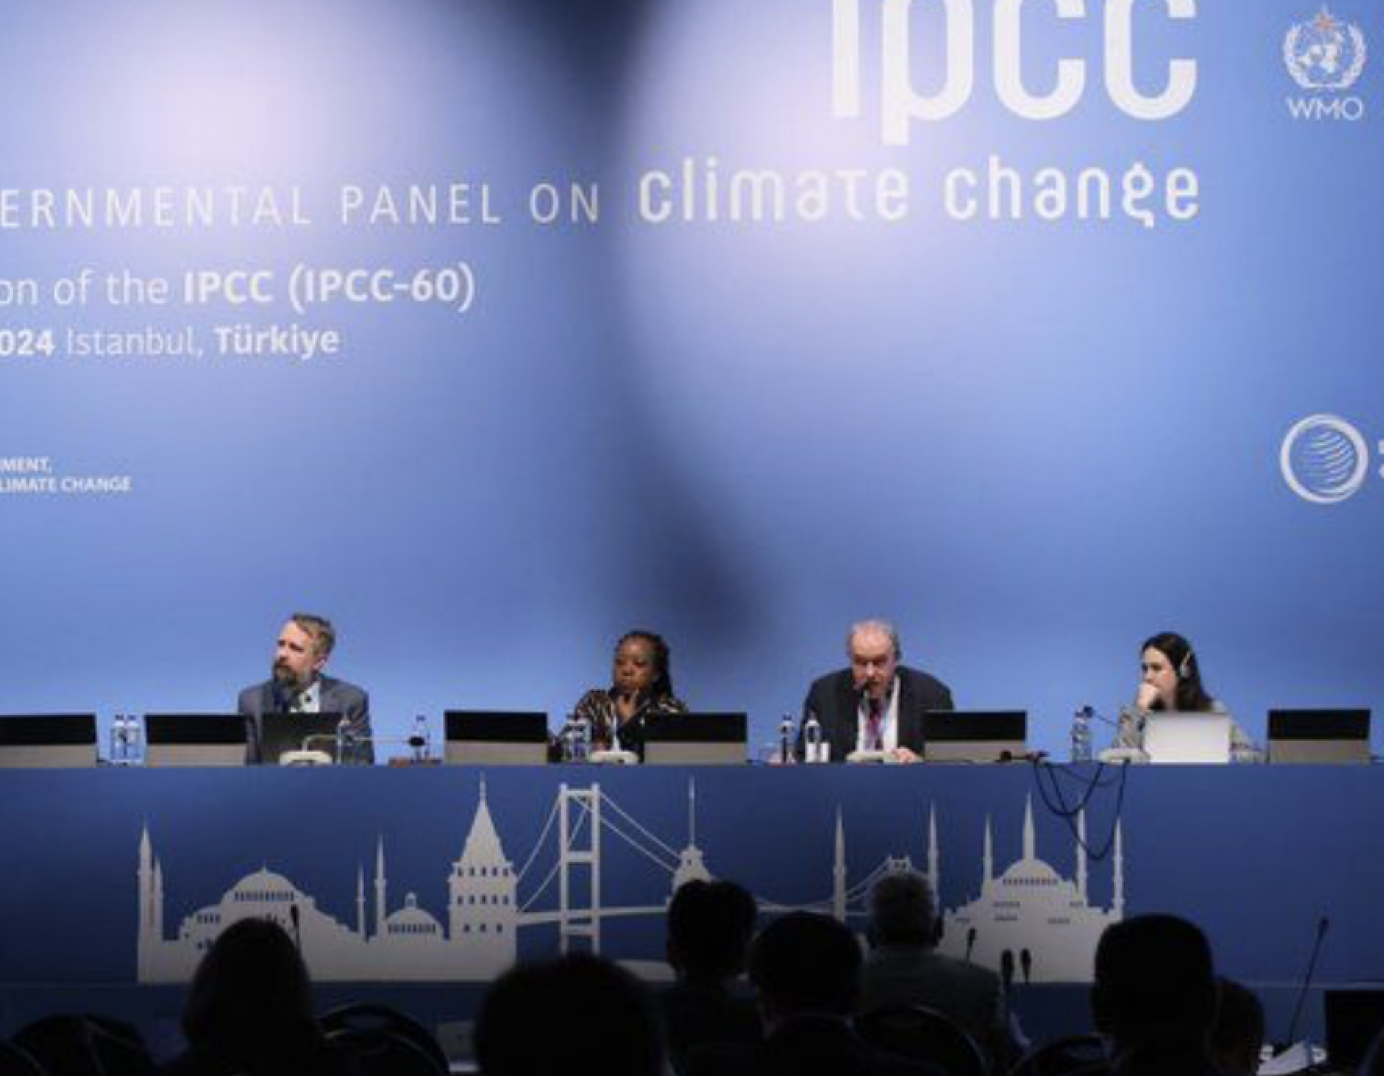
IPCC work in the 7th Assessment Cycle
Working Groups I, II and III
Special Report on Climate Change and Cities by early 2027
Synthesis Report (SYR) by late 2029
Working Groups reports (not clear yet if on time for 2nd GST!)
Task Force on GHG inventories:
Methodology Report on Short-lived Climate Forcers by 2027
Methodology Report on Carbon Dioxide Removal Technologies, Carbon Capture Utilization and Storage by 2027 (and Expert Meeting + Scoping Meeting in 2024)
Expert Meeting on Reconciling land use emissions in 2024

Slide 10
IPCC Expert Meeting on reconciling land use emissions
(9-11 July, Ispra, IT)
The meeting will gather a balanced geographic and gender representation of experts from the following communities:
Earth Observation
Tree cover change,
biomass stocks, stock change and productivity, CO₂ concentration &
inverse models
Global Carbon Budget
Historical emissions from Bookkeeping models +
DGVMs
WGI
Integrated Assessment Models
Emission scenarios in WGIII
National GHG LULUCF inventories
Biennial Transaparency Reports and NDC
Theory
-driven
Observation-driven
Aims:
Develop a common understanding of the land emissions gap
Set the basis for greater collaboration between communities
Outline concrete steps forward to ensure a greater comparability between future IPCC products during AR7 and national GHG data

Slide 11
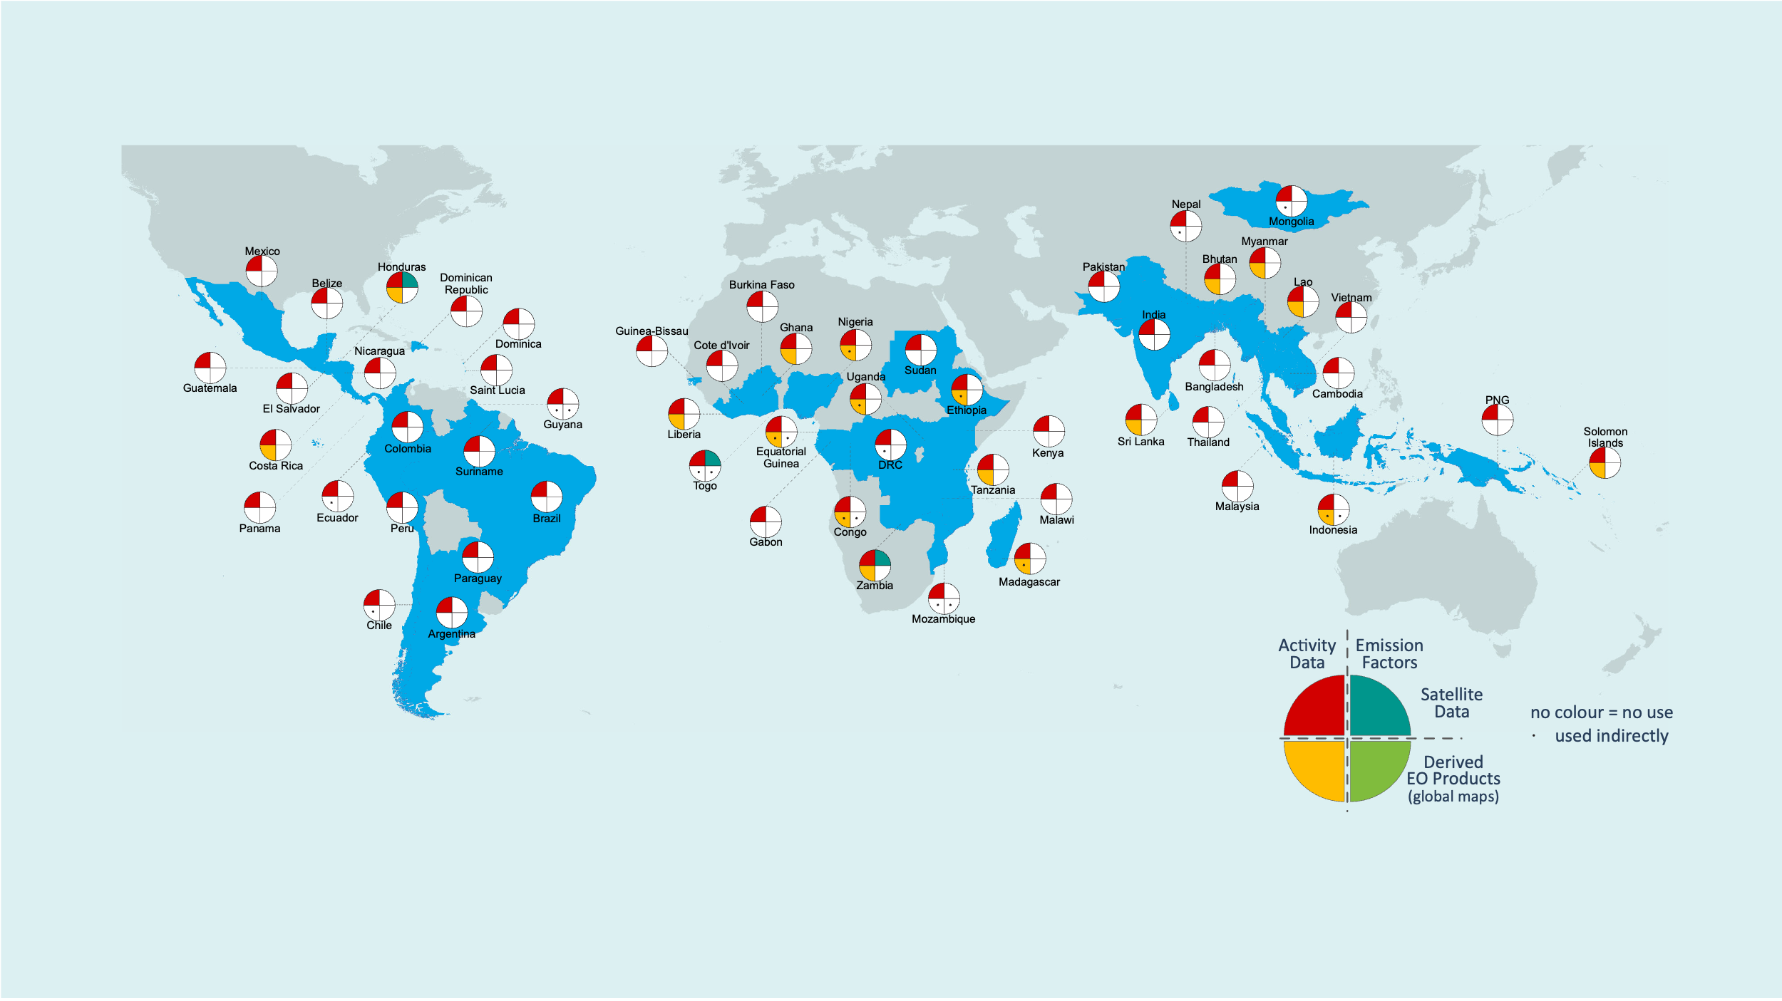
Satellite-based global maps in support of the GST Uptake in national GHG inventories
Melo et al 2023 Environ. Res. Lett. 18 034021
75 submissions to the UNFCCC
56 countries (a subset of the 153 developing countries included in the JRC database)
80% tropical forests

Slide 12
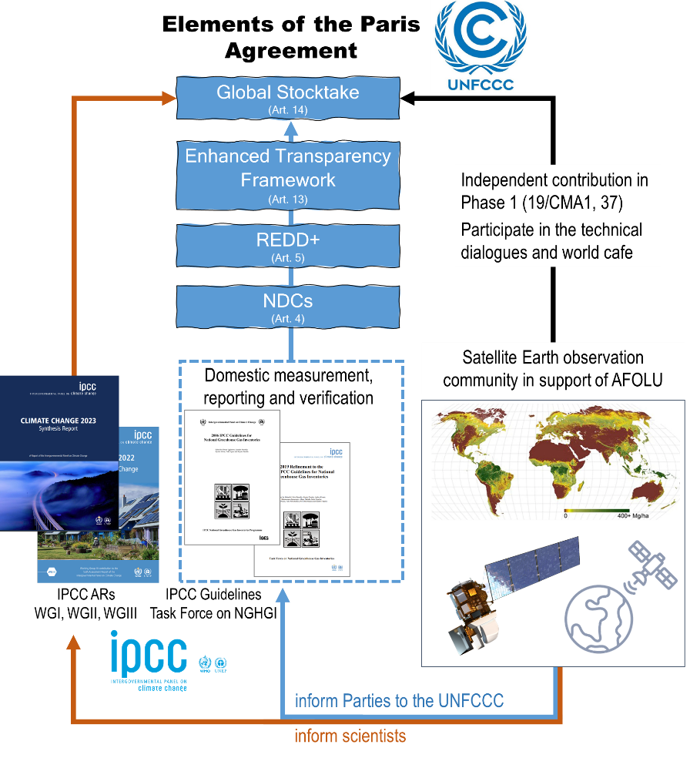

Slide 13
Conclusions
The main reason of the LULUCF gap between countries and global models is understood and can be largely reconciled.
No, that’s on managed land, thus anthropogenic
That’s natural
Steps ahead of GST2:
Countries: greater transparency and completeness of estimates, definitions/area of managed lands (forest and non-forests), more clarity of LULUCF within climate targets
Global models:
Enhance forest management/demography in the models, refine disaggregation
Enhance reconciliation with National GHGIs → ‘operational translation service’
Earth Observation
Provide more consolidated results (tree cover change, C stocks & changes, inverse models)
Connect better with NGHGIs (understand better the requirements)

