Slide 1
Climate Policy Impact Session
Introduction
Osamu Ochiai
JAXA SIT Chair team
Agenda Item 4.1
SIT-39 2024, Tokyo, Japan
10th - 11th April 2024

Slide 2
Objectives
“Climate Policy Impact” priority of our 2-year SIT term seeks to address obstacles and opportunities for CEOS agency data to have maximum impact in the key climate policy processes such as the Global Stocktake of the Paris Agreement
CEOS and its agencies invest more effort in the climate sphere than any other
We need to assess and reflect on whether we are engaging with the right stakeholders in the best way - or whether we might consider alternate or additional strategies

Slide 3
Some opportunities & achievements
The Global Stocktake of the Paris Agreement is a data-driven policy exercise - its the observations community’s opportunity to play a key role!
For GST1, CEOS collaborated with WMO, GCOS and other community players in promoting the role of observations in the process (“ GST-1 synthesis report”)
We delivered the first national-scale global budgets of GHG emissions, providing a critical, atmospheric baseline for both anthropogenic and natural GHG sources and sinks of CO2 and CH4 that could be used in the future
Highlighted key datasets from across CEOS agencies in the GST portal, ceos.org/gst
Developed a CEOS GST Strategy under SIT Chair to coordinate activities across the CEOS structure
All on top of ongoing fundamental work on ECV inventory, GCOS IP response, GHG Roadmap, AFOLU Roadmap and more…

Slide 4
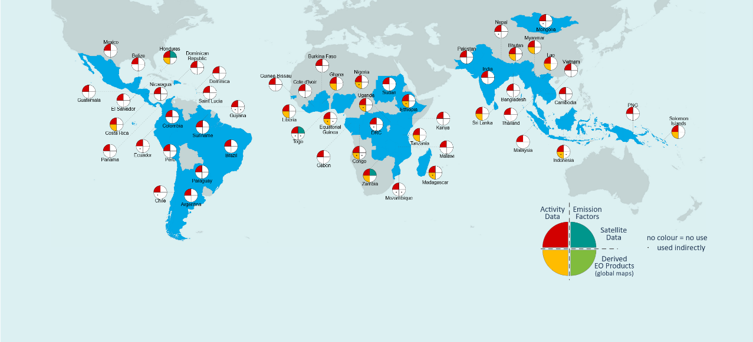
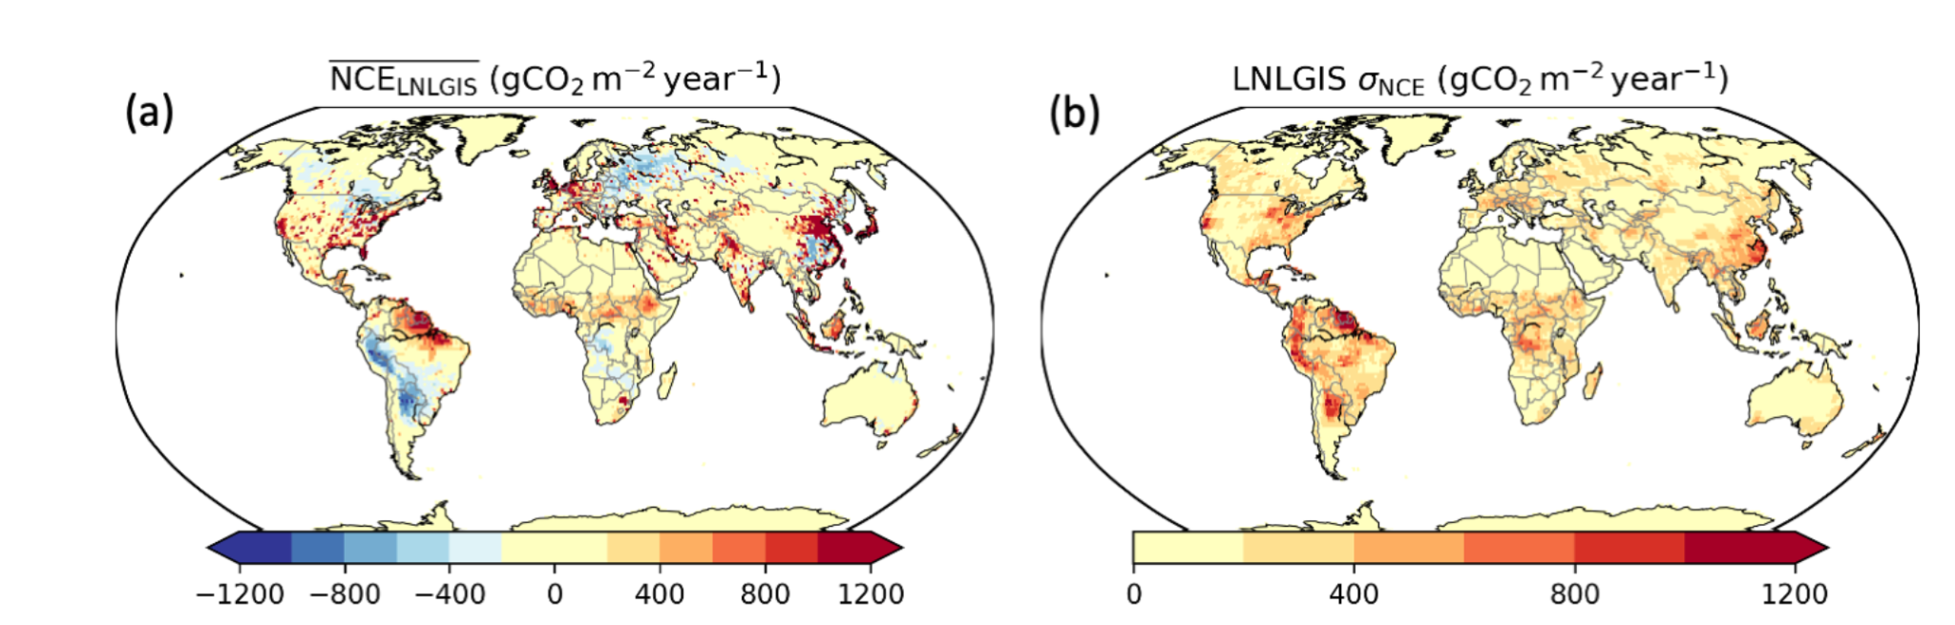
Some of our challenges…
Almost no countries use our derived global products in their forest reporting to UNFCCC
The biomass harmonisation work highlights challenges of user confidence in ‘competing’ products from different CEOS agencies
Pilot top-down national GHG products developed for GST1 got no traction. Indeed, only IPCC inputs appear to have had impact

Slide 5
Our SIT Term priority and threads
Addressing opportunities for EO data impact on climate policies
  Progress AFOLU Roadmap implementation
  Insights and new opportunities from important dataset harmonization studies
National Case Studies on EO data impact
  Asia focus of SilvaCarbon: working dataset for reporting and more
Responding to GST1 outcomes and reinforcement of UNFCCC engagement
  EO-related support arising from 1st Global Stocktake
  Effort targeting EO data role in the next update of the IPCC Task Force on Inventories Good Practice Guidance (circa GST2 in 5 years)
  Insecure interfaces for CEOS (and the observations community) to climate policy processes
Other policy engagement
  Updated Space Agency Response to GCOS IP (Plenary 2024)
  Alternate angles (eg large cities)

Slide 6
Our session
Several external voices (IGES, IPCC, UNFCCC) feature to help us understand the context for the observations community efforts in 2024 and the opportunities ahead
Reflection on
  current and upcoming policy priorities
  current stakeholder engagement efforts and how we might do better
  next decade priorities and implications

Slide 7
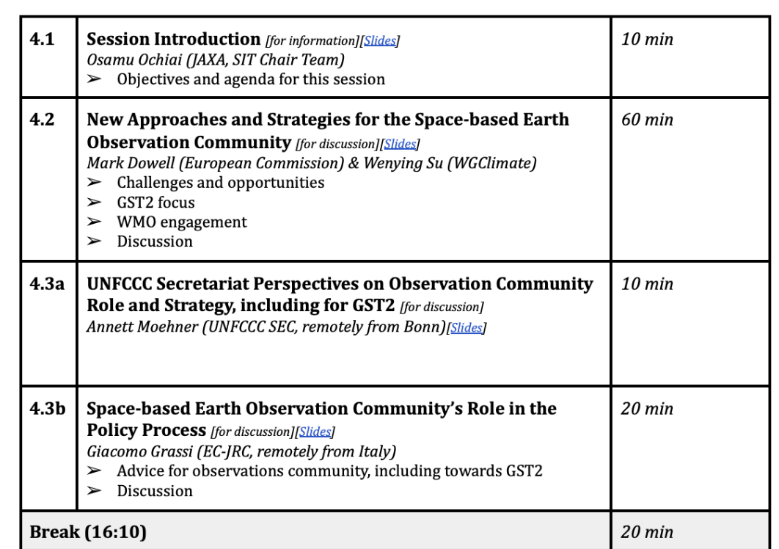
Our session

Slide 8
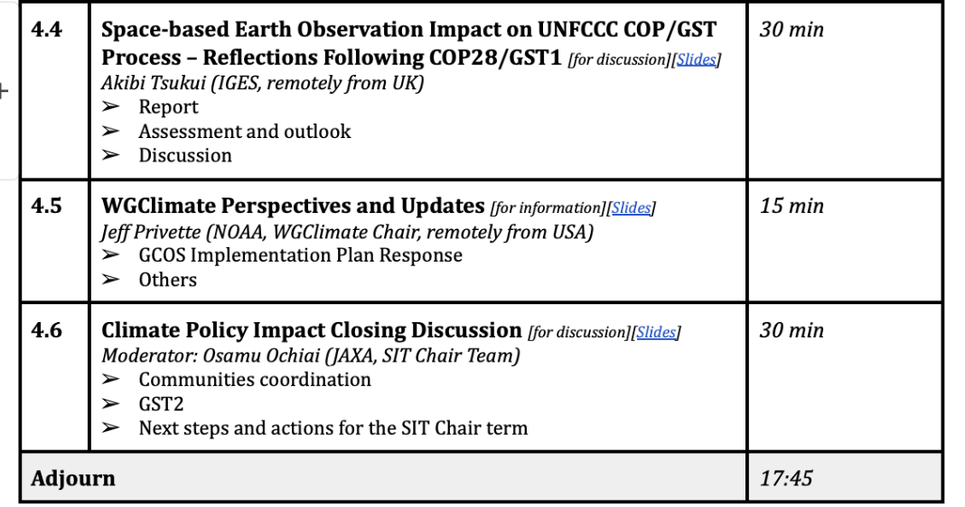
Our session

