Slide 1

SIT-39
2024
GEOGLAM
Alyssa Whitcraft | GEOGLAM
Agenda Item # 3.5
SIT-39 2024, Tokyo, Japan
10th - 11th April 2024

Slide 2
Bottom line up front
We need support from CEOS and the agencies for the Essential Agriculture Variables

Slide 3


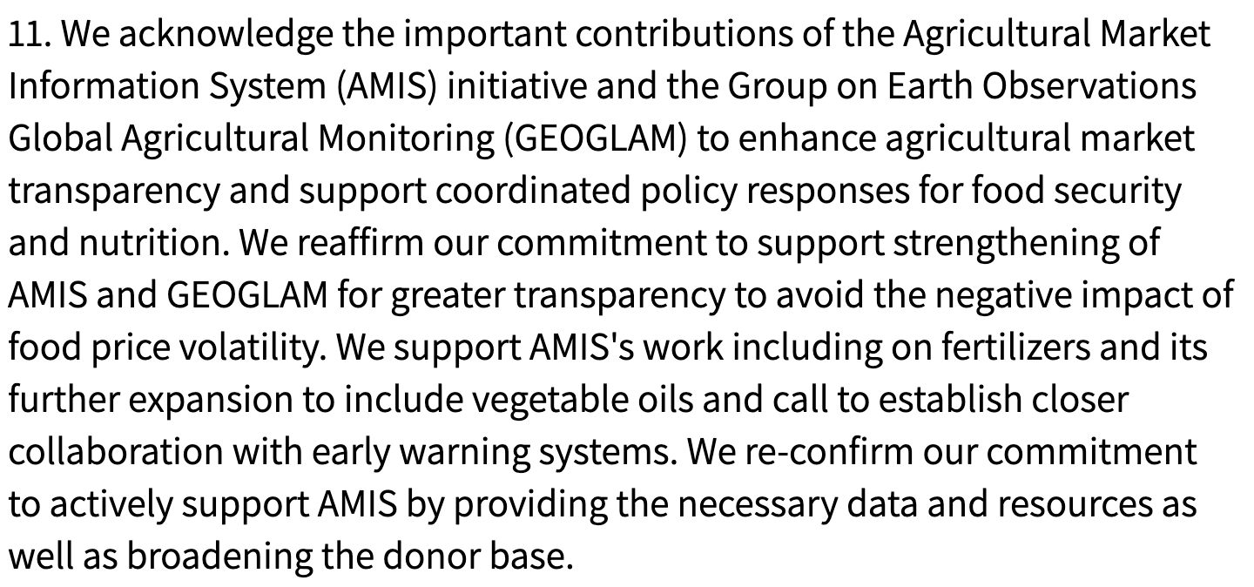
GEOGLAM General Update
New GEOGLAM Secretariat Director –
Sven Gilliams
  With thanks to Ian Jarvis for his 5 years as Director!
GEOGLAM Co-Chairs
  Wu Bingfang (Chinese Academy of Sciences)
  Chris Justice (University of Maryland)
  Bettina Baruth (European Commission)
  Jana Plogmann (German Ministry of Ag)
GEOGLAM again endorsed
by the G20 🡪
GEOGLAM also supporting national reporting, AFOLU, Sendai, SDGs, LDN…
CEOS is a key partner of GEOGLAM

Slide 4
For a complex policy and operations environment, we need an integrator from EO to Impact
  GEOGLAM is a bridge between communities
    Policy & decisions drive the information needs
        Information needs drive the analytical needs
    Analyses run on data
    Analytical needs identify capacity development and ICT needs
    Data requirements inform space agencies
Policy / Use
Analysing & Adding Value
Products
Justifying and
Defining Needs
Data
Notes:
Reminding people of why GEOGLAM exists as a community… how we are this key linkage between policy/use and data. I have intentionaly greatly oversimplified.

Slide 5
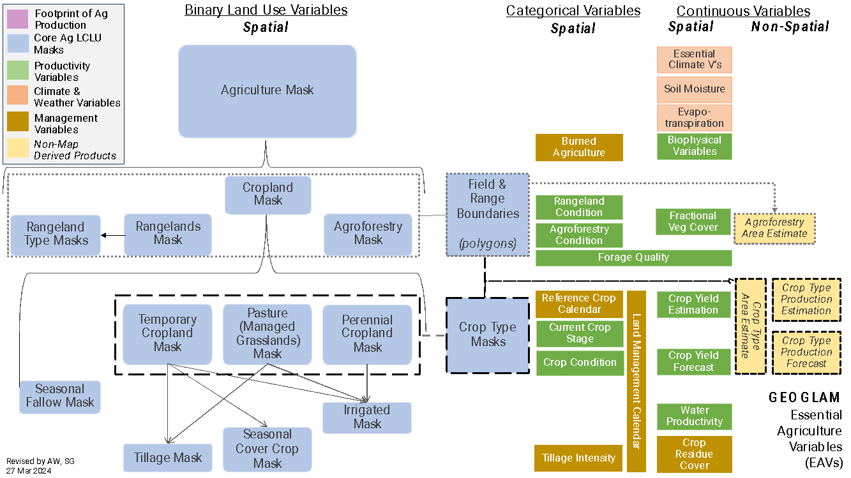
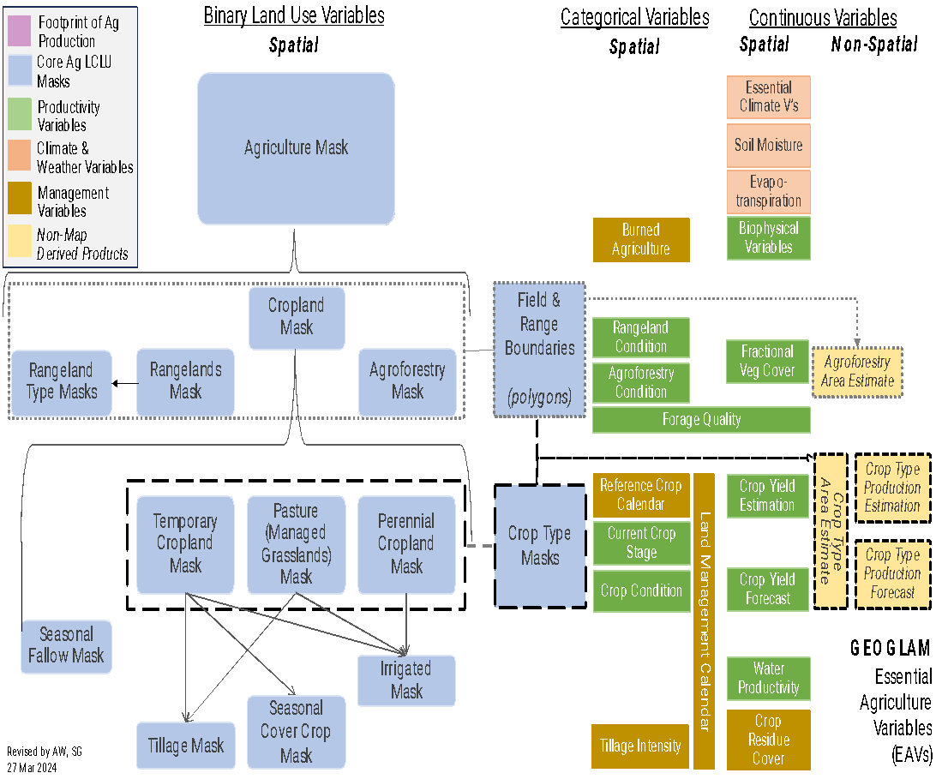
Essential Agriculture Variables are the Integrator
What:
  Satellite-based “building blocks” that in combination with one another and/or other non-EO information support actionable, policy-required information on the state, change, and forecast of agricultural land use and productivity.
  Learn from ECVs, seek to harmonize with other communities
  ~40 variables, 50-50 breakdown between “Climate & Weather” and “Agriculture Domain” Variables
Who:
  2 Co-leads (Whitcraft, Gilliams) + 27 ”EAV Stewards” from GEOGLAM operations or operational research Community
  Low space agency representation

Slide 6
EAV Implementation:
Progress & Impediments
The variables have been characterized and user communities have bought in
  G20
  National statistics
The most operational variables are:
  Ag Domain Variables: crop condition, cropland mapping, crop type mapping
  Climate & Weather Variables – several
  Largely space-agency supported already
But still missing a lot of variables, limiting the impact of EO in agriculture!!
Why?
  GEOGLAM initiating a gap analysis evaluating common barriers:
    EO data?
    In Situ Data?
    Method?
    Compute?
    Capacity?
Notes:
ESA WorldCereal → Crop Type maps for Wheat, Corn; working on others
Asia-RiCE → many variables for rice
China CropWatch 🡪 Crop Condition
NASA Acres Consortium → designed around EAV concept, for US
Yield
Cropland and Crop Type Mapping
Crop Calendar
Field Boundaries and Sizes
Multiple management EAVs
Rangeland Condition / Quality
Pest & Disease Mapping
Soil Organic Carbon Stocks & Change
ET
Copernicus Land Services

Slide 7
Example gap analysis
Variables… many, e.g. :
Use:
  National crop production forecasting (e.g. Min of Ag; Crop Monitor)
Need:
  Field-to- subnational level
  Weekly-to-monthly
Variables:
  ET
ET
EO data
Method
In situ data
Compute
Capacity (user-specific)
Temporal
Spatial
GEOGLAM EAVs identified a gap around temporal and spatial resolution thermal instruments used in ET methods.
- ET EAV Steward = Ben Koetz (ESA); this helped motivate ESA’s LSTM mission
We need more space agency involvement

Slide 8
We need CEOS + agency involvement
We know CEOS and the agencies are invaluable and indispensable partners in co-creating these variables and producing societal impact.
The GEOGLAM Subgroup of LSI-VC has very low membership
Missed opportunities:
  GEOGLAM is a less effective bridge
    Helping users adopt EO
    Helping agencies reach impact
  We do not know what (most) agencies are doing now or into the future in the agriculture domain
    Harder to communicate what we need
  Aligning cross-community EO-needs is harder (e.g. EAVs, ECVs, EBVs…)

Slide 9
Suggested CEOS Action:
Agencies identify points of contact and empower them to contribute to the LSI-VC Subgroup on GEOGLAM.
PoCs would support a roadmap of agency support for EAVs:
  Identification of agency activities around agriculture
    Method development + validation
    EO missions
  Identify missed opportunities
    Capacity building
    Computational systems
    Link to other communities
PoCs with skills/roles from one or more:
  Mission scientists
  Ag domain scientists
  Compute
  Cal/val

Slide 10
Thank you
Thanks to you all, we are no longer in an era of data scarcity – and now we can go further, together
Contact:
  Alyssa Whitcraft, GEOGLAM Programme Scientist
    akwhitcraft@geoglam.org
  Sven Gilliams, GEOGLAM Secretariat Director
    sgilliams@geosec.org

Slide 11
Backup slides

Slide 12
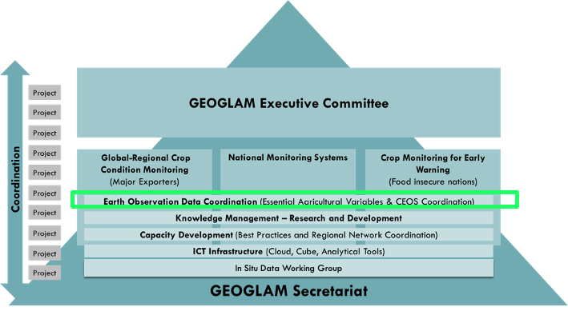
GEOGLAM’s Relationship with CEOS
GEOGLAM enjoys a long-term relationship with CEOS on coordination of EO data
GEOGLAM shares satellite data requirements:
  Acquisition:
    Spatial
    Spectral
    Temporal
    Radiometric
  Access & Compute
  Products??

Slide 13
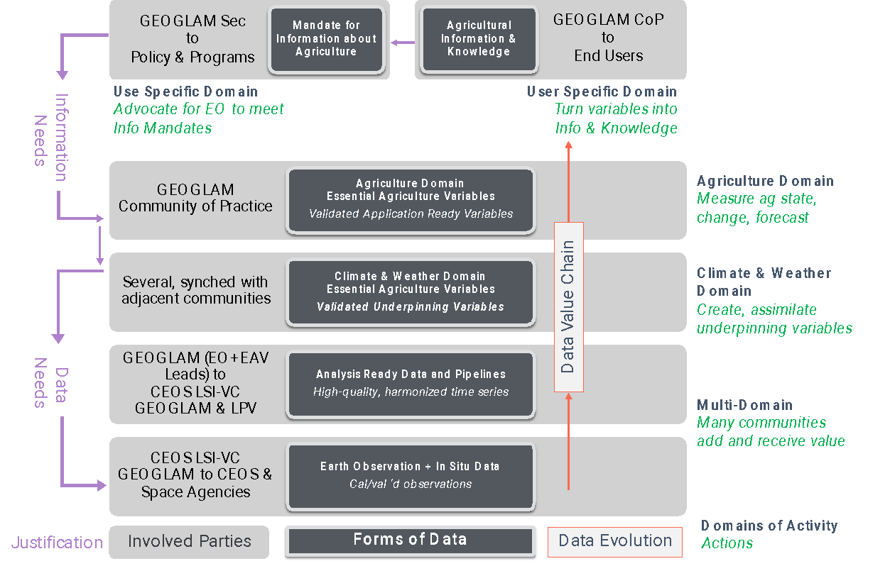

Satellite Data Value Chain
“Data produced must be policy-relevant and not exist for its own sake.” (UN Statistics Division, 2017)
  Clear mandate to harmonize and synergize
“Essential Agriculture Variables” (EAVs) emerged as a unifying framework to maximize EO value and meet multiple information and decision needs

Slide 14
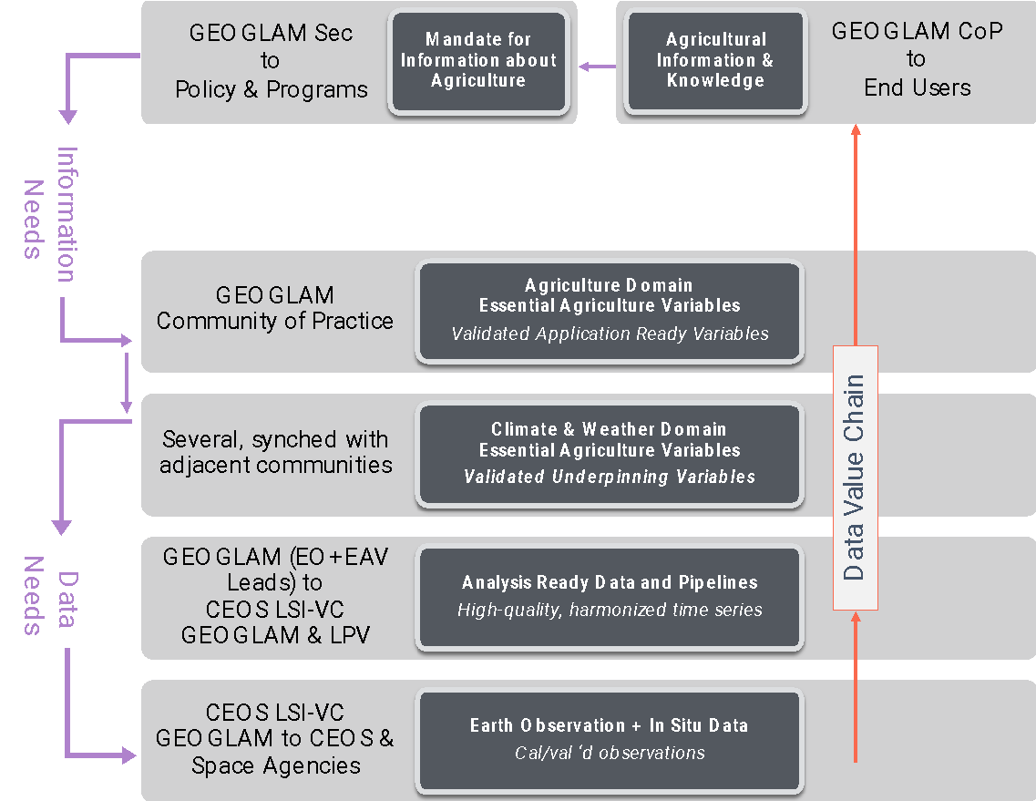
From a 2018 GEOGLAM community survey
(small sample, but representative)
From Ag Monitoring “End User” organizations:
All agreed that their organization would benefit from a greater use of EO data in their org’s decision making
Q: If your organization does not use satellite EO at any level of their decision making process, why is that the case?
“…org interested in EO, unsure how to incorporate”
“…org thinks EO data are too expensive or difficult to access…”
“…org thinks EO data are too unreliable to implement operationally…”
Other answers:
  Can’t keep up to date with which products are good
From EO-for-Ag practitioners:
<50% agreed that they had access to all of the EO they needed for their analyses
65% agreed they required additional technical support to download, process, or utilize EO (even seasoned EO practitioners!)
Strong indication of desire for standard products:
  Cloud-free, intercalibrated/harmonized time series (“ARD”)
  Essential Agriculture Variables like crop type map, crop calendar …
Most consistent boundary identified: lack of field data!
Whitcraft, et al. (2018)
Notes:
Recurring theme of difficulty in access/discovery as well as in perceived/actual unreliability.
New sensors, new methods 🡪 constant iteration
Need consensus voice 🡪 what’s real, what isn’t?

Slide 16
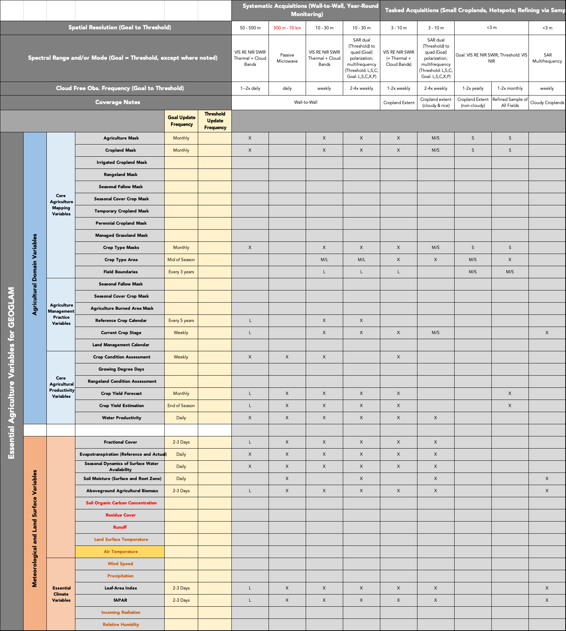
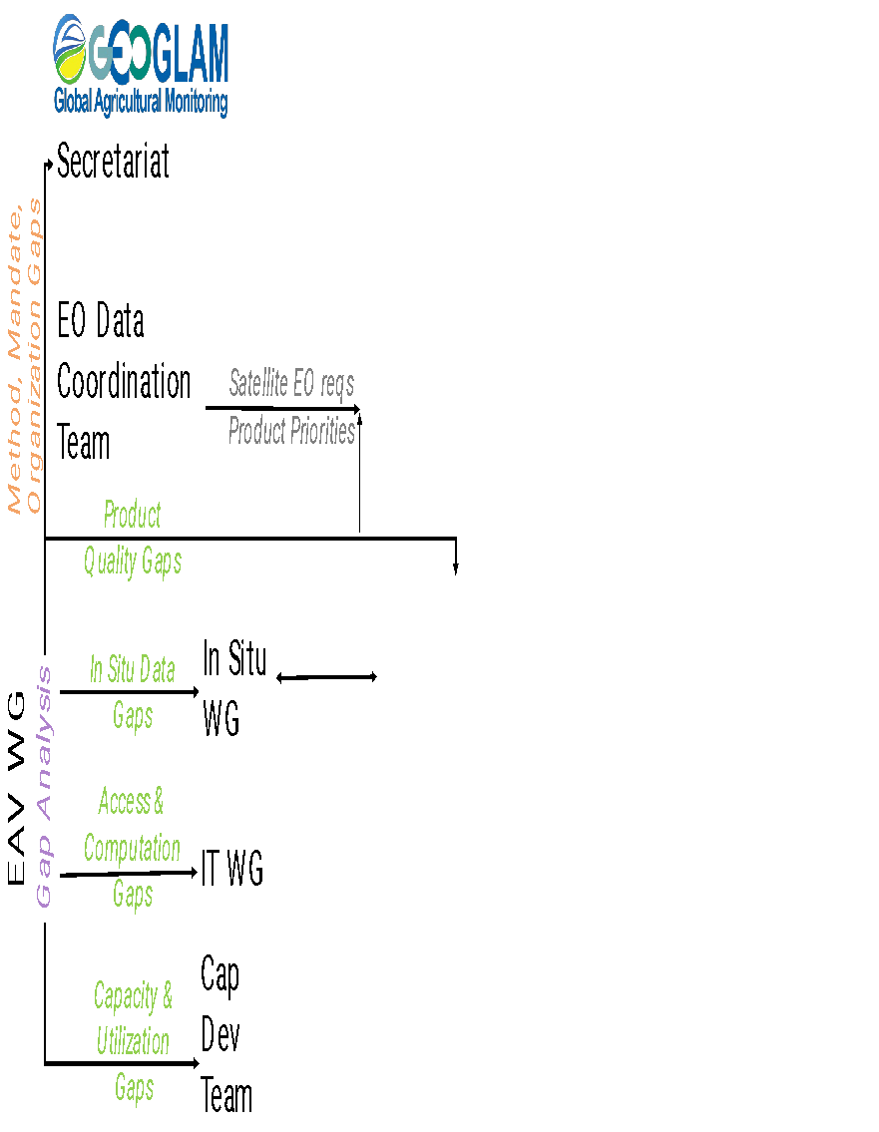
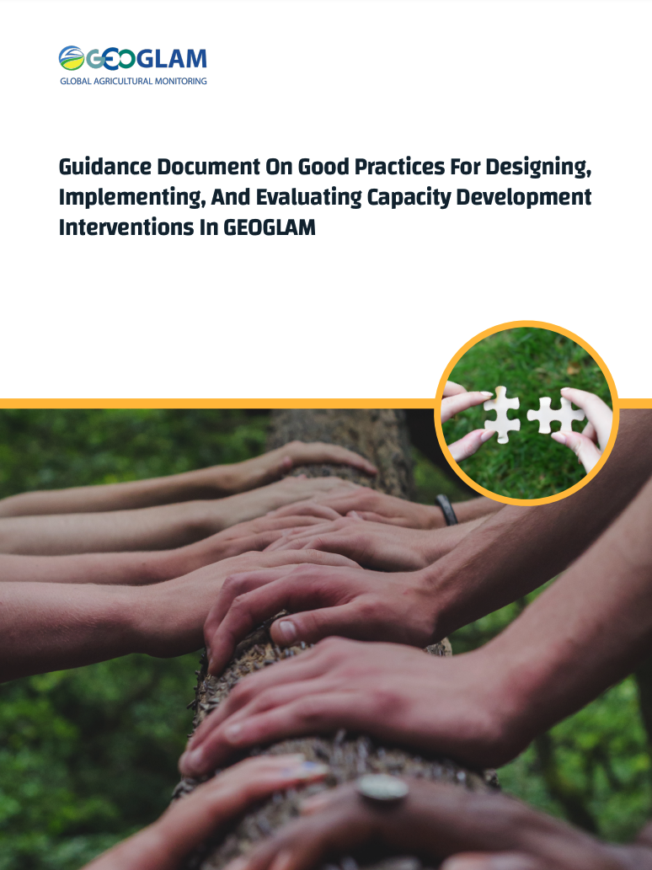
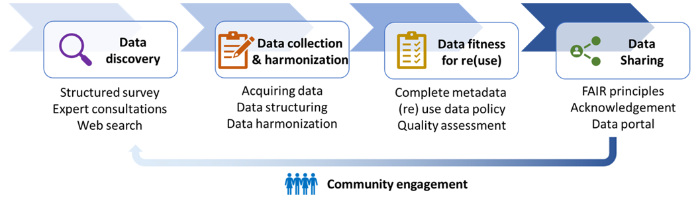
GEOGLAM Cross-Cut Activities Related to EAVs
(examples)
in progress revision of GEOGLAM Observation Requirements Table
Nelson, Teuben, Whitcraft et al. (2023)
Toward a global, extensive, open reference data repository
Notes:
Can add another figure here for the LPV meeting

Slide 17
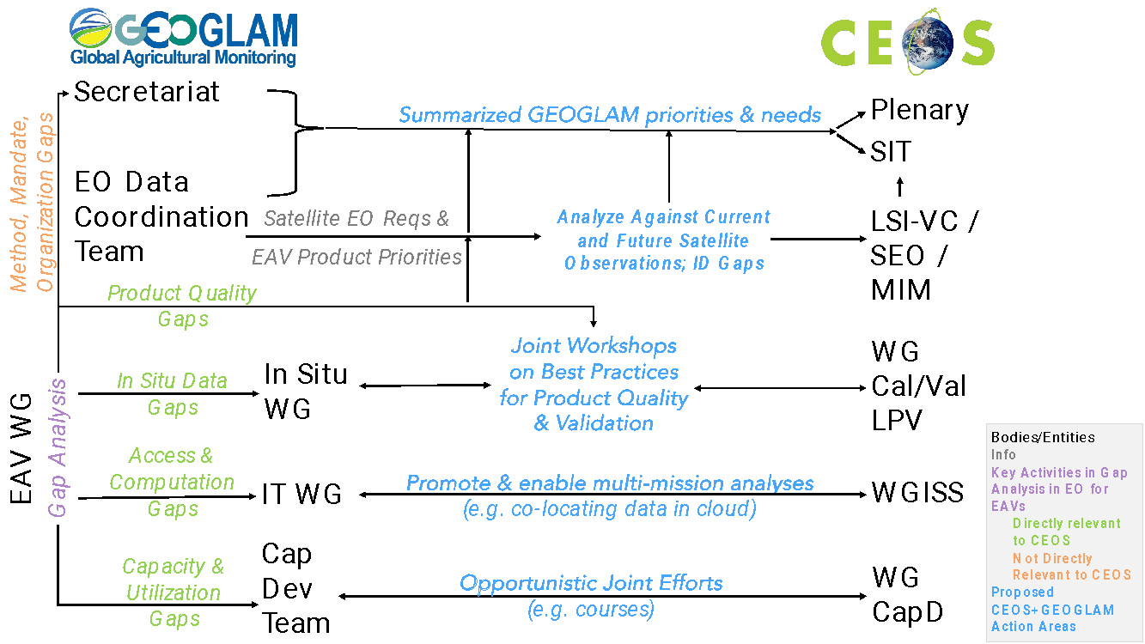
Opportunities for Collaboration
Assess gaps in satellite Earth observation capabilities e.g. SEO, MIM Database, USGS-RCA
Identify gaps and opportunities for easing access to and utilization of satellite data e.g. WGISS
Assess method status:
  Assess method quality, develop Validation Good Practices via the GEOGLAM Initiative on Product Quality, e.g. through Community Workshops with WG Cal-Val Land Product Validation Group
  Scalability and transferability.

