Slide 1
Final Proposal for a COAST-VC
Paul DiGiacomo
NOAA Center for Satellite Applications and Research
on behalf of COAST Ad Hoc Co-Lead: Rashmi Sharma, ISRO

Slide 2
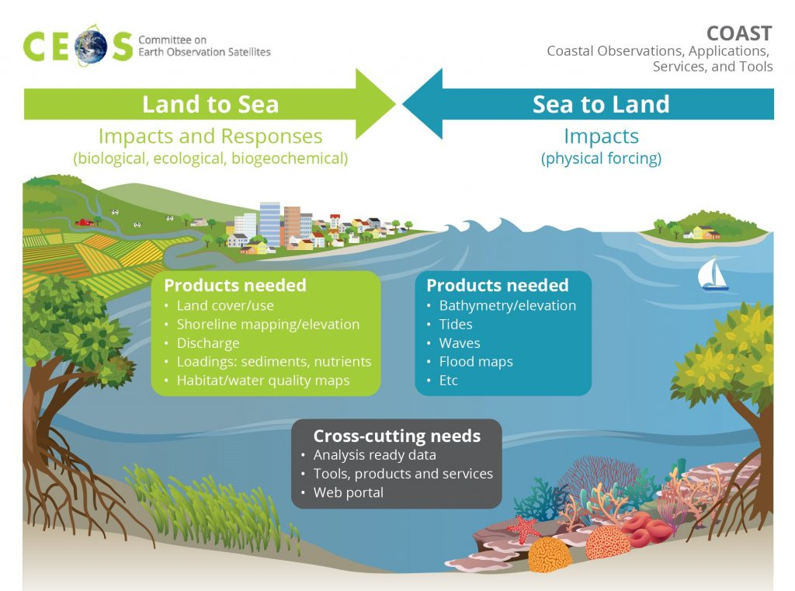
Why a CEOS COAST VC?
COAST-VC would address the Land-Ocean boundary remote sensing and new product development needs not being addressed in other fora.
COAST-VC complements existing VCs and WGs work and can support, where needed, user engagement in priority science areas.
COAST is CEOS’ IOC-endorsed Contribution to the UN Ocean Decade, a connection to GEO Work Programme Activities, and advances CEOS priorities, like biodiversity.
COAST is trans-parameter
parameter all ocean/water parameters
COAST is trans-boundary
ocean + land + atmosphere + cryosphere
COAST is trans-disciplinary
environmental plus social science
Slide ‹#›
Notes:
There is precedent for cross cutting VCs
As recommended, we have directly addressed concerns about scope and infringement upon activities of existing VCs with their leaders, which hasn’t been a problem during the past 4 years of COAST, but those discussions yielded areas of potential collaboration with other CEOS entities, and are captured in our schedule graphic within the Implementation Plan.
We hope COAST will grow in use - It is a nexus to valuable external stakeholder groups through ties to GEO and GOOS and continues to be CEOS’s contribution to the UN Ocean Decade and CoastPredict, and COAST holds potential to advance other CEOS and SIT chair priorities of interest to coastal users, like biodiversity.

Slide 3
Progress Since 2023 Plenary
CNES has agreed to serve as 3rd Co-Lead, joining NOAA & ISRO
Aurelien Carbonniere
Collaborations and partnerships identified with other VC/WGs
Followed the CEOS Process Document guidance and socialized iterations of the draft documents within CEOS
Identified future COAST activities that include:
Expand coastal product development: coastal blue carbon/habitat mapping, shoreline (e.g., UK) and in new Arctic pilot region
New Stakeholder Engagement & Co-Design Events using WGCapD guidance
including promotion of available CEOS solutions to users: biomass and ecosystem extent maps
Continue to utilise CEOS Analytics Lab to the extent enabled by SEO

Slide 4
Proposed DECISIONS
Request Approval of the COAST transition to a VC, now with CNES as 3rd co-lead
Request Approval of the COAST Final Terms of Reference and Implementation Plan documents, as presented
We reiterate our open call for COAST members from among CEOS agencies and associates

