Slide 1
Ecosystem Extent Task Team Update
Gary Geller*
NASA Jet Propulsion Laboratory
California Institute of Technology
Agenda Item 3.2
SIT-39
9-11 April 2024 Tokyo
*On behalf of co-leads
Shaun Levick, CSIRO
Sandra Luque, CNES & INRAE
Roger Sayre, USGS
(c) 2024 California Institute of Technology. Government sponsorship acknowledged

Slide 2
Agenda
EETT refresher
Non-demonstrator activities
Demonstrators
Hudson’s Bay Lowlands
Costa Rica Tropical Forests
Great Western Woodlands

Slide 3
Key Messages
Demonstrators are progressing
Maturity varies by start date
Hudson’s Bay Lowlands will be delivered at Plenary
All will continue past 2024 Plenary
EETT/Biodiversity has started engaging with WGs and VCs

Slide 4
Background
Biodiversity: The variety of life on Earth
Genes
Species
Ecosystem
Ecosystem Extent Task Team
2022 Plenary: Approved
2023 Plenary: white paper endorsed
2024 Plenary: Demonstrator(s)
Overarching goal: Enduring CEOS engagement with biodiversity
EO not yet fully exploited
Wikimedia Avoini

Slide 5
Non-Demonstrator Activities
Presentations/discussion with WGs & VCs
WGISS-57 (4-7 March)
WGCV-53 (5-8 March)
WGDisasters-21 (19-21 March)
LSI-VC-15 (3-5 April)
Scientific journal paper based on the White Paper
Target journal: Remote Sensing in Ecology and Conservation
Target submission date: September 2024

Slide 6
Non-Demonstrator Activities
Presentations/discussion with WGs & VCs
WGISS-57 (4-7 March)
WGCV-53 (5-8 March)
WGDisasters-21 (19-21 March)
LSI-VC-15 (3-5 April)
Scientific journal paper based on the White Paper
Target journal: Remote Sensing in Ecology and Conservation
Target submission date: September 2024

Slide 7
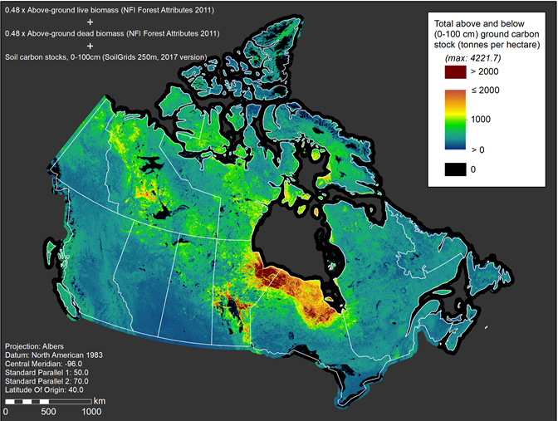
Hudsons’ Bay Lowlands
320,000 km²
Jason Duffe
Geomatics Research
Wildlife and Landscape Science

Slide 8
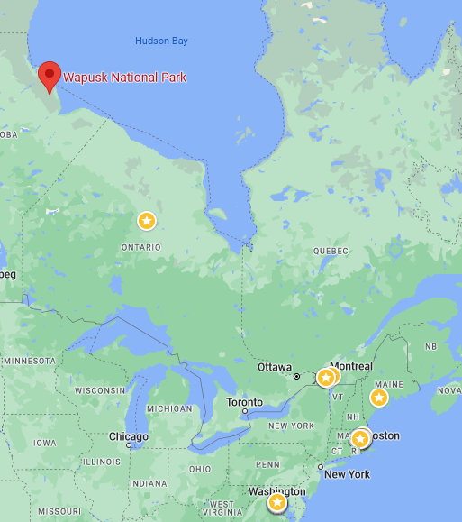
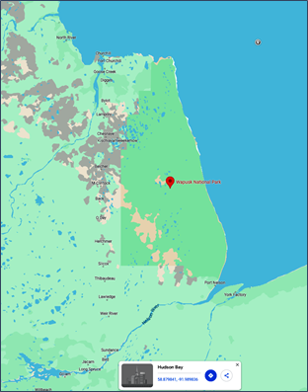
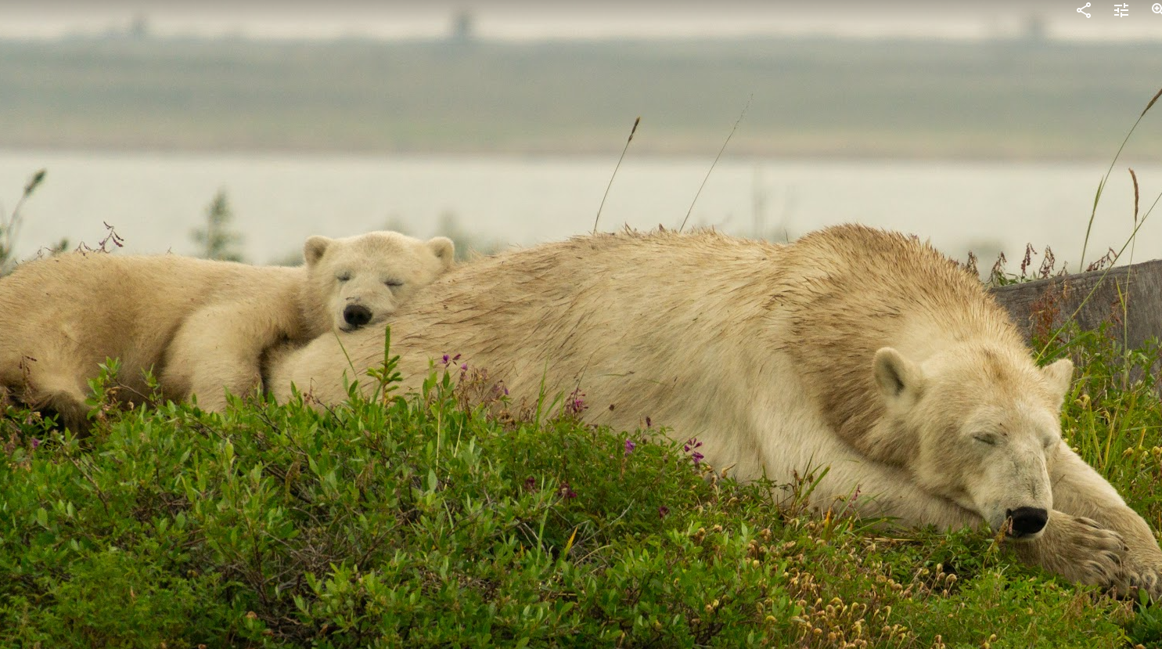
CEOS Demonstrator: Wapusk NP
11,475 km²

Slide 9
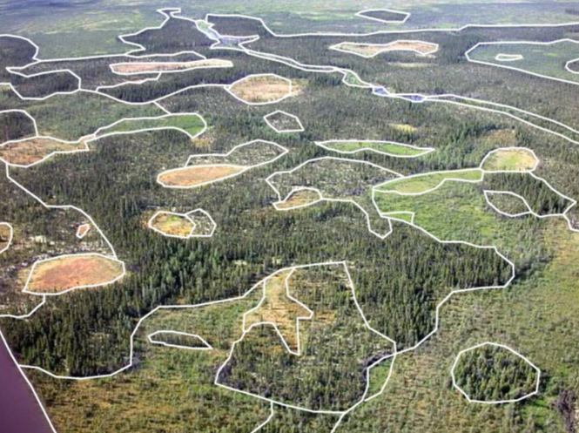
Varied Landscape

Slide 10
Goals
Generate detailed ecosystem map of Wapusk National Park
More classes than existing maps
Estimate size of each ecosystem
Approach:
Combine multiple EO sensors & other data sources
Utilize CEOS Analytics Laboratory (Open Data Cube)
Applications: biodiversity assessments, conservation planning, carbon cycling studies
Notes:
ODC core datasets (Landsat, Sentinel) – all of HBL
Obtain hyperspectral satellite data (ENMAP), ALOS L-Band, and TANDEM-X (12m DEM) - Wapusk National Park.

Slide 11
Progress to Date
Model inputs: assessed non-EO predictor variables
Vegetation outputs: standardized the classes & binned training data
Staff trained on using the CEOS Analytics Lab (SEO & CSIRO)
Developed & assessed classification methods
Applied to test sites
Obtained ALOS2-PalSAR2 data over Wapusk NP (JAXA)
Understanding processing needs with CEOS SEO

Slide 12
Next Steps
Continue demonstrator development towards delivery for Plenary
Focus is on Wapusk National Park
Continue development for larger Hudson’s Bay Lowlands beyond 2024
Work with Parks Canada and GEO BON on HBL and closely related projects

Slide 13
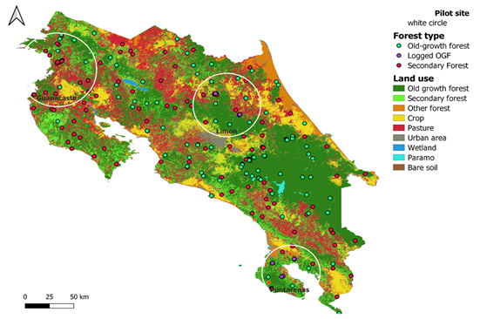
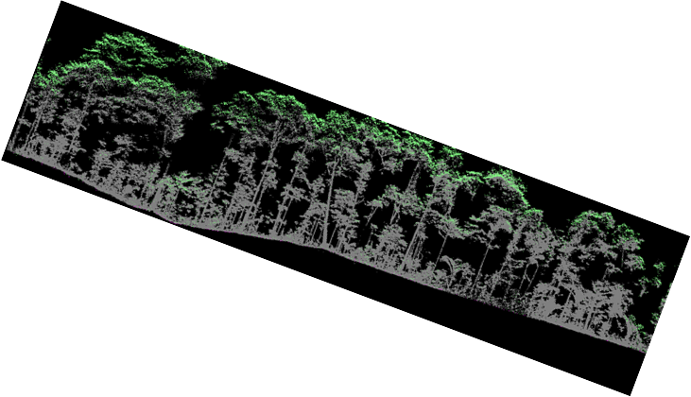
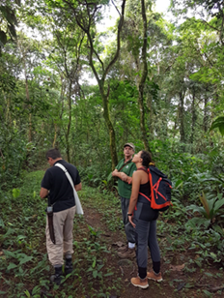
Costa Rica Tropical Forests
Costa Rica: 0.03% of earth's surface but nearly 6 percent of the world's biodiversity
Objectives
Understand the conservation potential of secondary forests in human-modified tropical landscapes
Compare intact and disturbed old-growth forests for conservation potential
Key questions
How to standardize forest ecosystems extent to assess indicators of biodiversity status
How can the conservation potential of secondary forests be assessed using multi-sensor satellite imagery coupled with field data?
Can we assess the conservation potential of forest ecosystems using diversity measures from spectral information?

Slide 14
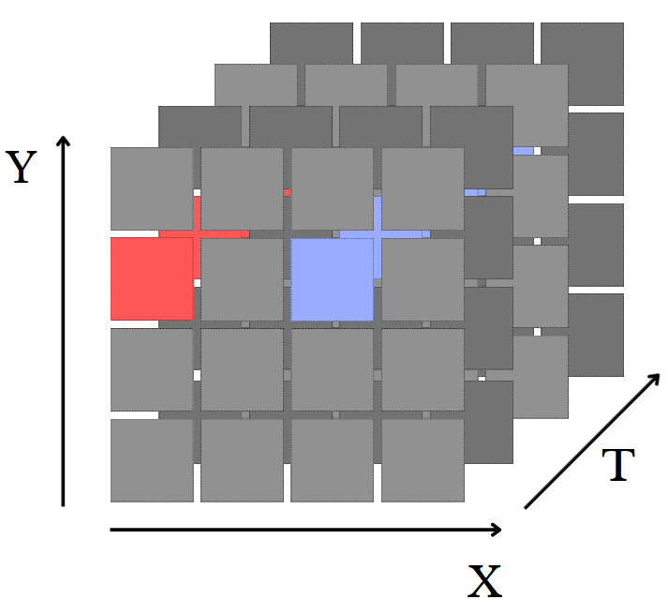
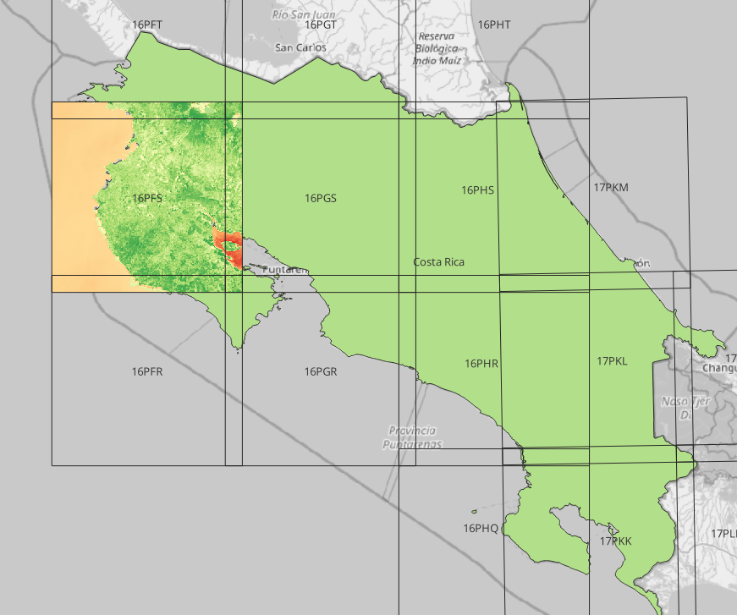
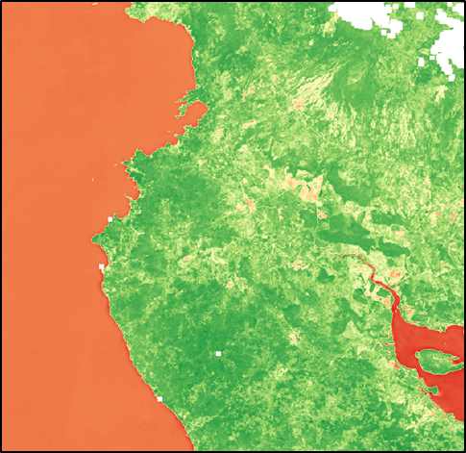
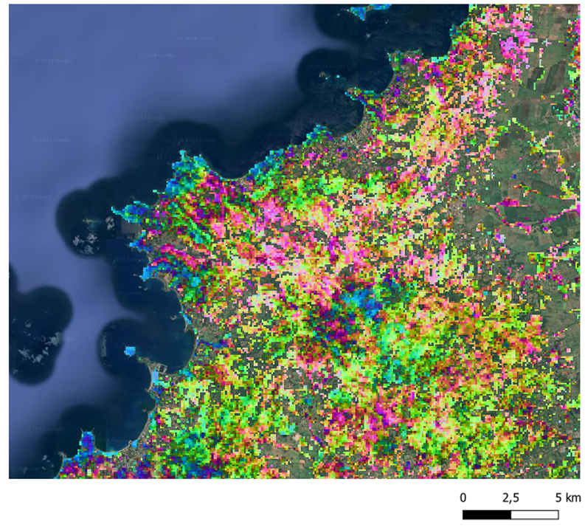
DataCube Catalog Collection Example
1
Remote STAC Catalog Search Parameters used :
Url : https://planetarycomputer.microsoft.com/api/stac/v1
Collection : [‘sentinel-2-l2a’]
Time range : 2017-01-01/2023-12-31
« eo: cloud cover » : {« lt » : 50}
« s2 : mrgs tile » : {« eq » : 16PFS}
Search Results Item Collection :
280 items
EBV-Beta-wet-20170501-20171130

Slide 15
Great Western Woodlands
Largest remaining area of temperate woodlands on Earth with significant biodiversity and cultural values
Under growing pressure from climate change and land-use intensification. High-quality maps of ecosystem extent are needed to inform conservation, restoration, and adaptation strategies
Key questions to be addressed.
Can stand age be reliably mapped from multi-sensor satellite imagery?
Can historic stand growth rates be derived from time-series imagery?
Status
Postdoc position filled (Dr. Adriana Parra).
Collaborations established between CSIRO, the Department of Biodiversity and Conservation Attractions (DBCA), and the University of Bristol
Landsat-5/-7/-8, Sentinel-2, Sentinel-1 and ALOS-2 ingested for analytics in CSIRO’S EASI platform (underpinned by the Open Data Cube)
Training data collation/preparation underway (field survey records/GEDI height data)
Shaun Levick and Adriana Parra
(CSIRO)

Slide 16
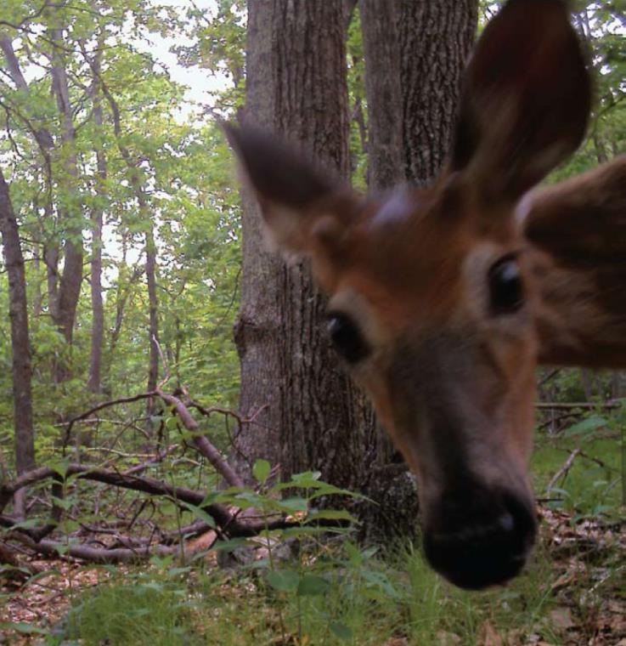
Thank you
US FWS

Slide 17
Backup

Slide 18
Additional resources
GEO BON website, and overview (slides and video)
Ecosystem Extent and Integrity (slides and video): key variables for which satellite EO is essential
UN SEEA: ecosystem accounting variables (extent, condition, services…)
Workshop linking EO and in situ for a global system
Example dashboard highlighting products ASEAN Biodiversity Dashboard
World Economic Forum Global Risks Report 2021
IUCN position paper for UNFCCC COP26

Slide 19
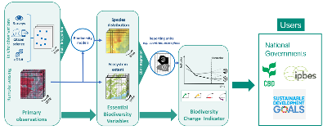
Challenges
Availability of value-added products (i.e. L3, L4)
Operationalizing workflows
EO data usability & technical capacity of users
Combining data from different types of sensors
US National Park Service

Slide 20
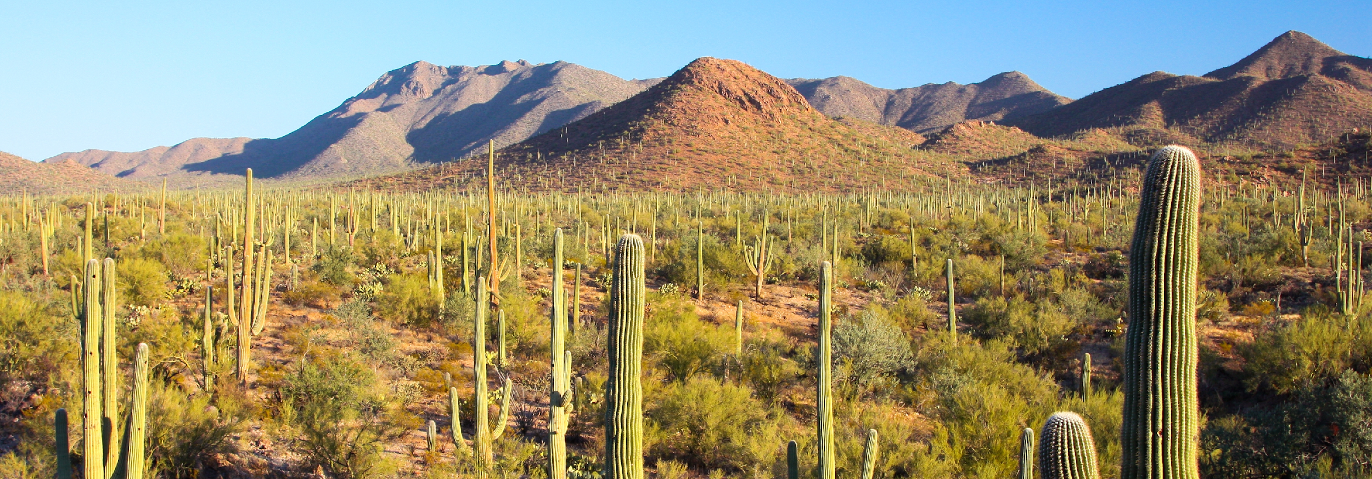
Opportunities
Combining data from different types of sensors
Use of hyperspectral data
Artificial intelligence
Data cubes
Joe Parks, Wikimedia

Slide 21
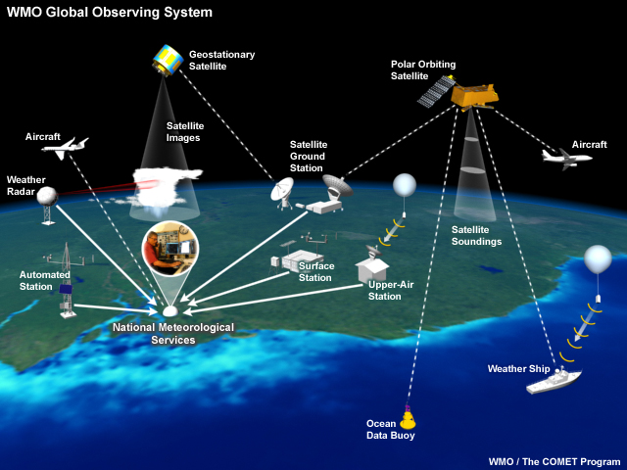
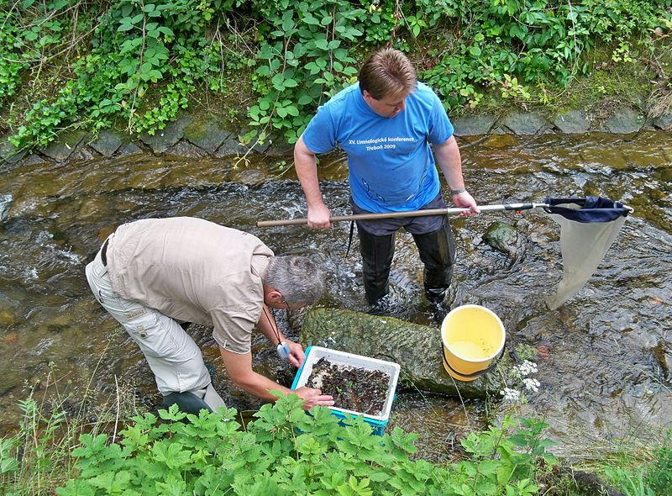
Global monitoring
Weather
Biodiversity
Notes:
WMO Global Observing System:
Globally integrated system with many components
Many partners
Developed and grown over time
Acquires data, processes it, shares it with others in the network, delivers it to users

Slide 22
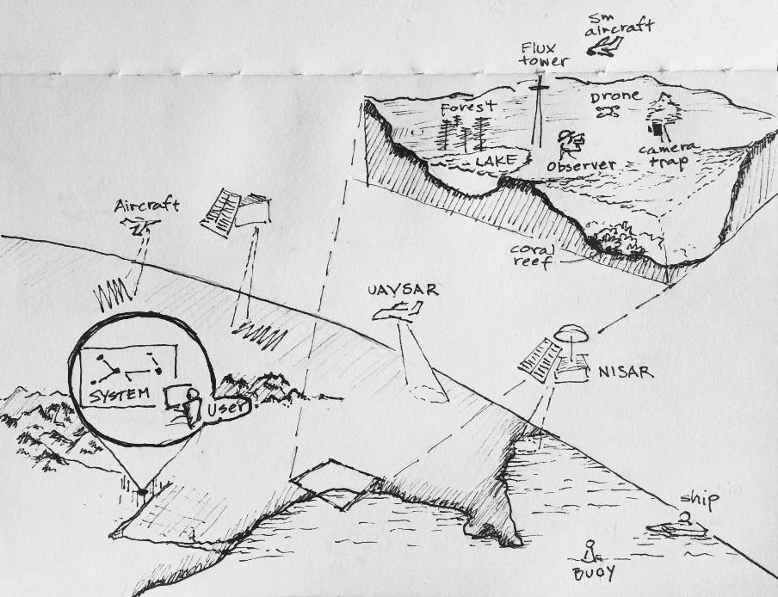
Global monitoring
Global Biodiversity Observing System (GBiOS)
Weather
Notes:
WMO Global Observing System:
Globally integrated system with many components
Many partners
Developed and grown over time
Acquires data, processes it, shares it with others in the network, delivers it to users

Slide 23
Recommendation Area 1
Thematic Recommendation
Specific Recommendations
1. User Engagement
Increase biodiversity community engagement with EO and CEOS through workshop(s) and other activities to improve ecosystem extent mapping.
Key organizations:
Convention on Biological Diversity
UN System of Environmental Economic Accounting
GEO Global Ecosystems Atlas initiative
Ramsar Convention on Wetlands
1a. Identify specific user requirements to guide EOs & identify products needed for ecosystem extent.
1b. Establish a sustainable communication channel between CEOS and user communities for continued interaction.
1c. Improve CEOS understanding of technological, socio-political, and cultural constraints for the biodiversity community to use EO data.

Slide 24
Recommendation Area 2
Thematic Recommendation
Specific Recommendations
2. Technical advances
Support development of technical advances to improve utilization of EO for ecosystem mapping.
2a. For each ecosystem, identify the key EOs and processing methods needed for its delineation.
2b. Facilitate combining data from different types of sensors to take advantage of their complementarity.
2c. Facilitate time series analysis and its application to ecosystem extent mapping.
2d. Explore ways to utilize EO to characterize ecosystem condition and its relationship to ecosystem extent.

Slide 25
Recommendation Area 3
Thematic Recommendation
Specific Recommendations
3. Capacity
Work to increase capacity of biodiversity users to utilize EO for ecosystem mapping and monitoring.
3. Identify opportunities for capacity development resources, e.g., a training or a Massive Open Online Course (MOOC) focused on the use of EO for ecosystem mapping and monitoring.

