Slide 1
BIODIVERSITY:
CEOS Chair Priority for 2024
(Background Slides)
Éric Laliberté
Canadian Space Agency
Agenda Item #3.1
SIT-39, Tokyo, Japan
10 April 2024

Slide 2
What is the context
CSA is prioritising one headline theme for 2024: Biodiversity
Biodiversity is a national priority for Canada
Objectives:
To outline a pathway to a more formal status for biodiversity within CEOS.
To identify how satellite data could support the development of EBVs
To identify how satellite data could support the implementation of the new GBF targets (post COP-15).

Slide 3
What can we measure with RS?
Environmental characteristics (Temperature, precipitation, topography…)
Optical characteristics of vegetation
Greenness
+ in situ data => Species distributions
Leaf & canopy “traits” (water content, structural compounds…)
Radar and lidar
Ecosystem structural characteristics (height, profiles)
Soil characteristics & content
Agriculture
Complementarity: Combine sources

Slide 4
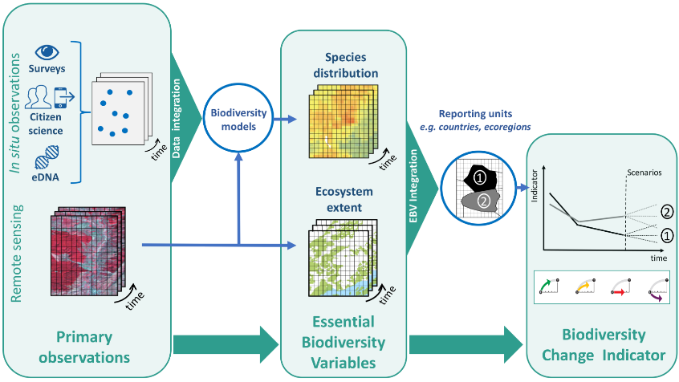
Workflow: from raw observations to users
Users
National Governments
Navarro et al. 2017 COES
Notes:
This is the overall workflow from observations to EBVs, indicators, and users…but, this is not commonly operationalized. GBiOS would facilitate that process.

Slide 5
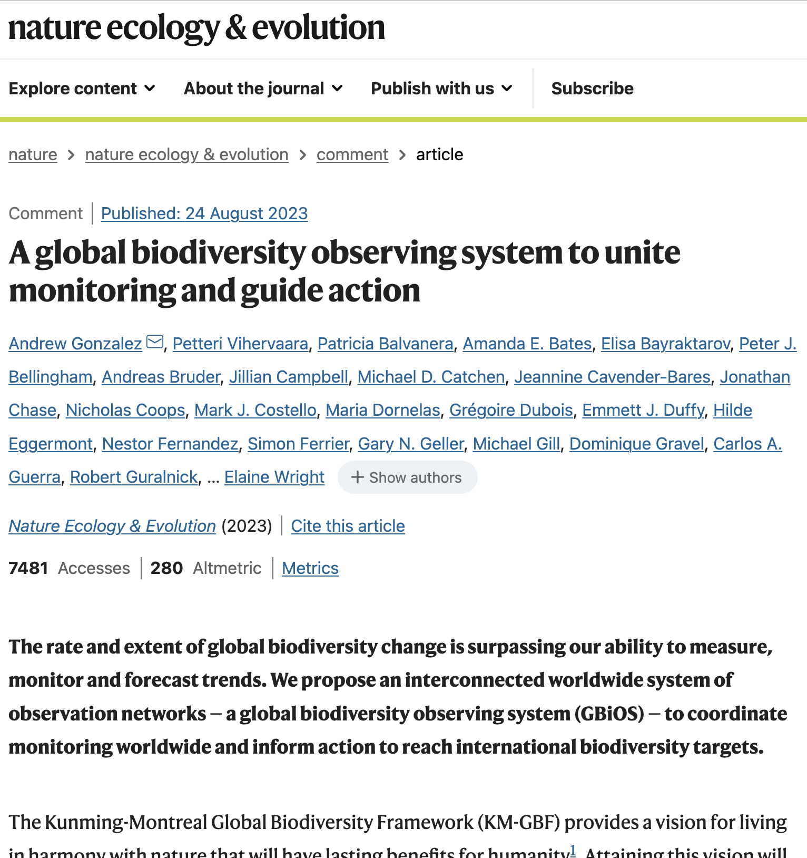
Biodiversity: A complex space
There is a broad portfolio of biodiversity-related projects and activities, as well as programs and stakeholders.
How could CEOS better contribute?
Scoping and leveraging is critical
Various angles: Ecosystem Extent - Composition - Condition, Ecosystem Accounting, (+ genetics, species)
Targets
EBVs
Indicators
GBiOS

Slide 6
Demonstrators: Paths to an enduring role for biodiversity within CEOS
Ecosystem Extent Task Team work: 3 demonstrators have emerged:
Hudson’s Bay Lowlands (HBL)- led by ECCC
Costa Rica Forested ecosystems - led by CNES/INRAE
Great Western Woodlands (GWW) - led by CSIRO

Slide 7
CEOS Chair’s Approach
Priority #1
(Internal)
Exploring a Post-2024 Strategy for CEOS and Biodiversity
Priority #2
(External)
Increase Policy Footing and Linkages to the Biodiversity Community
Paper available here

Slide 8
Priority #1:
CEOS Internal Study

Slide 9
Priority #1: Consultations with CEOS Agencies, WGs and VCs
Results:
WGCapD: Clear potential role in capacity development for biodiversity. Leverage MOOCs.
WGClimate: Potential overlaps between ECVs and EBVs, and lessons learned regarding response to such a framework (ECVs, CDRs, external stakeholder relationships). Clean linkage climate and ecosystem change
WGCV: Land Product Validation Subgroup validation protocols; intercomparison activities; FRMs focused on Biodiversity; fundamental cal/val of datasets is of course crucial for biodiversity applications.
WGDisasters: RO for biodiversity post-disasters; Wildfire pilot fuel component - species, drought conditions; disaster/climate vulnerability linkages; UNOOSA relationships, UNCCD definitely a potential user.
WGISS: Leverage Interoperability framework for complementarity/interoperability of datasets; data access activities, STAC, Open Data Cube, AI/ML – all enabling technologies for biodiversity community. Support data access and formats challenges.
-Understand which agencies, WGs and VCs are really active or have interest in biodiversity and how we might make connections.
-Avoid creating new structures where biodiversity tasks could be suitably assigned under existing mandates. Identify any gaps. Avoid duplication / disruption.

Slide 10
Virtual Constellations Potential Support
Results:
AC-VC: Hyperspectral instruments used for atmospheric composition measurements could also be used for biodiversity related parameters, although at km-scale resolution.
LSI-VC: Demonstrators are a great opportunity to test out both CEOS-ARD and the Interoperability Framework. CEOS-ARD key enabler for EO uptake by the biodiversity community.
OCR-VC: BiCOME and BOOMS projects are focused on the marine/coastal domains. Freshwater ecosystems (BIOMONDO) and Terrestrial ecosystems (EO4Diversity). Biodiversity in aquatic environments is an input to Copernicus Next Generation mission definition.
P-VC: Potential connection with water availability, drought induced stress, etc. GPM applications on agriculture could be useful.
SST-VC: No real biodiversity initiative connection for now

Slide 11
CEOS Members Activities
Current situation
NOAA: Marine focus, Marine BON, potential connection to COAST, Coastwatch Seascapes, Coral Reef Watch, IUU fishing, National Marine Sanctuaries, ecosystem accounting connections,
ESA: History with GEO BON, EBVs, workshops, Copernicus, ESA science goals
SANSA: Strong policy connections in South Africa, South African National Biodiversity Institution, Digital Earth Africa, Forestry, Invasive Species, EO Dashboards goal
JAXA: Providing data for EETT demonstrators, long mangrove / Ramsar / Global Mangrove Watch history
ISRO: Pilots on ecosystems in himalayan alps, mangrove areas, and coral reefs; working towards generation of EBVs for official reporting
NSO: Issuing three open calls for biodiversity projects (Nature, Agriculture, Water), EO planned for Dutch statistics office, strong demonstrator potential
USGS: Co-leading EETT (Roger Sayre), GEO Ecosystem Atlas activity, Silvacarbon, GFOI
DLR: Supporting German Ministries, Biodiversity MOOC suggestion, EnMAP applications and indicators, EETT support
CSIRO & GA: CSIRO co-leading EETT, Australian (WA) demonstrator; TERN (Terrestrial Ecosystem Research Network) and AusCalVal linkages noted; wildfire recovery interest;

Slide 12
Priority #2:
External Stakeholder Engagement

Slide 13
Engagement with External Stakeholders
3 meetings held with UN CBD & GEO BON to discuss enhanced collaboration.
Suggestion: wider group of parties interested in a better coordination of the biodiversity ecosystem – namely GEO, FAO and UN Stats Division.
Draft Dialogue proposal circulated to SEC members for comments

Slide 14
3.1 - CEOS & Biodiversity:
the way forward

Slide 15
CEOS Chair’s Approach
Priority #1
(Internal)
Exploring a Post-2024 Strategy for CEOS and Biodiversity
Priority #2
(External)
Increase Policy Footing and Linkages to the Biodiversity Community
Paper available here

Slide 16
Internal - Early thoughts
CEOS Governance Structure
No additional WG proposed in the short-term
Responsibilities similar in nature to those of newly created COAST-VC
Portfolio of biodiversity-related projects allocated to existing groups
Based on current role & expertise
Increased workload
Biodiversity oversight group
Coordination of biodiversity outputs from CEOS WGs & VCs
Point of contact for external partners
Similar to ARD, SDG existing oversight groups
Specific tasks TBD
Under SIT Chair? Under SEO?

Slide 17
External - proposed next steps
Overall objective:
to strengthen synergies for a lasting relationship
between biodiversity actors
-Biodiversity Dialogue between CEOS, UNCBD, GEO, FAO and UN Stats division
-Potential areas of cooperation among participating organisations:
Exploring how existing and future space assets can be mainstreamed to address needs related to monitoring and understanding biodiversity change at all levels (global, regional, national).
Supporting the development and engineering of EBVs defined by GEO BON to unify, harmonize, and standardize biodiversity monitoring and reporting (deriving EBVs from EO measurements).
Showcasing and promoting the contribution of satellite assets to biodiversity monitoring and conservation.
Provide guidance to national governments on how to the access, process, and analyse satellite data streams, proposing solutions for countries to access and develop tools
Supporting the development of EO capabilities for biodiversity monitoring by countries.

Slide 18
Biodiversity Dialogue between CEOS, UNCBD, GEO GEO, FAO and UN Stats division
Proposed approach:
UNCBD to host a preparatory workshop to discuss areas of collaboration (Montreal, June 10–11, 2024) - hybrid
Once all areas will have been discussed by interested experts, CSA to host a “Biodiversity Dialogue” during which recommendations stemming from June workshop will be confirmed and included in one generic document – to be agreed upon by all participants (CSA HQ, September 12-13, 2024) - hybrid
Such document would be used as the content of a statement - meant to enhance and structure coordination of activities between international biodiversity actors.
Document to be presented to CEOS members during 2024 Plenary for review.

Slide 19
Outcomes - April 9 Side Meeting
Biodiversity spread all across CEOS groups - need a way to tie it together
Connection to policy stakeholders key – there is a diverse range for biodiversity
Past Oversight / Coordination Groups have had narrower focus
Biodiversity would need a ‘cross-cutting’ VC – stretching definition of traditional VC
Creating a new VC complicates responsibilities of existing VCs (duplication)
Noted growing call for CEOS support to thematic products (EAVs/EBVs/ECVs)
May need a new paradigm
Perhaps it is a ‘responsive group’. Responding to needs coming from various stakeholders.

Slide 20
Discussion seed questions
CEOS Principals: what are your reactions to initial proposals from the CEOS Chair regarding the future of biodiversity in CEOS?
Proposed biodiversity Dialogue: do you have suggestions for leads to coordinate discussions on the 5 areas of collaboration?
In your views, what should be the future priority biodiversity activities for CEOS?
Is biodiversity as central of a focus theme as climate is?
If so, should CEOS devote it as much importance internally?
How? New resources? Dedicated WG?

Slide 21
Thank you!
Any questions or comments?

