Slide 1
AFOLU National Demonstrator Activities
Sylvia Wilson
US Geological Survey
SIT Meeting
April 10, 2024 - Japan

Slide 2








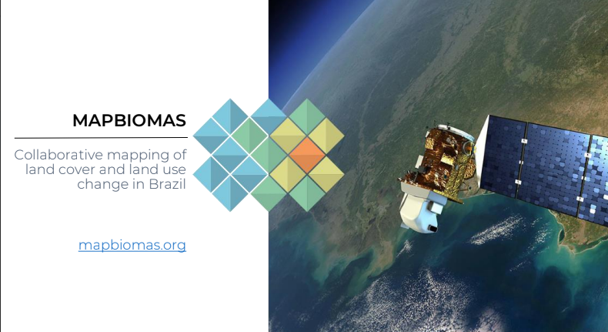


Country Uptake
Overarching Goals
Demonstration of uptake of satellite-based data and derived products in country reporting to the UNFCCC
Contribution with data and input from countries to the Biomass effort
Provide national feedback on, and contribute to the refinement of, available products derived from satellite-data (land cover and biomass).
Notes:
The overarching goals of the national user engagement effort are to demonstrate the uptake of space data and derive products in a way that is useful to guide country reporting to the UNFCCC. This is not easy, there is a lot of work and tweaking that needs to be done to datasets to fit specific country requirements. Also, is not a new problem, there have been many datasets distribute for free and available to all for a long time, but not being utilize, and the reason is that the uptake require specific work to adjust the dataset to each country definitions and classifications, but also there is a capacity building component to get the data ready to use it. If this capacity component is not set in place then the country will resource to what they know, and the data they have been using.
The next goals are to validate a harmonize biomass map with ground base data from countries and to provide national feedback to improve the data available, and this can be done by calibrating existing datasets with country-based data. This is a two-way benefit here. If we use country data to calibrate global products, the maps will be more accurate, and more likely to get use.

Slide 3
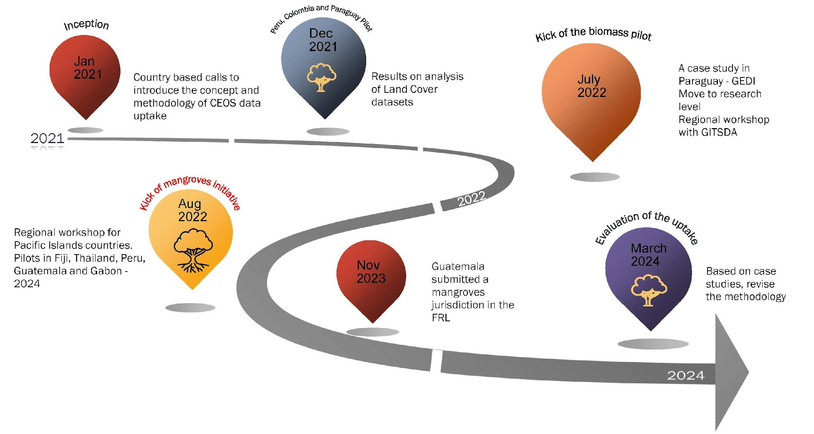
Country Uptake

Slide 4
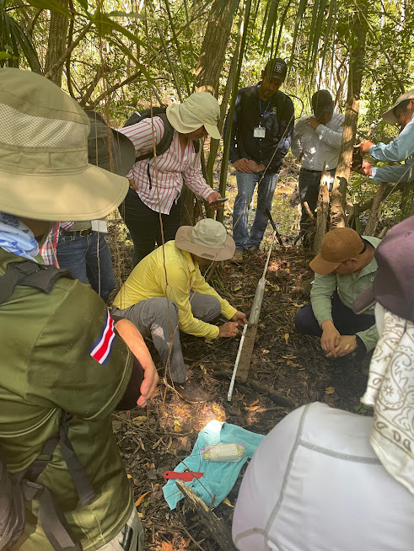
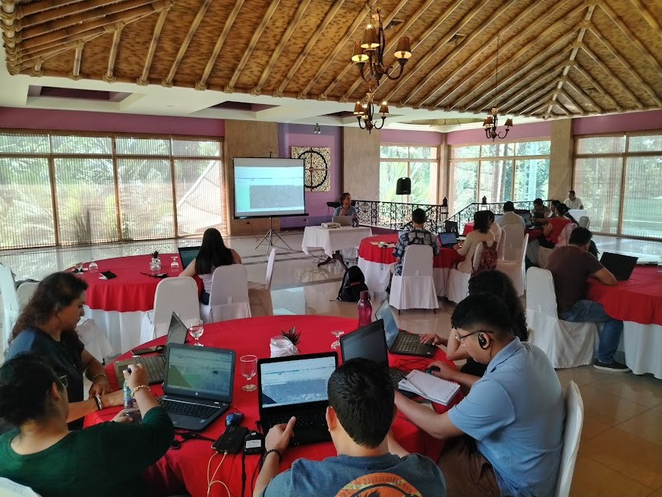
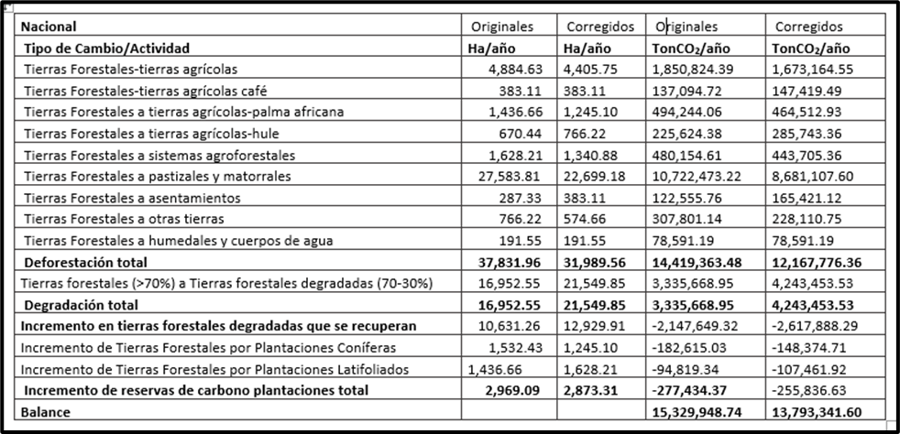

GUATEMALA RESULTS
1. Improved carbon balance, and revise submission of Forest Reference Level
2. Inclusion of a mangroves as a new jurisdiction in reporting
Notes:
The first reference level is from 2006 – 2016, and the second one is 2016 – 2021. They improved because they have access to Google Earth Engine algorithms, but also NICFI High resolution data through GEE from SEPAL and Collect earth

Slide 5
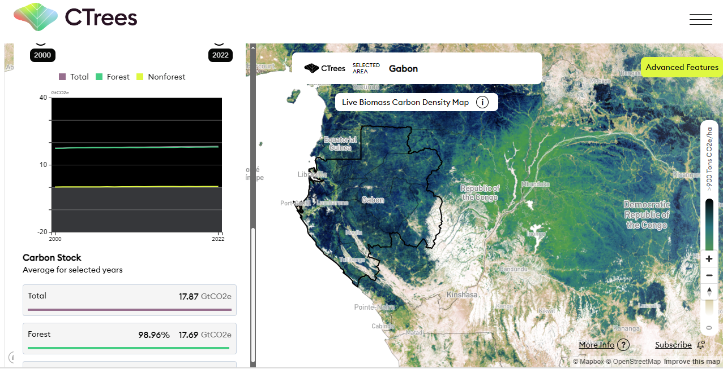

National Green House Gas Inventory vs Independent Estimates
Gabon Case Study
BUR1 with REDD+ Annex and FREL 2021
GHG inventory data Larger forest sink (-119 MtCO2 compared to
-86 MtCO2 in CTrees)
Geo for Good Summit 2023

Slide 6
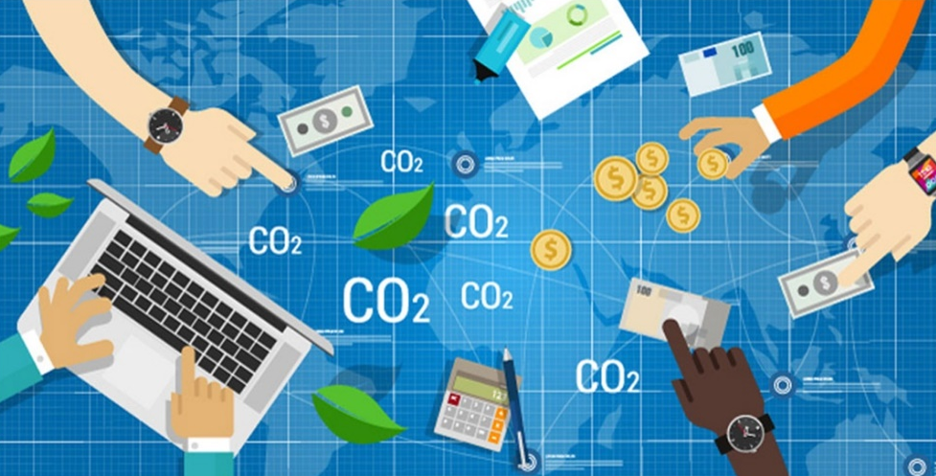

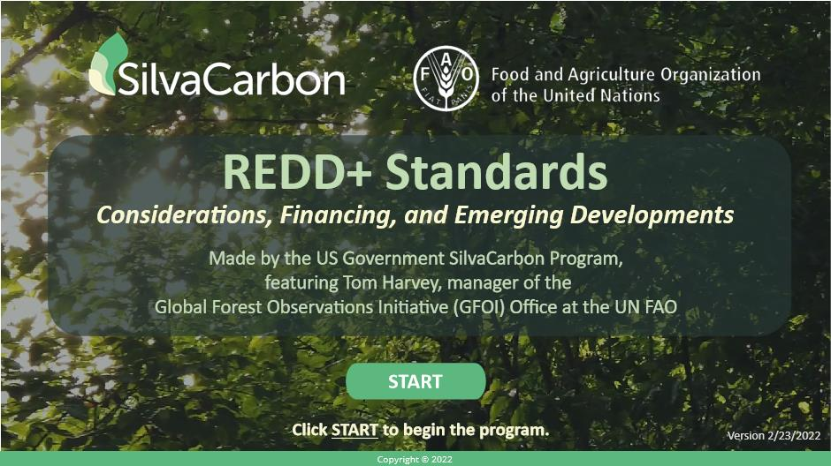
Voluntary carbon markets vs UNFCCC Reporting
As EO community:
Who do we have to inform?
Who are we informing?
How connected these two are?
Geo for Good Summit 2023

Slide 7
In conclusion and moving Ahead….
Cambodia (USGS and JAXA) initiative
EU Deforestation-free commodities policy - Move into the agriculture global products (AFOLU)
Evaluate the efforts
Request new partners within CEOS agencies
Strengthen the operational collaboration with ESA
Activities in respond to the AFOLU roadmap actions
    Continue a mangrove mapping initiative with Peru and Colombia
    CCI Biomass in Guatemala with Potsdam University

Slide 8
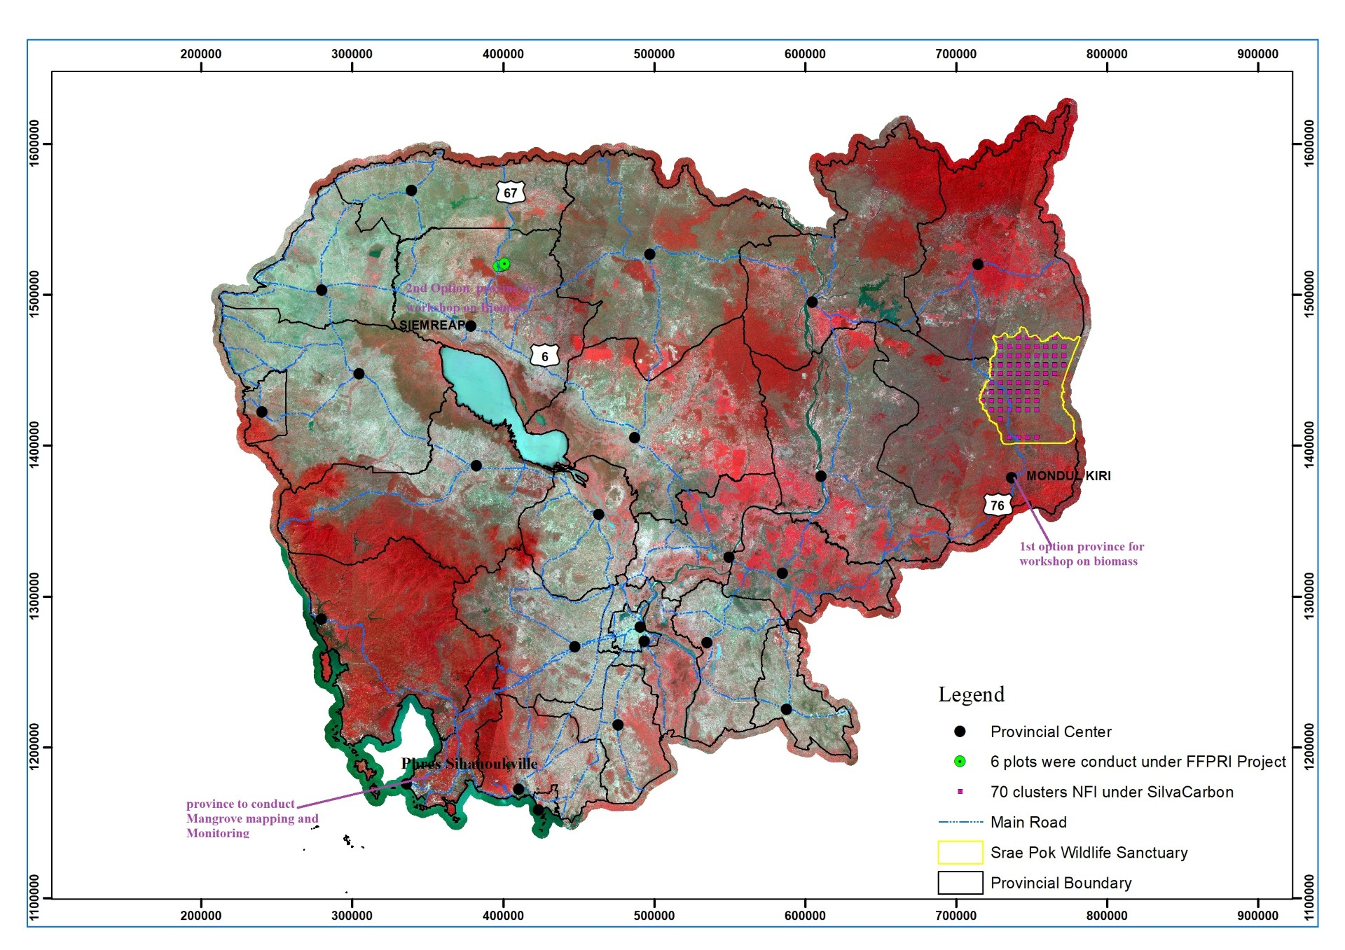
CAMBODIA BIOMASS MAPPING AND MANGROVE MAPPING AND MONITORING
Upcoming workshop:
June 25 – 29 Mangroves Mapping and Carbon Estimation
July 01 – 03 Biomass Mapping featuring new Jaxa product and GEDI estimates (Duncanson)

Slide 9
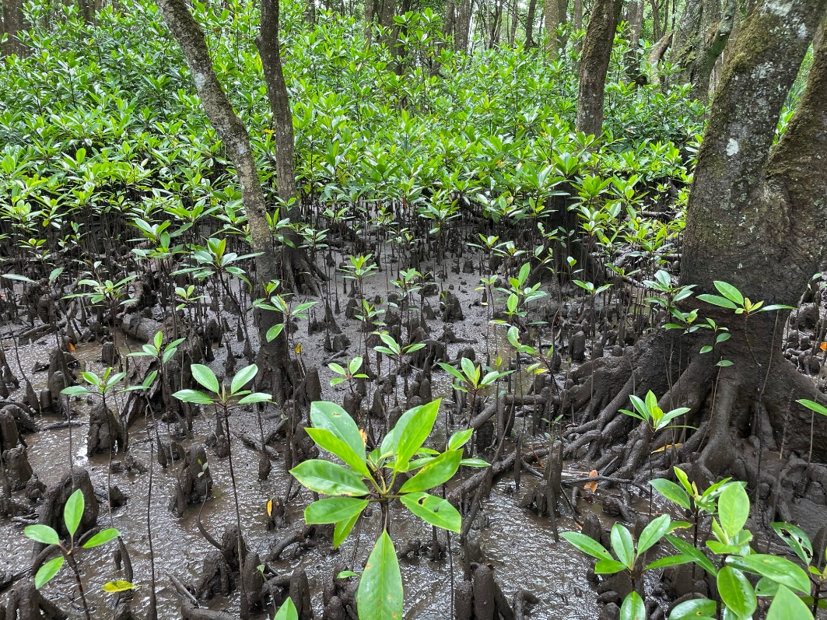
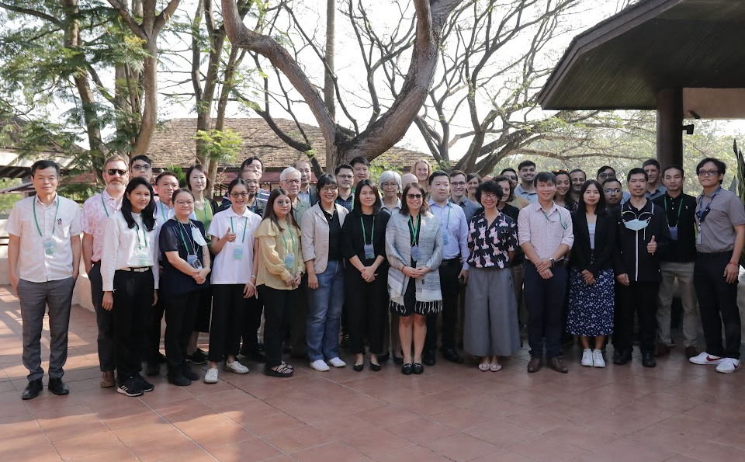
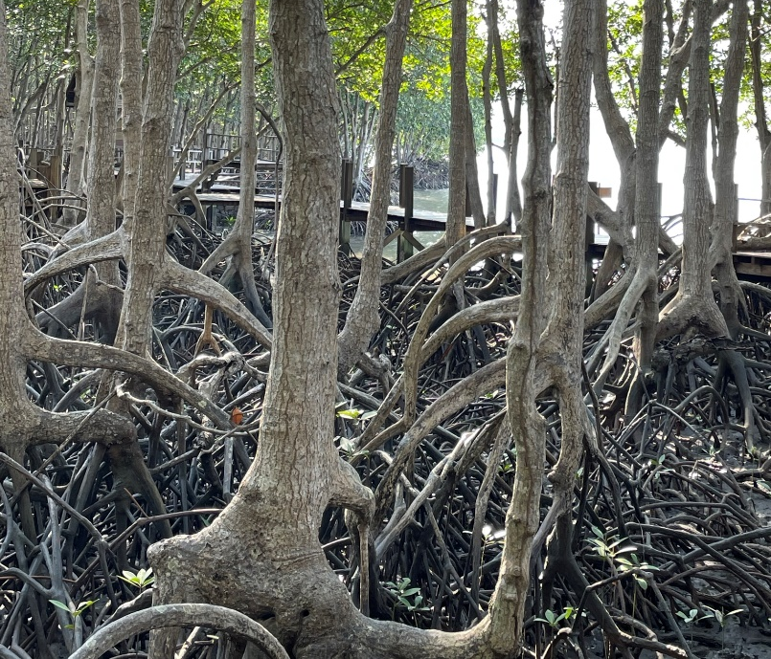
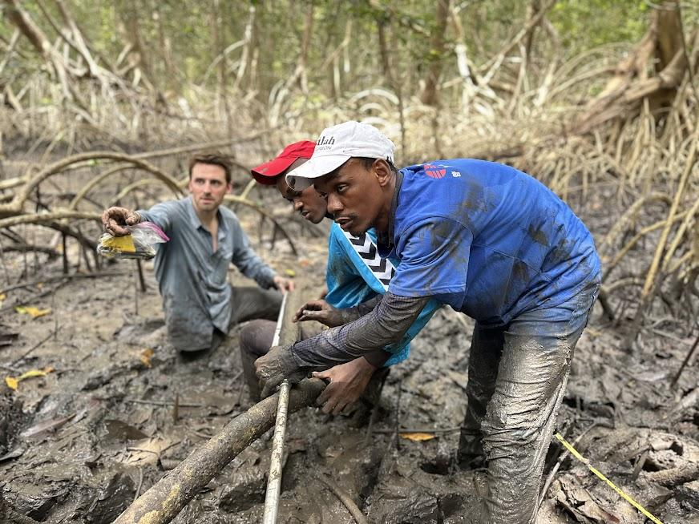
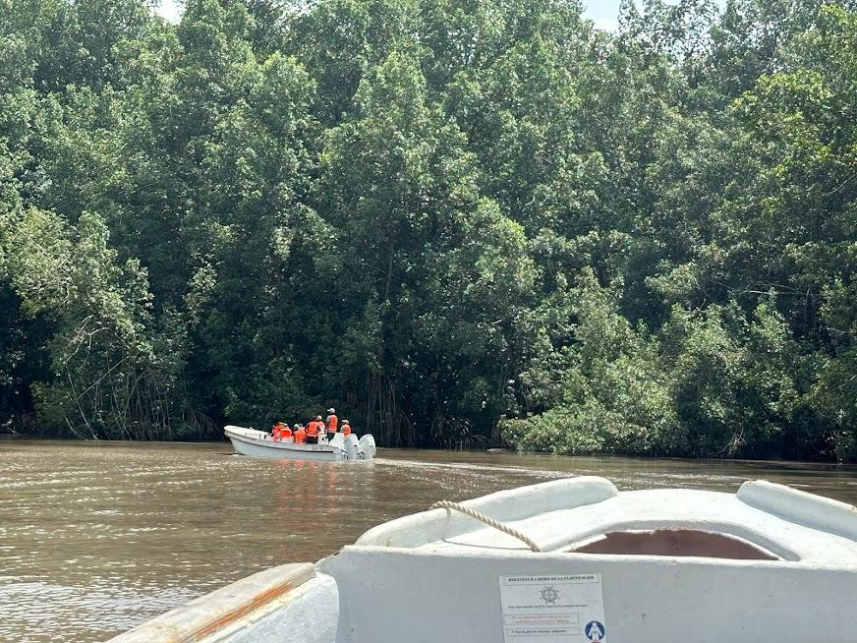
In conclusion and moving Ahead….
Thanks!
Sylvia Wilson
snwilson@usgs.gov

