Slide 1
AFOLU Activities Session
Introduction
JAXA SIT Chair team
Agenda Session 2
SIT-39 2024, Tokyo, Japan
10th - 11th April 2024

Slide 2
Objectives & contents
Review actions status of the CEOS AFOLU Roadmap and hear related activities
Biomass Harmonisation Project
Addresses issues around space agency global dataset uptake and need for cultural and technical changes
Seeking to improve climate policy impact for our data
National Demonstrator Activities
Demonstrate space-based AFOLU maps and compare with National inventory results
CEOS AFOLU Roadmap Actions
Analagous to GST Strategy Actions - compact appendix to Roadmap for ease of implementation and tracking

Slide 3
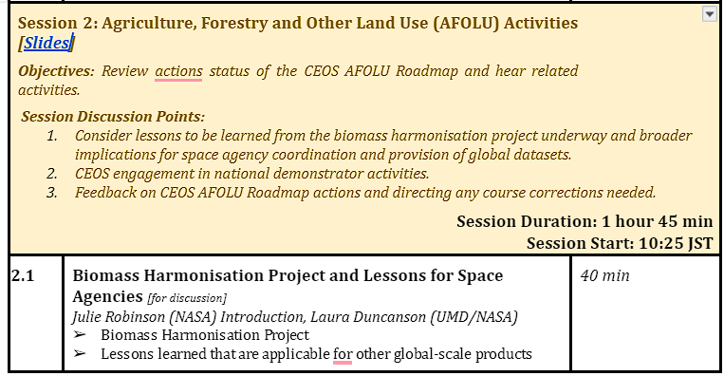
Our session

Slide 4
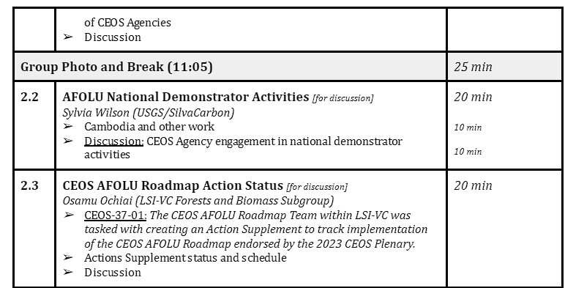
Our session contd.

