Slide 1
SIT-39 2024
Objectives & Action Review
Osamu Ochiai, JAXA
Agenda Item #1.2
SIT-39 2024, Tokyo, Japan
10th - 11th April 2024

Slide 2
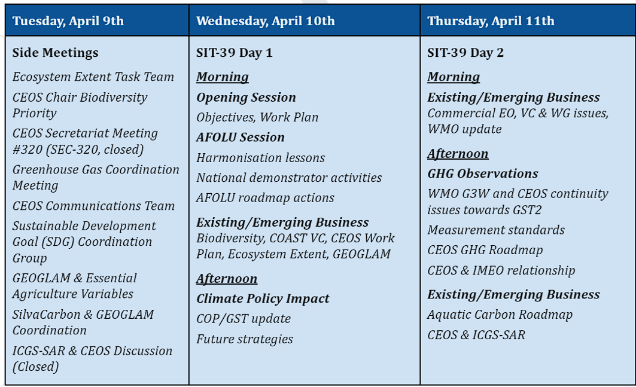
Week at a Glance

Slide 3
SIT-39 Main Sessions
SIT Chair Priorities
  Day 1: Agriculture, Forestry, and Other Land Uses (AFOLU)
  Day 1: Climate Policy Impact
  Day 2: Greenhouse Gas Observations
Existing and Emerging Business
  Day 1: Biodiversity, COAST VC, CEOS Work Plan, Ecosystem Extent, GEOGLAM
  Day 2: Commercial EO, VC & WG issues, WMO update
Other Business
  Aquatic Carbon Roadmap, SDGs, CEOS Comms, CEOS & ICGS-SAR, NASA’s Earth Science to Action Strategy

Slide 4
AFOLU Session
CEOS AFOLU Roadmap (2023) Actions Supplement feedback and forward actions
Consider lessons learned from biomass harmonisation project underway and implications for space agency coordination and global datasets provision.
Update on AFOLU national demonstrators for EO satellite uptake.

Slide 5
Climate Policy Impact Session
Take stock of EO community’s role in climate policy process, notably UNFCCC and GST, including IGES report on GST1 in 2023.
Debate enhancing coordination across EO frameworks, between CEOS and WMO, research and operational agencies.
Consider specific strategies for GST2 timeframe (2028) to provide focus and mobilisation of community efforts. Discuss potential updates on CEOS GST Strategy (2021).

Slide 6
Greenhouse Gas Observation Session
Update on WMO G3W initiative, its Implementation Plan, and CEOS collaboration opportunities. Discuss CEOS GHG Roadmap updates needed in response.
Consensus on CEOS GHG Roadmap (2020) updates in 2024 and associated actions for updating.
Assess CEOS Agency changes in GHG observation continuity and data supply/product generation outlook through to GST2 (2028).
Review activities underway to document best practices and standards for measurement of GHGs from space and seek consensus on coordination and CEOS goals.
Discuss way forward for CEOS relationship with IMEO and acknowledge the national policy dimension.

Slide 7
Existing and Emerging Business, Other Business
Update on biodiversity initiatives led by 2024 CEOS Chair, CSA; EETT Demonstrator reports;
  Discuss ideas from CEOS Chair regarding the future of biodiversity in CEOS
Discussion and potential decision on COAST VC Full Proposal, Implementation Plan, and Terms of Reference.
Update on CEOS Aquatic Carbon Roadmap + decisions to drive forward
Discuss GEOGLAM agricultural priority data needs and possible CEOS response
CEOS relationship with ICGS-SAR - discuss approach for increased coordination
Review SDGs, CEOS comms activities

Slide 8
Existing and Emerging Business II
Decision: Updated P-VC Terms of Reference
Review and discuss: ESA PolInSAR recommendations (from LSI-VC)
Review and discuss: CEOS-ARD Strategy 2024
Ocean Surface Topography (OST-VC) leadership update
For Information: Report on Tokyo LSI-VC industry engagement session
For information: CEOS Analytics Lab (CAL) commercial data interoperability study

Slide 9
Updates: CEOS Plenary actions due at SIT-39

Slide 10
2023 CEOS Plenary Actions Due at SIT-39
CEOS-37-01: CEOS AFOLU Roadmap Team to create an action supplement to track implementation of CEOS AFOLU Roadmap endorsed by 2023 CEOS Plenary.
  In progress - This will be covered under item 2.3 during AFOLU Activities session. Action will be closed.
CEOS-37-04: P-VC Leads to develop and present updated P-VC Terms of Reference (ToR) for review and potential endorsement at SIT-39.
  P-VC will present updated ToR during item 6.1 of the Existing & Emerging Business session. Action will be closed.

Slide 11
2023 CEOS Plenary Actions Due at SIT-39
CEOS-37-05: CEOS WG Chairs and VC Co-leads to review their key documents featured on ceos.org/observations and provide updates to SIT Chair Team.
  This is an ongoing task. Updates welcome at any point in time. SIT Chair will continue updating this page as needed. Action closed.
CEOS-37-06: CEOS Agencies to coordinate with the CEOS EETT Leads if interested in contributing a Demonstrator for Ecosystem Extent mapping activity.
  Progress update to be discussed under item 3.2 during Existing & Emerging Business session. Action closed.

Slide 12
2023 CEOS Plenary Actions Due at SIT-39
CEOS-37-07: CEOS COAST Ad Hoc Team Co-leads to develop Full Proposal for new COAST Virtual Constellation, incl. Terms of Reference & Implementation Plan for April 2024 SIT-39 decision.
  Required documents have been submitted. The final documents for SIT-39 consideration were distributed by the SIT Chair on March 19. To be further discussed under item 3.3. Action complete.
CEOS-37-08: CEOS Executive Officer and ESA 2022-2023 SIT Chair team to incorporate CEOS NSTT recommendations into CEOS 2024-2026 Work Plan with relevant CEOS entities' input, referencing 2023 CEOS Plenary discussion.
  Complete. This will be addressed during item 6.3 of Existing & Emerging Business session. Action complete.

