Slide 1
SIT-39 2024
Session 1: Welcome and Opening Session
SIT Chair Team, JAXA
Agenda Item #1.1
SIT-39 2024, Tokyo, Japan
10th - 11th April 2024

Slide 2
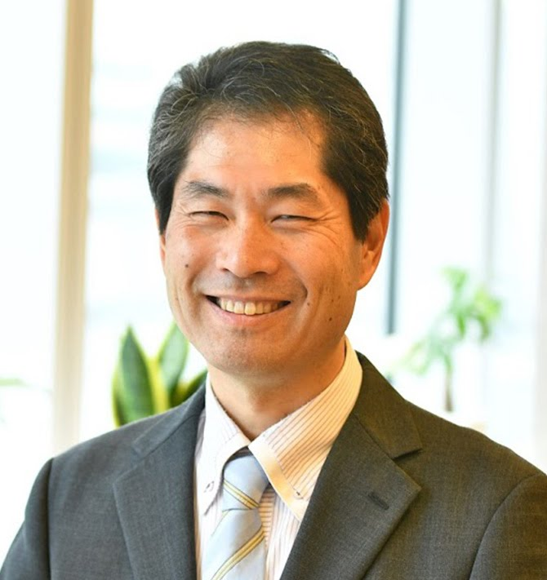
Welcoming Remarks
Hironori Maejima
CEOS SIT Chair 2024-2025
Senior Chief Officer of Earth
Observation Missions
JAXA
SIT Chair Team, JAXA
Agenda Item #1.1
SIT-39 2024, Tokyo, Japan
10th - 11th April 2024

Slide 3
SIT 2024-25 Approach
Focused: a few priorities reflecting major thrusts across civil EO programmes and priority needs, consistent with past CEOS outcomes
Tangible and achievable outcomes with enduring benefit
Ensuring continuity: for existing SIT and CEOS WP activities
Reflecting resource availability
Stressing CEOS agency participation
Consistent with the original vision for SIT:
Principals in SIT meetings address significant challenges via coordination and observing system harmonisation across space agencies
Effective use of the different meetings:
SIT: Significant debate and decision - for Principals
TW: Working Teams reporting, interaction, and prep for Plenary
All meetings cannot accommodate reporting of all CEOS business
Ensure effective intersection between CEOS management and WP contributors

Slide 4
JAXA SIT Chair Priorities
JAXA SIT Chair Priorities
Climate Policy Impact – addressing obstacles and opportunities for CEOS agency data, particularly AFOLU/Biomass map datasets, to have maximum impact in the key climate policy processes such as the Global Stocktake of the Paris Agreement
GHG observations from space – addressing coordination for data continuity challenges ahead and developing good practices so that operators of all kinds may contribute to societal needs
Supporting existing & emerging CEOS business
Escalating, elevating and expediting the CEOS WP activities underway and planned in which CEOS agencies are investing

Slide 5
Climate Policy Impact
Addressing opportunities for EO data impact on climate policies
Significance of AFOLU datasets to understand sink and source of GHG from the land surface which is the primary domain of human and natural activities
Progress AFOLU Roadmap implementation and actions
Important dataset harmonisation studies offer insights and new opportunities
National Case Studies on EO data impact
Space based AFOLU datasets (e.g., Biomass map) for potential GHG inventory reporting in Asian countries
Asia focus of SilvaCarbon: working dataset for reporting and more
Responding to GST1 outcomes and reinforcement of UNFCCC engagement
EO-related support arising from 1st Global Stocktake
Propose to launch a coordinated effort targeting EO data role in the next update of the IPCC Task Force on Inventories Good Practice Guidance (circa GST2 in 5 years)
Highly insecure interface for CEOS (and GEO, WMO) to UNFCCC SEC and COP process to explore mechanisms for improvement
Other policy engagement
Updated Space Agency Response to GCOS IP (Plenary 2024)
Alternate angles (eg Covenant of Mayors)

Slide 6
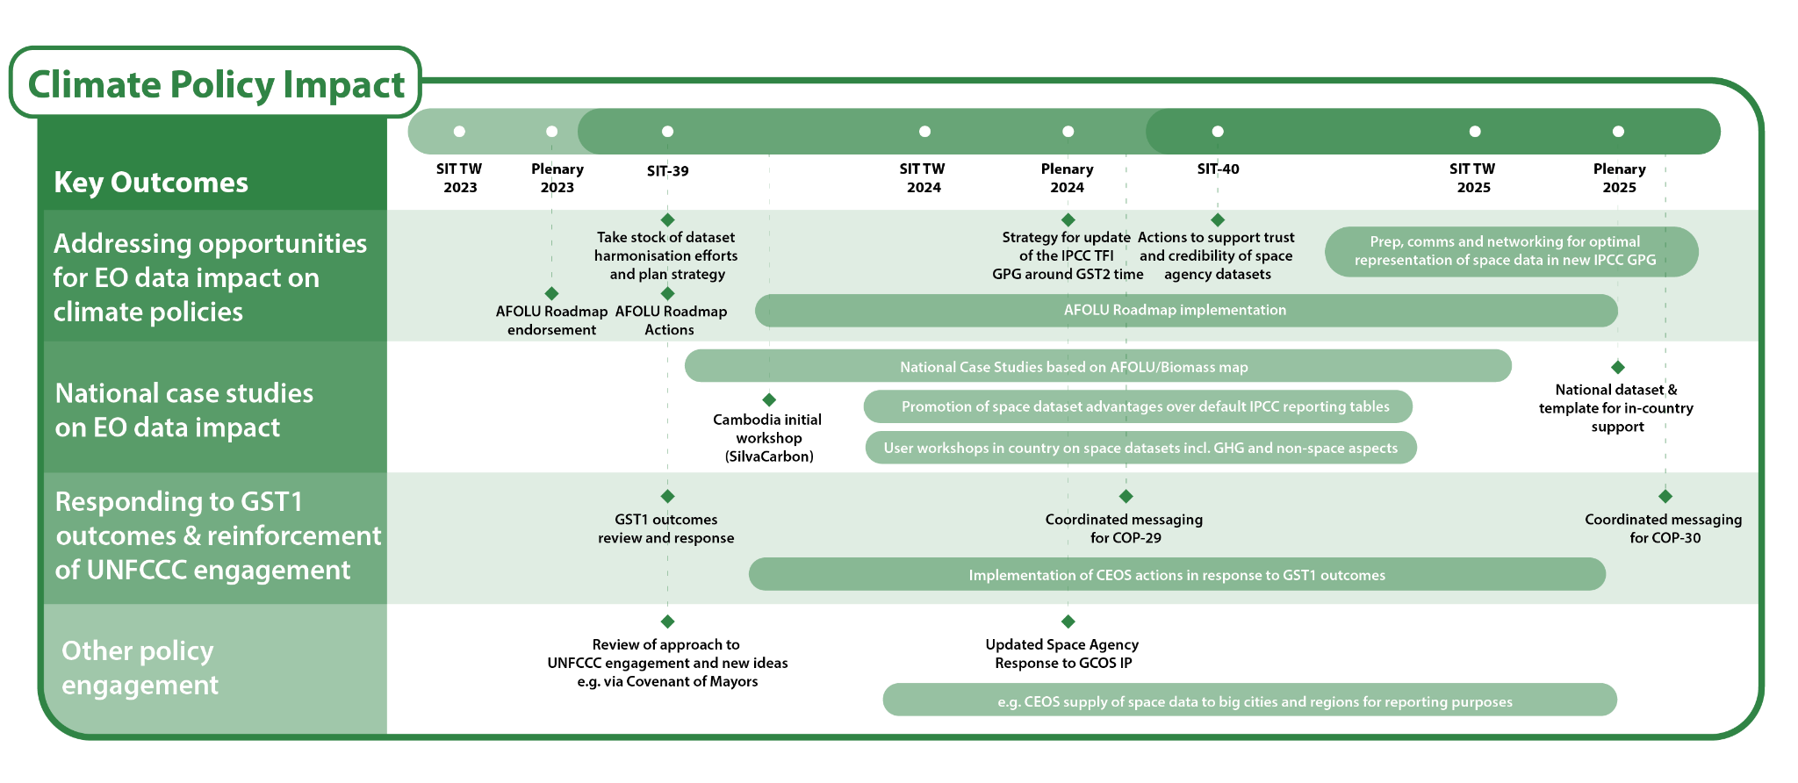
Climate Policy Impact

Slide 7
GHG Observations from Space
Observation continuity
Multiple delays, cancellations or program reductions of concern
Update GHG mission portal (with ESA MIM team) to aid coordination
Update space agency response to GCOS IP
GHG Roadmap Implementation
Implementation of the GHG Roadmap including CO2 emission from mega cities.
GHG Roadmap update
Good Practices for GHG Emission Estimates from Space
Diverse data contributors to goals like IMEO MARS - CEOS can help optimise contributions of smaller missions
Best Practices document including methods for evaluating commercial products through engagement with IMEO, WMO+
Case studies to monitor Methane from rice field
Active engagement with policy entities – UNEP IMEO and WMO G3W
IMEO Roadmap with CEOS inputs
Active engagement in WMO G3W discussion
Support to Global Methane Pledge

Slide 8
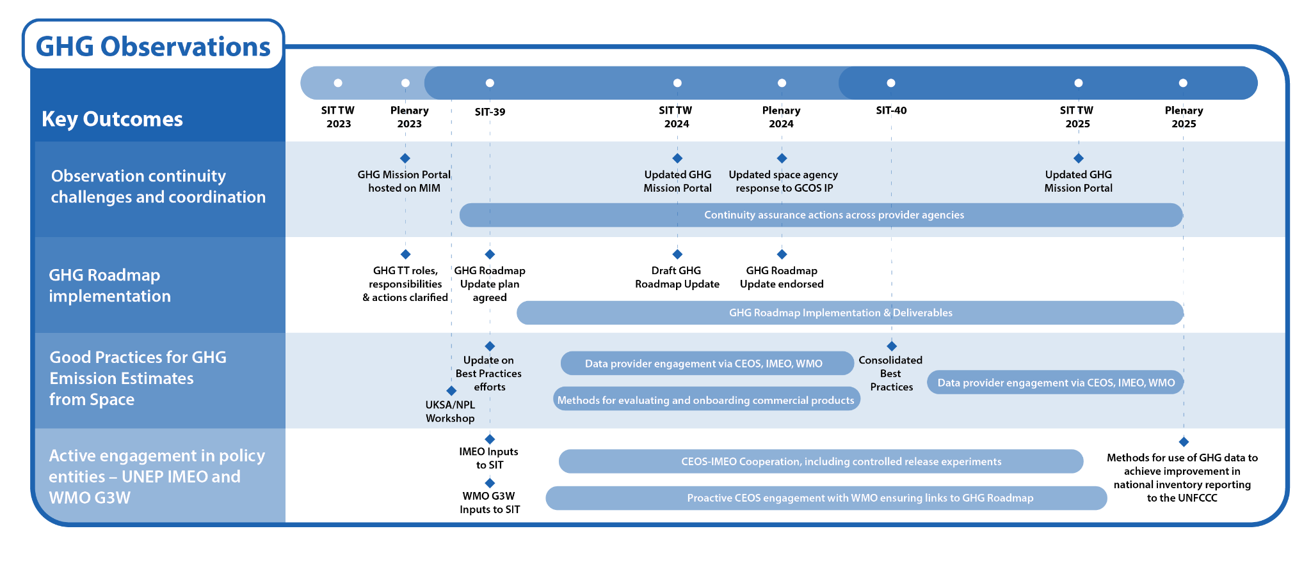
GHG Observations

Slide 9
Existing & Emerging Business
Support for current CEOS WP tasks & deliverables
2024-2026 CEOS Work Plan, 2025-2027 CEOS Work Plan
Including GEO contributions and interfaces
SDGs, ARD etc
Expedite emerging business as required
CEOS Aquatic Carbon Roadmap
Biodiversity Initiative of 2024 CEOS Chair
Ecosystem Extent Task Team Demonstrator outcomes
Review and reinforcement of the VC construct
COAST VC Terms of Reference and Implementation Plan
Updated VC timelines and comms materials
Continuity challenges for thematic observations
Support for GEOGLAM requirements

Slide 10
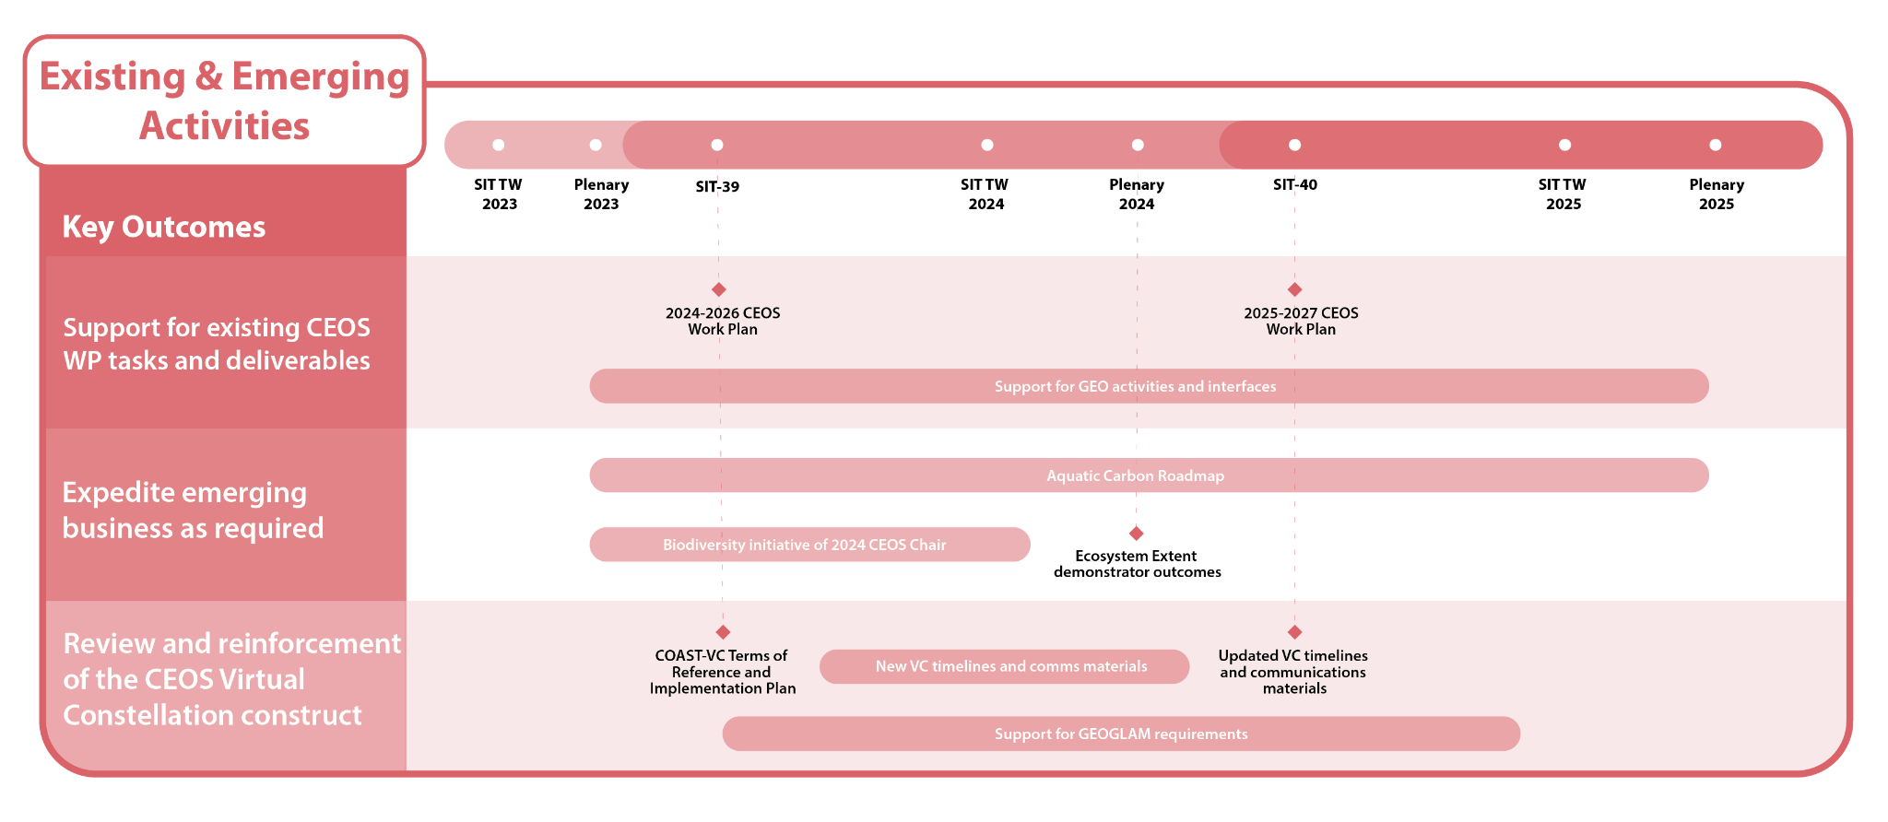
Existing & Emerging Activities

Slide 11
Tour de Table
Round table introduction by Principals of members of their delegation (in person and online)

Slide 12
Hybrid Meeting Protocols
Both in room and online presenters should join the WebEx and share screen to present
If you cannot present via webex, please arrange with SIT Chair Team ahead of your item to use the clicker
Presentations should be self-uploaded here. (default view only, ask SIT Chair Team for edit access as required)
https://drive.google.com/drive/folders/1eWWkaHdixiTHWsnN7PV0MFufuudqEljJ
Online Participants
Please do not activate your webcam unless you are presenting
If your bandwidth is slow while presenting, please turn off your webcam
Please mute if you are not presenting or making an intervention
If you want to intervene, please, send a message in the chat

