Slide 1
SIT-38
2023
SIT-38 2023, ESA/ESRIN
29th - 30th March 2023

Slide 2
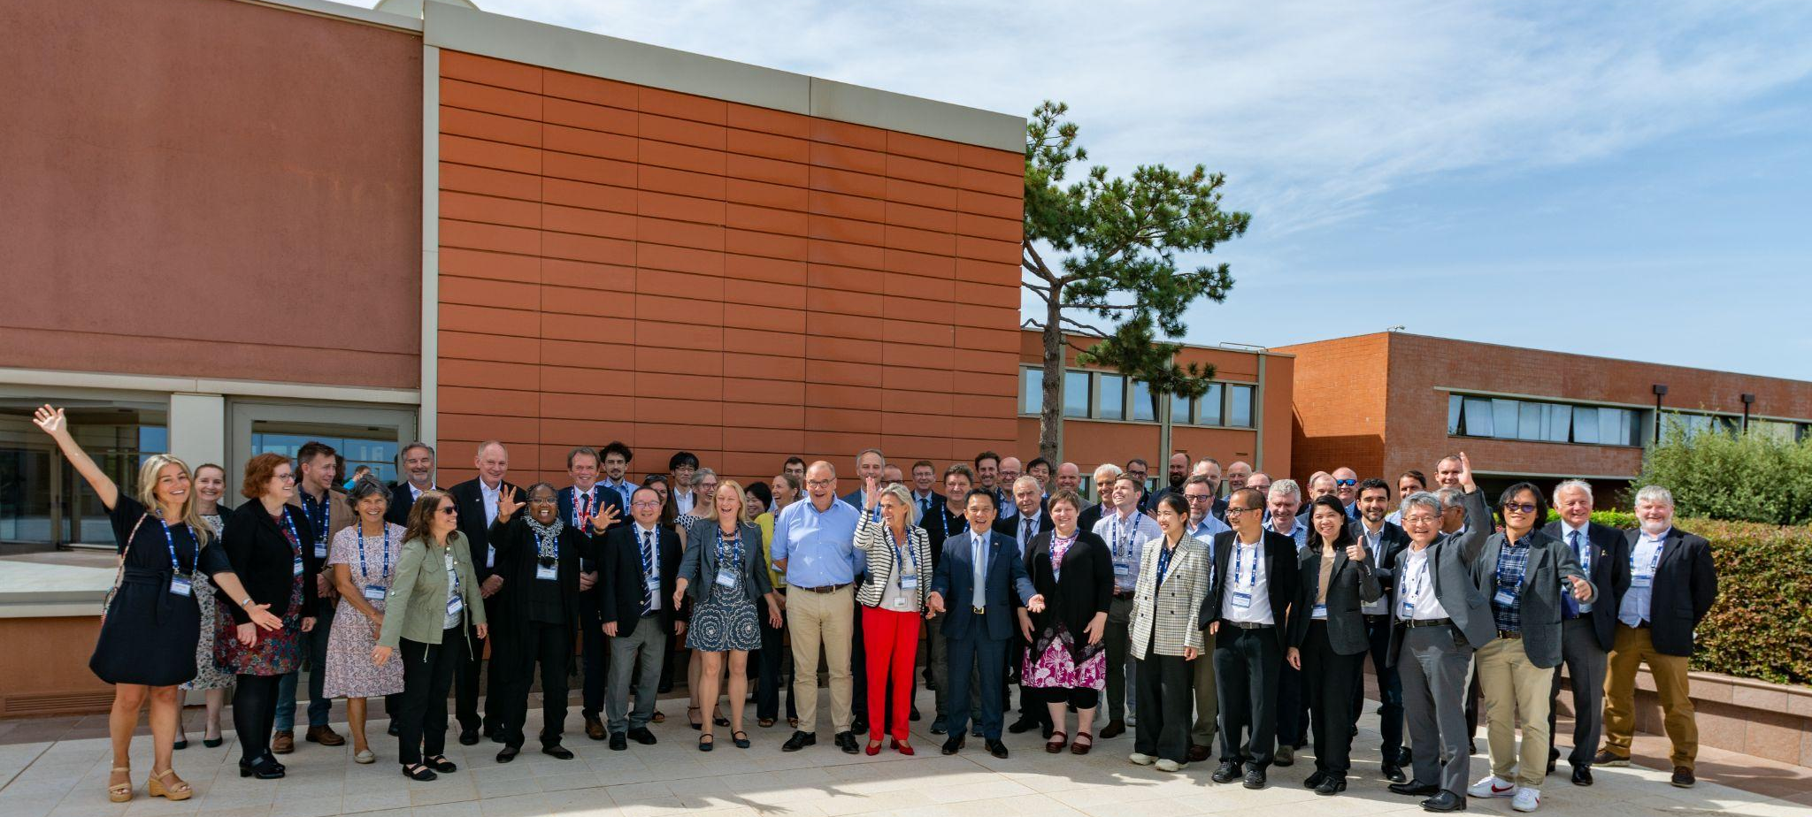
SIT Technical Workshop 2022

Slide 3
CEOS Plenary 2023

Slide 4
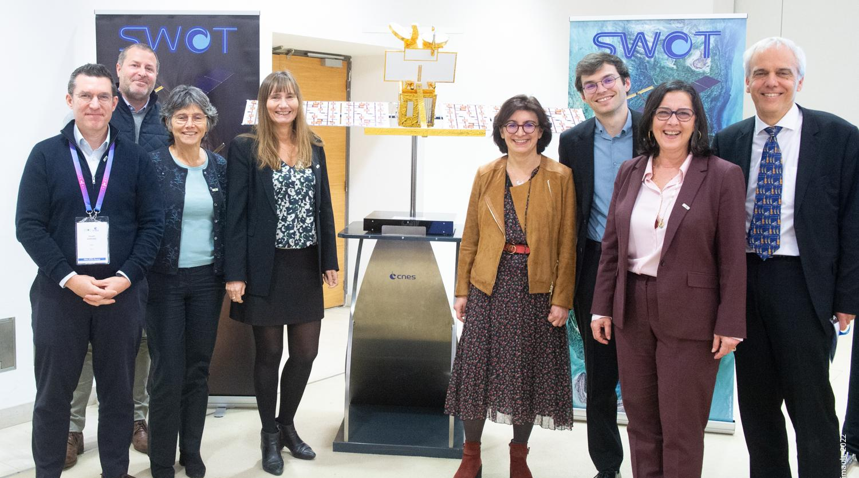
CEOS Plenary 2023

