Slide 1
SIT-38 Closing Remarks SIT Chair Team
SIT Chair Team
Agenda Item #9.8
SIT-38 2023, ESA/ESRIN
29th - 30th March 2023

Slide 2
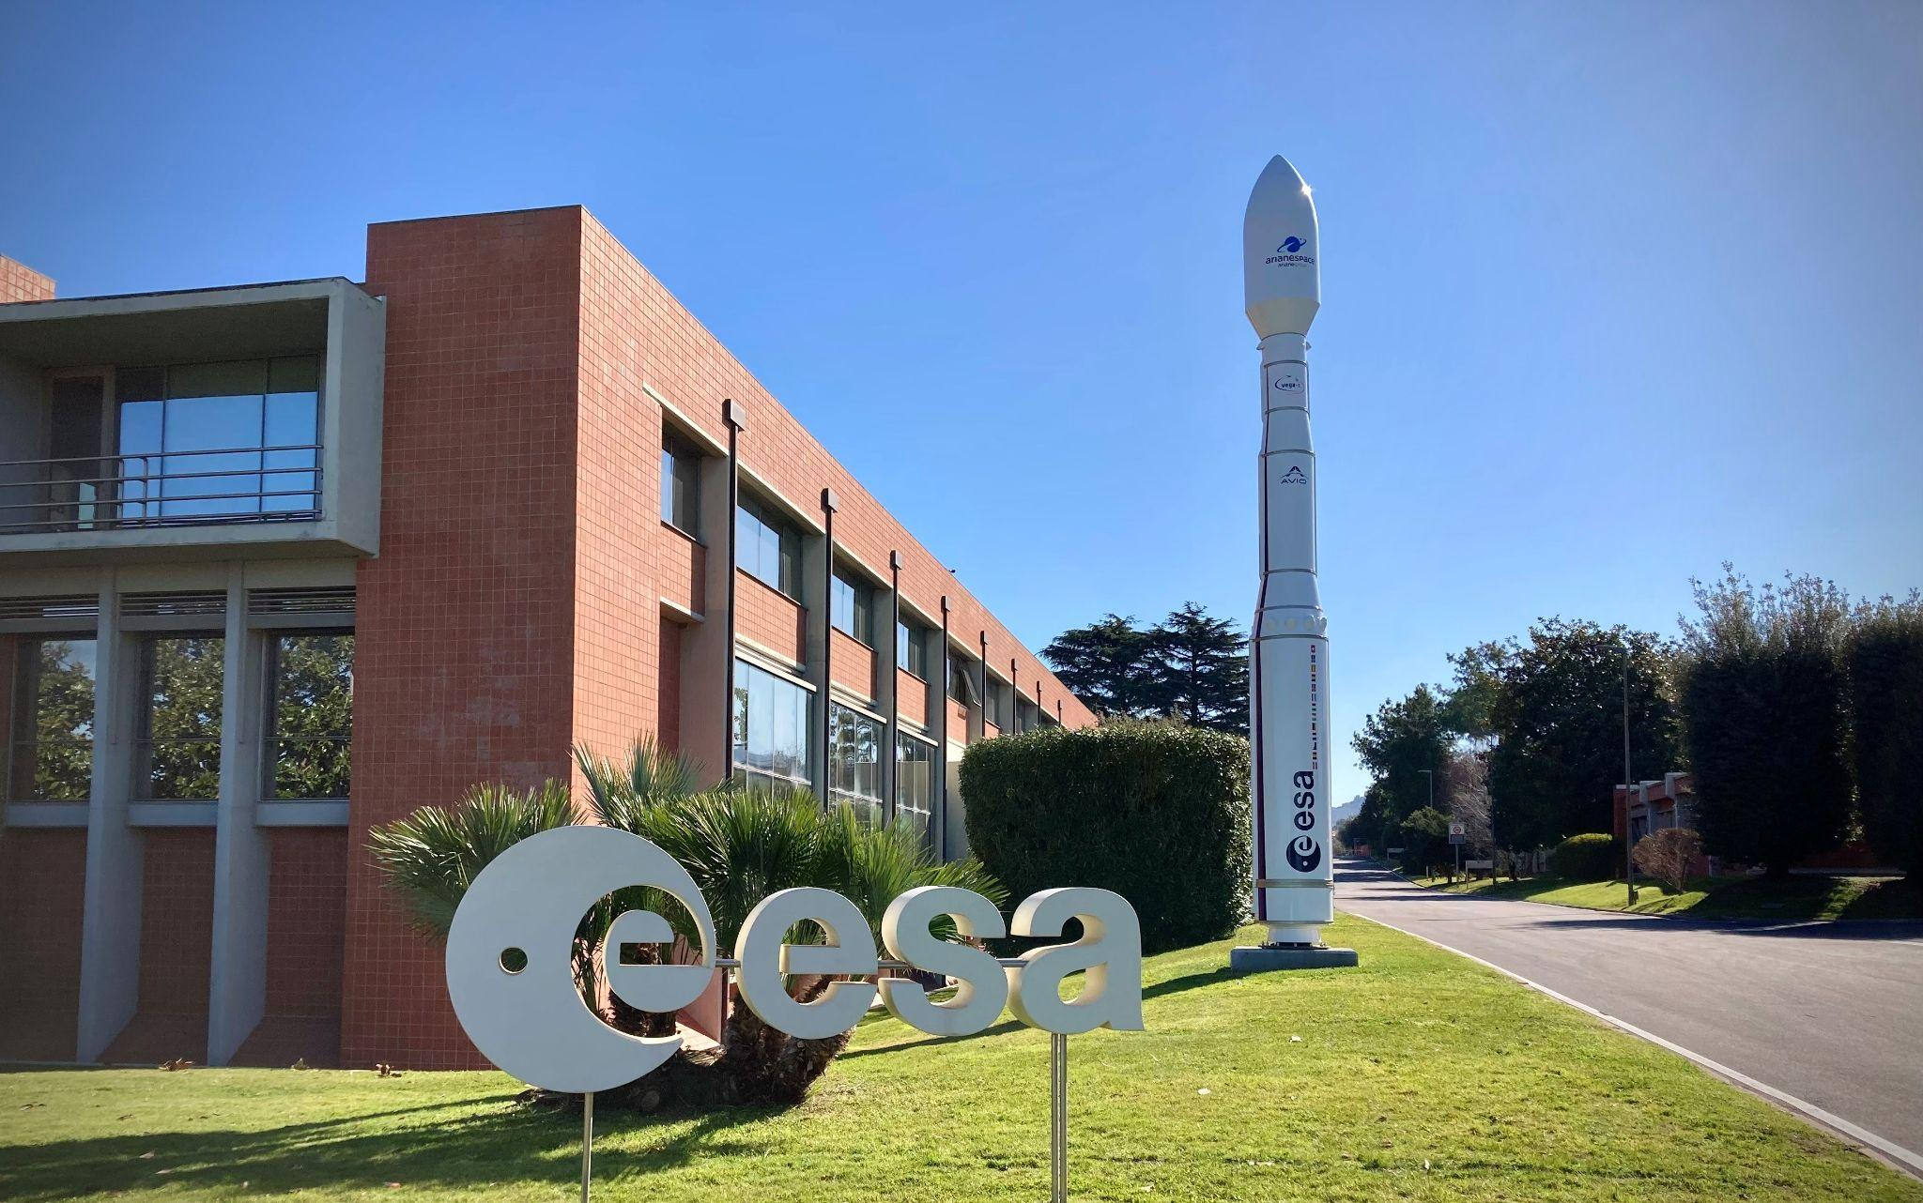
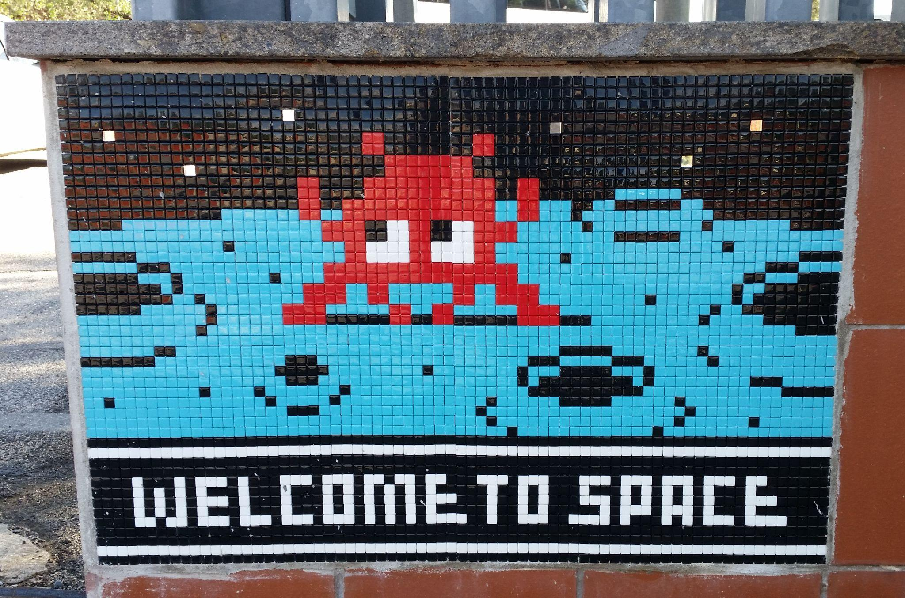
SIT Technical Workshop 2023
We look forward to welcoming you to SIT Technical Workshop 2023, 17-19 October hosted here at ESA/ESRIN

