Slide 1
CEOS Communications
Libby Rose
CEOS SEO Team
Agenda Item 9.3
SIT-38 2023, ESA/ESRIN
29th - 30th March 2023

Slide 2
CEOS Comms Channels
News posts on ceos.org/news
Twitter: @CEOSdotORG
Facebook: @socialceos
LinkedIn: Committee on Earth Observation Satellites
Youtube: @CEOSdotORG
Follow for the latest updates!
Notes:
Where to find ceos comms material
Tag us!

Slide 3
CEOS Mission
CEOS ensures international coordination of civil space-based Earth observation programs and promotes exchange of data to optimize societal benefit and inform decision making for securing a prosperous and sustainable future for humankind.
Notes:
The mission statement
Note the phrase ‘promote’
A clear role where CEOS comms fits in the overall ceos mission
Promote EO broadly rather than CEOS as a brand
Promote CEOS work in support of EO broadly
It was great to see the aquatic carbon roadmap presentation yesterday with a stated objective to serve as an effective means for communicating our intentions to society.
That’s why we’re here, let us know how we can support any work across CEOS.

Slide 4
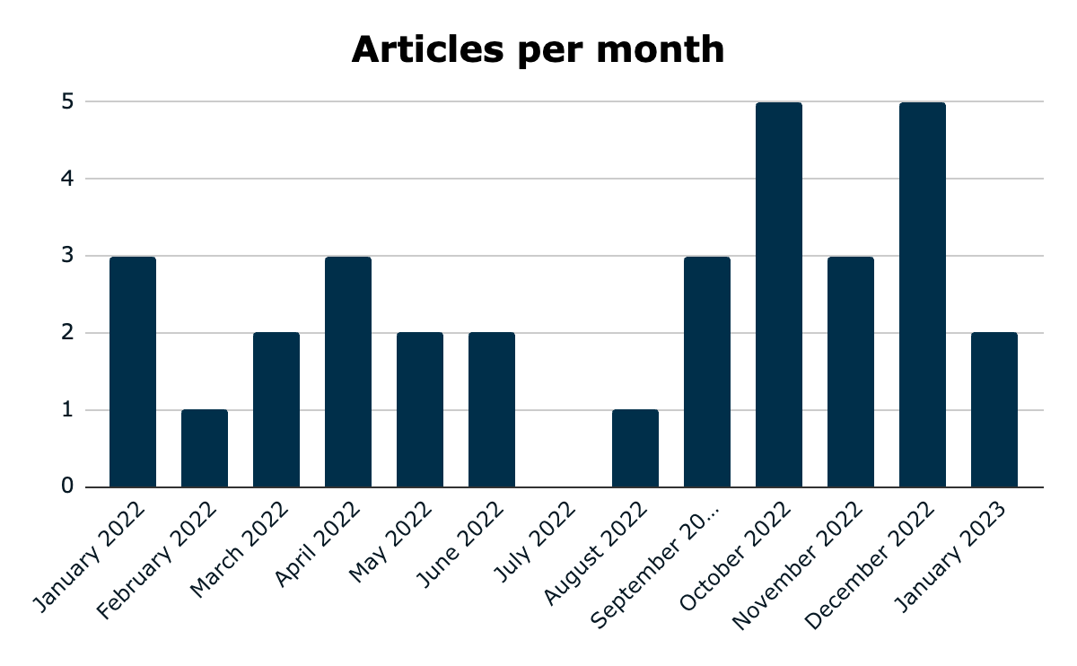
2022 News Articles
Total: 30 posts in 2022
Average unique page views per post: 81.67
Notes:
With thanks to the SEO & Kim Holloway, the 2021 ceos communications strategy saw a reboot and reinvigoration of CEOS Comms.
Over the last year, we have established a good baseline of communications activity
30 articles published in 2022
About 80 views per article

Slide 5
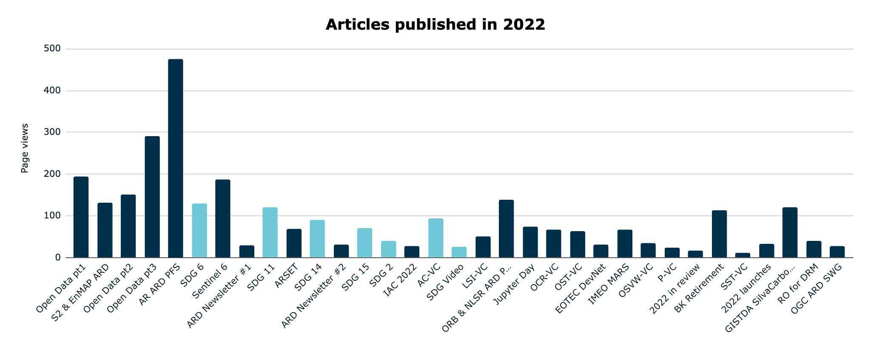
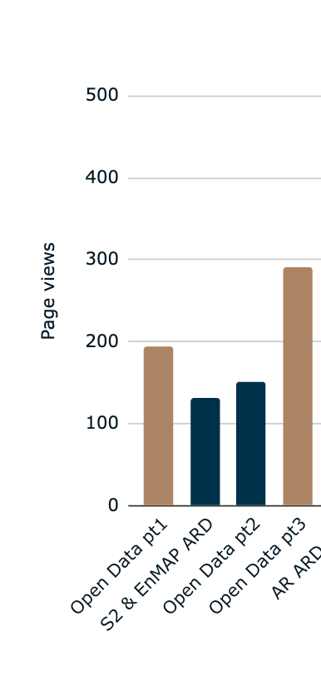
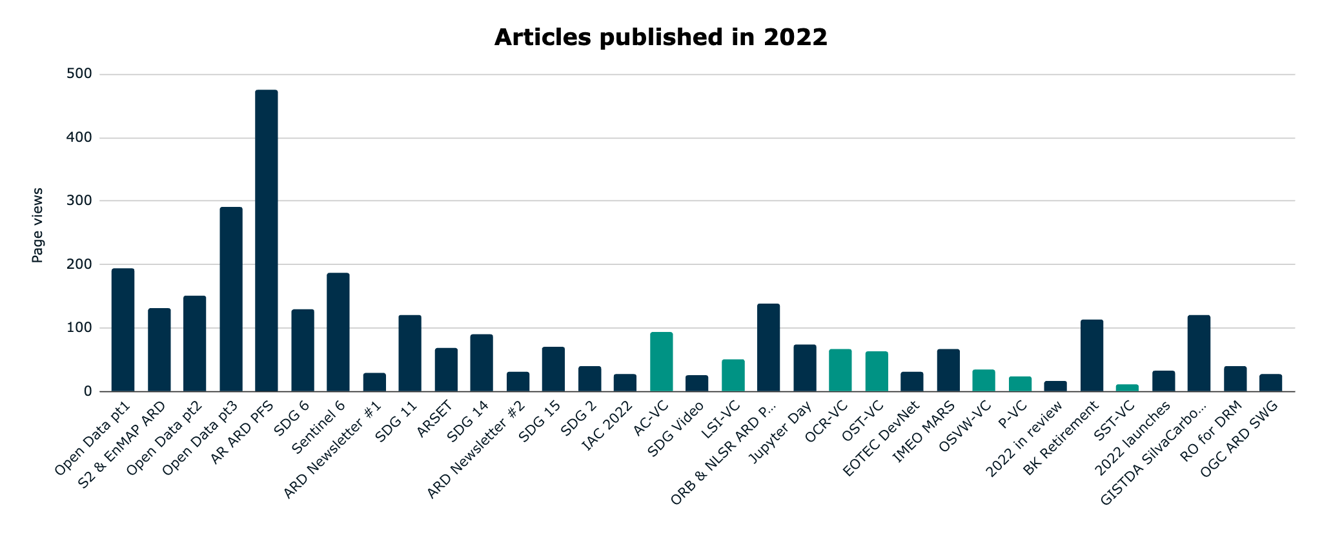
2022 News Articles
Open Data
SDGs
VC Updates
Shared by CSIRO
Notes:
Highlight open data articles and their popularity
ARD AR article was shared by CSIRO Aquawatch which shows in the article views

Slide 6
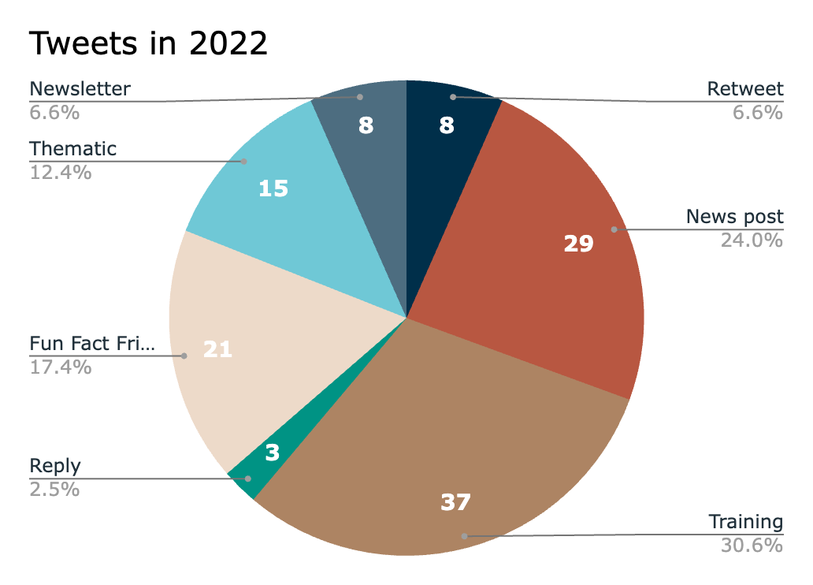
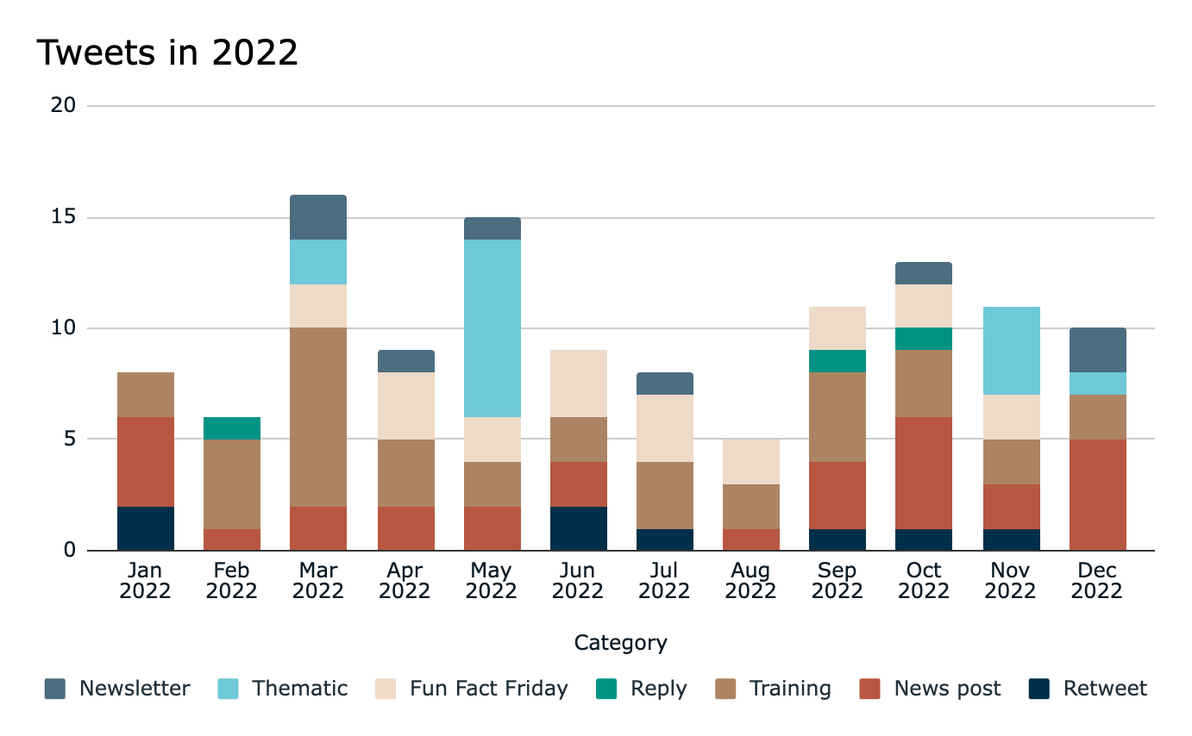
2022 Twitter Activity
Total: 121 tweets
Average 10 per month
WGCapD Training Calendar
training.ceos.org
Notes:
121 tweets over 2022
Training topic is popular
share links from the WGCapD training calendar

Slide 7
Target Audience
Current CEOS Communications Strategy (2021) defines the audience to be:
  Audience 1 – The EO Bubble: CEOS Agencies and other EO-involved organizations
  Audience 2 – Active Users: researchers/scientists/government employees and all other potential users of satellite Earth observation data, products, and related resources
  Audience 3 – The Supporters: strong interest in satellite EO, science, education, and societal benefit in diverse thematic areas.
This is very broad - hard to make an impact
Proposed clarification:
  Two distinct audiences: Internal CEOS and External EO & Geospatial Data Communities
  Define the audience clearly for each Communications Activity
Notes:
As we have progressed CEOS comms, we’ve noticed a couple of things about the current communications strategy which don’t fit anymore.
Target audience is defined a bit too broadly and non-specifically.
We are still discussing, but currently have landed at two clearly distinct audiences:
internal CEOS: which includes those around this table, online and those who couldn’t join us today
And the external EO & Geospatial community: this includes commercial data providers, data users, science experts, UN Custodian Agencies and more.
For each communications activity undertaken, the target audience will be defined clearly and precisely, to help focus the target for each piece.
Will start with the high level internal or external, and then more clearly break this down. Are we targeting principals, or CEOS subject experts. Or are we targeting data users, if so, what type. We would give examples, with clear descriptions of how we will target them (email addresses, contacts, twitter handles to tag).

Slide 8
Comms Team
CEOS Comms Team
  2021 Comms Strategy defines the team to be made up of:
    CEOS Executive Officer (CEO)
    SEO Communications Team
    CEOS Chair Secretariat Team
Proposed changes:
  Any CEOS community members who have experience or interest in Comms could be involved to provide feedback and advice
    E.g. Chris Barnes (USGS), Katy Matthews (NOAA)
Proposed Action:
CEOS community members to self-nominate to support the CEOS Communications Team.
Notes:
The why: we need people vetting ideas. People with experience
We are taking CEOS Chair Secretariat team to mean CEOS Chair Team.
This group isn’t broad enough or taking advantage of resources and experience available through our community.
Chris Barnes from USGS and Katy Matthews of NOAA have both kindly offered their support, and if there are any other interested people around this table, or within your agencies, we are asking that they contact us.
Support does not have to be a large amount
ask for feedback and advice on new activities, perhaps ad-hoc calls

Slide 9
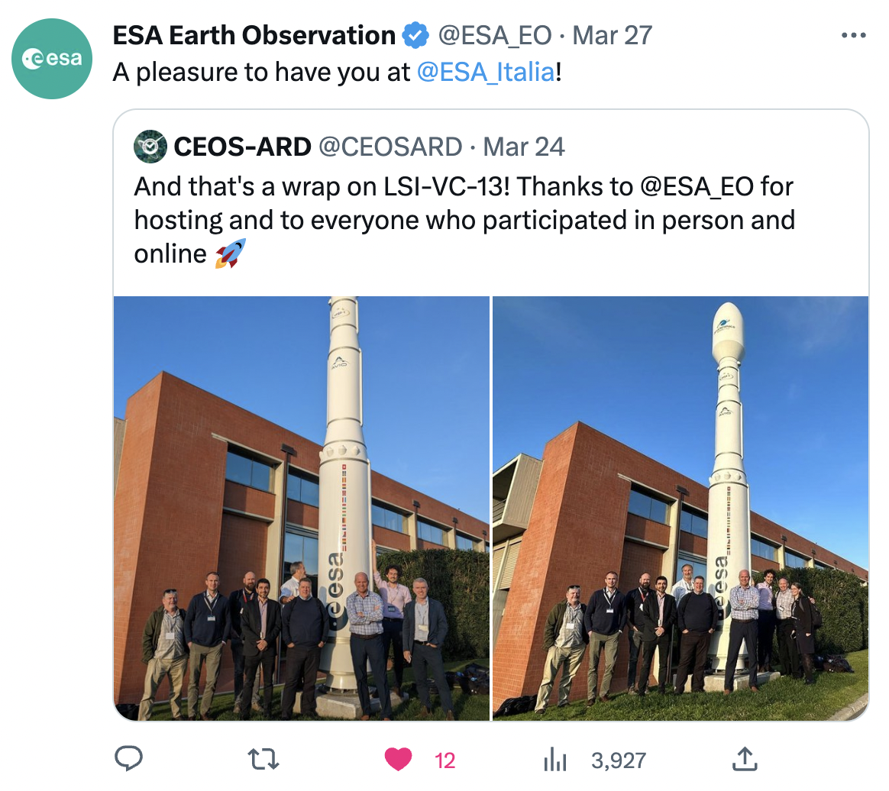
Comms Team Support
CEOS should leverage dedicated comms specialists within CEOS Agencies, however they are able to help
  Agencies often have much larger audiences who can help promote CEOS Activities
A POC for willing Agency communication staff would be a great start
Proposed Action:
CEOS Agencies to provide the SEO with contact details for communication staff within their Agency.
Notes:
Most CEOS Agencies have communications specialists within their Agencies, social media reach is often much broader than CEOS.
If there are any willing staff members within your Agency, please provide us with their contact details, and we can discuss how they could potentially help.
This is building on what I mentioned earlier about the ARD article which was shared by CSIRO, and we had another great example just last week.
Ferran Gascon of ESA kindly asked the ESA EO account owner to retweet our photo from LSI-VC, which gave a 10-fold increase in views.
We are very aware that some or all member agencies have established & rigorous protocols regarding their comms, which might limit their ability to support CEOS comms.

Slide 10
CEOS Communications Strategy
Current version endorsed by CEOS Plenary in 2021
SEO proposing a rewrite based on the proposed updated membership and target audience
Include CEOS Newsletter and it’s overall role in CEOS Communications
Proposed Action:
CEOS SEO to present an updated CEOS Communications Strategy for endorsement at the 37th CEOS Plenary, in November 2023.
Notes:
All this in mind
Want to update the strategy to include this
The current strategy was written prior to the new CEOS Newsletter online platform
Should consider how CEOS comms works alongside the ceos Newsletter
Plan to present the updated strategy at this year’s plenary, for endorsement by principals.

Slide 11
WG & VC Websites
WG & VC Leads:
Contact the CEOS Comms Team if your CEOS webpage needs updating
  Change of leadership
  New activities
  Publications
  Meetings
Contact:
  Dave Borges (david.borges@nasa.gov)
  Matt Steventon (matthew@symbioscomms.com)
  Libby Rose (libby@symbioscomms.com)
Notes:
Quick note

Slide 12





CEOS Comms exists to promote your work!
Please share any highlights with Libby Rose (libby@symbioscomms.com) & Dave Borges (david.borges@nasa.gov)
Committee on Earth Observation Satellites
@socialceos
ceos.org/news
@CEOSdotORG
@CEOSdotORG
Notes:
CEOS does so many great things, we are here to help get that into the world
Let us know when you have things we should promote

Slide 13
Proposed Actions
Proposed Action:
CEOS community members to self-nominate to support the CEOS Communications Team.
Proposed Action:
CEOS Agencies to provide the SEO with contact details for communication specialists within their Agency.
Proposed Action:
CEOS SEO to present an updated CEOS Communications Strategy for endorsement at the 37th CEOS Plenary, in November 2023.

