Slide 1
Systems Engineering Office Report
David Borges
CEOS SEO
NASA
Agenda Item 9.2
SIT-38 2023, ESA/ESRIN
30 March 2023

Slide 2
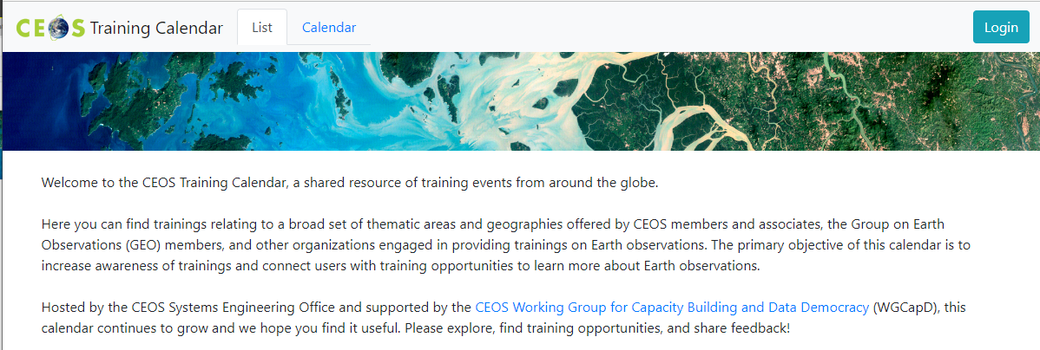
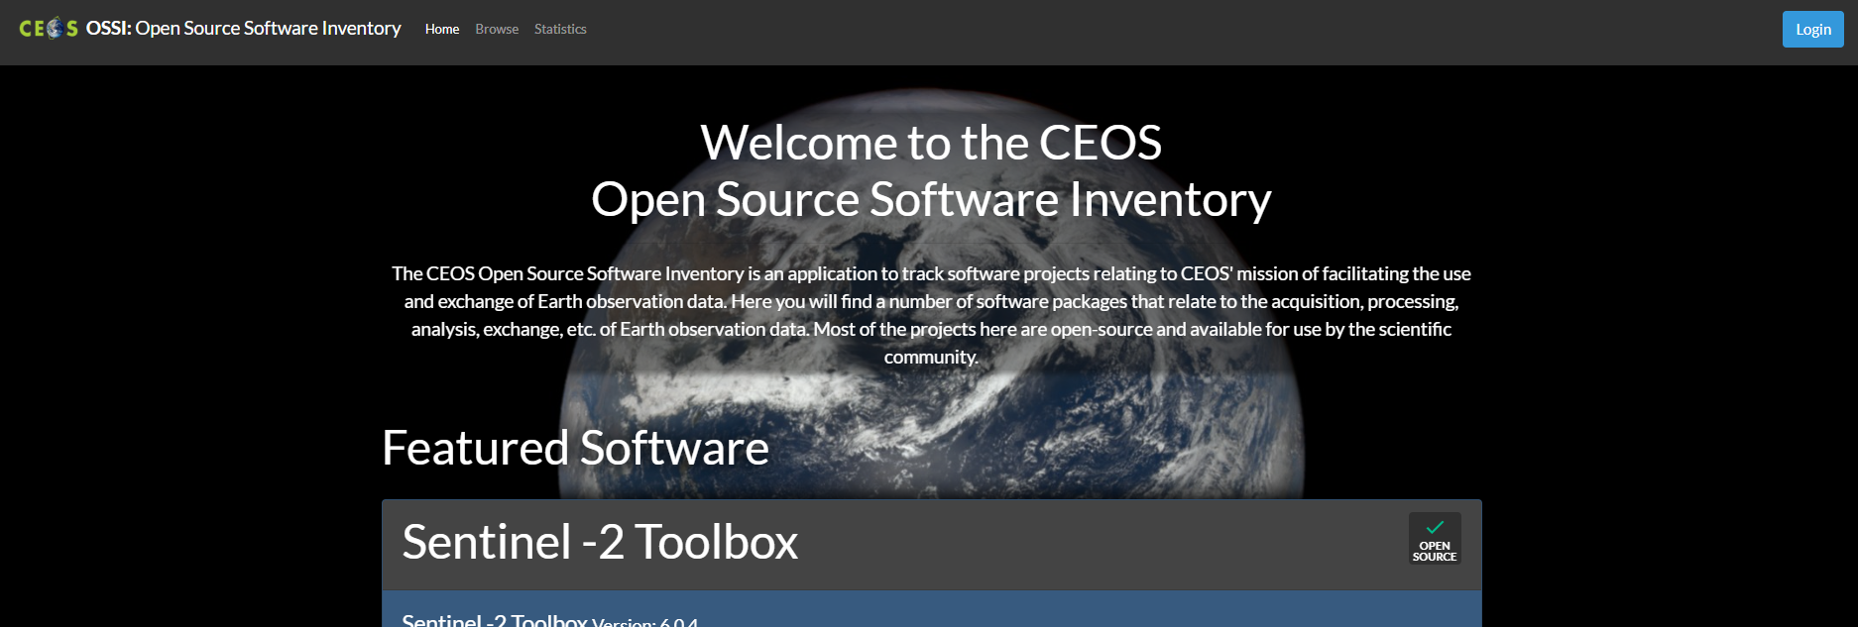
SEO Fundamentals
“Provide systems engineering leadership and support to CEOS through management and technical services and the development of tools and products that facilitate systems engineering solutions for societal benefit.”
CEOS website infrastructure
Deliverables Tracking Tool 2.0
CEOS Visualization Environment (COVE)
Open Source Software Inventory
Future Data Architectures Inventory
Training Calendar
EOTEC DevNet
Open Data Cube (ODC)
CEOS MIM Database Team support

Slide 3
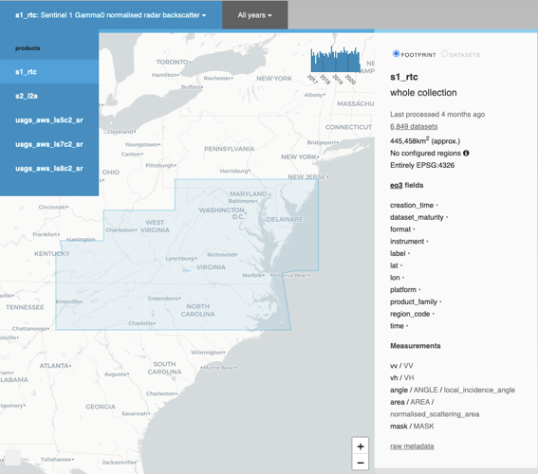
SEO Activities
CEOS Analysis Ready Data (ARD) Oversight Group
Nighttime Lights Surface Reflectance
OGC ARD SWG / ISO NP
CEOS Earth Analytics Interoperability Lab (EAIL)
SEO / CSIRO Chile partnership to leverage analytics platform (AWS, ODC, Jupyter, Dask)
COAST, WGDisasters (Flood), WGCV (DEMIX)
Ecosystem Extent Task Team
Demonstrator support (in discussion)

Slide 4
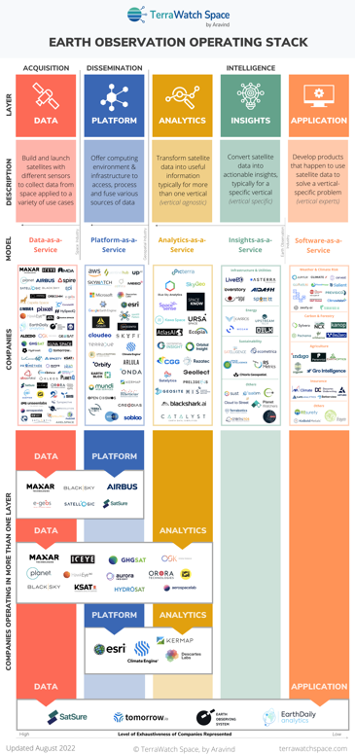
SEO Activities
Open Data Cube (ODC)
Digital Earth initiatives (Africa, Pacific)
MS Planetary Computer
Interoperability Framework / Roadmap
Use cases (Jupyter, ODC)
New Space Task Team
CEOS Data Policy Portal
COVE – new space mission inclusion feasibility
CEOS SDG Coordination Group
Implementation Lead
ODC Sandbox / SDG 15.3.1 GPG Assessment

Slide 5
Cross-Cloud Comparison Study
Motivations
Pecora Key Findings
GEO Common Infrastructure / GIDTT
Improving user experience
Understand differences in cloud providers
Develop plans for future benchmarking/optimizations
Platforms
Microsoft - Azure Cloud, Azure Labs, AWS Open Data Catalog
Amazon - AWS Cloud, SageMaker, AWS Open Data Catalog
Sentinel Hub - Singergise, CreoDIAS
Google - Google Cloud, Colab, Earth Engine

Slide 6
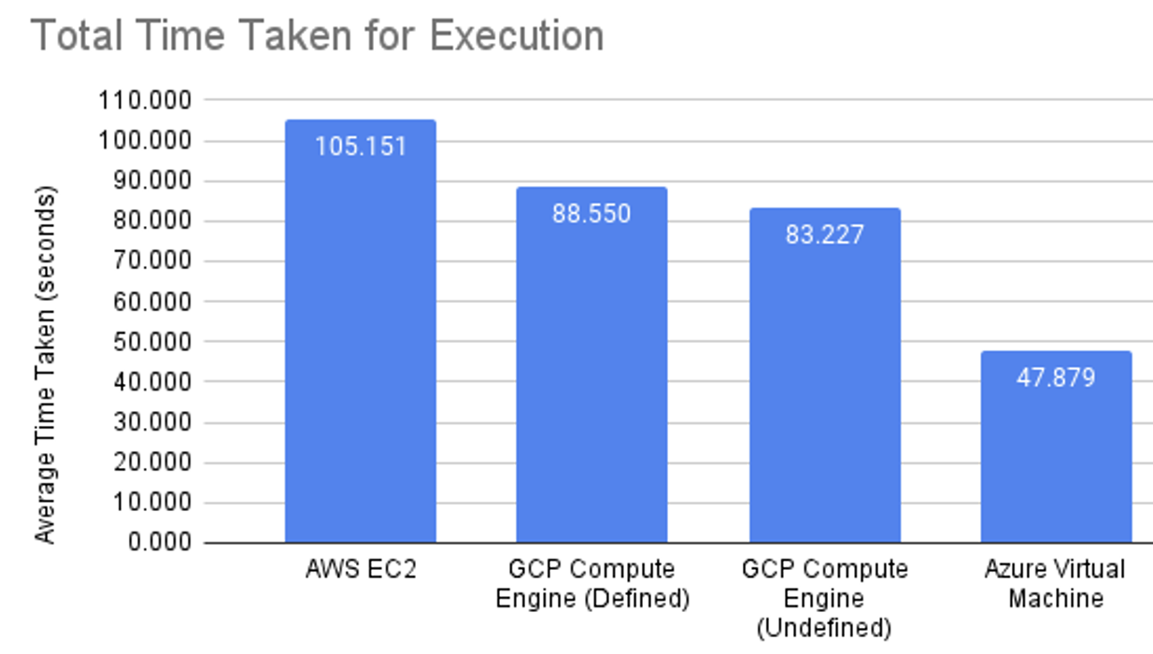
Cross-Cloud Comparison Study
Objectives
Understand quantitative and qualitative differences in performance from a user experience perspective
Reduce barriers to entry, help users get started, provide resources for new users
Test new CEOS ARD datasets in various cloud environments
Contribute to CEOS good practices:
Cloud search, discovery, access, exploitation

Slide 7
CEOS Outreach
CEOS Communications Team
ARD 23, California
GEO Open Data Open Knowledge Workshop, Geneva
IGARSS, California
GEO Week 2023, Cape Town

