Slide 1

Report on some GEO WP activities related to SDGs, Wetlands, Biodiversity and LDN
Laurent Durieux, GEO
Agenda Item 9.1
SIT-38 2023, ESA/ESRIN
29th - 30th March 2023

Slide 2
Potential incubators
  Global Ecosystems Atlas
Nature-based Solutions
  Global Land and Marine Debris Monitoring System
Land-Ocean-Pollution
Multi-hazard Risk/EW4All
  Integrated Floods Forecasting
  Global Wildfire Information System
  Global Monitoring of Drought
One Health
  Global Integrated Heat and Health Information Service

Slide 3
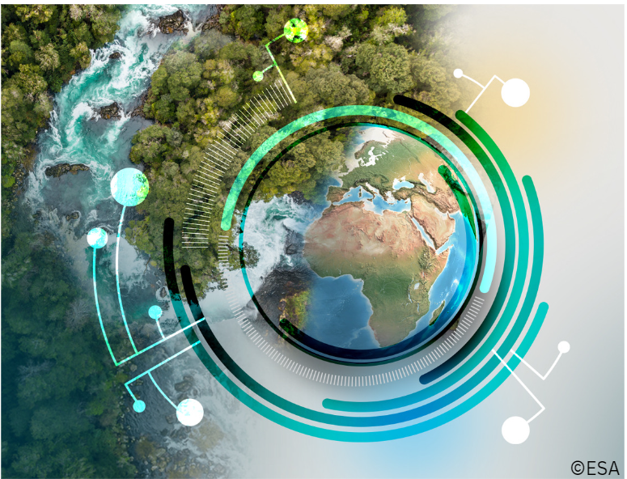

Global Ecosystems Atlas
OBJECTIVE
To create an open on-line resource with explorable interface to monitor and report on the condition and change of ecosystems extent with the goal of prompting urgent action to protect biodiversity and inform nature-based solutions.
Open Software
Collaborations

Slide 4
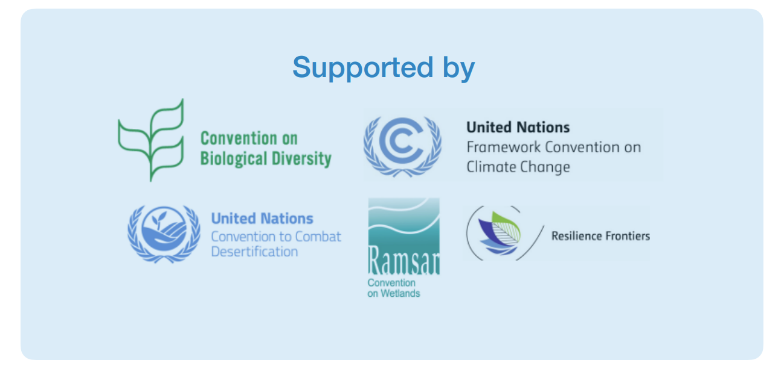
Key milestone
Collaborations

Slide 5
Next steps
1. Convening Workshop in May 2023 (Geneva) to establish consortium
2. Consortium designs project - workstreams, governance, resource needs
3. PB receives an update (June) and next steps on the 2 incubators for 2023.
4. Global Ecosystems Atlas plan presented at GEO Week 2023
5. Beta version of Atlas by December 2023 (pending funding)

Slide 6

Global Integrated heat and health service
OBJECTIVE
To build a global service to map heat across time scales and provide tools for local communities to understand and act on evolving health risks.
Open Software
Collaborations

Slide 7
Next Steps
Mar
GEO community
input
Apr
Wider engagement
with heat
& health
community
May
Revise concept note
Jun
Heat and Health concept endorsed at GEO symposium
Jul
Discussion at GEO ExCom61
Aug
Detailing project concept
Sept/Oct
GEO Programme
Board update
Nov
Heat & Health
Service presented
at GEO Week

Slide 8
GEO-LDN – New Flagship - UNCCD mandate

Slide 9
Strategic Elements
GEO-LDN follows a modular (federated) and open approach
in capacity development and in data analytics and standards.
Federated approach in capacity development:
Modules of post-graduate programme and MOOCs can be reused by others
Some post-grad modules will be available virtually for further training of professionals (MOOCs) and vice versa
Existing modules from partners to be used in post-graduate programme and in virtual trainings
Federated approach in data analytics and standards:
Reuse and improve existing data, tools and algorithms
Make tools „talk to another“ by developing and following standards and by connecting them via APIs
Connected tools address specific use cases, e.g. for ILUP or for specific geographies

Slide 10
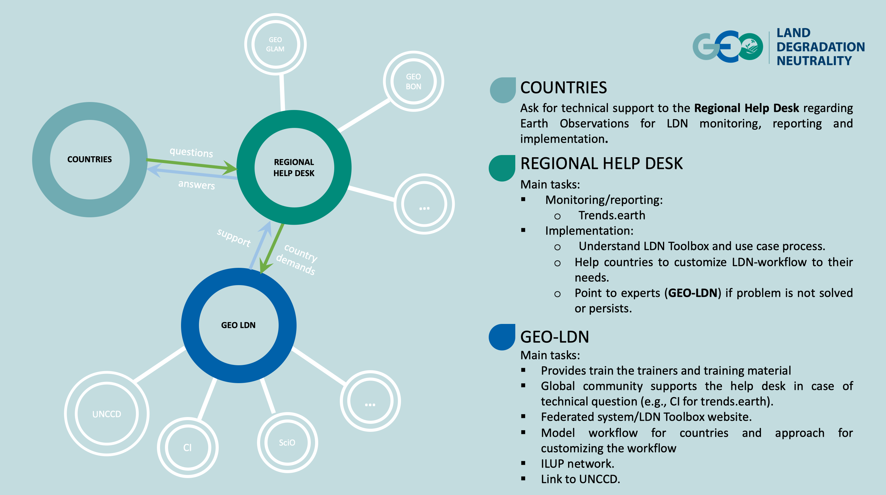

Slide 11
GEO Wetlands and Ramsar
Contribution of GEO Wetlands to STRP
  Nomination of L. Durieux as Scientific Expert of STRP
  Prep Call to position GEO Wetlands to support STRP
STRP works under 5 Thematic Work Areas (TWA):
  TWA 1: Wetlands of International Importance, development of the Site network and application of criteria
  TWA 2: Tools for wetland assessment, mapping and monitoring, and development of inventories
  TWA 3: Direct and climate change-related pressures on wetlands, their impacts and responses
  TWA 4: Wise use, sustainable management and restoration of wetlands in the wider landscape/seascape
  TWA 5: Cross-cutting issues, supporting functions, and synergies with other MEAs

