Slide 1
9.1 Update from GEO Secretariat
Work in the GEO post-2025 Working Group
CEOS SIT-38
Andreas Obrecht
Session 9, 15:10
30 March 2023

Slide 2
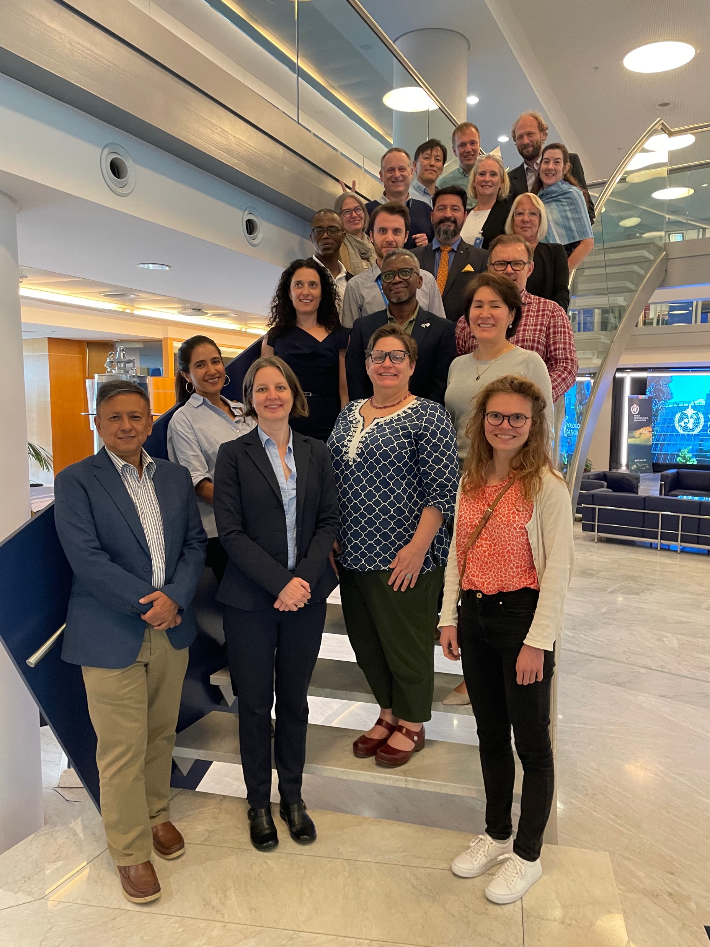
Status of the work of the post-2025 Working Group
7 meetings (2 in-person)
Outreach
Interim Report
Draft strategy document
Website (use the QR code)
https://earthobservations.org/geo_post25.php
Upcoming:
Virtual meeting on 31 March and an in-person meeting on 3-5 May
Online forum or survey for broad consultations
Draft strategy sent for formal consultations

Slide 3
What will be new or reinforced in a post-2025 GEO?
A renewed mission, a bold ambitious vision and value proposition
Focus on transformative programs to effectuate transformational systemic change
Strengthening of Global Partnerships
Development of Earth Intelligence
Amplification of Advocacy, Communications and Resource Mobilization
Focus on Equity

Slide 4
Outline of the strategy document
Preamble
Data for society (2005 – 2015)
Services for society (2016 – 2025)
New from 2025: Equity for society
GEO’s vision, mission, value proposition
Urgency
GEO’s strengths
Vision
Mission
Value Proposition
Action for post-2025
Achieving transformational change
Guiding principles

Slide 5
Post-2025 GEO
URGENCIES
Environmental challenges, fragementation and proliferation of organizations, state and non-state actors, emerging socio-economic inequities
STRENGTHS
GEO is: intergovernmental, transdisciplinary, multisectoral, multiscale, inclusive and adaptive
Vision
Mission
Value proposition
Guiding principles
Operating model
Action for post-2025
New from 2025: Equity for society
Data for society (2005 – 2015)
Services for society (2016 – 2025)

Slide 6
Action for post-2025
Seize the Momentum to Strengthen Global Partnership
Transform Earth observation into Earth intelligence
Strengthen coordination, integration and harmonization of data products
Invest in innovative, integrated advocacy, communications and members’ engagement
Increase and diversify resource mobilization to deliver Earth intelligence

Slide 7
GEO Post-2025 Value Proposition
GEO’s value proposition is to advocate for the use of Earth intelligence [and knowledge], lead and convene partners from across sectors and disciplines and throughout the Earth observation value chain to accelerate the co-design, co-creation and co-implementation of demand-driven, integrated, and innovative solutions for addressing global societal and environmental challenges.
In doing so, the GEO community learns, shares knowledge, technology and resources, develops capacity and amplifies benefits and impact.

Slide 8
Earth intelligence
It integrates analysis, modelling and simulation of data to create a predictive narrative that enables sound decision-making about our planet.
GEO will leverage Earth intelligence to:
derive new knowledge,
provide valuable insights
inform strategic decisions
and empower society to protect/ pursue a sustainable planet.
analysis, modelling and simulation of data
Earth observation data, socio-economic data, citizen observations, and other sources of information

Slide 9
GEO and the Earth observation value chain approach
Earth observation infrastructure
Data availability and access, research and assessments
EO products and services
Policy and decision-making
Societal, environmental and economic benefits as well as equity
Users / Stakeholder needs
Stakeholder contributions
Co-design
Notes:
‹#›‹#›

Slide 10
Process leading to the Ministerial Conference
7th Post-2025 Working Group meeting 9-10 Feb
ExCom Geneva 22-23 Mar
8th Post-2025 Working Group meeting 31 Mar
9th Post-2025 Working Group meeting 3-5 May
GEO Symposium 13-14 June
26th PB Geneva 15-16 June
ExCom Geneva 12-13 Jul
27th PB Geneva 5-6 Sept
Ministerial Summit Cape Town 6-10 Nov
Post-2025 Working Group
1 March Documents for ExCom
Consultations with the GEO community
6 – 21 Apr (tent)
Formal consultation May / June (tent)
7 July Documents for ExCom
25 Sept Documents for the Ministerial Conference
Ministerial Working Group
Ministerial Working Group meeting 16 Mar
Ministerial Working Group meeting 26 Apr

