Slide 1
Progress on CEOS Chair 2023 Priorities
Pakorn Apaphant, GISTDA
Agenda Item 8.2
SIT-38 2023, ESA/ESRIN
29th - 30th March 2023

Slide 2
CEOS Chair Priorities 2023
1
Supporting CEOS Preparations and Inputs to the Global Stocktake of the UNFCCC Paris Agreement
2
Supporting Exploration of New Geometries for Space Agencies and CEOS with New Space

Slide 3
Priority #1 Supporting CEOS Preparations and Inputs to
the Global Stocktake of the UNFCCC Paris Agreement
Workshop
GISTDA - SilvaCarbon 2023 CEOS Workshop on Uptaking Global AFOLU Datasets
CEOS Agencies Dataset
Continued expansion of the offering of CEOS Agency datasets available to support the GST and countries’ assessments of their Nationally Determined Contributions (NDCs)
GHG & AFOLU Roadmap
Support the Implementation of both
the GHG Roadmap and AFOLU Roadmap.

Slide 4
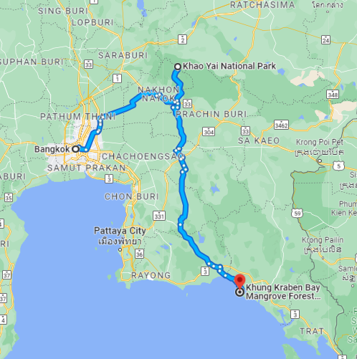

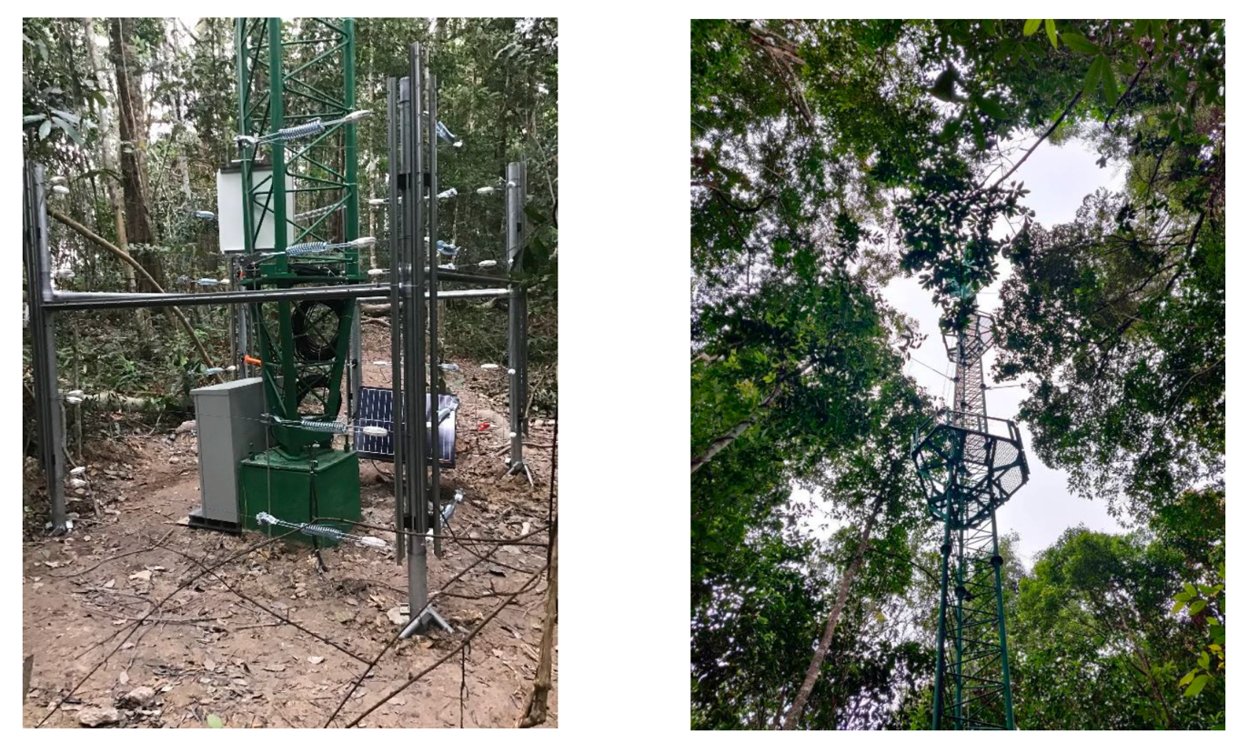






GISTDA - SilvaCarbon 2023 CEOS Workshop on Uptaking Global AFOLU Datasets
23 February - 3 March 2023, Thailand
Seminar on 22 February
~ 300 participants onsite and over 1,000 online participants
SilvaCarbon countries and agencies including USGS, USAID, USFS, NASA
CEOS agencies attendees including JAXA
Field Trip & Field Data Collection
Khao Yai National Park
Khung Kraben Bay Mangrove Forest, Chanthaburi
Please visit the link for workshop agenda and objective: GISTDA - SlivaCarbon 2023 CEOS Workshop Paper

Slide 5
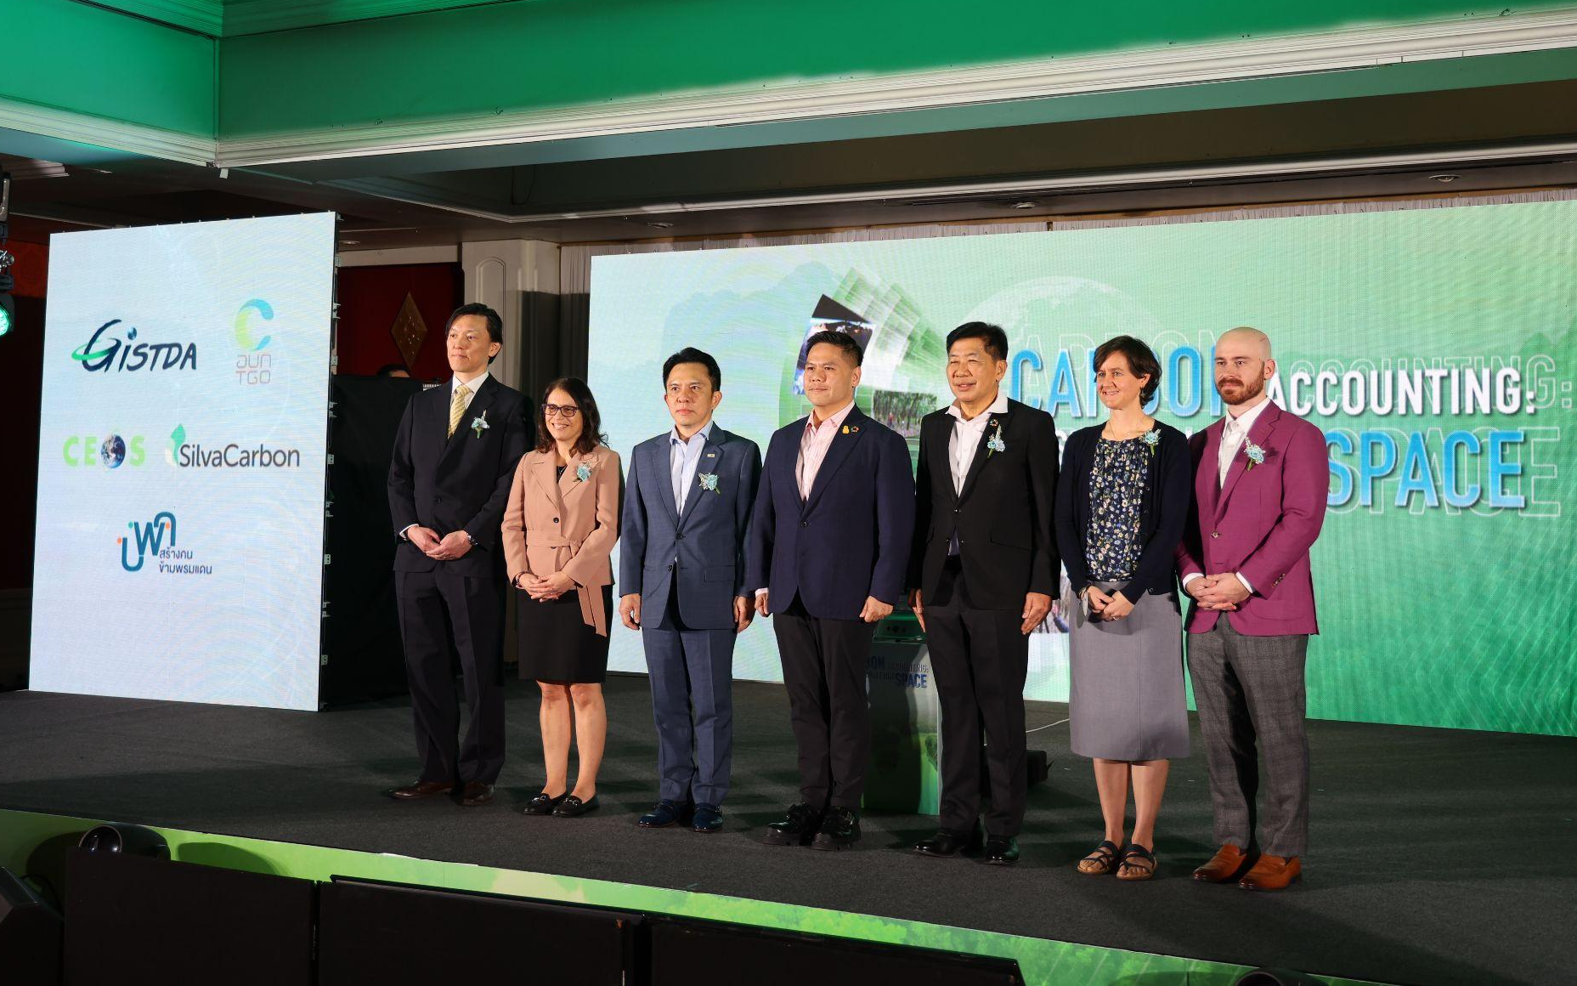
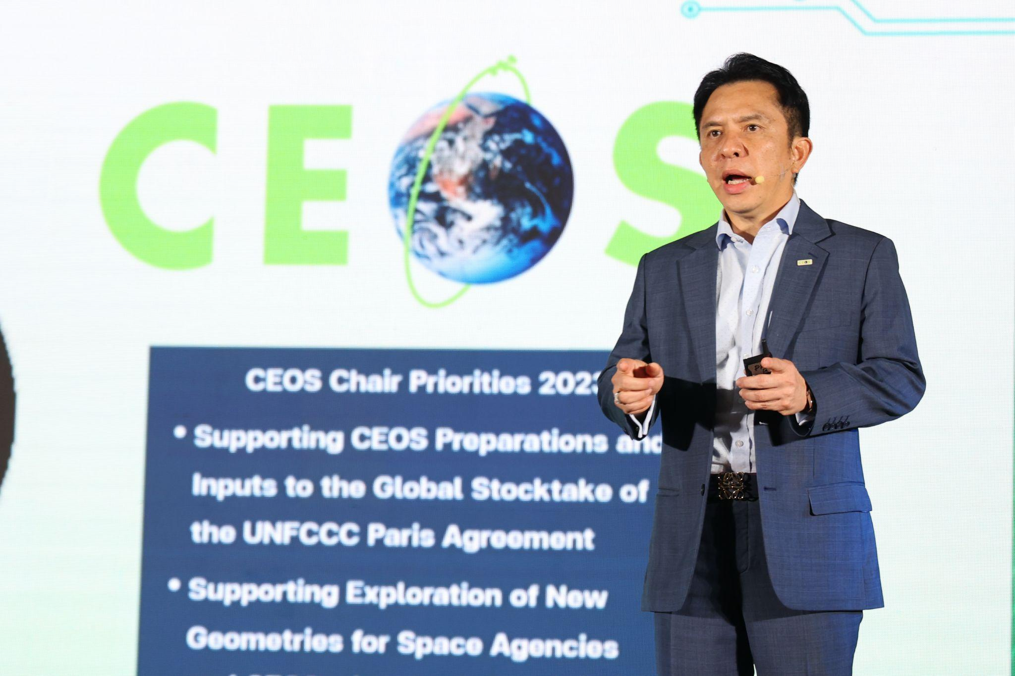
GISTDA SilvaCarbon Workshop 2023
Key outcomes:
Improved awareness and understanding of the potential of AFOLU datasets
Enhanced capacity and skills among participants to use and apply AFOLU datasets and technologies
Strengthened collaboration and partnerships among stakeholders and experts
Increased knowledge sharing of best practices and success stories related to AFOLU data and its application
Notes:
Improved awareness and understanding of the potential of AFOLU datasets for monitoring and managing forests and land use at the global scale
Enhanced capacity and skills among participants to use and apply AFOLU datasets and technologies in their work, research and policymaking
Strengthened collaboration and partnerships among stakeholders and experts working on AFOLU-related issues, leading to new research projects, initiatives, and networks
Increased knowledge sharing of best practices and success stories related to AFOLU data management and application, contributing to a more informed and evidence-based decision-making process

Slide 6
Priority #2: Supporting Exploration of New Geometries for Space Agencies and CEOS with New Space
New Space Task Team
Work with CEOS New Space Task team led by SIT Chair to develop New Space Economy document as a means for knowledge sharing with CEOS Agencies.
Collaboration Opportunities
Workshops/Meetings as inputs to the border CEOS discussion on New Space opportunities. (TBC)
Facilitate a discussion during CEOS 2023 timeframe

Slide 7
Priority #2: Supporting Exploration of New Geometries for Space Agencies and CEOS with New Space
New Space Task Team
Work with CEOS New Space Task team led by SIT Chair to develop New Space Economy document as a means for knowledge sharing with CEOS Agencies.
Collaboration Opportunities
Workshops/Meetings as inputs to the border CEOS discussion on New Space opportunities. (TBC)
Facilitate a discussion during CEOS 2023 timeframe

Slide 8
Contribution to NSST
Inputs provided to NSST Activities Working Document on Observation gaps, commercial opportunities to fill CEOS priority requirements for climate, SDGs and disasters from following activities;
  The International Seminar on Thailand Space Program on 16-17 March 2023
  THEOS-3 Seminar on Thai Space Ecosystem on 17 March 2023
  Observation gaps session during ASEAN Space Workshop on 24-26 May 2023

Slide 9
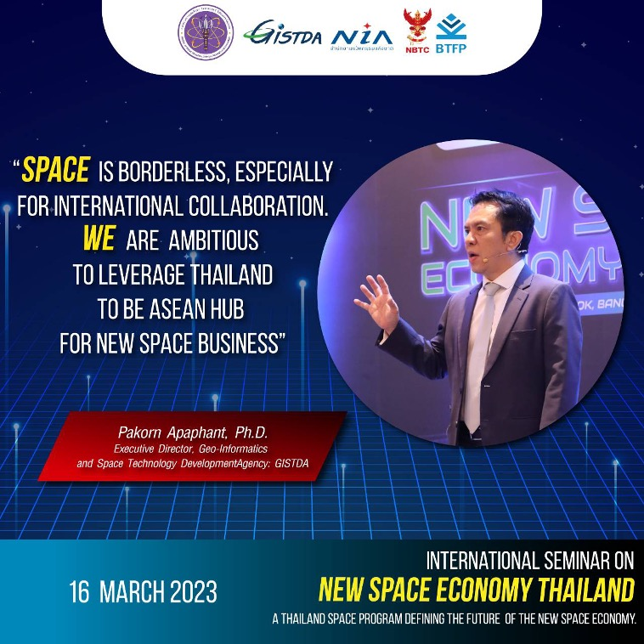
International Seminar ‘New Space Economy’
16-17 March 2023 in Bangkok, Thailand
International Seminar on Thailand Space Program: ‘Shaping New Space Economy’ 16-17 March 2023 in Bangkok, Thailand
Includes sessions on developing New Space Ecosystems and fostering the global space value chain for our Earth’s Future
Key outputs:
Strengthened Thailand-Japan New Space Economy Cooperation
Input from private companies and academia for the NSST Activities Working Document
Increased awareness and understanding of New Space Economy

Slide 10
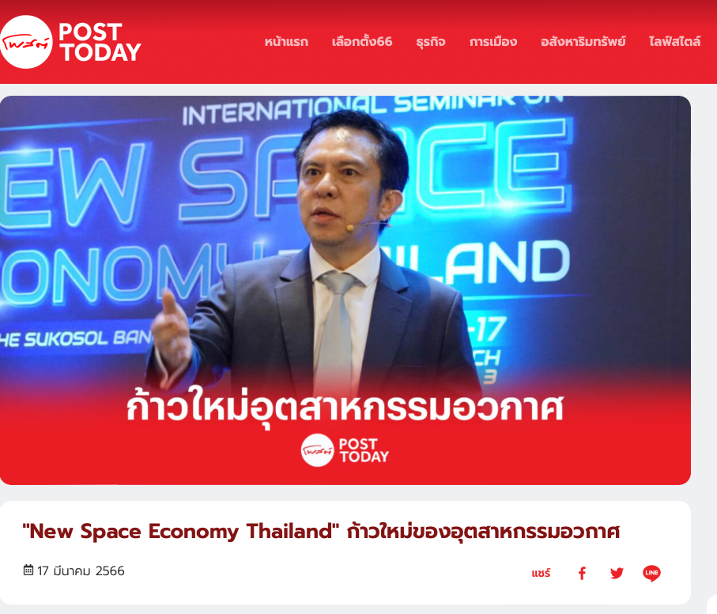
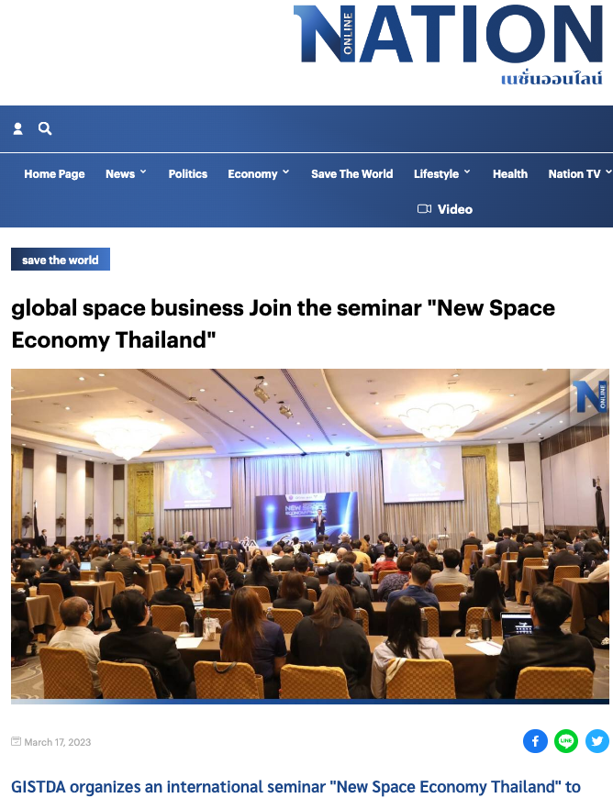
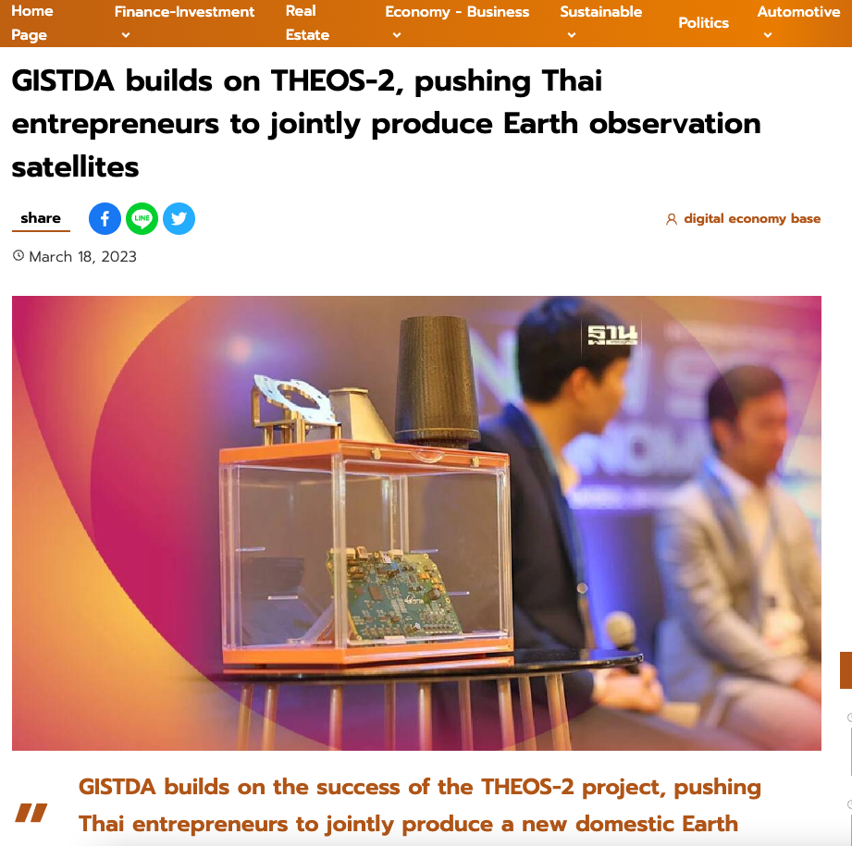
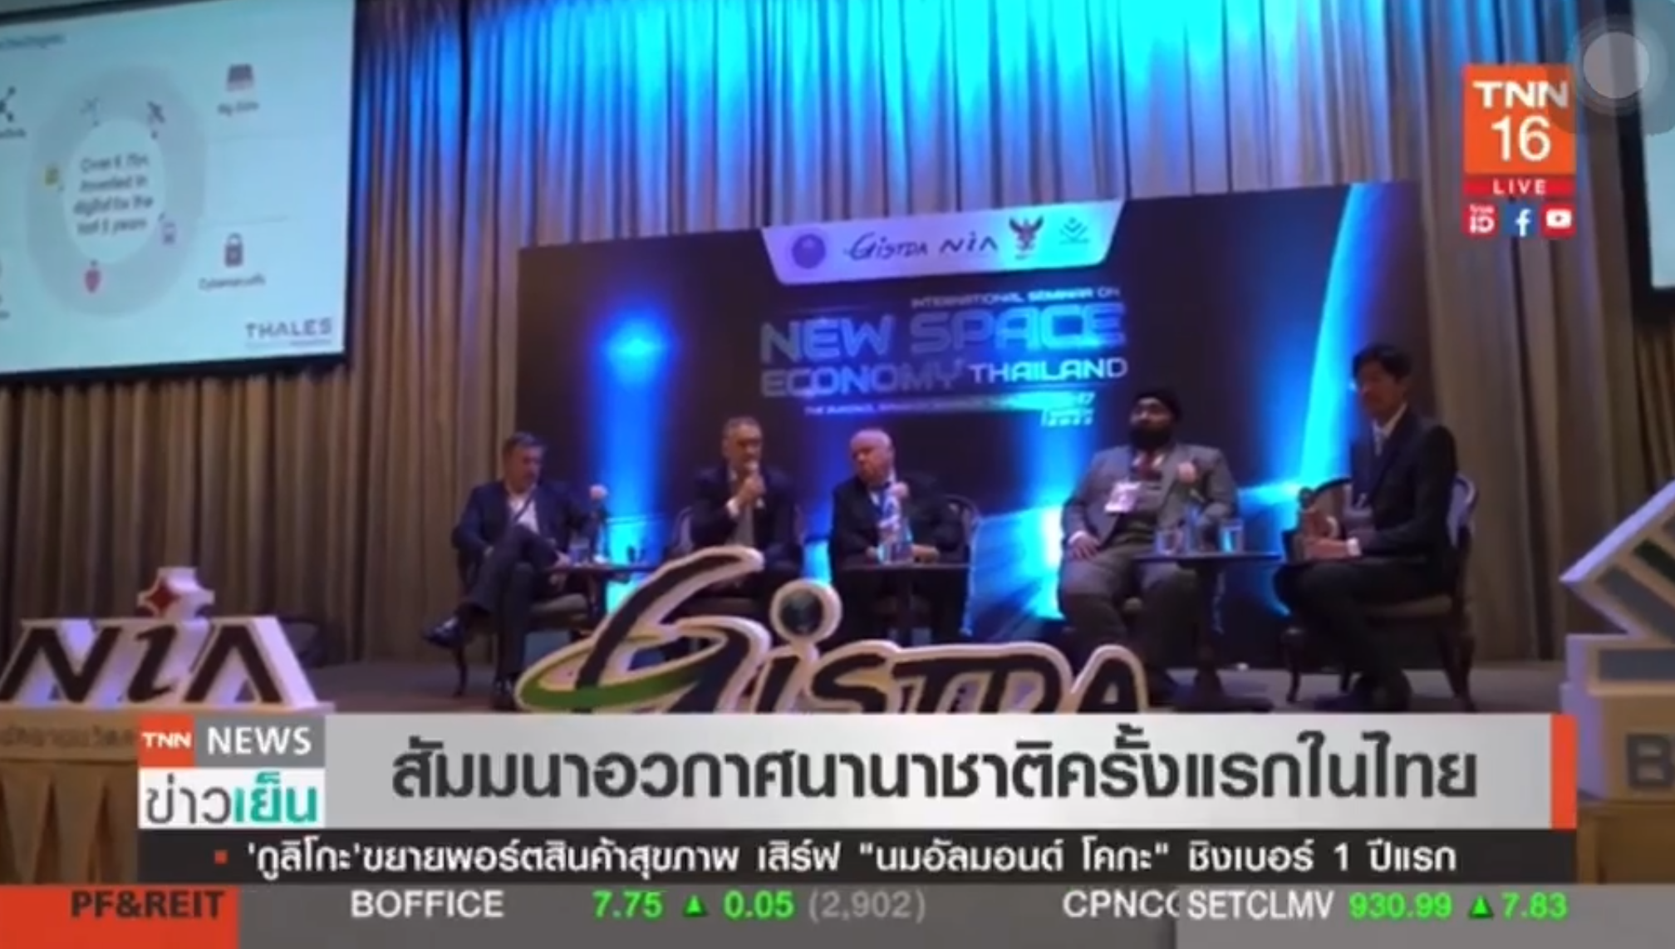
International Seminar ‘New Space Economy’
16-17 March 2023 in Bangkok, Thailand
●More than 500 participants from over 100 local and international agencies

Slide 11

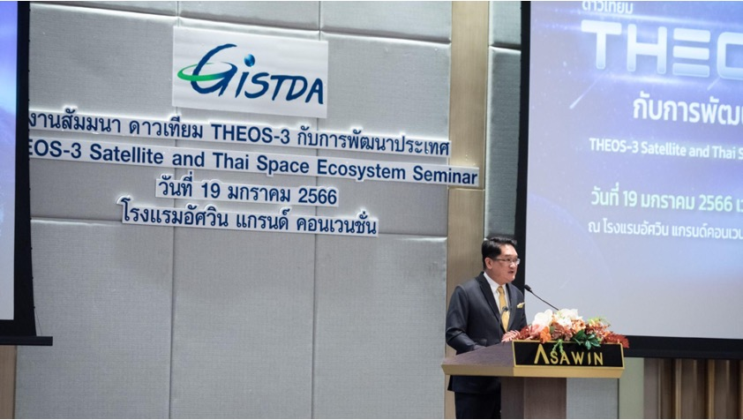
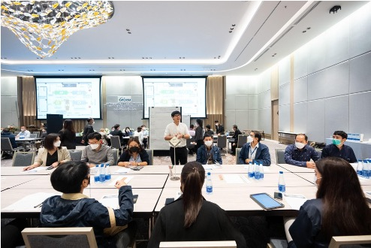
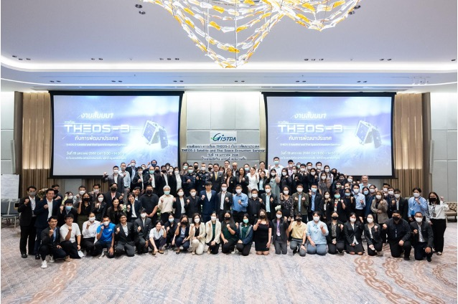
THEOS-3 Seminar on Thai Space Ecosystem
19 January 2023 in Bangkok, Thailand
Attendees from 32 affiliations
  Potential product users
  Disaster management body
  Private companies in downstream applications i.e. mapping services
To find observation gaps in Thailand
To foster cooperation between Thai space-related companies and stakeholders for THEOS-3 in-house development

Slide 12
Priority #2: Supporting Exploration of New Geometries for Space Agencies and CEOS with New Space
New Space Task Team
Work with CEOS New Space Task team led by SIT Chair to develop New Space Economy document as a means for knowledge sharing with CEOS Agencies.
Collaboration Opportunities
Workshops/Meetings as inputs to the border CEOS discussion on New Space opportunities. (TBC)
Facilitate a discussion during CEOS 2023 timeframe

Slide 13
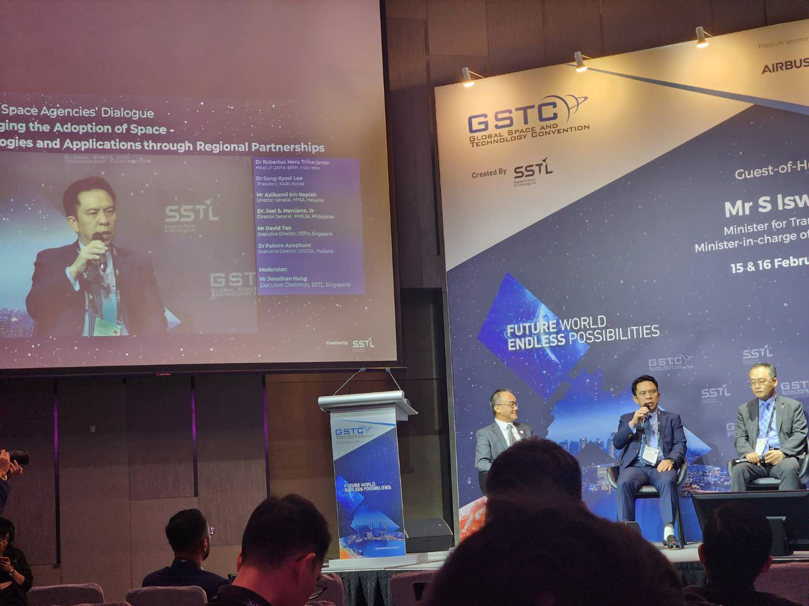
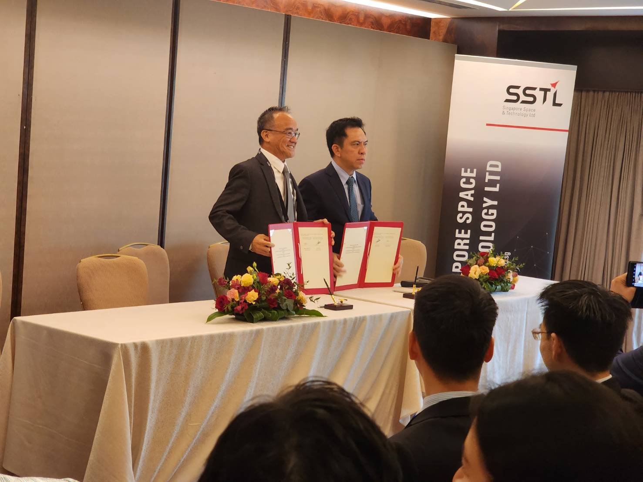
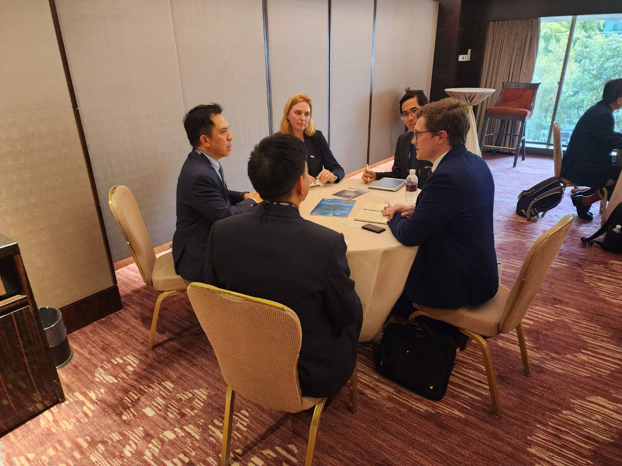
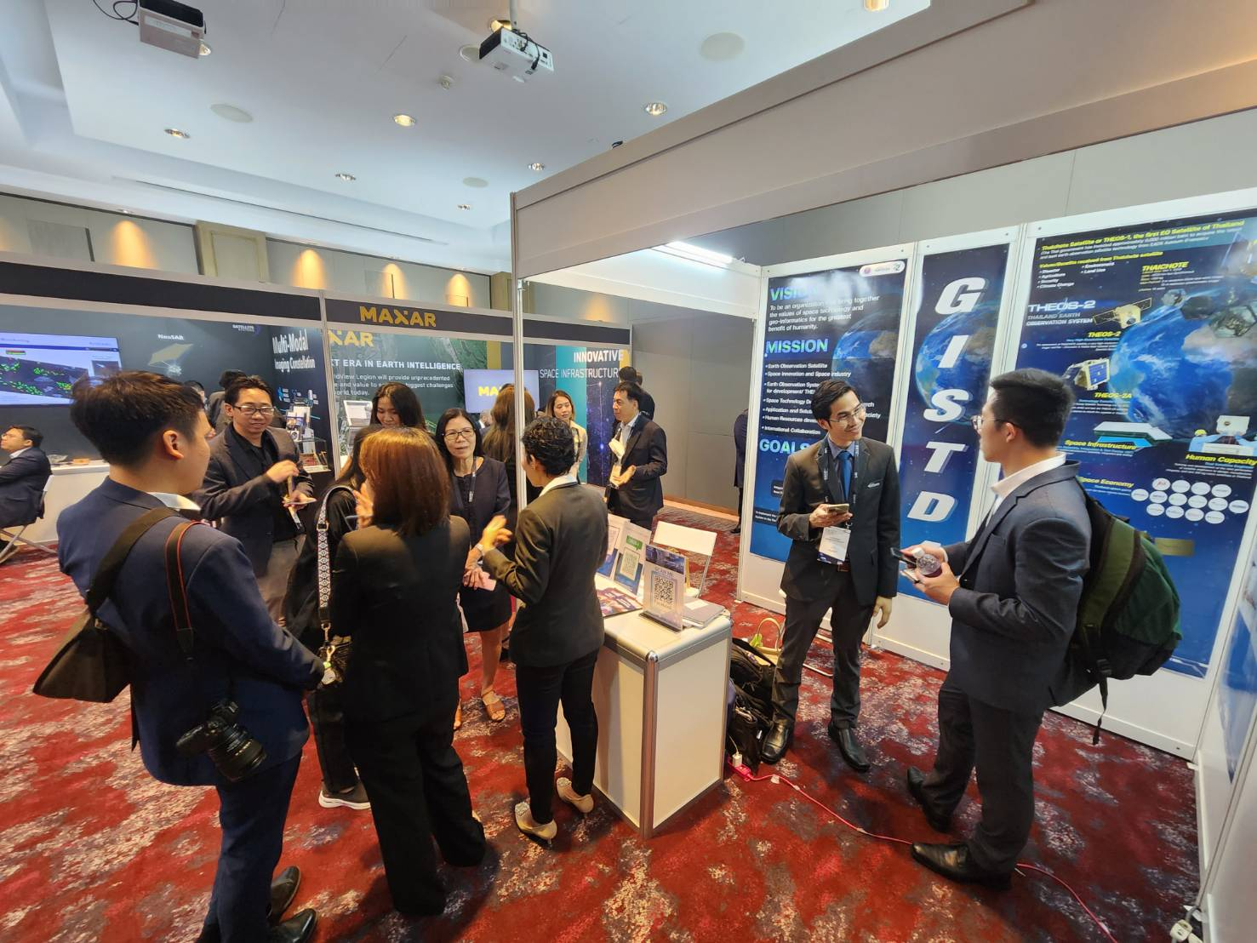
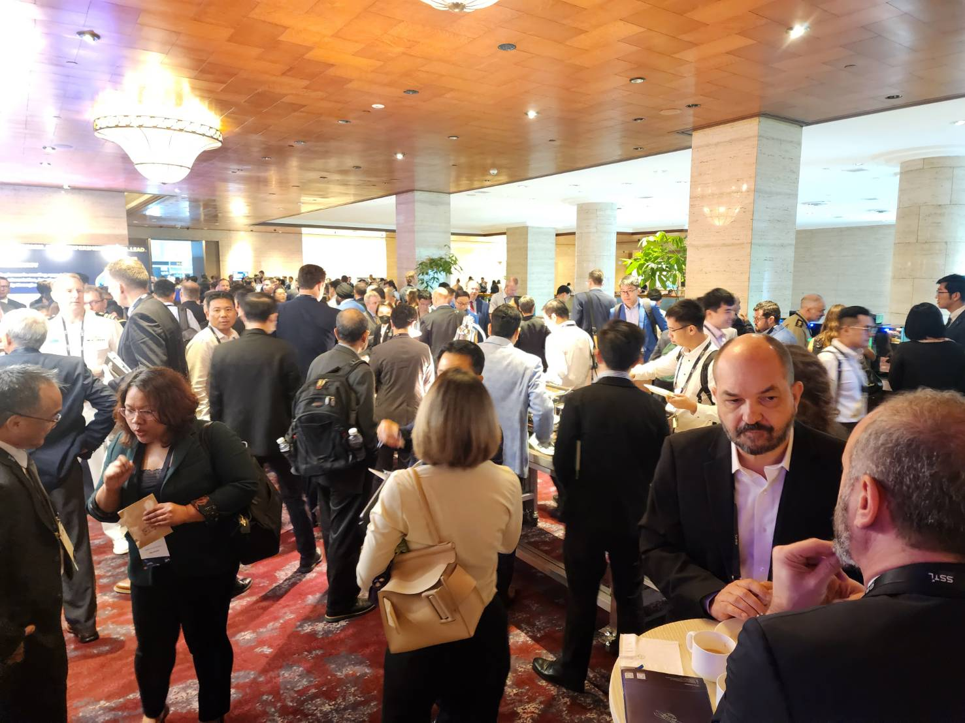
Global Space and Technology Convention 2023
Key Achievements
New agreement built between GISTDA-OSTIn(Singapore) on space-related cooperation
Engaged with other space-related startups and agencies
Joined a panel discussion on Regional Space Agencies’ Dialogue Encouraging the Adoption of Space – Technologies and Applications through Regional Partnerships

Slide 14
CEOS Chair Support
Re-engage with inactive CEOS members
Support the New Space Task Team
Co-develop the NSST Activities Working Document

Slide 15




The CEOS Plenary 2023
Date: 14-17 November 2023
Structure: 14 Nov - Side Meeting
15 - 16 Nov - CEOS Plenary 2023
17 Nov - Technical Exploration
Location: Chiang Rai, Thailand

Slide 16
THANK YOU

Slide 17
Plan for Pre-Plenary Side Events
TBD…

Slide 18
Expected Support and Contribution from CEOS
1
Support the implementation of the AFOLU and GHG Roadmap
2
Further update to the CEOS Global Stocktake Portal.
3
Ocean Carbon Workshop
4
Carbon Observation from Space
5
Support WGs/ Task Teams/ VCs activities to support GST
6
Support the collaboration between CEOS and GEO, WMO, and etc.

Slide 19
Expected Support and Contribution from CEOS
1
The experience sharing among CEOS Space Agencies
2
Support the New space activities from CEOS entities (Working Groups, Virtual Constellations, and Ad Hoc Teams)

Slide 20

Global Space and Technology Convention 2023
In person event in Singapore on 15- 16 February 2023
Around 1000 participants related to space technologies and businesses
Participants from many smaller space agencies from around the Asia-Pacific region
Many start-ups mainly from south-east Asian region also present, from both downstream and upstream areas
More information found at: https://www.space.org.sg/gstc/

Slide 21
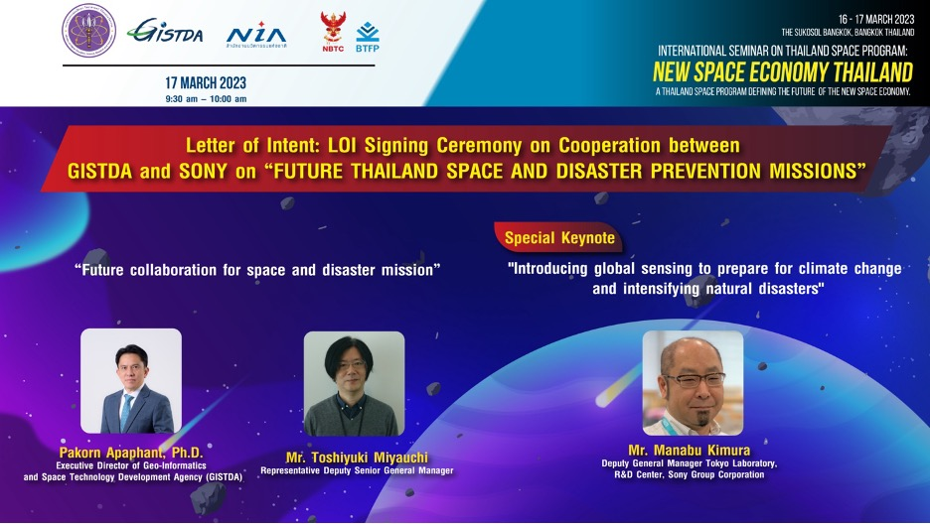
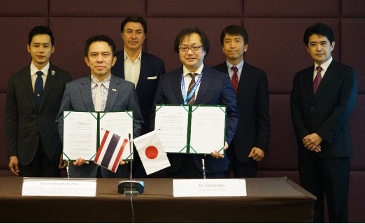
International Seminar ‘New Space Economy’
Key outcomes
Thailand-Japan New Space Economy Cooperation
I
Notes:
International Seminar on Thailand Space Program: ‘Shaping New Space Economy’ 16-17 March 2023 in Bangkok, Thailand

Slide 22
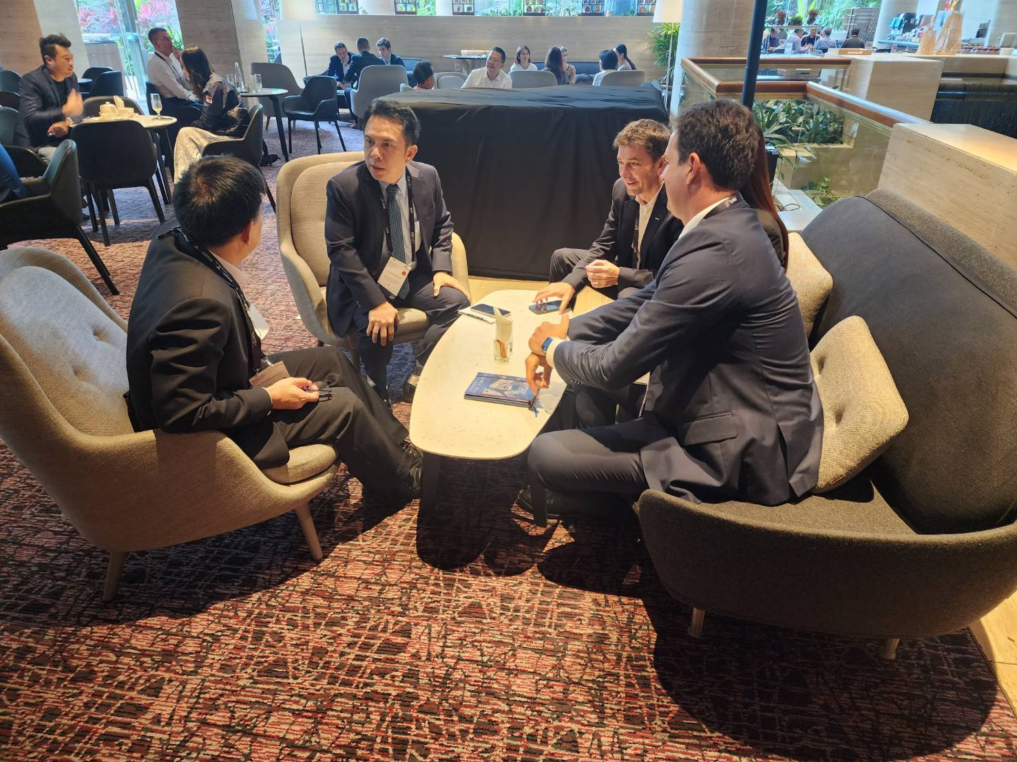
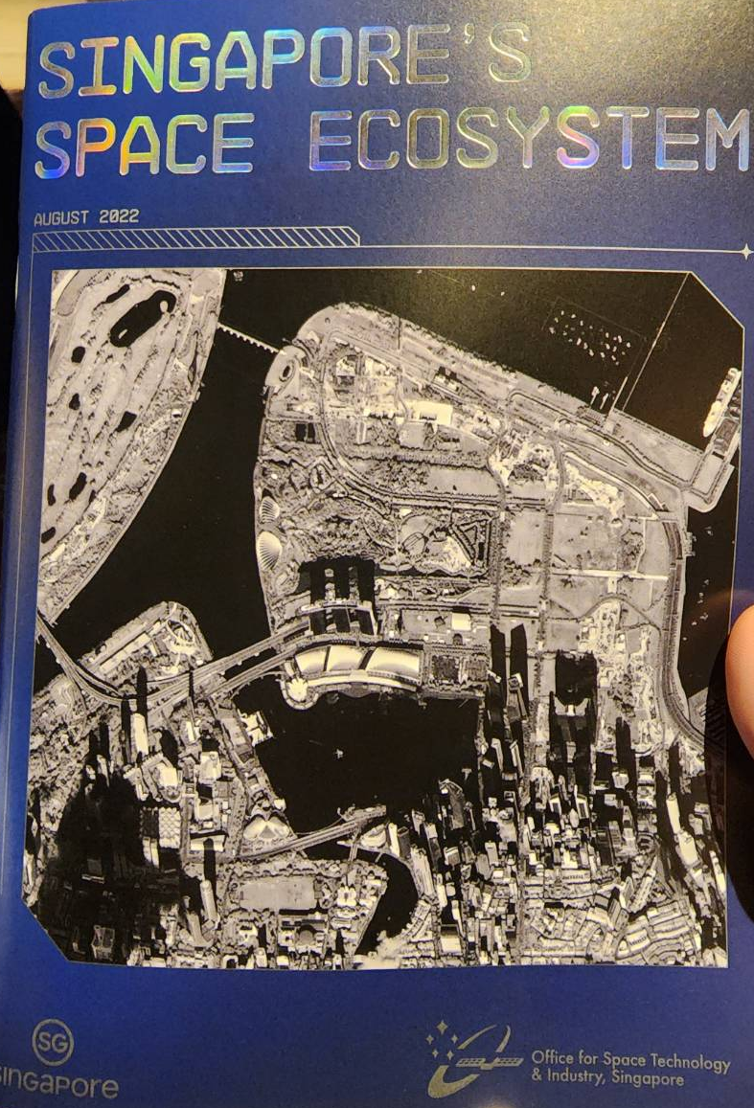
Global Space and Technology Convention 2023

Slide 23
Global Space and Technology Convention 2023
Singapore has successfully become the space business matching and networking venue
More than 200 companies in their Space Ecosystem and number keep growing in Singapore
GSTC is a great venue for Newspace startups to connect with potential users and build partnership
Ahead of the event, there is a dedicated bootcamp for space startups
All networking areas has been fully utilized and pack with numerous business matching opportunities
“One-stop shop for all space products”

Slide 24
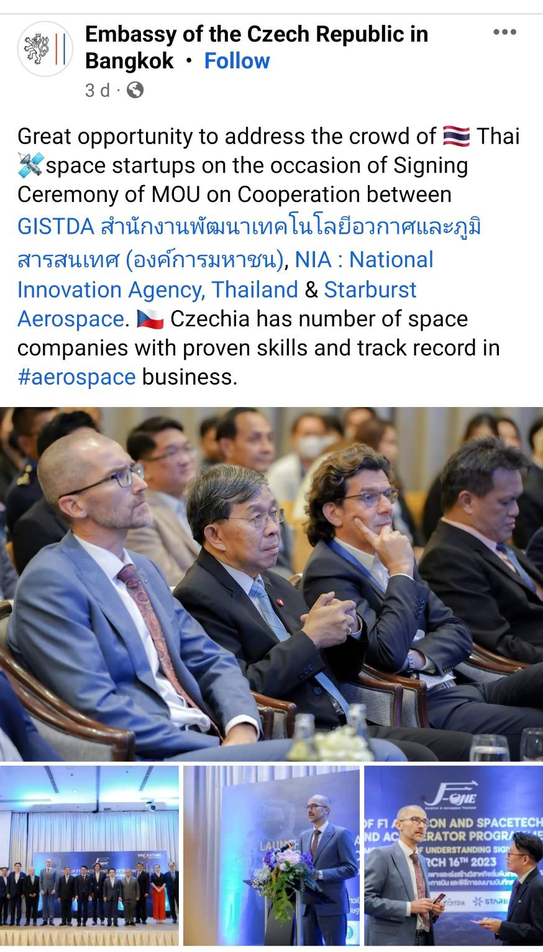
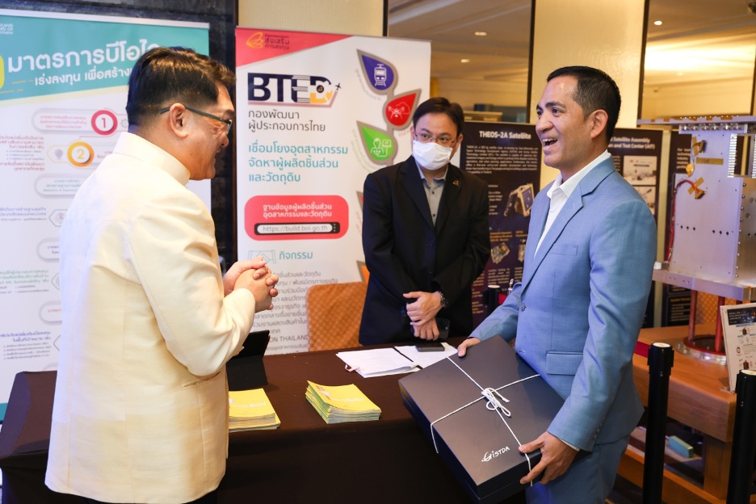
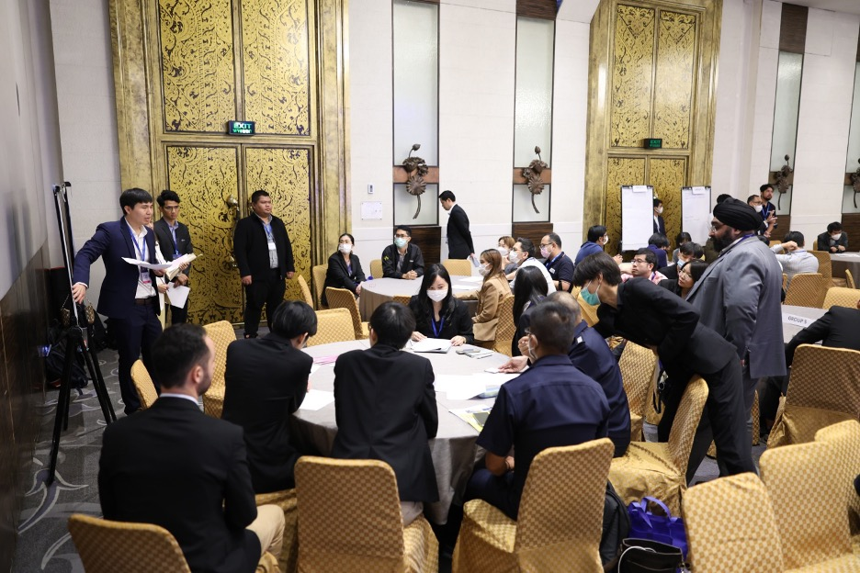
International Seminar ‘New Space Economy’
Board of Investment (BOI) exhibition
Workshop to get inputs from private sector

Slide 25



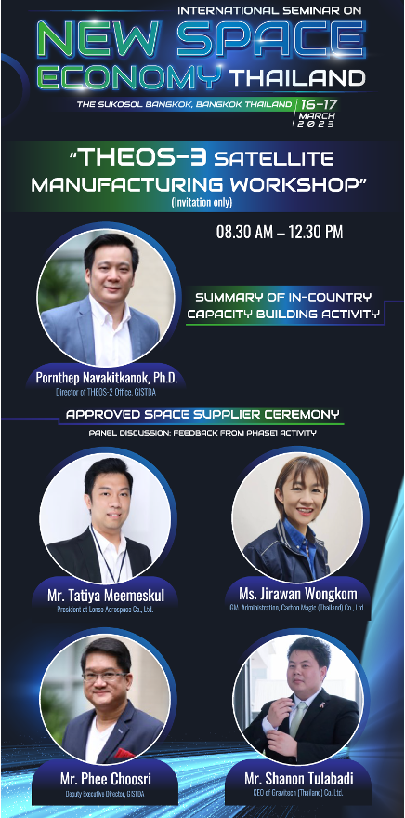
International Seminar ‘New Space Economy’

Slide 26
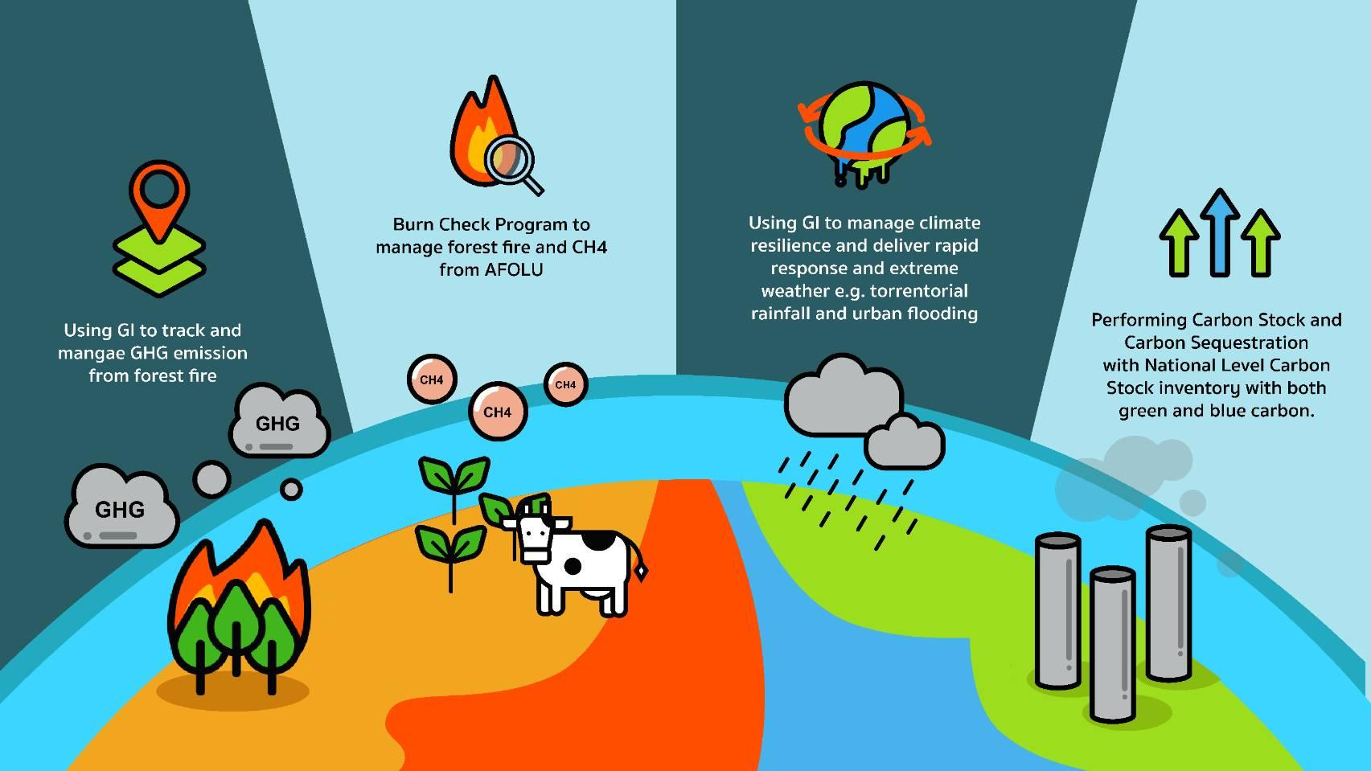
GISTDA activities to support GST

Slide 27
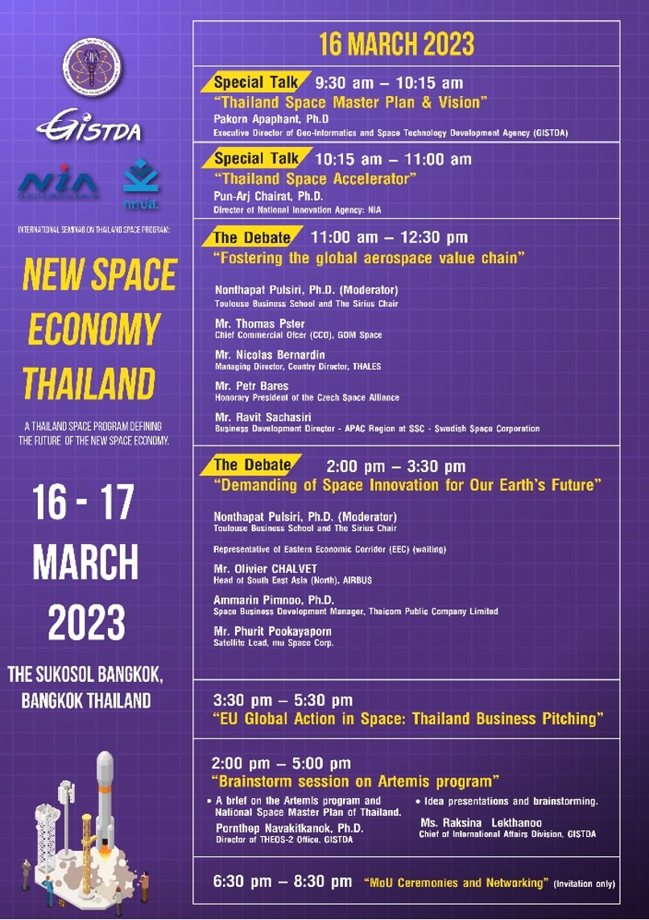
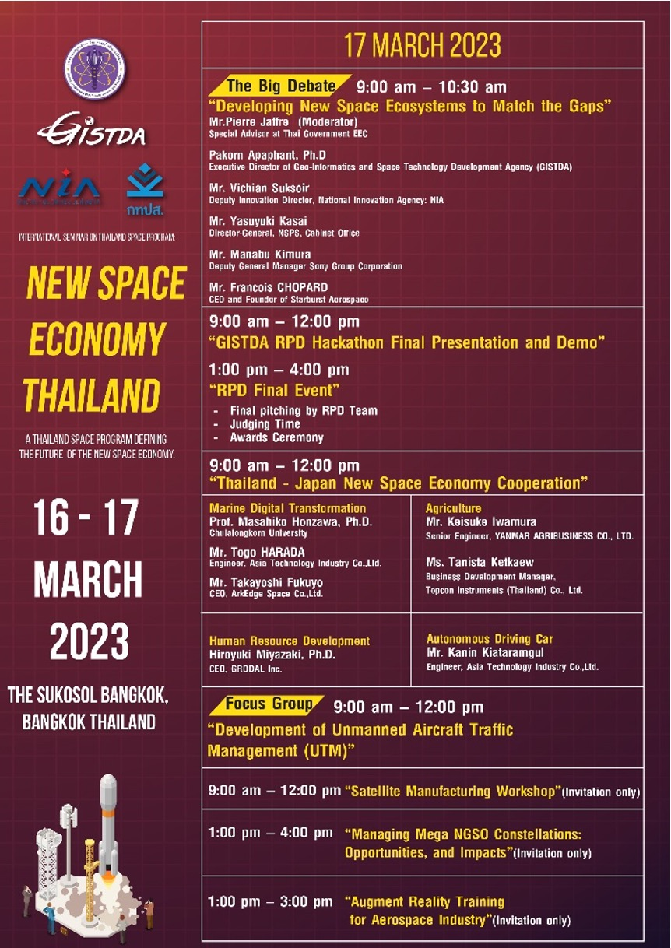
International Seminar ‘New Space Economy’
International Seminar on Thailand Space Program: ‘Shaping New Space Economy’ 16-17 March 2023 in Bangkok, Thailand
The two-days seminar includes sessions on developing New Space Ecosystems and fostering the global space value chain for our Earth’s Future
We saw more than 500 participants from industry, startups, policy makers, funding and academia.
Notes:
International Seminar on Thailand Space Program: ‘Shaping New Space Economy’ 16-17 March 2023 in Bangkok, Thailand

Slide 28
Contribution to NSST
Inputs provided to NSST Activities Working Document on Observation gaps, commercial opportunities to fill CEOS priority requirements for climate, SDGs and disasters
GISTDA plans to set an observation gaps session during ASEAN Space Workshop on 24-26 May 2023 to get input from players in the region
Inputs from the International Seminar on Thailand Space Program organised by GISTDA to be added to working document

