Slide 1
SIT-38
2023
Kahramanmaraş Event Supersite
Stefano Salvi
GEO-GSNL, WGDisasters
Agenda Item 7.8
SIT-38 2023, ESA/ESRIN
29th - 30th March 2023

Slide 2
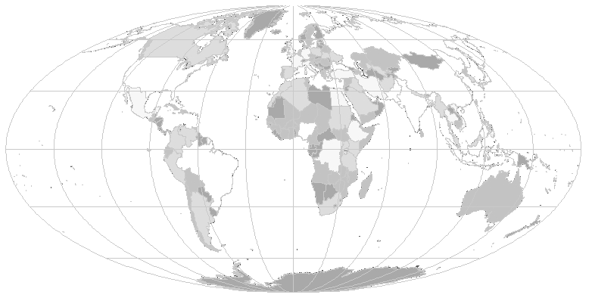
Geohazard Supersites
Icelandic volcanoes
Campi Flegrei
& Vesuvius volcano
Mt. Etna volcano
Marmara fault
San Andreas Fault
Kamchatka volcanoes
GEO-GSNL is a network of 13 Permanent Supersites and the San Andreas Fault Natural Laboratory.
Temporary Event Supersites can be established for special events.
Corinth Gulf faults
China faults
Nicaragua
volcanoes
Hawaiian volcanoes
Taupo volcanic zone
Virunga volcanoes
Ecuadorian volcanoes
Southern Andes volcanoes

Slide 3
Supporting CEOS agencies
Supersite | ASI (CSK-CSG) | DLR (TSX) | CONAE (SAOCOM) | CNES (Pléiades)
Hawaii volcanoes | 250 | 70 | 250 | Not requested
Iceland volcanoes | 700 | 250 | 200 | 5000 km²
Etna volcanoes | 200 | - | unlimited | 1200 km²
Vesuvius-C.F. volcanoes | 200 | 130 | unlimited | 1200 km²
Marmara fault | 200 | 250 | 200 | 1200 km²
Ecuador volcanoes | 200 | 130 | tbd | Not requested
New Zealand volcanoes | 200 | 130 | tbd | Not requested
Corinth Gulf faults | 0 | 0 | 0 | 400 km²
San Andreas Fault | 1600 | 320 | tbd | Not requested
Southern Andes volcanoes | 400 | 150 | 200 | 10000 km²
Virunga volcanoes | 400 | - | 200 | 1200 km²
China faults | 200 | - | - | 4000 km²
Kamchatka volcanoes | 100 | 150 | 100 | 12000 km2
Nicaragua volcanoes | 200 | 135 | tbd | 4000 km²

Slide 4
Supporting in situ data providers
A large quantity of seismic, geodetic, geological, geochemical, gravimetric + data are open for the scientific community

Slide 5
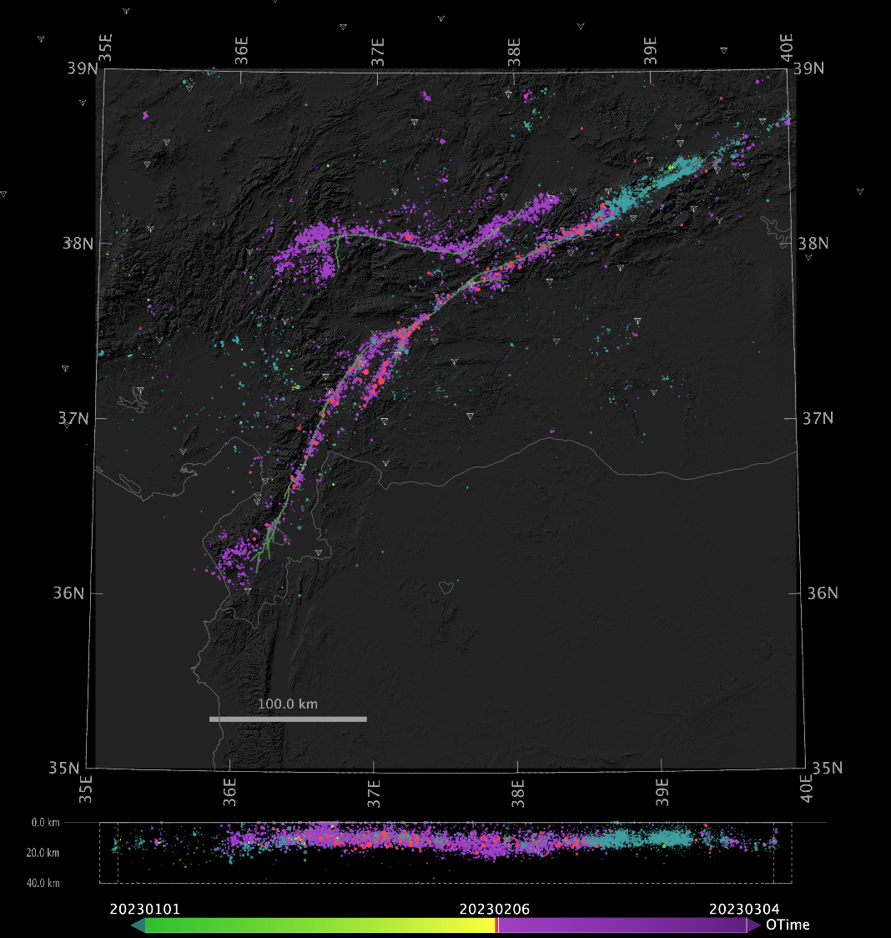
The Kahramanmaraş seismic sequence
Starts on February 6 at 4:17 a.m. local time
Mw 7.8 mainshock on the East Anatolian Fault (left-lateral strike slip)
9-hours later an Mw 7.6 earthquake occurs on a separate branching fault
To date over 12,000 aftershocks , up to Mw 6.7
Final death toll >57,000
>850,000 people are displaced
>160,000 buildings destroyed
Lenght of the main seismic ruptures: >400 km and >150 km

Slide 6
Scientific results from EO data
Several international groups are generating scientific results using EO data.
In general most of the effort aims at investigating the earthquake impacts or/and the earthquake source.
With respect to past earthquakes, we have seen an increasingly number of scientists willing to share their actual quantitative results through digital repositories with open licenses allowing reuse, even before publication.

Slide 7
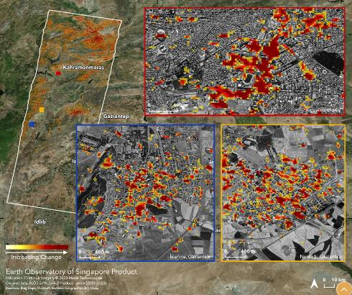
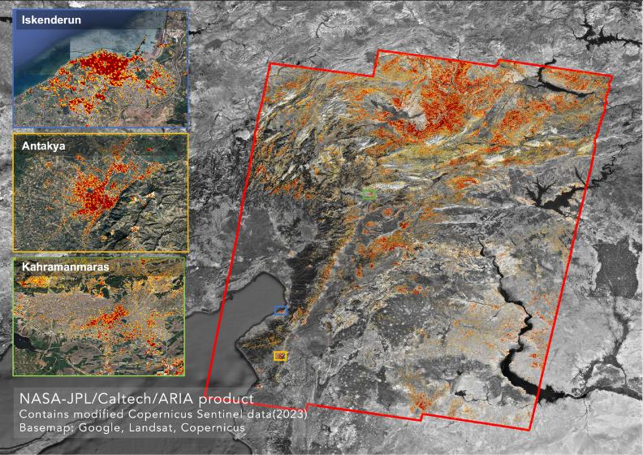
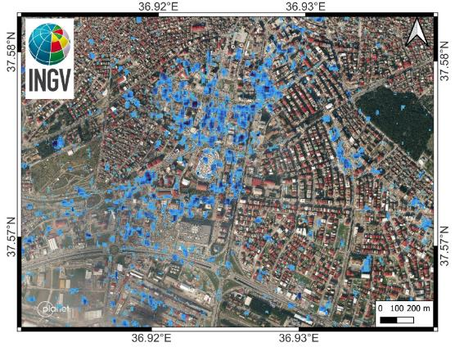
Results from EO data – damage proxy maps
Damage proxy maps were rapidly computed from InSAR coherence or SAR intensity data and released to the responders.
ALOS 2 coherence, by EOS-NASA
COSMO-SkyMed intensity, by INGV
S1 coherence, by NASA-JPL

Slide 8
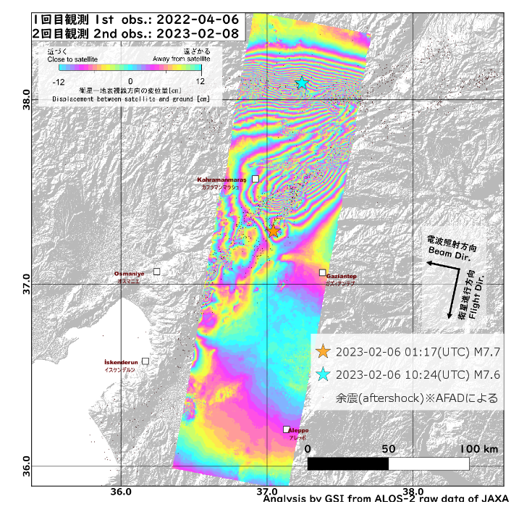
Results from EO data – ground deformation
First post-event image for co-seismic ground displacement mapping: ALOS 2 stripmap of February 8.
Although only partially covered, the displacement field due to the two main ruptures is evident.
Interferogram processed by GSI

Slide 9
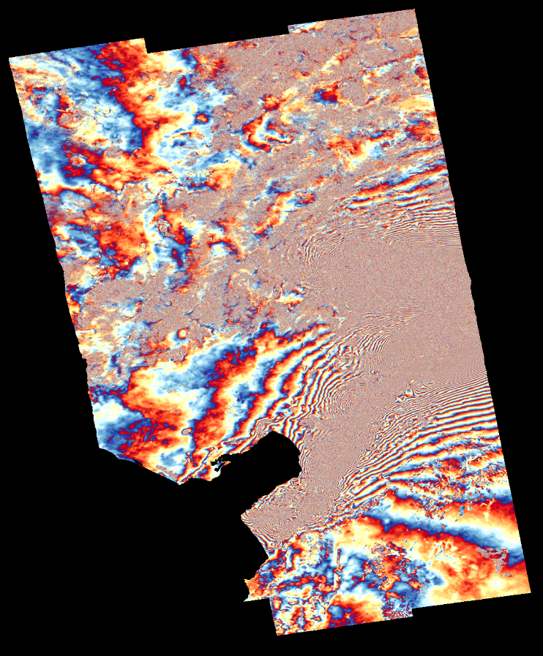
Results from EO data – ground deformation
First post-event S1 image acquired on February 9.
The high deformation gradients exceed the capacity of S1 InSar to measure ground motion over a large area.
Interferogram processed by COMET

Slide 10
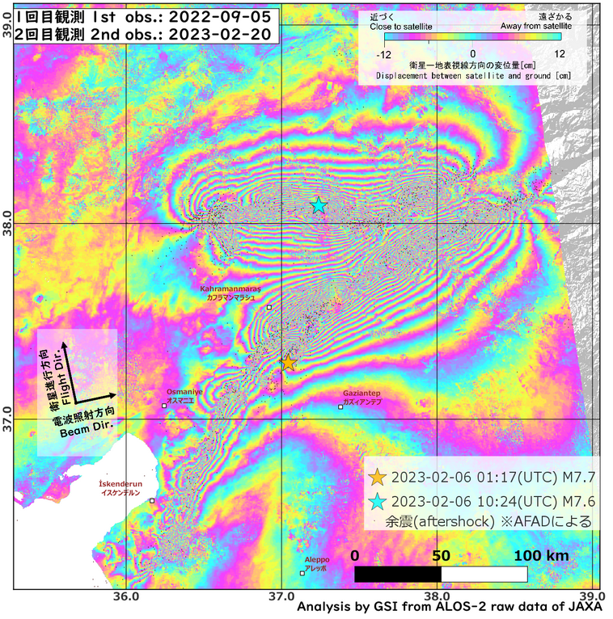
Results from EO data – ground deformation
Most complete mapping of the co-seismic ground displacement: ALOS 2 scansar image of February 20
The sheer dimension of the fault ruptures is evident: >400 km for the Mw 7.8 mainshock and > 200 km for the Mw 7.6 one
Interferogram processed by GSI

Slide 11
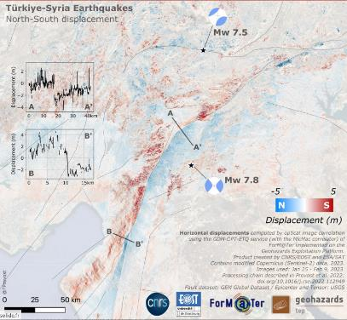
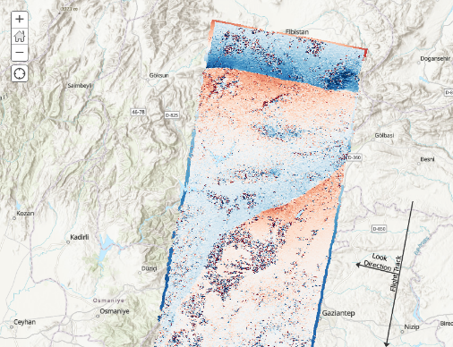
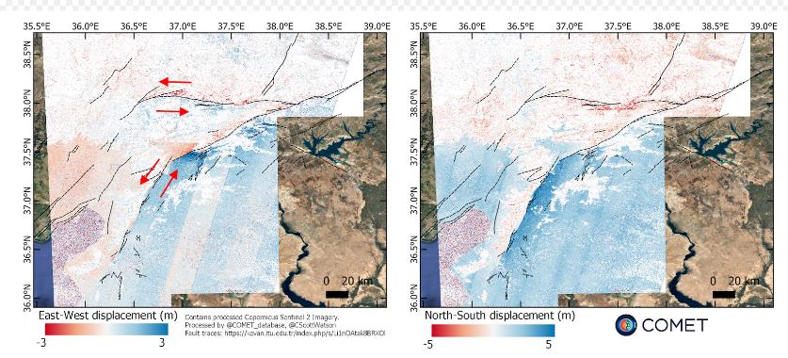
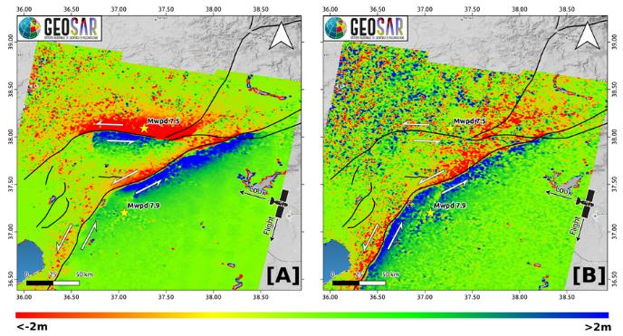
Co-seismic deformation from P.O.T.
Pixel offset tracking was also used to measure ground displacements, from S2 optical data (on the E-W and N-S components), from S1 and ALOS-2 amplitudes (on the range and azimuth components)
S2, processed by ForM@Ter
Alos-2, processed by NASA-JPL
S2, processed by COMET
S1, processed by INGV

Slide 12
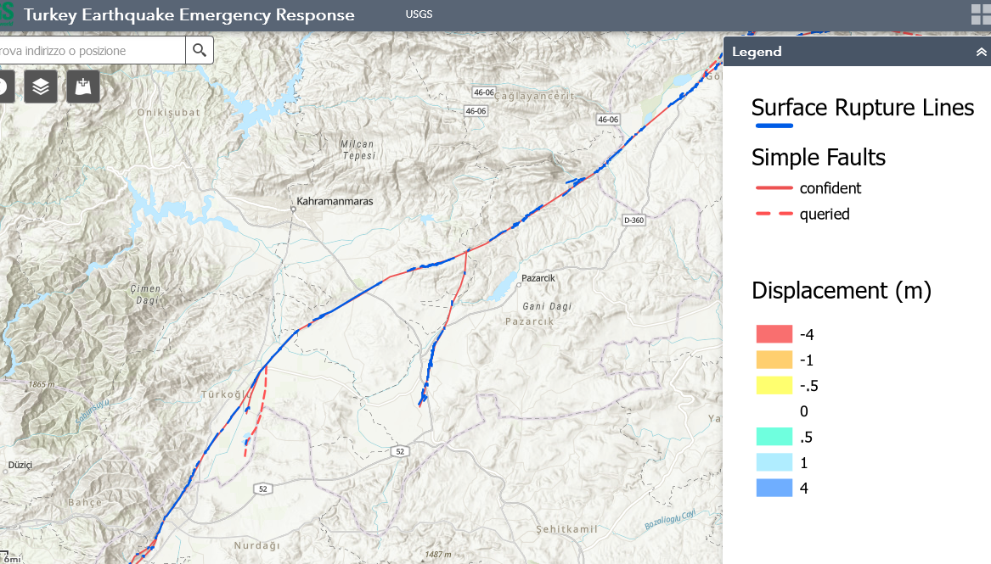
Fault mapping on VHR optical data
Pixel offset tracking and VHR optical image analysis was used to measure the scarp left lateral offset, reaching > 5 m at places
USGS - Fault trace and offsets from P.O.T and WV manual interpretation

Slide 13
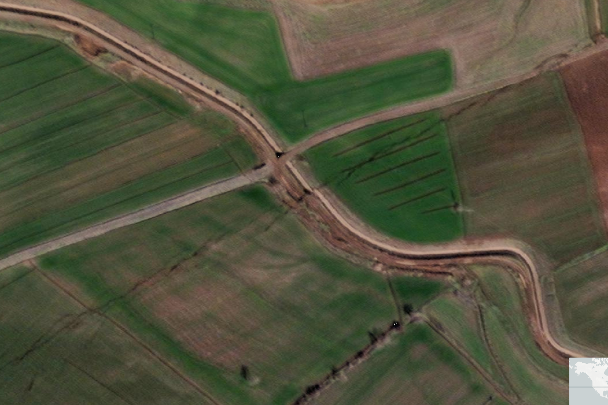
Fault mapping on VHR optical data
The fault scarp is very evident and continuous for hundreds of km, cutting across roads, urban areas and all types of utility lines.
WorldView 2, 30 cm image

Slide 14
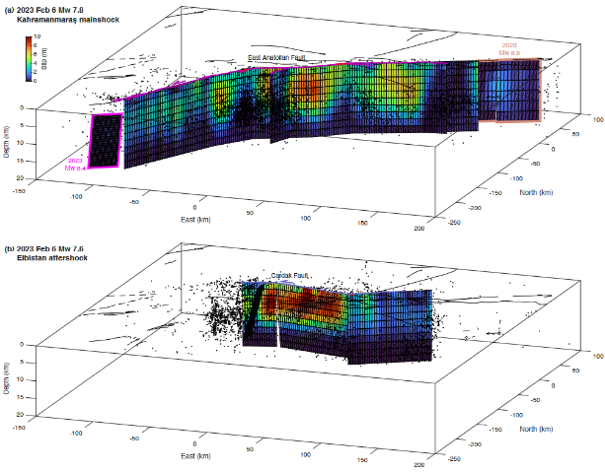
Seismic source models
Inversion source models constrained by ground deformation from InSAR and P.O.T. and seismological data.
From USGS NEIC
From Barbot et al.

Slide 15
How to use scientific information
The response from the international scientific community was immediate, and several potentially useful information products were generated and openly shared.
However, any information for decision making in any risk management phase, must be conveyed through authoritative channels.
This is why GSNL Supersites are coordinated by scientific institutes which are authoritative members of their national risk management frameworks.
Their role is to provide scientific support to the government agencies, in all phases of risk management.

Slide 16
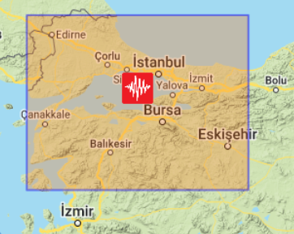
The Marmara Permanent Supersite
In Turkey, GEO-GSNL established, since 2014, the Marmara Permanent Supersite, focused on the Istanbul metropolitan area, which has the highest seismic risk in Europe (50% chance of a M7.3 in 30 years).
The Marmara Supersite is coordinated by the Kandilli Observatory and Earthquake Research Institute (KOERI) which maintains geodetic and seismic networks of national scale.

Slide 17
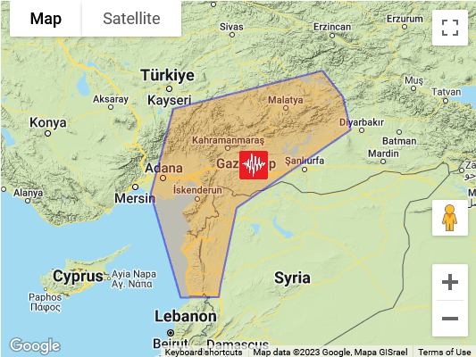
The Kahramanmaraş Event Supersite
It is coordinated by researchers from the Istanbul Technical University and KOERI, who provide scientific information to AFAD and other responding agencies.
The Supersite AoI includes areas where the additional stress transferred by the February 6 rupture may cause further fault activation in the next months/years.
The planned Supersite duration is one year.

Slide 18
The Kahramanmaraş Event Supersite
The main objective of the Kahramanmaraş Supersite is to promote scientific advancements in the following topics, using an Open Science approach:
Earthquake cycle and seismic hazard.
Co-seismic displacement field and post-seismic ground displacement and velocity.
Source properties of the largest earthquakes of the sequence.
Earthquake nucleation process.
Fault segmentation and earthquake rupture.
Coulomb stress transfer on nearby faults.
Earthquake effects (impacts) on the natural and anthropogenic environments

Slide 19
The Kahramanmaraş Event Supersite
This goal is obtained by:
Obtaining access to EO data for research, mainly from the CEOS agencies.
Facilitating access to in-situ data and scientific results generated by the international scientific community.
Managing the support by the international scientific community, to summarize and report the state-of-the-art scientific information to the national responders and decision makers.

Slide 20
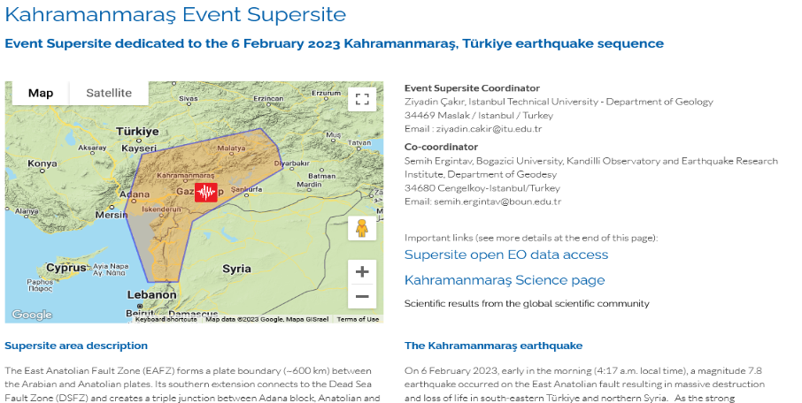
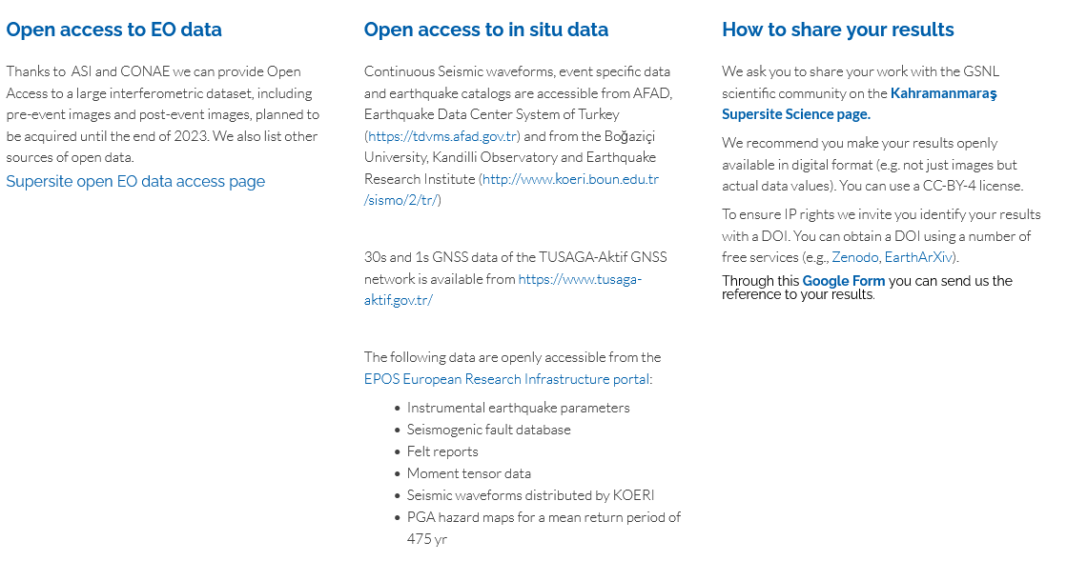
The Kahramanmaraş Supersite web pages
On the Kahramanmaraş Supersite web pages we provide information on the availability and access to EO data specifically obtained from CEOS agencies, how to access in-situ observations from local ground networks, and how to publicly share data and scientific results.

Slide 21
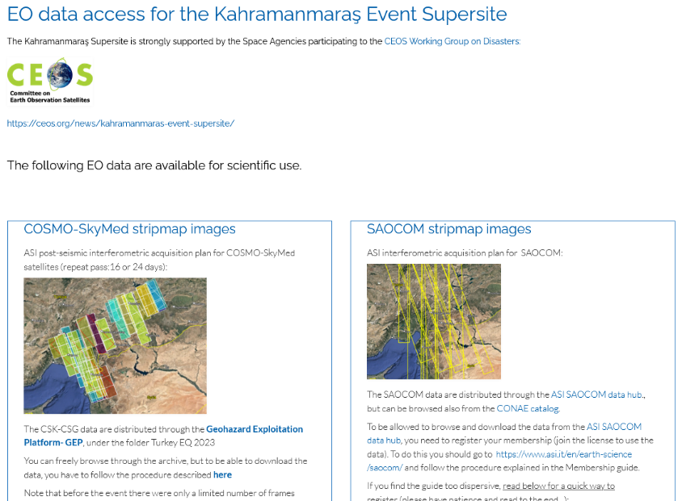
The Kahramanmaraş Supersite EO data
Presently three CEOS space agencies have agreed to provide image quotas to the Supersite:
ASI is providing over 40 CSK-CSG stripmap images per month, across the entire AoI
ASI is providing over 100 SAOCOM stripmap images per month, with a partial coverage of the AoI
CNES has agreed to acquire 4000 sq km of new Pléiades data
CONAE will provide SAOCOM data outside the ZoE of ASI if needed.

Slide 22
Further EO data of interest
DLR has been asked to support the Supersite and is evaluating the requests of TSX and TDX data.
JAXA has ended support to the Supersite initiative in 2016, however, for this earthquake JAXA has recently made available a limited number of ALOS-2 data.
We would like to request JAXA to provide access to additional Scansar ALOS 2 data for the Supersite scientific community, over the Event Supersite, and other Permanent Supersites.

Slide 23
We warmly thank CEOS for the continuous support to GEO-GSNL since 2012

