Slide 1
SIT-38
2023
WG Disasters Activities Report
L. Frulla, CONAE, WG
Vice-Chair &
H. de Boissezon, CNES, WG Chair, Agenda Item: 7.8
SIT-38 2023, ESA/ESRIN
29th - 30th March 2023

Slide 2
WGDisasters Objectives
Support the efforts of Disaster Risk Management (DRM) authorities in protecting lives and safeguarding property by means of satellite-based EO and science-based analyses
Support UNDRR Sendai Framework implementation
Foster increased use of EO in support of DRM & DRR, and express related EO needs
Raise the awareness of politicians, decision-makers, and major stakeholders of the benefits of using satellite EO in all phases of DRM
In pursuit of these objectives, the WGD should:
Contribute to the monitoring of the implementation of Sendai Framework
Support the work of international initiatives such as GEO
Strive to increase the awareness of decision-makers of the critical role of satellite EO
Reinforce the need for enhanced satellite EO programs to address DRM/DRR needs
Notes:
UNDRR: UN Office for Disaster Risk Reduction
Pursuit: search Strive: try
mainly Priority1 “Understanding Risk”
more recently Priority4 “Build Back Better”
The CEOS WGDisasters ensures the sustained coordination of disaster-related activities undertaken by the CEOS Agencies and acts as an interface between CEOS and the community of stakeholders and users involved in risk management and disaster reduction.
Who belongs?
Membership is open to all CEOS Agencies (Members and Associates).
Also experts from non-CEOS Agencies who have relevant expertise to contribute to the objectives of the WGDisasters.

Slide 3
WGDisasters Priorities 2023-2024
Path to sustainability - use cases or the operational uptake of satellite EO at local scale
Focus on Operational Uptake of WG successes to increase resilience
Demonstrators:
Continue to demonstrate potential, but begin building path to sustainable operations post demonstrator – stronger ties to international stakeholders and local actors
Increase focus on capacity building in all demonstrator activities
Strengthen ties to GEO WGs
Continue exploring linkages to Climate related activities
Explore linkages to other WGs
Exploit new Technology opportunities, either through new missions, new activities or new data exploitation techniques
Notes:
Current CEOS Presidency : Paths to Sustainability: from CEOS Strategy to practical measures

Slide 4
WGDisasters Subgroups
“Pilot” and “Demonstrator” projects:
Wildfire Pilot
Flood (GEO/LEO/SAR) Pilot
Landslide Demonstrator
Volcano Demonstrator
Seismic Hazards Demonstrator
Recovery Observatory (RO) Demonstrator
GeoHazards lab
Contribution to GEO:
GEO4DRM
GSNL (Geohazards Supersites & Natural Laboratories)
GEODARMA

Slide 5
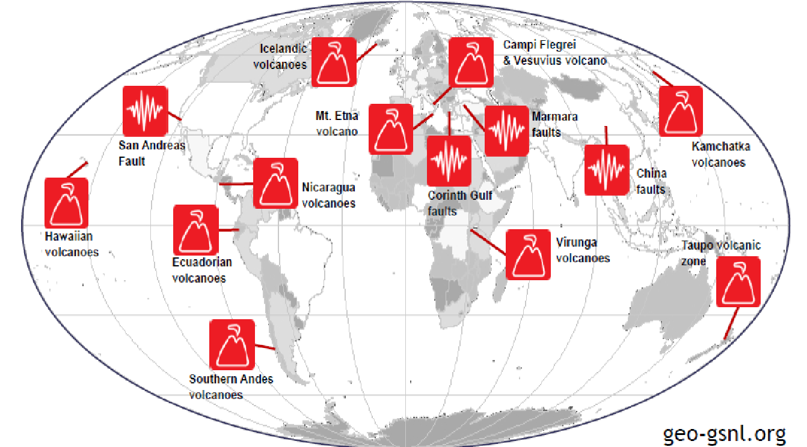
GSNL Supersites
Hawai volcanoes
Icelandic volcanoes
Etna volcanoes
Campi Flegrei/Vesuvius volcanoes
Marmara Western North Anatolian fault
Taupo Volcano
Ecuador Volcanoes
San Andreas Fault NL
Southern Andes volcanoes
Virunga volcanoes
15 GSNL Geohazard Supersites
Kamchatka kuriles volcanoes
China Earthquakes
Nicaragua supersite
New-Enceladus-Supersite
Kahramanmaraş

Slide 6
Links to other CEOS WGs
Ties to CEOS WGs:
WGCapD, joint activity to provide training and EO awareness to DRM leaders (El Salvador 2022; Africa and Asia 2023); presentation to WGCapD-12and UN-Space “Meeting on the identification of needs of Member States and United Nations entities for Capacity Building in the Use of Space Observations”, 1 to 3 March 2023
WG Climate, discussions to collaborate on climate adaptation and impacts at local level (underway)
WGISS, joint session in person with WGISS-55, 18-20 April 2023; discussion on machine learning for EO applied to Disasters
SIT, collaboration on sustainability and implication of new partners including private sector EO players (Volcano and Landslide Demos)
New Space Task Team (NSTT), will contribute with the to topic 10: “Observation gaps, commercial opportunities to fill CEOS priority requirements for climate, SDGs and disasters”.

Slide 7
Links to other CEOS WGs and GEO
Oceans Coordination Group, possible WGDisasters thematic contributions (under review)
coastal erosion
coastal floods due to Tsunamis
red tides
GEO:
DRR WG, RO one of 1st use cases for EO Risk Toolkit/RiX (UNDRR), Landslides to follow
New GEO thematic Incubators : WG Disasters working to develop use cases

Slide 8
Thank you

