Slide 1
WGCapD
2023
Jorge Del Rio Vera, WGCapD Chair
Agenda Item 7
SIT-38 2023, ESA/ESRIN
29th - 30th March 2023

Slide 2
Status of Actions
Action CEOS Plenary 36-04
CEOS members to review the proposed EOTEC DevNet Sustainability Plan and consider the outlined approaches to staffing, including in-kind support for the part-time positions of regional community of practice coordinators – in anticipation of further discussion at SIT-38.
EOTEC DevNet is staffed until next year thanks to generosity of NASA and University of Jena, other members of EOTEC DevNet are contributing with in-kind support.
Sustainability plan was presented at SIT-TW and Plenary in 2022. No further review is needed, but request authorization to carry on the initiative.
Limited support from CEOS SEO required, additional in-kind support from CEOS members most welcome.
Proposed action for CEOS SIT TW to present results of the achievements of EOTEC DevNet.
Action CEOS Plenary 36-12
WGCapD Chair and SEO to discuss training and capacity development opportunities for CEOS SDG work in the context of EOTEC DevNet
Presentation of CEOS SDG Work in UN-Space/WGCapD-12
Presentation of results and opportunities of UN-Space/WGCapD-12 in CEOS SDG Coordination Group
Slide ‹#›

Slide 3
EOTEC DevNet Sustainability
EOTEC DevNet Global Leadership Team and regional leads held a Strategy Meeting two days before CEOS WGCapD-12.
Pilot report and strategy recommendations available HERE
Good progress has been made in pilot phase:
Fostering a regular and consistent flow and exchange of information between a diverse set of partners at global and regional/national levels, particularly on regional/international capacity building opportunities.
Developing innovative products such as a flood tools tracker to advance discoverability of EO tools and global flood extent use case including five regional event analyses.
Collaborating with partners such as EO College, EO4GEO, Global Flood Partnership and others to identify gaps and overlaps and reduce duplication.
With NASA and U of Jena funding, proposing extending activity to 2025, and requesting CEOS endorsement.

Slide 4
EOTEC Network Mapping
Since the launch of the regional Communities of Practice in March 2022, over 600 individuals from 87 countries on six continents have used EOTEC DevNet to build connections, promote their activities, identify new opportunities and resources, and partner around common objectives.
EOTEC DevNet conducted an initial Network Analysis of these users using social network analytics methods, which resulted in a Network Intelligence Dashboard that can be used to observe overall performance. Analysis includes information such as people engaged over time, countries supported, and filters such as engagement type, professional affiliations, etc.

Slide 5
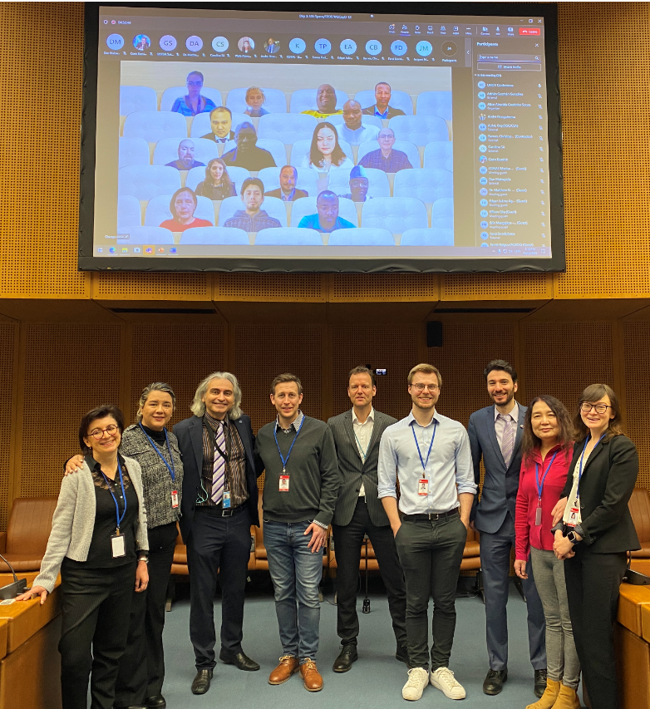
Joint UN-Space/WGCap-12 Summary
UN-Space/CEOS WGCapD-12
3-days meeting in Hybrid Format and in conjunction with the United Nations Inter-agency mechanism for coordination on the use of space in the UN system (UN-Space)
Possible because UNOOSA chairs WGCapD and is secretariat of UN-Space
Regional presentations (ECOSOC), UN entities presentations, WG groups presentations and WGCapD member presentations.
Results and actions will be discussed at the next WGCapD monthly meeting
Slide ‹#›

Slide 6
Joint UN-Space/WGCap-12 Summary
Focused on identify areas of action for different actors to continue moving forward in capacity-building and data democracy in the use of Earth observation.
The meeting in numbers:
187 unique participants from more than 160 entities registered
24 UN entities presented their work connected to Earth observation
18 Space agencies made presentations
4 Working groups of CEOS presented their work
The meeting revolved around five topics:
Education/Training
User Uptake
Data Access
Software Tools
Infrastructure

Slide 7
Joint UN-Space/WGCap-12 Summary
Day 1: Identifying Regional Needs and Capacity Building Resources
Africa:
More information about open software, open source algorithms and real time applications
Education and training on: floods, drought, landslide, wildfires, water extent, crop monitoring and early warning systems
Facilitate data access
Americas:
Indigenous co-development of Earth observation activities and training
Training on Disaster Risk Reduction
Training at city and county-level
BARRIERS:
Funding
Lack of awareness among decision makers
Need for open-source, standardized and free data and capacity building resources

Slide 8
Joint UN-Space/WGCap-12 Summary
Day 1: Identifying Regional Needs and Capacity Building Resources
Asia-Oceania
Open source techniques and tools for Earth observation data processing
Training on Disaster Risk Reduction
Training for decision-makers
Europe
Training for young professionals
Needs for open, standardized access to learning resources
Access to free or cheap cloud processing platforms
BARRIERS:
Funding
Lack of awareness among decision makers
Need for open-source, standardized and free data and capacity building resources

Slide 9
Joint UN-Space/WGCap-12 Summary
DAY 2: Presentations by UN Agencies
The key takeaway is that Earth observation is already used widely across the UN system for different purposes, although in some cases there is willingness to explore better what it can offer. Some use cases where assistance in terms of capacity building is needed were presented.
DAY 3: Presentations by CEOS members, working groups and space agencies
There is a wealth of resources already available, some of them already answering the needs expressed by the users. Coordination to respond to user needs expressed will be undertaken by CEOS WGCapD
Full report coming soon.

Slide 10
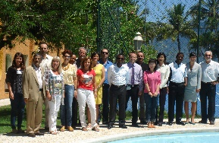
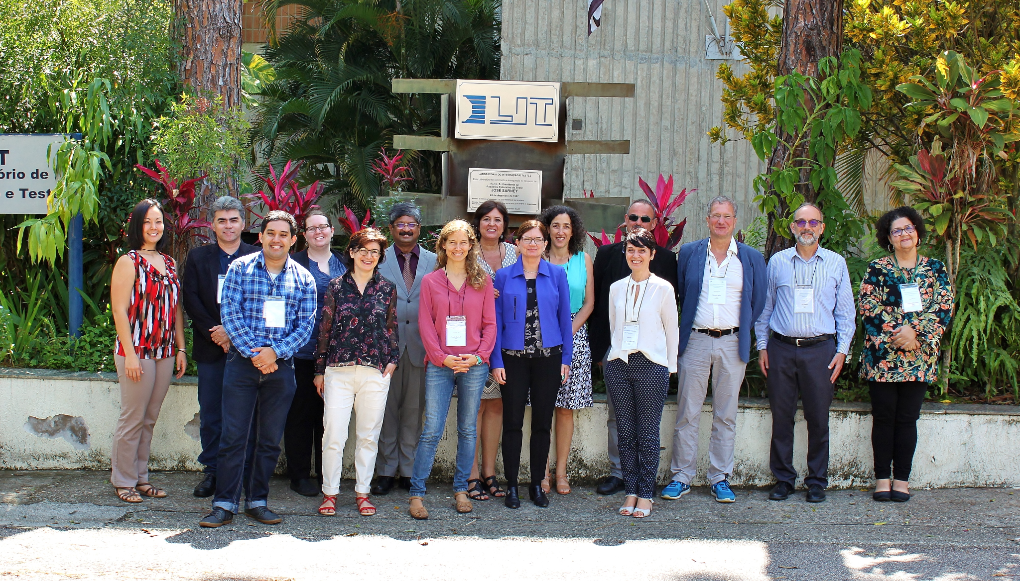
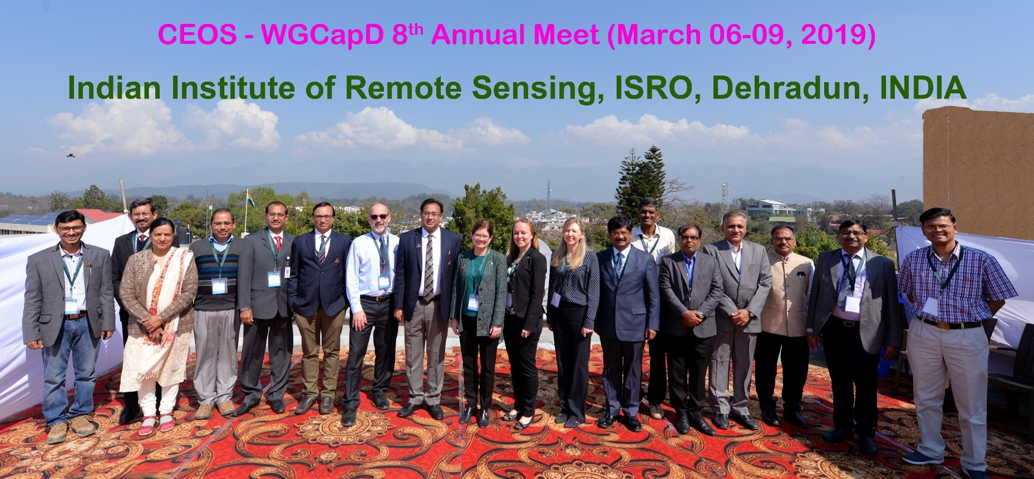
WGCapD Sustainability
Focus: GeoCab Portal support, KenyaCube, SAR trainings
COVID-19 drives first all-virtual annual meeting; virtualization of many deliverables
WGEdu Formed
WGEdu 🡪 WGCapD
Focus: Growing training, workshops, and data collections
Focus: Support of Data Cubes, AmeriGEOSS & AfriGEOSS
Revisiting needs and priorities of regional groups and of members
2003
2013
2015
2017
2019
2021
2023
1999
2012
2014
2016
2018
2020
2022
WGEdu formally adds capacity building to mandate
Focus: DEM Workshops
Focus: Increased number of trainings, workshops, and online courses
EOTEC DevNet established, Resource Portal & CEOS Webinar Toolkit launched
UN-Space and WGCapD joint meeting;
First hybrid after COVID-19
Focus: Awareness building
Focus: Deeper engagement of GEO

Slide 11
WGCapD-11 Findings in America’s region needs
Education/Training
• Training activities for decision-makers demonstrating measurable benefits of EO.
• Capacity-building activities on EO use in management topics (e. g. water, disasters, environmental resources.)
• Training on the use of Cloud-based platforms (GEE).
• EO training for companies to increase competitiveness.
User uptake is closely related to education and training.
• Courses on the use of ARD as it lowers the barrier for the use of the data for planning and decision-making.
• Showcase the benefits of EO by creating use cases for the utilization of the data.
• Undertake need assessment studies to provide capacity-building tailored to the requirement of the user communities
CB-20-23
CB-22-04
CB-20-01
CB-22-05
CB-22-16
Data Access
• Access to existing data archives that have little commercial value but important value for capacity-building.
• Maintain and promote free and open data policies.
Software tools
• Repositories for tools and open workflows are needed for processing the data. Ensuring interoperability of the tools.
Infrastructure
• Connectivity is an issue for accessing data and cloud-based platforms.
• Considering the EO data volume, open and easy access to processing and data platforms with enough computing power to run models. Also needed are guides to access existing platforms.
Barriers
• Lack of knowledge and awareness on different EO topics is a barrier.
CB activities for entities other than space agencies are needed.
Tools
• Capacity building devoted to coding skills for EO in different programming languages (e. g. Python), is desirable.
• Having access to demo licenses or discounted versions of processing software would be beneficial for the region.
Data Access
• There is a need to increase access to national datasets, mostly in situ data, which can complement EO data sources.
• Cost of cloud-based tools is also a barrier, which together with bad connectivity make difficult certain ways of accessing and processing data.
CB-22-01
CB-22-10
CB-22-13

Slide 12
WGCapD needs you!
WE NEED AN INCOMING VICE-CHAIR

