Slide 1

Copernicus Data Space Ecosystem
CEOS SIT 38 Meeting
30 March 2023

Slide 2
Copernicus Data Space Ecosystem – Main Principles
Contribute to building an attractive European solution to access and process Copernicus Sentinel data
Provide users a long-term perspective building trust and
unlocking the potential of Sentinel data
Support European industry in developing high-quality competitive operational services
https://dataspace.copernicus.eu

Slide 3







Copernicus Data Space Ecosystem – Main features
Open ecosystem
Public services complemented with extended commercial capacity
3rd Party services deployments
Federation capabilities
Open and free services under fair use policy and adjustable capacity and performance
Rich data portfolio, with all Copernicus Sentinel data and CCM core data sets easily available
Data distribution service combined with advanced processing APIs & services and cloud resources
API

Slide 4
Building an open ecosystem
Initially configured open and free capacity
e.g. Configured Number of parallel downloads per user
Extended open & free capacity
Extended open and free capacity
e.g. increased data access capacity according to user scenario evolution
Open & free service with configured operational capacity
Seamless expansion for large-scale use under commercial models by 3rd party operators
API
Extended commercial 3rd party capacity
Extended capacity with commercial 3rd party services
(direct agreement between user and third party)
e.g. Dedicated user data access capacity
3rd party services
3rd party service
* 3rd Party services preserving identity and governance
3rd party service
3rd party service
3rd party service

Slide 5
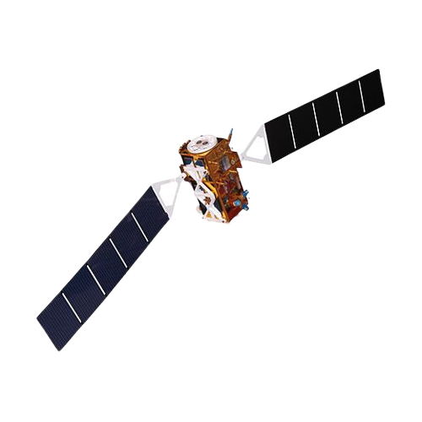
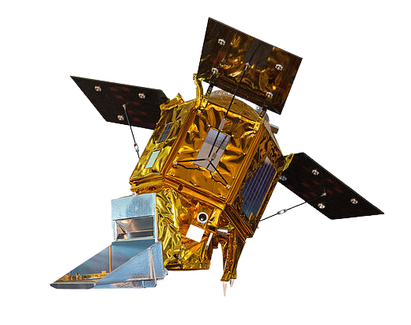
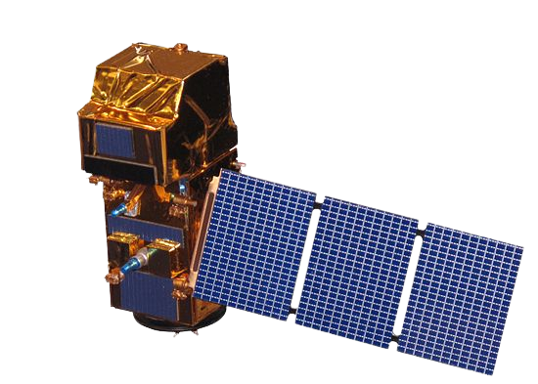
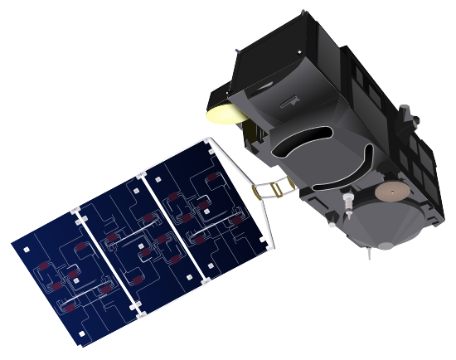
Public Data Portfolio overview
All Copernicus Sentinels User Level Data
Copernicus Sentinels Auxiliary data
Copernicus Core DataSets
  Copernicus Digital Elevation Models
  Contributing Missions Core Datasets
Copernicus Sentinels “Expert” Data
* Open & Free
* Open & Free
Sentinel-1
Sentinel-3 Land
* Licence & access restrictions may apply
Sentinel-2
Sentinel-5P
* Access restrictions may apply
+ Complementary 3rd party data with 3rd party access conditions
* Licence & access restrictions and conditions may be applied by 3rd parties

Slide 6

Sentinel Data Lifecycle Configurability
All Sentinel data available
All Sentinel data immediately available
Data Hub Baseline (2023)
Cop. DS Ecosystem Configuration
Immediate Access
Sentinel user level data
Worldwide < 6months
Immediate Access
“Refreshed data”: on-demand with latest processing baseline
Allowing a tradeoff between storage volumes, access performance and on-demand capacity according to evolving user scenario
Deferred Acccess
Sentinel-1/2/3(land)
User level data
Sentinel user level data > 6m months
Worldwide coverage
Full mission timeline
on-demand
*very limited data
Deferred
Level 0
Preserved data
Level 0

Slide 7
A plethora of services and APIs
Data Discovery and Download
Data Visualisation
An advanced set of tools to ease the access and exploitation of the large and ever increasing Coperncius data volumes
Data analysis and processing APIs
Traceability
Cloud resources (3rd party service)
Federation & On-boarding
API
https://documentation.dataspace.copernicus.eu/#/README

Slide 8
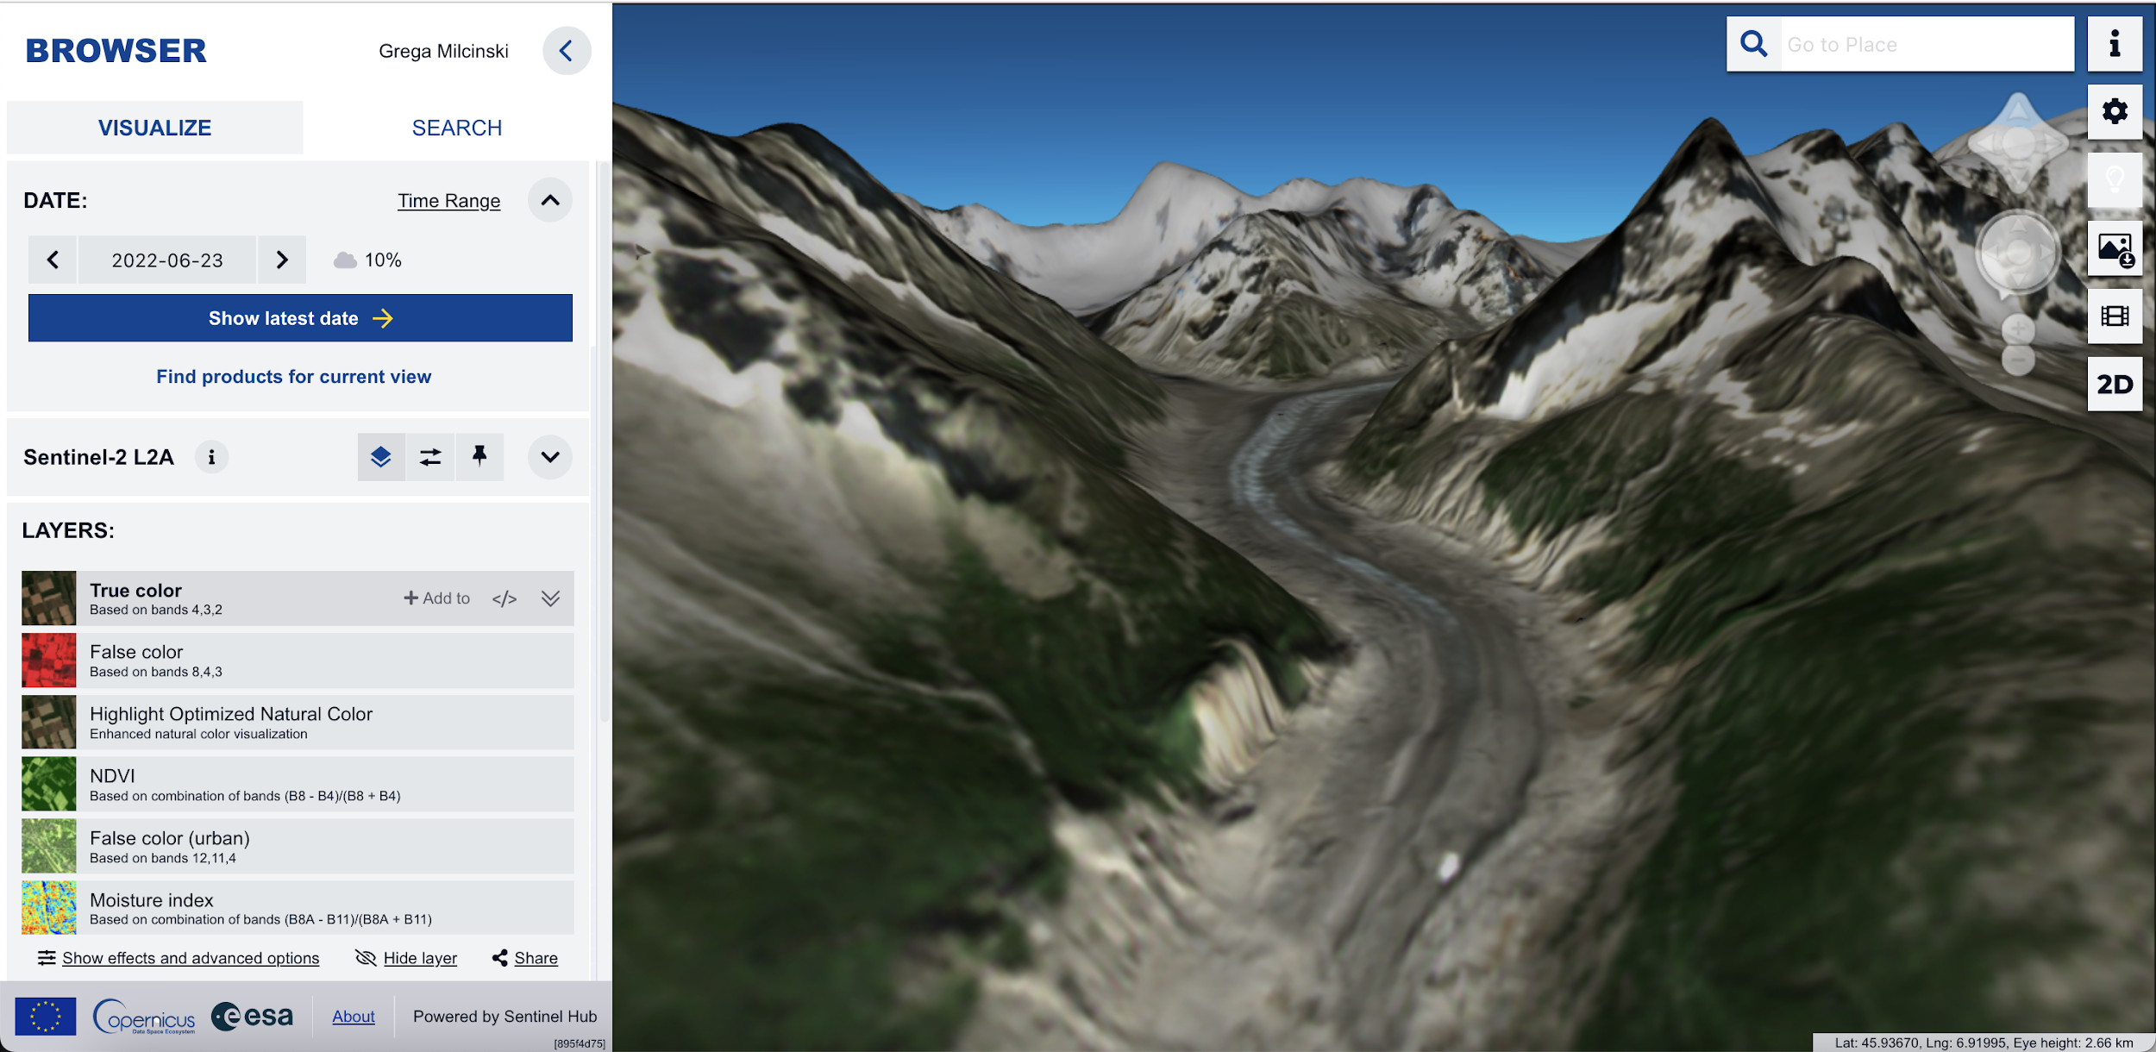







Full flexibility for users to access and process data
Maximising efficient data analysis and exploitation
Minimising download needs
Data discovery and visualisation
Copernicus Browser
APIs for discovery and download
OGC WMS and SentinelHub APIs
APIs for streamline access & data analysis
On-demand processing capabilities
Access and analyse specific data subsets, no need download
ON-DEMAND
processing capabilities
ESA Copernicus Sentinel-1/2/3(land) L1/L2 data processing
+ 3rd party on-demand processing capabilities

Slide 9




Full flexibility for users access management
One single entry point configurable to support the needs of different user groups
Data access services capacity configured for different user groups
User group membership governance ESA & EC
Open & free service with configured operational capacity
General users
Standard quota
Copernicus Services
Priviledged service capacity
API
Collaborative National Entities
Priviledged service capacity
International Agreements
Ad-hoc service capacity

Slide 10
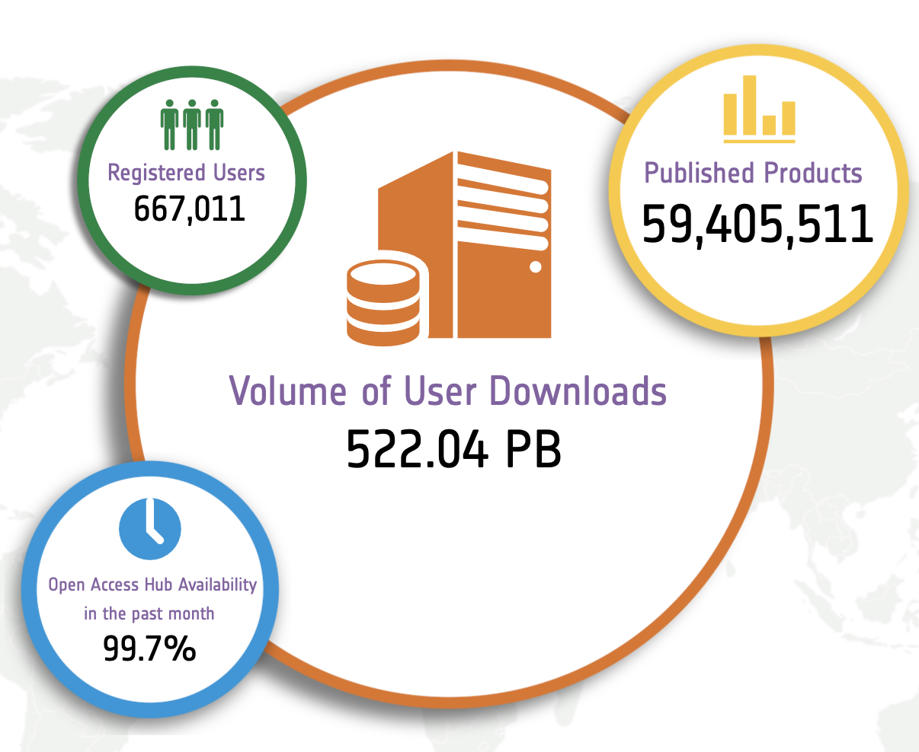
Copernicus Data Access Timeline Highlights
DataHub full service continuity guaranteed until end June 2023
DataHub service capacity ramp down until end September 2023
DataHub service discontinuity planned by end September 2023
Copernicus Data Access Service (Datahub)
Service Continuity
Copernicus DataHub Service in operations since 2014
Successfully ensuring massive daily data publication and user download
New service planned for 6 years
(plus optional 4 years)
User Migration
Copernicus Data Space Ecosystem
2015
2016
2017
2018
2019
2020
2021
2022
2023
2024
2025
2026
2027
2028
Gradual service phase-in with public roadmap
Notes:
The transition to the new Data Access Service will be announced as soon as the new DA contract is kicked-off

Slide 11
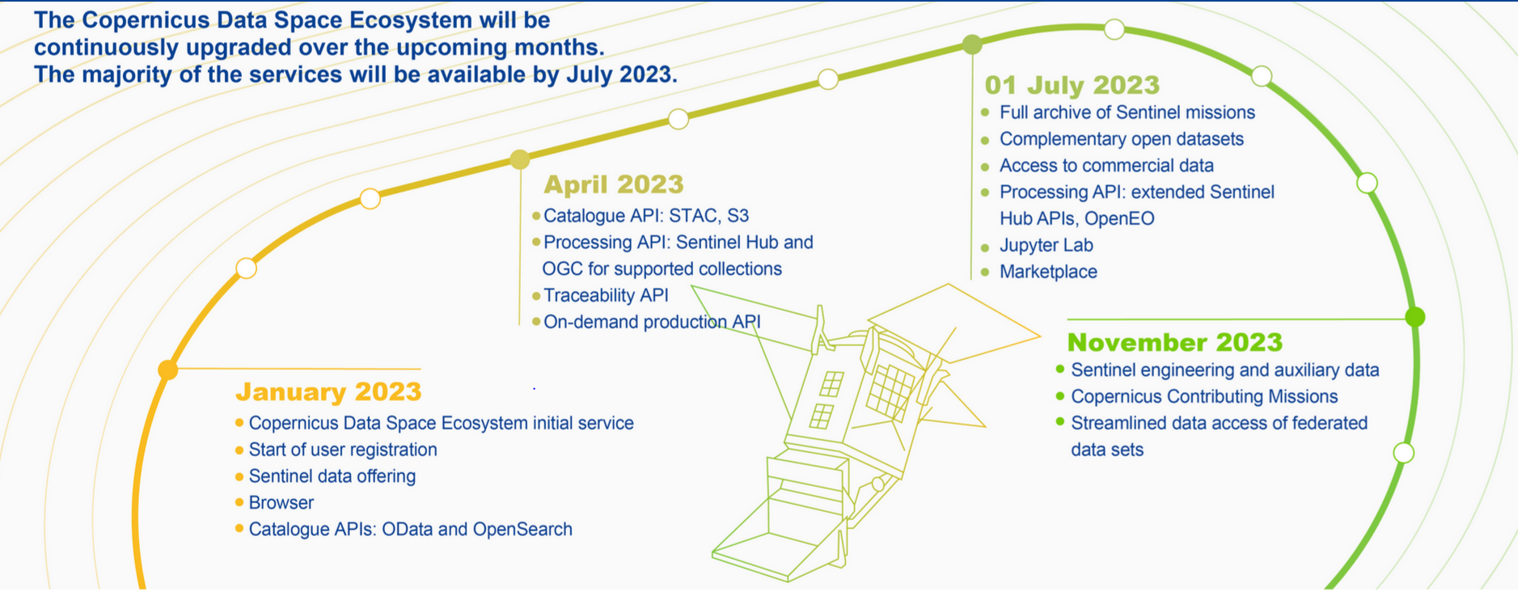
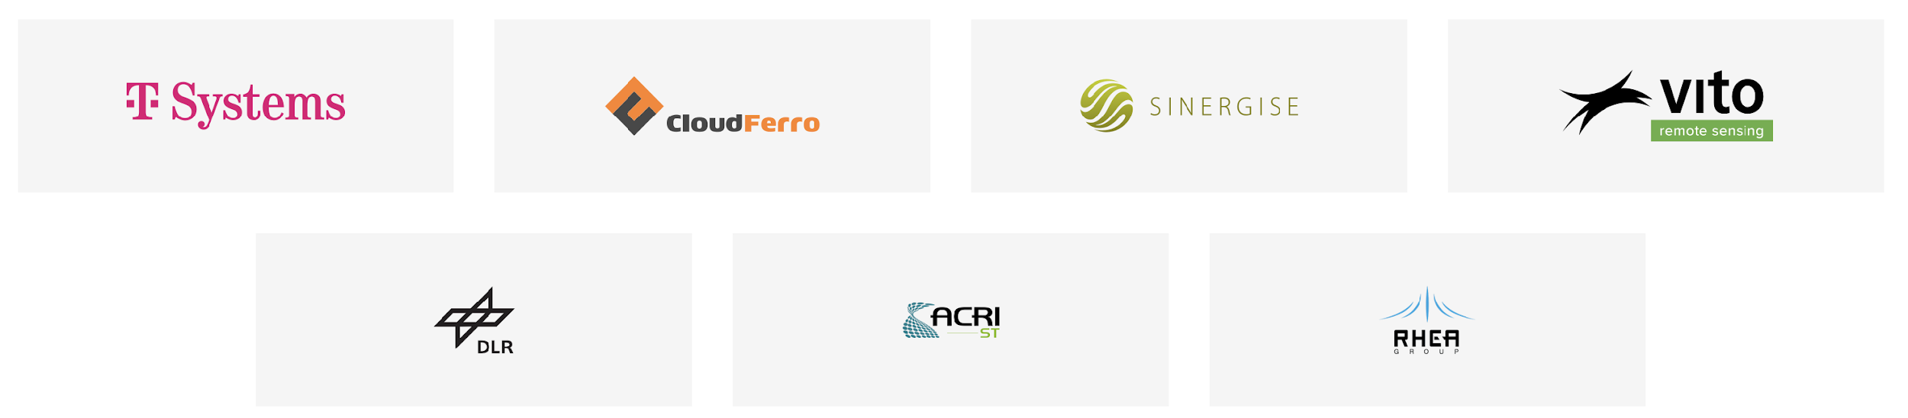
Copernicus Data Space Ecosystem Roadmap
https://dataspace.copernicus.eu/index.html#resources
The Industrial Service Team
https://dataspace.copernicus.eu/index.html#resources

Slide 12
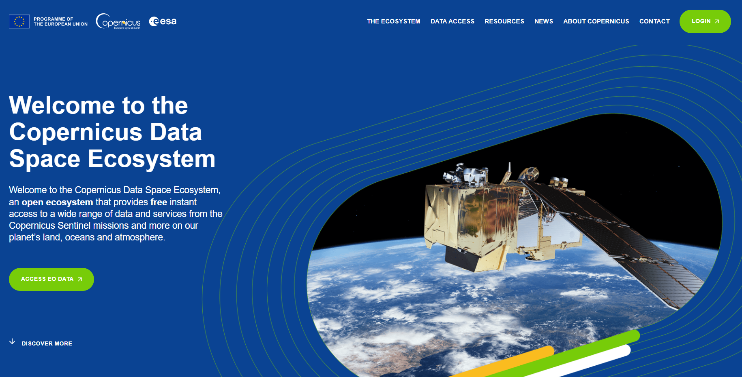
https://dataspace.copernicus.eu

Slide 13
Copernicus Data Space Ecosystem
To request support
help-login@dataspace.copernicus.eu
Stay tuned
https://dataspace.copernicus.eu/index.html#news

