Slide 1
SIT-38
2023
Landsat Next Update
Tim Newman, USGS
Agenda Item 7.5
SIT-38 2023, ESA/ESRIN
29th - 30th March 2023

Slide 2
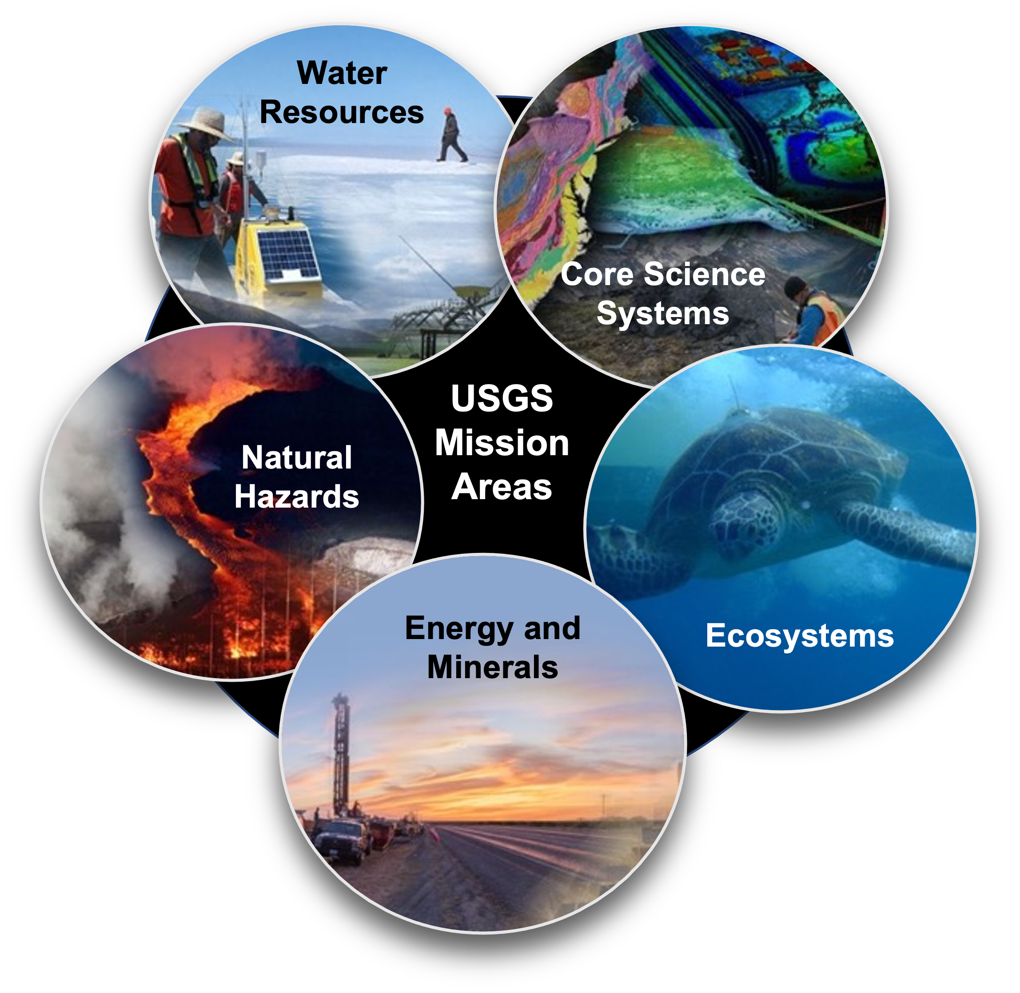
USGS Mission and Vision
The USGS Mission is to monitor, analyze, and predict current and evolving dynamics of complex human and natural Earth system interactions and to deliver actionable information at scales and timeframes relevant to decision makers.
The USGS Vision is to lead the Nation in 21st-century integrated research, assessments, and prediction of natural resources and processes to meet society’s needs.

Slide 3
USGS National Land Imaging Program: Roles & Responsibilities
As defined by Public Law and National Space Policy, to carry out the Public Interest of the United States:
  Operate and maintain a National Land Imaging Archive to house a Basic Data Set of global data – for historical, scientific, and technical purposes – includes data obtained from U.S. civil, commercial and foreign satellite systems
  Operate and maintain the Landsat flight and ground systems
  Collect, process, archive and distribute these data as Public Domain holdings of the United States
  Determine U.S. civil operational requirements for global land surface data and to conduct a national program of civil-operational land imaging
  Conduct research and development in the applications of remote sensing in order to enhance the ability of the U.S. to manage and utilize its renewable and nonrenewable resources
  Develop civil applications and information tools using known standards and protocols and make them available to the general public; facilitate federal civil agency use of National Security Space system data via the Civil Applications Committee
Fundamental goal: Ensure public availability of a primary data record about the historical condition and current state of the Earth’s land surface and to predict its future condition

Slide 4

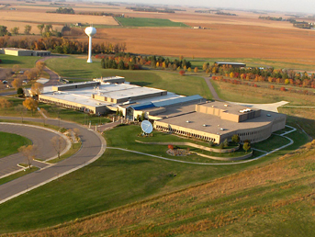

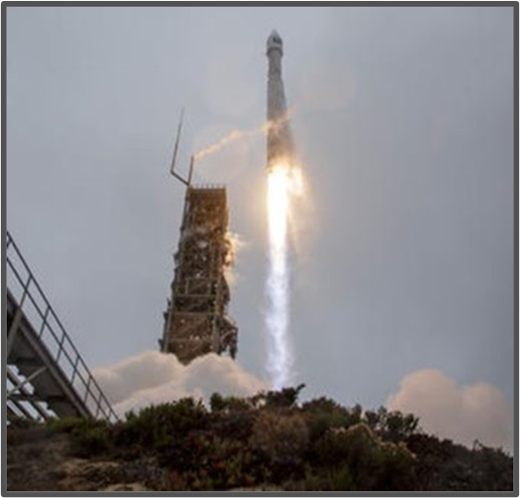


Landsat Operations Status
Landsat 9 (2021 - )
Collecting more than 700 new scenes per day; full mission transitioned to USGS in August 2022
Earth Resources Observation
and Science Center (EROS)
Sioux Falls, SD
Landsat Archive Operations
10 Million unique Landsat scenes available in the near 50-year archive, with well over 100 million downloads since Landsat data became freely available in 2008.
More than 4 billion Landsat data accesses via the commercial cloud in the past year alone.
Landsat 8 (2013 - )
Collecting more than 700 new scenes per day; night and off-nadir imaging of volcano and fire imaging
Landsat 7 (1999 - )
Recently lowered out of its operational orbit; awaiting NASA satellite rendezvous and refueling while continuing to provide imagery
Landsat 9 Launch

Slide 5







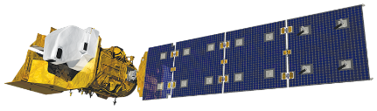

Multi-Decadal Sustainable Land Imaging Program
First Phase of SLI
Second Phase of SLI
Landsat Next
Landsat 9
Commercial/Interagency/
International Partnerships
SLI Technology Development and Infusion (NASA)
(USGS)
User Needs Development (USGS)
11/22/2017
JSG
04/01/2020
JSG
02/10/2022
JSG
SLI
Architecture
Study
2018-2019
SLI
Architecture
Study
2026-2027
2010 2020 2030
LANDSAT 8
SLI
Architecture
Study
2013-2014
LANDSAT 9
LANDSAT NEXT
LANDSAT BEYOND
JSG=Joint Steering Group Meeting

Slide 6
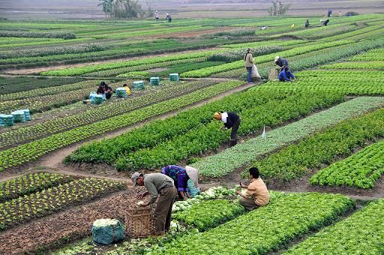
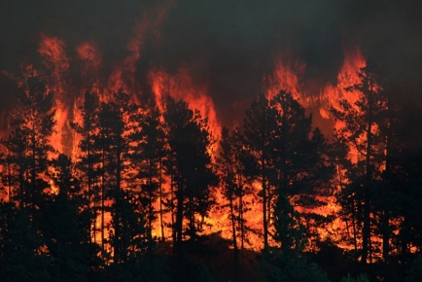
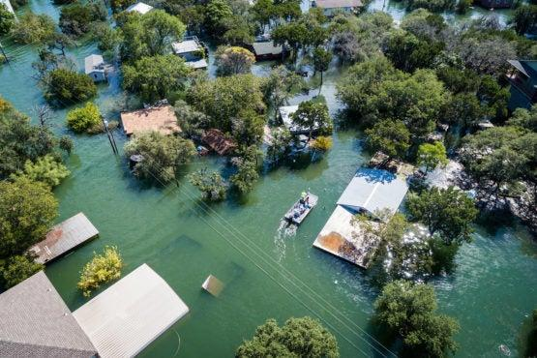
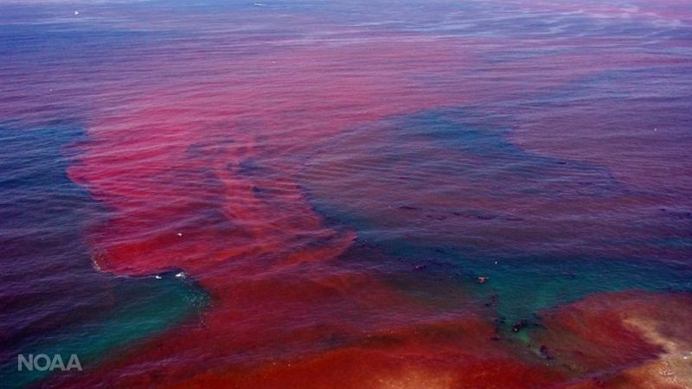


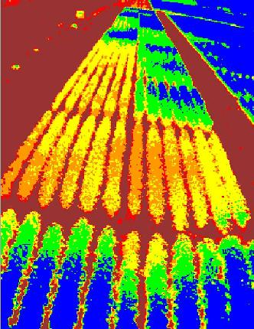
USGS Sustainable Land Imaging (SLI) User Needs Findings
  USGS-collected SLI User Needs is a key building block for the SLI Architecture Study to define the mission concept of Landsat Next.
  US Federal agency land imaging users identified the need to maintain Landsat data continuity and improves in temporal, spatial and spectral resolution from Landsat Next
    Improve temporal coverage to at least weekly observation for agriculture, forestry, disasters, water quantity and quality
    Improve spatial resolution to 10/20m (Sentinel-2 example) for VSWIR and 30/60m for TIR for agriculture, land use/cover, glacier/ice sheet, urban and coastal applications
    Specific targeted spectral bands to support emerging applications and improving atmospheric correction and surface temperature retrieval

Slide 7
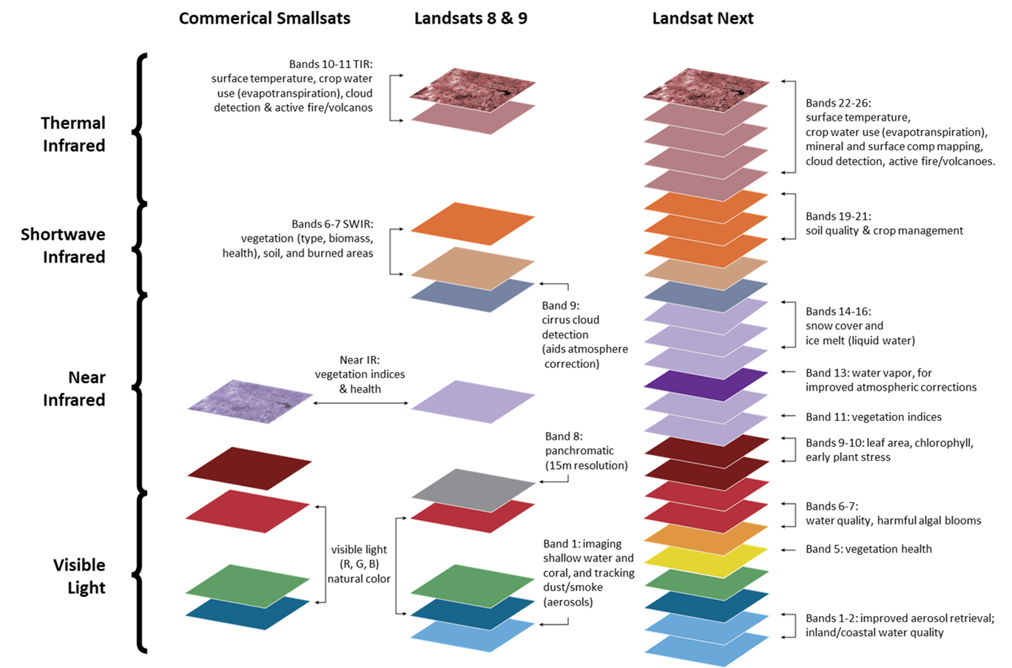
Landsat Next Requirements Meet Emerging Needs
The USGS spent several years engaging with the user community to develop and validate requirements and set priorities for Landsat Next to meet emerging needs:
Improved revisit frequency to support applications which require ~weekly clear views, such as crop health & productivity, water quality, snow/ice state, wildfire
Higher spatial resolution (10-meter data vs 30-meter) to support monitoring of small agricultural fields, forest disturbance, urbanization, and other applications
Additional spectral bands to support emerging applications in water quality, snow hydrology, soil mapping, and other areas
Maintaining radiometric quality established by Landsat 8/9
Multi-spectral 🡪 Super-spectral
Landsat Next will provide more than twice as many spectral bands as Landsat 8/9, with spatial resolution improved by a factor of 2, and significantly improved repeat coverage
‹#›

Slide 8
SLI “Second Phase” Program Activities
SLI Phase 2 Architecture based on SLI Architecture Study conducted 2018-2020
Three new elements
  Landsat Next – Government-managed, contractor-built observing system
    High-quality calibrated data continuity and traceability with 50-year Landsat data record
    Supports current and emerging applications with validated user needs
  Expanded International partnerships
    Continue international data harmonization efforts with the European Copernicus Sentinel 2 mission and others
    Provide technical assistance to the Satellite Cross-calibration Radiometer (SCR) project with Australia
  Commercial Data Program
    Exploring use of commercially available high spatial resolution / high revisit Visible-Near-Infrared data & services
Continued investment in user needs assessment and technology development
  Ensures the state of the art continues to advance for future Earth observation systems in order to meet evolving user needs
SLI Vision: Long-term operational availability of a wide range of government, commercial, and international land-imaging data and services to meet the Nation’s needs for environmental monitoring and forecasting

Slide 9

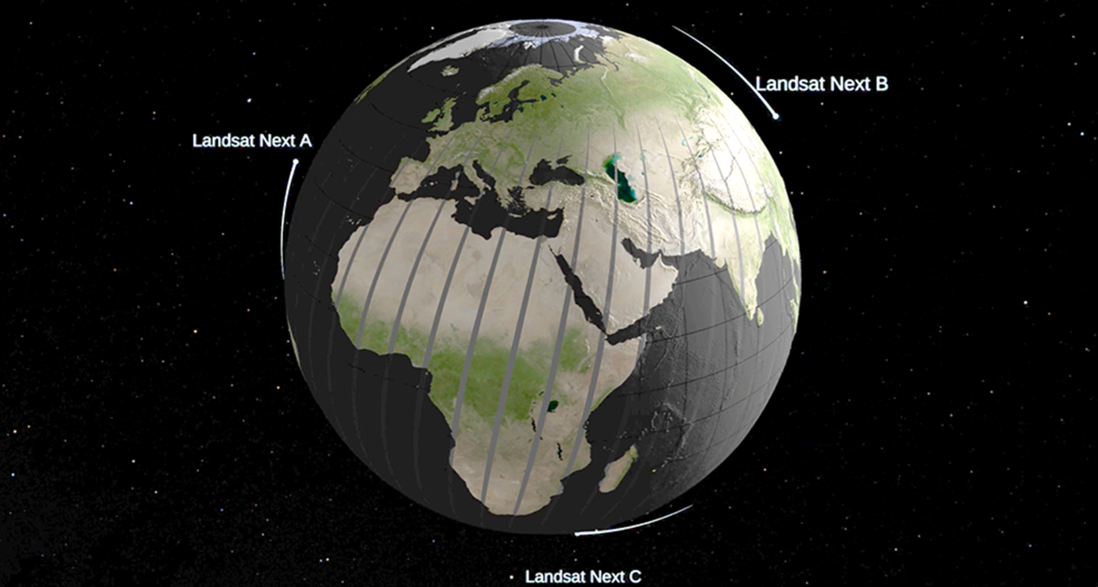
Landsat Next
A robust spaceborne, land imaging system to ensure continued collection of data for processing into useful and efficient information products for use by the wide range of interested science communities
Mission Concept: Collection of “superspectral” land observations featuring richer spectral information and higher spatial resolution than Landsat 8 and 9 with improved temporal frequency
  Intended to replace Landsat 8 to ensure continuity of the Landsat data record in the event of an unexpected Landsat 9 failure on-orbit
Enables users to:
  Observe areas experiencing the most rapidly changing landscape from drought, glacier and permafrost melt, harmful algal blooms, and urban heat islands
  Track and monitor Earth surface condition and change, including their drivers and impacts
  Predict future risk and vulnerabilities for mitigation and adaptation strategies

Slide 10
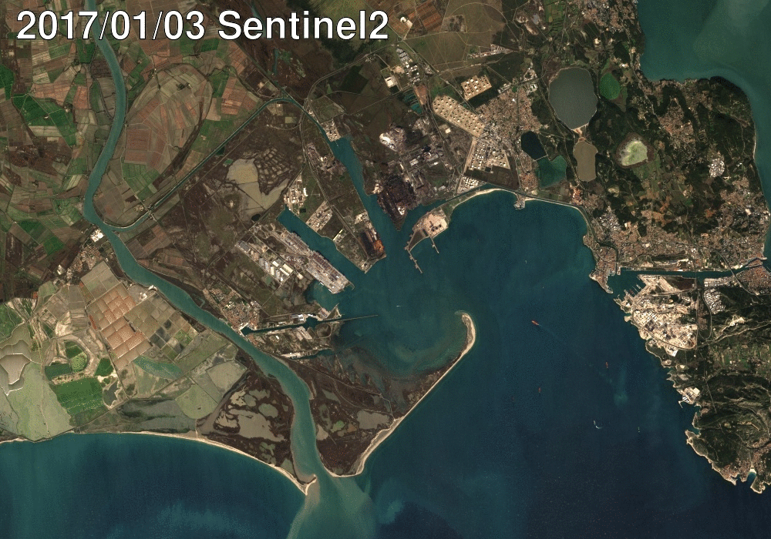
USGS OBJECTIVES FOR GLOBAL LAND IMAGING
Enhanced complementarity of future Copernicus, Landsat, and related satellite systems through the CEOS LSI-VC and bilateral coordination mechanisms
Consultation/coordination w/NASA, ESA, EC in future mission planning
Shared vision of full, free, and open data policies
More comprehensive and timely coverage
Increased efficiencies and reduced costs
Enhanced data access, validation, and quality control
Enhanced instrument inter-calibration and data validation
Collaboration in the development of improved and hybrid data products
Fundamental Goal: Better serve U.S. and global users

