Slide 1
CEOS Interoperability Framework Status on the Roadmap
Makoto NATSUISAKA, JAXA
Peter STROBL, COM
Agenda Item #7.3
SIT-38, ESA/ESRIN
29th - 30th March 2023

Slide 2
Mission
Decision at CEOS Plenary 2022: CEOS Principals confirm that coordination of interoperability related work remains within the WGISS perimeter.
【CEOS-36-10】: WGISS invited to propose an interoperability roadmap at SIT 38. Any other CEOS group/VC which wants to contribute is invited to contact WGISS.
【CEOS-36-11】: CEOS Agencies to consider nominating individuals to the ongoing WGCV / WGISS / LSI-VC effort to define a CEOS common dictionary of terms.

Slide 3
Framework Development Team
WGISS invited contributors from other CEOS entities and organized the framework development team.
Lead: Makoto Natsuisaka (WGISS)
Contributors
WGISS: Tom Sohre
WGCV: Philippe Goryl, Paolo Castracane
LSI-VC: Steve Labahn, Peter Strobl, Ake Rosenqvist
CEOS-ARD OG: Ferran Gascon
SEO: Dave Borges
Slide ‹#›

Slide 4
Discussions
Meeting | Date | Topics
Kick off meeting | Feb. 15, 2023 | Discussed vision, teams, topics, membership and annual process. WGISS, LSI-VC, CEOS ARD OG, WGCV, SEO
#2 meeting | Mar. 1, 2023 | Discussed the components and the topics. WGISS, LSI-VC, CEOS ARD OG, WGCV, SEO
#3 meeting | Mar. 17, 2023 | USGS roadmap was proposed USGS roadmap. Discussed the components and the topics based on the roadmap. Further discussions in each VC/WG were requested. WGISS, LSI-VC, CEOS ARD OG, WGCV, SEO
SIT-38 side meeting | Mar. 28, 2023 | To be given feedbacks for USGS roadmap WGISS, LSI-VC, CEOS ARD OG, WGCV, SEO
SIT-38 | Mar. 30, 2023

Slide 5
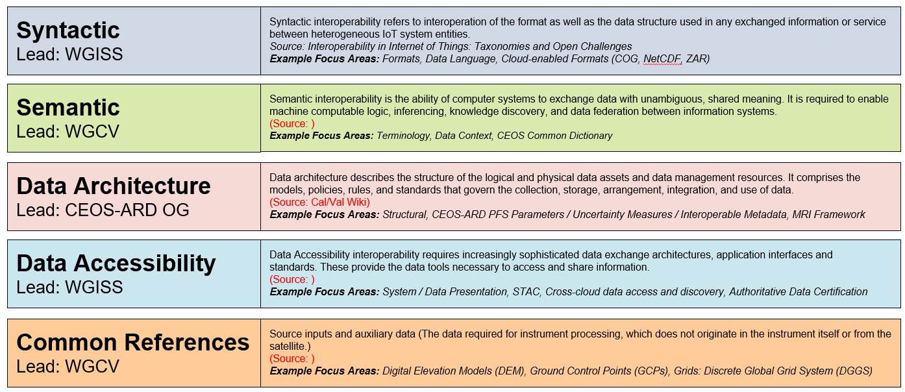
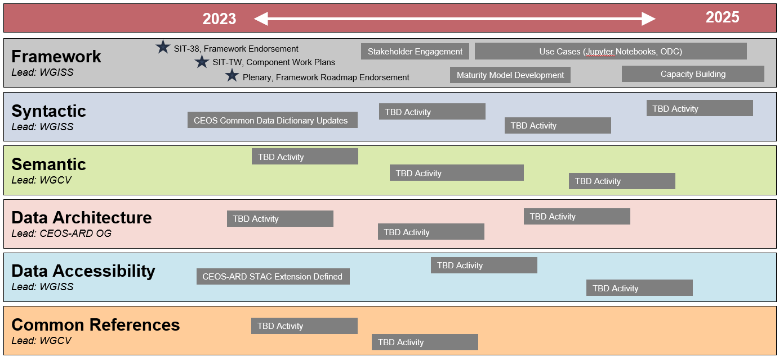
Interoperability Blocks
“Interoperability blocks” are focus-area-specific task teams. Based on the USGS draft, definition of the blocks, the focus areas to be dealt with in each blocks, visions, etc. have been discussed. Further discussions in each blocks are requested.
Draft
Under review!
Slide ‹#›

Slide 6
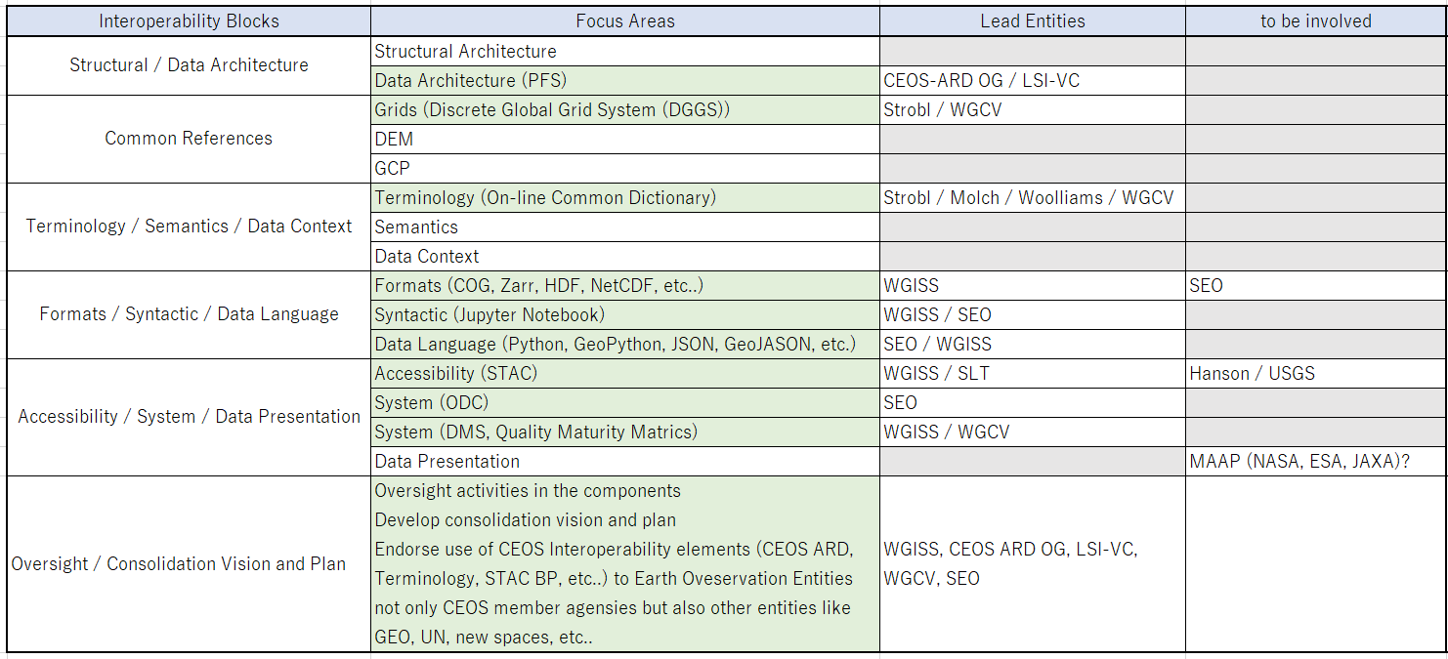
Gap Analysis
Co-existing activities of CEOS entities can’t cover all focus areas and more expertise and resources will be needed to accomplish all.
To be consideration!
Slide ‹#›

Slide 7
Summary for 【CEOS-36-10】
WGISS invited volunteers from CEOS entities for the activities and the framework development team consisting of WGISS, WGCV, LSI-VC, CEOS ARD OG, and SEO was organized.
Interoperability Framework Interoperability blocks, focus areas, visions, etc. have been discussed, but further discussions were requested.
The development team requests extension of the roadmap due by SIT-TW.
Slide ‹#›

Slide 8
Summary for 【CEOS-36-11】
In terms of the action “CEOS Agencies to consider nominating individuals to the ongoing WGCV / WGISS / LSI-VC effort to define a CEOS common dictionary of terms”, Peter Strobl (COM), Katrin Molch (DLR) and Emma Woolliams (NPL) are compiling a paper on the first phase of work which has been completed. Action will be closed at SIT-38 but the group is still looking for more people to help advance the effort as a key part of CEOS interoperability discussions.
Slide ‹#›

