Slide 1
SIT-38
2023
Opportunities for Engagement with Commercial Sector
Cal/Val Maturity Matrix
WGCV SITSAT Task Team
Philippe Goryl ESA / WGCV
Agenda Item 7.2
SIT-38 2023, ESA/ESRIN
29th - 30th March 2023

Slide 2


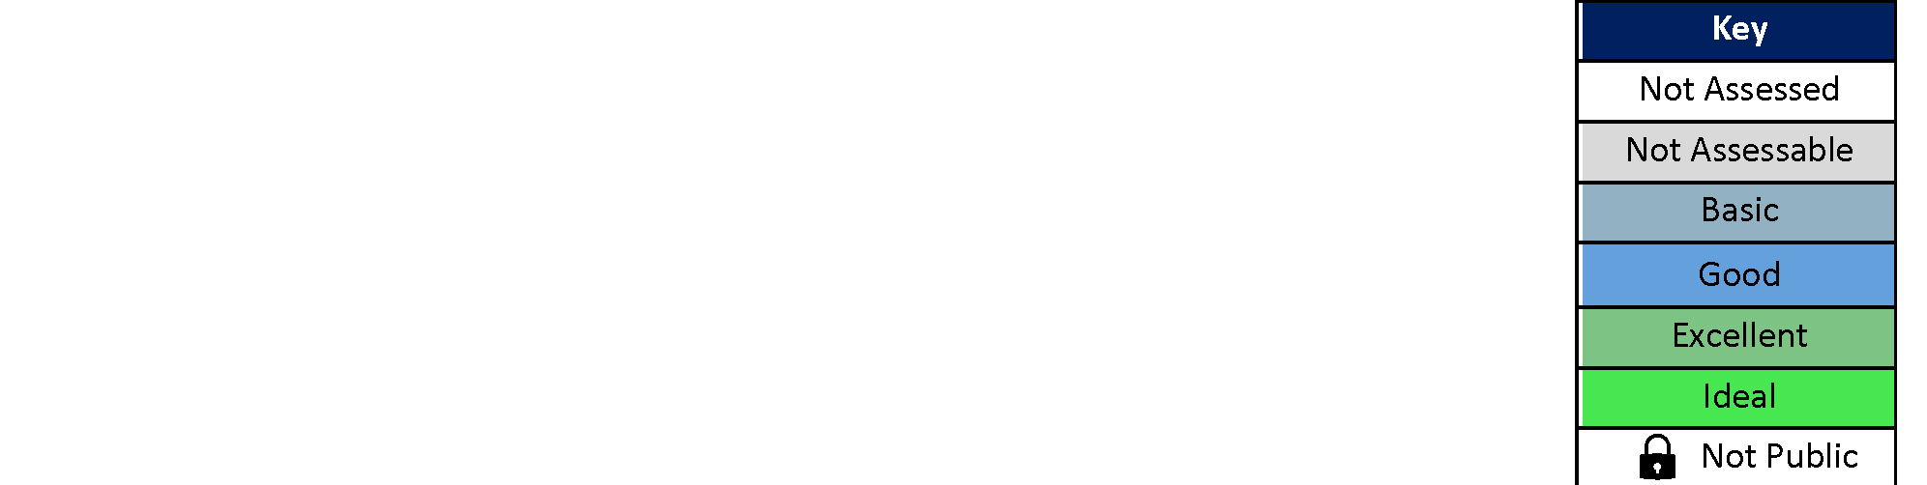
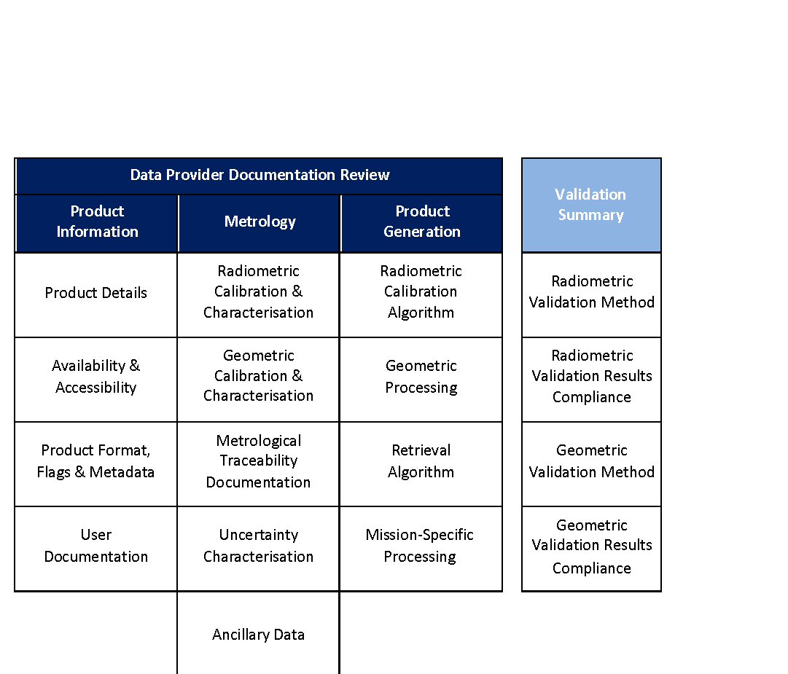
Quality Assurance and Data Useability Assessment Frameworks for Earth Observation Data Products
Sam Hunt¹, Jaime Nickeson², Leonardo De Laurentiis³, Sébastien Saunier⁴, Clément Albinet³,
Batuhan Osmanoglu², Alfreda Hall², Philippe Goryl³, Paolo Castracane⁵, Valentina Boccia³ + others
(1) NPL, (2) NASA, (3) ESA, (4) Telespazio, (5) RHEA/ESA
https://www.youtube.com/watch?v=IRjR_611-ao

Slide 3
Commercial Satellite Sector Growth
In 2030, it is projected that there will be over 8000, with the most explosive growth in the hyperspectral and hybrid sensor domains.
The need was identified by Space Agencies for systematic evaluation of commercial satellite data to understand how it may be integrated into their programmes.
NASA launched the CSDA Project and ESA the EDAP project to meet this need.
(source: the US National Geospatial-Intelligence Agency)

Slide 4
The Value of QA
Mission success is dependent upon quality assurance. Evidencing data quality adds significantly to the value of datasets.
Gives potential customers the confidence data is fit for their purpose.
Many aspects of data quality are aimed at facilitating communication to users → required for e.g. to interoperability.

Slide 5
QA Standards
Developing increasingly comprehensive definition of mission quality:
Analysis ready data & interoperability – e.g. CEOS ARD
Fiducial reference measurements
Uncertainty evaluation e.g. Sentinel-2, Sentinel-3, Landsat 9
Traceability – CLARREO, TRUTHS, Libra missions
Framework brings together this work to define a
combined QA standard

Slide 6
Assessment Philosophy
The assessment framework is aimed at verifying claimed mission performance and adheres, where applicable, to community best practices to an extent that is “fit for purpose”.
Assessment divided into two parts
  Review of mission quality as evidenced by its documentation
  Validation analysis performed by mission quality assessor

Slide 7
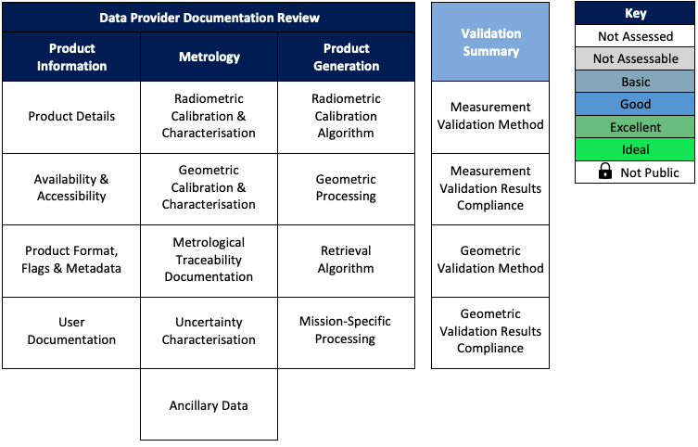
Framework Structure

Slide 8
Framework Structure
Validation Summary
Summarises validation activity undertaken by assessor

Slide 9

Framework Structure
Validation Summary
Summarises validation activity undertaken by assessor
Data Provider Documentation Review
Review of mission quality as evidenced by its documentation
Product Information
Review of descriptive information accompanying products
Metrology
Review of underpinning evidence for observation quality
Product Generation
Review of “fitness for purpose” of product generation

Slide 10
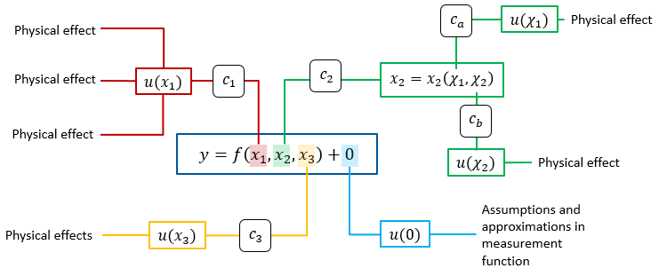

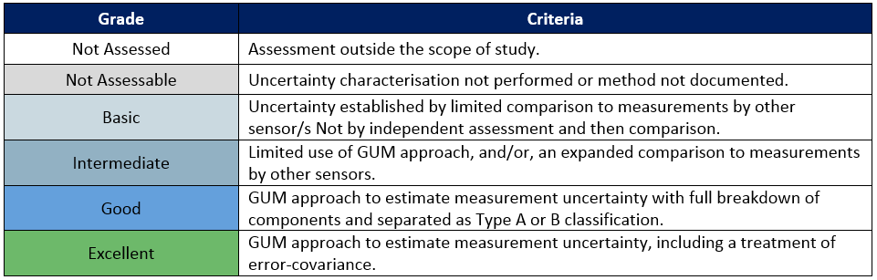
Example: Uncertainty Characterisation
Description of Best Practice
Earth observation metrology techniques developed within the H2020 FIDUCEO project.
www.fiduceo.eu
Grading Criteria
Based on the extent to which application of the Guide to the Expression of Uncertainty is applied, wrt fitness for purpose in the context of the assessed mission

Slide 11
Approach to Assessments
This framework is something data producers can refer to as they define products and evidence themselves.
Common framework between ESA and NASA simplifies process for vendors, and makes results more comparable
Assessment process is an interactive activity between assessors and missions

Slide 12
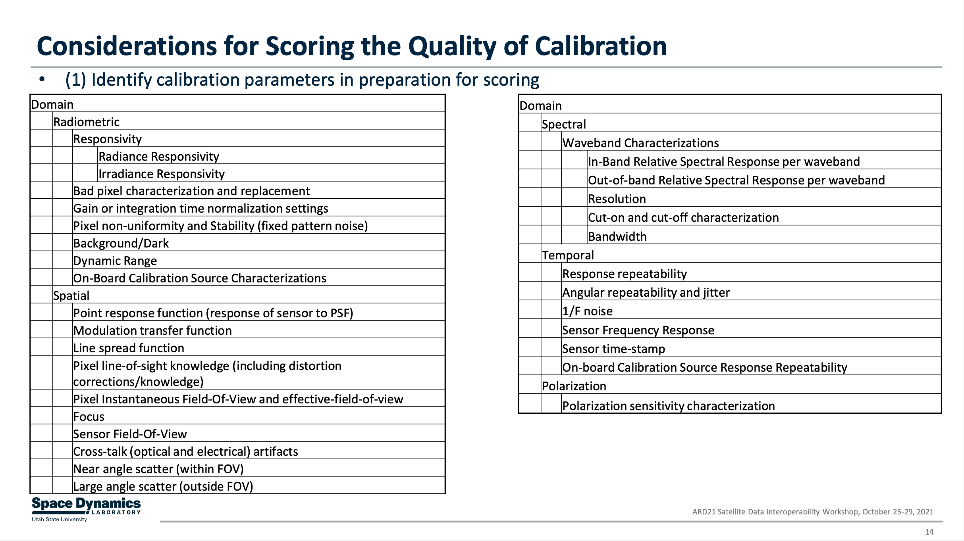
Calibration Assessment
MM underpinned by available best practice
Assessing compliance at times requires assessor expert judgement
Recommendation
Where missing, develop best practice material that is objectively testable
Tansock, ARD21

Slide 13


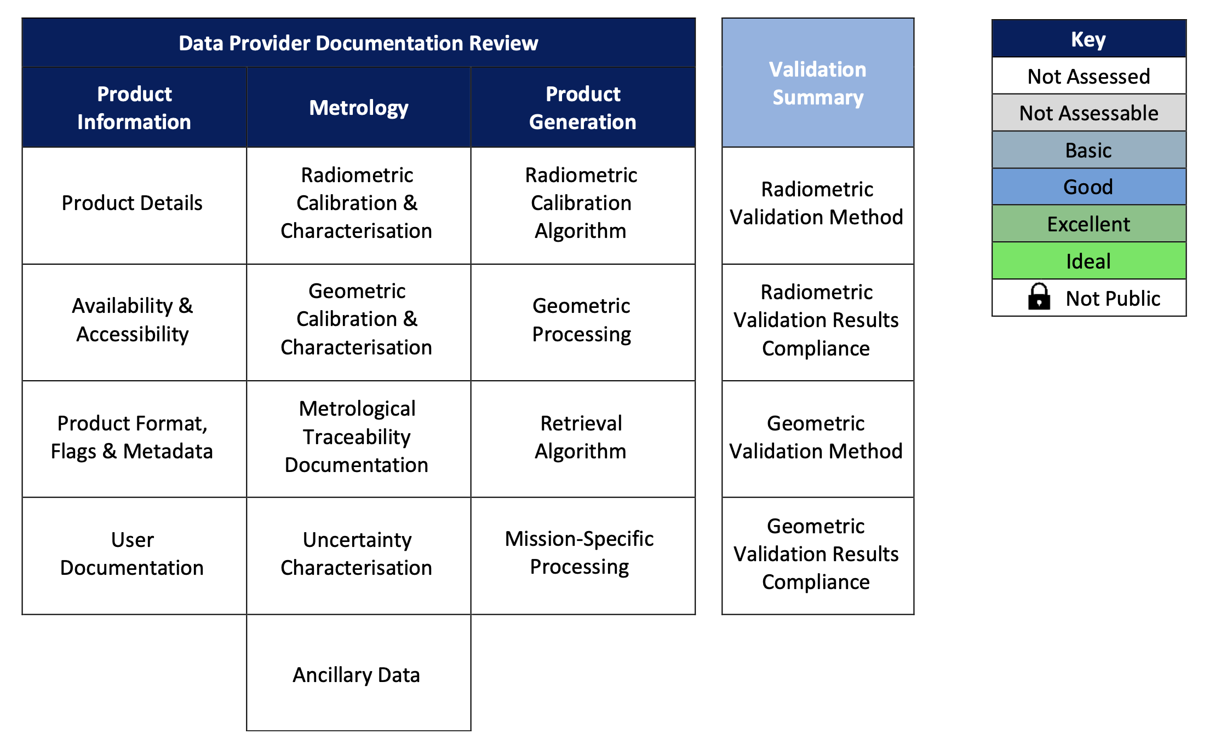
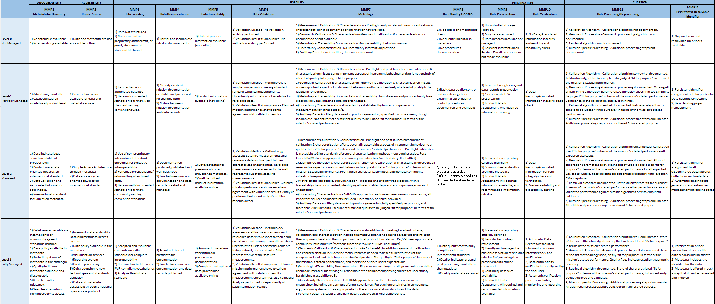
CEOS WGCV and WGISS Context
ESA Earthnet
NASA Commercial Smallsat Data Acquisition (CSDA) Program
NASA and ESA are working toward a comprehensive ESA-NASA Evaluation Framework. EDAP is intended to perform quality assessment for various EO missions in the QA4EO, Earthnet and New Space context.
EDAP approach aims to define a mission quality Cal/Val Maturity Matrix
CEOS WGISS Data Management & Stewardship Maturity Matrix
Reference: WGISS DMSMM
EDAP Cal/Val Maturity Matrix
EDAP Cal/Val Maturity Matrix provides input for quality aspects to the CEOS WGISS Data Management & Stewardship Maturity Matrix that includes information on all aspects of the data records, including discoverability, accessibility, usability, preservation and curation

Slide 14
Conclusion
Comprehensive standard for mission quality defined by ESA & NASA
Currently in use in ESA/NASA commercial missions QA evaluation
The results are summarised in the Cal/Val maturity matrix
The assessment opened a “communication channel” between Agencies and New Space companies
Cal/Val Maturity Matrix integrated in the CEOS WGISS Maturity Matrix
https://www.youtube.com/watch?v=IRjR_611-ao

Slide 15
SITSAT Coordination Group
With the emergence of a number of SI-Traceable Satellite missions (SITSats the CEOS WGCV has considered the need for a group to coordinate on issues of common interest and to foster mutual benefits. SITSATs have great potential to increase the accuracy of climate records and can also serve as high quality references for both CEOS Agency missions and the commercial sector – including ‘New Space’. Both of these topics are headline priorities for CEOS and the ESA SIT Chair. The WGCV has proposed the establishment of a joint Task Team with GSICS which will include representatives from agencies operating and developing these missions, and others as interested, as a means to promote dialogue and coordination.
The Task Team will work on collaborative activities, discuss future developments, mission coordination, new technologies and spectral domains interoperability topics, and generally serve as a forum for international coordination on SITSat missions, aiming to build an integrated system approach to their development and utilisation. The Task Team will build on the findings of the workshop “SI-Traceable Space-based Climate Observing System: a CEOS and GSICS Workshop hosted by UK space agency at National Physical Laboratory in London in September 2019. The goal of the workshop was to assess the benefits and requirements of a space-based climate observing system, summarising current measurement capabilities, climate-based needs, and future implementation plans, together with recommendations in a published report (available in the CEOS Cal/Val portal: https://calvalportal.ceos.org/sitscos-ws)

Slide 16
SITSAT Coordination Group - ToR
Objectives
Specifically, the SITSat Task Team will:
Establish clear definitions of what constitutes a SITSat and minimal requirements[1] requirments needed to evidence this status.
Serve as a forum for agencies developing/planning SITSat missions to share experiences and knowledge.
Discuss collaboration opportunities, joint Cal/Val activities, campaigns, data sharing, etc.
Provide an opportunity for mission coordination, gap analyses, efficient tasking and acquisition planning, etc.
Allow coordination on technical topics, reporting of uncertainty and traceability information, interoperability, methods of dissemination etc.
Aim for a systems-based approach, rather than having missions being developed and operated in isolation, along the lines of a CEOS Virtual Constellation.

Slide 17
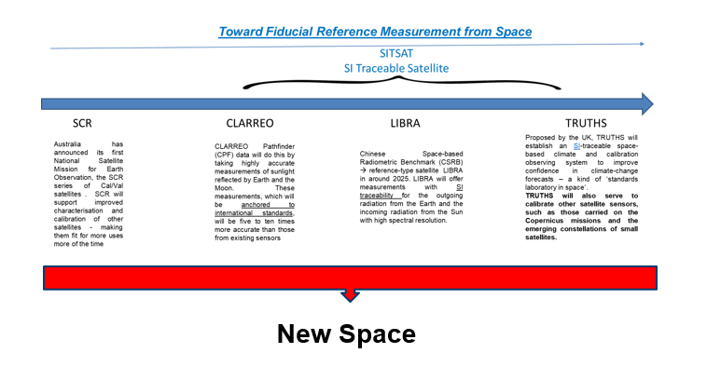
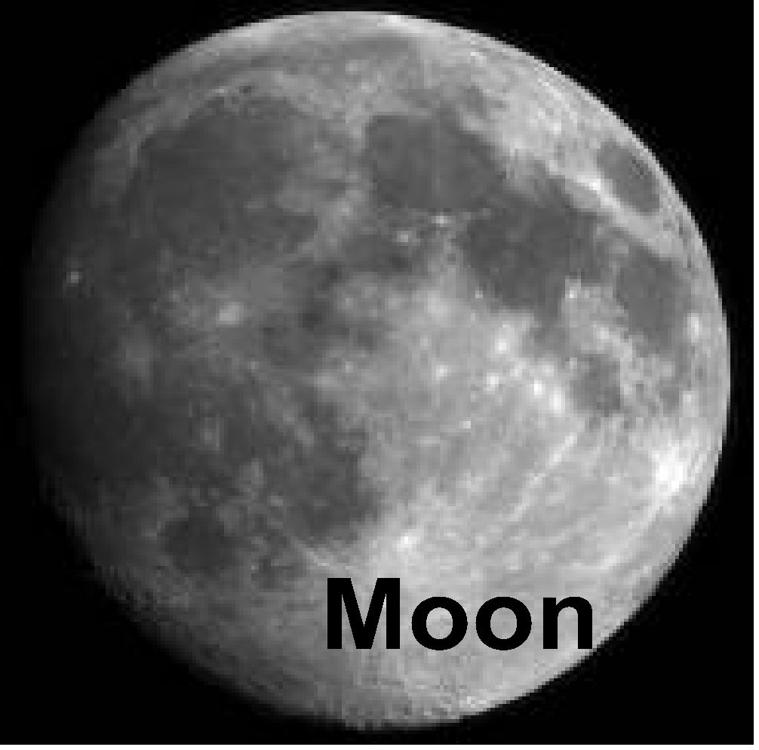
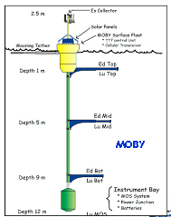
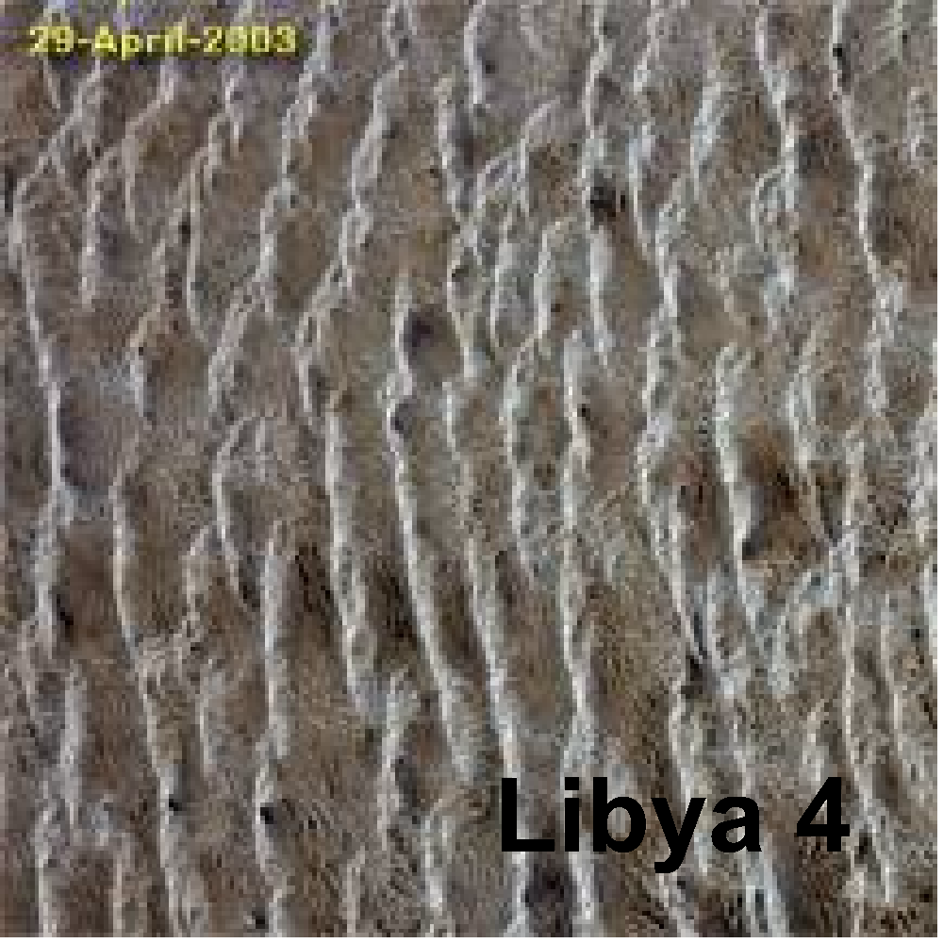
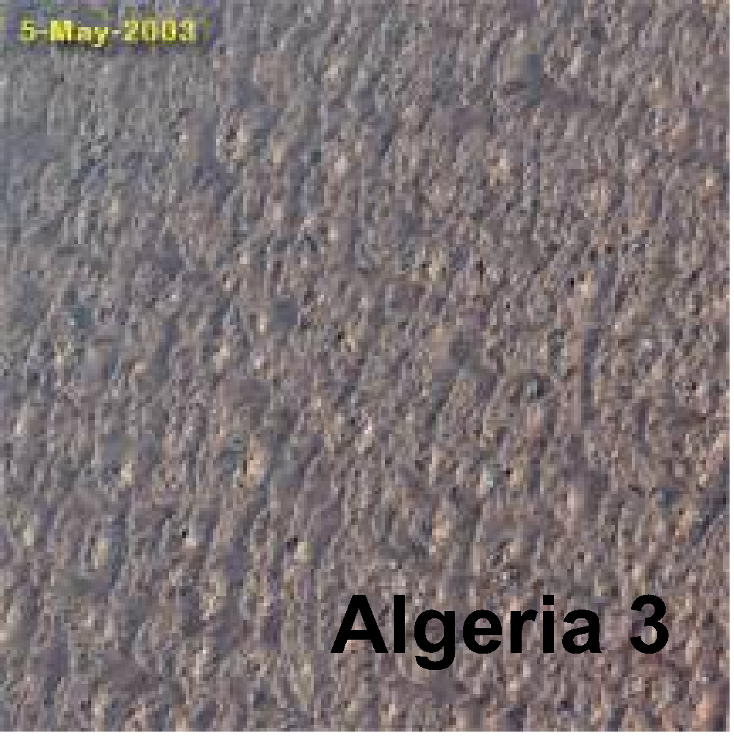
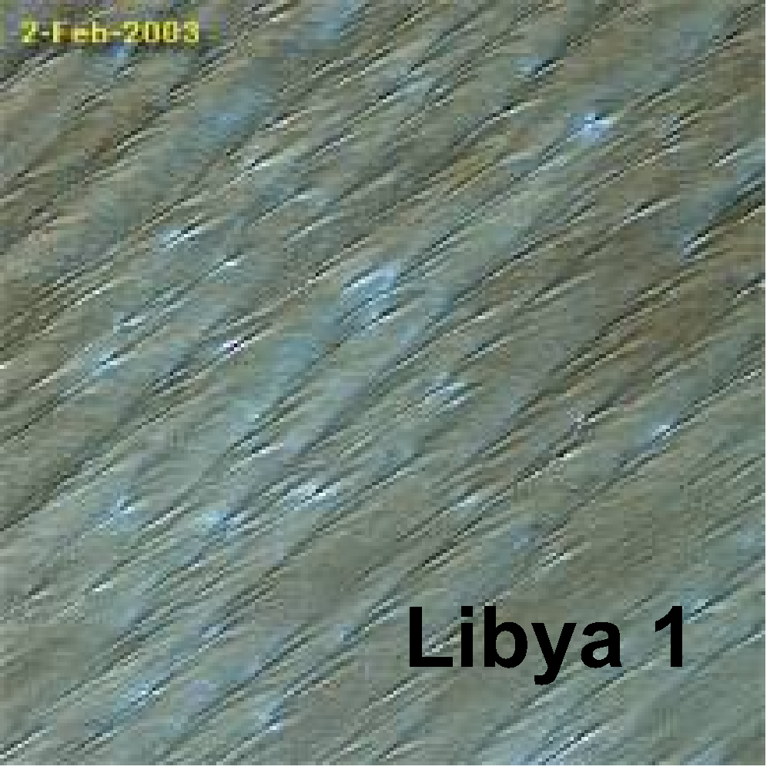
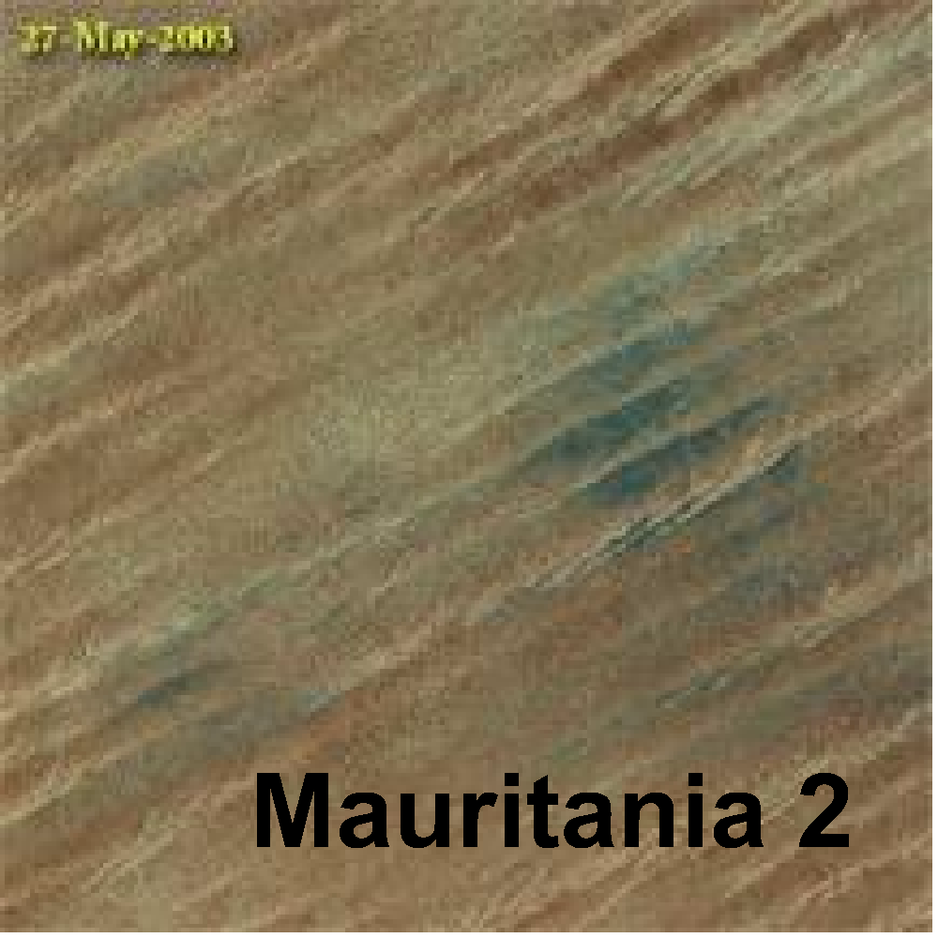

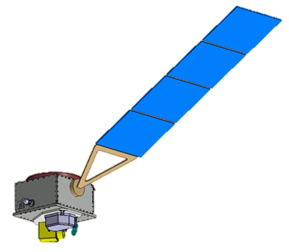
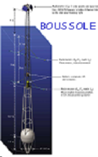



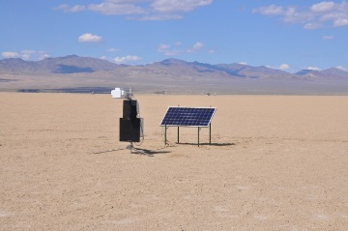



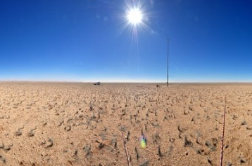

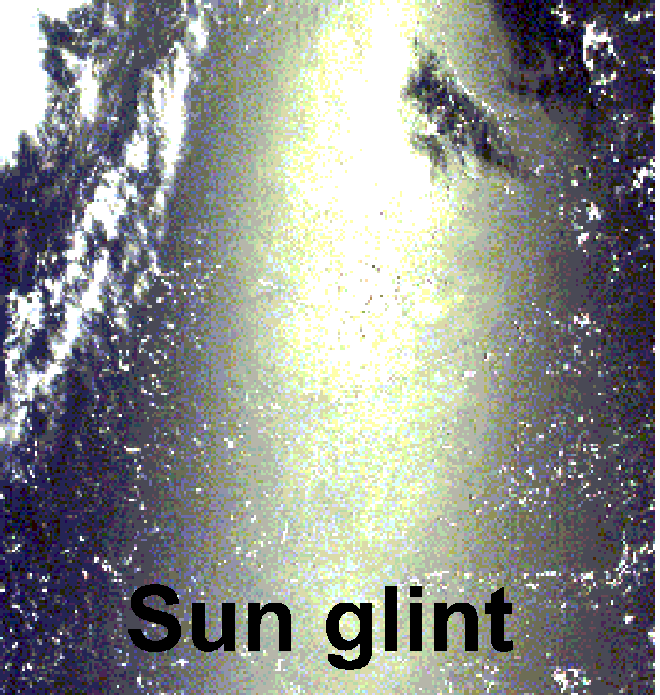
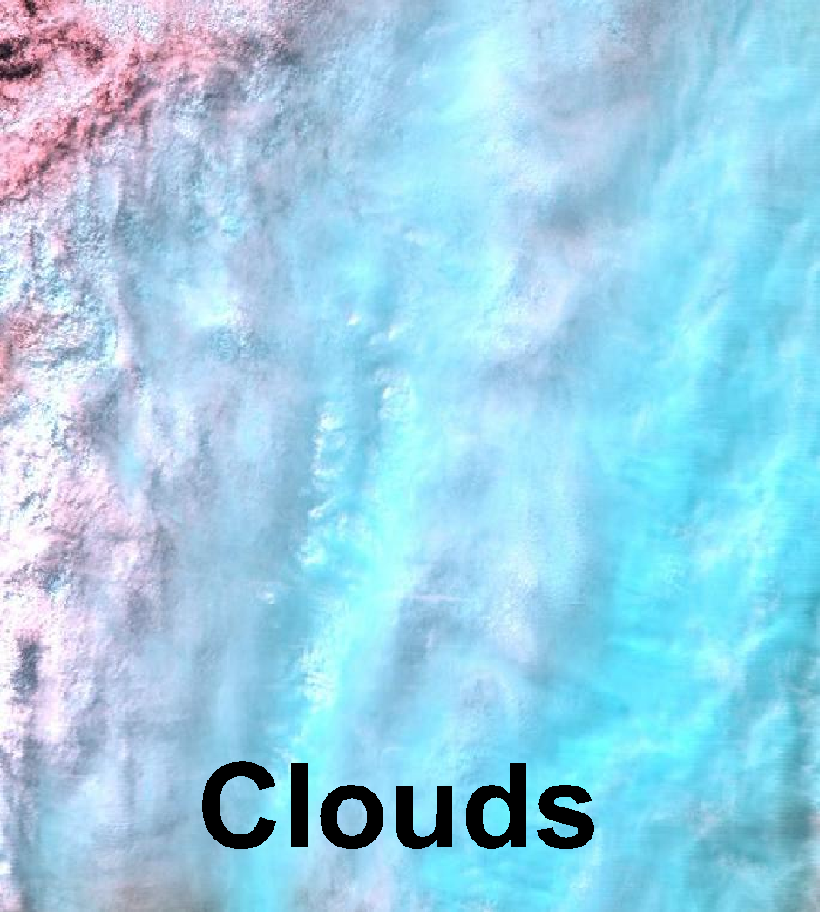
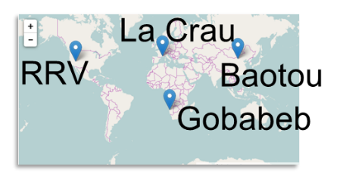
Achieving SI Traceable Cal infrastructure /methods
PICS
Dome C
For each method dominant source of uncertainty is systematic ‘absolute level’
and
often unknown effects caused by time differences of observations (e.g. atmosphere, solar/view angle etc
Much of latter can be randomised by multiple observations/corrections <<1%
SNO (or angle matched) can reduce random component significantly minimising number of match-ups needed
Establish minimal set of references/methods
Target: Combine information weighted by Uc for particular sensor and application noting individual sensor characteristics
TRUTHS/CLARREO/
Libra
Ocean Colour
SI
Anchors absolute level of methods at TOA constraining models to reduce uncertainties.
RadCalNet
SI
Natural Phenomena

