Slide 1
SIT-38
2023
Precipitation Observation and Product Continuity
Chris Kidd, NASA/GSFC
Agenda Item 7.10
SIT-38, ESA/ESRIN
29th - 30th March 2023

Slide 2
Introduction
Water and precipitation are:
essential to life on Earth - the only planet (we know) that has abundant, usable water.
a fundamental component of the Earth’s energy and water cycle, redistributing energy through evaporation and condensation across the Earth’s surface and its’ atmosphere.
critical to our social and economic well being: too much or too little can be disastrous.
increasingly important politically: water resources transcend national boundaries.
Quantifying precipitation, its accuracies and errors is problematic due to its’ temporal and spatial variability: Issues affecting and influencing the observation and measurement of precipitation include:
characteristics of the precipitation being observed;
observational capability of the instrument;
interpretation of the measurements/observations and derived parameters, and;
perceived versus real requirements of subsequent applications.

Slide 3
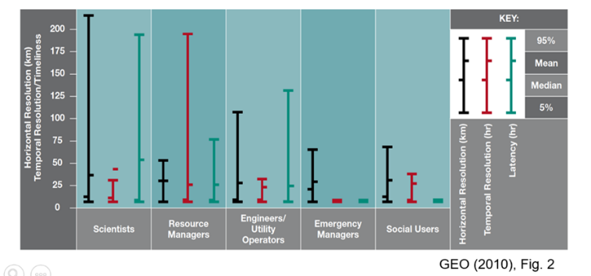
Precipitation user requirements
Wide range of users - wide range of requirements:
Spatial resolutions: 300 m to 50 km;
Temporal scales: 18 mins to 15 days;
Latency (acquisition): 6 mins to 24 hours.
No ‘one-size fits all’!

Slide 4
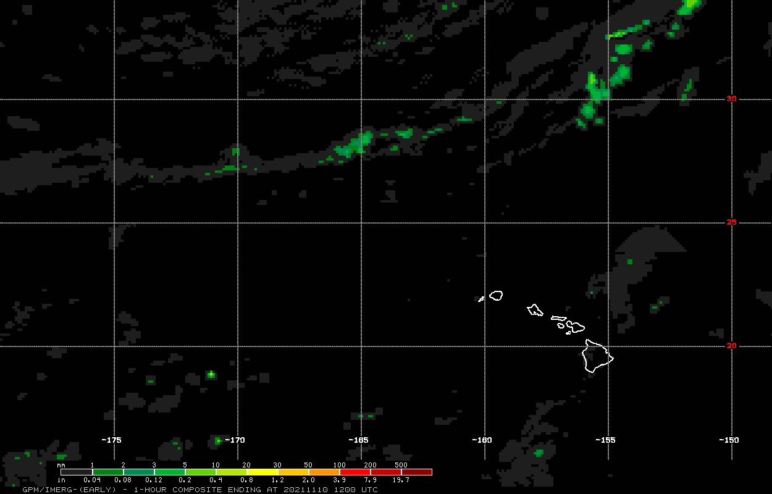
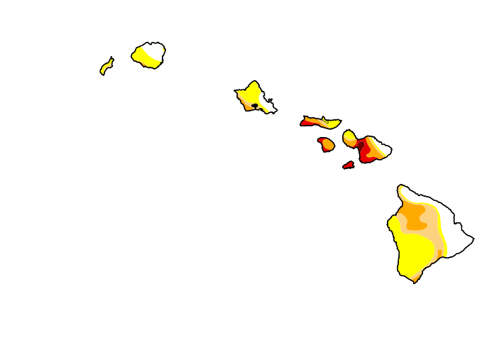
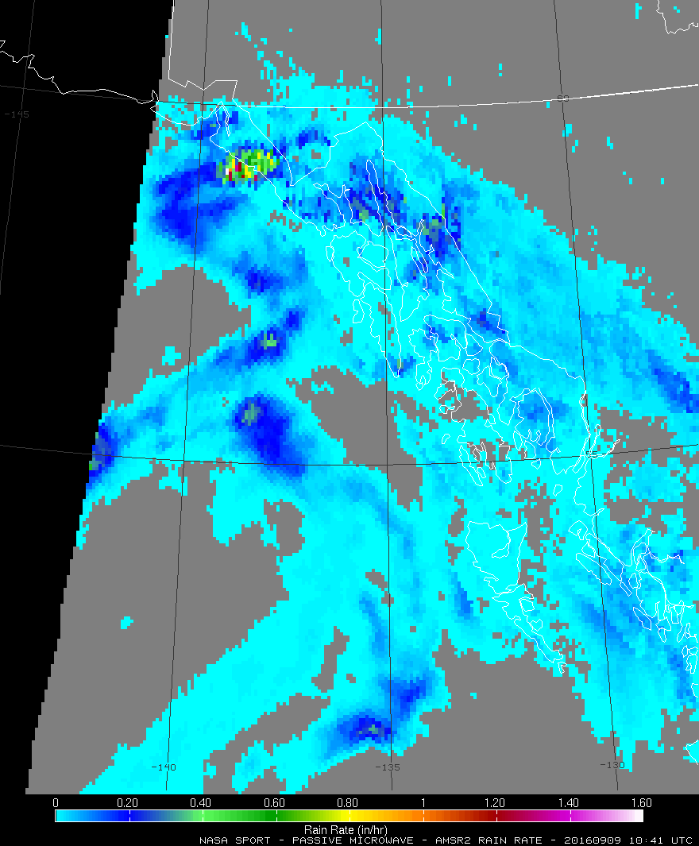
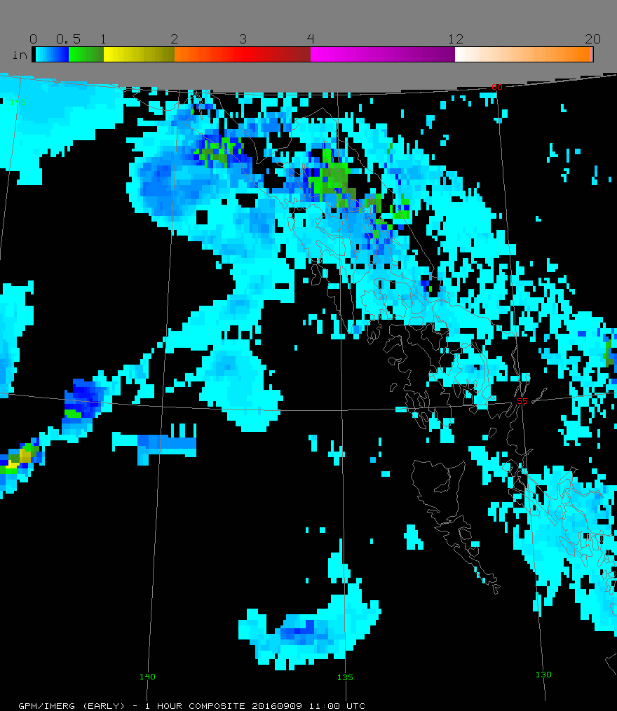
Applications – GPM examples
Connecting Observations to Decision-making
Use Cases
Hawaii US Drought Monitor Report: using IMERG accumulations
NWP; TC monitoring; S2S & climate modeling
Landslide nowcasting; Flood estimation; Reinsurance; Situational awareness
Track precipitation anomalies for vector and water borne diseases
Atmospheric river/extremes nowcasting and forecasting: using L2 rain rate and 1-hr accumulation of IMERG, NASA SPoRT/ NWS WFOs
Assimilation of GMI Tbs in NWP for initializing model runs at ECMWF
Assess freshwater inputs for hydropower generation
Monitor changes in precipitation associated with animal migration
Assess freshwater inputs to quantify water fluxes

Slide 5
Precipitation observations: the P-VC
The Precipitation Virtual Constellation is currently built around the Global Precipitation Measurement (GPM) mission, formed of the GPM Core Observatory and a constellation of international partner satellites/sensors:
GMI/DPR (NASA/JAXA), AMSR-2 (JAXA), 3xMHS (2xEUMETSAT, 1xNOAA), 3xATMS (NOAA - NOAA-21 launched Nov 2022), 3xSSMIS (US DoD)
Provides a mean revisit time of 3 hours 90% of the time – although observational gaps of 4-5 hours possible.
Currently, all but the GPM-Core satellite are in sun synchronous orbits – (some not necessarily providing independent observations, e.g. NPP & NOAA21).
Retrieval resolutions are sensor-dependent but generally 15-20 km.
GPM products also utilise data from the Geostationary Vis/IR sensors - merged/morphed products with Geo-IR to improve temporal/spatial sampling (e.g. GSMaP and IMERG).

Slide 6
Microwave Instruments (US/Euope/Japan)
Microwave instruments for precipitation
The precipitation science community has become very adept at adopting and utilizing a range of satellite observations to provide the necessary (temporal and spatial) products to meet user requirements.
Only two missions, TRMM and GPM, have been precipitation-focused mapping missions.
Upcoming precipitation-capable missions include: NASA/MIT TROPICS (x4); JAXA AMSR-3; EUMETSAT EPS-SG A/B (2x3); US DoD WSF-M1/2; NOAA JPSS-3/4; ESA CIMR#; EUMETSAT Sterna; NOAA QuickSounder; NASA/JAXA/+ AOS*
*precipitation processes-focused
# CIMR highest frequency is 37 GHz

Slide 7
PMW radiometer constellation ca.2028
Overpass clock
There are significant temporal gaps in coverage which could be filled with smallsats/cubesats.
210 minutes
00
AMSR-3,
JPSS
Sterna
FY-3F
FY-3H
EPS SG-A/B
CIMR
Drifting orbits
Drifting orbits
F15
N19
A low-inclination ‘calibrator’ sensor(s) is critical for any constellation – but may/will not be available after GPM.
FY-3G GPM FY-3J
09
03
F16
Sterna
F18
210 minutes
Sterna
Note: this assumes:
no orbital drift (newer missions?)
no continuation of current missions
no Russian Meteor series
F17
2030
2020
240 minutes
06
QuickSounder
WSF-M, FY-3I

Slide 8
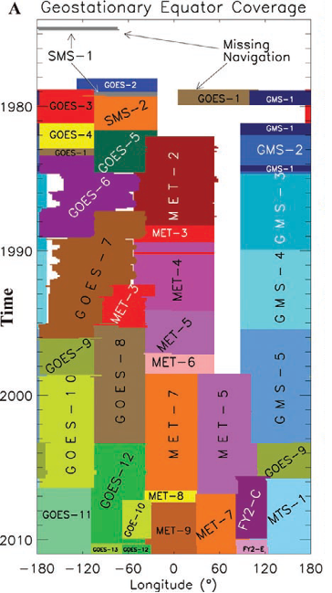
Geostationary observations
Geostationary observations in the Vis/WV/IR available since ca. 1980
(Easily) available combined products – for IR at least – from 2000 onwards (e.g. CPC Global-IR 4km)
New effort to provide multi-spectral data through the GEO-Ring project for whole Geo-period (1979-ish onwards)
Vis/IR GEO-observations are an integral part of global precipitation measurement
primarily due to their temporal sampling and good spatial resolution

Slide 9
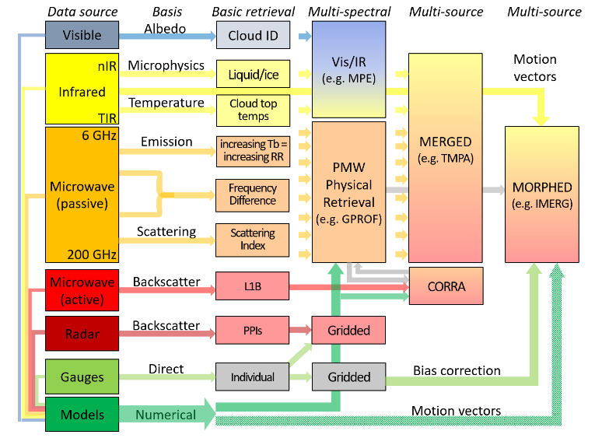
Satellite precipitation estimation
Satellite estimates of precipitation encompass a wide range of frequencies together with auxiliary data.
Retrieval of precipitation from satellite observations is complex since the range of precipitation properties and characteristics is large (cloud, rainfall, snowfall, hail).
Requires a multi-spectral, multi-satellite, multi-sensor approach
satellite
surface

Slide 10
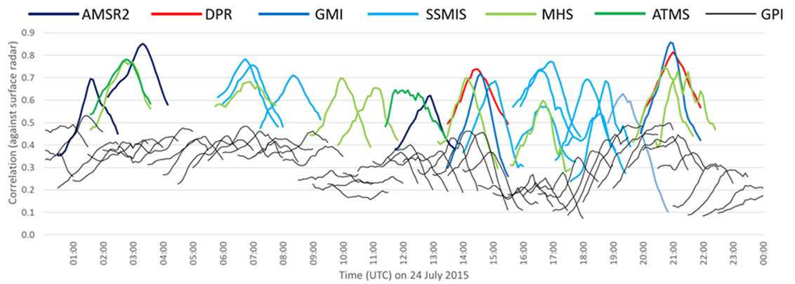
Why the reliance on passive microwave?
Satellite:surface correlations peak at time of observation
correlations decline markedly away from time of observation
PMW
IR
Radar-calibrated IR retrievals never match those of the PMW
Instantaneous passive microwave retrievals are more direct than IR retrievals and are generally very good but temporal sampling greatly decreases their impact

Slide 11
Precipitation Data sets
A multitude of precipitation data sets from surface, satellite, model and combined:
CGMS/IPWG identified 89 precipitation data products (http://ipwg.isac.cnr.it/data.html):
Combined datasets with gauge data (21 products)
0.04°x0.04° to 2.5°x2.5°, 30min to seasonal, lat-range/Africa to global.
Satellite combined datasets (22 products)
2x2 km to 2.5°x2.5°, 10min to 5-day, lat-range/regional/disk to global
Single-source datasets (32 products)
FOV to 2.5°x2.5°, instantaneous to monthly, lat-range/regional/disk to global
Precipitation gauge analysis (14 products)
(individual) 0.25°x0.25° to 2.5°x3.75°, daily to monthly, regional to quasi-global.
Total of 89 identified ”publicly-available” precipitation products (+many more)
2x2 km to 2.5°x2.5°, instantaneous to seasonal, regional to global.
Many thanks to George Huffman!

Slide 12
ECV precipitation inventory
Domain=Atmosphere, ECVName=Precipitation, ECVProduct=Estimates of liquid and solid precipitation
RecID | PhysQuantity | Status | ResponsibleOrg |  | Satellites | Sensors |  | region | time | spatial
10121 | Liquid precipitation | Existing | NASA | 2016 | SSMI SSMIS | Wentz/RSS | netcdf | ocean | 1 d | 0.25 deg | 35+ yrs
10301 | Liquid precipitation | Existing | NOAA/NESDIS/NCEI | 2014 | GeoIR | PERSIANN-CDR | netcdf | land ocean | 1 d | 0.25 deg | 44+ yrs
10318 | Precipitation (liquid and solid) | Existing | EUMETSAT (CM SAF) | 2012 | SSMI | HOAPS 3.2 | netcdf | ice-free ocean | 1 mo | 0.25 deg | 20 yrs
10320 | Precipitation (liquid and solid) | Existing | EUMETSAT (CM SAF) | 2017 | SSMI SSMIS | HOAPS 4.0 | netcdf | ice-free ocean | 1 mo | 0.25 deg | 28 yrs
10785 | Precipitation (liquid and solid) | Existing | NASA-NOAA-EUMETSAT-CNES | 2016 | AMR | Jason-3 | netcdf | ocean | 10 d | 0.25 deg | 1 yr
10786 | Precipitation (liquid and solid) | Existing | NASA-NOAA-EUMETSAT-CNES | 2016 | AMR | Jason-2 | netcdf | ocean | 10 d | 0.25 deg | 8 yrs
10787 | Precipitation (liquid and solid) | Existing | NASA - CNES | 2016 | AMR | Jason-1 | netcdf | ocean | 10 d | 0.25 deg | 12 yrs
10788 | Precipitation (liquid and solid) | Existing | NASA - CNES | 2016 | TMR | Topex/Poseiden | netcdf | ocean | 10 d | 0.25 deg | 14 yrs
10789 | Precipitation (liquid and solid) | Existing | ISRO - CNES | 2016 |  | SARAL/AltiKa | netcdf | ocean | 35 d | 7x35 km | 4 yrs
11527 | Liquid precipitation | Existing | NASA | 2016 | SSMI SSMIS | Wentz/RSS | netcdf | ocean | 7 dy | 0.25 deg | 35+ yrs
11528 | Liquid precipitation | Existing | NASA | 2016 | SSMI SSMIS | Wentz/RSS | netcdf | ocean | 7 dy | 0.25 deg | 35+ yrs
11529 | Liquid precipitation | Existing | NASA | 2016 | SSMI SSMIS | Wentz/RSS | netcdf | ocean | 1 mo | 0.25 deg | 35+ yrs
11623 | Precipitation (liquid and solid) | Existing | NOAA/NESDIS/NCEI | 2016 | Multi-sensor | GPCP 2.3 | netcdf | global (all) | 1 mo | 2.5 deg | 44+ yrs
11627 | Precipitation (liquid and solid) | Existing | NOAA/NESDIS/NCEI | 2016 | Multi-sensor | GPCP 3.1 | netcdf | global (all) | 1d | 1 deg | 44+ yrs
11648 | Liquid precipitation | Existing | NOAA/NESDIS/NCEI | 2016 | PMW sounders | MSPPS | netcdf | global (all) | 2/6 d | 48/16 km | 22+ yrs
Existing
10321 | Precipitation (liquid and solid) | Planned | EUMETSAT (CM SAF) | 2024 | PMW imagers | HOAPS 5.0 |  | ice-free ocean |  | 0.5 deg | 33 yrs
10440 | Precipitation (liquid and solid) | Planned | EUMETSAT (CM SAF) | 2023 | PMW (I+S) & IR | GIRAFE |  |  |  | 1.0 deg
11839 | Precipitation (liquid and solid) | Planned | EC (Copernicus C3S) |  | PMW (I+S) | CM-SAF/H-SAF |  | global | 1 d | 1.0 deg
11856 | Precipitation (liquid and solid) | Planned | EC (Copernicus C3S) |  | PMW (I+S) |  |  | global | 1 mo | 1.0 deg
Planned
Precipitation ECVs need evaluating and expanding for WGClimate

Slide 13
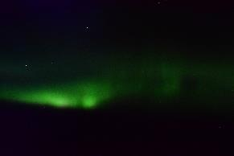
Product Continuity: NASA PPS
The NASA Precipitation Processing System (PPS) currently acts as the central processing system for data and data products from the (GPM) precipitation constellation.
Ingests data in near time from the GPM-Core satellite, EUMETSAT, NOAA and (US) DoD.
Implements quality-control, homogenization/orbitisation of incoming data.
Undertakes calibration of Level-1 data (to ‘Level-1C’) to ensure consistency.
Generates Level-2 and Level-3 (IMERG) precipitation products.
Products made available to the user community, often within 1 hour of observation.
PPS activities are scheduled to cease 1 year after end of GPM (2028?)
current issues as to whether new sensor data will be incorporated;
NOAA ingests Level-0 data from the 3 DoD SSMIS satellites/sensors, but has terminated processing Level-1 and Level-2 data products;
JAXA relies upon the PPS for GPM partner data sets;
EUMETSAT H SAF and CM SAF use PPS Level 1 and 2 data sets.
Aurora Borealis: JFK-CDG 27/11/2022

Slide 14
Product Continuity: Key Questions
Life after GPM - precipitation-capable missions will exist after GPM!
New missions/commercialisation - who will process data from new missions?
In particular, who will be responsible for :
Ingesting data for all precipitation-capable missions;
Consistent quality control, organisation/homogenisation/orbitisation;
Data processing (Level 0 – Level 1 – Level 2 – Level 3) – and distribution;
Reprocessing, updates and upgrades;
Data archiving and access;
Continuity of data and products across different data streams;
Outreach, public engagement and education (e.g. schools, agencies, users, etc);
Role of AI: e.g. AI-driven sensor duty cycles (driven by ‘areas of interest’?);
Science vs commercial priorities* for data and products.
* there is no single science or commercial priority.

Slide 15
Product continuity: New observations
Providing observations at scales that reflect the natural variability of precipitation is key to improving estimates and understanding of the properties and characteristics – but
Precipitation (rain/snow) is highly variable in time and space;
Intensities are heavily skewed towards zero;
Temporal/spatial scales are intrinsically linked: improving spatial resolution requires better temporal sampling.
Providing consistency through the data record requires:
Continuation of ‘baseline’ sensors in the AMSR/GMI class of sensors;
Provision of low inclination orbit high-quality sensor(s) for a calibration standard;
Integration of new and commercial* sensors (e.g. smallsats/cubesats) to improve temporal sampling (*subject to commercial pricing).
However:
not all observations used for retrievals are the same - different channel availability, spatial resolution, noise/accuracy levels, etc… .

Slide 16
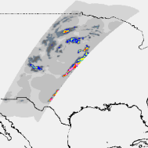
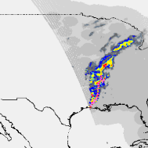
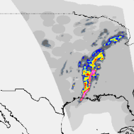
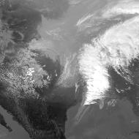
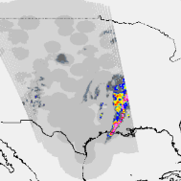
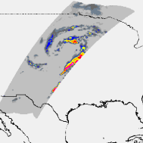
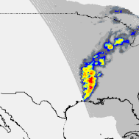
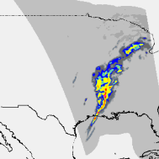
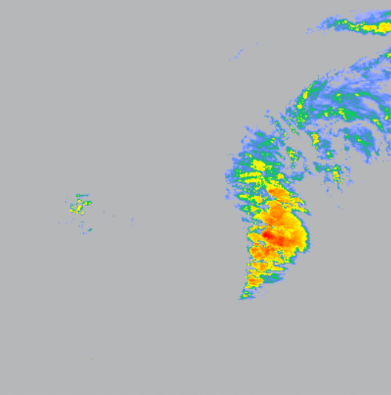
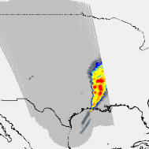
Product Continuity: channel selection
Different sensors with different channels = different retrievals
2022-03-30_01:08UTC
2022-03-30_19:14UTC
2022-03-30_19:40UTC
2022-03-30_20:06UTC
2022-03-30_19:30UTC
Small passive microwave sensors use high frequencies to achieve reasonable spatial resolution.
High frequencies are sensitive to frozen hydrometeors (ice), rather than liquid hydrometeors (rain).
Shift from low-frequency (or wide-frequency range) to high-frequency observations changes what is measured.
MRMS radar
MRMS radar
MRMS radar
MRMS radar
GOES Thermal IR
Ice
particles
Ice
particles
GPROF-GMI
GPROF-ATMS/N20
GPROF-AMSR-2
GPROF-ATMS/NPP
GOES Thermal IR
10-183 GHz
89-183 GHz
10-89 GHz
89-183 GHz

Slide 17
Defining future requirements
Defining future requirements (2030+):
Spatial and temporal resolutions need to be commensurate with precipitation:
Q: what is the spatial scale of precipitation features? (ideally < 5-km, ideally 1-km).
Q: how fast do precipitation features change? (ideally hourly sampling or better).
Sensors must meet science requirements for observing/measuring rainfall and snowfall:
Q: which frequencies are best to meet science requirements?
Q: how many channels are needed?
These requirements are all inter-dependent and constrained by science/engineering
Data management systems (by sensor, or by geophysical product?):
Q: how quickly can users access data and products (as little as a few minutes)?
Q: what temporal/spatial resolutions are available (NRT vs ‘climate’)?
Q: how can (a wide range of) users access data?
Q: How is data quality-controlled, calibrated and archived (and by whom)?
Q: Who pays for commercial data (single source vs combined data/products)?

