Slide 1
SIT-38 2023 NEW SPACE
A. Ciccolella, ESA
Agenda Item #6
SIT-38 2023, ESA/ESRIN
29th - 30th March 2023

Slide 2
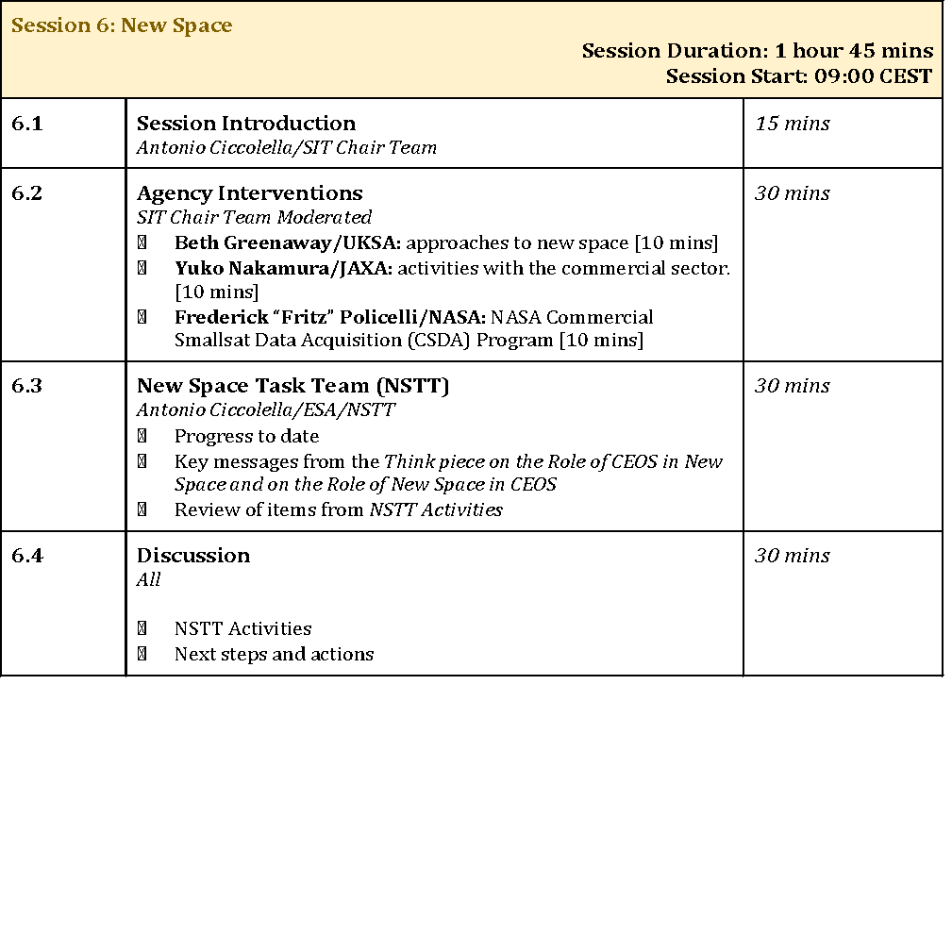
Agenda

Slide 3
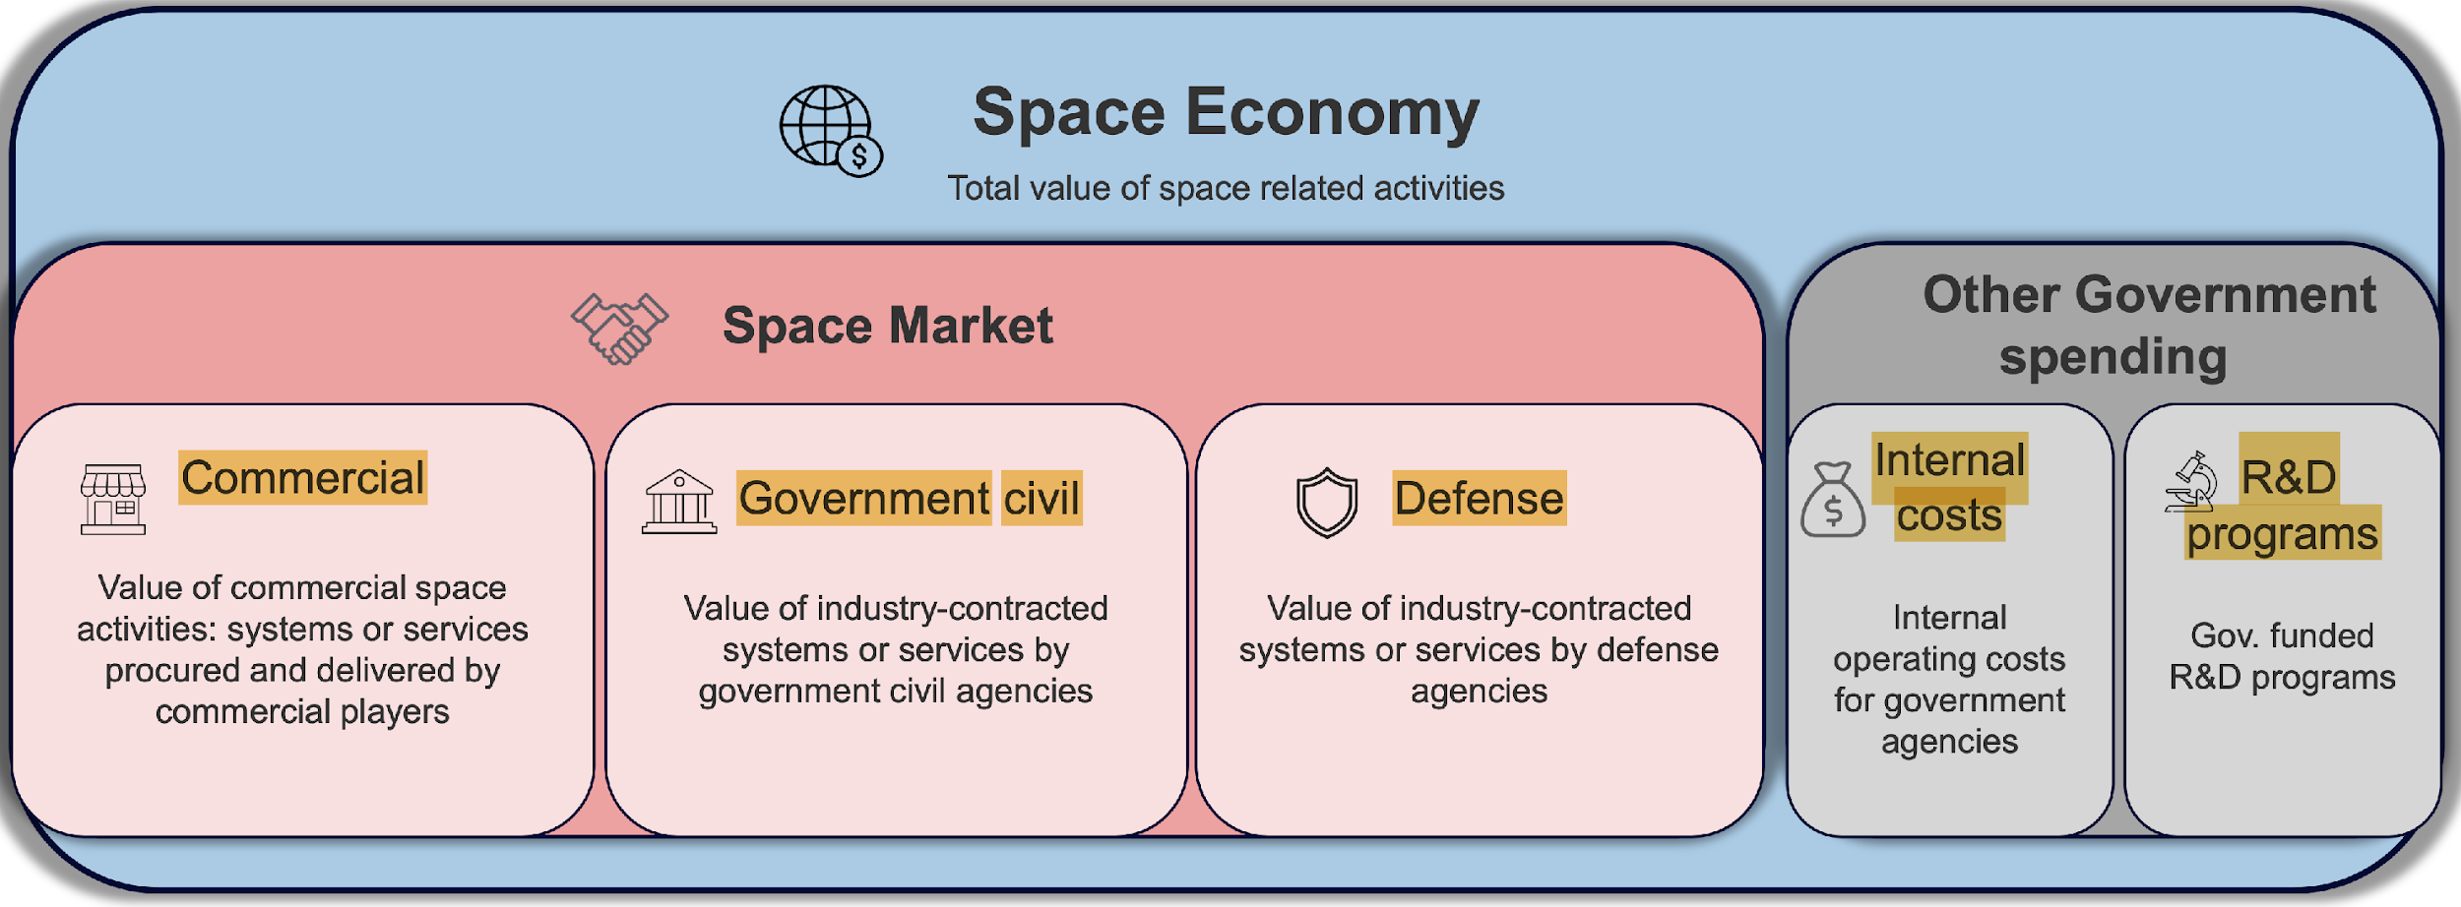
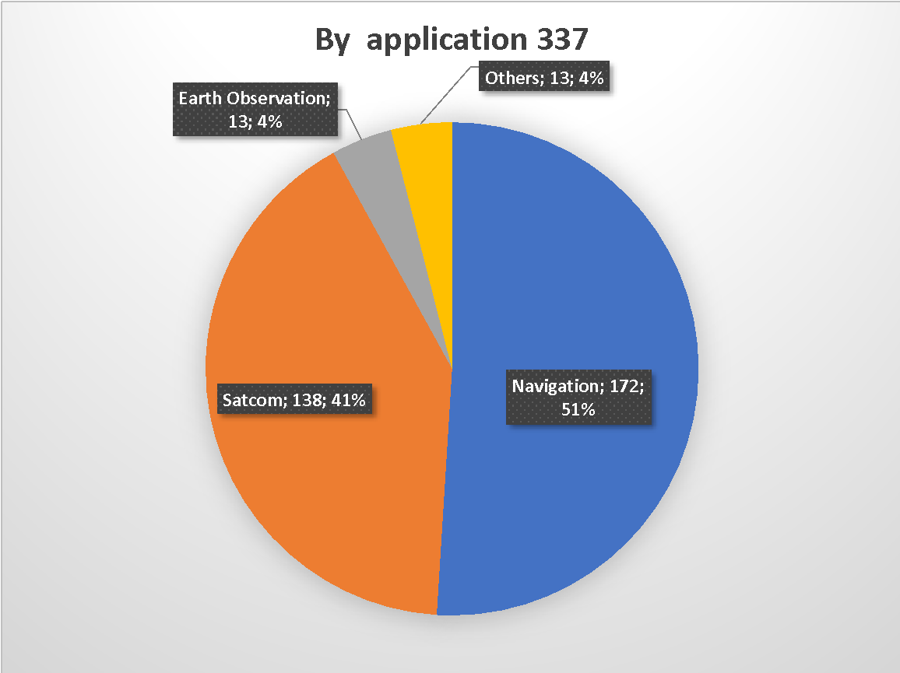
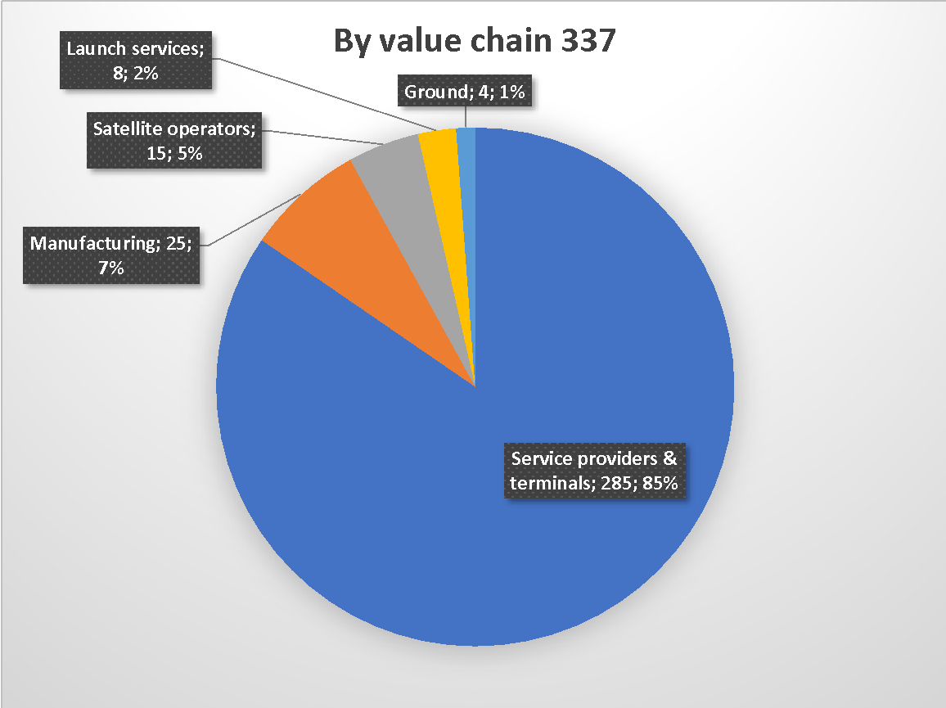
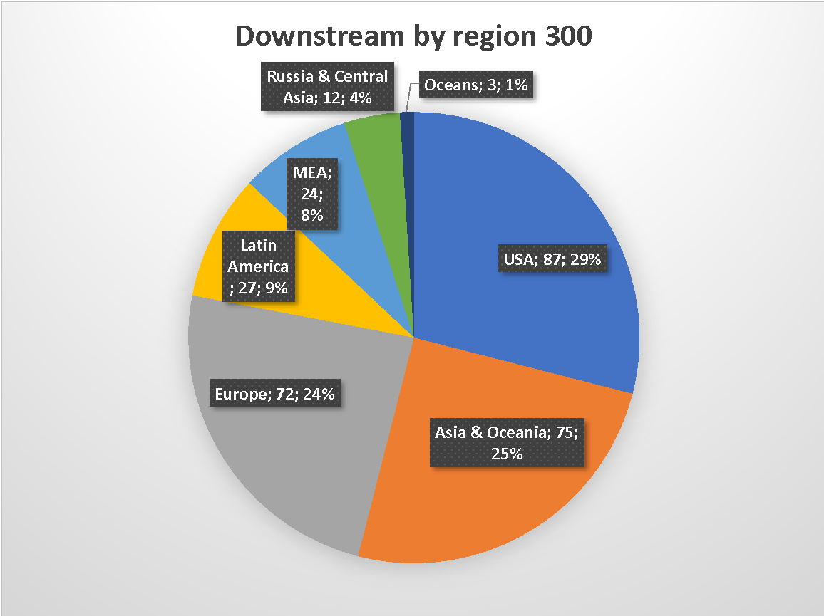
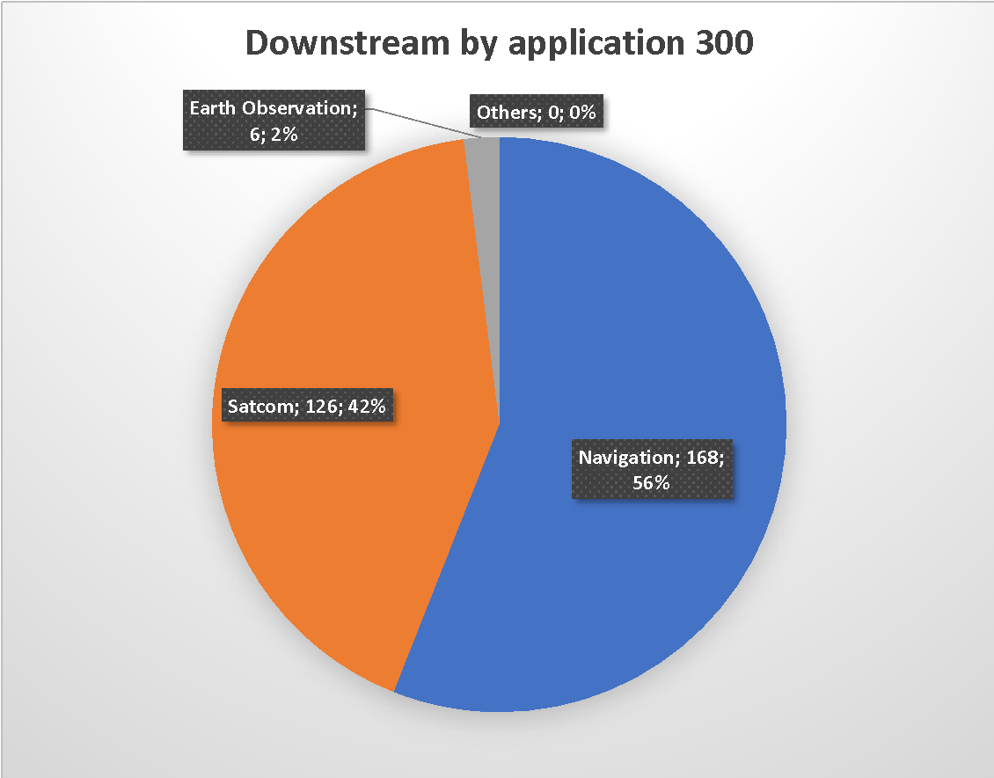
Space Economy breakdowns
Space Economy is 370B$ and Commercial is 75%
Downstream is the 89% of the Space Market (337 B$)
USA 29%, ASIA 25%, EU 24%, rest 22%
56% Nav, 42% Satcom, 2% EO
EO commercial market is still a niche market : about 3-5% of Space Market
Source: Euroconsult

Slide 4
Evolution of the Space Market structure
The traditional space market is characterised by the following features:
- Highly concentrated demand and supply structures (e.g. oligopoly, mono/oligopsony)
- Few large transactions
- Direct government regulation and administration of transactions
- Negotiated prices between suppliers and customers
- Imperfect competitive interactions among economic agents
If the space economy is on the path towards transforming into a more open commoditised market one should expect:
- Balanced distribution of spacecraft ordered by government versus non-government customers
- Significant share of commercial versus non-commercial applications (i.e. commoditisation of the space economy); and
- Openness of the market structures (i.e. internationalisation of the space economy)
Slide ‹#›
Notes:
New Space companies are a subset of Commercial Operators acting for profit:
Commercial goals are stimulated by Venture Capital funding or corporate investments
Start-ups or SME with aggressive growth plan to reach quickly the break-even for allowing investors profitable exit.
New Space methods are characterized by:
Simplified spacecraft architectures, fast developments, miniaturization of (commercial) components, streamlined testing, largely automated operations
Constellation of many small satellites (e.g. < 200 kg) produced in series exploiting manufacturing paradigms derived from large production industry to achieve very frequent revisit, thus targeting applications out of reach for the traditional missions
Data distribution and data analysis through IT platforms, allowing application development on cloud

Slide 5
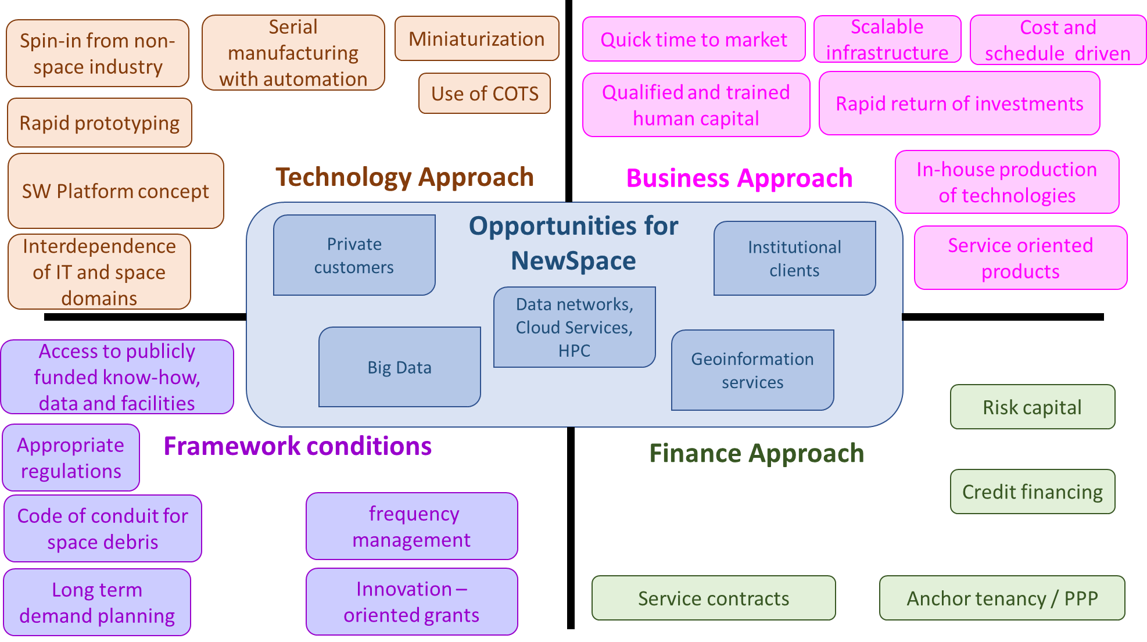
“New Space” – what is all about

Slide 6
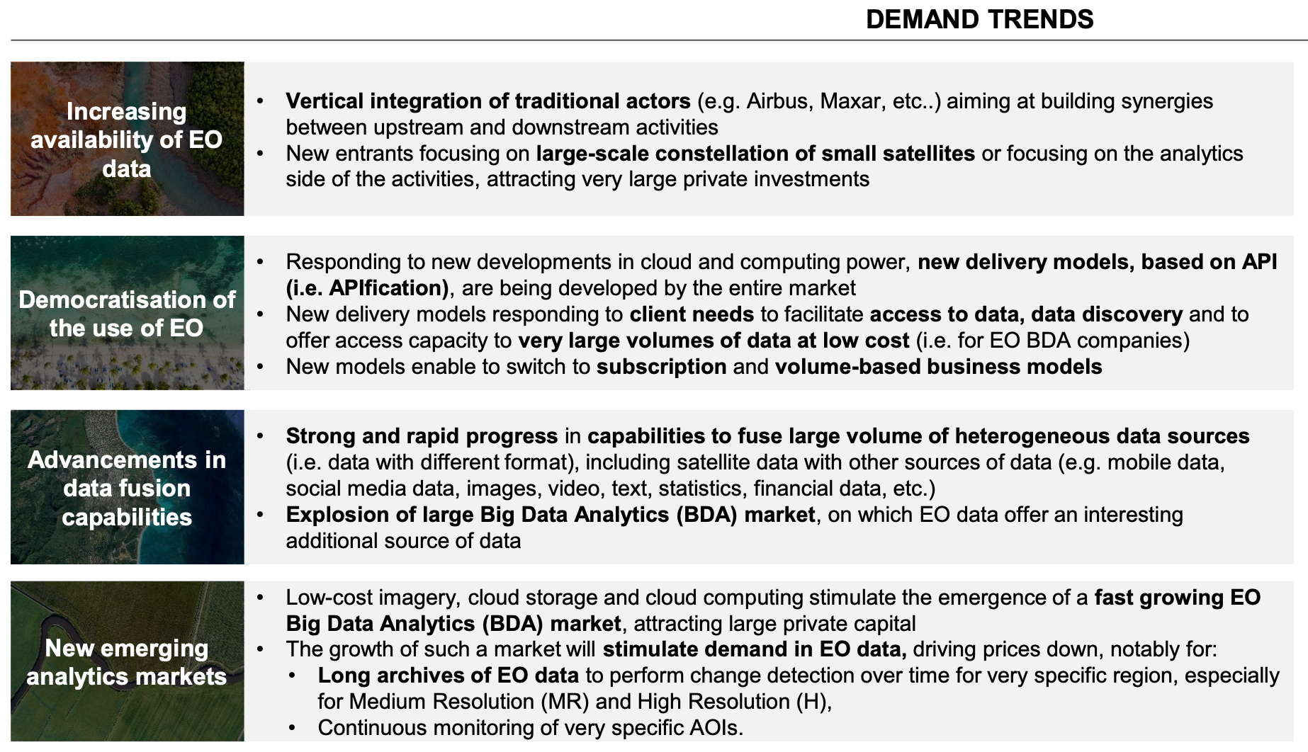
Trends supporting growth in EO data products & services: importance of the downstream sector
Slide ‹#›

Slide 7
Boost EO commercialisation
Four barriers to EO commercial market expansion:
unserved demand / market creation
availability of diversified data and innovative services
price barrier and access to funding
data/service price too high
Difficulties in access to credit
product dependability
product quality/ availability/ reliability…
and customers uncertainty
many business cases are not demonstrated

Slide 8
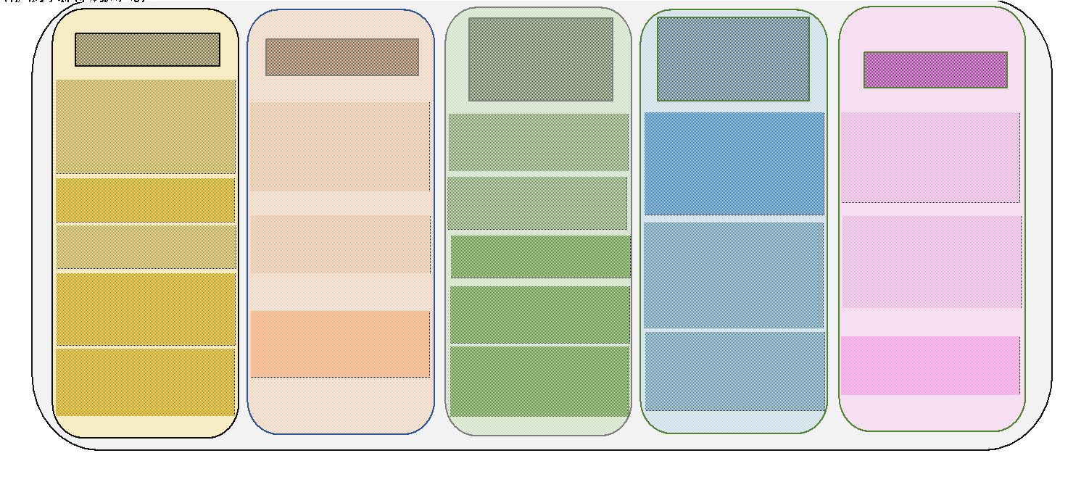
Potential role of the public sector for emerging EO industry in Europe

Slide 9
“New Space” – Definition
“New Space” encompasses technology and business model innovations, driven by commercial interest of the private sector, with a prominent risk-taking approach
The term “New Space” is not univocally used; it may refer to two distinct concepts:
Commercial companies characterised by business goals often driven by private investors, such as Venture Capital, seeking a return of Investments
Commercial, non-traditional manufacturing methods based on rapid development and focused on cost reduction and fast prototyping
A universally adopted definition of New Space is not available 🡪 a common definition of New Space for the objectives of CEOS is needed
The support of the public sector oriented to innovation is crucial for the development of this domain since, for EO, the B2G is still the predominant commercial case

Slide 10
Agencies’ experiences about “New Space”
Beth Greenaway – UKSA
Approach to “New Space”
Yuko Nakamura – JAXA
Activities with the Commercial Sector
Fritz Policelli – NASA
NASA Commercial Smallsat Data Acquisition (CSDA) Program

Slide 11
Overview, Objectives NSTT
In this scenario, a New Space Task Team established for a period of one year, until 2023 CEOS Plenary
Objective 1: Explore collaboration opportunities in New Space that bring mutual benefit to all parties, in delivering public benefit, including the identification of concrete actions
Define and propose actions within the CEOS framework that enhance the outcomes of CEOS entities (WGs, VCs, AHTs) working with New Space companies
Foster partnership at national level between individual CEOS members and their national “New Space” industry
Focus on the whole value chain – upstream and downstream sectors
Objective 2: Continue sharing country-level experience among CEOS

Slide 12
Approach
Commence with an assessment of the areas and issues that are common among CEOS agencies and that are predicted to impact public EO programmes in future
Dec/Jan: Call for Ideas
Telcon # 1 (23 Jan 2023): Kick-off discussion
Telcon #2 (10 Feb 2023): Discussion on draft Think Piece
Telcon #3 (06 Mar 2023): Discussion continued
Develop a series of objectives and activities that will guide CEOS in fostering the combined use of public and private EO New Space capabilities, both upstream and downstream
SIT-38: Continue agency sharing of experience from SIT-37 and TW, and Accelerate the definition of actions
2023 Plenary: Issue a White Paper with Findings & Recommendations. The White Paper will highlight which topics are most productive for CEOS to pursue and which may be out of scope or problematic.
Notes:
T

Slide 13
First Outcome: The Think Piece
Initial document to define the Role of CEOS in New Space and the Role of New Space in CEOS and includes a series of questions & topics to be addressed by NSTT in the coming months - draft from J. Carpaay (NSO) and B. Greenaway (UKSA)
This is a living document addressing:
Need for the definition of “New Space”, encompassing upstream, downstream and new working methods
What CEOS can do for New Space but also what New Space can do for CEOS; perimeter of the activities and of the interaction with the New Space Industry;
Identification of complementarities between CEOS Agencies and New Space companies, lessons learnt from collaborations of CEOS Agencies with “New Space” Industry
Understanding of what the “New Space” ecosystem needs from Space Agencies (e.g. quality assurance characterisation, or common assessment framework to perform such characterisations, for New Space companies with societally relevant data, free use of cal/val data from public missions for the calibration of smallsats etc);

Slide 14
First Outcome: The Think Piece
Understanding what “New Space” can do for CEOS, having in mind that the user is the ultimate beneficiary of any possible CEOS ”New Space” Partnership: in particular can UR be fulfilled?
What Identification of complementarities between CEOS Agencies and New Space companies, lessons learnt from collaborations of CEOS Agencies with “New Space” Industry
CEOS activities should not privilege a particular “New Space” satellite provider or a specific downstream company. On the contrary, the CEOS community should define actions that can benefit ALL commercial companies without any distinction

Slide 15
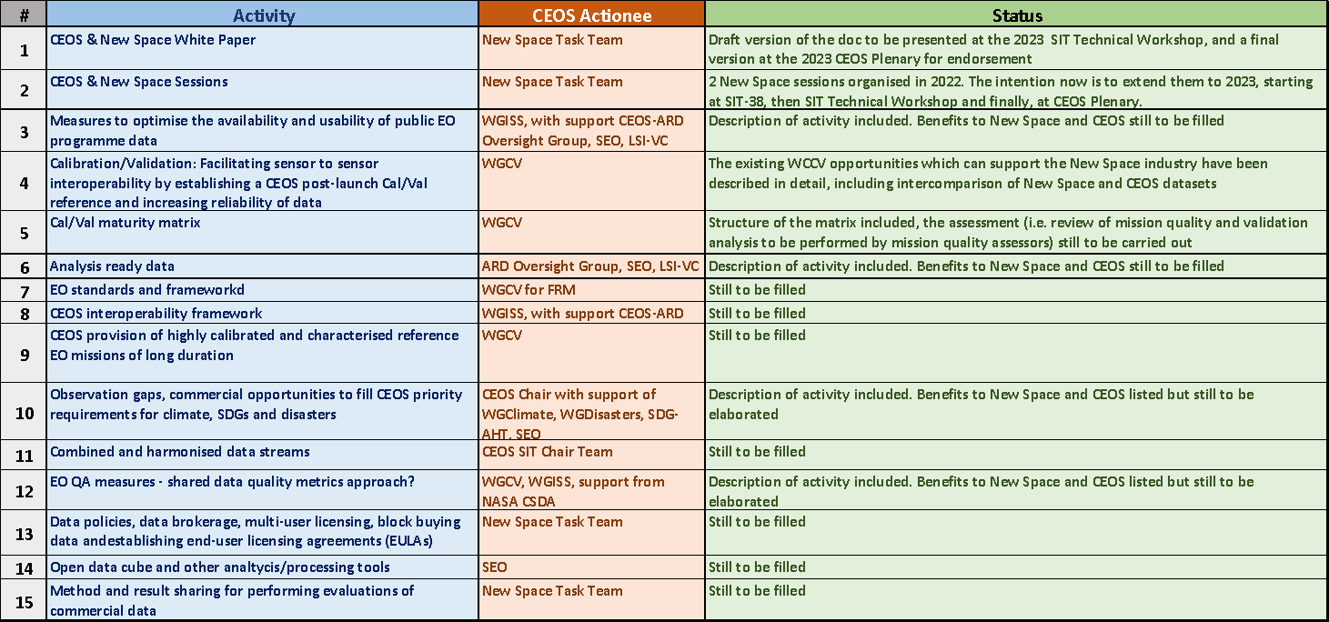
NSTT – Action Status

Slide 16
Question for discussion:
1. What is meant by "New Space"?
2. What is out of scope?
3. What could be the win-win partnership opportunities?
4. What interactions have there been so far at the CEOS agency level - lessons learned?
5. What does an integrated EO industry look like?
6. What can CEOS do for New Space?
7. What can New Space do for CEOS?

