Slide 1
SIT-38
2023
UKSA ‘New Space’ activities
Beth Greenaway, UKSA
Agenda Item 6.2
SIT-38 2023, ESA/ESRIN
29th - 30th March 2023

Slide 2
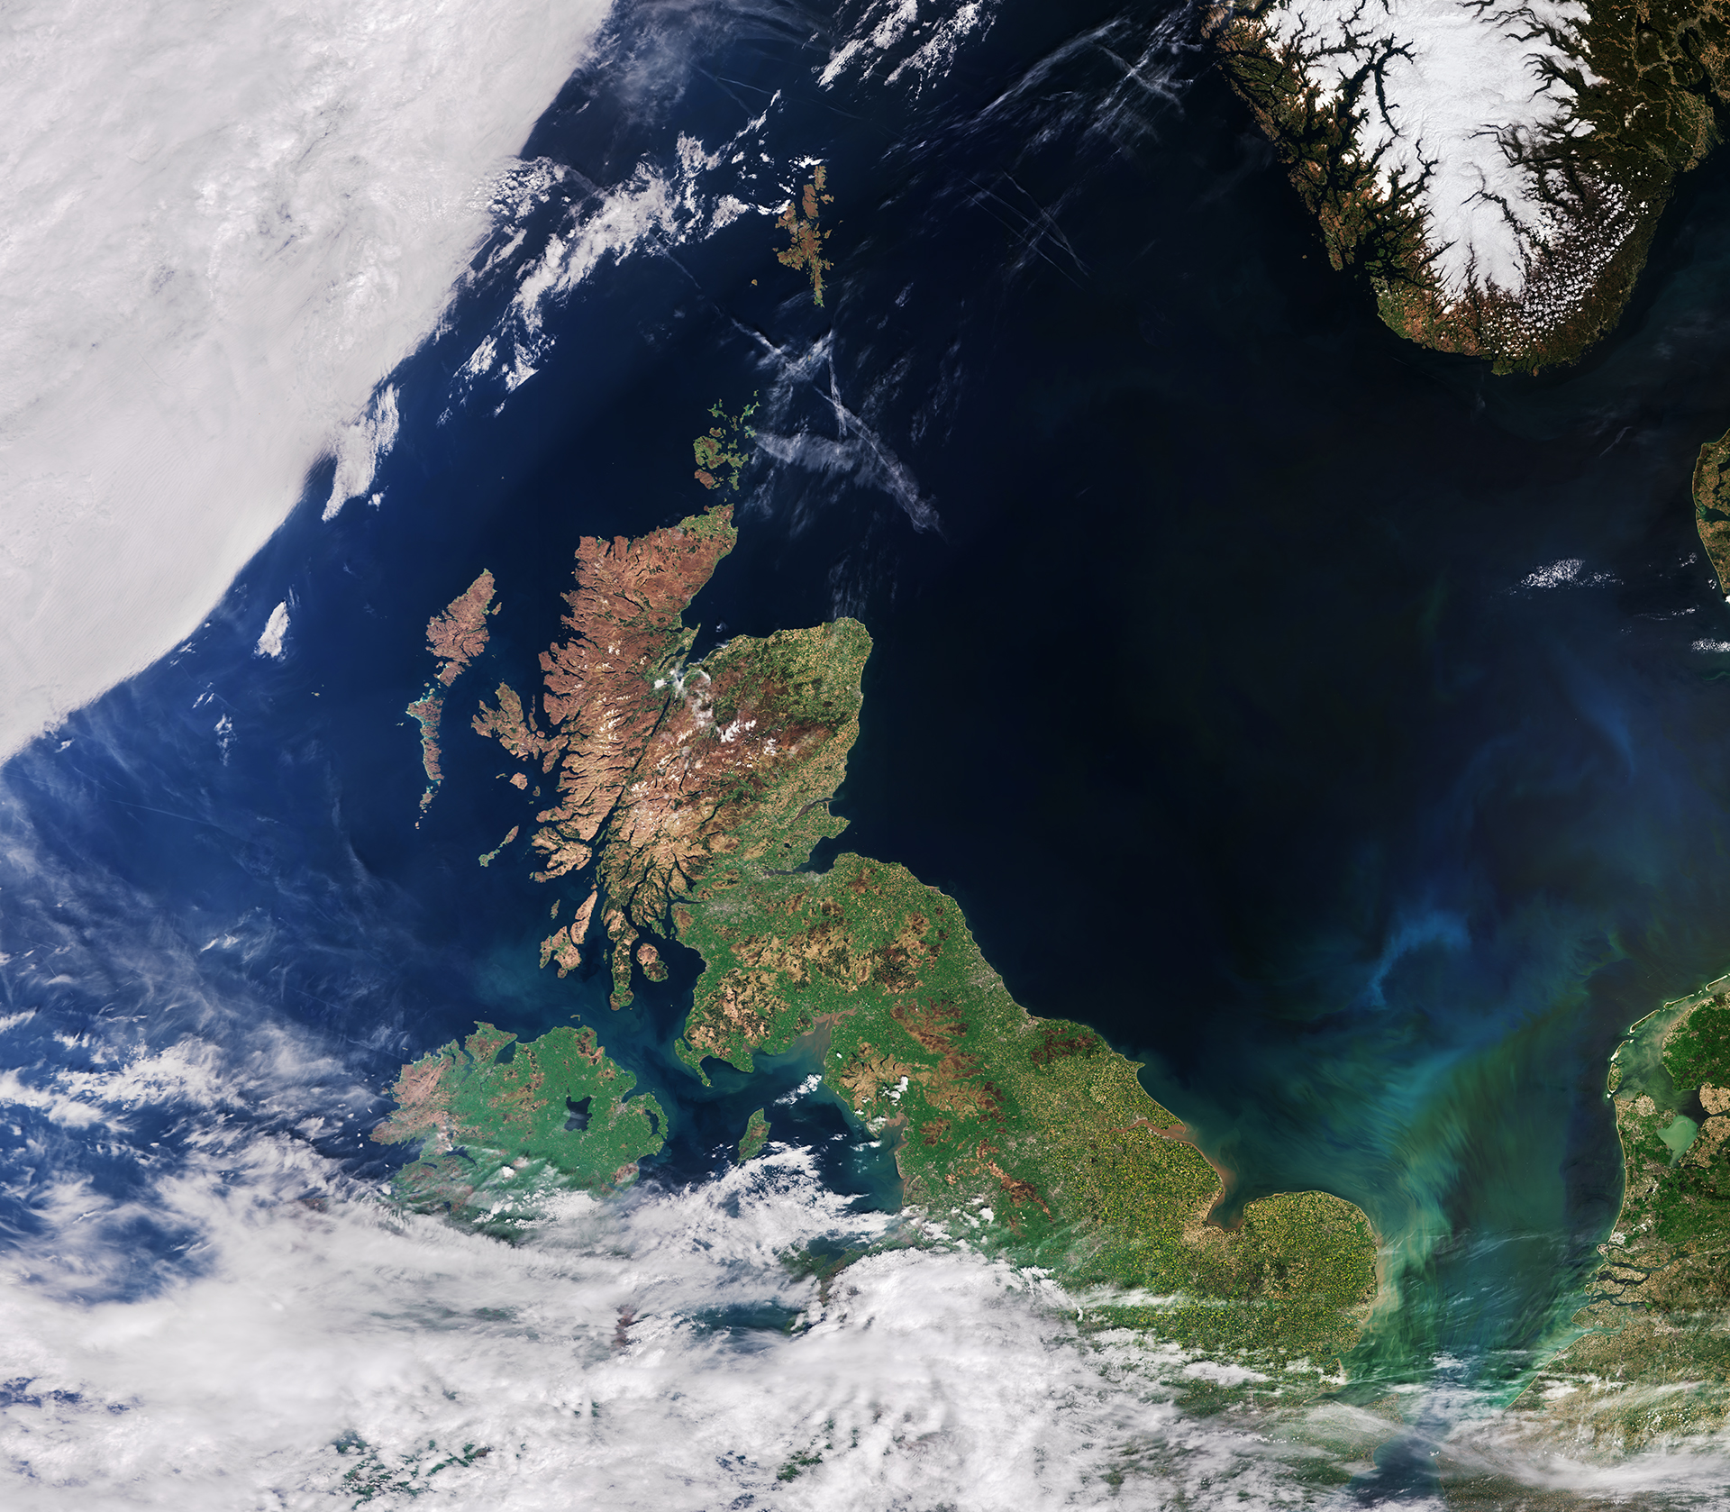
Earth Observation is a UK priority
The UK Space Agency plays a major role in delivering the government’s National Space Strategy and support a thriving space sector in the UK, which generates an annual income of £17 billion and employs 48,000 people. The remit is to:
Catalyse investment to support projects that drive investment and generate contracts
Deliver missions and capabilities that meet public needs and advance our understanding
Champion the power of space to inspire people, offer greener, smarter solutions, and support a sustainable future
Earth observation is one of 8 Priority areas: studying our planet to drive discovery and tackle climate change

Slide 3
Definition of ‘ New Space’
New space is ‘old news’ .
The space landscape has been changing for many years and ‘new’ actors who do things with private monies, are focused on making a business use smaller, ready to use technology – many in constellations – to provide data or a service – to the users.
All new actors want to compliment not duplicate existing
Many take staff and expertise from existing traditional actors

Slide 4
Benefits:
Smaller, cheaper missions produced in 6 months to 3 years
Space more accessible to and beings in new users / more customers
Range of business models and customers brings in new thinking and innovations
Inspiring for a new generation – can work on a mission for 6 months and see it fly - not 20 years like SWOT.

Slide 5
Challenges:
Expectation raised by government and non space actors that everything should be cheaper and faster.
Getting funding for the science missions and the ones that are by necessity large and complex is harder.
You can not ‘rush’ new and novel science and technology and all the traditional tests and qualifications in a few months

Slide 6
How does UKSA help?
Direct investment though grants e.g. to derisk the technology development stage / pre market ready or create a pre commercial application algorithm e.g. CEOI
Open market opportunities – trade shows, business case training, sector reports – e.g. Space 4 Climate,
Champion space – bring in government monies and new investors including local councils and commercial users
Promote standards and ‘trusted data’ concept
Address the skills gaps on a national basis

Slide 7
TRUTHS and New Space?
TRUTHS an ESA mission will enable an upgrade of the performance of the global EO system, both in space and on the ground. It will estimate the Earth’s radiation budget by direct measurement of the Earth’s incoming and outgoing radiation
Will enhance the performance of other satellites.
UK leading 70% - training and inspiring a new generation
Will record its own carbon footprint – to help others reduce the impacts.

Slide 8
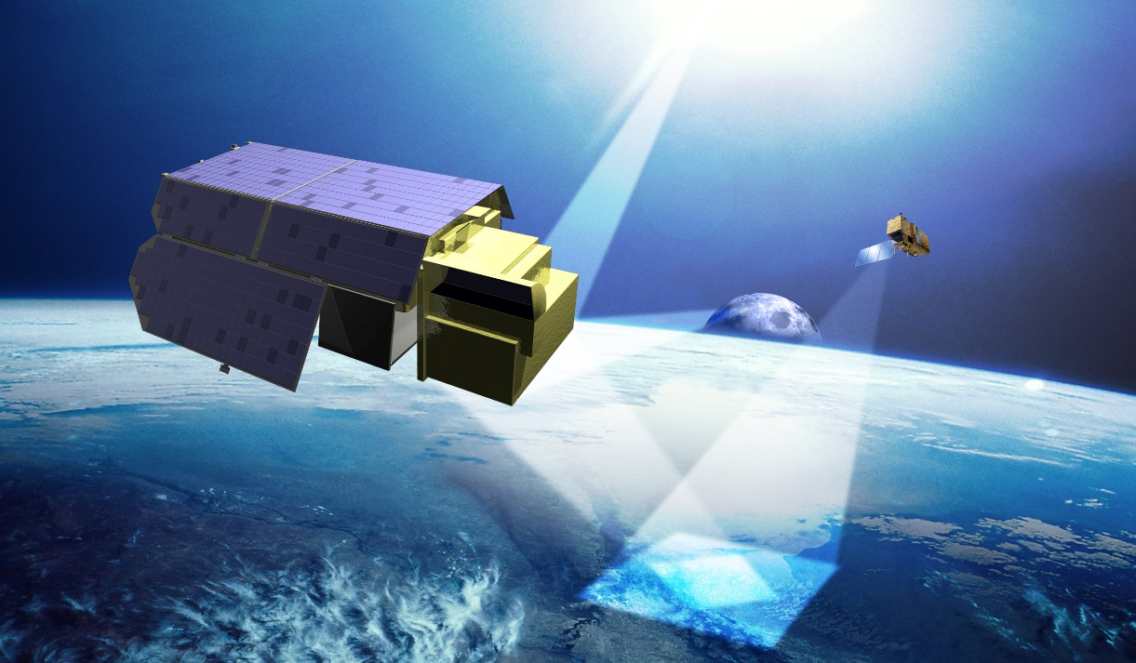
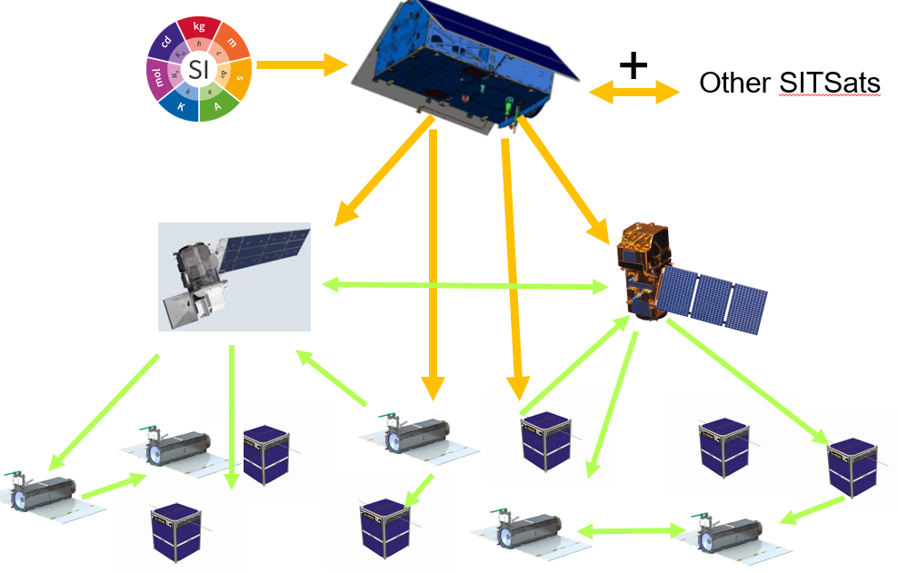
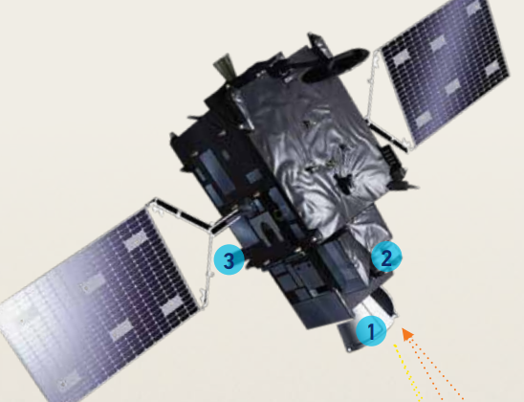
TRUTHS and New Space
TRUTHS is an enabler of new & old space
  Providing the pinnacle of an international in-flight calibration framework
  - sensor to sensor & via CEOS infrastructure
  PICS/RadCalNet/OC Buoys
  Facilitating interoperability/Trust & ARD
  Upgrading performance of other satellites towards climate quality (including new space)
  Transformational in encouraging lower cost
  - reducing need for complex on-board cal
  - free and open Cal/Val

Slide 9
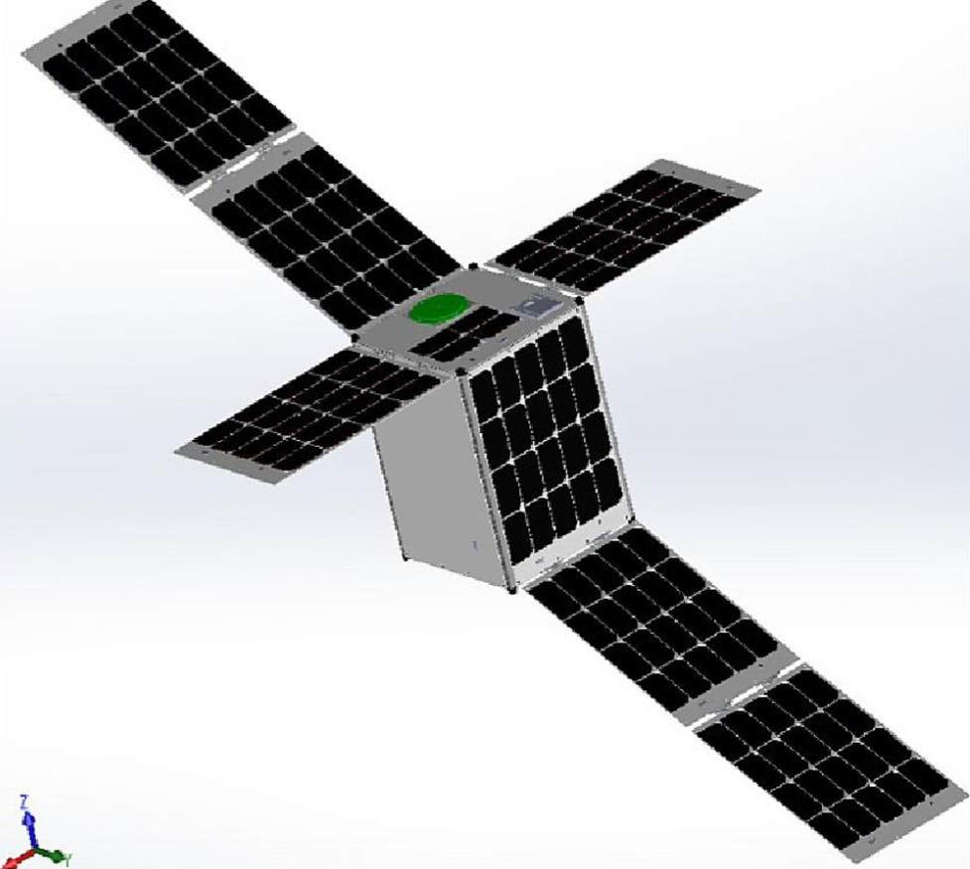
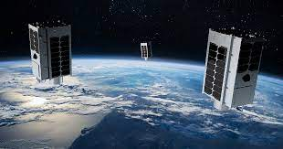

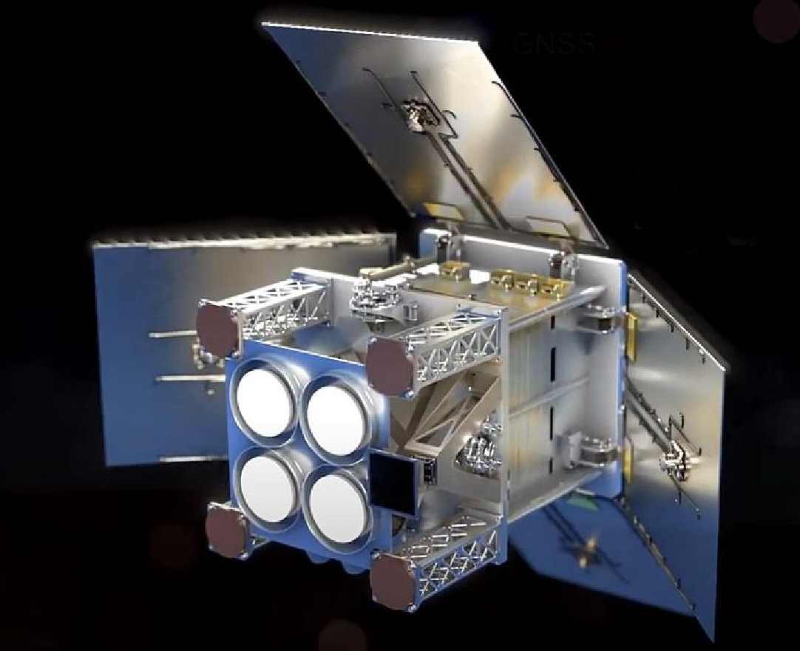
UKSA Support for New Space through ESA EO Programmes
InCubed2
funds the development of innovative commercial products and services that generate and exploit the value of EO.
MANTIS is a demonstration mission to develop, build, launch and operate an innovative nanosatellite platform that will fly a high-resolution Earth camera..
MANTIS is expected to launch later this year and will be a key part of OpenCosmos's 'Open Constellation'
SCOUTS (FutureEO)
A small-class research mission aimed to advance the Earth Science agenda. Developed using a rapid (3 years from selection to launch) and a low-cost approach (~30 M€ CaC industrial cost including launch and in-orbit commissioning)
Within the first round of missions, two UK missions were selected:
HydroGNSS – a constellation of two satellites that will use Global Navigation Satellite System (GNSS) reflectometry to provide measurements of key hydrological climate variables.
CubeMAP - a constellation of CubeSats that will focus on understanding and quantifying atmospheric processes in the upper troposphere and in the stratosphere by observing gases such as Water Vapour, Methane and Ozone
Purchasing of Third-Party Mission Data (Earthnet)
Earthnet provides access to data from Third Party Missions.
Earthnet acts as a customer for New Space companies, providing a market to foster science and pre-operational applications development.
Examples include: GHGSat and ICEYE while data from NovaSAR and Spire is under assessment.
The assessment framework is a vital step in the process.
GHGSAT Constellation
Credit: ESA/GHGSAT
HydroGNSS
Credit: ESA/SSTL
MANTIS Credit: ESA/OpenCosmos

Slide 10
Open Questions for CEOS
How should the activities of CEOS incorporate all missions?
Should the data policy of CEOS be adapted to account for different business models – or should institutionally bought data be available as free and open like the data of institutionally built missions?
How do we collectively ensure all types of missions can be progressed to suit all types of user needs? What are the win- wins?

Slide 11
Conclusion
New space is not new –space is a mixed economy and ecosystem with many actors.
UKSA want a thriving space sector – resilient , skilled and making a difference to the world we live in.
UKSA champion the sustainable use of space, diversity and inclusion of all ideas business models etc
There are open questions how to co exist and take the benefits of all models.

