Slide 1
CEOS Ocean
Coordination Group:
Status of Deliberations &
Proposed Next Steps
Paul DiGiacomo, NOAA
Agenda Item 5.5
SIT-38 2023, ESA/ESRIN
29 March 2023

Slide 2
Some History…
CEOS has over the past 5+ years been increasingly focused on ocean & coastal coordination, e.g.,
2017 Plenary: “to establish broader understanding of the various activities related to water observations, and achieve clarity on the priorities and way forward for CEOS in relation to GEOGLOWS, COVERAGE, AquaWatch, and GEO Blue Planet”; COVERAGE in 2017
2020 Plenary: “COVERAGE, COAST, and SIT Chair Teams to discuss and conclude on how CEOS will coordinate internally and externally on CEOS involvement in the United Nations Decade of Ocean Science for Sustainable Development (2021-2030)”; COAST in 2019/2020
2021 Plenary: “ESA SIT Chair to seek CEOS Agency nominations for a small working team to scope options for improved coordination and communication of the full range of CEOS ocean-related activities and groups.”; Ocean Coordination Group in 2021/2022

Slide 3
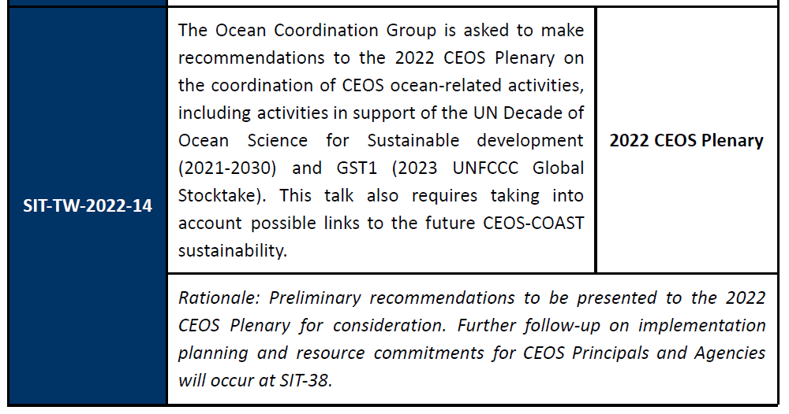
The Present…

Slide 4
The Present…

Slide 5
Ocean Coordination Group (OCG)
What: progress has OCG made?
Since SIT-TW-2022, 5 OCG Meetings were held. Engagement also occurred between meetings (verbal and written exchanges). Focus on consensus building via extensive discussions and group inclusivity
In those 6 months OCG identified 5 candidate actions and narrowed those down to 2 options under discussion (one more formal/intensive and one more ad hoc/best effort)
Current SIT Chair (ESA) and Incoming SIT Chair (JAXA) have been engaged, as well as all four of the Ocean Virtual Constellations
Notes:
What, Who

Slide 6
Ocean Coordination Options Moving Forward
OPTION #1: Establish 2-year Aqua - Ocean/Coast Ad Hoc Team (AHT)
Description: Form a new 2-year Ocean/Coastal CEOS AHT that is potentially a stepping stone to a new CEOS Working Group. This follows the path of the WG-Disasters when it became a working group and enables time to look at work outcomes. An AHT/Working Group could cover both technical and programmatic issues and provide scientific support to other WGs on ocean/aquatic issues. This option also provides continuity of activities and progress for CEOS-COAST, which reaches the end of its 3-year term as an AHT in 2023.
Approach: Recommend two Sub-Groups under this proposed Ocean/Coastal AHT=>WG:
1) Ocean Observations subgroup/panel bringing together Co-Chairs of the SST-VC (links to GHRSST), OCR-VC (links to IOCCG); OSVW-VC (links to IOVWST), OST-VC (links to OSTST). Facilitates ARD etc technical activities above.
2) Ocean/Coastal Application – links to GEO and other external partners as above, including CEOS-COAST technical activities as above.
Notes:
How

Slide 7
Ocean Coordination Options Moving Forward
Pros to Option #1:
Achieves better scientific, technical, and programmatic coordination and support across CEOS for all ocean and coastal opportunities (especially COAST, SDG 14 efforts, etc).
Enables a 2-year planning time as an AHT before potentially pursuing the already defined CEOS WG creation process.
Several agencies have expressed an interest and/or willingness to support this WG and provide leadership (including NOAA and ISRO).
Provides an immediate continuity path for COAST, and can coordinate and incorporate water-related activities now in AHT’s and VC, though VCs in particular do not need to be incorporated up front but could instead be considered over time for specific manner of linkage/integration
Should there be broad desire, can in the future subsume inland water support, as “water is water”.
Provide relevant scientific, technical and thematic inputs to CEOS Three‐Year Work Plan
Potentially moves some of the VCs under the WG which puts less of a burden on the SIT Chair team.
Cons to Option #1:
This path to a WG requires up front investment by some members in additional staffing and sustained commitment of time/resources (Chair, Vice Chair etc).

Slide 8
Ocean Coordination Options Moving Forward
OPTION #2 - Establish a dedicated Oceans/Coast Subject Matter Expert
(SME) function under the SIT Chair Team
Description: Establish a cross-cutting informal team, under the SIT Chair, of dedicated Domain SMEs for Oceans, Coasts and Cryosphere (potentially Atmosphere and Land as well if the need/desire exists within CEOS). This would be akin to how the SDGs are now managed under SEO. SMEs would only provide programmatic support and coordination internal to CEOS.
Approach: SMEs for the Ocean Coasts and Cryosphere will be nominated to engage topically with other VCs and WGs, as needed.
The SIT Chair Team (pending ultimate concurrence) will manage and coordinate across VC/WGs. Staffing both by the SMEs and the SIT Chair Team will be required for management and coordination duties.
For each domain SME implemented, envision approximately 25% time being required for a 2-3 year term
Notes:
How

Slide 9
Ocean Coordination Options Moving Forward
Pros to Option #2:
Provides necessary domain expertise to inform and cross-cut the various CEOS WGs, VCs and other internal entities.
Needed as VC’s are limited in scope and do not meet/address all user needs and interests (i.e., VCs provide very specific, intra-parameter coordination)
Can help facilitate linkages between CEOS and other international partners for this topic area, ensuring routine, sustained and fit for purpose communications and exchanges
SME role is less of a CEOS Agency leadership commitment than a WG Chair/Vice Chair.
Provide relevant thematic inputs to the CEOS Three‐Year Work Plan
Cons to Option #2:
Is not a long term solution to support and sustain COAST or other ocean/coastal technical activities.
Does not have a formal place within the CEOS governance structure.
Adds additional responsibilities to the SIT Chair Team.

Slide 10
Guidance and Action Requested
Any additional guidance to provide the Ocean Coordination Team?
Open to additional input and discussion
Way Forward
OCG will take input from today’s session and finalize development of the option(s) paper.
Brief the option(s) paper at an upcoming SEC meeting.
After input and decision from the SEC on the option(s), OCG will create any relevant documentation and circulate as needed for review
At the SIT TW, have documentation, including specific technical tasks to be pursued, and seek any final review and needed decision.
At Plenary, seek a formal decision for implementation of the final option
SIT Action: OGC extended at 2022 Plenary for six months. Requesting approval for a 6 additional month extension of OCG to finalize this proposal by Plenary 2023

