Slide 1
CEOS-COAST Pilots
Updates since SIT-37
Paul DiGiacomo, NOAA
Agenda Item 5.4
SIT-38 2023, ESA/ESRIN
30 March 2023

Slide 2
CEOS-COAST General Progress
COAST and the UN Ocean Decade: attended the Decade’s June/December 2022 Co-Design Workshops, including with CoastPredict as part of the Storm Surge use case
Our Progress since SIT-37 includes:
  MANY successful stakeholder outreach programs locally and globally, both technical and more user-oriented talks.
  Several publications and science talks internationally, especially on progress of pilots in Africa, India, and USA
  Ongoing stakeholder co-design/co-development of products in the India, USA, Africa, and SE Asia pilot regions
Slide 2

Slide 3
CEOS-COAST Pilot Updates
Continued work co-developing COAST thematic products with regional stakeholders in project areas such as flooding, coastline mapping, coastal eutrophication and broader water quality applications
Progress Highlights include:
  Successful expansion of Geoscience Australia’s Shoreline Mapping product Africa-wide through Digital Earth Africa and a variation in Chesapeake Bay (EAIL); submitted for peer-reviewed publication
  Successful Cal/Val testing in Latin America for the Coastal Eutrophication Indicators and public release for testing of Flooding/Inundation products
  Public Beta-Testing release of COAST Application Knowledge Hub which make several COAST products available
  ISRO held user/stakeholder workshop to demonstrate their SAR products on flooding, coastline mapping, bathymetry of river deltas

Slide 4
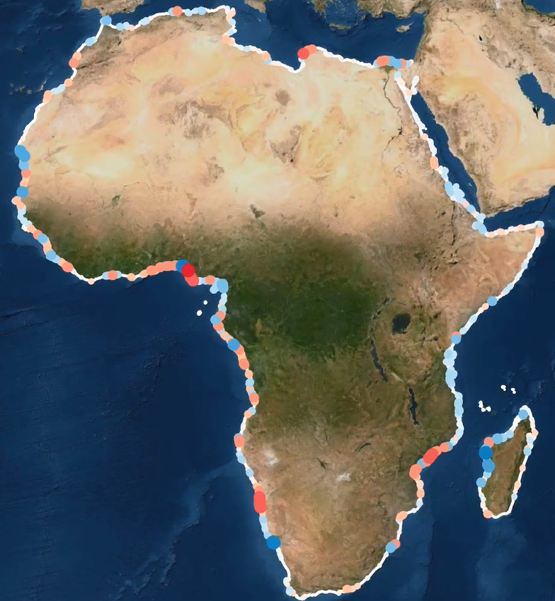
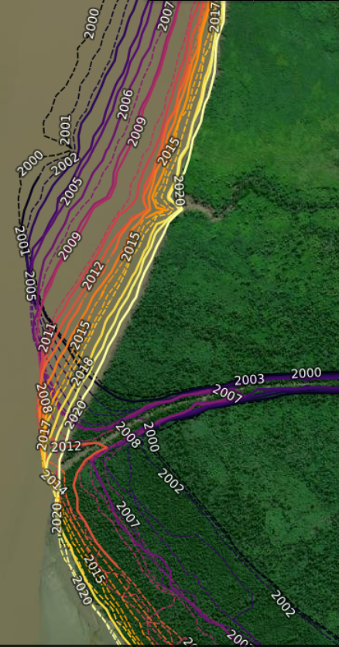
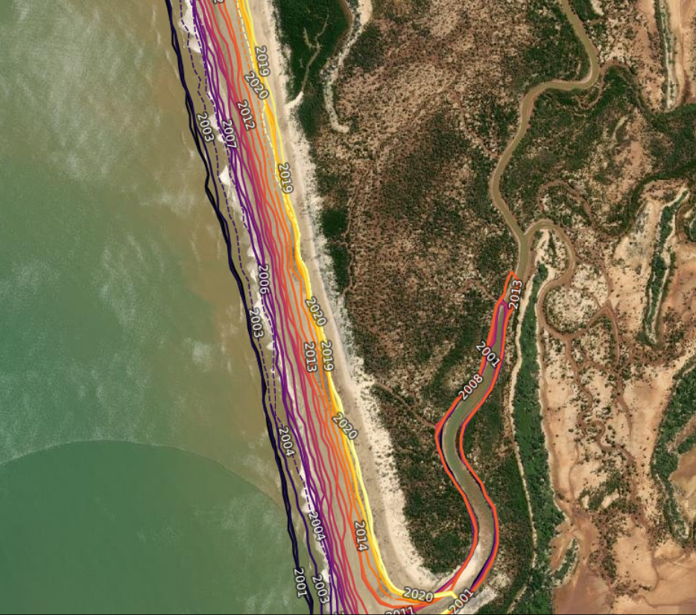
Geoscience Australia – CEOS COAST related activities update
Digital Earth Africa Coastlines was launched at the GEO Blue Planet Symposium, 24-28th Oct 2022
This product had its beginnings in a CEOS COAST Pilot in the West African region, that ported and validated workflows from GA’s established Digital Earth Australia Coastlines product.
Improved version of the Digital Earth Australia Coastlines
Co-developed and validated with implementing partners in Africa
First Africa-wide Coastlines monitoring service
Tracks continental changes from 2000 to present
Monitor more than 60,000 km of coast
Provides free interactive access to
  Hotspots
  Rates of changes
  Average yearly shorelines
Mangrove dynamics in Mozambique
200 meters of shoreline retreat, Madagascar

Slide 5
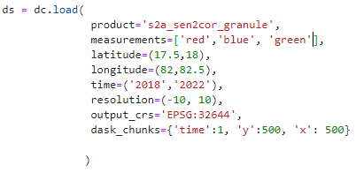
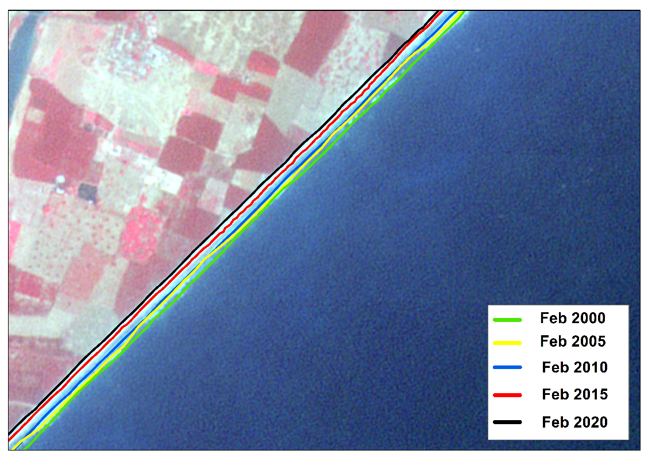
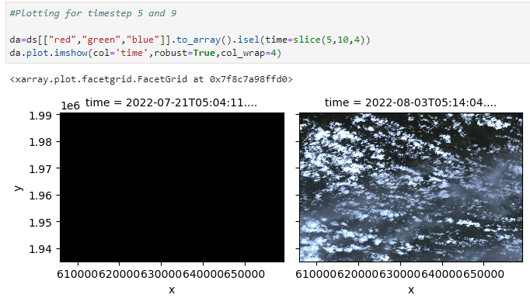
ISRO Updates: CEOS - COAST Bay of Bengal
Use of CEOS Data cube for shore line change analysis & bathymetry estimation, joint activity with WGISS
Indexing
Ingestion
Data Loading
Analysis
Sample Result : Long term shoreline changes for selected hot spots
Area of Interest Selection
Automatic detection of shoreline and long term change analysis from 2000 to 2020
Operations Supported
Resampling
Re-Projection
Computations for automatic shoreline change detection and Hotspot identification
Saving output
Interactive Visualization between 2 different years
Bay of Bengal coast
Time Slicing
Uppada, Andhra Pradesh

Slide 6
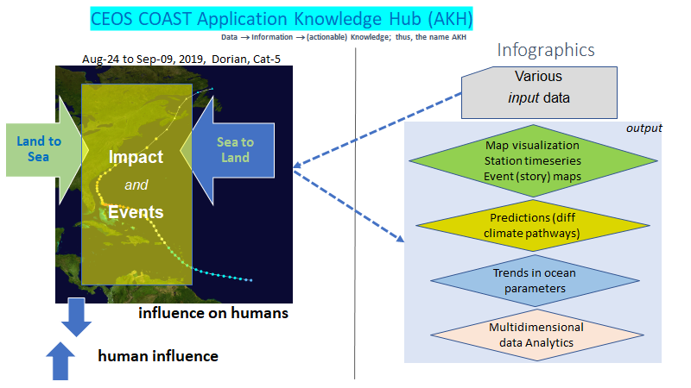


COAST Application Knowledge Hub

Slide 7
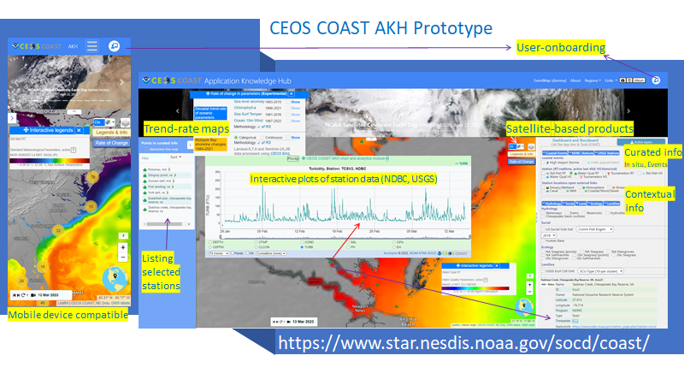
COAST Application Knowledge Hub
Notes:
login:coast password: coast@socd

Slide 8
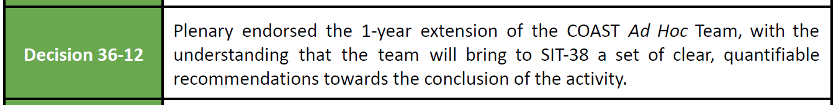
CEOS-COAST: Next Steps
Much work remains to be done:
  Transition of demonstrated pilot products to additional regions, esp least developed nations
  Additional product development: Blue Carbon, Habitat Mapping/Monitoring, Biodiversity
  Future Pilot Regions in Asia and Arctic
  Leveraging data from more missions: SWOT, NISAR, PACE et al.
Continuity mechanism TBD but important as COAST is formal Ocean Decade Contribution
  Potential continuity as part of CEOS Ocean Coordination Group (i.e., Option #1)
  Otherwise continue as part of an unofficial multi-agency partnership for the Decade
  Need to further partnerships with CoastPredict and other international projects/programmes
Notes:
Future Product Development Areas: Blue Carbon (with GEOBON) - Evaluate nature-based solutions to coastal resilience.Take the USGS-led Ecological Coastal Units to the next level, advance Habitat Mapping/monitoring (seagrasses/mangroves). Biodiversity - using Radarsat, SWOT for ice monitoring and coastal change over time - perhaps Aquaculture.
Asia and Arctic for pilot regions,
better fulfillment of collaboration with CoastPredict in support of the UN Ocean Decade.

