Slide 1
UN Decade of Ocean Science for Sustainable Development
Status & Opportunities for Engagement
Dr. Emma Heslop, Act. Director GOOS Office, IOC/UNESCO
Proff. Nadia Pinardi, Co-Lead Coast Predict Programme,
David Legler, NOAA, Proff. Sabrina Speich IPSL, Co-Leads Ocean Observing Co-Design, and Andrea McCurdy, UCAR (satellite community link)
CEOS SIT-38 29/03/2023

Slide 2
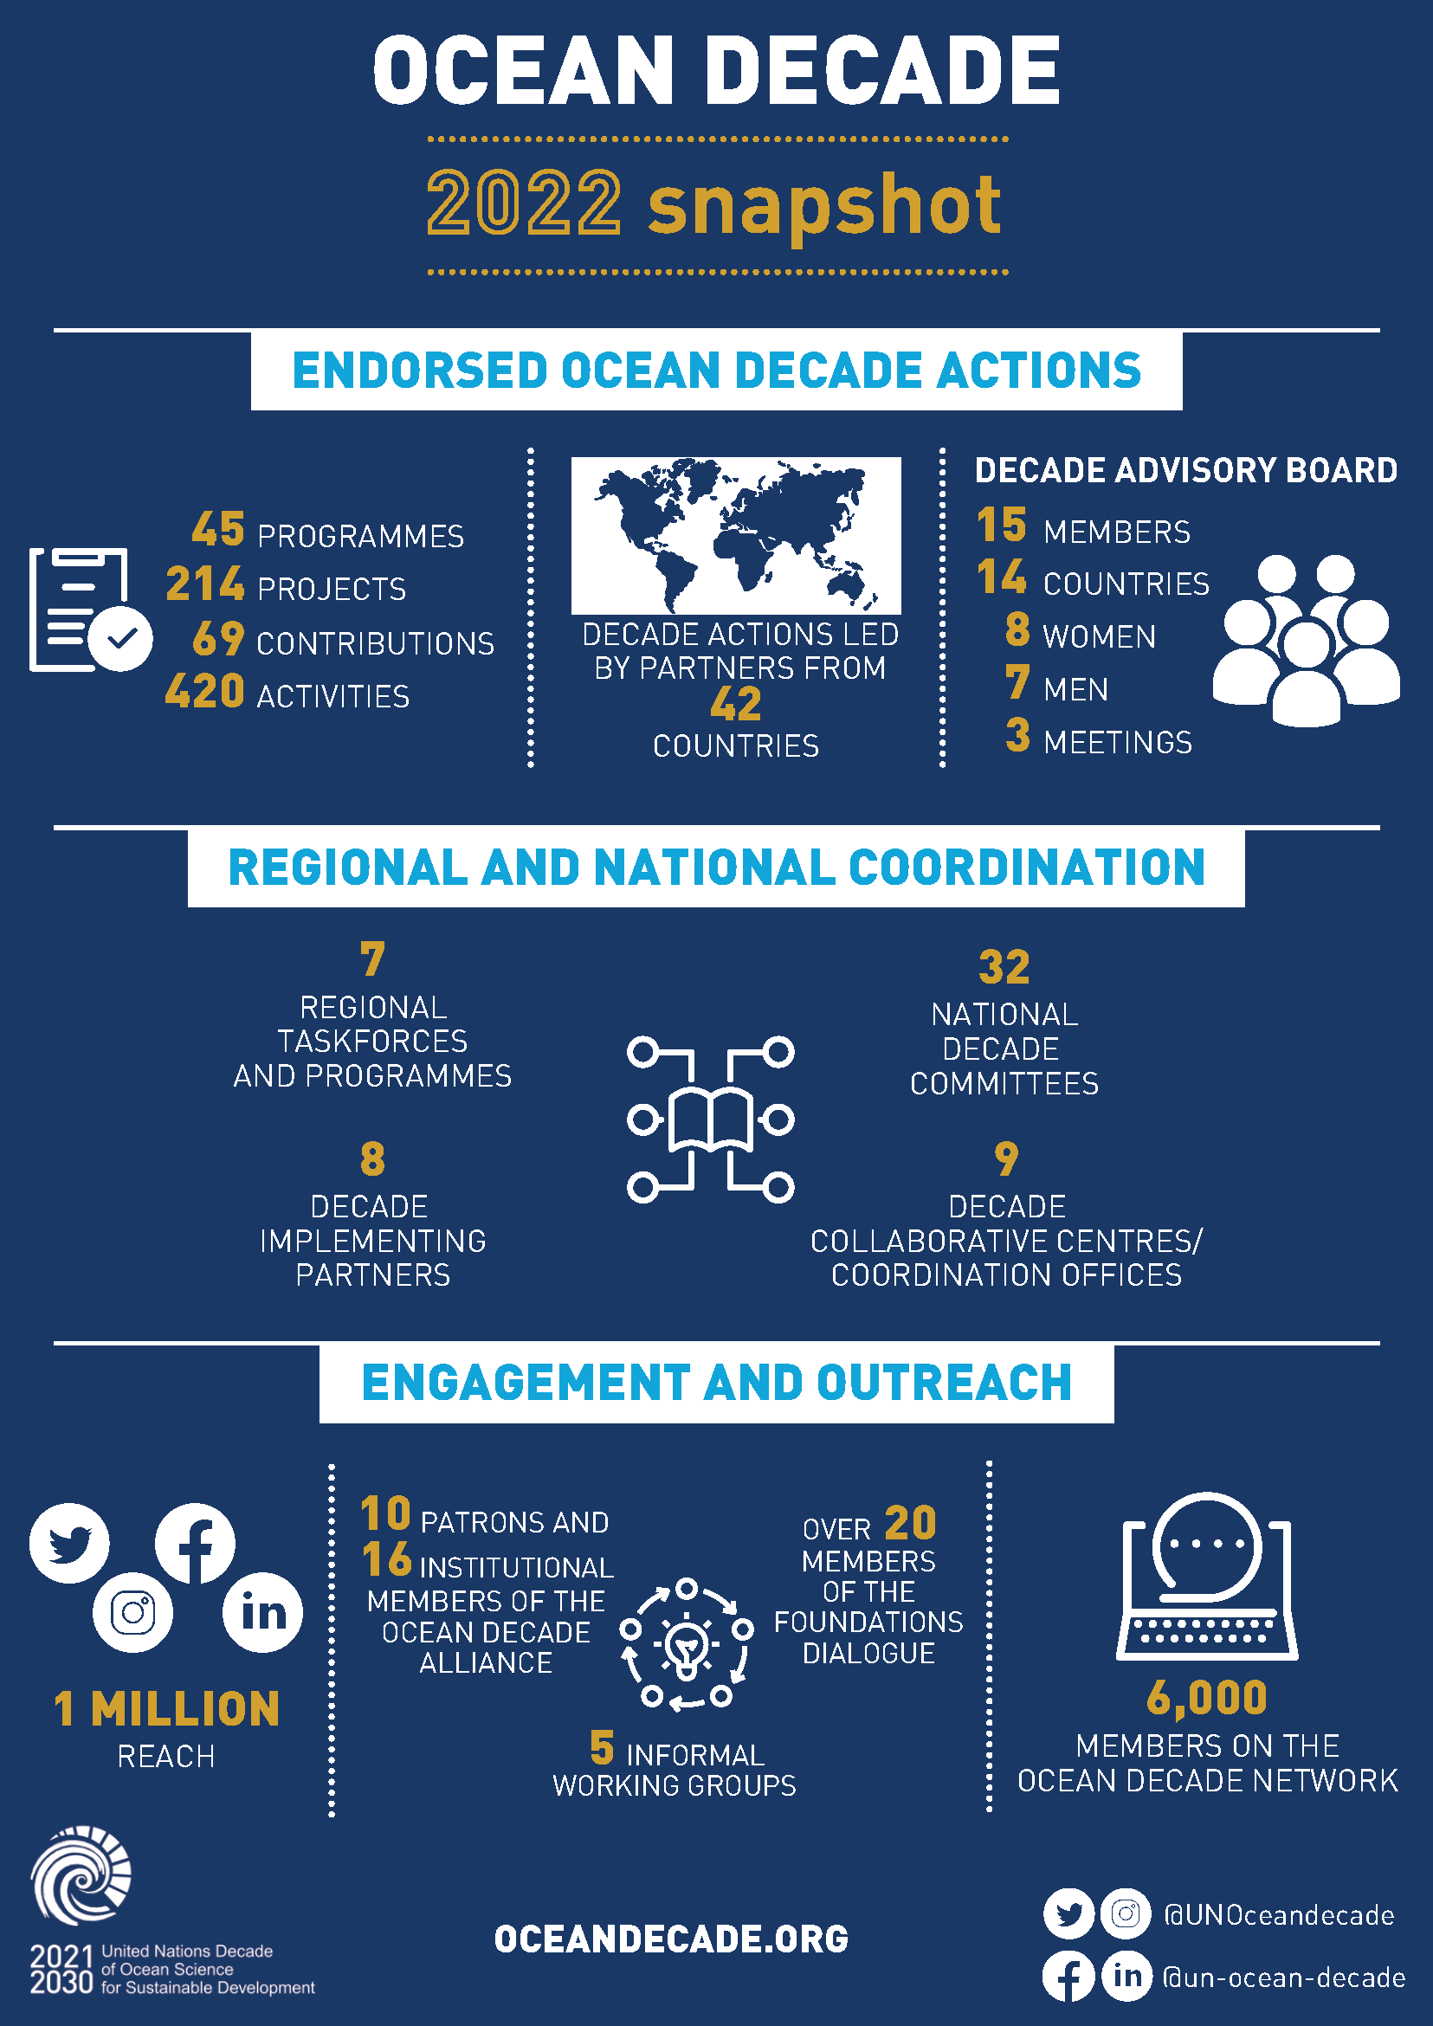
2022 Highlights

Slide 3
Progress and perspectives at a glance…
2021: Visibility & engagement
2022: Infrastructure & processes
2023: Building the scientific impact
2024: Stocktake and set a collective vision
2025 UN Ocean Conference and beyond…

Slide 4
Decentralised Coordination Structures
Decade Coordination Offices
Decade Collaborative Centres
Decade Implementing Partners
National Decade Committees
Data Sharing (IOC – IODE)
Ocean Prediction (Mercator Ocean International)
European Marine Board
33 NDCs established – additional efforts needed to encourage new NDCs in SIDS and LDCs including in Africa
Best Practice Manual being developed
Structured system for supply and demand of support being established
DCOs/DCCs have an essential role to play in coordinating existing Decade Actions, catalysing new Actions and building the enabling environment
Discussions advancing on Arctic, Southern Ocean, Caribbean and South Pacific DCCs/DCOs
Coastal Resilience (University of Bologna)
JPI Oceans
Ocean Observations (IOC – GOOS)
Ocean-Climate Nexus (FIO China)
Heirs to Our Ocean
Western Pacific (IOC)
EurOcean
Ocean-Climate Solutions (Ocean Visions)
National Institute of Oceanography and Fisheries (NIOF)
IOC AFRICA – being scoped
North East Pacific (Tula Foundation)
Peking University
Indian Ocean (INCOIS)
The Administrative Centre for China’s Agenda 21
IOCARIBE – being scoped
Pacific SIDS, Arctic and Southern Ocean – being scoped
Royal London College of Art

Slide 5
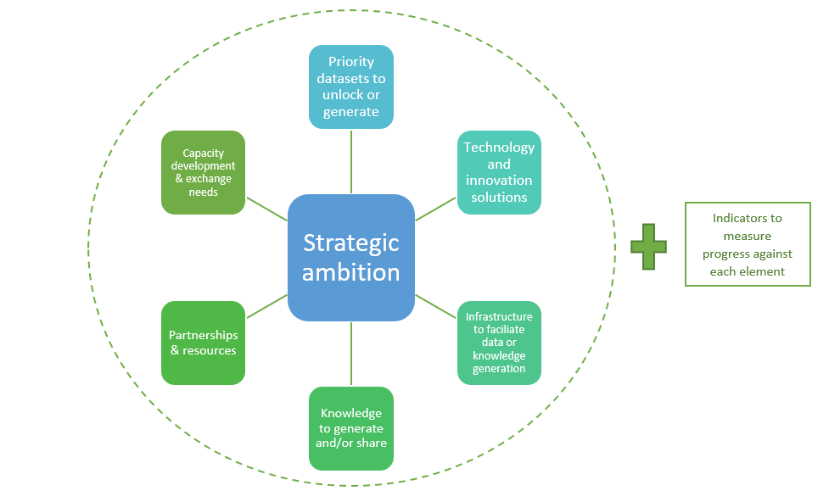
Vision 2030 – a collective ambition for the Ocean Decade Challenges
Next step in development is collectively identify the end-goal Ocean Decade Challenges, and steps measure progress to that goal
Engagement by African partners will be essential via Expert Working Groups & review processes

Slide 6
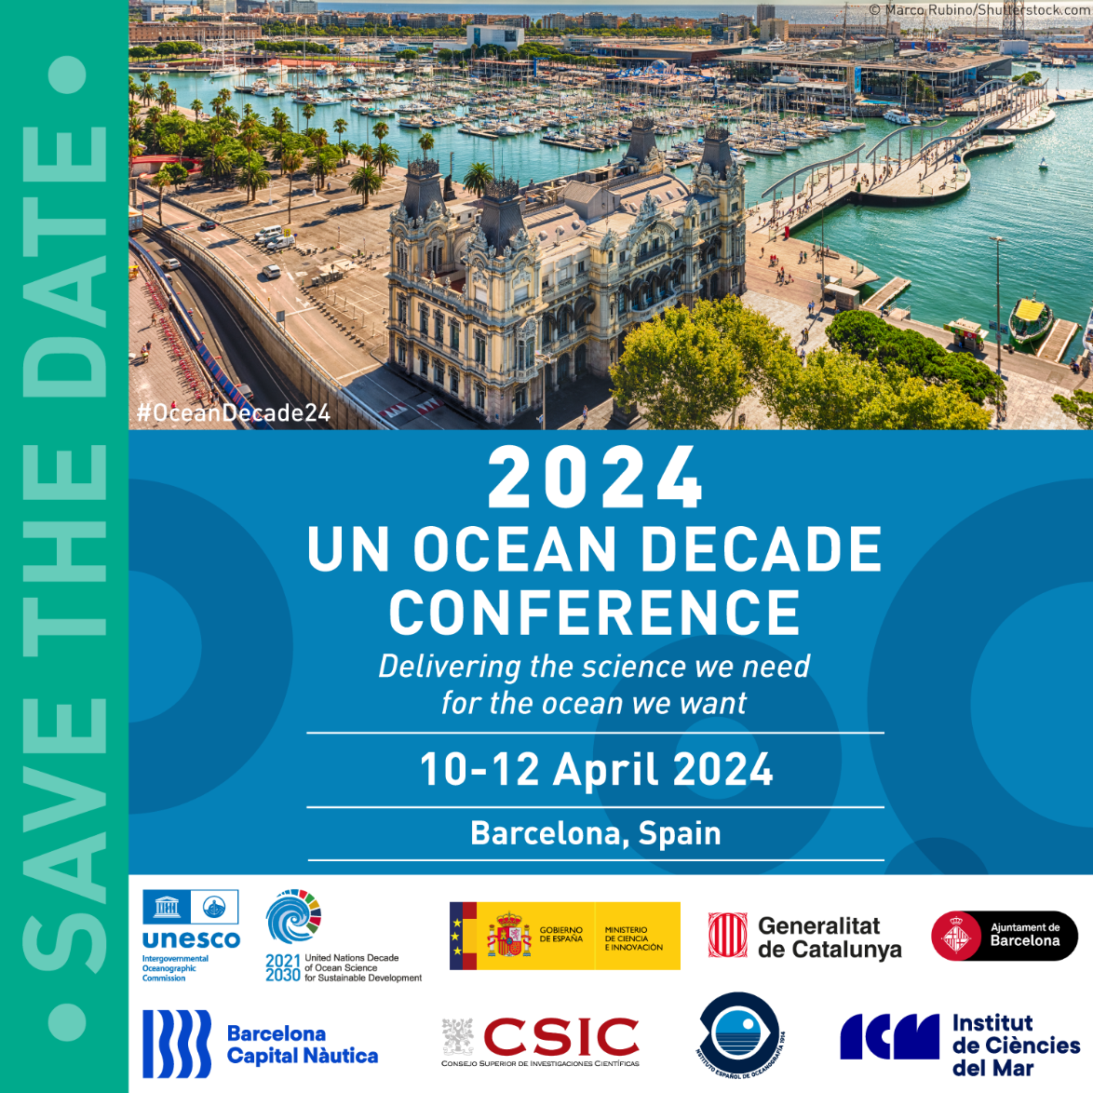
2024 Ocean Decade Conference
Barcelona, Spain: 10 - 12 April 2024
Convene Actions and Partners to celebrate achievements, take stock and set collective vision
Results of Vision 2030 will be workshopped and ‘validated’
3-day conference, complemented by partner-led satellite events

Slide 7
Collaboration with
GOOS and the Ocean Decade

Slide 8
DECADE CHALLENGES
Getting the right data and information, to the right people, at the right time, is key for all Challenges
1. Understand and beat marine pollution​
2. Protect and restore ecosystems and biodiversity​
3. Sustainably feed the global population​
4. Develop a sustainable and equitable ocean economy​
5. Unlock ocean-based solutions to climate change​
6. Increase community resilience to ocean hazards​
7. Expand the Global Ocean Observing System​
8. Create a digital representation of the Ocean​
9. Skills, knowledge and technology for all​
10. Change humanity’s relationship with the ocean

Slide 9
To achieve transformation for the Ocean Decade GOOS has launched 3 integrated programmes
CO-DESIGN
COASTAL OCEAN
CAPACITY DEVELOPMENT

Slide 10
Transforming our ocean observing system assessment and design process
Programme leadership:
David Legler, NOAA; Sabrina Speich IPSL;
Emma Heslop, IOC/UNESCO
Notes:
Demands for ocean information are on the rise. We have the tools, and the technologies. OUr aim is indeed to transform how we think and implement our ocean observing system. We will move towards a system driven by users and stakeholders and more quickly showing benefit to ocean observing investment.
Acknowledging my co-chairs Sabrina and Emma and our expanding international team of expert partners supporting our activities.
THe response to this workshop and to the Exemplar development discussions has been, well, simply incredible. We’ve had over 300 registrants to today’s meeting.

Slide 11
Key Challenges
Not enough ocean information to effectively meet global challenges
Need to establish clear priorities Societal need and value / ROI on investment
Connecting across the value chain of observing, modeling and user engagement
Our big ambition is to transform the quantity, fitness for purpose and availability of ocean information through co-design
Notes:
In order to bring about this step change, We need more information on the ocean (including from new technologies) to meet challenges such as climate change mitigation and adaptation, improving ocean, coastal and weather prediction, food security, and human health and safety.
We also need to establish clear priorities for how we invest in ocean observing for the future and better integrate observations and models to produce useful ocean knowledge
This demands a step change in how we design our global ocean observing system: integrating across the value chain of observing, modeling, and user engagement.
Programmes big ambition is to transform the global ocean enterprise from the current platform-focused paradigm, to one with more observations, improved and demonstrated fitness for purpose, and availability of ocean information - through CO-DESIGN - in the Decade
NEXT SLIDE

Slide 12
THE EXEMPLARS
*Each exemplar is at different levels of maturity
The Ocean Carbon Cycle
Improving carbon data to inform climate targets, such as net zero
Tropical Cyclones
Advancing tropical cyclone forecasting to save lives & property
Storm Surge Improving predictions to minimise impacts on vulnerable communities & natural resources
Marine Life
Conserving marine biodiversity and supporting sustainable use of resources
Boundary Currents
Understanding key current systems that significantly influence productivity, weather and climate
Marine Heatwaves Monitoring marine heatwave impacts on biodiversity and economies
Notes:
In general each exemplar will follow a similar development path. From the basics of initiating communications and a co-design process (engaging users, describing the value chain, etc) to full-scale globalizaiton of their intended activities.
Different exemplar areas are at different readiness levels - some will mature to implementation within a year, others will need longer to determine the design and the value - often down to the maturity of the sector and the service - e.g. tropical cyclone forecasts are well connected to users - we are increasing the accuracy, but for carbon, and marine resource management the services do not yet exist.
They all share in common the common purpose of developing tools/diagnostics, and best practices and demonstrating their effectiveness through pilot projects that, if successful, could then be scaled to a more permanent and global scale system.
NEXT SLIDE
======================================
- requiring alignment and investment - to deliver design for obs & recommendations for models and services (connected chain)
Work out scaling too…..
GOOS synthesises recommendations
Linked to observing projects - programme/GOOS
At same time programme is developing over the next 1-4 years
tracking and reporting capability
Developing infrastructure - DCCs, DCOs, GOOS, WMO connecting to other processes (RRR), and UN Policy, GCOS
Develop knowledge for best practice - deliver this for more exemplars - global and regional scale
Work on cultural change…
Where will we be at 5 years?
X exemplars?
System lifted in key areas
Ability to now test the system for needs - WNO others,
New exemplars - perhaps even regional/ local to lift the system
Expanded testing facility with ability to access for GOOS Projects,
Links between prediction and observing firmly established, assessment of value routinely undertaken
AT 5 years - ASSESS - what need to do to move from exemplars to systemic - size of any core facility/management… is it even needed

Slide 13
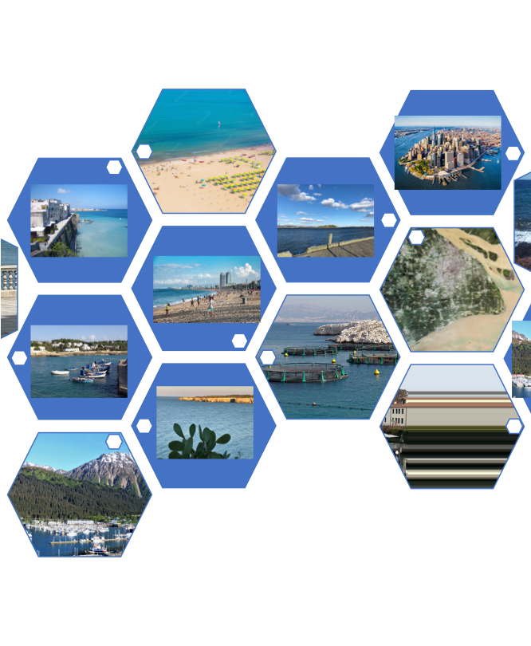
Revolutionising Global Coastal Ocean observation and forecasting and offering open and free access to coastal information
Programme leadership:
Nadia Pinardi, University of Bologna
Villy Kourafalou, University of Miami
Joaquín Tintoré, SOCIB and IMEDEA (CSIC-UIB)
E.Heslop, GOOS, Unesco-IOC
Notes:
Demands for ocean information are on the rise. We have the tools, and the technologies. OUr aim is indeed to transform how we think and implement our ocean observing system. We will move towards a system driven by users and stakeholders and more quickly showing benefit to ocean observing investment.
Acknowledging my co-chairs Sabrina and Emma and our expanding international team of expert partners supporting our activities.
THe response to this workshop and to the Exemplar development discussions has been, well, simply incredible. We’ve had over 300 registrants to today’s meeting.

Slide 14
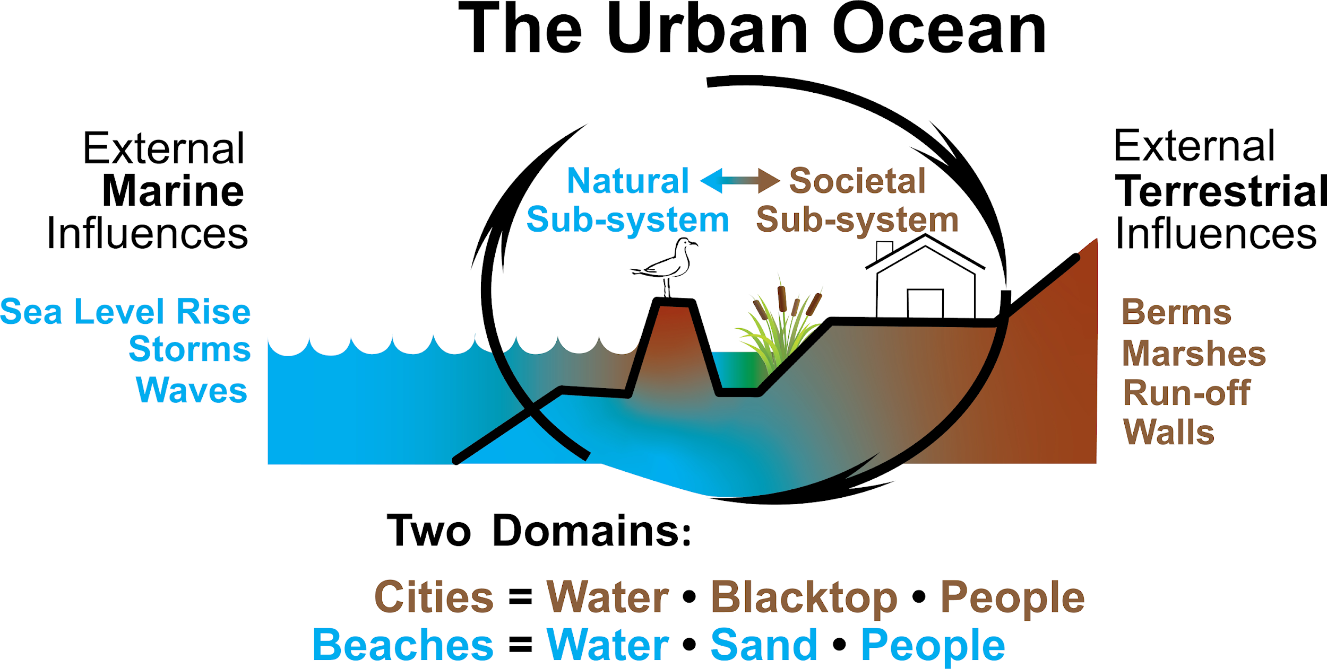
CoastPredict new modelling approach
improved urban oceanographic predictions
provided by:
Alan Blumberg

Slide 15
Focus areas and initial projects
Focus Area 1
Integrated observing and modelling for short term coastal forecasting and early warnings
Focus Area 4
Coastal ocean and human health
10 GlobalCoast Experiment Areas
Focus Area 2
Earth system observing and modelling for coastal climate monitoring and downscaling
Focus Area 5
International open and free access to coastal information
Focus Area 3
Solutions for integrated coastal management
Focus Area 6
Equitable coastal ocean capacity
3 Core Projects endorsed
30 contributing partner projects endorsed

Slide 16
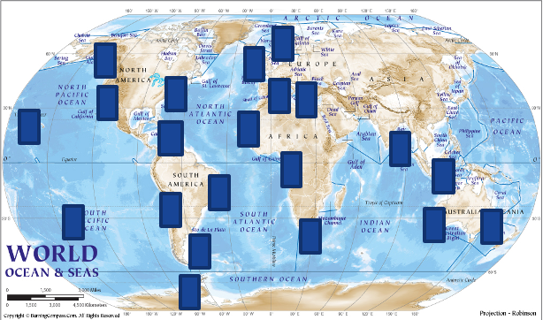
Global Coast
Area with different coastal features, societal needs, and level of development - same backbone
Global Coast - 10 coastal sites selected for diversity: coastal features, needs, infrastructure
Pilots for developing new technologies and services, public and private partnerships
Common data and best practice backbone

Slide 17
Co-Design Exemplars with a Coastal Focus
Opportunities
Co-Design and CoastPredict focus on ocean observing and modeling for ocean services
Exemplars for marine heatwave, boundary currents and storm surge focus on major areas of urgent need
Recognise the importance of cal/val satellites
Integrated (obs/modelling solution)
Pilots designed to integrate satellite observations
Global Coast
Site planning now in early development
CoastPredict recognises vital importance future satellite developments - keen to actively collaborate

Slide 18
Other Programmes: Observing Air-Sea Interactions Strategy (OASIS)
Opportunities
Improved in situ & satellite data, constraining improved models
Contribute to the UN Decade goals of a Predicted Ocean, Clean Ocean, Safe Ocean, Accessible Ocean & Productive Ocean.
OASIS overview (contacting Meghan)
Evolving Satellite and in situ network Requirements
Known
Evolving These improved in situ & satellite data, constraining improved models, will then lead to improved ocean information and Earth System forecasts serving stakeholders around the world.
And help contribute to the UThese improved in situ & satellite data, constraining improved models, will then lead to improved ocean information and Earth System forecasts serving stakeholders around the world.
And help contribute to the UN Decade goals of a Predicted Ocean, Clean Ocean, Safe Ocean, Accessible Ocean & Productive Ocean. Decade goals of a Predicted Ocean, Clean Ocean, Safe Ocean, Accessible Ocean & Productive Ocean.

Slide 19
Improved Engagement with UN Decade Programmes
Opportunities
Co-Design and CoastPredict to enhance regional operational ocean modelling using a multi-platform approach
Develop and mature interfaces and co-design mechanisms, some suggested early interfaces:
ESA (Copernicus satellites)
NASA (SWOT, PACE, NSLC-TT/sea level change)
BluePlanet / Mercator
CIRES - Colorado
HAPS initiatives (High Altitude Pseudo Satellites)
Determine additional interfaces and points of engagement
Process:
Identify organizational points of contact and establish regular communications designed to exchange progress and requirements

Slide 20
Thank you
goosocean.org

Slide 21
Summary
EXEMPLAR INFORMATION
Notes:
<<<<<<<<<<<<<SHOW EXCITEMENT>>>>>>>>>>>>>>
Delighted today to give a preview of the progress in developing the co-design programme and the first key projects that will launch the process and the change.
These exemplars are at the intersection of critical needs, engaged user communities, opportunities to innovate our observing approaches, and engaging new communities and voices.
Because of their importance, because of the opportunities, there is a lot of energy and enthusiasm behind each of the exemplars which you’ll hear about next.
It’s my pleasure to introduce Tammy Morris, Senior Scientist/Marine Coordinator from the S African Weather Service who will begin our roundtable of Exemplar summaries
NEXT SLIDE
====================================
Exemplar projects do 3 things: help lift the system, embed new co-design practices, the programme then develop process and infrastructure for wide spread co-design
Each exemplar will
Address key gaps in an integrated value chain across observing – modelling - services – users
Engage key user stakeholders to understand their needs
Integrate along the chain from observers to users to assure deliver
Assess value of investment on ocean observation
Support the development of co-design best practice

Slide 22
Impacts of ocean current structures on climate phenomena
Boundary current variability and prediction is critical to short-term and seasonal weather forecasts, climate adaptation, regional fisheries, food security and blue economies.
Co-design to enhance regional operational ocean modelling using a multi-platform approach:
Product and services for ocean industries (i.e., shipping)
Integrated boundary current observing system strategy
Report on economic value of a boundary current monitoring system
BOUNDARY CURRENTS
Users:
Weather services; Regional fisheries; Ocean Industries, e.g. shipping; Marine resource management, Other Exemplar Projects [Carbon, Cyclones, Heatwaves]
Pilot Region: Agulhas Current, Gulf Stream and Kuroshio

Slide 23
Disproportionate impacts in Less Developed Countries and Small Island Developing States
Impacts are being amplified by warming ocean, rising sea levels, growing coastal populations - how do we improve forecasts to save lives and property in the future?
What is the best system design to support equity and resilience for all coastal regions?
Co-designed regional systems will:
Test new responsive observing technologies
Improve early-warning systems
Enhance forecasting capacity in critical regions (e.g. LDCs, SIDS)
TROPICAL CYCLONES
Users:
Cyclone Forecasting Centres,
Emergency Response, Blue economy
Pilot Region: Tropical Atlantic/Caribbean Sea, North Pacific and Marginal Seas, Indian Ocean/Bay of Bengal
Notes:
The Tropical Cyclones Exemplar Project we present as this is quite an advanced exemplar because observing capabilities are already being evaluated and used in a few regions. Together these disparate efforts will make more progress. MOreover, there is vast inequality in the tropical cyclone forecasting depending on world regions. Not all Tropical Cyclone forecasting centres have a connected ocean-atmospheric prediction model to base forecasts on. And globally there has been little improvement in forecasting cyclone intensity.
This Exemplar will involve testing of new technology and leveraging knowledge and experiences from regions to support improvements in other regions, particularly those regions where communities are most vulnerable.
There is a very active community in the US evaluating new ocean observing technologies and what impact they will have on hurricane forecasts AND on providing much needed informaitno to coastal communities as they prepare for storms and monitor storm conditions as they happen.
We aren’t yet realizing the value of ocean knowledge for cyclone prediction, but already we can envision the use of scalable technologies.
NEXT SLIDE

Slide 24
Co-design a sustainable monitoring system of marine heatwaves
This exemplar will develop a sustainable monitoring system to better advice management to ensure food security through transformative science.
Co-design of operational forecast models for marine heatwaves:
Real-time in-situ information for validation and corrections of operational forecast models
Early warning systems for end-users
Sustainable monitoring systems of marine heatwaves and their impacts on marine ecosystems co-designed with stakeholders
MARINE HEATWAVES
Users:
Climate change adaptation; Aquaculture; Commercial, artisanal & Industrial fisheries; Operational forecast centers; MPA & coral reef management
Pilot Region: Mediterranean Sea, Caribbean Sea, West Africa

Slide 25
Ocean Observing Co-Design will develop a more user-focused co-design process to evolve a truly integrated, responsive ocean observing system.
Notes:
This statement sums up the ambition of the Ocean Observing Co-Design programme. By 2030 we want to have processes and tools that will be modular and globally applicable to evaluate observing systems in order to inform investment. Sponsors will be able to ask key questions about cost and benefit and receive clear answers.

Slide 26
Calls for Decade Actions
Call for Decade Actions No. 03/2022
Focused on Challenge 3 – Sustainable Blue Food & Challenge 4 – Sustainable Ocean Economy
2 Decade Programmes (sustainable blue food) and 22 Decade Projects endorsed
Emergence of potential new regional coordination structures in Arctic and Southern Ocean
3 new Decade Implementing Partners
Call for Decade Actions No. 05/2023 (opens 15 April 2023)
Programmes related to:
Challenge 1 – Marine Pollution, with a focus on sub-themes of plastic pollution and nutrient pollution
Challenge 2 – Ecosystem Restoration and Management, with a focus on sub-themes of area based management, restoration and multiple ocean stressors
Contributions for decentralized coordination structures (DCO/DCCs) with a focus on:
Marine pollution
Ecosystem restoration & management
Sustainable blue food
Programmes wishing to solicit new projects
Call for Decade Actions No. 04/2022
Focused on Challenge 6 - Coastal Resilience & Challenge 8 – Digital Ecosystem
26 Decade Programmes solicited new projects
21 programme submissions received
59 projects submissions
Review currently underway with announcements on 8 June 2023

Slide 27
Supporting Demand Driven Capacity Development
Concept developed for Ocean Decade Capacity Development Facility
The objective of the Facility is to identify specific needs for Capacity Development in the Decade and to meet those needs through existing and new initiatives
Initial 2-year funding secured as a first step in a multi-partner Facility for the life of the Decade
Initial support would include dedicated human resources in DCU for capacity development
Identify CD needs of existing & future Decade Actions
Identify available CD initiatives
Develop partnerships & mobilise resources
Match supply and demand & identify gaps
Develop new initiatives to fill gaps

