Slide 1
Convention on Biological Diversity (CBD) COP 15 Outcome
Marc Paganini, ESA Gary Geller, NASA/JPL
(with inputs from Anne Teller EC DG ENV)
SIT-38 2023, Agenda Item 4.3
29th - 30th March 2023

Slide 2
Outcomes of the CBD COP 15 Adoption of the Kunming-Montreal Global Biodiversity Framework (GBF)
2050 Vision “by 2050, biodiversity is valued, conserved, restored and wisely used, maintaining ecosystem services, sustaining a healthy planet and delivering benefits essential for all people”
GBF Mission for 2030
“To take urgent action to halt and reverse biodiversity loss to put nature on a path to recovery for the benefit of people and planet by conserving and sustainably using biodiversity and by ensuring the fair and equitable sharing of benefits from the use of genetic resources, while providing the necessary means of implementation”.
4 overarching long-term Goals for 2050
23 targets
for 2030
GBF Monitoring Framework
Resource Mobilisation

Slide 3
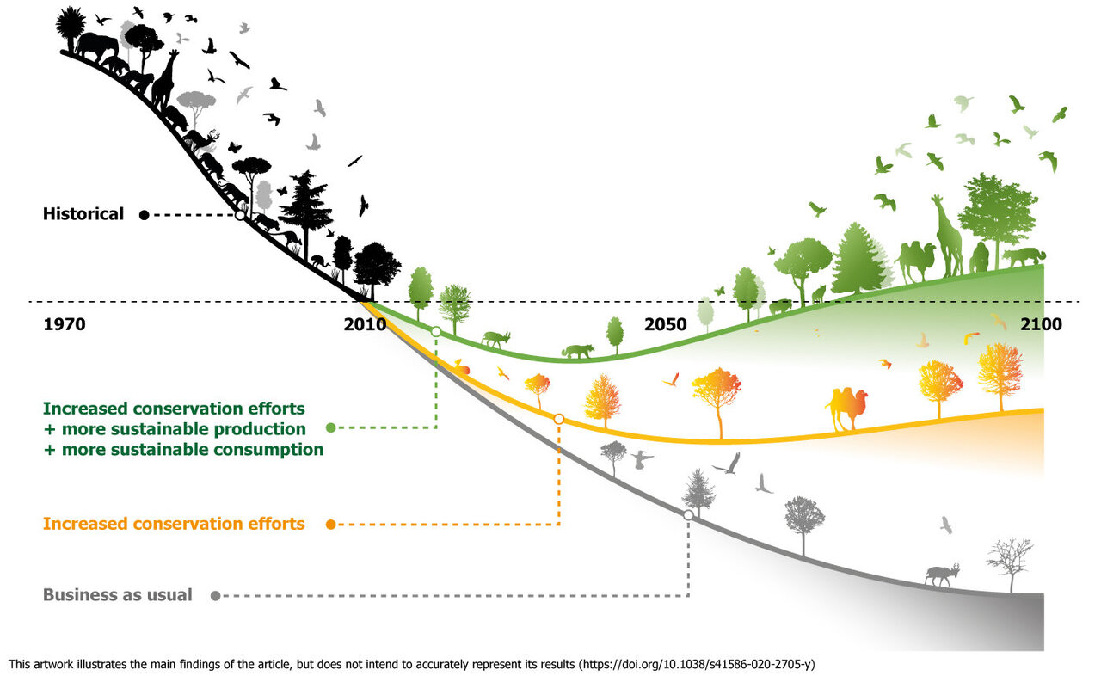
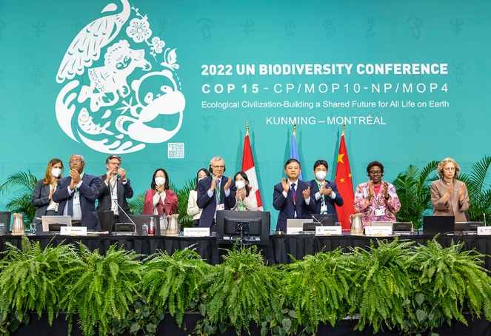
Outcomes of the CBD COP 15 32 decisions adopted by the Parties
Scientific and Technical Evidence for the GBF
Kunming-Montreal Global Biodiversity Framework
Monitoring framework
Decision on reporting & review of implementation
Decision on Capacity Building and Technical and Scientific Cooperation, & Knowledge Management
IPBES work programme
Decision on Resource Mobilisation

Slide 4
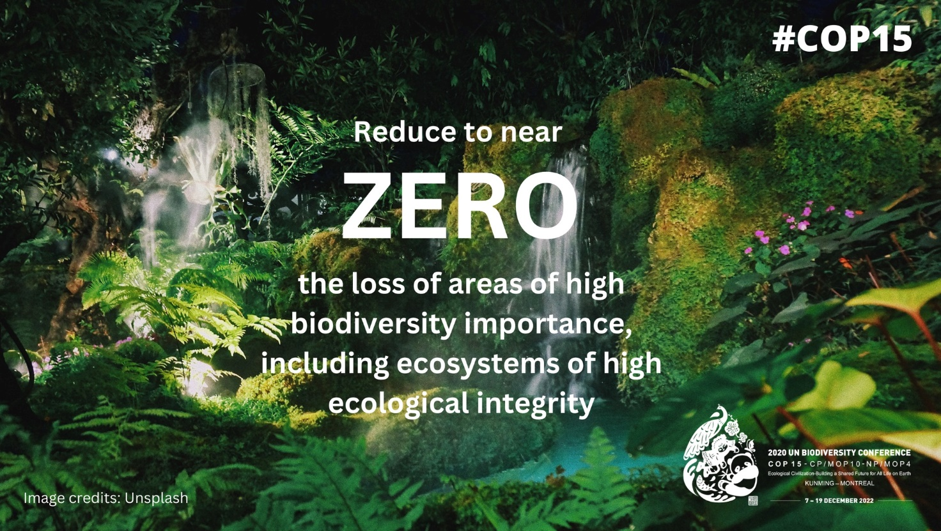
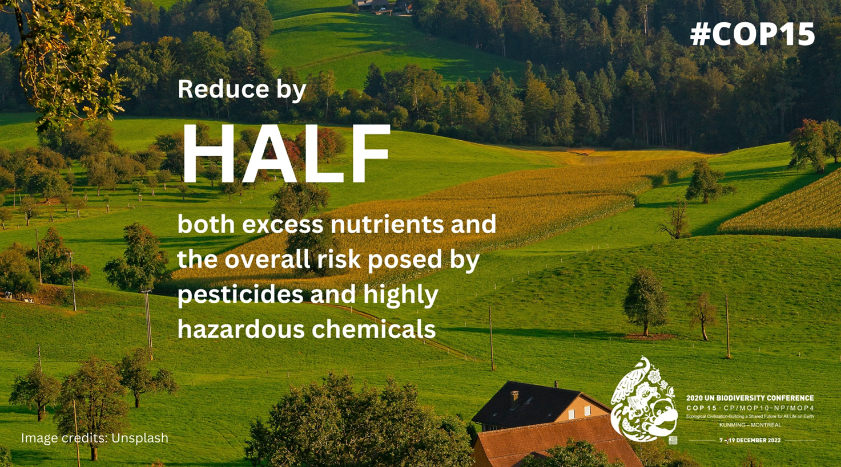
Target 1
Target 3
Target 7
Target 4

Slide 5
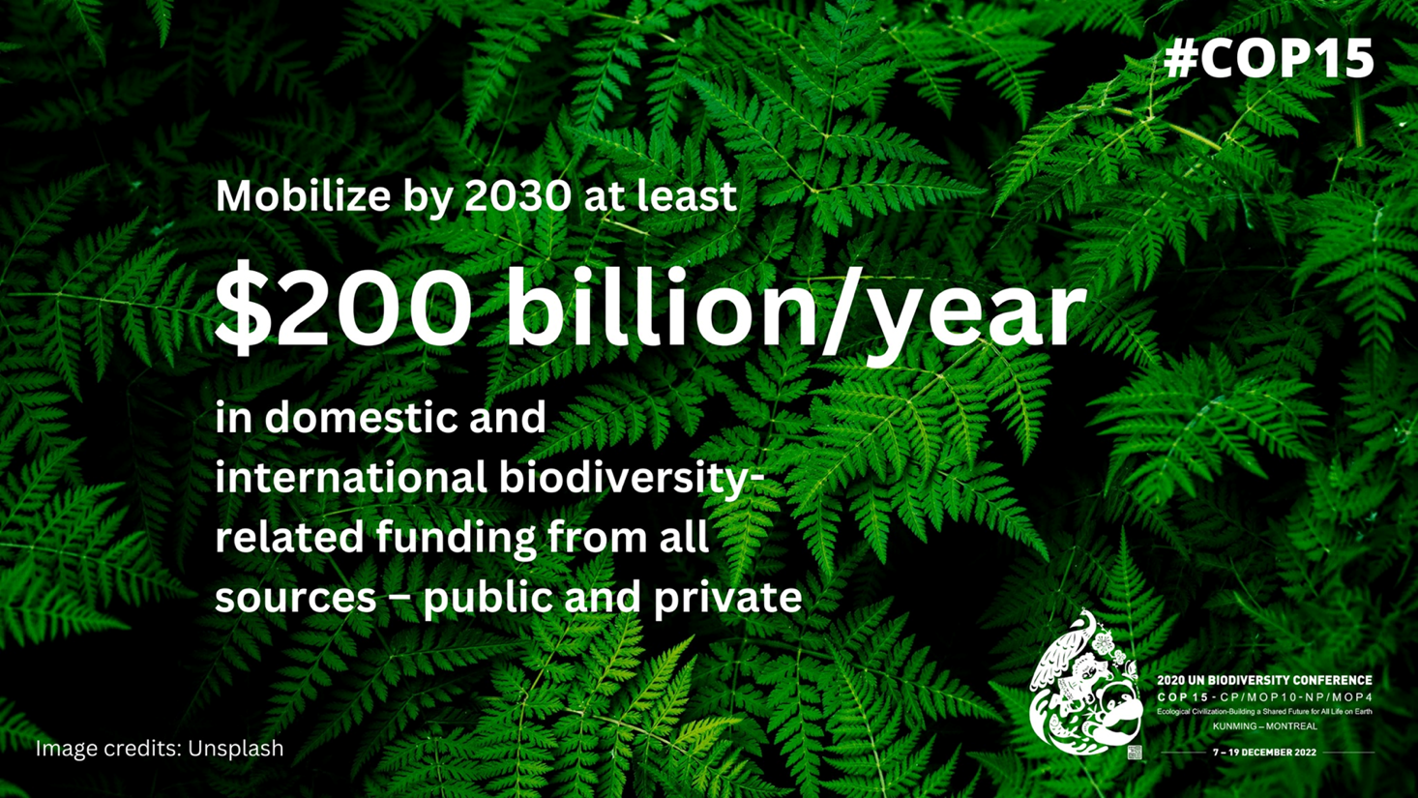
Target 16
Target 15
Target 19
Target 18

Slide 6
Decision 15/5 on the Monitoring Framework
Adoption of the GBF monitoring framework (MF).
Compulsory set of 26 headline indicators to monitor progress on the GBF implementation.
Additional Component (63), Complementary (236), National and subnational indicators.
Reference period 2011-2020, where data is available/ unless otherwise indicated.
The indicators in the MF will be reviewed until COP 16.
Establishment of an Ad Hoc Technical Expert Group (AHTEG) on the indicators for the GBF monitoring framework.
UNSC, GEF, Biodiversity Indicator Partnership (BIP), IPBES, GEO BON and others organisations are invited to support the operationalization of the Monitoring Framework (national, regional and global biodiversity monitoring systems).
CBD Secretariat should facilitate the development of guidance on the development of regional and national monitoring systems and on the implementation of the MF and facilitate the use of relevant tools.
Notes value of aligning national monitoring with UN System of Environmental-Economic Accounting (SEEA) statistical standard

Slide 7
Headline Indicators for the GBF monitoring Framework Framework
2050 goals
2030 action targets
Goal/ Target | Proposed headline indicators
A | A.1 Red List of Ecosystems A.2 Extent of natural ecosystems A.3 Red List Index A.4 The proportion of populations within species with an effective population size > 500
B ^{b} | B.1 Services provided by ecosystems*
C ^{b} | C.1 Indicator on monetary benefits received* C.2 Indicator on non-monetary benefits*
D | D.1 International public funding, including official development assistance (ODA) for conservation and sustainable use of biodiversity and ecosystems D.2 Domestic public funding on conservation and sustainable use of biodiversity and ecosystems D.3 Private funding (domestic and international) on conservation and sustainable use of biodiversity and ecosystems*
1 ^{b} | A.1 Red List of Ecosystems A.2 Extent of natural ecosystems 1.1 Percent of land and seas covered by biodiversity-inclusive spatial plans*
2 | 2.2 Area under restoration*
3 | 3.1 Coverage of protected areas and OECMs
4 | A.3 Red list Index A.4 The proportion of populations within species with an effective population size > 500
5 | 5.1 Proportion of fish stocks within biologically sustainable levels
6 ^{b} | 6.1 Rate of invasive alien species establishment
7 | 7.1 Index of coastal eutrophication potential 7.2 Pesticide environment concentration*
8 ^{b} | -
9 ^{b} | 9.1 Benefits from the sustainable use of wild species* 9.2 Percentage of the population in traditional occupations*
10 | 10.1 Proportion of agricultural area under productive and sustainable agriculture 10.2 Progress towards sustainable forest management
11 | B.1 Services provided by ecosystems*
12 ^{b} | 12.1 Average share of the built-up area of cities that is green/blue space for public use for all
13 ^{b} | C.1 Indicator on monetary benefits received* C.2 Indicator on non-monetary benefits*
14 ^{b} | -
15 ^{b} | 15.1 Number of companies reporting on disclosures of risks, dependencies and impacts biodiversity*
16 ^{b} | -
17 ^{b} | -
18 | 18.1 Positive incentives in place to promote biodiversity conservation and sustainable use 18.2 Value of subsidies and other incentives harmful to biodiversity that have been eliminated, phased out or reformed.
19 | D.1 International public funding, including official development assistance (ODA) for conservation and sustainable use of biodiversity and ecosystems D.2 Domestic public funding on conservation and sustainable use of biodiversity and ecosystems D.3 Private funding (domestic and international) on conservation and sustainable use of biodiversity and ecosystems*
20 | -
21 | 21.1 Indicator on biodiversity information for the monitoring the global biodiversity framework
22^{b} | -
23^{b} | -
Headline indicators that are ”ready”(16 st)
Headline indicators that need to be further developed (10 st)
Targets without headline indicators, but proposals for binary indicators

Slide 8
Decision 15/6 on Planning, reporting and review
NBSAPs to be aligned by COP16 in 2024 – Mapping global versus national targets and indicators in a standardised manner
7th and 8th National reports due by 28 February 2026 and 30 June 2029
Global review of collective progress in GBF implementation (aka ‘Stocktake’) at COP17 in 2026 and COP 19 in 2030.

Slide 9
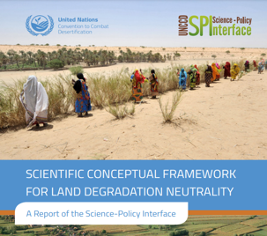
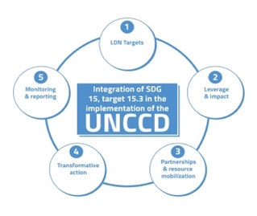
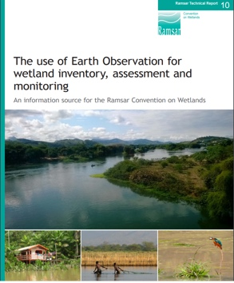
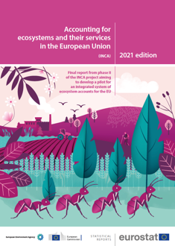
Decision 15/13 on cooperation with other conventions and international organizations
UN Convention to Combat Desertification (UNCCD)
Convention on Biological Diversity (CBD)
UN Framework Convention on Climate Change (UNFCCC)
UNCCD 2018-2030 Strategic Framework
Strategic Objective 1: to improve the conditions of ecosystems
Post 2020 Global Biodiversity Framework (GBF) and its monitoring framework
UNFCCC Paris Agreement
Glasgow Climate Pact
Ramsar Convention on Wetlands
UN SEEA Ecosystem Accounting
Sustainable Development Goals (SDGs)
International standard on Ecosystem Accounting that regulates the production of statistical accounts on ecosystem extent, condition and services, underpinning the development of monitoring frameworks of other MEAs.
Ramsar Strategic Plan (2016 – 2024)
Conservation and wise use of all wetlands
SDG Target 6.6 Protect and restore water-related ecosystems
SDG Target 14.2 Sustainably manage and protect marine and coastal ecosystems
SDG Target 15.1 Ensure conservation, restoration and sustainable use of terrestrial and inland freshwater ecosystems.

Slide 10
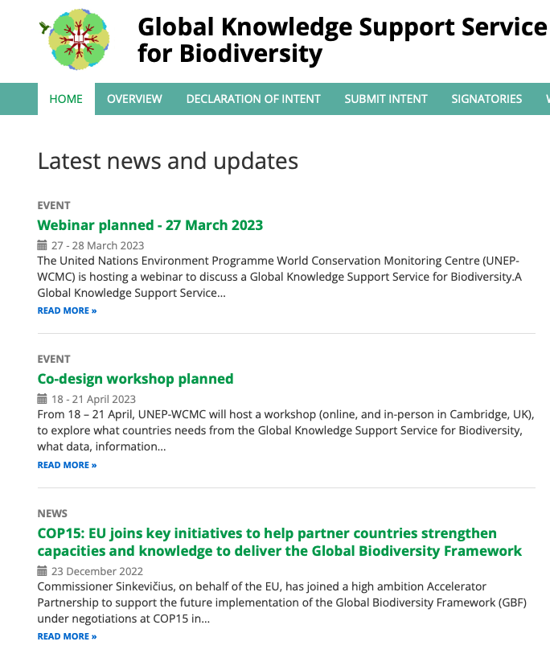
Decision 15/8 on Capacity-building, technical and scientific cooperation
Global Knowledge Support Service for Biodiversity (GKSSB) and new mechanisms
Establishment of regional and/or sub-regional capacity-building centres for technical and scientific cooperation
Development by the European Commission and UNEP-World Conservation Monitoring Centre (WCMC) of a Global Knowledge Support Service for Biodiversity
Pre-workshop webinars on 20 and 27 March awareness raising
Co-design workshop for GKSSB from 18 – 21 April (scope, content, functionality, governance, financing for a long sustainability of the service)
Establishment of an Informal Advisory Group on Technical and Scientific Cooperation

Slide 11
Global Biodiversity Observation System (GBiOS) led by GEO BON
A GBiOS will address four critical issues
Biodiversity Services &
Information System
Systematic biodiversity monitoring designed to fill gaps and assess outcomes of actions
GBiOS
Federate ‘actors’ and ‘users’ in the monitoring community
Trend
Monitoring
Modeling
& Forecasts
Network scaling: capacity and technologies transform translation of knowledge up and down social and ecological scales
Biodiversity Observation Networks
Supporting fit-for-purpose data to global and regional biodiversity models and assessments

Slide 12
Key messages for CEOS Agencies
EO is recognised as an important source of information for the implementation of the Global Biodiversity Framework, in particular to detect changes in biodiversity globally and in a consistent way.
Opportunities for CEOS to support the production of indicators from the GBF monitoring framework, starting with the headline indicators (e.g., A.2 extent of natural ecosystems).
Important for CEOS to engage with existing mechanisms on technical and scientific cooperation (e.g. Global Knowledge Support Service for Biodiversity)
Resource Mobilisation for capacity building will be high. Opportunities for CEOS and WGCapD (EOTEC DevNet) to support the development of capacities in countries, in partnership with the organizations involved in the GBF monitoring framework.

