Slide 1
SIT-38 2023 Ecosystem Extent Task Team Agenda item 4.2
Marie-Josée Bourassa, CSA
Gary Geller, NASA Jet Propulsion Laboratory
California Institute of Technology
Sandra Luque, CNES/INRAE
Frascati, Italy 28-30 March
(c) 2023 California Institute of Technology. Government sponsorship acknowledged.

Slide 2
Outline
Introduction
White Paper
Demonstrator
Challenges and wrap-up
US National Park Service

Slide 3
Task Team Purpose
(From the Terms of Reference)
To assess the utility for mapping Ecosystem Extent
using current and forthcoming space-based observations
The overall driver for the task team is to increase the engagement CEOS has with Biodiversity: The Task Team is a vehicle for that.
Notes:
NOTE: The overall driver for the task team is as a vehicle for increasing the engagement CEOS has with Biodiversity

Slide 4
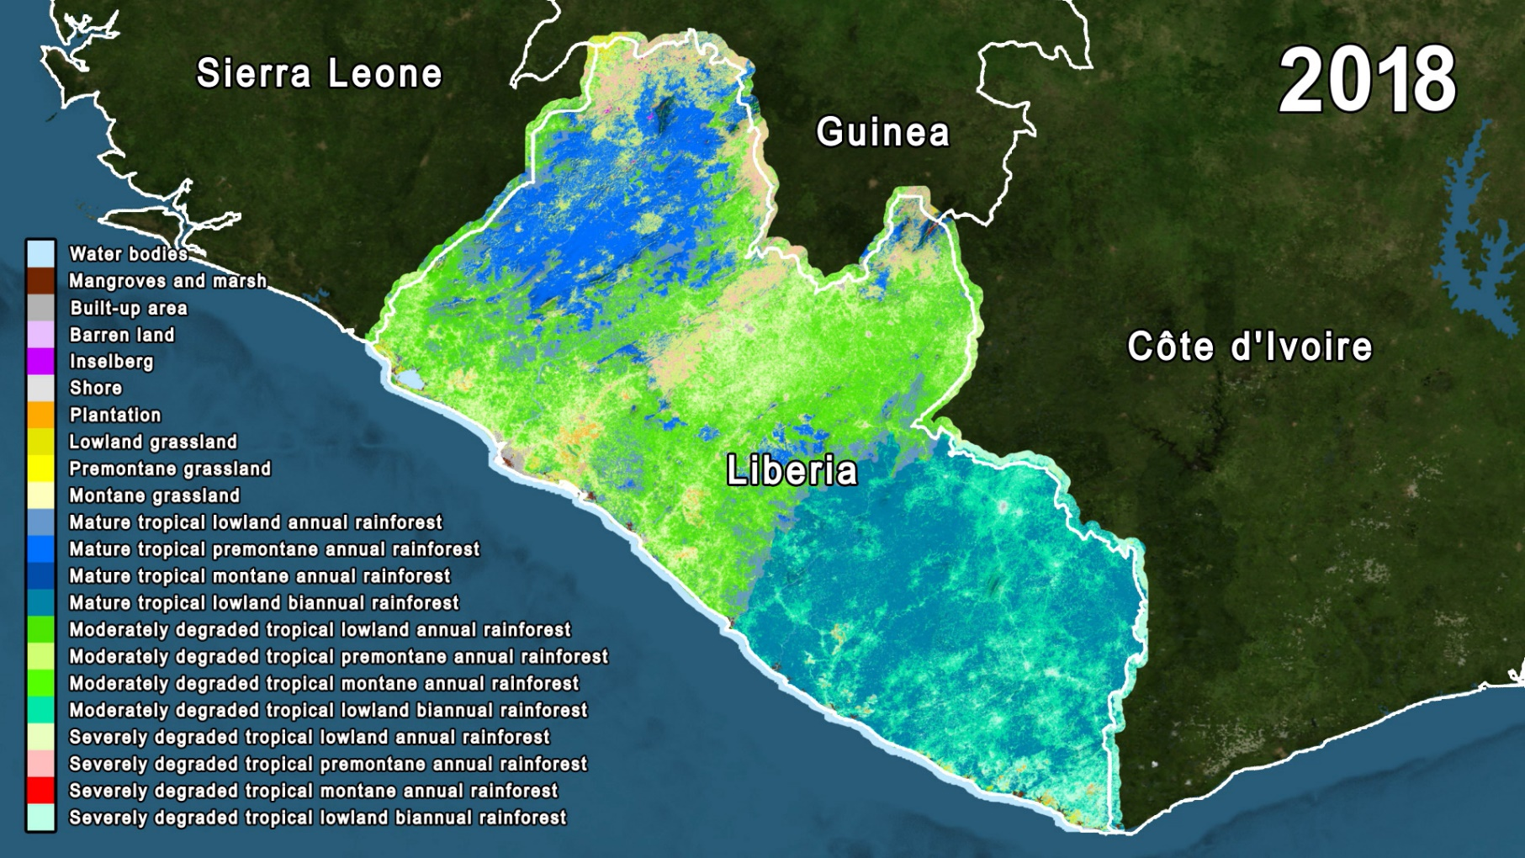
What is Ecosystem Extent?
“Land cover on steroids”
Geographic distribution of ecosystems
NASA GSFC/ Conservation International

Slide 5
Why Ecosystem Extent?
Highly demanded product 🡺
Many key users
UN CBD
UN SEEA
Governments
Ecosystem loss is the largest driver of biodiversity loss
Primary input: Earth observation
Demanded across applications*
Biodiversity & ecosystems
Ecosystem accounting
Natural resource management
Climate
Health
Water
Agriculture
Planning of all kinds
…
Notes:
* Because it is needed across so many different communities, GEO is developing a concept for an Ecosystem Atlas

Slide 6
Task Team Key Deliverables
White paper
Demonstrator

Slide 7
White Paper

Slide 8
White Paper Objective
From the Terms of Reference:
Develop a white paper that will provide an integrated international perspective on how space-based Earth observations can be used to support ecosystem mapping and monitoring with a focus on ecosystem extent.

Slide 9
White Paper: Approach
Length: Less than 25 pages
Audience: Should resonate with…
CEOS community
Biodiversity community (headline indicators for the Kunming-Montreal Global Biodiversity Framework (CBD GBF )
UN SEEA EA (System of Environmental-Economic Accounting)
Development approach:
In parallel by section
Voluntary/negotiated assignments with topic/sections leaders
Milestones
Voluntary work / commitment
First order draft: 30 June
Notes:
Other milestones still under discussion, tentatively:
Second FOD 31st July
Final FOD mid-September
Final version 23rd October

Slide 10
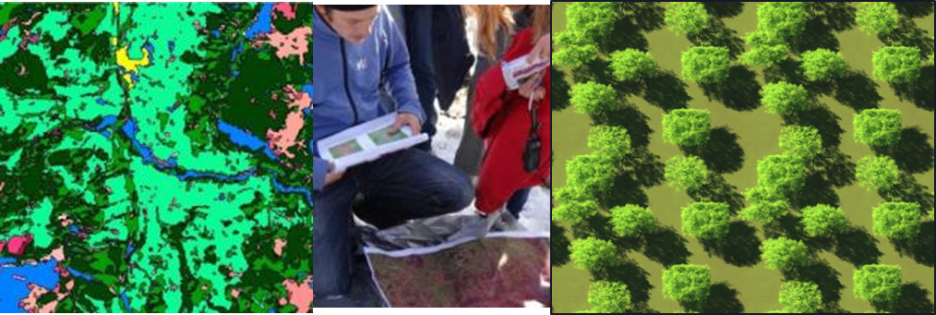
White Paper: Key challenges
Understanding ecological systems at a global or regional scale is a complex problem, requiring the integration of a wide variety of different sources, types of data and interdisciplinary expertise
Getting a group of experts to cover a number of key ecosystems
Synthesis: will need good figures and tables
Voluntary work: resources/people’s availability & commitment

Slide 11
White Paper: overall message
EO is underutilized for biodiversity applications
Ecosystem Extent is a key product needed by a wide range of organizations
Advancing technology and both current and forthcoming missions have the potential to greatly improve existing products
New missions will greatly extend biodiversity capabilities
Operational methods & tools to be linked to policies for improvement of public awareness and cost-effective management of biodiversity

Slide 12
Demonstrator

Slide 13
Demonstrator Objective
Demonstrate the use of EO
for ecosystem extent mapping and monitoring
US Fish and Wildlife Service
Notes:
Paraphrased from the Terms of Reference

Slide 14
Demonstrator
Delivery during fall 2024
Audience
CEOS (show what is possible, and its value to agencies)
Biodiversity community (demonstrate that EO is valuable to them)
Development approach
Find and leverage partner initiatives (vs. starting a new one)
CEOS Roles
Facilitating data provision (e.g., radar, hyperspectral)
Sharing expertise (EO, biodiversity, data cube….)
Exploring new ideas and approaches
Notes:
CEOS Roles: Another one is outreach—each demonstrator is an opportunity to connect with a particular suite of users/potential users

Slide 15
Demonstrator Status
Three promising initiatives
Canada: Hudson’s Bay Lowlands (Jason Duffe)
Australia: Pilliga Forest (Shaun Levick)
Costa Rica (Sandra Luque)
Notes:
A possible 4th is under discussion: (Liberia(+)….Conservation International/NASA)

Slide 16
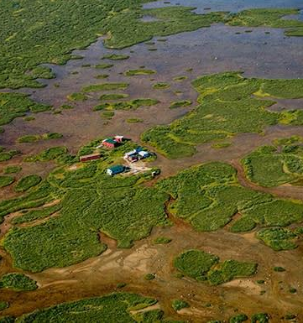
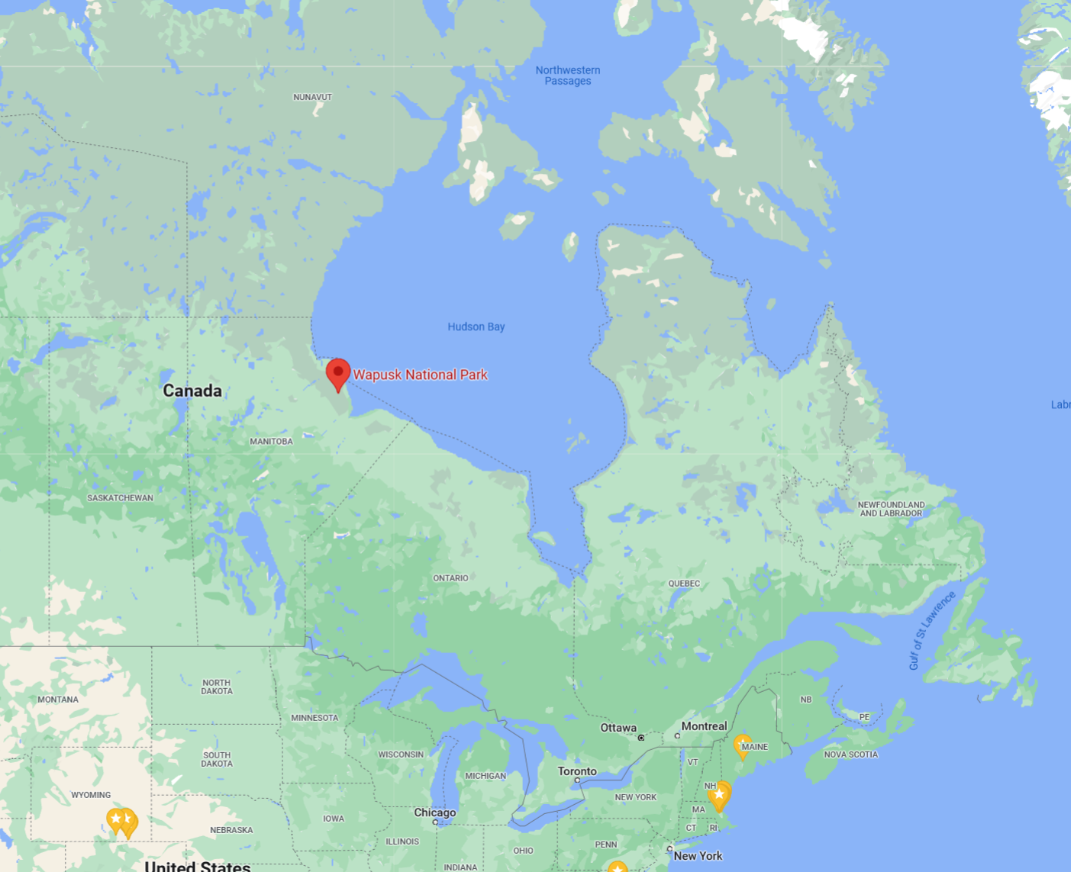
Hudson’s Bay Lowlands
Focus: Map and monitor wetlands
Partner: ECCC
Ongoing, staffed
Transition between boreal forest and arctic tundra
Lots of peat
Drivers include carbon reporting requirements
5 basic classes, 11 detailed classes
Google Maps
Google Maps
Parks Canada

Slide 17
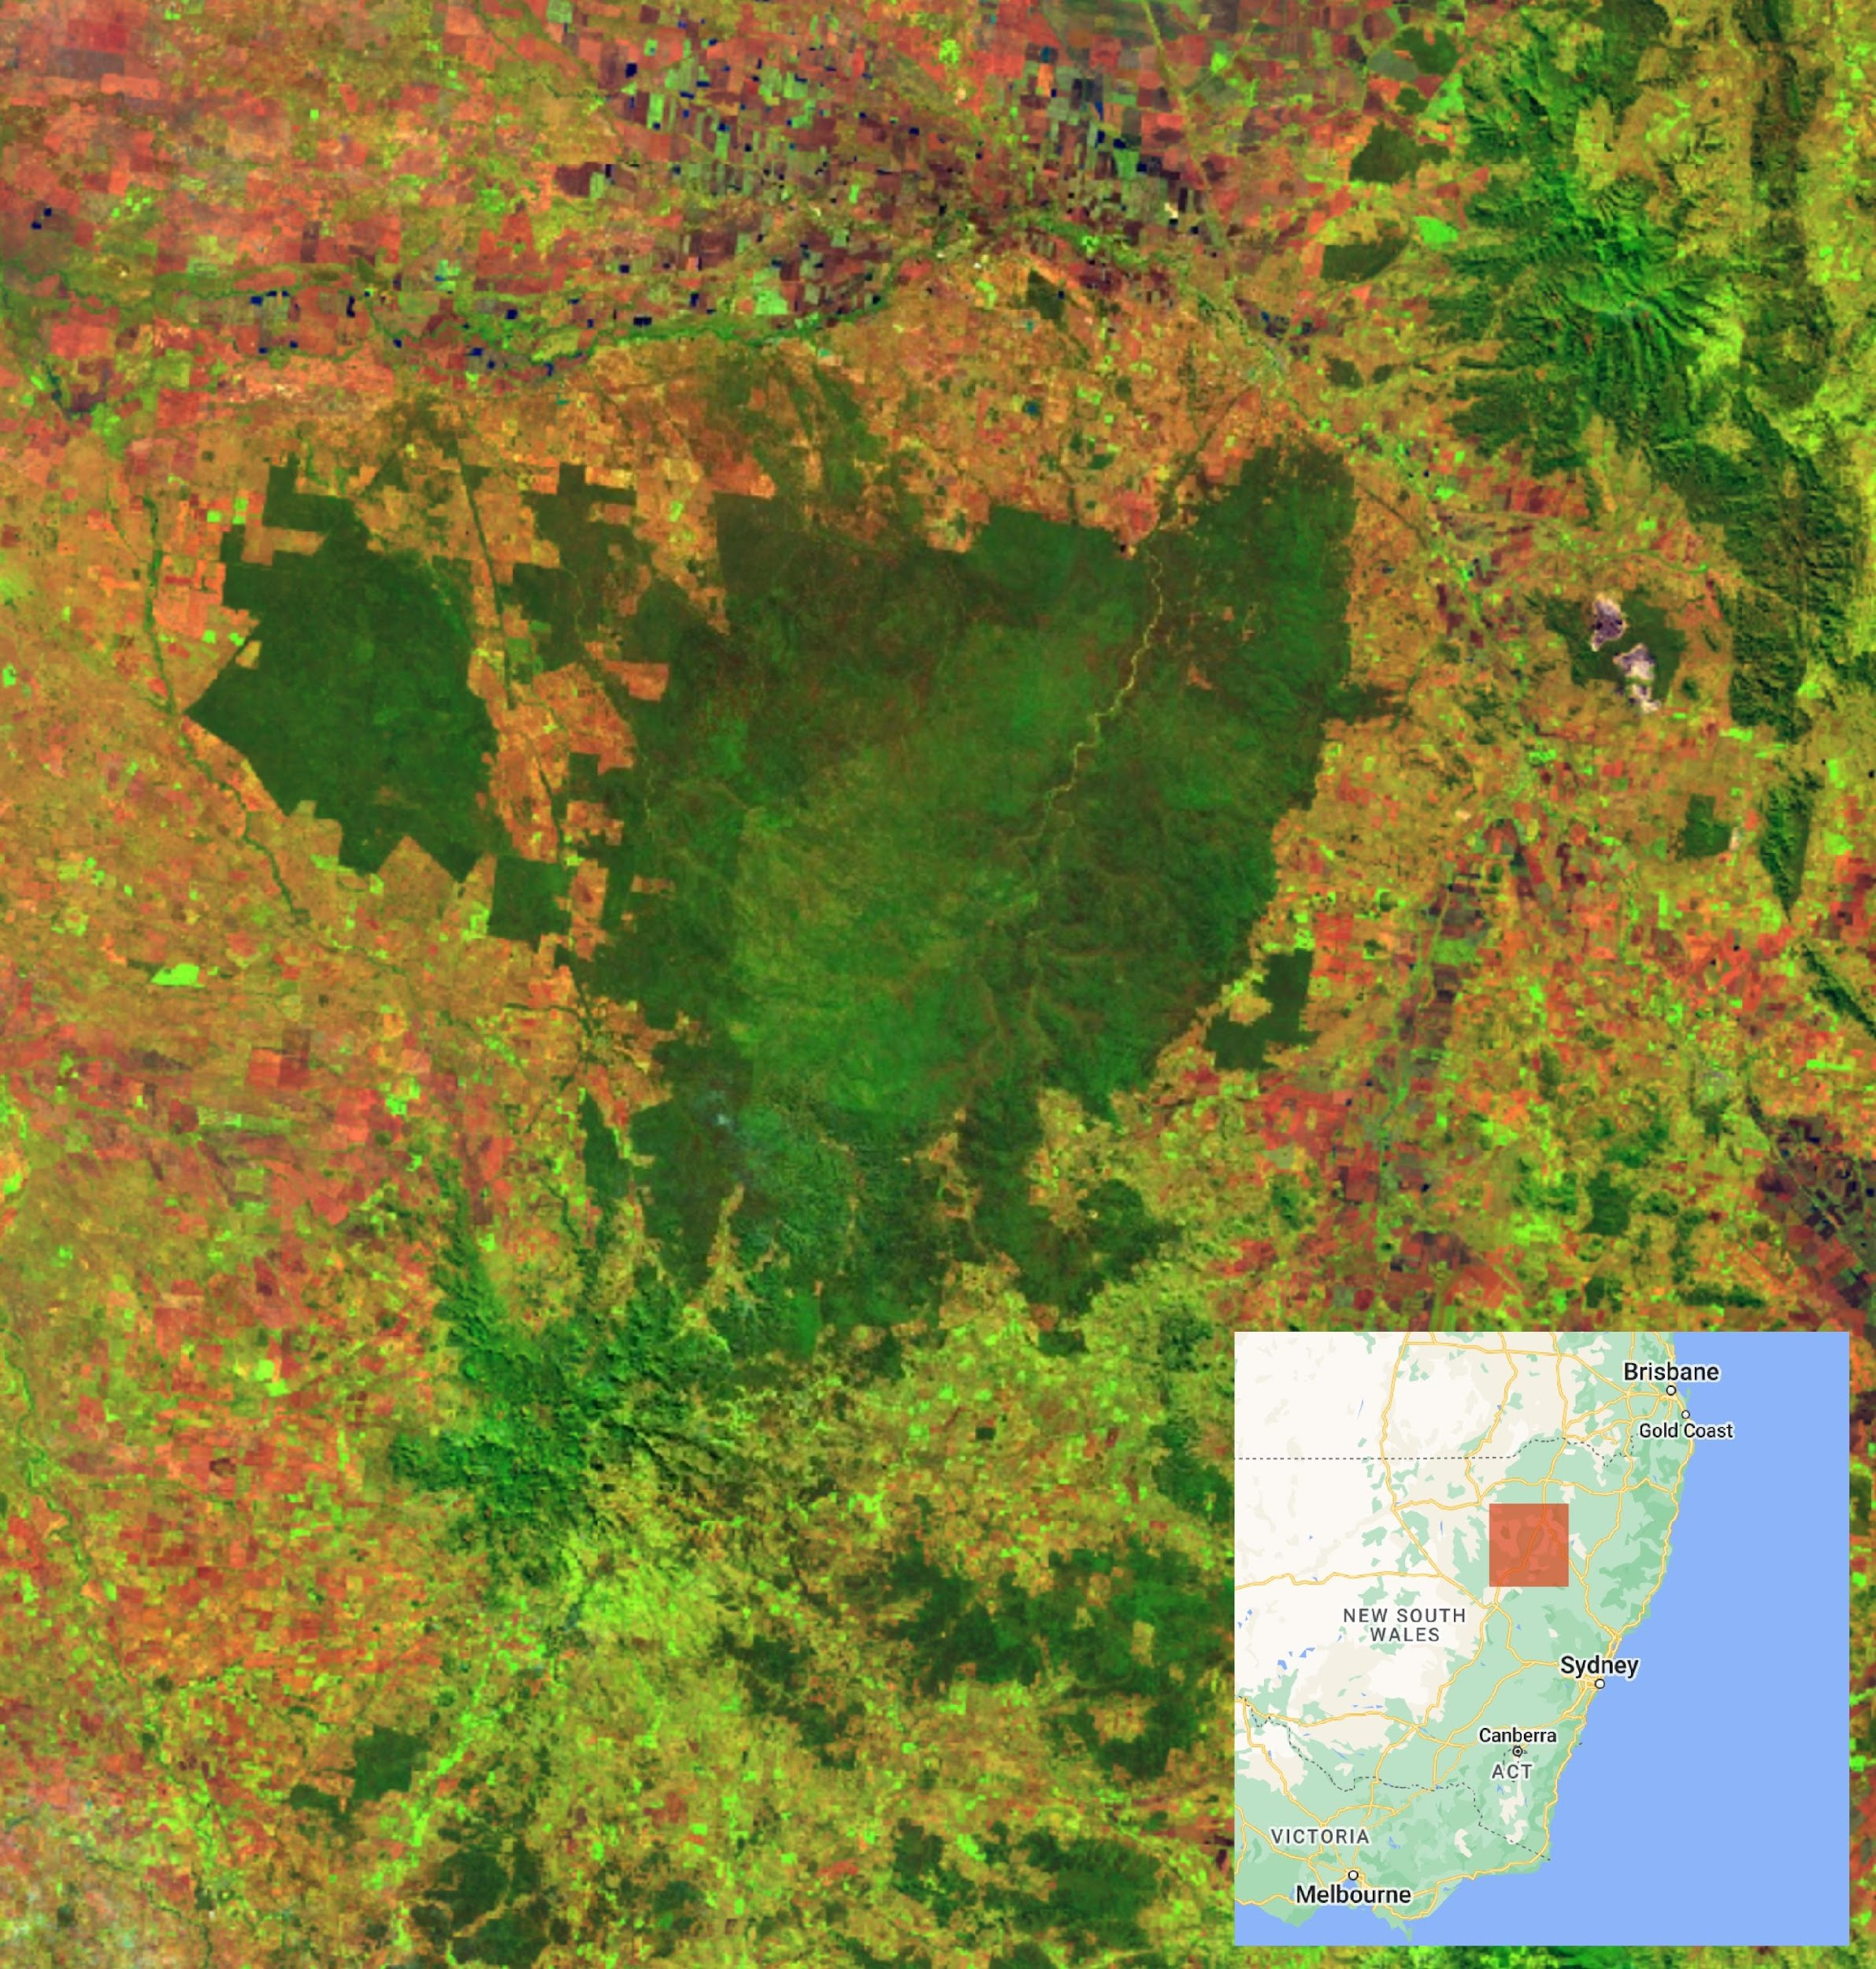
Pilliga Forest, NSW
Focus: Map & monitor Ecosystem Extent
Partner: CSIRO
Ongoing, staffed
Remnant, protected ecosystem
Drivers include: habitat connectivity; impacts from development
13 ecosystem assemblages
Also: potential 3 yr postdoc position

Slide 18
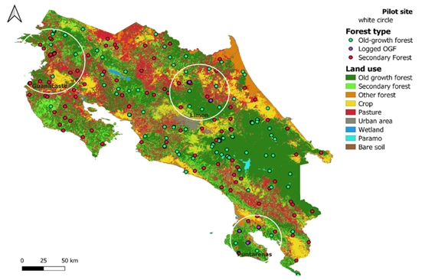
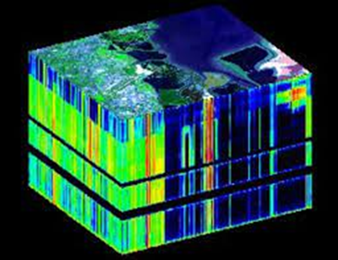
Demonstrator – Costa Rica
Focus on tropical forest ecosystems & transitional forests
Integration Classical ecology & remote sensing: Structure, Composition, Function
Using a diversity of sensors (incl. Lidar, Sentinel, hyperspectral data…)
Deriving textural indices
Calculating diversity metrics (i.e. spectral variation)
Partnership INRAe, CNES, INRIA, University of Bologna
Very good existing & local partners
Training data
In situ data
Local expertise
Milestones
Secure funding (Voluntary expertise + contractual/post doc)
Prioritization of options
Notes:
Function is a new and developing field

Slide 19
Challenges and Wrap up

Slide 20
Challenges
Resources
TT member bandwidth
Many of them are volunteer outside experts
TT expertise
For example: artificial intelligence, perhaps data cube
Schedule
“Scope creep”
Co-leads must match scope to resources

Slide 21
Wrap-up and Next Steps
White Paper
Refine writing assignments
Write, targeting draft by June
Demonstrator(s)
Develop detailed plans forward
Post-doc funding (Australia, Costa Rica)
Data cube
Clarify role in demonstrators, e.g., data needs, challenges

Slide 22
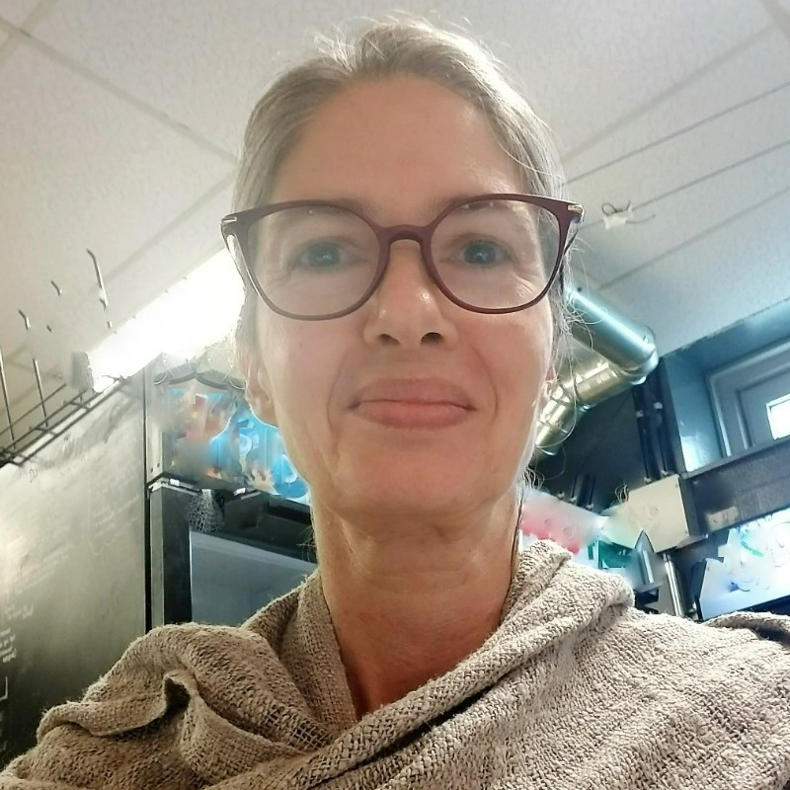
One more thing…
We need to say goodbye to our co-lead, Marie-Josée…
Thank you, Marie-Josée!!

Slide 23
Backup

Slide 24
CBD COP-15 Outcomes
Key outcome for Ecosystem Extent TT
Ecosystem Extent is a “headline indicator” (A.2)
Broader outcomes
Monitoring Framework was endorsed
Remote sensing plays a key role
Ecosystem condition highlighted
Condition impacts extent
Out of scope for current activity, but good follow-on area for CEOS
Side event on GEO BON’s Global Biodiversity Observation System (GBiOS)

Slide 25
White Paper Contents
Introduction
Current situation
Earth Observation role
Instruments overview & innovative technologies
Data needs beyond EO
Considerations and Challenges
Recommendations

