Slide 1
Sustainable Development Goals
Coordination Group
David Borges, NASA, SEO
Flora Kerblat, CSIRO
Marc Paganini, ESA, SIT Chair Team
With contributions from the Coordination Group members
Agenda #3.2
2023 CEOS Meeting
Frascati, Italy
March 29-30, 2023

Slide 2
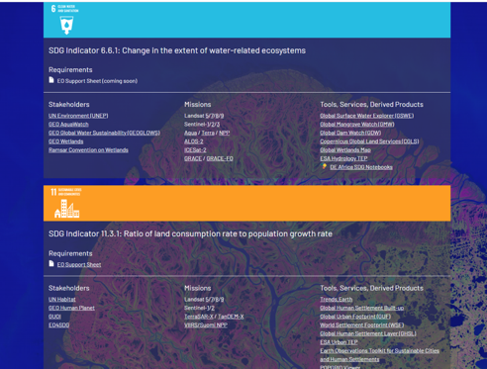
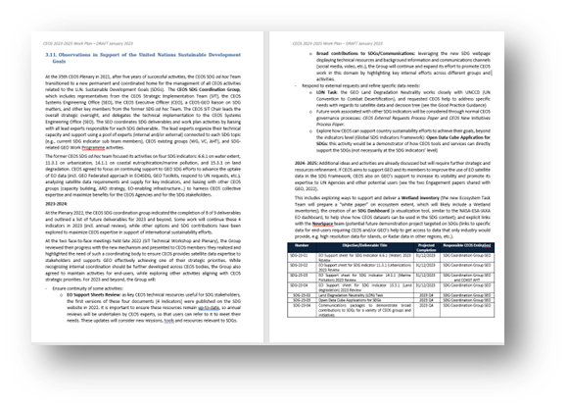
Excellent progress since Plenary 2021
Since its creation at Plenary 2021, the SDG Coordination Group has:
Meeting monthly (last one 15th March): Notes
Completed most of planned 2022 deliverables (8 of 9)
Reassessed our communications and relationship with GEO,
Held 3 in-person SDG Side Meetings (SIT-TW, Plenary 22, SIT-38)
Reviewed progress while fostering coordination across CEOS
Discussed strategic and technical issues
Invited external speakers (e.g. UNEP at Plenary, UNCCD at SIT-38 )
Agreed on new and impactful deliverables for 2023 and beyond
Provided SDG inputs to the CEOS Work Plan – February 2023
ceos.org/sdg
Slide ‹#›

Slide 3
2022 Deliverables
Deliverables # | Name | Status | Comments
SDG-19-02 | Data Cube prototypes | COMPLETE | Posted in GitHub
SDG-20-03 | Water Support Sheet | COMPLETE | Posted online
SDG-20-04 | Urbanization Support Sheet | COMPLETE | Posted online
SDG-20-05 | Eutrophication Support Sheet | COMPLETE | Posted online
SDG-20-06 | Land Degradation Support Sheet | COMPLETE | Posted online
SDG-20-07 | EO Enabling Infrastructures | COMPLETE | Posted online
SDG-20-08 | EO Good Practice Guidance | COMPLETE | Superseded by EO Support Sheets
SDG-20-09 | EO Demonstration Cases | Removed | Removal recommended, replaced by new tasks
SDG-22-01 | SDG webpage (CEOS website) | COMPLETE | https://ceos.org/sdg/
8 of 9 deliverables are complete

Slide 4
ESA CEOS SIT Chair 2022-2023
Outputs (as of end 2021) | Link to Deliverables | Comments
Review and Update all 4 Indicators Report | SDG-23-01 > SDG-23-04 | Included in updated WP
Summary of the 4 reports | Not planned | Do we need it? What would be the benefits (outreach?) Communication material?
SDG e-leaflet or video | Video Completed (2022) | Anything to be prepared ahead of GEO Plenary ? (updates?)
ODC algorithms for SDG | Completed (2022) | Plans for training and documentation in place.
Integration of EO enabling infrastructures in GEO EO Toolkits | Completed (List on the CEOS website) | Other than Urban one … any plans?
Consolidated Good Practice Guidance | Not planned | Partially included into EO support sheets; collaborate more with WGCapD?
Powerful communications materials on SDGs | SDG-23-05 | Specific outputs?
CEOS response to external requests | SDG-23-02 (LDN) | More in support of the Pacific Islands ? Linked to New Space?
Where are we today?
More deliverables have been considered: must be reviewed and aligned with the strategic vision

Slide 5
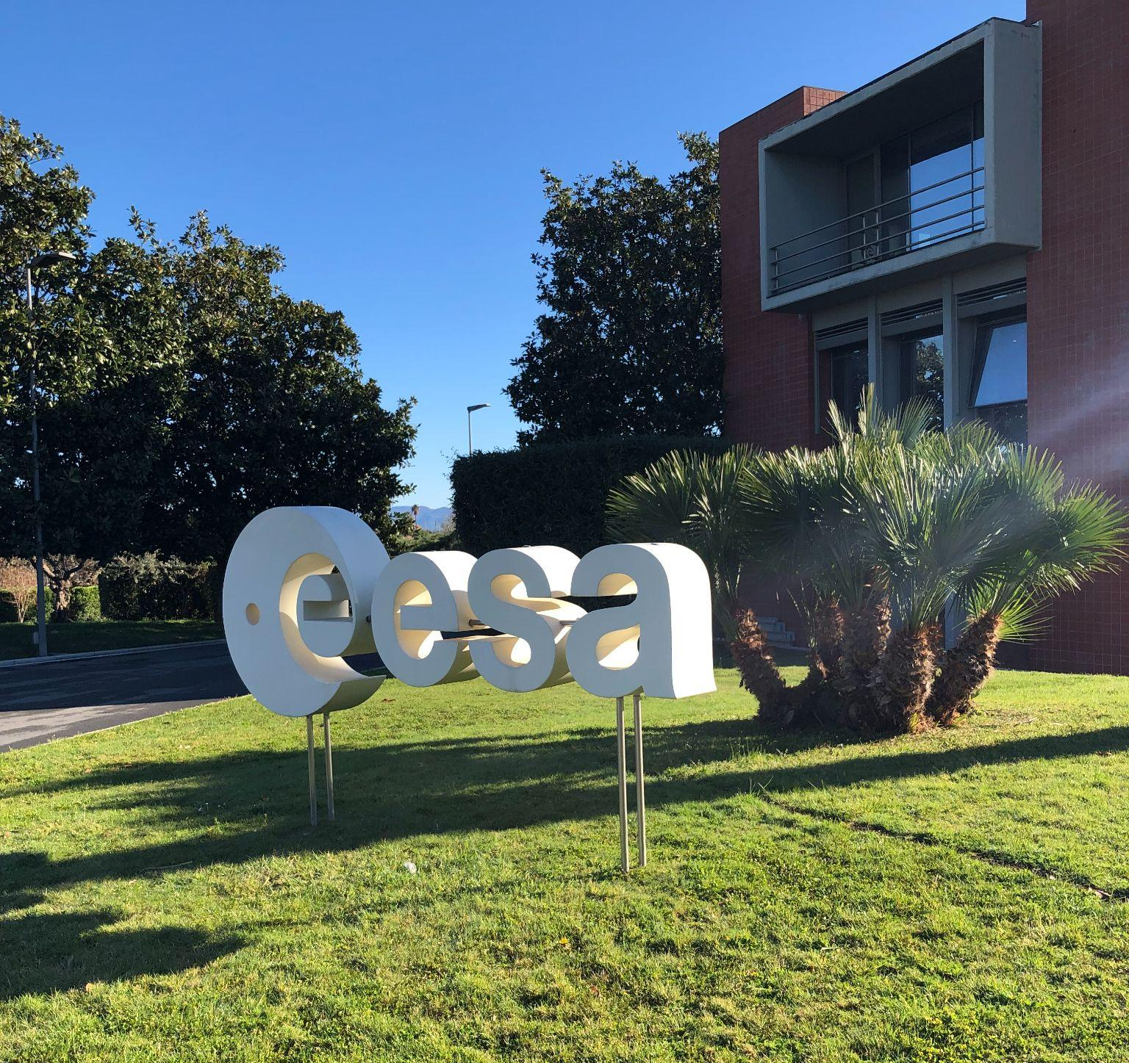
Side-meeting Outcomes
Side-meeting held at ESRIN, Tuesday 28th March:
~30 attendees in-person and virtual
Updates and strategic discussion with:
Current & Future SIT Chair, SIT-38 participants
UNCCD, GEO LDN, GEO SEC (Urban Coordinator), WGCapD
Outcomes:
SIT Chair Priorities review
Updates & issues discussed on SDG Coordination Group mechanism
2023 deliverables confirmed with responsible leads (tasks added to CEOS work plan)
New opportunities identified with UNCCD on Land Degradation Neutrality (e.g. Soil Organic Carbon task with GEOGLAM; higher resolution for small islands; arid regions…)
GEO organisation changes -> impacts on CEOS SDG efforts (SDG Coordinator leaving and replacement unknown)
Plan to host a ½ day workshop at next SIT TW to explore future opportunities

Slide 6
2023 SDG Deliverables
Number | Objective/Deliverable Title | Projected Completion | Responsible CEOS Entity(ies)
SDG-23-01 | EO Support sheet for SDG Indicator 6.6.1 (Water) 2023 Review | 31/12/2023 | SDG Coordination Group SEO
SDG-23-02 | EO Support sheet for SDG Indicator 11.3.1 (Urbanization) 2023 Review | 31/12/2023 | SDG Coordination Group SEO
SDG-23-03 | EO Support sheet for SDG Indicator 14.1.1 (Marine Pollution) 2023 Review | 31/12/2023 | SDG Coordination Group SEO and COAST AHT
SDG-23-04 | EO Support sheet for SDG Indicator 15.3.1 (Land degradation) 2023 Review | 31/12/2023 | SDG Coordination Group SEO
SDG-23-05 | Land Degradation Neutrality (LDN) Task | 2023 Q4 | SDG Coordination Group SEO
SDG-23-06 | Open Data Cube Applications for SDGs | 2023 Q4 | SDG Coordination Group SEO
SDG-23-07 | Communications packages to demonstrate broad contributions to SDGs for a variety of CEOS groups and initiatives | 2023 Q4 | SDG Coordination Group SEO
Lead Person
Marc P. (ESA)
Argyro K. (NASA)
Paul DiGiacomo (NOAA)
Neil S. (CSIRO)
Neil (CSIRO) and Brian K. (SEO)
Brian (SEO)
Libby R. (SEO) and Flora K. (CSIRO)

Slide 7
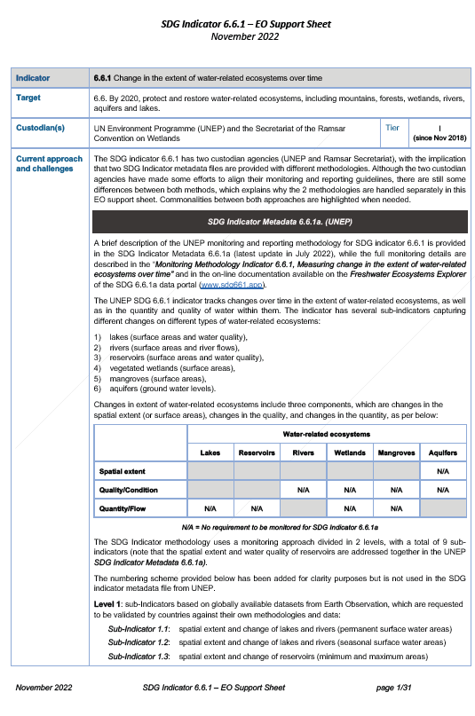
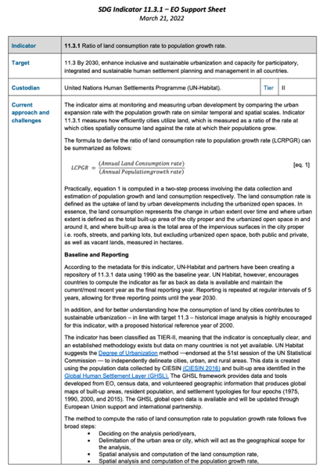
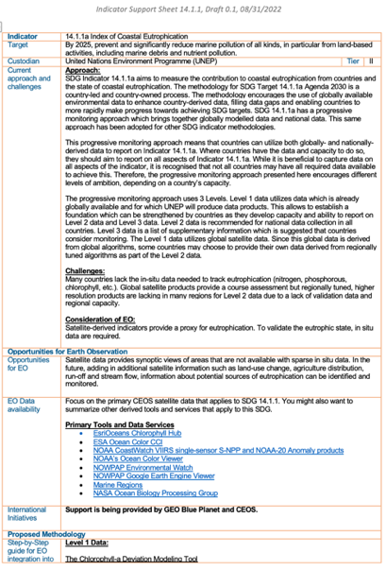
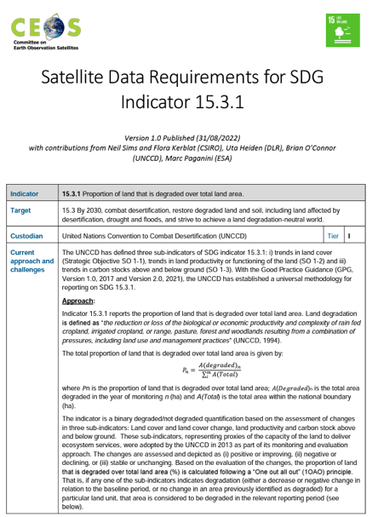
EO Support Sheets
ceos.org/sdg
SDG-23-01
Water
SDG-23-02 Urbanization
SDG-23-04
Coastal Eutrophication
SDG-23-05
Land Degradation
The Earth Observation (EO) Support sheets are a valuable resource for the user community and Custodian Agencies: CEOS plans to keep them updated by undertaking an annual review to ensure that details including current approaches and challenges, data requirements, access and tools, and publication references remain up-to-date and useful.

Slide 8
Land Degradation Neutrality (LDN)
SDG-23-05
Review the decision-tree workflows described in the Good Practice Guidance (GPG) document to understand data issues for particular geographies (e.g., island countries, mountains, arid regions) in relation to land productivity.
Perform analyses to understand the issues … mission coverage and data availability, cloud cover, data issues (e.g., radar terrain slope and shadow issues).
Recommend changes to the workflows for these regions such as the consideration of new datasets (e.g. HLS, radar, high-resolution).
Review and summarize future mission plans to offer potential solutions that could eliminate current issues.

Slide 9
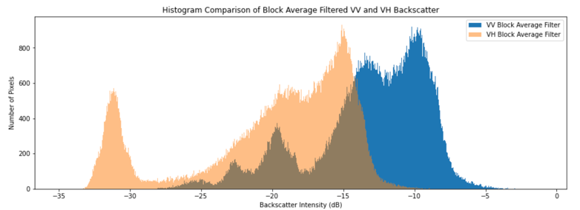
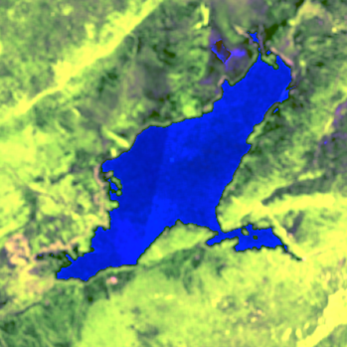
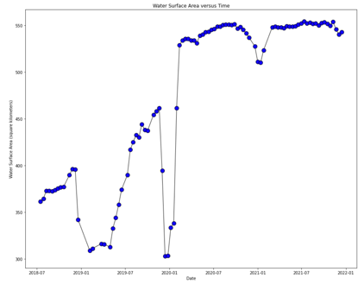
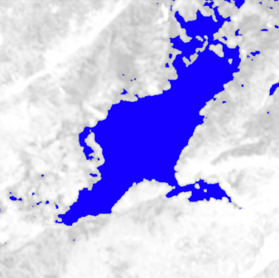
Open Data Cube Applications
SDG-23-06
In 2022, the SEO completed the development of a water extent (SDG 6.6.1) use-case using the Open Data Cube (ODC) Sandbox.
The Jupyter notebook algorithm uses Sentinel-1 radar data to detect water extent every 12 days.
For 2023, the focus is to develop documentation and training resources for these notebooks.
Plans to advertise via EO4SDG and also connect to WGCapD for training opportunities
https://github.com/ceos-seo/odc-colab/tree/master/notebooks

Slide 10
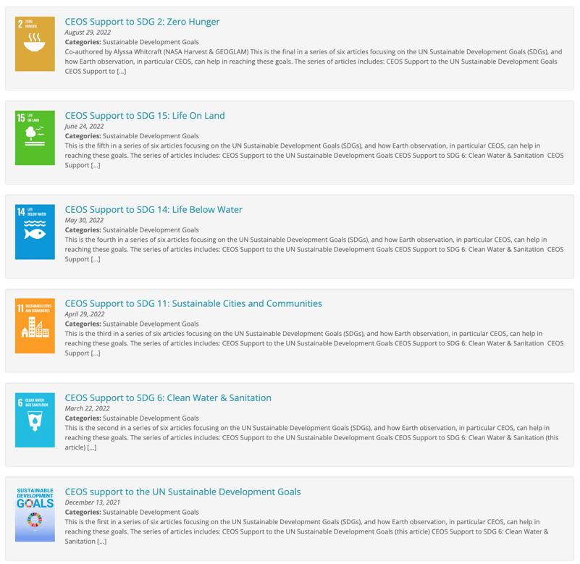
SDG Communications
SDG-23-07
In 2022:
The CEOS Communications team has worked with SDG team members to complete significant updates to the CEOS SDG webpage: www.ceos.org/sdg
A series of 6 news articles focused on SDGs have been published on the CEOS website. These articles have been released over several months in 2022 to maintain a steady flow of SDG material for CEOS visitors.
The CEOS Communications Team created an SDG video, played at the CEOS booth at the GEO Week in Ghana (attracted visitors)
2023: The team will work with CEOS bodies to promote their SDG-related activities and highlight capacity building activities: e.g. SDG communication material for IGARSS, GEO Ministerial and other key events/conferences

Slide 11
Summary & Timeline
2023 deliverables with identified resources and tasks have been added to the CEOS Work Plan.
COAST Bathymetry project moved out of CEOS and SDG deliverables. It will be run through the GEO Blue Planet Initiative.
New SDG Coordination Group has been working well, but increased awareness/engagement is needed across CEOS groups to remain relevant and have greatest impact.
Future deliverables are under consideration for: wetland inventory (via new Ecosystem Task Team), SDG dashboard, and New Space.
Feb
March
Apr-May
June-July
Sept
Oct
Nov
25th Jan
6th Feb
15th Mar
28th March
12th Apr
SDG Monthly call
CEOS SIT-38 side-meeting
SDG Monthly call
SDG Monthly call
SDG Monthly call
CEOS SIT TW: ½ day workshop
GEO Ministerial side-event with EO4SDG?
CEOS Plenary
side-meeting
SDG Monthly call
CEOS-GEO annual meeting

Slide 12
Topics for Discussion
SIT Chair provides the strategic oversight for the SDG Coordination Group and the SEO is the implementation lead. We will need to continue to work closely with JAXA (to be represented in this CG) in the transition of the SIT Chair for 2024, to ensure efficient functioning.
Improve CG awareness of relevant activities across CEOS to effectively coordinate
Deliverables should be jointly proposed, leveraging expertise across CEOS
SDG-23-07: opportunities to promote CEOS efforts supporting SDGs
Ongoing discussion with WGCapD regarding cross-cutting capacity building
SIT Chair and CEO to provide CEOS-wide SDG related updates during monthly Coordination Group meetings
Review current CEOS Expectations for the GEO Secretariat
“CEOS does not expect to have regular interactions with Custodian Agencies and will depend on GEO to maintain those interactions”

