Slide 1
Update on CEOS Support to IMEO
S Ward, SIT Chair Team
Agenda Item 2.9
SIT-38 2023, ESA/ESRIN
29th - 30th March 2023

Slide 2
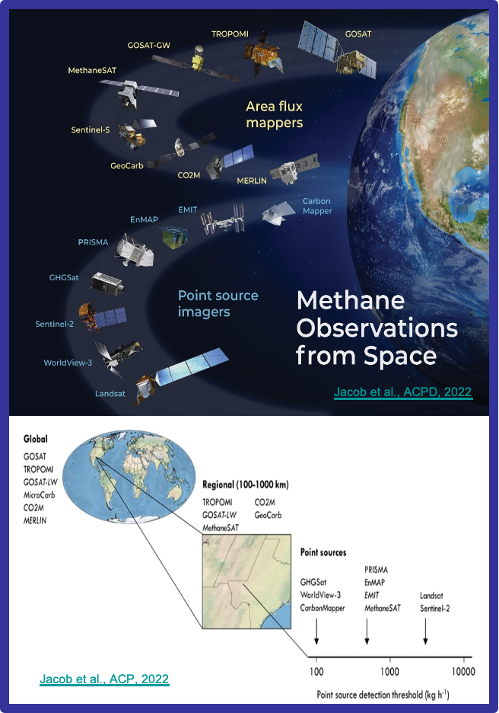
IMEO & MARS
IMEO: The broader focus of the IMEO is to catalyze reductions of methane emissions using transparent, data-driven approaches.
MARS:
•The first phase of MARS system will use satellite remote sensing for detection and attribution of methane emissions (above current detection thresholds) AND will also include notification and mitigation-tracking workflows
•MARS was kicked-off at COP27. It includes:
•Detection of global, daily super-emitters (> 10,000 kg/hr) and 3-weekly updated global ‘hot-spots’ (> 1,000 kg/hr) with S5P/TROPOMI
•High-resolution (~30 m) point-source imagers for targeted attribution (e.g., Sentinel-2, PRISMA, EnMAP, EMIT.)
•Non-satellite data (e.g., OGMP2.0 asset data, visual/facility data, science study results)

Slide 3
MARS

Slide 4
Context
Australia SIT Chair initiated engagement with IMEO/UNEP in 2021
Recognised mutual activities and objectives
Opportunity for CEOS space agencies to support important policy objectives with EO
IMEO attended several of our virtual meetings in 2021-22 & discussions continue
Today’s update focuses on several ongoing threads:
IMEO interest in easier access to GHGSat (CSA)
IMEO request for a near real-time methane product from TROPOMI (ESA/EC)
IMEO request for EnMAP data access to support experiments on its use in MARS
Possible joint campaign planning

Slide 5
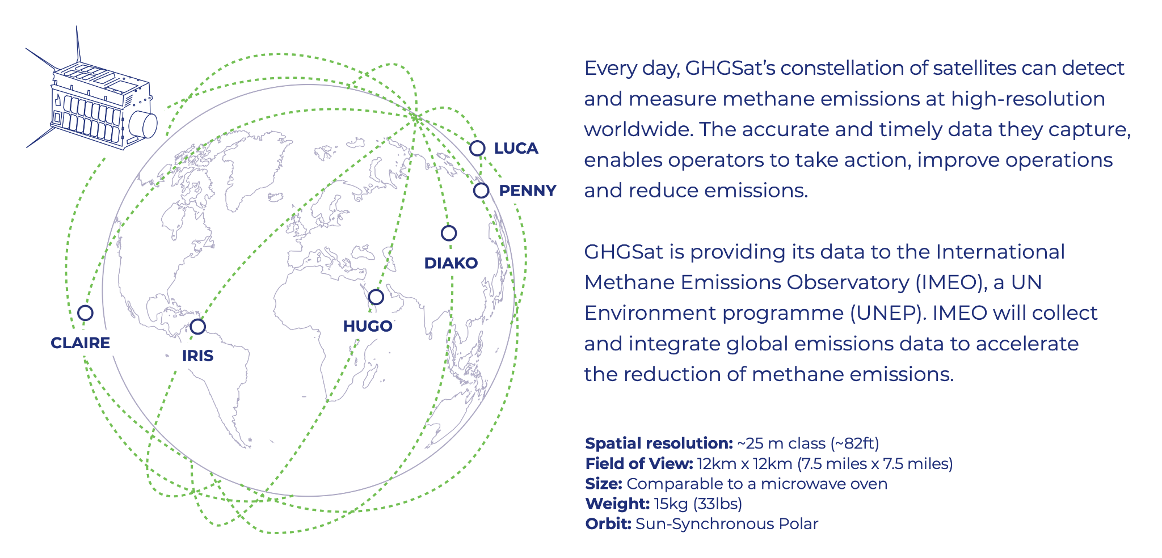
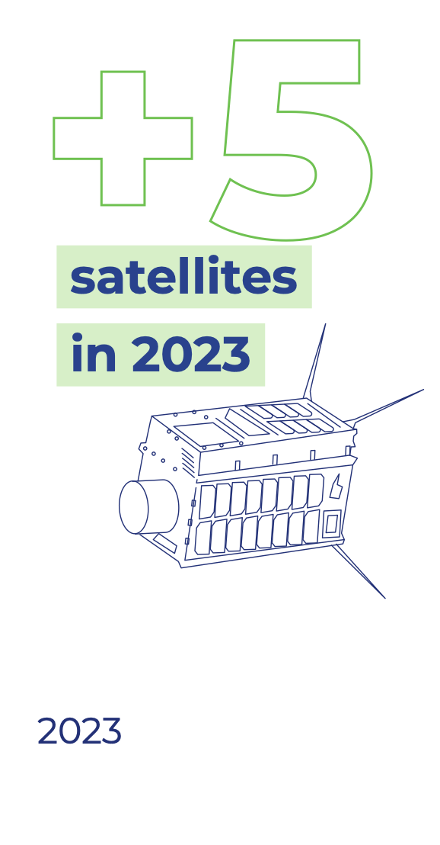
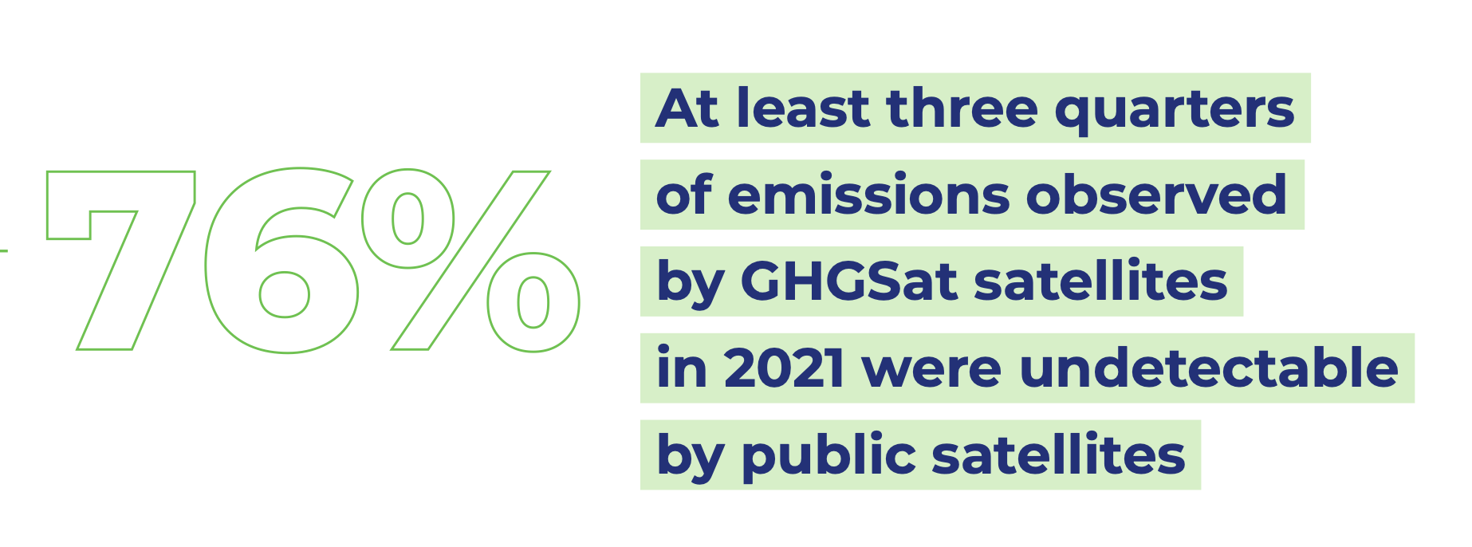
1. GHGSAT
IMEO actively discussing potential approaches for GHGSat to participate in IMEO/MARS.
GHGSat is currently providing data to IMEO with support from the Government of Canada
IMEO exploring different options to make it happen
CSA involvement might be helpful as this progresses
Watch and wait for the moment…

Slide 6
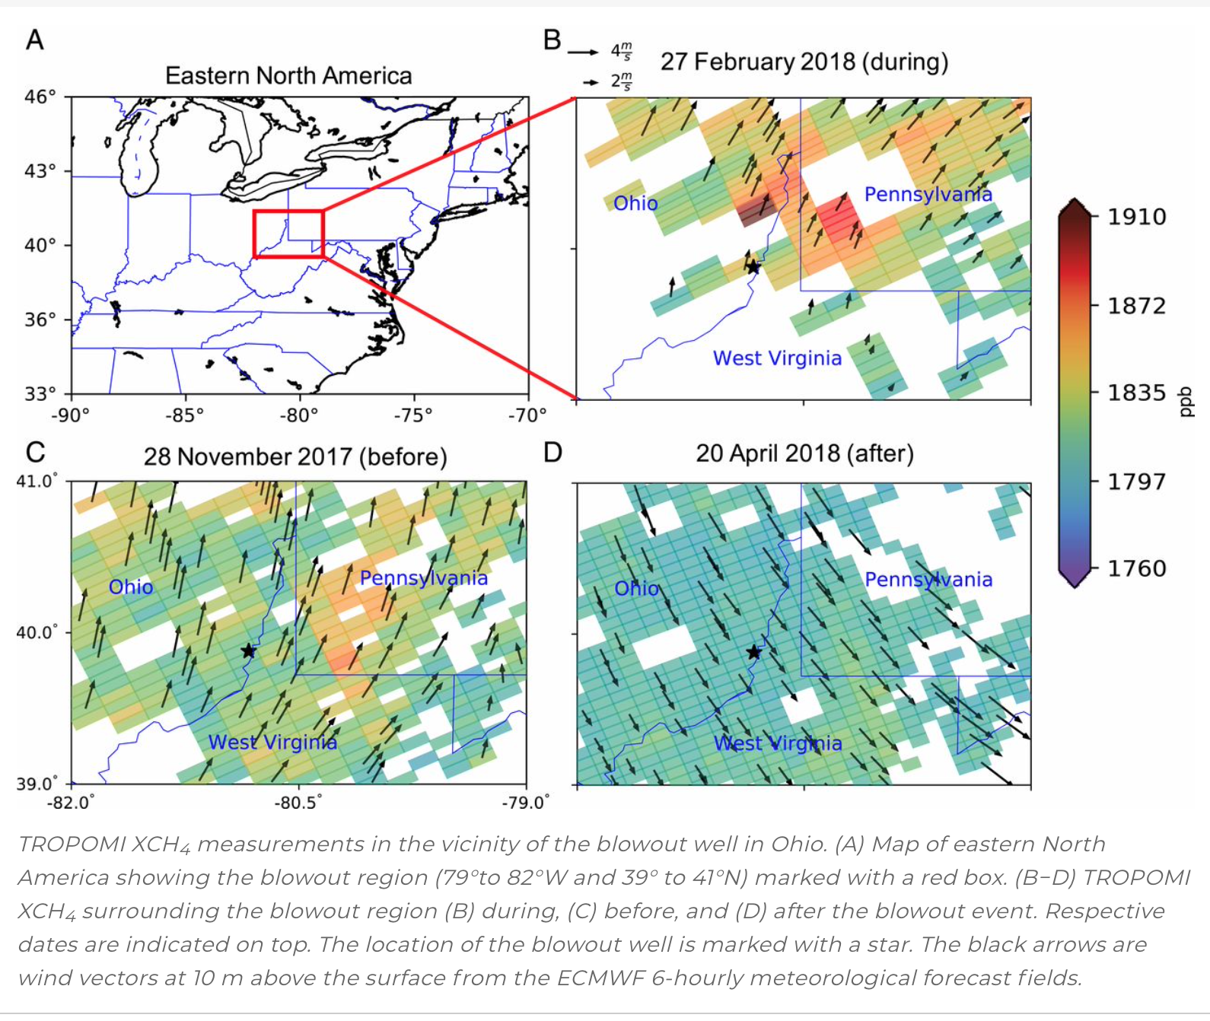
2. NRT TROPOMI PRODUCT
IMEO/MARS would greatly benefit from a S-5P NRT Data product
Sentinel-5P (S5p) Methane Near Real Time (NRT) Retrieval Algorithm/Product
SRON (NL Space Research Institute) has started to work on a NRT Cloud filter for the TROPOMI CH4 retrieval, in direct response to IMEO request
This is the first step towards a S5p NRT Methane product - independence of the SUOMI-NPP VIIRS cloud information (that is not available in NRT)
first results are promising

Slide 7
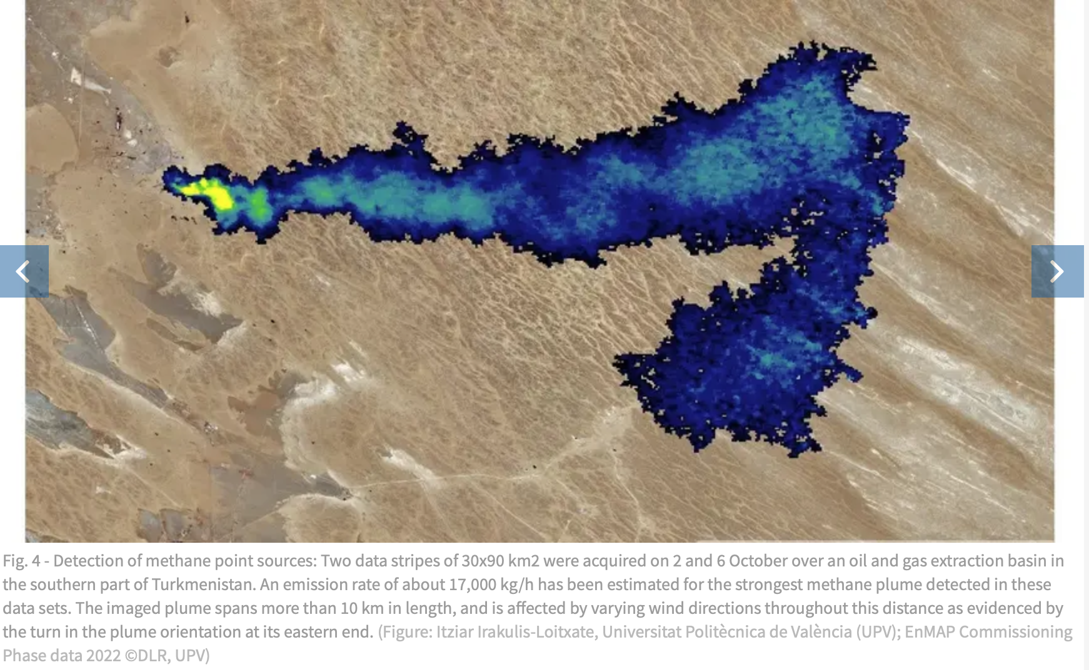
3. EnMAP data
IMEO agreed to send DLR a detailed list of requests regarding access to data, including data quota and acquisition priorities.
IMEO are using the current 6-month pre-operational phase of MARS to better understand their needs.
IMEO will discuss with DLR as soon as these details can be better formulated.
Watch and wait / DLR keeps contact running

Slide 8
4. Joint Campaign Planning
CEOS GST Strategy - Recommendation 4: CEOS should consider, in conjunction with modellers, setting up one or more focussed observational campaigns as a major contribution to the understanding of trends in natural GHG emissions and removals in key areas.
Discussions on campaigns with both public sector and private sector in oil and gas extraction locations e.g. Permian Basin through IMEO

Slide 9
Thanks!

