Slide 1
WGClimate Update
Agenda item 2.8
J. Privette, NOAA
W. Su, NASA
SIT-38, ESA/ESRIN
28-30 March 2023

Slide 2
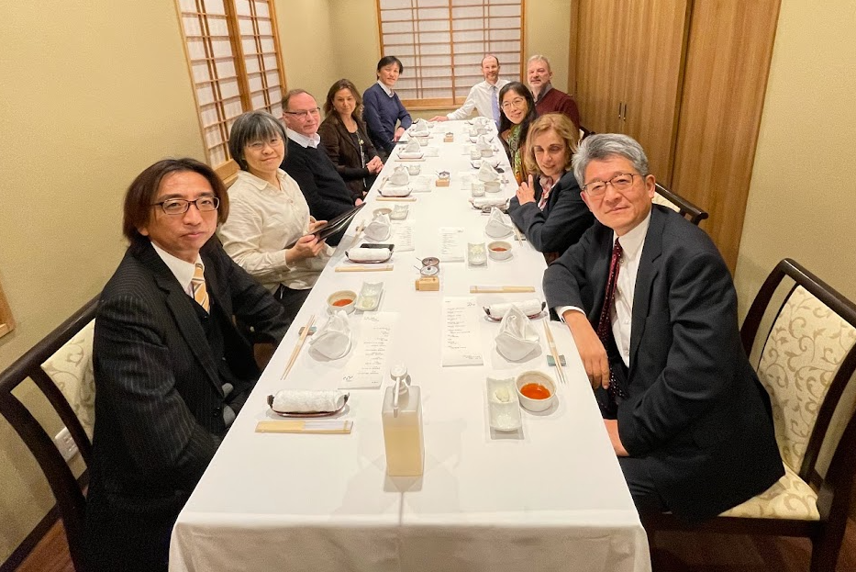
Outcomes from WGClimate-18
JAXA kindly hosted WGClimate-18 in Tokyo (28 Feb–2 Mar 2023)
Focus: 2023 Work Plan
  Prioritize initiatives, tasks, opportunities
  Staffing activities, partnerships
Top 2023 Priorities
  Space Agency Response to
  GCOS Implementation Plan (2022)
    Release Gap Analysis Report (v3/4.1)
    Update Coordinated Action Plan (© 2016)
  ECV Inventory update and restructuring
  Statement for UNFCCC COP-28
    Contributions to Earth Information Day

Slide 3
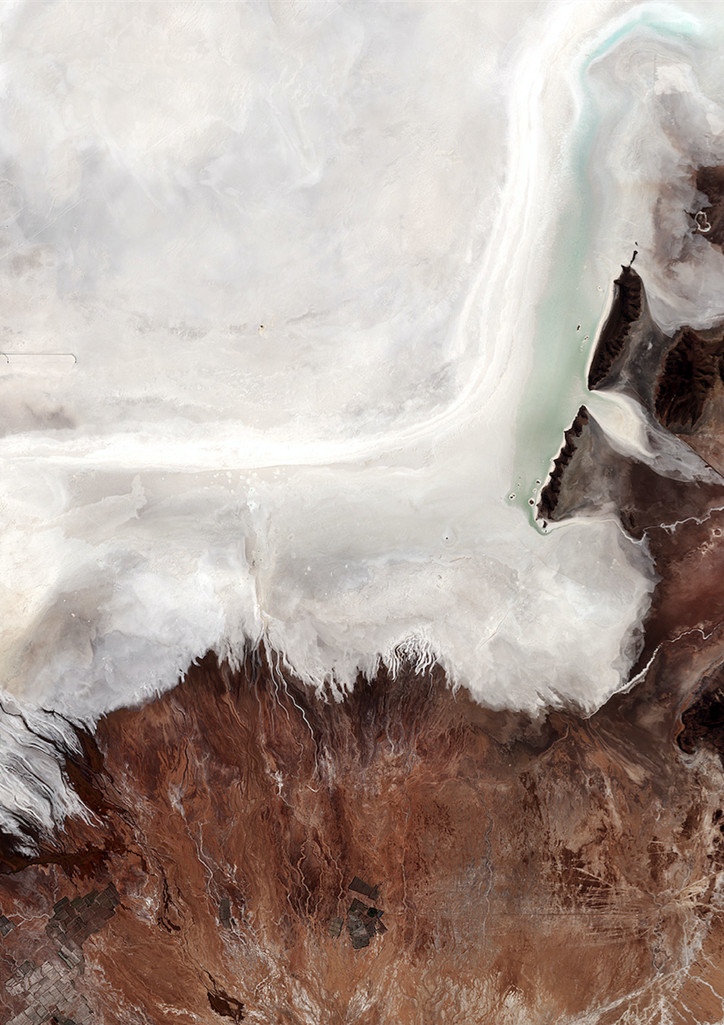
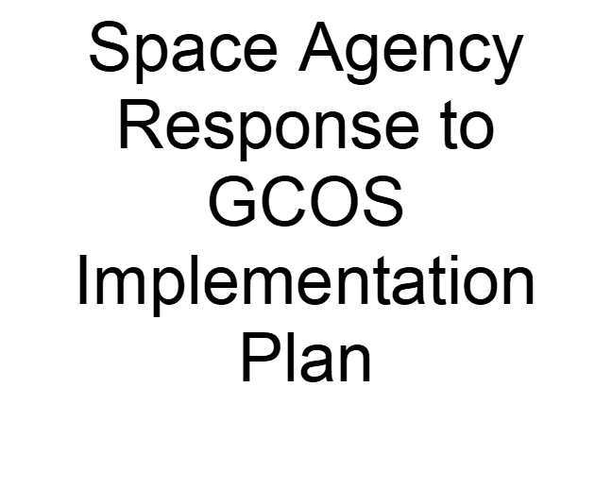

New Response Approach to GCOS IP (2022)
Last version: 2017 Response to 2016 GCOS IP
Initiated routine coordination with GCOS leadership
New Response approach
  Goal: More responsive, timely and balanced in workload
  Expert teams co-develop responses with GCOS Panel experts
  Stagger start dates and delivery schedule as appropriate
  Identified leads for each relevant GCOS Action
  Virtual kick-off event in mid-April
  Currently prioritizing Actions per space agency activities
© 2017

Slide 4
ECV Inventory Update and Restructuring, 1/2
Critical review conducted
  Costs include development, support, updates, oversight, agencies, experts
  Inventory grew much larger than first anticipated (200 🡪 2000)
  Conclusions
    Unique compendium serves many roles
      Links CDRs to instruments and space architecture
        Agency planning, responding to GCOS, UNFCCC, GEO
      Searchable library for users, researchers, developers, modelers, agencies
      Provides “state of the system” snapshot – e.g., evaluating Global Stocktake readiness
    Challenge to maintain, update Inventory, and conduct gap analyses
      EC / EUMETSAT provide active development and support team
      Requires iterative training and hand-holding with CDR providers: slow
      Gap analyses requires effort from limited pool of domain experts: fatigue
    Full potential not yet realized for users/uses outside of WGClimate

Slide 5
ECV Inventory Update and Restructuring, 2/2
Path forward
  Release Version 5 in 2023 by adding ~45 already-submitted records
  Revamp ECV processes and infrastructure based on lessons-learned
    Reconsider its users and uses
    Develop simpler access and discoverability-focused public-facing front end
    Reduce complexity
      Keep fields required to meet known needs
      Minimize fields whose content changes more often
      Send (link) users to providers for details
    Decrease burden on providers to (re-)learn definitions, tools, useful inputs
      Inventory Support Team will take greater role in the submission, update processes
      Submitters will provide only most basic information, Support Team combs accessible information to develop draft record, Submitter completes/validates final record
  Work with WMO/OSCAR team to modify API to meet our Gap our needs

Slide 6
Statement to UNFCCC COP-28
Helpful discussions with UNFCCC/SBSTA (Jo Post) in October
  Better understanding of COP processes, negotiations, drafting steps
  Late adjustments to COP-27 EID posters advocating observation network
Role: Advocate Agencies’ observation needs and findings
  Statement to SBSTA
  Earth Information Day materials
Jo Post moved to a new position, replacement not yet named
WGClimate will coordinate messaging with new lead once seated

Slide 7
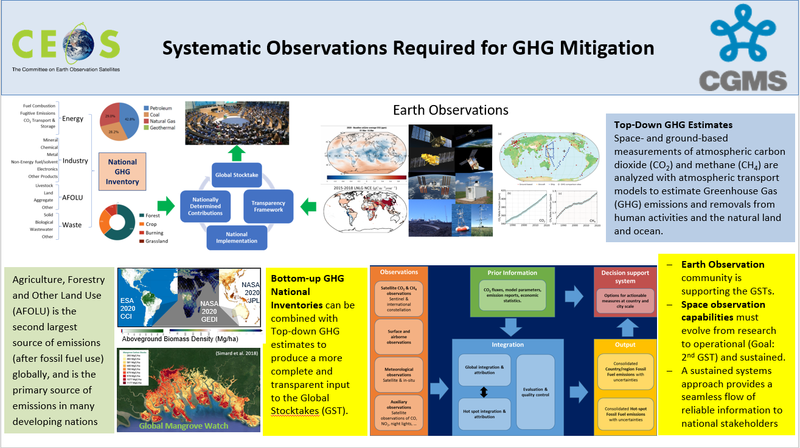
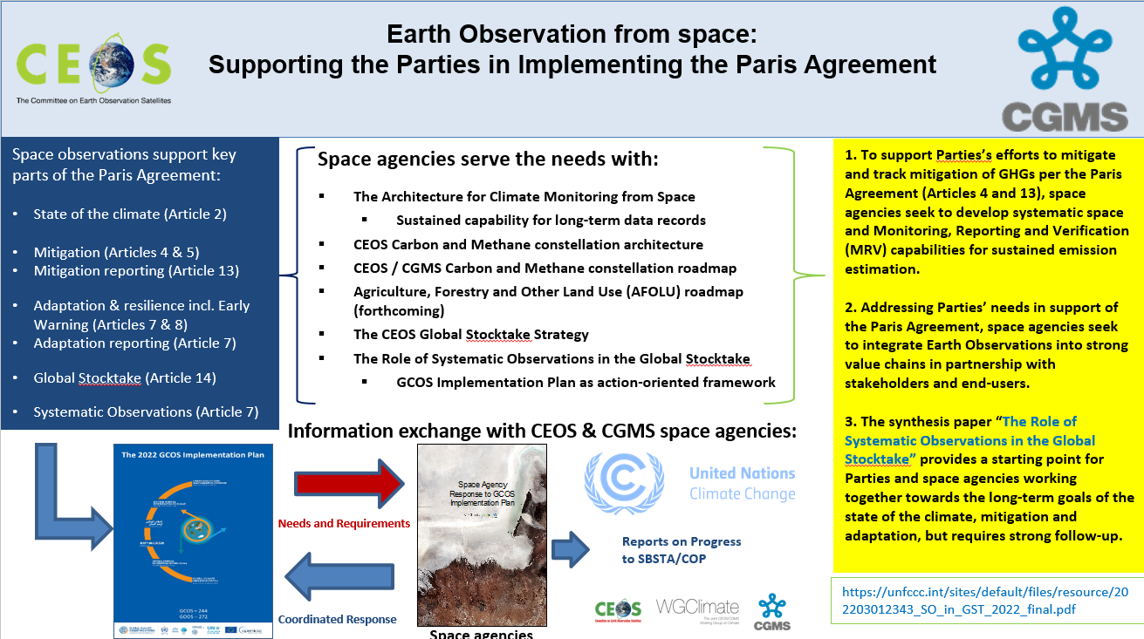
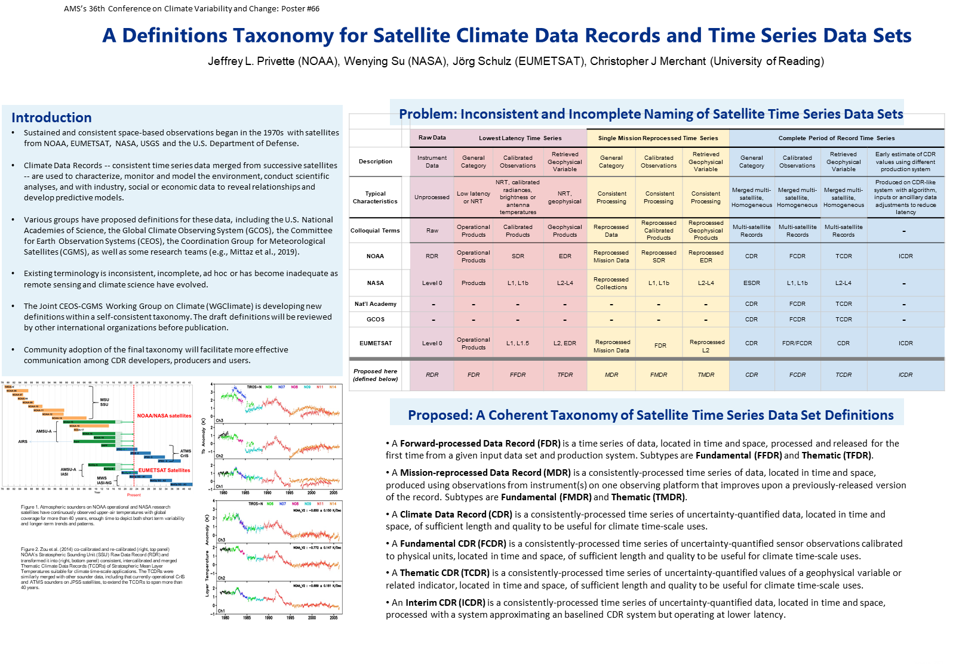
Recent Advocacy: COP-27, AMS

Slide 8
WGClimate-18: Other developments
GEO seeking WGClimate collaboration on many specific events
Space for Climate Observations (SCO) may partner on CDR Use Cases
CEOS Precipitation VC provided helpful review of precipitation CDRs
  WGClimate will seek additional reviews via VCs, GEWEX, etc.
Issue
  More invitations and activities to support than active membership allows
    Unable to further support NewSpace, CEOS ARD and Oceans Coordination presently
Request to agencies
  Consider naming representative to WGClimate if none currently exists
  Offer additional support to WGClimate tasks (e.g., IP Response, Gap Analysis)

Slide 9
CDR Use Cases Update
Purpose
    Show CDR end-value to stakeholders, public
    Show links from observations to societal benefit
    Support capacity development
Background
  Latest effort began in 2020
  Builds on original collection in 2015
Current status
  22 received
  15 published online

Slide 10

CDR Use Cases Update
Purpose
    Show CDR end-value to stakeholders, public
    Show links from observations to societal benefit
    Support capacity development
Background
  Latest effort began in 2020
  Builds on original collection in 2015
Current status
  22 received
  15 published online

Slide 11
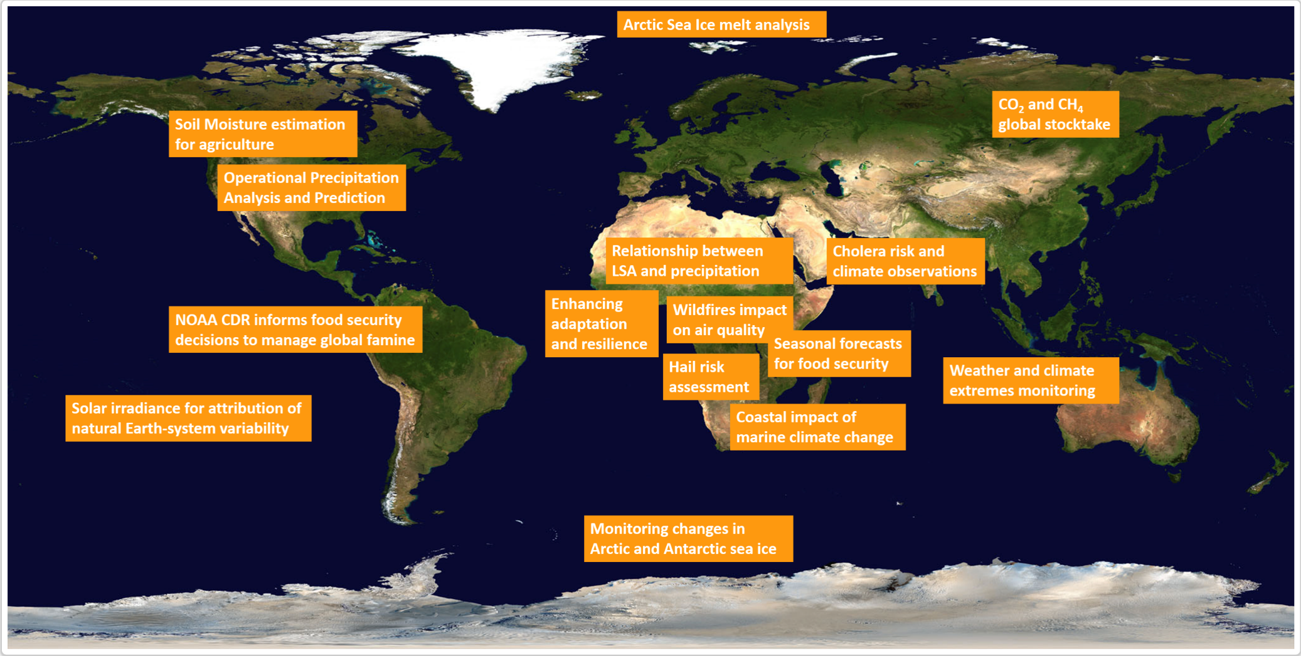
Use Cases Geographical Distribution
http://climatemonitoring.info

Slide 12
Use Cases: Next Steps
Engage other organizations (e.g., GEO, ECMWF CAMS, GFCS, SCO, IMEO)
  Seek contributions or link existing Use Case portfolios
Request to agencies
  Continue contributing Use Cases that leverage CDRs from ECV Inventory
    Special call out to VCs and Working Groups
  Stand ready to assist with reviewing submitted cases

Slide 13
2023 Top-line Schedule
January
February
  GHG TT meeting
  WGClimate-18
March
  CEOS SIT-38
April
  CGMS WG II
  Kickoff: Response to GCOS IP*
May
June
  CGMS-51
August
  COP-28 Statement
September
October
  WGClimate-19
  SIT Technical Workshop
November
  CEOS-37 Plenary
  COP Earth Information Day
December
* Dates for Responses to GCOS IP Actions will vary

Slide 14

Thank You

