Slide 1
SIT-38
2023
Aquatic Carbon Roadmap Proposal Marie-Helene Rio, OCR-VC with inputs from IOCCG Committee members Proposed Aquatic Carbon Roadmap and what is needed for its realisation
Marie-Helene Rio, ESA
Agenda Item #2.6
SIT-38, ESA/ESRIN
29th - 30th March 2023

Slide 2
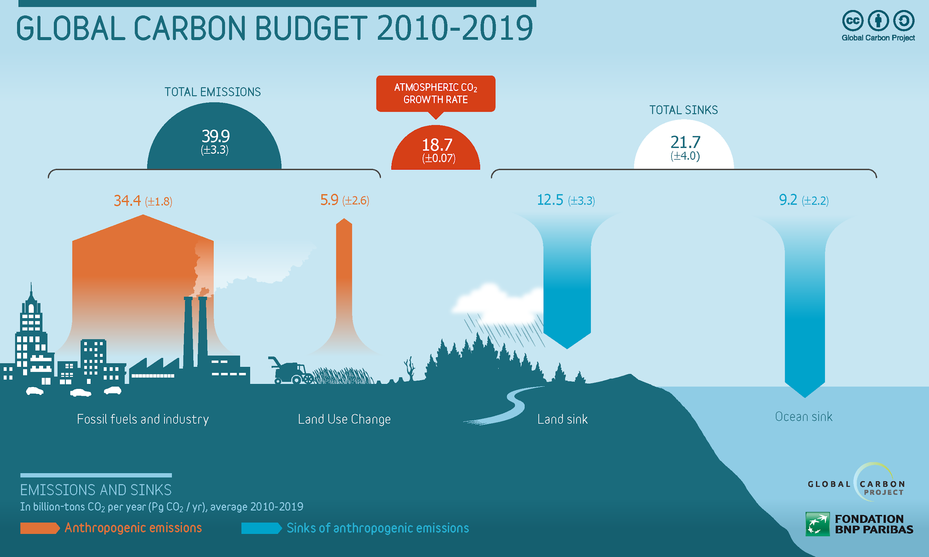
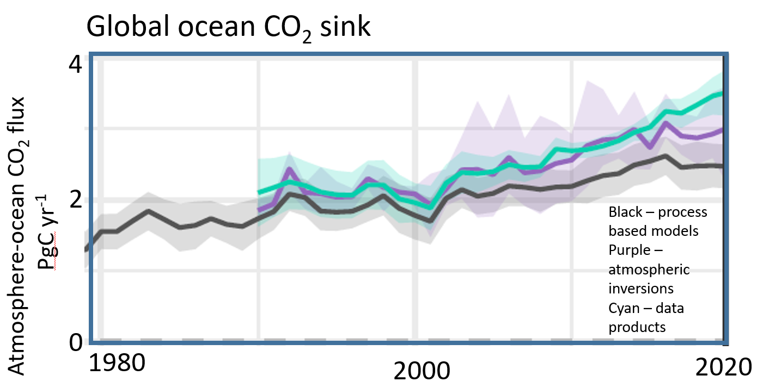
Ocean carbon: a key constraint to the Global Carbon Budget
Oceans play a major role in the Global Earth Carbon Cycle
They have absorbed over 25% of all anthropogenic CO2 released in the atmosphere.
The global land sink is currently impossible to observe, so its modelled estimate relies upon ocean & atmosphere data.
Ocean and atmosphere are the two observational constraints on global carbon budgets.
Improving ocean carbon estimates will improve the land carbon budget and global carbon assessment!
Despite the GCB ocean component now has a greater reliance on observations than models, discrepancies exist between observations and model
good estimates
poor estimates
good observations
Modelled or calculated using all other components
measured
Friedlingstein et al, 2022
Notes:
Each year, the global carbon budget is assessed to track how well, or not, humanity is achieving any reductions in greenhouse gas emissions.
The huge variations in land cover, vegetation, terrain and their year-to-year variations mean that it is currently very difficult to measure the total global land sink accurately. Solving this issue is complex and complicated. However, it can be estimated indirectly.
By absorbing increased carbon dioxide from the atmosphere, the ocean reduces the warming impact of these emissions were they to remain in the atmosphere. However, carbon dioxide dissolved into the ocean causes seawater to acidify,

Slide 3
Ocean carbon: a changing component of the global system
Ocean carbon is a key constraint to the global carbon budget, but its monitoring is also essential as increasing anthropogenic CO2 emission are reducing the pH of oceans (ocean acidification)
Global ocean pH stripe, determined using satellite data and illustrating how global carbon emissions are making the oceans more acidic. Data: Gregor & Gruber, (2021).
With direct impact on
Phytoplankton
CaCO3 and O2 cycles
biodiversity
Higher trophic levels
So far the ocean sink has increased with emissions. But its future response is not known (can the sink continue to increase, or how will biology change and influence it?)
Including a reduction of the oceans capacity to continue to provide this service

Slide 4
Toward an Aquatic Carbon Roadmap
CEOS Global Stocktake strategy paper
-> demonstrate the value of Earth Observation satellite datasets to support the Global Stocktake process
CEOS Aquatic Carbon Roadmap?

Slide 5
OCR-VC contribution to the CEOS Workplan
2020-2023
2023-2025

Slide 6
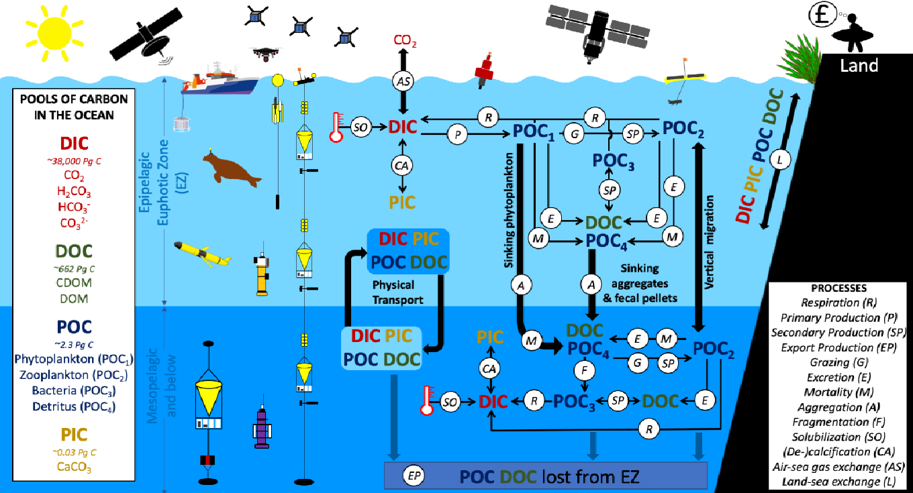
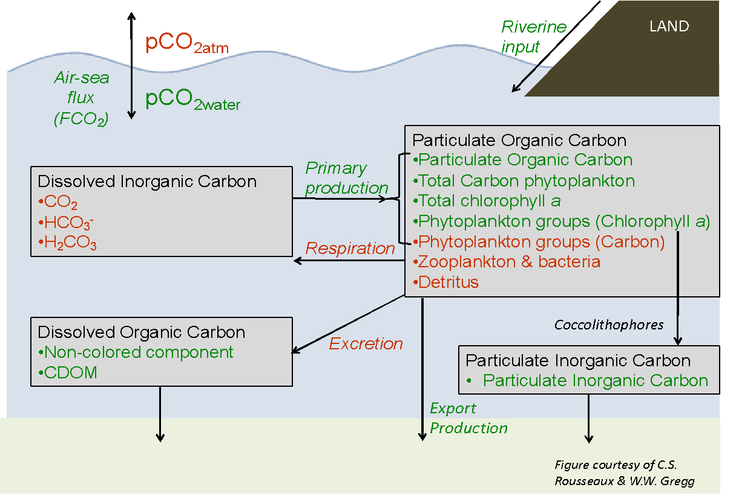
Toward an Aquatic Carbon Roadmap
CEOS Carbon Strategy Report 2014
From Brewin et al, 2021*
Some additional pools have become amenable to remote sensing:
Phytoplankton groups
Detritus (a first approximation)
We have today a budget for most of the pools and fluxes of carbon in the mixed layer, BUT…
Global assessments are using satellite data in inconsistent and non-optimal ways.
Large uncertainties exist in our understanding of trends in fundamental biological carbon fluxes in the ocean, notably primary production and export production.
Knowledge gap in freshwater production and land-ocean fluxes is even greater.
We have little knowledge on blue carbon and its changes.
*Brewin et al, 2001:Sensing the ocean biological carbon pump from space: A review of capabilities, concepts, research gaps and future developments, Earth-Science Reviews 217 (2021) 103604.
Magnitude and regional distribution of biologically-mediated carbon fluxes come from a variety of climate-related modifications to the marine environment (ocean acidification, storminess over the oceans, vertical stratification, changing temperature, increasing sea level, disappearing sea ice, and their combined impacts), which still need to be better understood and assessed and will likely impact inorganic carbon pools (e.g. ocean sink)

Slide 7
Aquatic Carbon Roadmap focus
The GHG Roadmap has a very pragmatic focus on the major milestones of GST1 (2023) and subsequently for GST2 (2028) and the production of prototype inventories in support of those milestones. The AFOLU Roadmap has a similar pragmatic focus on GST1 and GST2 and what can be delivered effectively to support these and the national reporting to them.
Conversely, the Aquatic carbon roadmap would not address only the ocean carbon sink (air-sea CO2 exchange) monitoring but, more widely:
cover all horizontal (from lakes to coastal and open oceans) and vertical dimensions (from exchange of CO2 with atmosphere, through the land to ocean aquatic continuum, up to the vertical transport of carbon to the deep ocean until overturned)
Cover the linkages between organic and inorganic carbon and how the two relate to each other.
cover all the components of the Earth System from assessing how long the oceans (open ocean and coastal) will be able to keep up at taking anthropogenic CO2 to how this will affect the pH and biodiversity of the aquatic systems to the effects of human’s action on land (deforestation, increasing nutrient input from rivers etc) on the aquatic carbon.
contribute to support the needs and ambition cycle of the Global Stocktake of the Paris Climate Agreement, by constraining the global carbon budget but also supporting countries reporting on their NDC by improving the estimation and monitoring the changes in CO2 fluxes from/to the Oceans at country level (within each country’s exclusive economic zone (EEZ)) also including improving the monitoring of major Blue Carbon coastal ecosystem’s extent and carbon stock around the world.

Slide 8
Aquatic Carbon Roadmap Objectives
To serve as a guiding vision for long term space agency coordination around Aquatic Carbon by providing a framework for long-term (~ 15+ years) coordination of CEOS agency observing programmes in support of the needs for Aquatic carbon related information.
Characterizing the needs, gaps and challenges, regarding the required products, services and applications and the observing systems that can support, including the needs to plan for ground segment, space segment and services.
Addressing basic observation continuity and the necessary agency coordination to achieve it.
Such information should encompass:
Satellite-based aquatic products and associated uncertainties to constrain models better, and to reduce uncertainties in the global carbon budget
Satellite-based tools to improve our understanding of the magnitude of, and trends in:
Aquatic primary production (inland waters, coastal waters, open ocean)
Export production
Aquatic ecosystem structure and geographical distribution, and impact on carbon flux
Quantification and mapping of blue carbon at the global scale
Integration of satellite observations with field observations and models to reduce uncertainties in carbon fluxes
Assessment of regional differences in carbon pools and fluxes and their implications, notably for the polar seas that are undergoing rapid changes.
Serve as an effective means for communicating our intentions to society, UNFCCC, national inventory community

Slide 9
Toward an Aquatic Carbon Roadmap – Expected challenges
The development of an Aquatic Carbon roadmap is a very timely, needed, but at the same time very ambitious commitment
The contribution and coordination from IOCCG/CEOS OCR-VC agencies will be essential to work towards actual deliverables.
Most of these agencies have carbon related activities on which the roadmap will build on ;
At IOCCG level, an IOCCG Ocean (Aquatic ?) Carbon from Space Task Force is being initiated, and also a Working Group on Primary Production, which could both support the production of the roadmap
However, the coordination and compilation for such a roadmap is very time consuming.
The Aquatic Carbon Roadmap will also likely require a degree of coordination and collaboration with AFOLU Roadmap and the GHG Roadmap, in particular for what regards Blue Carbon ecosystems (Wetland/mangroves are part of the AFOLU roadmap).
Need of CEOS support on these two aspects as we progress with the roadmap
CEOS agencies are requested to put the necessary resources to contribute to the roadmap

Slide 10
Toward an Aquatic Carbon Roadmap
Timeline
March 2023 Aquatic Carbon Roadmap presented at CEOS SIT-38
3-5 October 2023 “Earth Observation for Carbon Markets” workshop, ESA-ESRIN, Italy
14-17 November 2023 International Ocean Colour Symposium (IOCS)
Breakout session on Land to Ocean Aquatic Continuum
?
Aquatic Carbon Roadmap Outline and assignments
Q2 2024 Blue Carbon ISSI Workshop
December 2025 Aquatic Carbon Roadmap delivered

