Slide 1

Toward top-down, internationally coordinated monitoring of greenhouse gas fluxes to support mitigation action under the Paris Agreement
WMO Global Greenhouse Gas Monitoring
Lars Peter Riishojgaard, WMO Secretariat
(lriishojgaard@wmo.int)

Slide 2
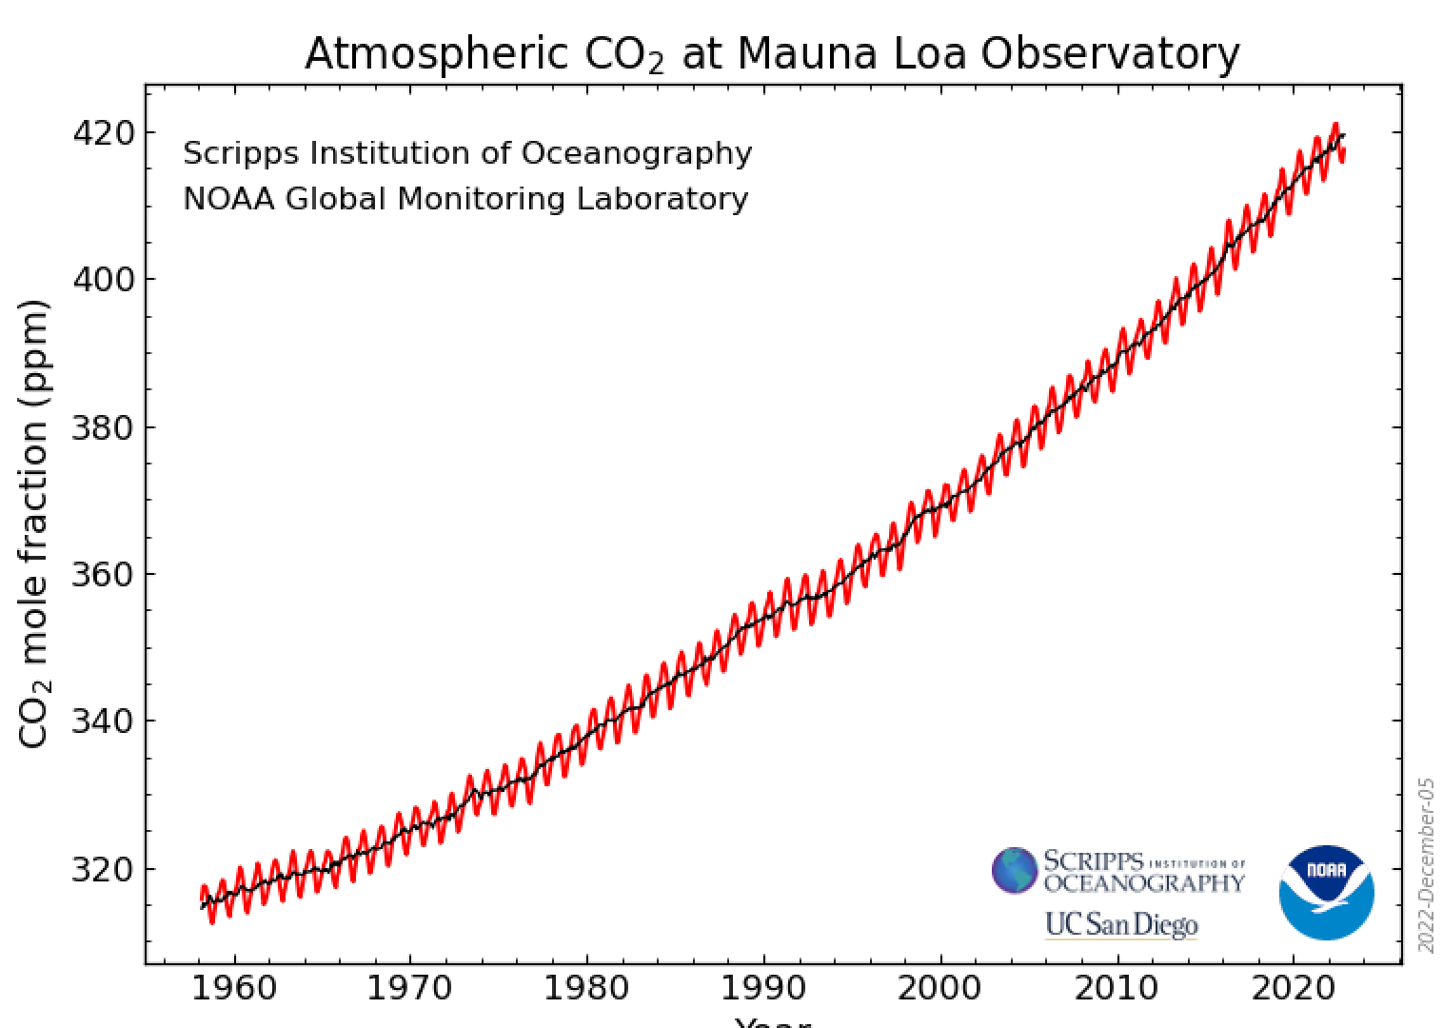
Problem Statement
The Paris Agreement has been adopted with the aim of limiting climate change via reducing net anthropogenic greenhouse gas (GHG) emissions;
Paris focuses on accurate reporting of anthropogenic GHG emissions; however, GHG fluxes driven by natural processes are often much larger and are not explicitly taken into account;
Natural fluxes respond to anthropogenic emissions and climate change in ways not yet understood;
In UNFCCC parlance, ”Emissions” can be positive as well as negative (GHG removals), but
Accounting for negative emissions (carbon offsets and credits) is problematic, poorly regulated and ineffectively monitored, leading to risk of overestimating of impact, double counting,…;
UNFCCC, Rio, 1992
Kyoto, 1997
The climate responds to the atmospheric GHG concentrations, not to what we claim to be doing to reduce or offset our GHG emissions;
Paris, 2015
Notes:
Globally coordinated: to ensure consistency between Parties, and ensuring global coverage by the information
Sustained: to ensure evaluation of the trends

Slide 3
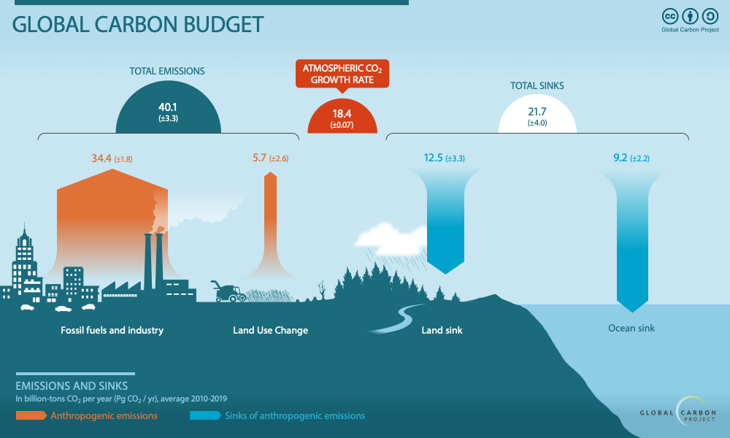
How well do we understand the CO₂ fluxes ?
(Graphic by the Global Carbon Project)
Top level global budget is well understood
Focusing our efforts only on the areas with low uncertainties (green) will not work!
Fossil fuel: Some uncertainty (~5%), especially for developing countries
Land use: Very large uncertainty (~45%)
Natural sinks: Fairly large uncertainties (~25%); subject to climate feedbacks

Slide 4
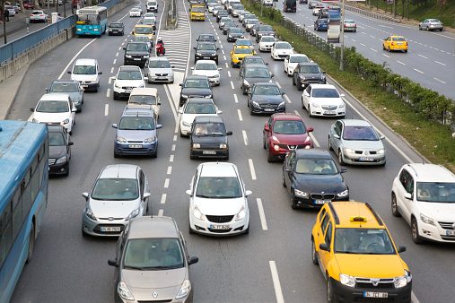

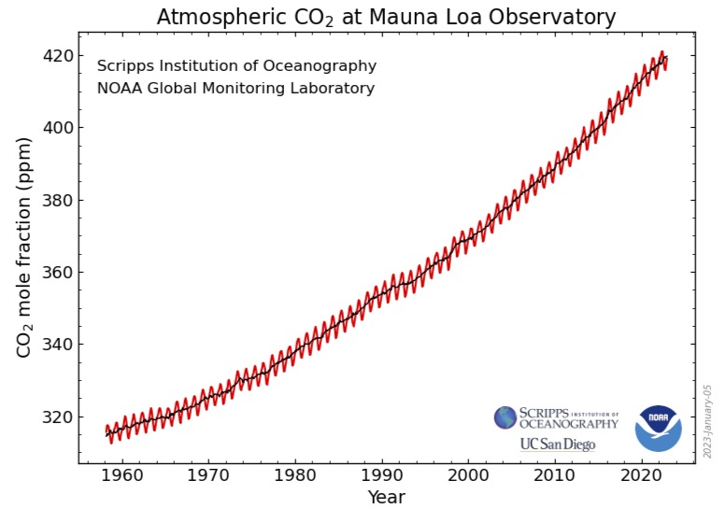


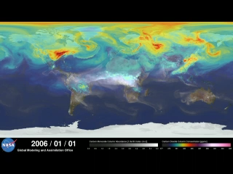
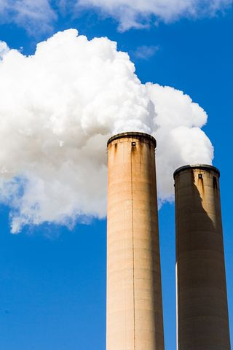
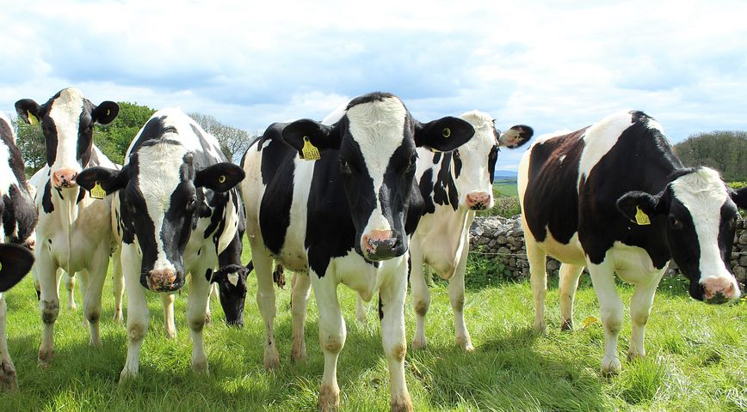


Two ways to monitor greenhouse gas concentration changes:
(both will be needed!)
Global infrastrucure required for top-down GHG monitoring is very similar to WMO-coordinated infrastructure for weather prediction and climate analysis;
Bottom up: Add up individual sources and sinks of carbon and calculate overall contributions;
  Can provide very accurate estimation of anthropogenic emissions;
  Bulk data national only, 1-2 years delayed;
  Does not work well in developing countries;
  Not applicable to most natural sources/sinks;
Top down: Use atmospheric observations and atmospheric modeling to see overall contributions:
  Direct link to ”centralized accounting”;
  Global coverage, spatially disaggregated;
  Estimates of net fluxes rather than of emissions;
  Can be made available in near-real time;
NWP model with CO2; NASA Goddard Space Flight Center
Almost all activities under IPCC and the Paris Agreement are based on bottom up
Top-down technology mature, used by Parties individually, not yet in context of Paris Agreement
Notes:
Two approaches can not be directly compared, the best approach is a combination of both (e.g. best inventory is used as a prior for the creation of posteriori estimate in combination with atmospheric observations)

Slide 5
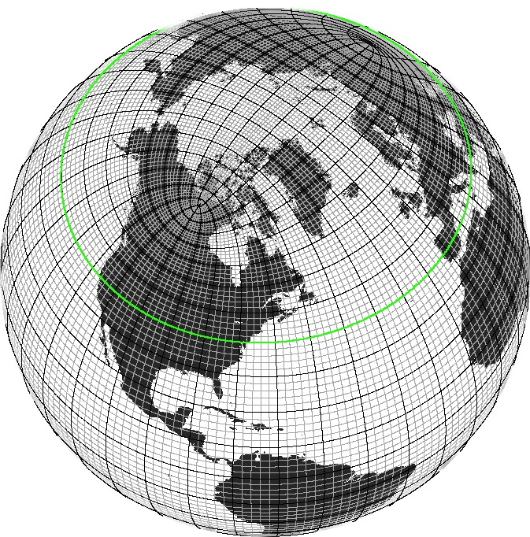

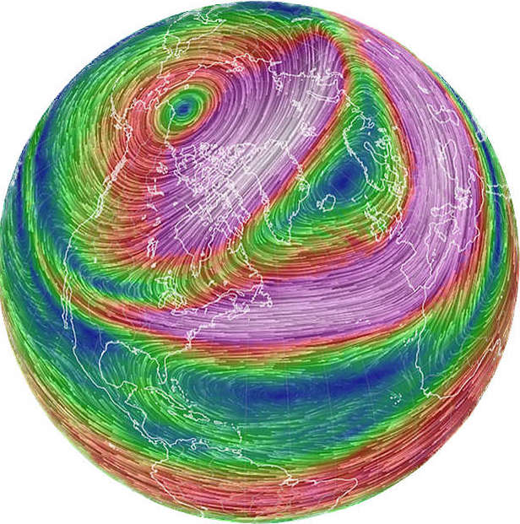
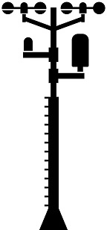
A primer on top-down atmospheric monitoring
At the local level
Globally - basically just more of the same …
418 PPM
Many (thousands) of CO2 measurements, complemented with satellite data.
CO2 measurement
The building blocks for this already exist today. However, we do not yet have an integrated global system that operates the way weather prediction and climate analysis is done.
420 PPM
Divide the globe into hundreds of thousands of grid cells
CO2 measurement
Set up and solve a simple equation for the net CO2 flux over the forest, given the atmospheric flow and the observations
Solve large set of simultaneous equations for the net CO2 flux in all grid cells based on atmospheric flow and observations

Slide 6
WMO and partners are developing top-down greenhouse gas monitoring framework, building on existing elements and 60+ years of weather/climate experience
Key components
Integrated global observing system (both surface- and space-based)
Near-real time international exchange of all observations;
24/7 operational GHG modeling (multiple model systems), converting observations into flux estimates;
Routine internationally coordinated intercomparison and verification of model output;
Primary output
Time-continuous global fields of CO2, CH4 and N2O concentrations;
Consolidated, top-down, monthly estimates of GHG fluxes at (initial) global 100 by 100 km resolution (1 by 1 km will become possible);
In order to provide authoritative data to UNFCCC Parties and other users, GHG monitoring must be conducted
Openly - with participation from all interested Parties;
Transparently – with free and unrestricted access to all input and output data as well as verification results;
Using documented (preferably published) methodologies and algorithms.
Users of GGMI output
Parties to the Paris Agreement (Global Stocktake);
Regional and local users, e.g. via IG3IS;
Participants in voluntary carbon markets, ;
Scientific community working on GHG budgets;
IPCC, for emissions pathways, future scenarios;

Slide 7
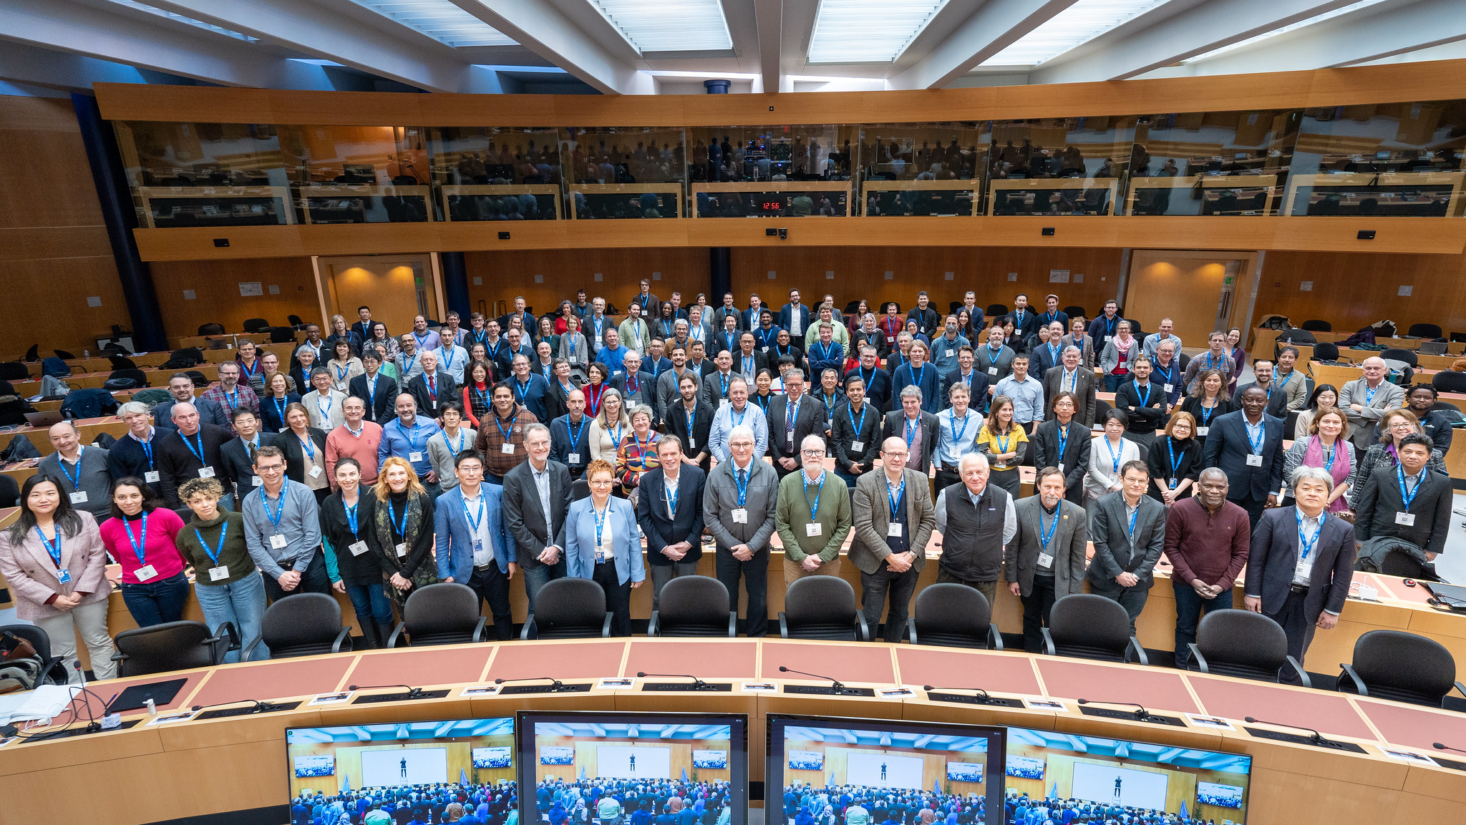
WMO Greenhouse Gas Monitoring Symposium, Jan 30- Feb 1
170 on-site participants (+Secretariat staff), 500 online;
57 oral presentations,
Five Panel discussions;
Two poster sessions; 66 on-site posters, 15 online;
Consensus Symposium Statement
Initial draft prepared by an open committee of 20+ volunteers;
Discussed by all participants during final session;
Finalized via two rounds of email comments after the event;
Available on Symposium website

Slide 8
WMO Greenhouse Gas Symposium Statement (excerpt):
We, a broad group of 170 greenhouse gas monitoring stakeholders attending the WMO International Greenhouse Gas Monitoring Symposium held in Geneva January 30 to February 1, 2023, agree on the following points:
{…} There is an urgent need to build on {existing, disparate greenhouse gas monitoring efforts} to develop a global, internationally coordinated GHG monitoring framework that will help us accurately quantify greenhouse gas sources and sinks {…} support for the UNFCCC process{…}
WMO, because of its intergovernmental nature, its role in international coordination of research and operational activities in the field of weather, climate and water, its expertise in observing systems, modeling and data exchange {…} is uniquely positioned to play a significant role in advancing the ambitions outlined above.
Recognizing the urgency of actions required to mitigate and adapt to climate change, we therefore call on WMO, {…}, to take ownership of {the task of leveraging the disparate efforts and systems} in a common framework via the following actions:
  Convening {…}experts and stakeholders across United Nations agencies, international programs, {…} governments, academia and the private sector to develop consolidated requirements and deliverables for {…} operationonal global greenhouse gas monitoring systems,
  Leading the development of an initial concept for an integrated framework for the operation of these systems,
  …

Slide 9
Timeline
COP27/SBSTA-57; nearly all Parties expressed very strong support for this;
WMO Greenhouse Gas Monitoring Symposium, Jan-Feb 2023; very strong support from the research community;
WMO Executive Council (Feb-Mar 2023); green light for Congress proposal;
19th World Meteorological Congress, May-June 2023; goal is intergovernmental agreement to develop and implement this system;
Development starting this year - pilot capabilities already exist in Europe, the US, Japan, …, international coordination and (especially) exchange of observations is missing; this is where WMO can help;
Multi-party operational capability at 100 x100 km within five years;
Operational capability at 1x1 km within 10 years, if adequately resourced;

Slide 10
Some of the GGMI development activities planned for 2023
Greenhouse gas modeling/assimilation workshop, tentatively in Bonn late August/early September 2023
  Agreement on data exchange, run-time procedures, metrics of skill, common input data, data requirements, ….
Greenhouse gas observing workshop, tentatively in Geneva mid-September 2023
  First step toward consolidated design of an integrated global observing system, addressing requirements for top-down global greenhouse gas monitoring, consisting of both surface- and space-based assets;
  Near-real time data exchange, current status, expected capabilities;
  Expected technology development (space- and surface-based),
  …
Private sector engagement
  Strong interests in GGMI from many corners: Philanthropy, venture capitalists (technology development), logistics companies (deployment), banks, hedge funds (carbon markets), …

