Slide 1
Greenhouse Gas (GHG) Roadmap Progress & Way Ahead
Yasjka Meijer, ESA
GHG Task Team Lead
In WG Climate
Agenda Item 2.3
SIT-38, ESA/ESRIN, 29th March 2023

Slide 2

Recent GHG Task Team meeting
Following the WMO GHG Monitoring Workshop at WMO, we had a one-day hybrid meeting
In total 30 participants
Presentations & Minutes on CEOS website:
https://ceos.org/meetings/wgclimate-ghg-task-team-meeting-2/
One of the main agenda points was to move forward with
  Review of Roadmap, then especially Annex C
    What has been achieved?
    How did reality change?
    Where are we?
    Where do we want to go?
Slide 2

Slide 3
Update GHG Roadmap
Roadmap Actions & responsibilities
Annex C, each Area now with identified lead (contributor(s):
Stakeholder Engagement (2) - Mark (John, Wenying)
System Development Facilitation (5) – Richard (John, Kevin)
Operational Preparation and Training (3) – TT discuss
Sensor Development (6) – John (AC-VC) (Yasjka)
L1 & L2 GHG Product Development (9) – Ruediger & Dave
Flux Inv. Model Development (9) – Kevin (Frederic)
Calibration & Validation (7) – Hiroshi (Kuze)
Review of Actions → Rephrase to SMART
Responsibility and what to achieve & monitor
Explicit near term TT action plus due date
Extract elements specific for other groups
Drop down: 1. action;
2. on-going & monitor*;
3. completed
Person in TT to act or to monitor
* If the status is to monitor or actions can be split in several steps, then indicate a specific Next Milestone under the “Due Date” of that activity.
Resources needed
Aim for completion by end Q2-2023

Slide 4
Split Actions by Scale & GHG
        The (Annex C) Area Leads have been tasked to thoroughly consider splitting actions, challenges, missions, etc.
        Various aspects are not the same on different scales and for different GHGs
        Therefore:
        Split along various scales (point/area vs national/regional)
        Split between CO₂ & CH₄
        Possibly also along national agencies & commercial providers

Slide 5
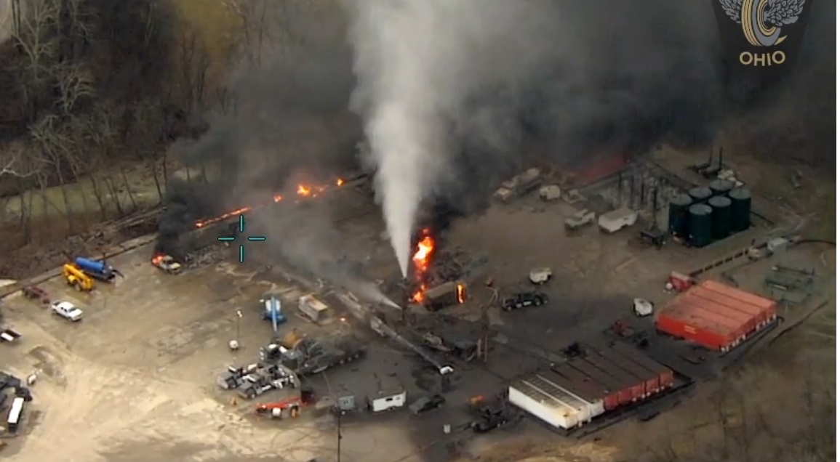
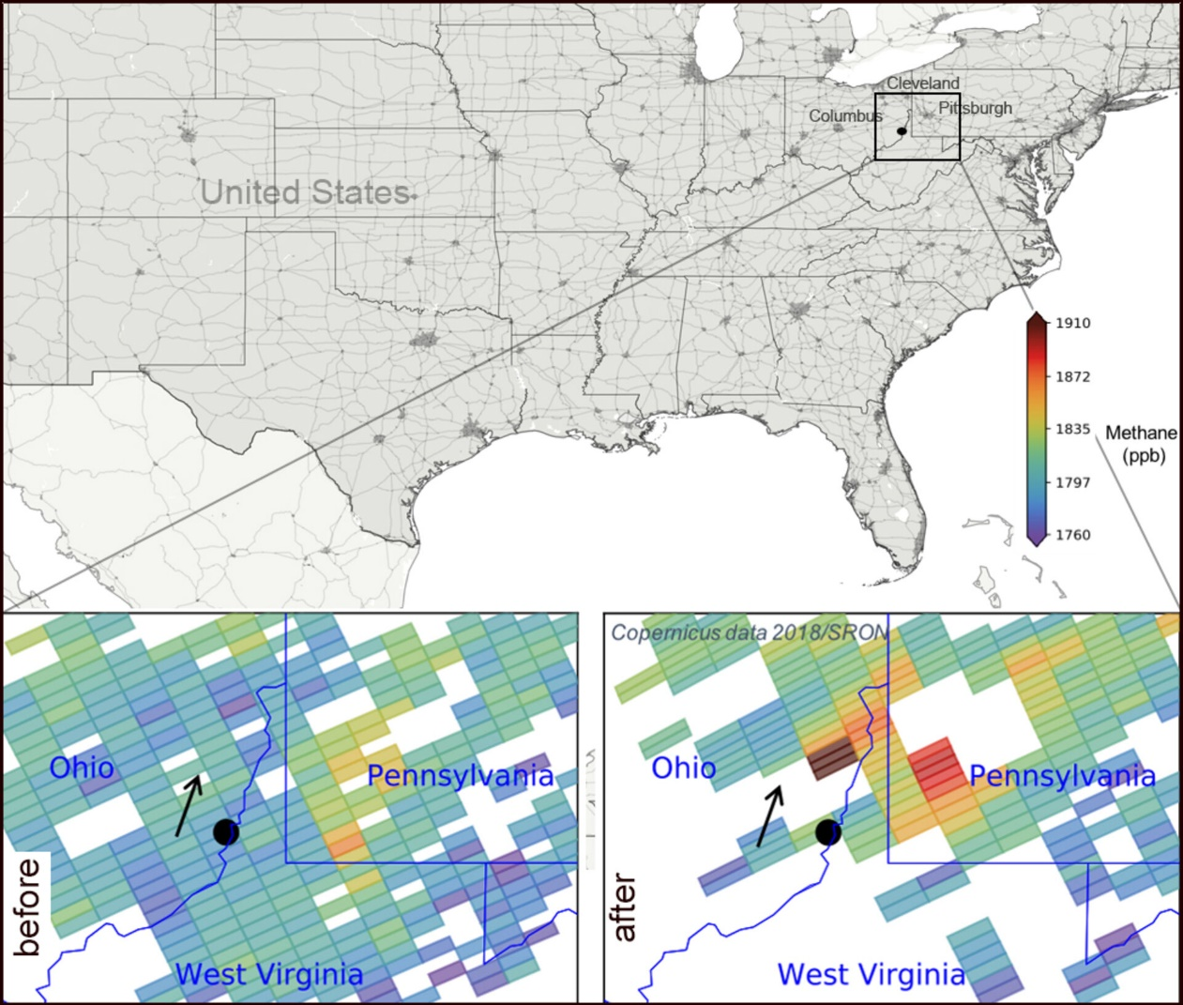
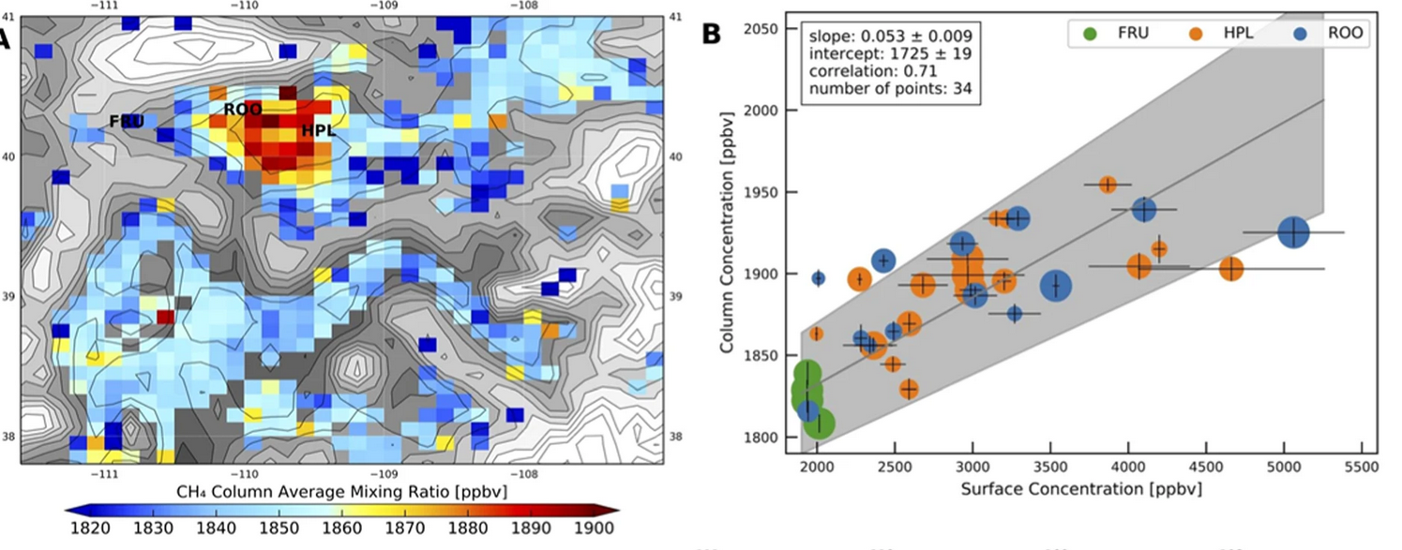
Measuring CH₄ in the atmosphere
CH₄ has ~1800 parts per billion in air.
Atmospheric lifetime around 12 years
No significant biogenic fluxes leading to a stable background.
Sentinel-5-Precursor
NO₂
Methane leaks by S-5p, in footprints of 40 km² with an anomaly up to ~90 ppb (5%)
NB smaller footprints will give higher anomalies
Courtesy: I. Aben, SRON

Slide 6
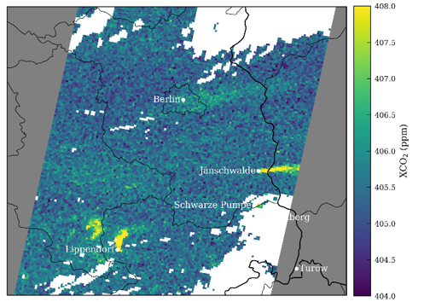

Measuring CO₂ in the atmosphere
CO₂ has roughly ~420 parts per million in air
Atmospheric lifetime is very long (long-lived trace gas)
Biogenic fluctuations are large; 5–10 ppm (unstable background)
Credits: EMPA
Simulated CO₂ plumes of Berlin and East German power plants.
City anomaly 1 ppm (0.25%)
Power plant anomaly 2 ppm (0.5%)
We are looking for ripples (emissions) in an ocean with large waves.
Observing the ocean is the easy part.
Detecting the ripples is a challenge, but characterizing them allowing emission quantification is the major challenge

Slide 7
Monitoring & Verification Support (MVS) Capacity
End-to-end System requirements to monitor CO₂
Detection of emitting hot spots such as megacities or power plants
Monitoring the hot spot emissions
to assess emission reductions/increase of the activities
Assessing emission changes against local reduction targets
to monitor impacts of the NDCs
Assessing the national emissions and changes
in 5-year time steps to estimate the global stock take

Slide 8
Monitoring & Verification Support (MVS) Capacity
End-to-end System requirements to monitor CO₂
Detection of emitting hot spots such as megacities or power plants
→ high precision CO2 data, high spatial resolution, no local biases
Monitoring the hot spot emissions
to assess emission reductions/increase of the activities
→ quantify emissions (plume info), frequent revisit
Assessing emission changes against local reduction targets
to monitor impacts of the NDCs
→ no regional biases, separate biogenic from anthropogenic fluxes
Assessing the national emissions and changes
in 5-year time steps to estimate the global stock take
→ no long-term drifts, high accuracy data, inter-calibrated

Slide 9
Overview of GHG Satellite Missions
GENERIC

Slide 10
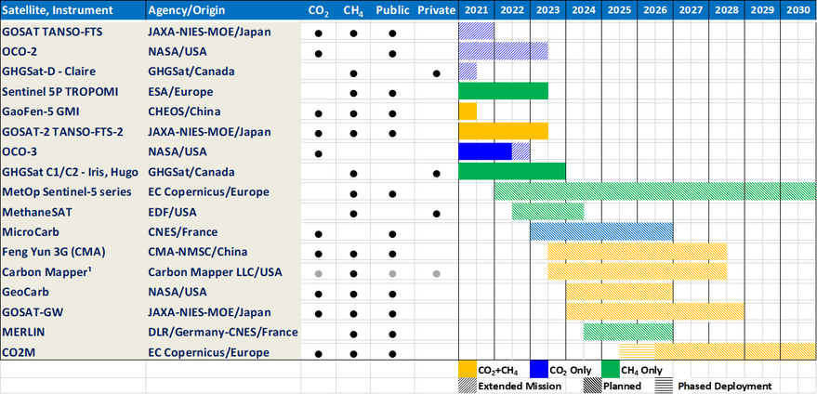
CO₂ Missions – Detection of Local Scale Emissions
At least some background compared to an enhancement should be detectable by these missions.
Not addressing frequency of observations or coverage.
DISCLAIMER: exemplary assessment & based on old overview
Not capable Capability unknown

Slide 11
CEOS Work Plan & Way forward 1/2
        Next steps of GHG Task Team:
        Align for GHG TT activities and converge with the AFOLU Roadmap
        (covered in CARB-20-01 & GST-2022-06)
        Prepare the community for the products of new upcoming satellite missions & ensure continuity to earlier/existing missions
        New GHG Task Team actions with resources/support required, CEOS Work Plan (2023–2025):
        CARB-23-01: Lessons learnt from pilot CO2 and CH4 products (delivered for GST-1) → next slide
        CARB-23-02: Standards for uncertainty monitoring of flux estimates (side mtg. @IWGGMS), which is also an outcome of our GST-1 products ”Lessons learnt”
        CARB-23-03: GCOS IP response for GHG-related activities → second next slide
        CARB-23-04: Update GHG Roadmap (focus on Action List)
        CARB-23-05: New Space and GHG product development and standards setting

Slide 12
Lessons learned from GST pilot CO₂ and CH₄ products
Kindly provided by B. Byrne and J. Worden (NASA-JPL)
Key take-home message:
A number of challenges have been noted that need to be addressed for the GST product. However, it’s also important to note the substantial interest from both the public and policymakers in the product.
As noted at the WMO Workshop and the press release on these products, there is a clear need for this information with over 50 countries not reporting emissions in the last decade.
These lessons learned provide the context and motivation to advance and improve on these products.
→ Further details in backup slides

Slide 13
GCOS IP Response for GHG-related activities
B3.1 – Improve diurnal sampling of observations and coverage of GHGs, precursor
aerosols, and solar-induced fluorescence (SIF) to improve estimation of
emissions and vegetation carbon update
F2.2 – GHG at high latitudes with a focus on the permafrost regions in wintertime
F5 – Develop an integrated operational global GHG monitoring system
Design a constellation of operational satellites to provide near-real time global coverage of CO2 and CH4 column observations (and profiles to the extent possible)
Improve and coordinate measurements of relevant ECVs at anthropogenic emission hotspots (large cities, powerplants) to support emission monitoring and the validation of tropospheric measurements by satellites

Slide 14
CEOS Work Plan & Way forward 2/2
        GHG Task Team aims to meet again on Monday 16 October, which is jointly with WG Climate & before CEOS SIT TW of October 2023.
        Closing comments:
GHG Task Team welcomes the potential WMO initiative aiming to develop a
GHG Monitoring Infrastructure. Our role is likely to continue, as space expertise
lies within CEOS/CGMS.
We greatly thank Mark Dowell for leading the GHG Task Team in the past period!

Slide 15
Following slides are back-up slides with info on lessons learnt

Slide 16
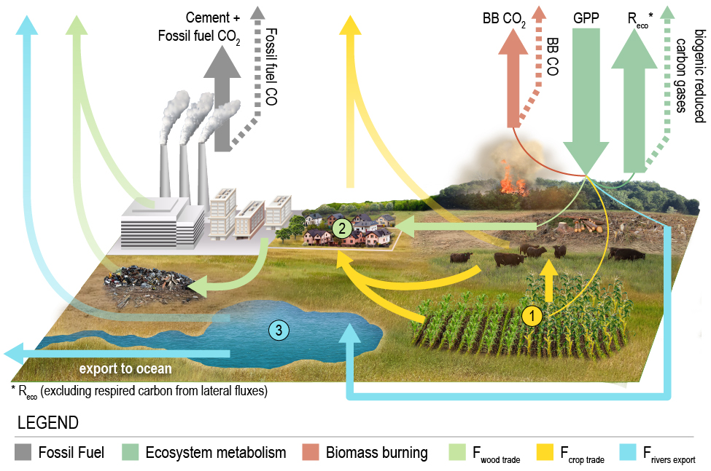
Review – CO₂ dataset
Byrne et al. (2023): https://doi.org/10.5194/essd-15-963-2023
Based on ensemble of CO₂ inversions (11 inversion systems)
  Luckily could take advantage of ongoing OCO-2 MIP activities.
  Allowed estimate of uncertainty from ensemble spread
Net surface-atmosphere fluxes were
corrected for fossil fuel emissions and
lateral fluxes to estimate carbon stock
changes (to be more comparable to
bottom-up inventories).
Provided estimates of country and 1x1 gridded
fluxes with uncertainties of: net surface-
atmosphere flux (NCE), change in terrestrial
carbon stocks (dC) and bottom-up fossil fuel
and lateral flux estimates
Illustration of how lateral C fluxes impact carbon budget

Slide 17
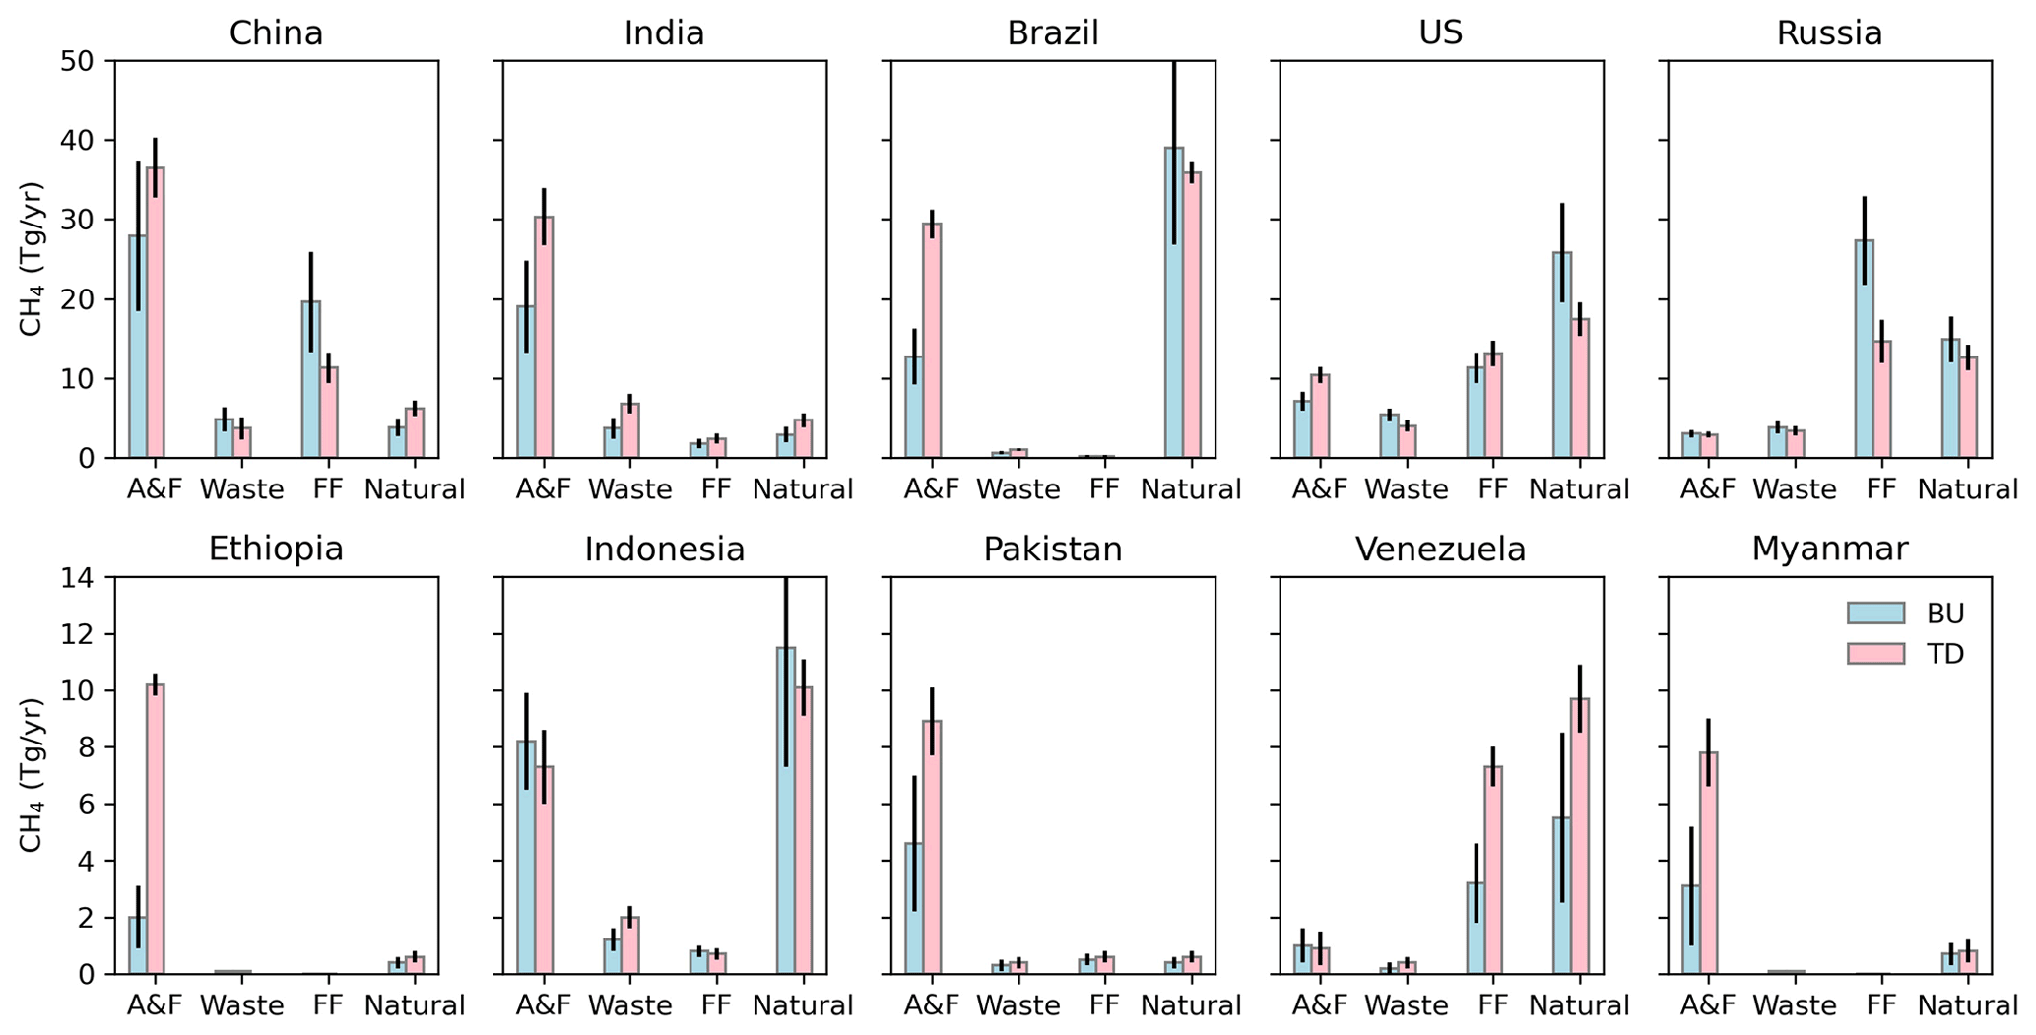
Review – CH₄ dataset
Worden et al. (2022): https://doi.org/10.5194/acp-22-6811-2022
Example Sectoral CH₄ emissions
Analytic inversion using GEOS-Chem model
  Allowed estimate of Bayesian uncertainty and information content from CH4 data (DOFs)
Net CH₄ emissions were decomposed into sectors:
Livestock, Rice, Waste, Fire, Oil, Coal, Gas, Seeps, and Wetland.
Provided sectoral emissions estimates with uncertainty estimates for countries and on a 1x1 grid.

Slide 18
Lessons learned:
1. Challenges in making apples-to-apples comparisons
Changes in atmospheric CO₂/CH₄ mole fractions are a result of net fluxes due to all sources and sinks. Inventories track emissions/removals due to specific processes.
Particularly challenging for CO₂, where isolating impact of land management is challenging:
  Countries do not provide maps of managed lands.
  There are also large uncertainties in lateral fluxes, particularly at sub-national scales.
  Fossil fuel biases (which are assumed un-biased) will also impact land emission/removals estimates.
CH₄ benefits from comparatively distinct sectoral sources, which show distinctive enhancements in CH₄.
An Analytic solution also improves the comparison between estimates as prior information and correlations in the estimate (e.g. smoothing error) can be quantified and accounted for with the comparison

Slide 19
Lessons learned:
2. Uncertainty quantification
Accurate assessment of uncertainties is critical. Challenging to characterize all components:
Errors associated with atmospheric inversion model/configuration (transport, biased priors).
  Can be estimated by using an ensemble of inversion models (was possible for CO₂ dataset but not CH₄)
Errors in GHG measurement – biases in particular.
  CO₂ dataset attempted to identify biases through comparisons of posterior model CO₂ fields with independent atmospheric CO₂ measurements that were not assimilated (found OCO-2 ocean glint data had significant biases).
  Regional biases are very challenging to identify due to sparse data for evaluating performance. For example, large regional flux differences in tropical in situ and OCO-2 inversions were indistinguishable when compared with independent data.
Bayesian posterior uncertainties.
  This characterizes the impact of errors in the observations and prior constraints on posterior flux estimates.
  Not characterized in many inversion techniques, only small subset of MIP models calculate. Of those that did, the estimates were hugely variable.
  Posterior errors and degrees of freedom were calculated for CH₄ dataset

Slide 20
Lessons learned:
3. Limitations for small and mid-sized countries.
Uncertainties are very large for mid-sized (e.g., Turkey-sized) and smaller countries. CH4 dataset suggests 57 countries are well constrained by the GOSAT data, with increased information expected when we can fully utilize TROPOMI data plus the plume mapping observations (i.e. an integrated multi-scale inversion approach)
Several main limitations:
  Data density from GOSAT / OCO-2 is still pretty sparse. Denser observational coverage would help capture smaller areas.
  Transport models are too coarse (many run at 4 x 5 degrees, which is insufficient for many countries).
  Biases in model transport and potential regional greenhouse gas retrievals limit the spatial scales that can be captured. We need to reduce both of there errors.

