Slide 1
SIT-38 2023 SIT Chair Priority Synthesis Report
Climate & Carbon
Stephen Briggs, ESA SIT Chair Team
Agenda Item 2.1
SIT-38, ESA/ESRIN
29 – 30th March 2023

Slide 2
SIT Chair Themes & Priorities

Slide 3
Climate & Carbon activities 2022-23
Bringing together a number of relevant activities across the CEOS program:
CEOS Global Stocktake Strategy Action Status (Item 2.2)
GHG Roadmap (Item 2.3)
WMO GHG Initiative (Item 2.4)
AFOLU Roadmap development (Item2.5)
Ocean Carbon Roadmap proposal (Item 2.6)
AFOLU/GHG Roadmaps relationship (Item 2.7)
WGClimate Activities Report (Item 2.8)
Update on CEOS Support to IMEO (Item 2.9)
GEO-TREES (Forest Biomass Reference System from Tree-by-Tree Inventory Data) Item 2.10)
EO Handbook Progress (Item 2.11)
Slide ‹#›

Slide 4
Session 2 – Climate and Carbon
Principal internal and external dependencies for this activity?
Internal: WGClimate, OCR-VC, AC-VC, WG Disasters, WG CapD, GHG and AFOLU Roadmap Teams
External: UNFCCC & Global Stocktake process, WMO, GCOS, GEO, IMEO
Main issues for Principal consideration in this session?
Is CEOS delivering an effective response to the GST?
Is our ‘Roadmap approach’ working and what is our strategy around their combination/evolution
How is CEOS connecting to adjacent activities in UNFCCC, WMO, GCOS, GEO, and IMEO?
Decisions in this session
Whether and how we progress towards an Ocean Carbon Roadmap
What data support can be provided to IMEO
CEOS connection to WMO GHG initiative
Resource and other requests to support those decisions?
Further actions towards GST-1 / 2023
Roadmap actions
Possible data support to IMEO
EO Handbook contributions by request

Slide 5
SIT-38 2023 CEOS GST Strategy Update
Stephen Briggs, SIT Chair Team
Agenda Item 2.2
SIT-38 2023, ESA/ESIRIN
29 – 30th March 2023

Slide 6
GST Strategy actions - update
GST Strategy Document V3.1 approved at CEOS Plenary Nov 2021
Document contains 9 Recommendations for specific actions on CEOS Agencies and CEOS bodies to support the GST
Actions derived from the recommendations are included in the overall CEOS Work Plan and are complementary to those already carried out by CEOS bodies in support of the GST. Ongoing work contributes significantly in areas such as adaptation.
Many different elements of CEOS (WGs, VCs and others) contribute under SIT Chair leadership.
Recommendations status summarised in below with more detail in agenda Items 2.3 – 2.8

Slide 7
GST Actions - update
GST Recommendations 1,2: Update WG Climate GHG Task Force Report Annex C: Contributions to updates include those from:
WGClimate Workshop on Gap Analysis 18-20 May 2022 and GHG TF Report + Recent meetings of GHG TF (2 Feb 2023) and WGClimate (1 March 2023) discussing Annex C (see Item 2.3)
WMO GHG workshops 10-12 May 2022, 30 Jan -1 Feb 2023 (Geneva) on Carbon Cycle in Earth System Science and GHG Observations (reports available from WMO) designing overall way forward
AFOLU/GHG Workshop Nov 2021, JRC/virtual + AFOLU Workshop 12 Sept 22 Items 2.5, 2.7
Ocean Carbon Workshop Feb 14-18 2022 (virtual) led by ESA/NASA, proposal for follow up of Ocean Roadmap discussed in Item 2.6
Carbon from Space IV October 2022, ESRIN - CEOS GST Presentation, wide discussion between space agencies and global terrestrial carbon science community.
Notes:
(Item 2.3)

Slide 8
GST Actions - update
Recommendation 3: Inform the report of CEOS to UNFCCC/RSO discussion on observations to support the implementation of the Paris Agreement and should pro-actively flow into the consultancy process of the UNFCCC / Ad hoc group for the Synthesis Report on Observations for the GST. CEOS should also report on this at the Earth Information Day at COP. Actions undertaken include:
Multiple contributions to Earth Information Day at COP 27, Sharm El-Sheikh and preparations ongoing for EID at COP-28 in UAE. Possible CEOS participation in proposal of GEO for EO Task Force and Space Pavilion at COP 28?
Representation from WG Climate, GHG Task Force and AFOLU Task Team at RSO discussion at COP 27
Contributions from all these to the Synthesis Report on Systematic Observations fto COP27: substantial document (140 pp., see Item 1.13)

Slide 9
GST Actions - update
Recommendation 4: CEOS should consider, in conjunction with modellers, setting up one or more focussed observational campaigns as a major contribution to the understanding of trends in natural GHG emissions and removals in key areas.
NASA/ESA/CNES/DLR conducted AMPAC Campaign aimed at understanding methane emissions from tundra under warming conditions. AMPAC Training Course on Arctic Methane and Permafrost held Sept 2022, Norway. Possible extension of AMPAC to 2024 season.
Ongoing discussion re possible 2024 Amazon airborne /in situ/ satellite campaign on Carbon cycle and GHG, INPE/ESA/NASA et al. held with science community at CFS4 workshop, October 2022
Discussions on campaigns with both public sector and private sector in oil and gas extraction locations e.g. Permian Basin through IMEO

Slide 10
AMPAC Follow-on campaign and related actions
2021 data from Kiruna analysed as part of MAGIC project {FR(CNES&CNRS) /DLR/ESA/EUM}, Comet 2.0 data analysis {DLR, NASA} about to start
January 2023 workshop, Helsinki - initial results from AMPAC 2022:
Need for winter data
Include MERLIN and other data in future
L-band SAR data (NISAR,ROSE-L) to address permafrost issues such as tipping point melting and identifying wet-dry transitions
ENMAP tasked to assess plant functional types over key sites (preparing for CHIME mission), monthly/biweekly
AMPAC data held at Alfred Wegener Institute APGC website (DE)
Further MAGIC campaign planned for northern latitudes in 2024

Slide 11
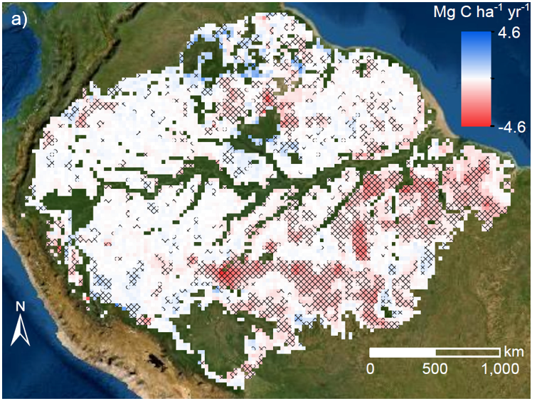
CLIMATE-SPACE: Scoping an Amazon experiment
Full demonstration of GHG stock-taking over the Amazon (Q3 2024?)
Trends in Amazon AGC 2011-2019 using satellite L-VOD
Potential Location: Tapajos (Para state)
Ongoing discussion with INPE
Climate Risk
Area was massively impacted by the last El Nino in 2015/16 leading to increased burning
(Increases in temperature, longer dry seasons, Gatti et al., 2021, Nat.)
Land Cover
Full range of land cover types (degraded, agriculture, secondary and intact forests)
Mix of challenges for models in the arc of deforestation
Spatio-temporal variation in carbon stocks and fluxes (CO₂, CH₄) associated with different land cover types
Fire modelling; response of intact forest to climate
Lack of representation of secondary / degraded forests in models (disturbance & recovery dynamics; new PFTs for secondary forests)
Mosaic and edge effects (i.e. landscape heterogeneity)
Representation of agriculture
…
Fawcett et al., GCB,
Amazon biomass in decline due to deforestation and degradation (esa.int)

Slide 12
GST Actions - update
Recommendation 5: The AFOLU Roadmap Team and WGClimate GHG Task Team should work together to ensure consistency between data for emissions reported via AFOLU and for prior biogenic terrestrial emissions, and those due to changing land use, in implementing monitoring and verification systems.
Joint AFOLU – GHG Workshop held at JRC/virtual in Nov 2021
Outcomes inform WG Climate discussion on GHG TF Annex C requirements
Discussions at AFOLU Workshop Sept 2022, and see items 2.5, 2.7
Work of both Teams contributes to overall approach to developing satellite - based emissions estimates

Slide 13
GST Actions - update
Recommendation 6: It is recommended that to help in ensuring the take-up of satellite-based methods for AFOLU (and indeed in the context of MVS) CEOS should work with a few selected demonstrator countries to assist them in their national reporting under AFOLU (the model of GFOI can be compared).
Silvacarbon has led action in this area with local training courses in 2022, to be fully described tomorrow under the LSI-VC reporting by Sylvia Wilson
Recommendation 7: CEOS should work with various partners set out above to identify data requirements and actions for CEOS in relation to adaptation.
Primary actions through collaboration on adaptation with GEO through GEO Climate Change Working Group sub-group on Adaptation. Reported to COP27.
Ongoing work in e,g, WG Disasters, LSI-VC, SDGs etc.
WG Climate Use Cases for climate services provide examples of adaptation
Possible side event at SBSTA-58 June 2023 with GEO?
3.4)
Notes:
c

Slide 14
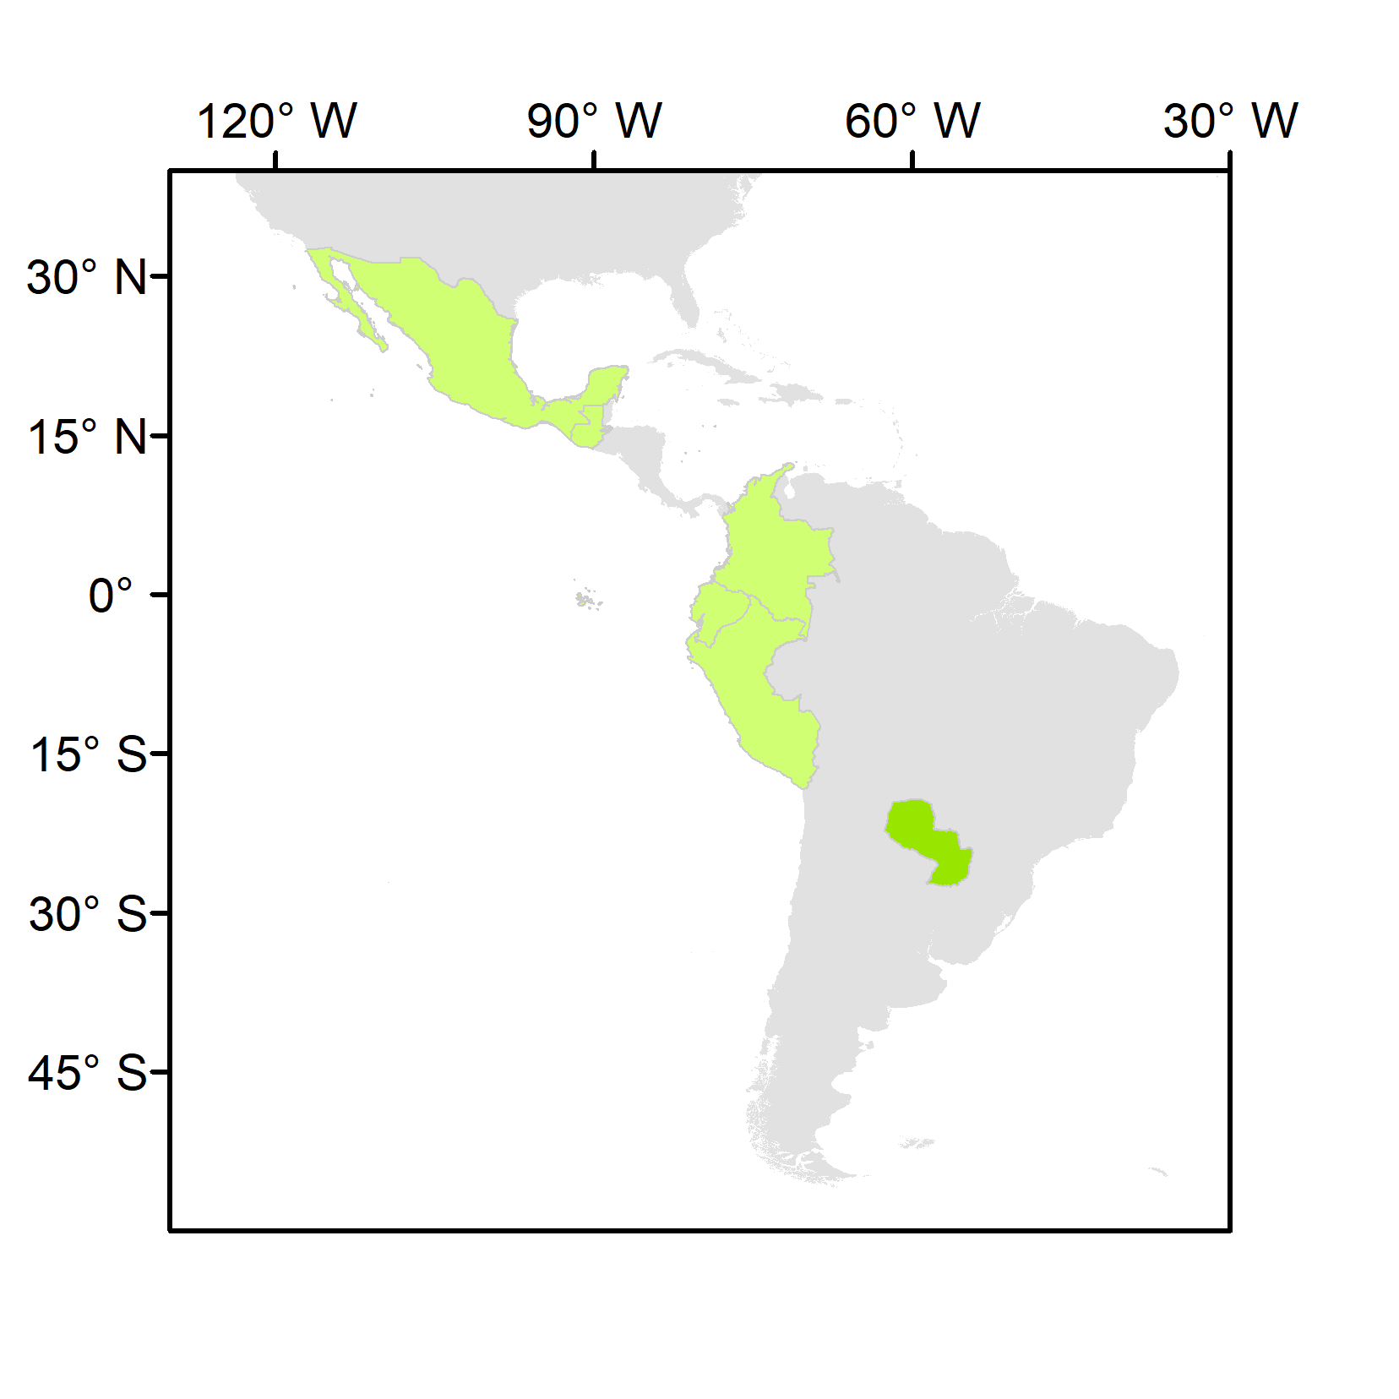
National Inventory User Engagement
1st SilvaCarbon/CEOS Regional Workshop – Biomass measurements
Paraguay, June 2022
 | Country | REDD+ FRL latest submission | REDD+ FRL previous submissions | BUR REDD+ Annex | BUR | NIR | NFI
Latin America and the Caribbean | Colombia | 2020 | 2015 | 2016, 2019 | 2015, 2018, 2022 | 2019 | Yes
 | Ecuador | 2020 | 2015 | 2016 | 2016 | 2017 | Yes
 | Guatemala | 2022 | n.a. | n.a. | n.a. | n.a. | partial
 | Mexico | 2020 | 2015 | n.a. | 2015, 2019 | 2019 | Yes
 | Paraguay | 2022 | 2016 | 2019 | 2015, 2018, 2021 | n.a. | Yes
 | Peru | 2021 | 2016 | n.a. | 2014, 2019 | 2019 | Yes
National teams to present their NFIs, and the data and methods currently used in reporting and domestic MRV
JAXA, ESA, NASA to present:
the available datasets and methodologies to measure land use GHG fluxes
demonstrations of opportunities for their uptake
a clear plan for sharing of NFI data and collaborating in the calibration/validation of products
LULUCF experts in IPCC guidance (nominated in the UNFCCC roster by their Governments or contributors to the 2019 refinement of the IPCC guidelines)
Colombia Ecuador Guatemala Mexico Paraguay Peru

Slide 15
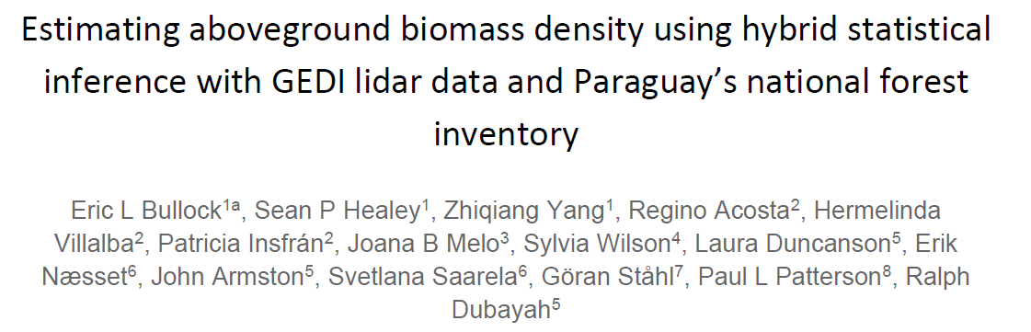
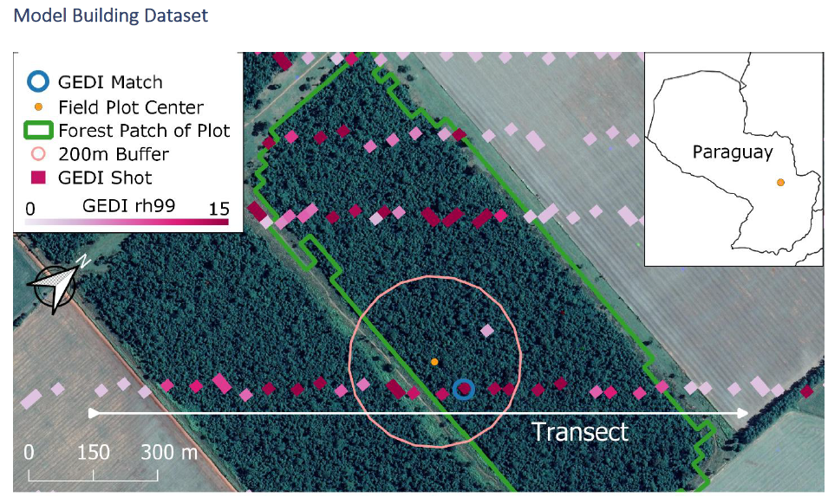
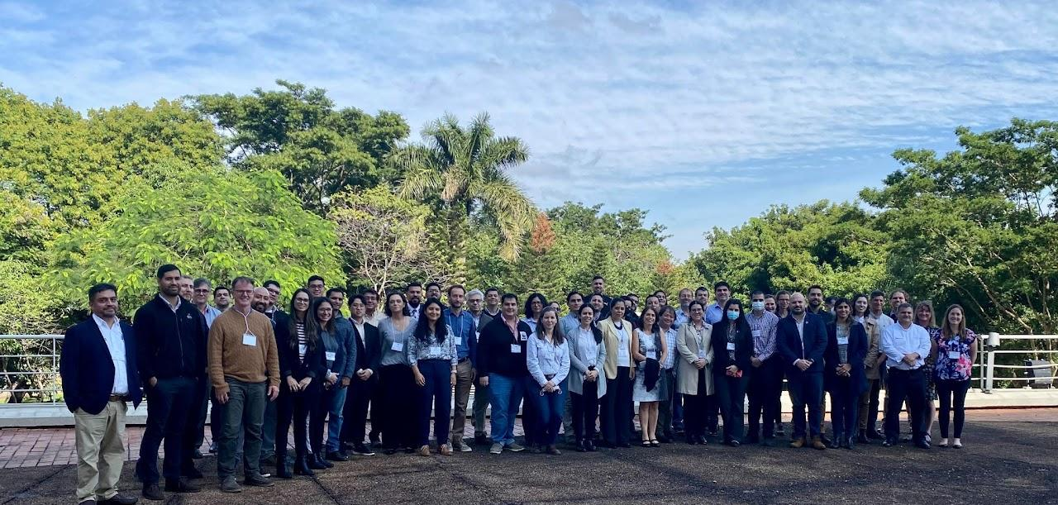
National Inventory User Engagement
2023 update
1st SilvaCarbon/CEOS Regional Workshop – Biomass measurements; Paraguay, June 2022

Slide 16
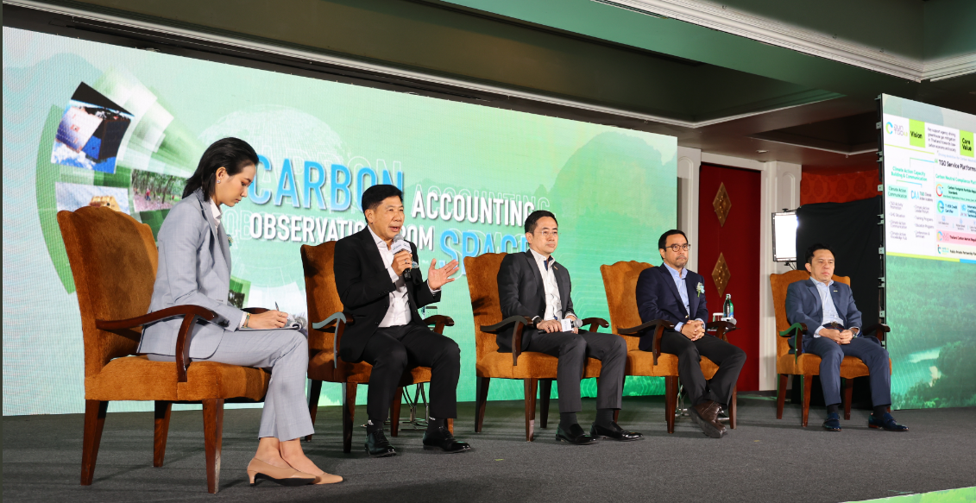
National Inventory User Engagement
2nd SilvaCarbon/CEOS Regional Workshop – Uptaking Global AFOLU Datasets
Thailand, February 2023
The workshop has the broad objective of better connecting Southeast Asian national forest inventory agencies with CEOS space agencies to improve the uptake of EO datasets.

Slide 17
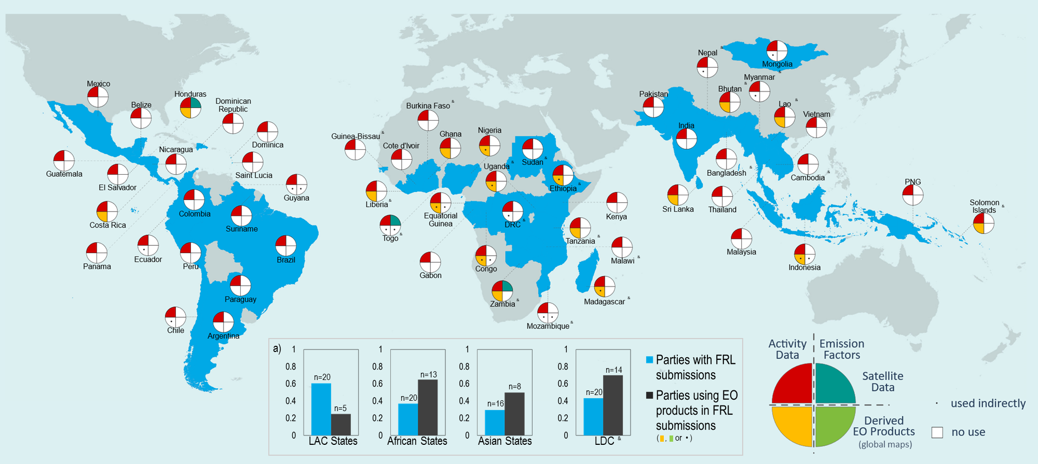
National Inventory User Engagement
2023 update
Baseline to measure progress on the uptake of satellite-based global maps in the next cycle of the GST
(developing countries covering 80% of tropical forests)
Joana Melo et al 2023 Environ. Res. Lett.

Slide 18
GST Actions - update
Recommendation 8: CEOS should maintain a watch over the implementation of projects funded through climate fund mechanisms to ensure that all appropriate assistance is given by agencies in their implementation and governance.
Work for COP-28 with GEO on likely focus on loss and damage and other funding issues under UAE leadership, technically similar to adaptation needs
Private finance issue becoming increasingly important: economic basis for climate action stressed in some countries and ongoing discussion with GEO.
Recommendation 9: CEOS must continue all efforts to provide the necessary baseline
climate data records which support the long term modelling of the Earth system, its response to changing GHG emissions and other drivers, and impacts of climate change.
Supported through WGClimate gap analysis (see item 2.8) for ongoing support to modelling
Cooperation with GCOS on GCOS IP 2022 satellite supplement (also item 2.8)
Further discussion with GCOS and WMO through WMO GHG Workshops (May 2022, Jan 2023) with focus on processes related to GHG emissions and removals

