Slide 1
CEOS 2023-2025 Work Plan
Marie-Claire Greening
CEOS Executive Officer
Agenda Item 1.2
SIT-38, ESA/ESRIN
29th - 30th March 2023

Slide 2

Governance & Work Planning
Four key governing documents primarily guide the work of CEOS:
  CEOS Terms of Reference defines the mission and scope of CEOS activities
  CEOS Strategic Guidance document articulates the overarching long-term (7-10 years) purpose and goals of CEOS
  CEOS Governance and Processes document provides guidelines on the structure, operations, and processes CEOS employs to achieve its goals
  CEOS Work Plan (3-year rolling) sets forth near-term actions to achieve the goals outlined in the CEOS Strategic Guidance document
The CEO is the custodian of all CEOS Governing Documents, including the annual update of the 3-year CEOS Work Plan and the definition and monitoring of the deliverables it informs

Slide 3


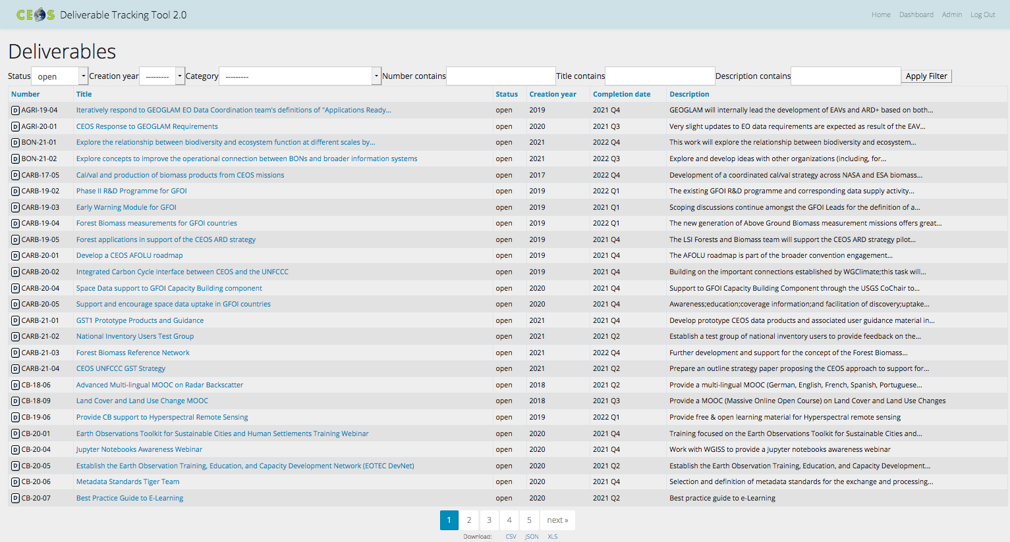
CEOS Work Plan
3-year plan updated by all CEOS entities every year and put forward for formal endorsement at SIT in March. Rigorous work planning, execution and monitoring is critical to CEOS’s credibility.
Jan
Dec
Feb
SIT
Nov
Mar
Plenary
Oct
Apr
Sep
May
SIT TW
Aug
Jun
Jul
Detailed work defined as deliverables: outlined in the WP, reconciled and tracked in CEOS deliverable tracking tool

Slide 4
CEOS Work Plan Structure
 | Chapter in Work Plan | Responsible
1 | Climate Monitoring, Research, and Services | WGClimate
2 | Carbon Observations in Support of Climate Science and Policy | GHG Task Team, GFOI, AFOLU
3 | Observations in Support of the Global Stocktake of the UNFCCC | UNFCCC
4 | Observations for Agriculture | GEOGLAM, AFOLU
5 | Observations for Disasters | WGDisasters
6 | Observations for Water | GEO AquaWatch
7 | Data Quality | WGCV
8 | Capacity Building and Data Democracy | WGCapD
9 | Data Discovery, Access, Preservation, Usability and Exploitation: approaches, systems, tools and technologies | WGISS
10 | Advancement of the CEOS Virtual Constellations | VCs, ARD Oversight Group
11 | Support to Other Key Stakeholder Initiatives | SDG Coordination Group, NSTT, EETT, COVERAGE, COAST AHT, UN SDGs, GEOBON, GEO Blue Planet, MBON
12 | CEOS Services

Slide 5
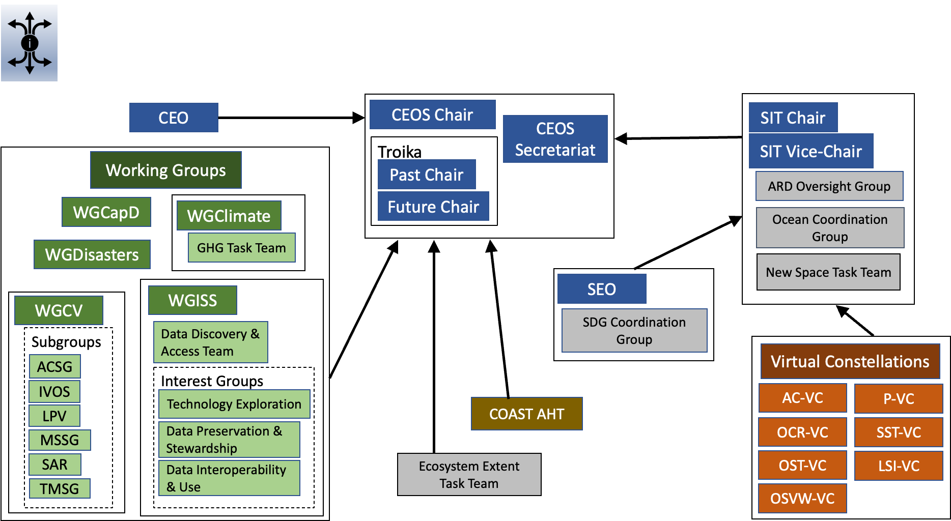

Slide 6
2022 Progress
Chapter |  | Closed from 2022-24 WP | Carried over from 2022-24 WP | New for 2023-25 WP
1 | Climate Monitoring, Research, and Services | 3 | 4 | 4
2 | Carbon Observations in Support of Climate Science and Policy | 0 | 11 | 5
3 | Observations in Support of the Global Stocktake of the UNFCCC | 2 | 8 | 0
4 | Observations for Agriculture | 1 | 3 | 0
5 | Observations for Disasters | 4 | 9 | 0
6 | Observations for Water | - | - | -
7 | Data Quality | 1 | 7 | 6
8 | Capacity Building and Data Democracy | 16 | 12 | 8
9 | Data Discovery, Access, Preservation, Usability and Exploitation: approaches, systems, tools and technologies | 2 | 5 | 2
10 | Advancement of the CEOS Virtual Constellations | 12 | 17 | 13
11 | Support to Other Key Stakeholder Initiatives | 12 | 3 | 15
 | Totals | 53 | 79 | 53

Slide 7
Current deliverable deadlines
Chapter |  | 2023 | 2024 | 2025 & beyond
1 | Climate Monitoring, Research, and Services | 5 | 2 | 1
2 | Carbon Observations in Support of Climate Science and Policy | 15 | 1 | 0
3 | Observations in Support of the Global Stocktake of the UNFCCC | 8 | 0 | 0
4 | Observations for Agriculture | 1 | 2 | 0
5 | Observations for Disasters | 3 | 5 | 1
6 | Observations for Water | - | - | -
7 | Data Quality | 6 | 4 | 3
8 | Capacity Building and Data Democracy | 16 | 4 | 0
9 | Data Discovery, Access, Preservation, Usability and Exploitation: approaches, systems, tools and technologies | 6 | 1 | 0
10 | Advancement of the CEOS Virtual Constellations | 13 | 8 | 9
11 | Support to Other Key Stakeholder Initiatives | 17 | 1 | 0
 | Totals | 90 | 28 | 14

Slide 8
CEOS Work Plan links to SIT-38
 | Chapter in Work Plan | SIT-38 Session links
1 | Climate Monitoring, Research, and Services | 2
2 | Carbon Observations in Support of Climate Science and Policy | 2
3 | Observations in Support of the Global Stocktake of the UNFCCC | 2
4 | Observations for Agriculture | 7
5 | Observations for Disasters | 7
6 | Observations for Water | 5
7 | Data Quality | 7
8 | Capacity Building and Data Democracy | 7
9 | Data Discovery, Access, Preservation, Usability and Exploitation: approaches, systems, tools and technologies | 7
10 | Advancement of the CEOS Virtual Constellations | 7
11 | Support to Other Key Stakeholder Initiatives | 3, 4, 5, 6

Slide 9
Thank you!
Marie-Claire Greening
CEOS Executive Officer
Agenda Item 1.2
SIT-38, ESA/ESRIN
29th - 30th March 2023

