Slide 1
SIT-38
Session 1 SIT Chair Welcome and Session Introductions
SIT Chair Team, ESA
SIT-38 2023, ESA/ESRIN
29th - 30th March 2023

Slide 2
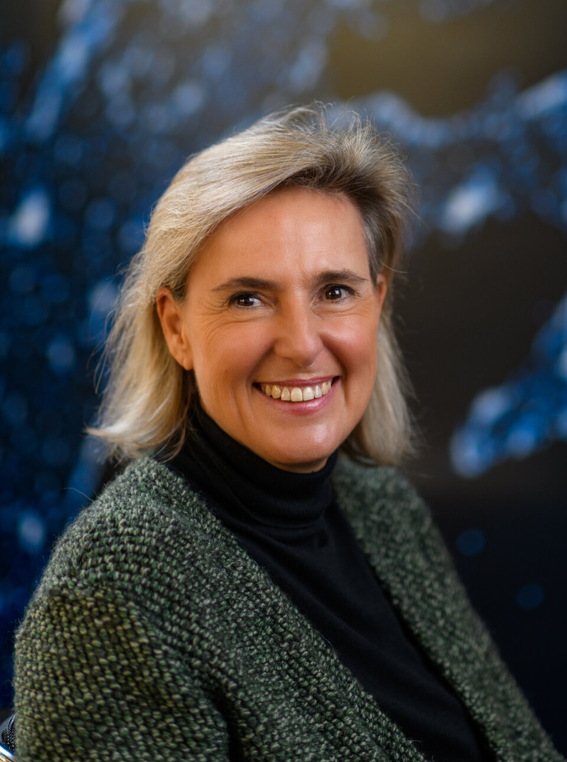
Welcoming Remarks
Simonetta Cheli
CEOS SIT Chair 2022-2023
ESA Director of Earth Observation Programmes
Head of ESA/ESRIN
SIT Chair Team, ESA
SIT-38 2023, ESA/ESRIN
29th - 30th March 2023

Slide 3
SIT Chair Priorities
Good progress on all 2022-2023 SIT Chair priorities:
Support to Societal Challenges and the Global Agendas
Create new opportunities for EO space agencies by expanding the communities of users through GEO and other key stakeholders
Define and implement the actions necessary for fostering the partnership of CEOS agencies with the New Space sector, in order to improve the quality of information and services provided to users.
Foster the development and use of innovative Digital Services (data access, data processing,..)

Slide 4
SIT-38 Topics and Objectives
CEOS Engagement with Global Agendas
Climate and Carbon UNFCCC, Paris Agreement and Global Stocktake
Sustainable Development Goals 2030 Agenda
Disaster Risk Reduction Sendai Framework
CEOS Principal-level discussion, decision making, and resource allocation and coordination focused on realising defined two-year targets

Slide 5
SIT-38 Agenda at a Glance
Tuesday March 28th | Wednesday March 29th | Thursday March 30th
Side Meetings CEOS SEC; SDGs, ARD OG, New Space, Interoperability, Communications, | SIT-38 Day 1 CEOS 2023-2025 Work Plan; Carbon and Climate; SDGs; Biodiversity; Oceans and Coasts; | SIT-38 Day 2 New Space; Working Group and Virtual Constellation Topics; CEOS Mini-Plenary Session; GEO Update; SEO Update and, SIT-38 Outcomes and Actions Review
Day 1 will close with a Phi Experience Tour (ESRIN), followed by bus transfer to a hosted dinner
Slide ‹#›

Slide 6
Core Questions for SIT-38
Is CEOS and its Agencies maximising the impact Earth observation can have on the Paris Agreement and Global Stocktake, Oceans and Coasts, Biodiversity, and the Sustainable Development Goals?
Are we (CEOS) making the most of the ‘New Space moment’? Are there actions we can be taking to maximise the impact made by the foundational technologies and datasets CEOS Agencies have invested in creating? What could be the respective roles of both CEOS and the New Space sector in this changing landscape? Can this be translated into coordinated actions at the CEOS and/or Agency level?
Slide ‹#›

Slide 7
SIT-38 Sessions - Day 1
Session 2 - Carbon and Climate: engagement with the Global Stocktake (GST) Process under the UNFCCC Paris Agreement, carbon Roadmaps, International Methane Emissions Observatory (IMEO)
Session 3 - Oceans and Coasts: Improved coordination of CEOS oceans and coasts-related activities, support to the UN Decade of Ocean Science for Sustainable Development, and the Paris Agreement GST.
Session 4 - Biodiversity How is the Ecosystems Extent Task Team (EETT) progressing, outcomes of the Convention on Biological Diversity (CBD) 15th Conference of the Parties (CBD COP15) in December 2022
Session 5 - Sustainable Development Goals: review of current and planned deliverables, confirm future governance
Slide ‹#›

Slide 8
SIT-38 Sessions - Day 2
Session 6 - New Space Significant interest in how best to engage companies in the “New Space sector” that may bring an important added value to the public upstream and downstream sectors, for which the ultimate beneficiaries are data users.
Session 7 - Working Groups and Virtual Constellations topics nominated
Session 8 - CEOS Chair session on priorities (a need for a mini-Plenary session was not identified)
Session 9 - Closing Session including GEO, review of outcomes and actions
Slide ‹#›

Slide 9
Tour de Table
Round table introduction by Principals of members of their delegation (in person and online)
Slide ‹#›

Slide 10
Hybrid Meeting Protocols
Both in room and online presenters should join the WebEx and share screen to present
Presentation machine in the room available (with clicker)
Presentations should be self-uploaded here.
https://drive.google.com/drive/u/0/folders/1TbhAFWJHEwt7f6rwQXZe_F6pM02S54bJ
Online Participants
Please do not activate your webcam unless you are presenting
If your bandwidth is slow while presenting, please turn off your webcam
Please mute if you are not presenting or making an intervention
If you want to intervene, please, send a message in the chat

Slide 11
Session Introduction Slides
Slide ‹#›

Slide 12
Session Introduction Slides
At the start of each Session the SIT Chair Team will review a brief set of introduction slides
The aim of these slides will be to identify an initial set of key discussion and decision points to address during the Session
Intention is not to be prescriptive but to help focus the discussion on what needs to be decided here this week at SIT-38
Questions
Who are the internal and external dependencies for this activity?
What are the main issues for Principal discussion in this session?
What are the decisions to be made in this session?
What are the resource and other requests being made to support those decisions?
Slide ‹#›

Slide 13
Session 2 - Climate and Carbon
See Session 2 Introduction slides linked here
Slide ‹#›

Slide 14
Session 2 - Agenda Outline
2.1 | Session Introduction SIT Chair Team | 10 mins
2.2 | Update on the CEOS Strategy for the Global Stocktake Stephen Briggs/SIT Chair Team | 20 mins
2.3 | Greenhouse Gas (GHG) Roadmap Yasjka Meijer, WGClimate GHG Task Team | 20 mins
2.4 | WMO GHG Initiative Update (for information) Lars Peter Riishojgaard, WMO | 20 mins
2.5 | CEOS AFOLU Roadmap Ben Poulter, LSI-VC Forests & Biomass Team | 20 mins
2.6 | Aquatic Carbon Roadmap Proposal Marie-Helene Rio, OCR-VC | 15 mins
2.7 | AFOLU and GHG roadmaps - comparison of paradigms Discussion led by Stephen Briggs, ESA SIT Chair Team | 10 mins
2.8 | WGClimate Activities Jeff Privette, WGClimate [remotely] | 20 mins
2.9 | Update on CEOS Support to IMEO Stephen Ward, SIT Chair Team | 5 mins
2.10 | GEO-TREES SIT Chair Team for Klaus Scipal, ESA | 5 mins
2.11 | EO Handbook Progress Stephen Ward, SIT Chair Team | 10 mins
2.12 | Discussion SIT Chair Team Moderator | 15 mins
Slide ‹#›

Slide 15
Session 3 - Sustainable Development Goals
Internal and external dependencies for this activity?
Internal: SEO, contributing VCs, WGs
External: GEO/EO4SDGs, GEO Secretariat, SDG Custodian Agencies and other stakeholders
Main issues for Principal discussion in this session?
How is the CEOS approach to SDGs working in practice? (incl. Coordination across CEOS entities)
Should CEOS undertake data analysis for more SDG Indicators (EO support Sheets) or explore other contributions to SDG (e.g. consider Targets level - still supporting the 2030 Agenda)?
Decisions in this session?
Agree on the proposed way forward for achieving the Deliverables for 2023
Resource and other requests to support those decisions?
Confirm support from across CEOS to realise 2023 Deliverables
Continued Coordination Group governance (SIT Chair strategic oversight with SEO implementation)
Slide ‹#›

Slide 16
Session 3 - Agenda Outline
3.1 | Session Introduction SIT Chair Team | 5 mins
3.2 | CEOS Support to the SDGs Dave Borges, CEOS SEO | 20 mins
Slide ‹#›

Slide 17
Session 4 - Biodiversity
Internal and external dependencies for this activity?
Internal: Ecosystems Extent Task Team, particularly resources (people’s time) and perhaps technical capabilities
External: Feedback from users
Main issues for Principal discussion in this session?
White paper outline/draft and related resource requirements
Demonstrator initiative(s) selected by the Task Team and related resource requirements
Decisions in this session?
Feedback on white paper and demonstrator
Possible leverage of other CEOS activities to support the selected demonstrator(s)
Co-Lead replacement for Marie-Josée Bourassa
Resource and other requests to support those decisions?
Sustained resources for the Ecosystems Extent Task Team to complete its white paper and develop the proposed demonstrator(s)
Slide ‹#›

Slide 18
Session 4 - Agenda Outline
4.1 | Session Introduction Marc Paganini/SIT Chair Team | 5 mins
4.2 | Ecosystems Extent Task Team (EETT) Gary Geller, Sandra Luque/EETT Co-Chairs | 20 mins
4.3 | Biodiversity COP-15 Outcomes Marc Paganini/ESA | 10 mins

Slide 19
Session 5 - Oceans and Coasts
Internal and external dependencies for this activity?
Internal: Ocean Coordination Group, CEOS-COAST, COVERAGE, SST-VC, OCR-VC, OSVW-VC, OST-VC
External: UN Decade of Ocean Science for Sustainable Development (‘UN Decade’), GST
Main issues for Principal discussion in this session?
Progress and impact of CEOS support to UN Decade
Accomplishments of COVERAGE over five years, and its evolution
How can CEOS best optimise the coordination of its ocean-related activities
Feedback from Principals on the options presented
Decisions in this session?
Confirm priorities for CEOS ocean activity coordination: contributions to UN Decade and GST
Agree on the extension of the CEOS Ocean Coordination Group until CEOS Plenary 2023
Resource and other requests to support those decisions?
Resources to further develop the options for coordination
Slide ‹#›

Slide 20
Session 5 - Agenda Outline
5.1 | Session Introduction Marie-Hélène Rio/SIT Chair Team | 5 mins
5.2 | UN Decade of Ocean Science for Sustainable Development Emma Heslop/IOC, Nadia Pinardi/Co-Chair of CoastPredict | 15 mins
5.3 | COVERAGE Project Summary and Evaluation Nadya Vinogradova Shiffer, NASA | 15 min
5.4 | CEOS-COAST Pilots Paul DiGiacomo, NOAA | 10 mins
5.5 | Ocean Coordination Group Paul DiGiacomo, NOAA | 15 mins
5.6 | Day 1 General Closing Remarks SIT Chair Team | 10 mins
Slide ‹#›

Slide 21
Conclusion of Day 1
After the adjournment of day 1, a tour of the Phi Experience will be offered
Two parallel groups will start at different points along the tour, and rotate through
The approximate duration is 45-60 minutes
A hosted dinner will take place from 18:45 at La Collinetta
The bus will leave directly from ESRIN for the hosted dinner following the Phi Experience tour
www.lacollinettaeventi.com
Slide ‹#›

Slide 22
Session 6 - New Space
Internal and external dependencies for this activity?
Internal: New Space Task Team; External: New Space community
Main issues for Principal discussion in this session?
Scoping questions (preliminary list) from ‘Think Piece’
What is meant by “New Space”
What is out of scope ?
Win-win partnership opportunities
What interactions have there been so far at CEOS Agency level - lessons learned
What does an integrated EO sector look like?
What CEOS can do for New Space?
What New Space can do for CEOS?
Feedback on items from the NSTT Activities working document
Decisions in this session?
None.
Resource and other requests to support those decisions?
None.
Slide ‹#›

Slide 23
Session 6 - Agenda Outline
6.1 | Session Introduction Antonio Ciccolella/SIT Chair Team | 15 mins
6.2 | Agency Interventions (By Request) SIT Chair Team Moderated Beth Greenaway/UKSA: approaches to new space [10 mins] Yuko Nakamura/JAXA: activities with the commercial sector. [10 mins] Frederick “Fritz” Policelli/NASA: NASA Commercial Smallsat Data Acquisition (CSDA) Program [10 mins] | 30 mins
6.3 | New Space Task Team (NSTT) Antonio Ciccolella/ESA/NSTT | 30 mins
6.4 | Discussion All | 30 mins
Slide ‹#›

Slide 24
Session 7 - WGs, VCs
Internal and external dependencies for this activity?
Internal: WGCV, WGISS, WGCapD, P-VC, LSI-VC, AC-VC
External: EOTEC DevNet, GEO-GSNL
Main issues for Principal discussion in this session?
Potential contribution complementary to the way forward with New Space
Discussion and initial first steps towards engagement with standards organisations
Potential supports to the EOTEC DevNet Sustainability Plan
Potential support to the GEOGLAM Rapid Response for Food Security activity
Further support to the Kahramanmaraş Event Supersite
Precipitation Observation and Product Continuity
Support to the PM2.5 Roadmap
Decisions in this session?
None identified prior
Resource and other requests to support those decisions?
TBD
Slide ‹#›

Slide 25
Session 7 - Agenda Outline
7.1 | Session Introduction Philippe Goryl/SIT Chair Team | 5 mins
7.2 | Opportunities for Engagement with Commercial Sector in Calibration and Validation Philippe Goryl, WGCV | 20 mins
7.3 | CEOS Interoperability Framework Makoto Natsuisaka/WGISS, Peter Strobl/COM | 10 mins
7.4 | CEOS Engagement with Standards Organisations Discussion, SIT Chair Team | 20 mins
7.5 | Landsat Next Update Tim Newman/USGS | 10 mins
7.6 | Copernicus Data Space Ecosystem Ferran Gascon/ESA | 10 mins
7.7 | EOTEC DevNet Sustainability Plan Jorge Del Rio Vera/WGCapD | 20 mins
7.8 | WG Disasters and Kahramanmaraş Supersite Stefano Salvi/INGV, GEO-GSNL, WGDisasters | 20 mins
7.9 | Session Remarks SIT Chair Team | 5 mins
Slide ‹#›

Slide 26
Session 7 - Agenda Outline Continued
7.10 | Precipitation Observation and Product Continuity Chris Kidd, P-VC | 15 mins
7.11 | GEOGLAM and Rapid Response for Food Security Ian Jarvis/LSI-VC GEOGLAM Subgroup/GEOGLAM Project Office | 10 mins
7.12 | Progress Report on the PM2.5 Roadmap Barry Lefer/NASA/AC-VC | 5 mins

Slide 27
Session 8 - CEOS Mini-Plenary
Internal and external dependencies for this activity?
Internal: CEOS Chair
External: -
Main issues for Principal discussion in this session?
Feedback on progress on CEOS Chair 2023 Priorities
Decisions in this session?
None - mini-Plenary will not be required
Resource and other requests to support those decisions?
None
Slide ‹#›

Slide 28
Session 8 - Agenda Outline
8.1 | CEOS Mini-Plenary Topics CEOS Chair | No topics identified so no time allocated
8.2 | Progress on CEOS Chair 2023 Priorities CEOS Chair Team/GISTDA | 10 mins
Slide ‹#›

Slide 29
Session 9 - Other Business and Closing
Internal and external dependencies for this activity?
Internal: SEO, CEOS Chair, SIT Chair
External: GEO Secretariat
Main issues for Principal discussion in this session?
GEO post-2025 Working Group and CEOS
Focusing the purpose of CEOS meetings
Hear the opinion of the WG and VC teams as to the need for a VC/WG session in addition to TW.
Discuss outcomes from Sessions and confirm understanding
Decisions in this session?
Agreement not to replace Marie-Josée Bourassa on the post-2025 GEO Working Group (due to the WG nearing the end of its work)
Confirm the list of draft actions from SIT-38
Resource and other requests to support those decisions?
-
Slide ‹#›

Slide 30
Session 9 - Agenda Outline
9.1 | Update from GEO Secretariat Laurent Durieux (GEO Secretariat), Andreas Obrecht (GEO Secretariat), CEOS post-2025 Working Group Participants | 10 mins
9.2 | CEOS Systems Engineering Office Report David Borges, CEOS SEO | 10 mins
9.3 | CEOS Communications Libby Rose, CEOS SEO | 10 mins
9.4 | Distinct Purposes for CEOS Meetings ESA SIT Chair Team | 10 mins
9.5 | AOB | 5 mins
9.6 | Review of SIT-38 Session Outcomes SIT Chair Team | 30 mins
9.7 | Review of Draft Actions SIT Chair Team | 10 mins
9.8 | Closing Remarks SIT Chair Team | 5 mins
Slide ‹#›

