Slide 1
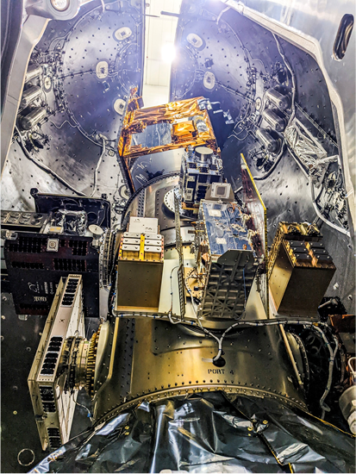
Next generation Hyperspectral Mission ready for launch with SpaceX on Friday April 1st 18:24 MEZ (12:24 EDT) livestream (starting 1h before launch): https://www.phoenix.de/mission-enmap-a-2730959.html?ref=suche
some previews:
https://www.dlr.de/content/en/articles/news/2022/01/20220302_to-space-from-bremen-via-hanover-and-florida.html
https://www.dlr.de/content/en/articles/news/2022/01/20220330_environmental-data-for-researchers-worldwide.html
6 months commissioning phase
Data freely available for scientists worldwide, archive and proposal for new acquisitions; check out https://www.enmap.org for more details and info
:

