Slide 1


Driving action through Data
International Methane Emissions Observatory - IMEO
CEOS - IMEO Cooperation,
Collaboration & Synergy
March 2022
Steven Hamburg
Chair – Scientific Oversight Committee
Notes:
Thanks for the invitation and for the opportunity to present the work of UNEP on the International Methane Emissions Observatory.

Slide 2


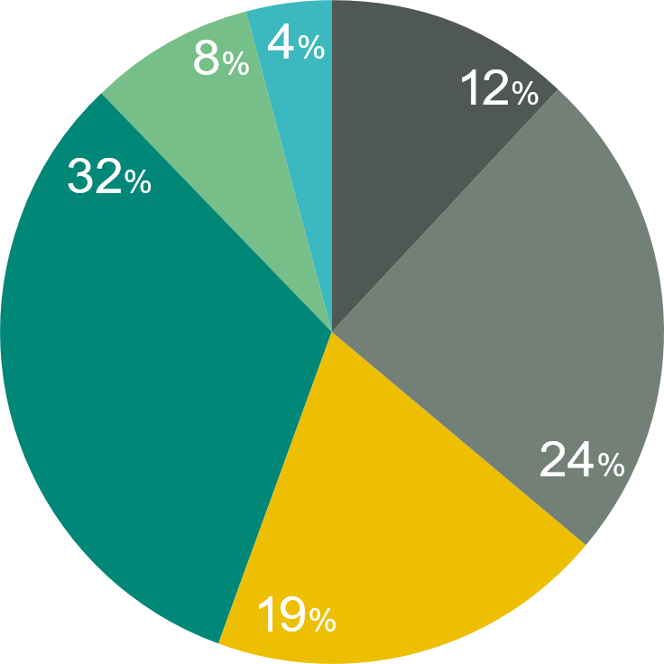



Anthropogenic methane emission sources
Anthropogenic Sources of Methane Emissions
Methane Emissions Reduction Potential by Sector
145
Total Emissions
(MMT)
Other
Rice
cultivation
Coal
84
Oil and gas
68
44
Min. abatement potential
Max. abatement potential
Remaining emissions
19
27
35
113
Livestock
Waste
Coal
Oil and gas
Waste
Agriculture
Maximum
Abatement
Potential
61%
68%
48%
22%
Source: Climate and Clean Air Coalition Global Methane Assessment
Notes:
Graphic Design:
We would like a bar chart displaying the mitigation potential for each sector based on the table above (design suggestions in the following slide). This chart should show the total abatement potential as well as the amount that can be mitigated at no net cost. IF POSSIBLE it would be great to have an animated chart that when clicked displays a 50% growth of the mitigation potential for all sectors.
Messaging:
Fossil fuels are responsible for 35% of human-caused emissions. In the fossil fuel sector, oil and gas extraction, processing and distribution account for 23 per cent, and coal mining accounts for 12 per cent of emissions.
Oil, gas and coal: the fossil fuel sector has the greatest potential for targeted mitigation by 2030. Readily available targeted measures could reduce emissions from the oil and gas sector by 35–57 Mt/yr and from the coal sector by 12–22 Mt/yr. Up to 80 per cent of oil and gas measures and up to 98 per cent of coal measures could be implemented at negative or low cost. (Section 4.2)
Methane reduction of 75% across the oil and gas sector could close the emissions gap by up to 15%.Mitigation potential from all measures is expected to increase by roughly 50 per cent between 2030 and 2050. (Section 4.2)
We would also like to be able to add 1-2 lines of text here:
-$20 billion in methane emissions was wasted in 2019
-Methane reduction of 75% across the oil and gas sector could close the emissions gap by up to 15%
If this is too much for one slide let’s remove something rather than splitting (we are time-constrained)

Slide 3
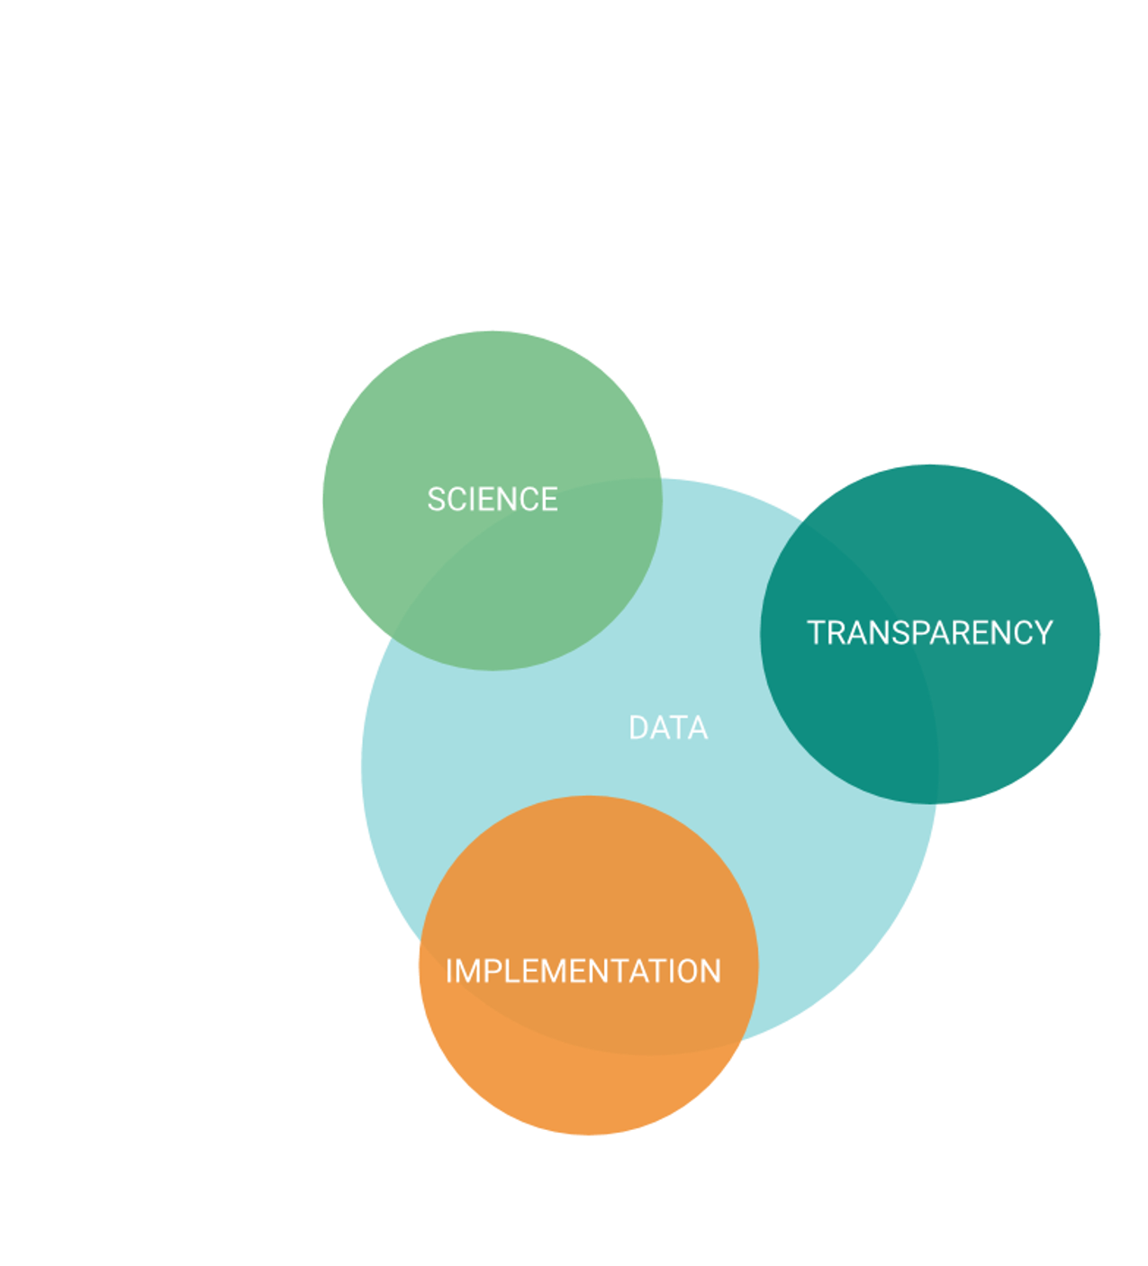
IMEO interconnects better data with action on transparency, science, and implementation
Close the knowledge gap
peer-reviewed studies and data reconciliation.
Provide accurate, unbiased and up-to-date information on methane emissions
Raise awareness and increase the capacity of governments to pursue science based-policy options to manage methane emissions.
Notes:
Speaking Points:
Data is the foundational need for targeted and accelerated action on methane emissions
However, this data needs to be combined with other important priorities, including science, transparency, and implementation
This interconnection is the basis of the theory of change of the International Methane Emissions Observatory
Through its data-driven approach, IMEO aims to progress against three key goals:
Close the knowledge gap
Provide accurate, unbiased, and up-to-date information
Raise awareness and increase the capacity of governments

Slide 4
CEOS – IMEO collaboration
Data integration of similar data sources
  Remote sensing data (addressing spatial & precision differences)
    Target mode
    Mapper
    Hybrid
  Regional empirical data
    Towers
    Aircraft
Data integration across types of data
  Remote sensing, inventories, self reported (OGMP 2.0), campaigns
Notes:
Regulation
+
Investment

Slide 5
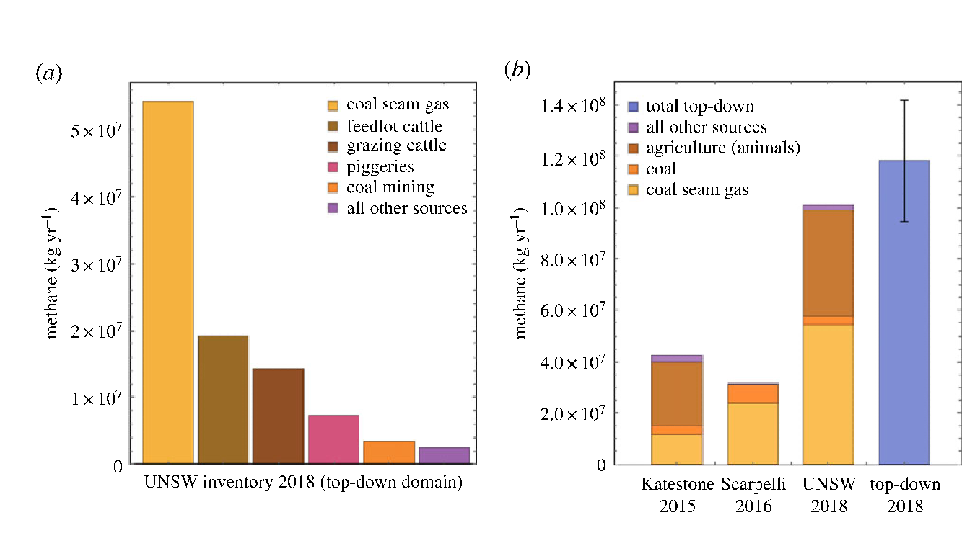
Methane emissions Surat Basin, New South Wales, Australia
Neininger et al. 2021

Slide 6
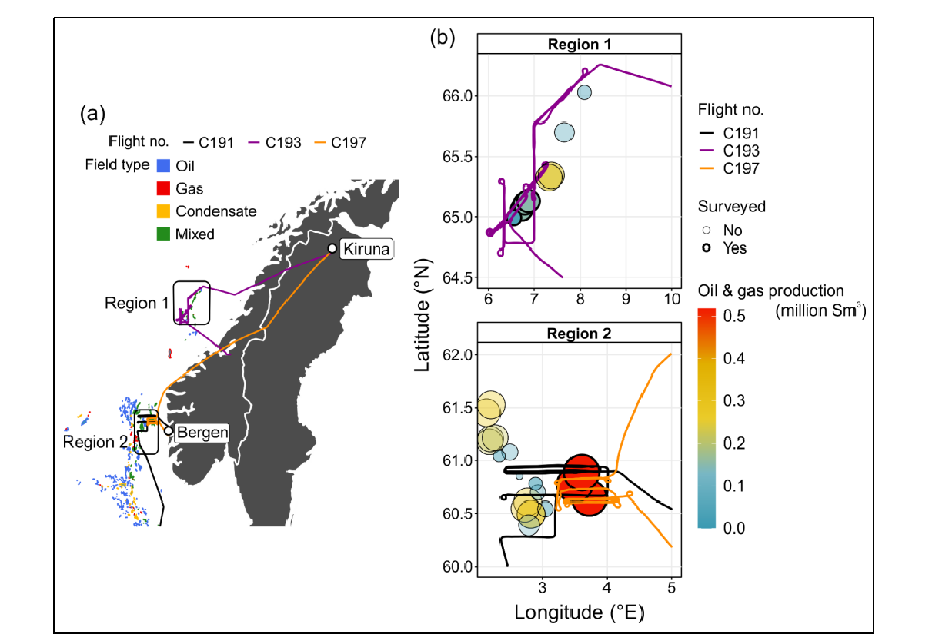
Norway Offshore
O&G production
Foulds et al. 2022
preprint

Slide 7
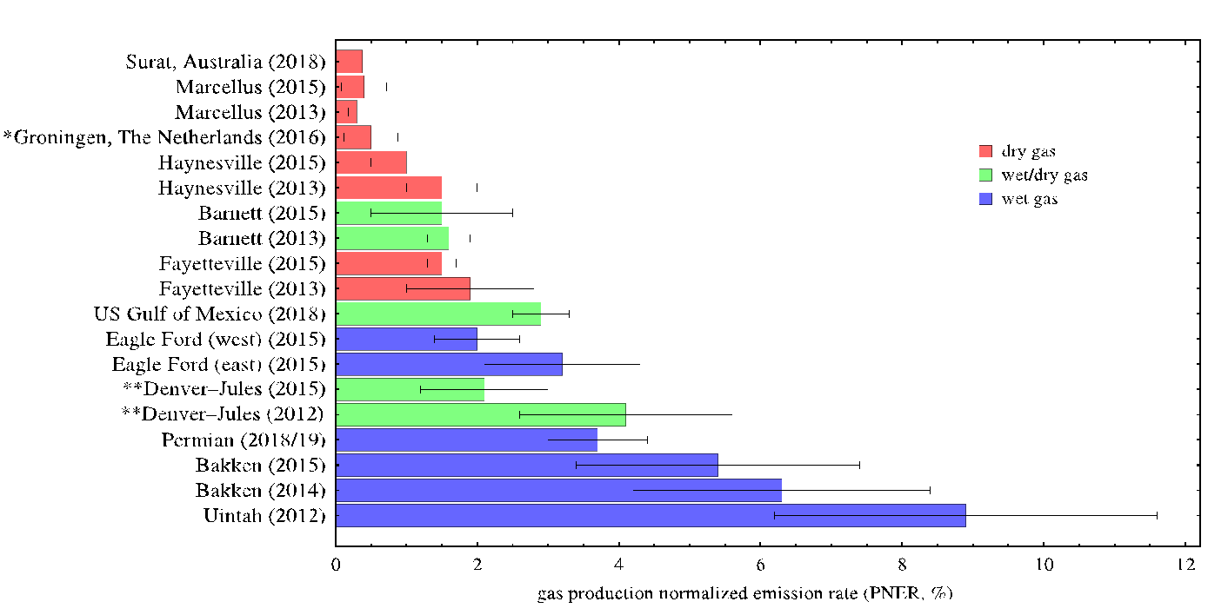
Methane Emissions across O&G Basins
Neininger et al. 2021

Slide 8







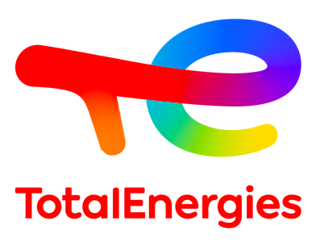
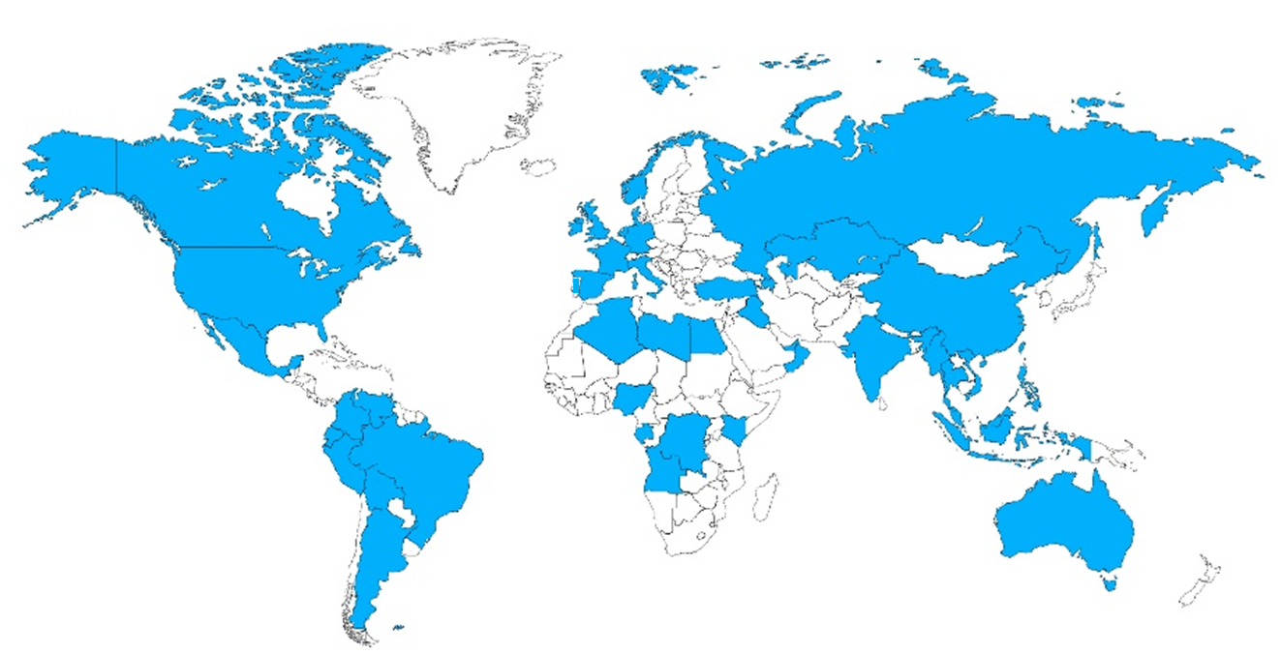








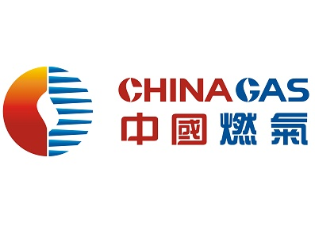
Oil and Gas Methane Partnership 2.0
What is OGMP 2.0?
Comprehensive, measurement-based reporting framework
Global coverage and scope
  77 companies
    Upstream, midstream and downstream
    Public, private and national oil companies
  Assets in scope represent over 50% of global oil and gas production in over 60 countries
OGMP 2.0 Partners
Snapshot of Company Membership
Notes:
Regulation
+
Investment

Slide 9
OGMP 2.0 Reporting Levels
Level 1
  Venture/Asset Reporting
  Single, consolidated emissions number
  Only applicable where company has very limited information
GOLD STANDARD:
Integrates “bottom-up” source-level reporting, with independent “top-down” site-level measurements for the majority assets
Level 2
  Emissions Category
  Emissions reported based on IOGP and Marcogaz emissions categories
  Based on generic emissions factors
Level 3
  Generic Emission Source Level
  Emissions reported by detailed source type
  Based on generic emissions factors
Level 4
  Specific Emission Source Level
  Emissions reported by detailed source type using specific emissions and activity factors
  Based on direct measurement or other methodologies
Level 5
  Level 4 + Site Level Measurement Reconciliation
  Direct measurement methodologies at a site or facility level*, typically through sensors mounted on a mobile platform
  Reconciled with Level 4
  * on a representative sample of facilities

Slide 10
Why do better methane emissions data matter?
Legend
Target
Scientific study
Estimate
Data Landscape Today
Methane intensity (emissions / natural gas produced)
3.5-3.7%
A lack of empirical, verified data on methane emissions limits action at the scale and speed needed to avoid the worst impact of climate change.
~2.3%
~1.3%
0.20%
OGCI 2019 Annual Report; EPA Inventory of U.S. Greenhouse Gas Emissions and Sinks: 1990–2018; Alvarez et al 2018, DOI: 10.1126/science.aar7204 (EDF Synthesis paper based on over 400 site-level measurements from 6 basins); Zhang et al 2020, DOI: 10.1126/sciadv.aaz5120 (Permian Basin assessment based on PermianMAP initiative and 2018/19 TROPOMI satellite observations).

Slide 11
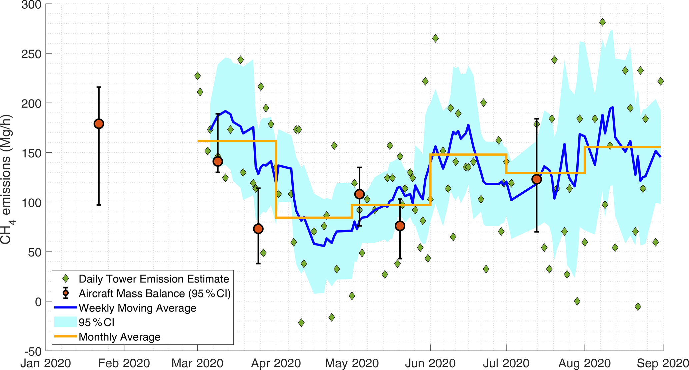
Permian Basin Methane Emissions Trends in 2020
Lyon et al. 2021. Concurrent variation in oil and gas methane emissions and oil price during the COVID-19 pandemic.
Atmospheric Chemistry and. Physics 21: 6605–6626, https://doi.org/10.5194/acp-21-6605-2021

Slide 12
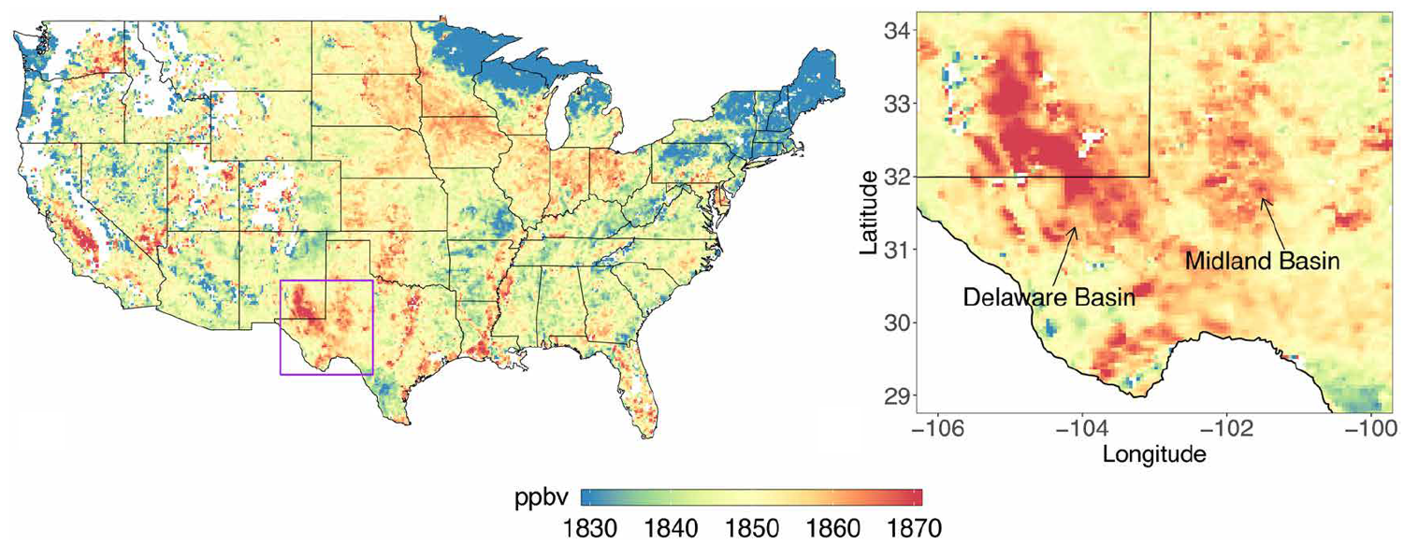
Satellite observations of the Permian Basin
TROPOMI methane data averaged from May 2018 – March 2019
Zhang et al. (2020) Science Advances. 6: eaaz5120

Slide 13
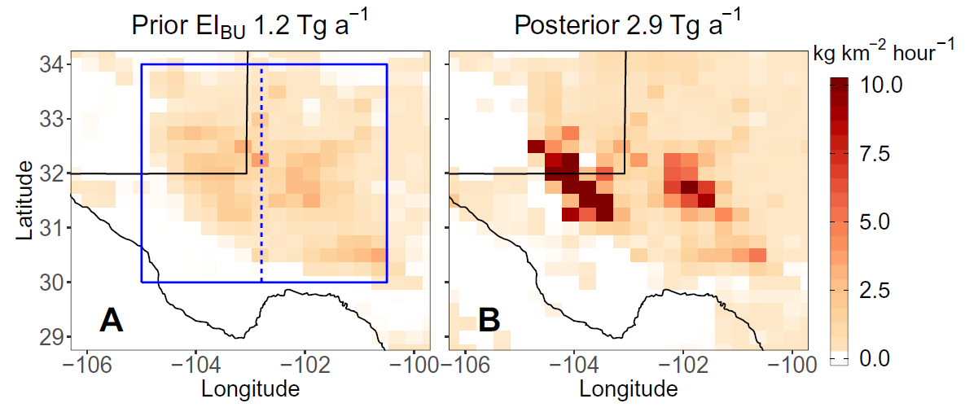
TROPOMI data reveal high methane emissions from the Permian Basin
Zhang et al. (2020), Science Advances. 6: eaaz5120

Slide 14
Methane Detecting Satellites
Diversity can be Complementary
Instrument | Dates operational | Grid size (subgrid pixel) (km) | Swath (km) | Precision (ppbv)
MethaneSAT | 2023- | 1 × 1 (0.1 x 0.4 raw) | 200± | 2-3*
GOSAT | 2009 - | 10 km dia., single | Sparse | ~13
GHGSat | 2016 - | 0.05 x 0.05 | 12 x 12 | ~50
TROPOMI | 2017- | 7 × 5 | 2600 | ~11
GOSAT-2 | 2018 - | 10 km dia., single | Sparse | ~8
GeoCARB | 2022 - | 3 × 6 | 2800 | ~18
Carbon Mapper | 2023 - | 0.03 x 0.03 | 18 | ~30
* Gradient measured over 10 – 100 km length scales.
* Gradient measured over 10 – 100 km length scales.
Notes:
The main differences are scale, precision, and data usage
GHGSat’s small swath is well-suited to allow governments or companies to monitor specific facilities for compliance
TROPOMI has a large swath, but less resolution and a higher detection limit; useful for data on large emissions sources
MethaneSAT combines a wide swath with a low resolution limit so that we can capture almost all emissions specific to oil and gas operations, allowing us to see the full picture of global emissions

Slide 15


Slide 16






How will IMEO answer the methane emissions data problem?
Data flow of the IMEO
GENERATE FINAL PRODUCTS
Reconcile inconsistencies and identify gaps
COLLECT DATA
Apply Big Data, data science, and machine learning
OGMP companies’ assets data
Science measurements studies
National inventories
Satellite data
Full methane emissions dataset
Annual methane report
Direct measurement studies
Science-based implementation support
Notes:
How will IMEO answer the methane emissions data problem?

Slide 17






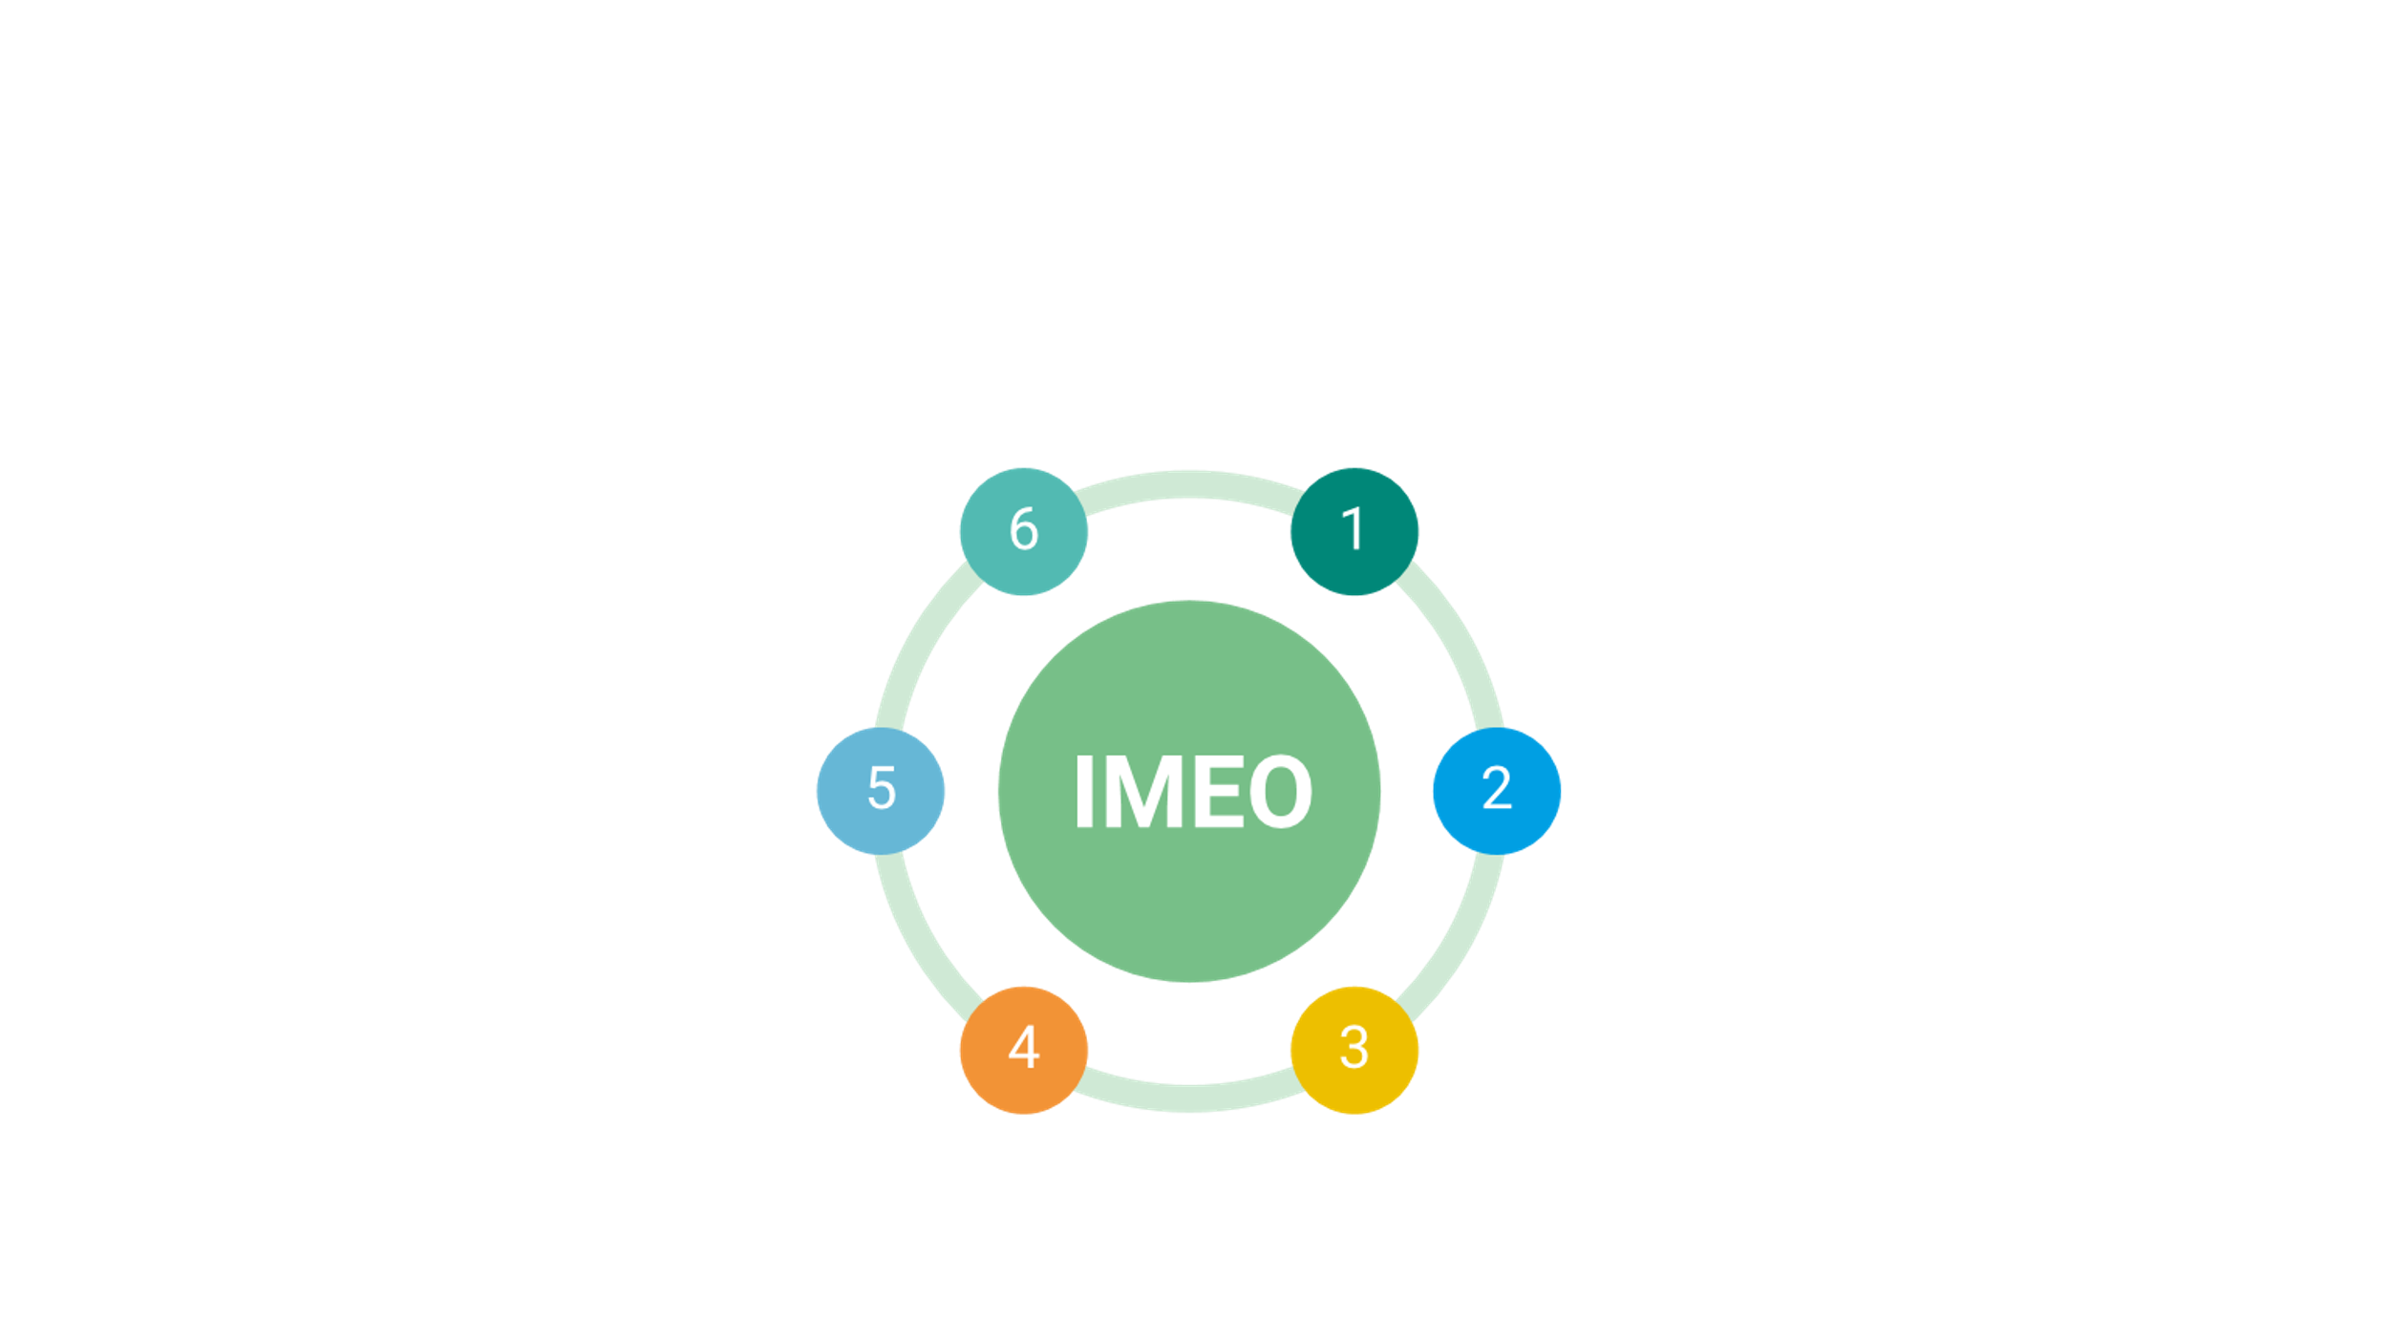
IMEO Core Functions
Sponsor science studies to fill emission data gaps, validate remote sensing data and provide insight into data discrepancies
Collect and verify OGMP 2.0 company reporting
Produce policy-relevant science to support enhanced government ambition
Integrate and analyze methane emissions data from various sources
Develop and publish a global dataset of methane emissions at an increasing level of accuracy and granularity
Hold companies accountable to methane performance goals
Notes:
We won’t have time to get into the details of the different functions of IMEO, but let me just say that it intends to provide unbiased, precise information to catalyze targeted mitigation actions and hold governments and companies accountable for their commitments – including the Global Methane Pledge.

Slide 18
Drive action through Data
March 2022
Steven Hamburg
Notes:
Thanks for the invitation and for the opportunity to present the work of UNEP on the International Methane Emissions Observatory.

