Slide 1
CEOS-ARD
Oversight Group Update & General Status
Ferran Gascon, ESA
Steve Labahn, USGS
Agenda Item #5.1
SIT-37
Virtual Meeting
29-31 March 2022

Slide 2
Presentation Overview
Background
CEOS-ARD Oversight Group Terms of Reference (For Endorsement)
Other CEOS-ARD Updates
CEOS-ARD for Land Updates (Steve Labahn, USGS, LSI-VC Co-Lead)
Product Assessments
PFS Updates: Aquatic Reflectance
Recent topics: STAC, Standardisation

Slide 3
Background
CEOS Analysis Ready Data broadened to be ‘beyond land’.
Governance framework for CEOS Analysis Ready Data (CEOS-ARD) endorsed at CEOS Plenary 2021
Available here
Formalises the process LSI-VC has used for CARD4L and generalises it
References the CEOS-ARD Oversight Group, which was also initiated at CEOS Plenary 2021 as a result
Other key documents:
Template for Product Family Specifications
CEOS-ARD Strategy 2021

Slide 4
CEOS-ARD Oversight Group
Identified as a core component of the CEOS-ARD Governance Framework.
Act as a forum for all matters related to CEOS-ARD.
Representatives from the CEOS Virtual Constellations are integral to the effort going forward, as these are the CEOS entities with the technical expertise to recommend, develop and maintain Product Family Specifications.
Also provide:
Strong coordination across CEOS
Promote CEOS-ARD in a unified way

Slide 5
CEOS-ARD OG Members
Ferran Gascon (Lead) SIT Chair Team
Matthew Steventon Secretariat
Andreia Siqueira LSI-VC
Steve Labahn LSI-VC
Peter Strobl LSI-VC
Maycira Costa OCR-VC
Mark Higgins OST-VC
Raj Kumar Sharma OSVW-VC
Ed Armstrong SST-VC
Chris Kidd P-VC
Medhavy Thankappan WGCV
Philippe Goryl WGCV
Makoto Natsuisaka WGISS
Jorge Del Rio Vera WGCapD
Mailing list: ard-oversight-group@lists.ceos.org

Slide 6
Terms of Reference
Present Terms of Reference for CEOS-ARD OG at SIT-37
Elaborates and clarifies the role of the group beyond what appears in the CEOS-ARD Governance Framework
Document here
Covers: Mission Statement, Scope of Activities, Membership and Leadership, Meetings

Slide 7
CEOS-ARD OG Activities
CEOS coordination on ARD
Maintenance of the CEOS-ARD Strategy and CEOS-ARD Governance Framework
Support and guidance to data providers
Coordination of CEOS-ARD Product Family Specifications (PFS)
Template PFS
Technical topics related to CEOS-ARD: accessibility and utilisation, data discovery mechanisms, data and metadata formats, STAC, pilots, etc.
CEOS-ARD representation to broader community
Coordination of outreach activities: webinars, conference representation, promotion and information resources (CEOS-ARD website, presentations, flyers/brochures, etc.)
Championing the ARD concept and providing guidance for the community
Primary external focal point for CEOS on matters related to ARD
Represent CEOS on matters related to the further standardisation of ARD in the wider community
Decision: Endorsement of CEOS-ARD Oversight Group Terms of Reference is requested

Slide 8
CEOS-ARD for Land (CARD4L) Updates (Labahn / LSI-VC)
New CARD4L Datasets:
ESA Sentinel-2 Level-2A
DLR EnMAP Surface Reflectance
Under peer review:
Element84 Sentinel-2 Level-2A
Sentinel-1 RTC (Sinergise & Digital Earth Africa)
Various other self-assessments are underway (next slide).
See the website for more details.

Slide 9
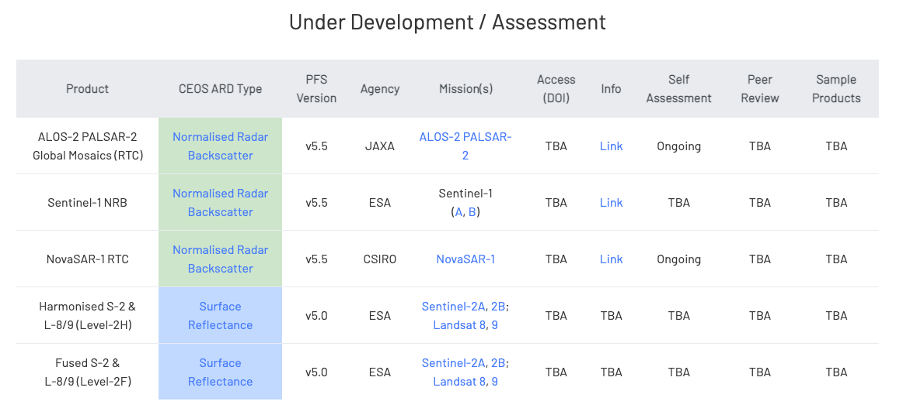
CEOS-ARD for Land (CARD4L) Updates (Labahn / LSI-VC)

Slide 10
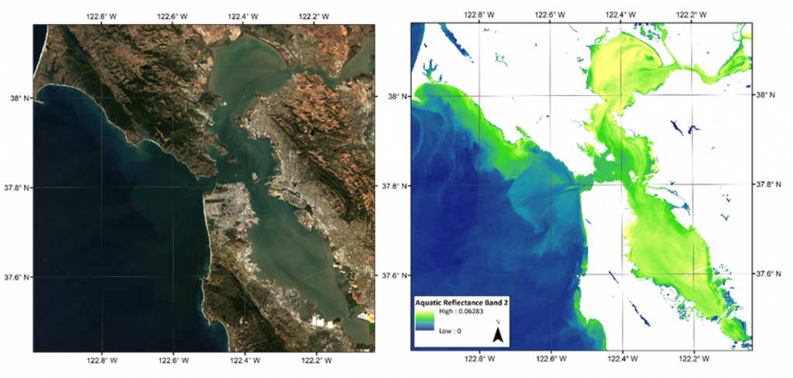
Aquatic Reflectance (AR) PFS
Aquatic Reflectance (AR) PFS was recently finalised (Link)
Inland water bodies and nearshore coastal regions
Preliminary self-assessment of the USGS AR product has been completed
Thanks to GEO AquaWatch, LSI, team at USGS and other contributing experts

Slide 12
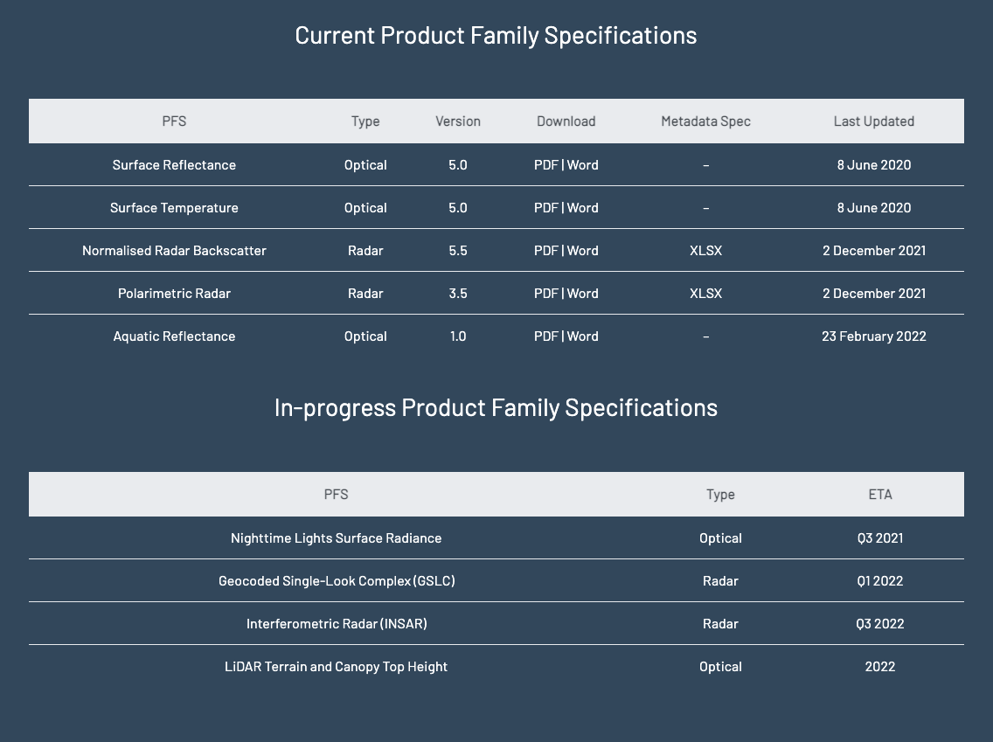
PFS Status (Current)

Slide 13
PFS Status (Being Developed)

Slide 14
Some recent CEOS-ARD OG topics (for information)
Standardisation
Overwhelming request for standardisation of CEOS-ARD from government and commercial sectors
Standardisation is likely necessary for widespread engagement in CEOS-ARD
CEOS-ARD OG will take this discussion forward in partnership with standardising authorities such as OGC, IEEE
CEOS-ARD STAC Sprint (March 1-3)
SpatioTemporal Asset Catalog (STAC): common specification to describe a range of geospatial metadata, so it can more easily be indexed and discovered by building interoperable catalogues
Work ongoing on CEOS-ARD extension (mapping CARD4L requirements to STAC fields)
Also covers processing provenance and validation
CEOS-ARD OG now revising template PFS
VC representative input critical to move us ‘beyond land’ – providing great insight
EUMETSAT team providing briefing on their atmospheric composition ARD

Slide 15
Thank you!
Questions?

