Slide 1
New Space & Future CEOS
Session 4
CEOS SIT-37
Virtual Meeting
29-31 March 2022

Slide 2
Scene-setting
SIT Chair Team
Agenda item 4.1
CEOS SIT-37
Virtual Meeting
29-31 March 2022

Slide 3
Session objectives & decisions
Objectives:
  Reflection on the new geometries in the satellite EO sector, including increasing proportion of commercial missions, and CEOS agency arrangements for commercial data buy and partnerships - hearing agency experiences and examples and strategising how public programmes and CEOS must adapt in the decade ahead with this new context. Please refer to the background paper distributed ahead of SIT for further context and objectives.
Slide ‹#›

Slide 4
Session Agenda
4.1 Scene-Setting [15 mins]
4.2 Case Studies from CEOS Agencies [30 mins]
4.3 Discussion on CEOS strategy [15 mins]
A fairly brief & preliminary discussion about trends in the sector and the implications for public EO programmes and for the work of CEOS
Role of public and private EO and the changing dynamic
Trends of relevance to CEOS agencies and CEOS
Possible responses to explore
Slide ‹#›

Slide 5
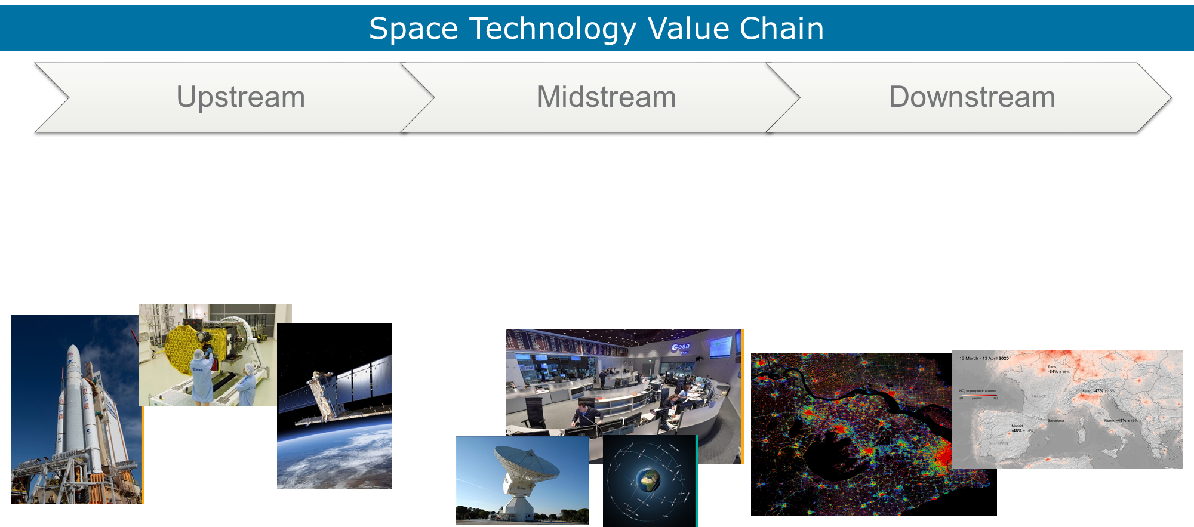
Space Market Segments

Slide 6
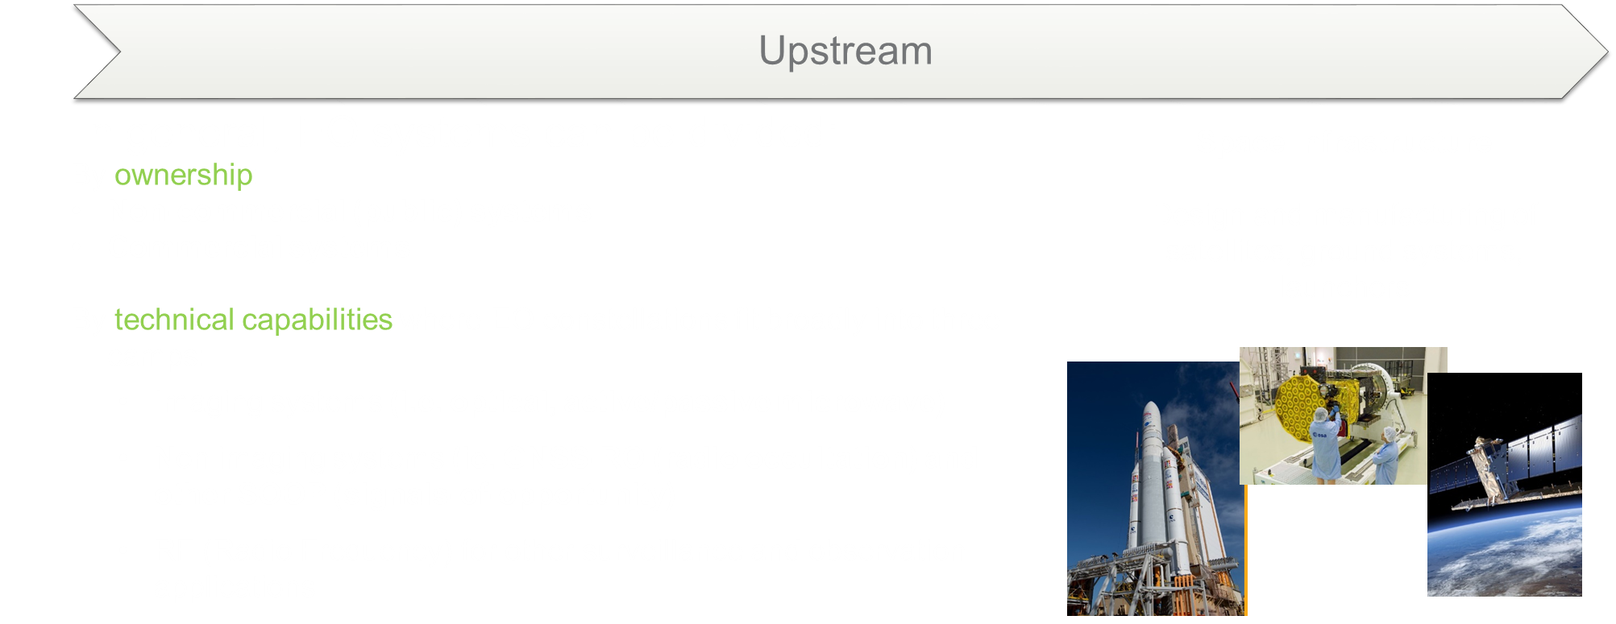
Investment opportunities across entire value chain

Slide 7
Context
The share of on-orbit EO satellites belonging to public EO programmes is shrinking rapidly
10 years ago, CEOS agencies launched 14 EO missions during 2012 calendar year (MIM)
  5 from China
  Some with commercial data aspects
  SPOT-6 and Pleaides 1B the only identified commercial sector launches that year
By 2020, more than 50 companies have announced their intention to develop Earth observing missions or constellations, representing roughly 1,800 small satellites, the majority of which are under 50kg
  Eg Planet already has ~ 200 active EO satellites in orbit
  8 CEOS launches in 2021 (5 from China)
  MIM activity shows 80+ commercial EO missions in 2021 (mostly Planet)
These companies raised ~$US 5Bn in each of 2020 and 2021, up from $1Bn in 2019
Slide ‹#›

Slide 8
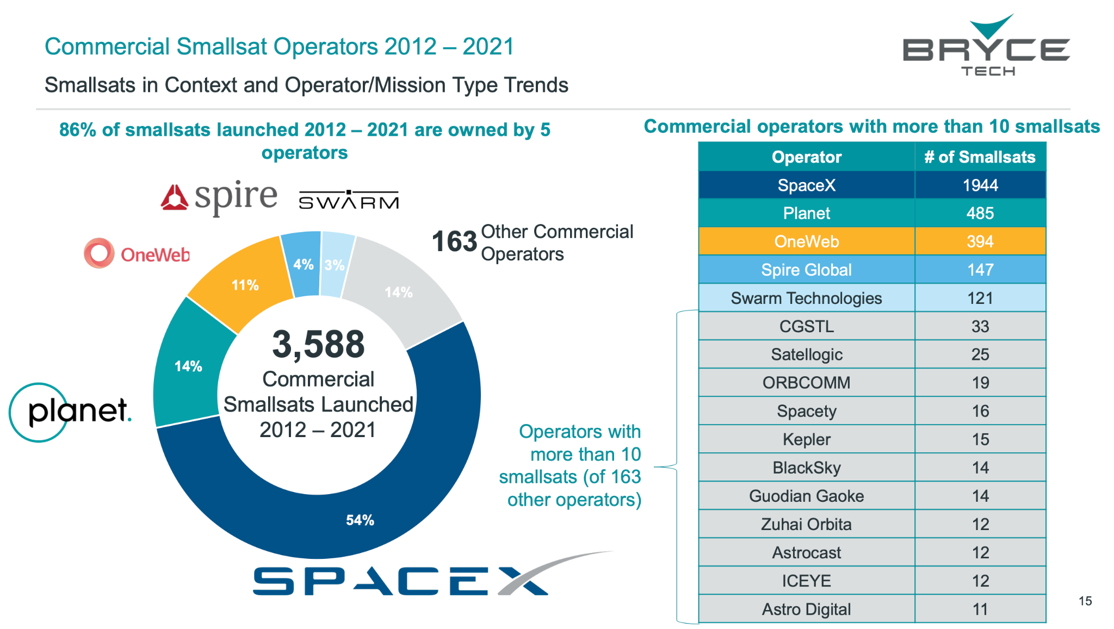
Context
EO missions
Slide ‹#›

Slide 9
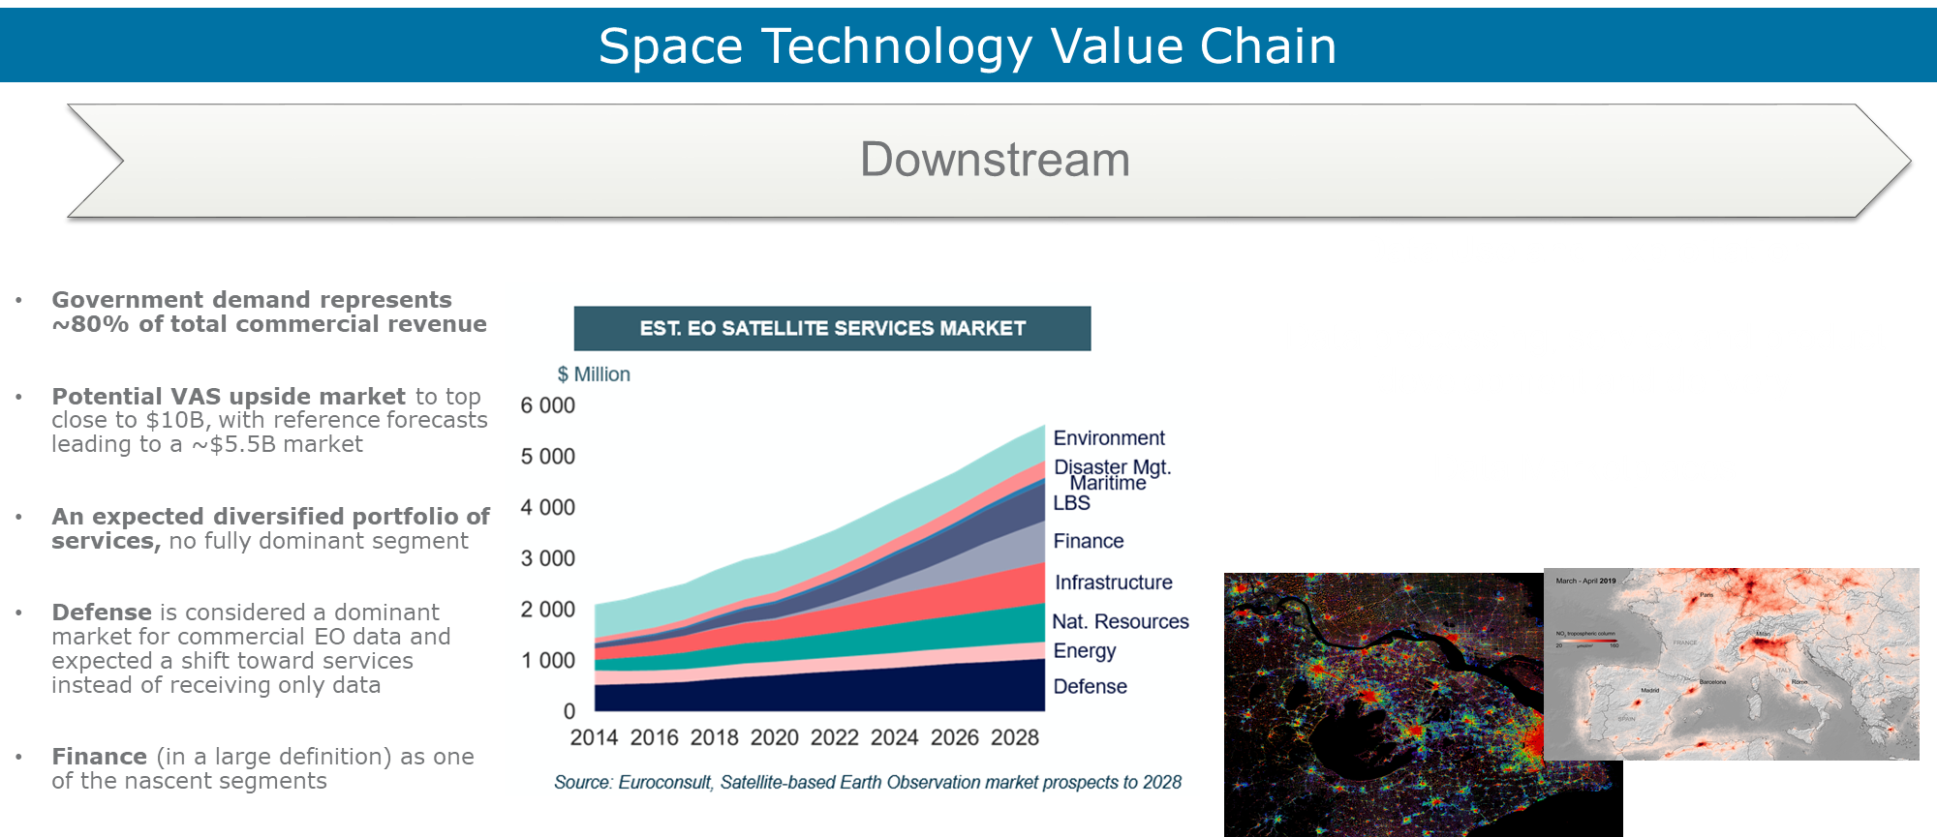
Investment opportunities across entire value chain

Slide 10
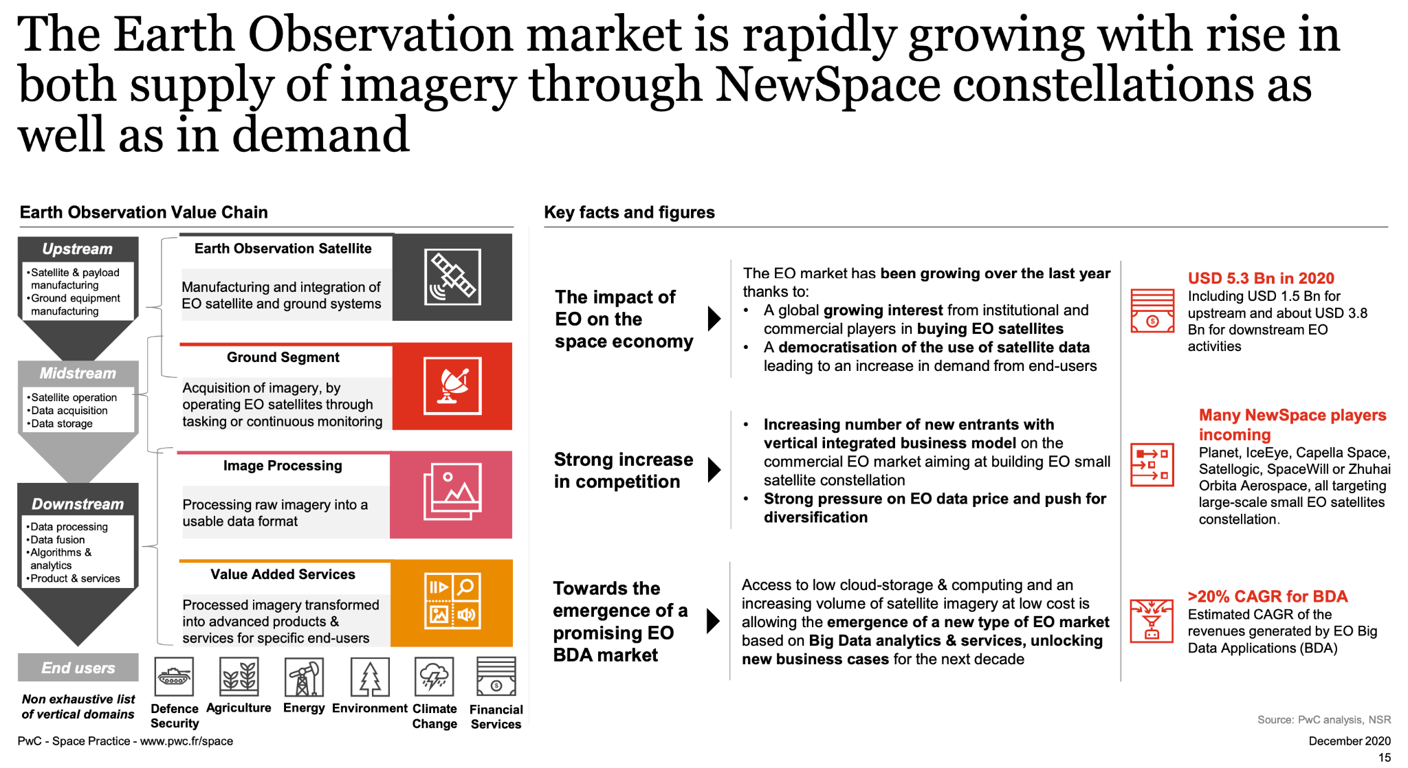
Context
Slide ‹#›

Slide 11
Context
The space value chain is evolving, with the traditional upstream driven technology push transitioning into a market demand pull.
Space has attracted an important number of actors in the past decades, with New Space and non-space companies entering the different streams of the value chain
Generally EO domain remains geared towards defence and security markets, but an increasing demand from a diversified pool of customers is leading a rapid evolution - with more supply from new entrants, and innovative delivery models for data and analytics to support situational awareness
Cloud computing is bypassing the need for hardware and software ownership, opening up the market to startups and allowing companies to provide ground stations as well as full turnkey solutions as a service (GSaaS concept - allows satellite operators to focus on the core of their business: data)
Machine learning is facilitating the extraction of actionable insights from large amounts of data, automation of repetitive processes, and extending the use of space-based applications to new markets
Slide ‹#›

Slide 12
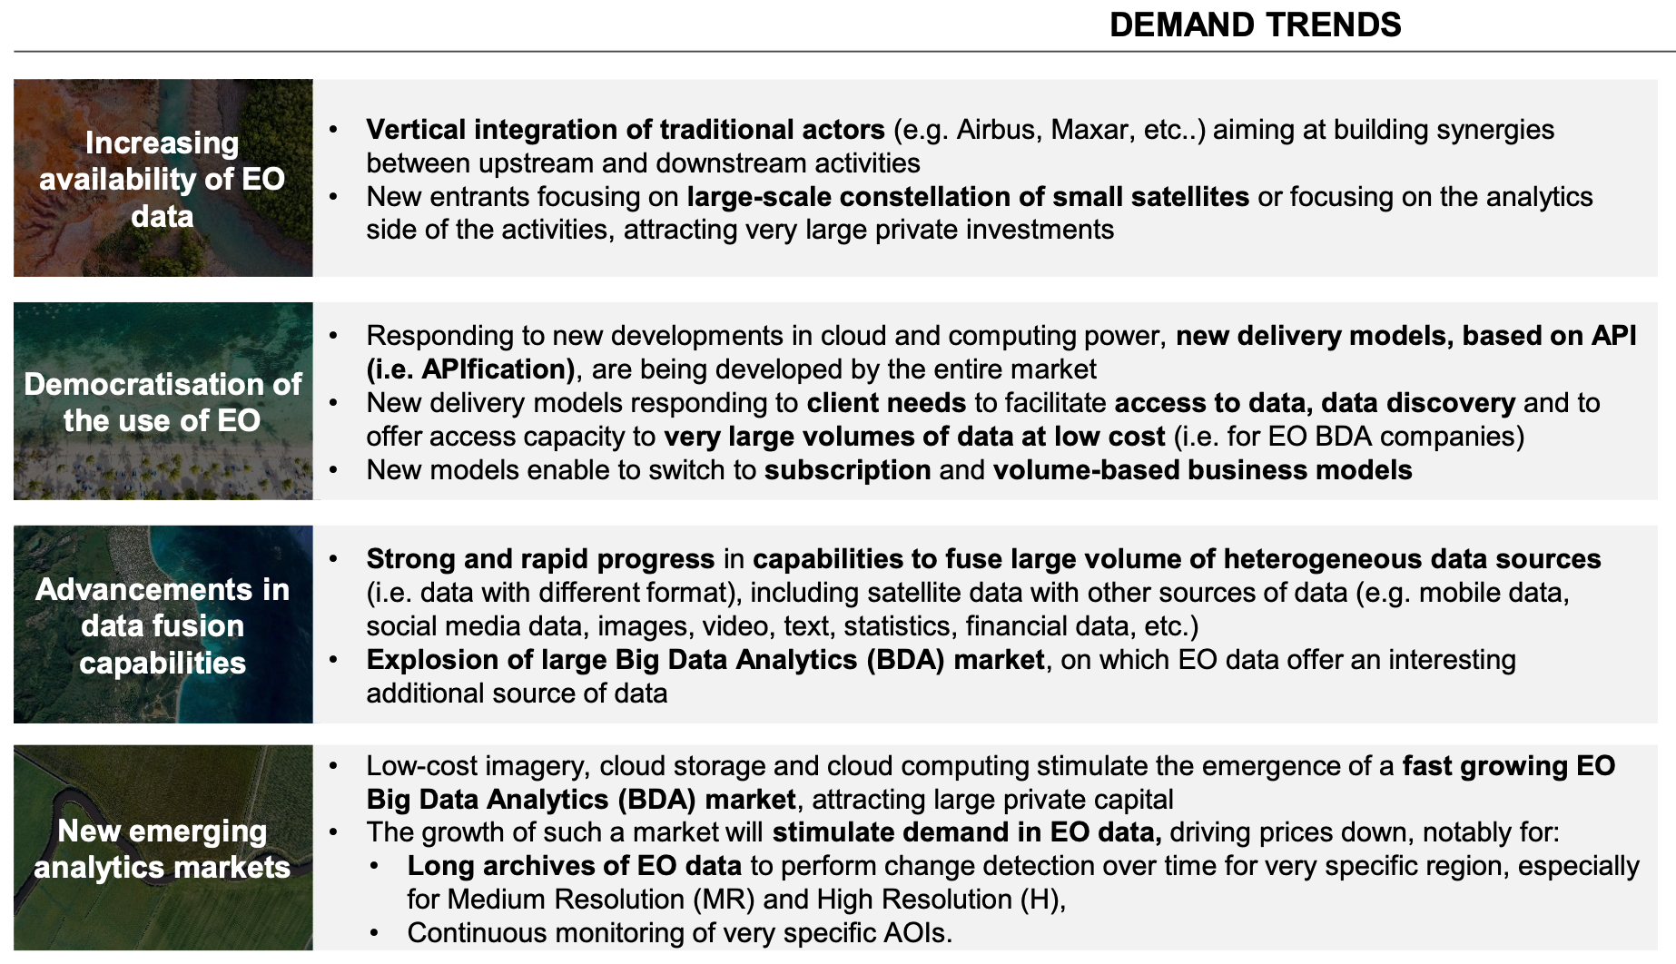
Important trends supporting growth in EO data products & services
Slide ‹#›

Slide 13
ESA and New Space
Main expected ESA’s role (from the point of view of New Space EO companies):
New Space companies working with ESA (i.e. not developing satellites for ESA, but ESA’s role as anchor customer or as co-funding the development):
    through the EU Copernicus Contributing Missions activity for operational purposes
    through the ESA Earthnet Third Party Missions activity for scientific purposes
    through the ESA InCubed Public Private Partnership co-funding development programme
EOP performs technical and business case assessment of new commercial initiatives
Commercial EO
New Space companies working for ESA (i.e. developing satellites for ESA, role is identical to that of established companies but with new development methods):
    FutureEO Scout missions (managed as an EOP-P project
    PhiSats missions (managed as an EOP-ΦM project)
    PROBA-V Cubesat companion (managed as TEC GSTP project)
    AWS prototype (managed as an EOP-P project)

Slide 14
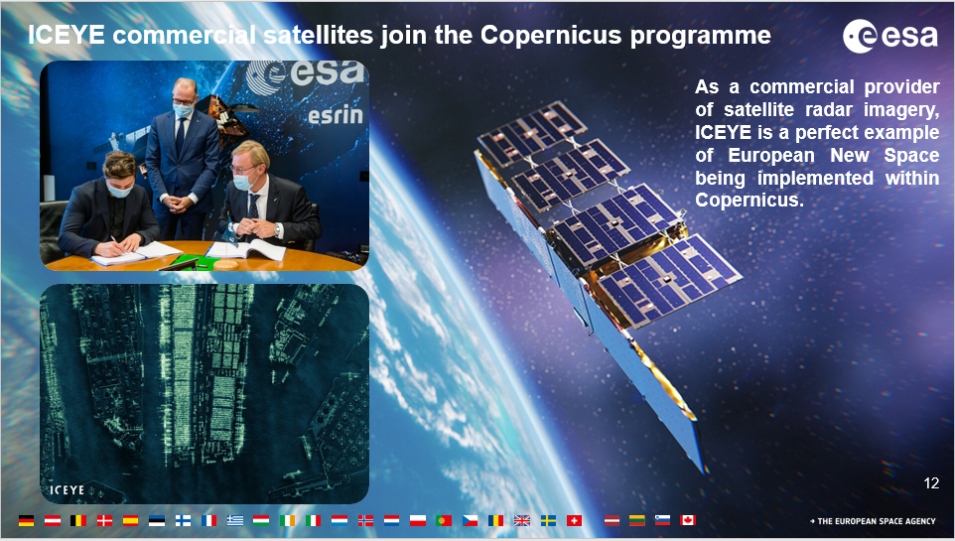
ESA and New Space
Finnish satellite imagery specialist ICEYE - commercial constellation of 14 small SAR satellites (18 by mid-2022).
Average access time: 3 hours anywhere on Earth.
Monitoring floods and mining activities, marine vessel detection and iceberg monitoring.
Copernicus Contributing Mission
Notes:
All current ICEYE imaging modes are offered through this programme. Users get access to the very high-resolution Spot imaging mode covering areas of 25 km², the high-resolution Strip and the recently launched Scan imaging mode covering areas of 10,000 km², respectively. It is possible to obtain archive data or request new image acquisitions.\
ICEYE builds and operates a commercial constellation of small synthetic aperture radar satellites. So far, 14 satellites have been launched and ICEYE and plans to expand its constellation up to 18 satellites by mid-2022, with the objective of reaching an average access time of three hours anywhere on the globe. The mission is used in many sectors, from monitoring floods and mining activities, to marine vessel detection and iceberg monitoring.
The ICEYE satellite constellation is a Copernicus Contributing Mission, complementing existing synthetic aperture radar missions in the Copernicus programme.
Read full story: ICEYE commercial satellite
at COP26, more than 100 countries have just signed up to the Global Methane Pledge, which aims to limit emissions by 30% compared with 2020 levels.
With both public and commercial satellite data playing key roles in assessing progress on climate action, ESA and GHGSat are supporting the United Nations Environment Programme’s new International Methane Emissions Observatory, also announced at COP26.

Slide 15
Case Studies from CEOS Agencies
30 Mins
total
TBA
Agenda item 4.2
CEOS SIT-37
Virtual Meeting
29-31 March 2022

Slide 16
Discussion on CEOS Strategy
Agenda item 4.3
CEOS SIT-37
Virtual Meeting
29-31 March 2022

Slide 17
Candidate measures in response
Examples to leverage our long technical heritage:
CEOS has spent decades investing in data standards for interoperability, ARD, catalogues etc. If we anticipate an explosion in diversity of datastreams and sources, including through space agency data buys, is NOW not the time to seek uptake of those standards
  For maximum benefit across the whole sector
  To allow public EO programmes to be bigger than the sum of their parts
  Ensure all our good work is not lost in the noise of a rapidly expanded sector
Likewise we have huge investment by CEOS agencies in legacy infrastructure for cal-val
  Supporting easier access and application of the legacy infrastructure for New Space would increase utility and value of the commercial data
  Australia and UK discussion of Data Integrity Framework for that purpose
  Open Source Toolkit for use of CEOS agency cal-val sites
SITSAT (SI Traceability Satellites) efforts by ESA/UK (TRUTHS), NASA (CLARREO), GA (SCR)
DISCUSS!
Slide ‹#›

Slide 18
Next steps
CEOS Principals actioned to provide feedback and suggestions on the next steps to support SIT Chair Team planning of further investigations in 2022 and 2023
Complex and strategic matters like these need in-person discussions and we continue at SIT TW and hopefully at Plenary (by agreement with CNES)
Slide ‹#›

