Slide 1
ESA SIT Chairmanship Priorities
Ivan Petiteville, ESA
Conference Agenda Item #
2021 CEOS Plenary
Virtual Meeting
1-4 November 2021

Slide 2
SIT Term Priorities
WHAT do we want to do?
Focus on global challenges with strong UN mandates, GEO support, and high relevance for satellite EO
HOW do we want to do it?
Exploring how CEOS can employ new geometries with industry, new missions, and new data and analysis techniques for maximum impact and continued relevance in a changing sector

Slide 3
Thematic Priorities
Strong UN mandates, GEO support, and high relevance for EO
Climate & Carbon (UNFCCC, Paris Agreement and the GST)
Sustainable Development Goals (2030 Agenda)
Disaster Risk Reduction (Sendai Framework)
We will track the emerging (4th) GEO priority
Resilient Cities & Human Settlements (New Urban Agenda 2016, SDG #11)
And ensure support for ongoing CEOS thematic observing strategies, such as in Ocean domain with COVERAGE, COAST and our VCs (e.g. GEO Blue Planet & SDG 14.1 eutrophication)
Outcome focused term with SIT and TW agendas supporting our 2-year targets
Success in these thematic priorities will translate into opportunities for engaging new users not familiar with EO from space, on these and other themes
Notes:
Potential future users: international, regional and national organisations such as UN agencies (incl. SDG Indicator Custodian Agencies), National Statistical Offices, and the Financial Institutions (e.g. World Bank)

Slide 4
CEOS and SIT Chair Team Coordination
CNES and ESA Teams have conferred carefully in deriving their respective plans and ensured synergy between them. Both prospectuses apply common nomenclature for ease of understanding.
CEOS/GEO established policy framework priorities
Evolution to sustainability
Following the migration to the cloud etc
New geometries with New Space and new user communities for CEOS missions

Slide 5
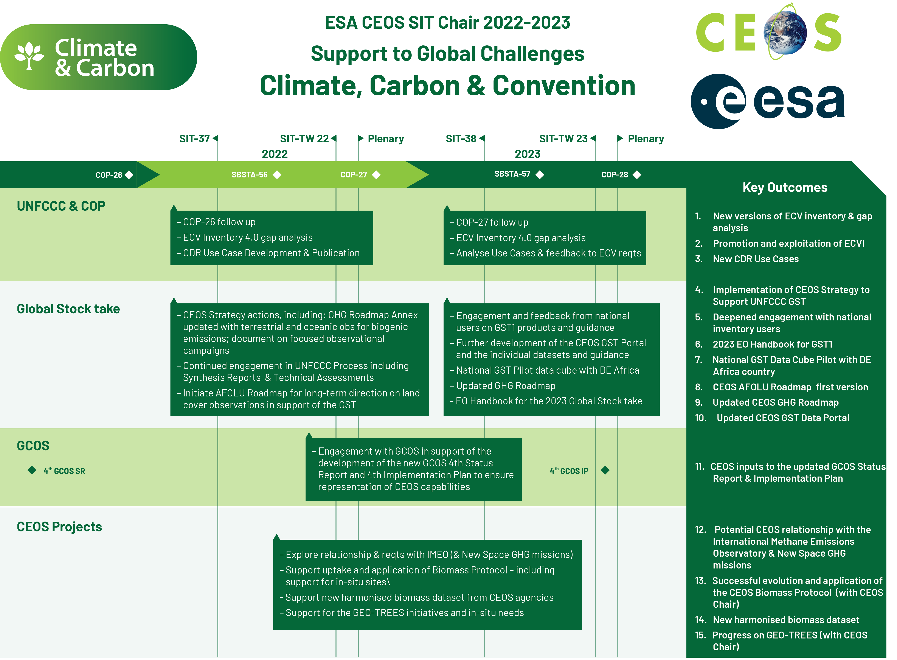
Support to Global Challenges – Climate & Carbon
Notes:
UN Environmental Programme (UNEP) on 2 March 2021 officially announced the creation of the International Methane Emissions Observatory (IMEO).

Slide 6
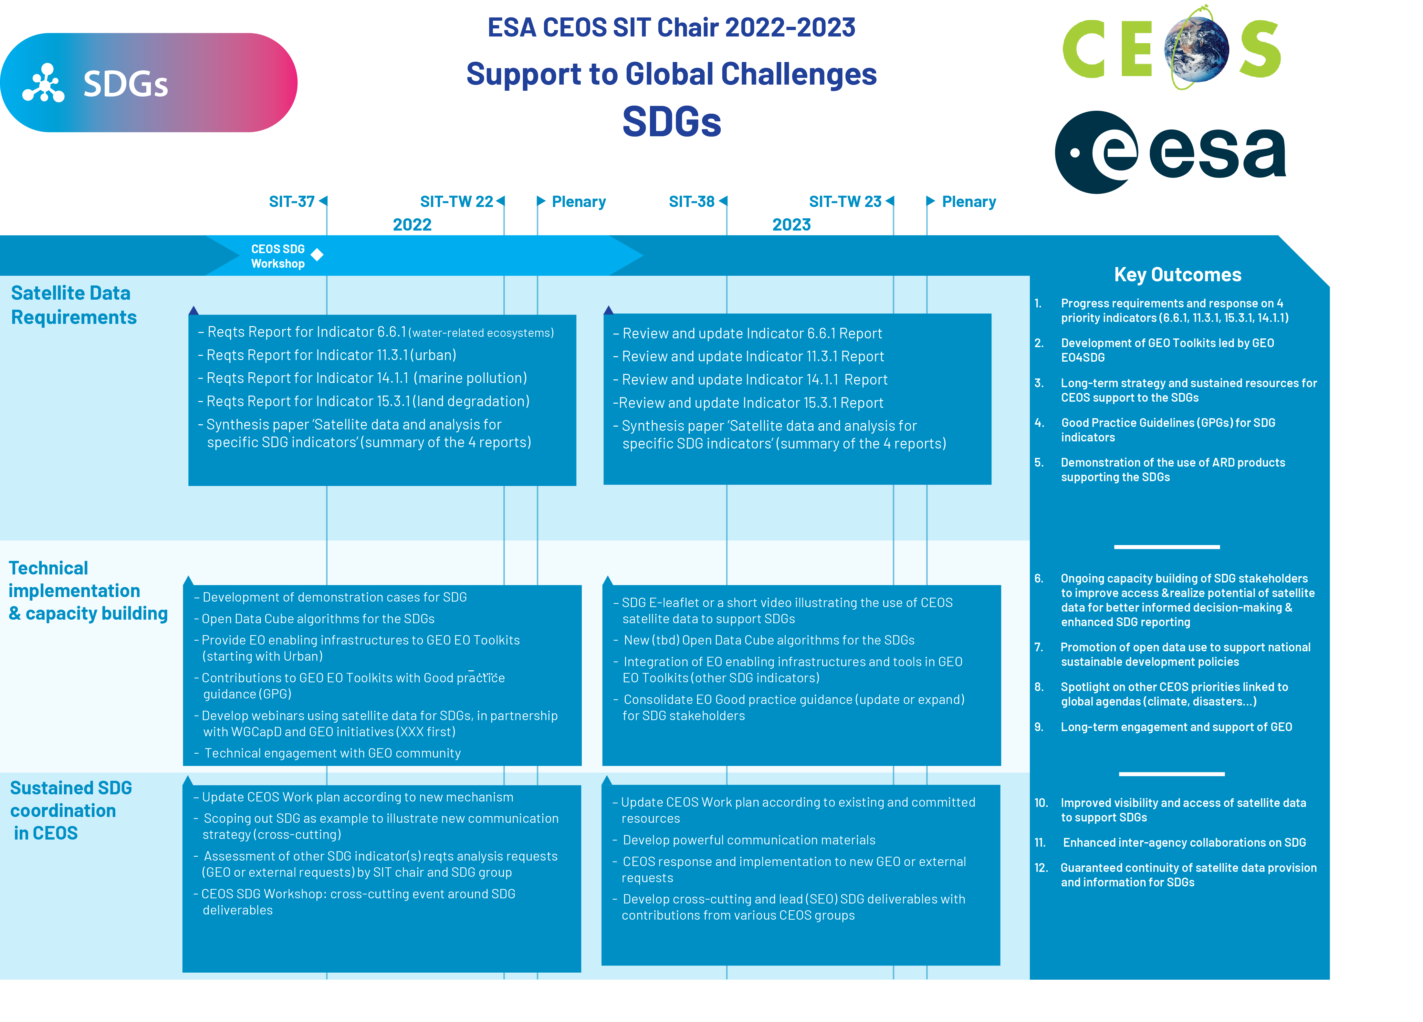
Support to Global Challenges - SDGs
Notes:
A new indicator (5th one ) is going to appear at SIT TW: 2.4.1 (proposed by SEO)

Slide 7
Support to Global Challenges - Disasters

Slide 8
SIT Term Priorities – Forward looking!
Improve CEOS support to global challenges with 3 lines of action:
New geometries for space agencies and CEOS with New Space companies
New mission needs and users
New data techniques

Slide 9
New Geometries with New Space
Governments are integrating new arrangements with Space 2.0 firms into their satellite EO programme planning
Expected mutual benefits, added-value and the duality / complementarity of the missions operated by both New Space and Space Agencies.
CEOS must keep up and consider implications for its thematic observation strategies
Exchange of experience and ideas, lessons learned
Possible Case Studies & Pilots e.g. International Methane Emissions Observatory (combined use of GHGSat/EDF and Sentinel-5P / TROPOMI )
Notes:
EDF: Environmental Defense Fund (ww.edf.org)

Slide 10
New Mission Needs and Users
CEOS agency programmes and EO technologies continue to evolve in order to improve the service to the User Community.
Give opportunities for agencies to report to CEOS WGs, VCs and Agencies and seek feedback on their planned and candidate missions and concepts.
ESA will present the Copernicus missions (Expansion, Extension, Contributing) to the CEOS Agencies and Working Teams, and seek feedback on their utility for the CEOS thematic observing strategies.
And explore potential new collaborations:
e.g. UN Agencies, International Financial Institutions, National Statistical Offices

Slide 11
New Data Techniques
Significant CEOS investment already in Future Data Architectures, Open Data Cube, Analysis Ready Data,…
New platforms, new software tools (e.g. AI, Machine Learning), more cloud storage to foster the exploitation of data from both public and private EO programmes
New opportunities for new applications and new users
CEOS agencies can reflect on opportunities for maximum interoperability and user ease for space agency data and analytics in the cloud
Forward thinking to ensure continued competitiveness and relevance

Slide 12
2022 Dates for your Calendars
SIT-37 (ESRIN): week 28 March – 1 April
SIT-TW-22 (ESRIN): week 12 – 16 September
Exact dates and formats are TBC

Slide 13
Thank you!

