Slide 1
Mauro Facchini,
Head of Earth Observation COM
Session 4:New Space & Future CEOS
SIT-37
Virtual Meeting 29-31 March 2022

Slide 2
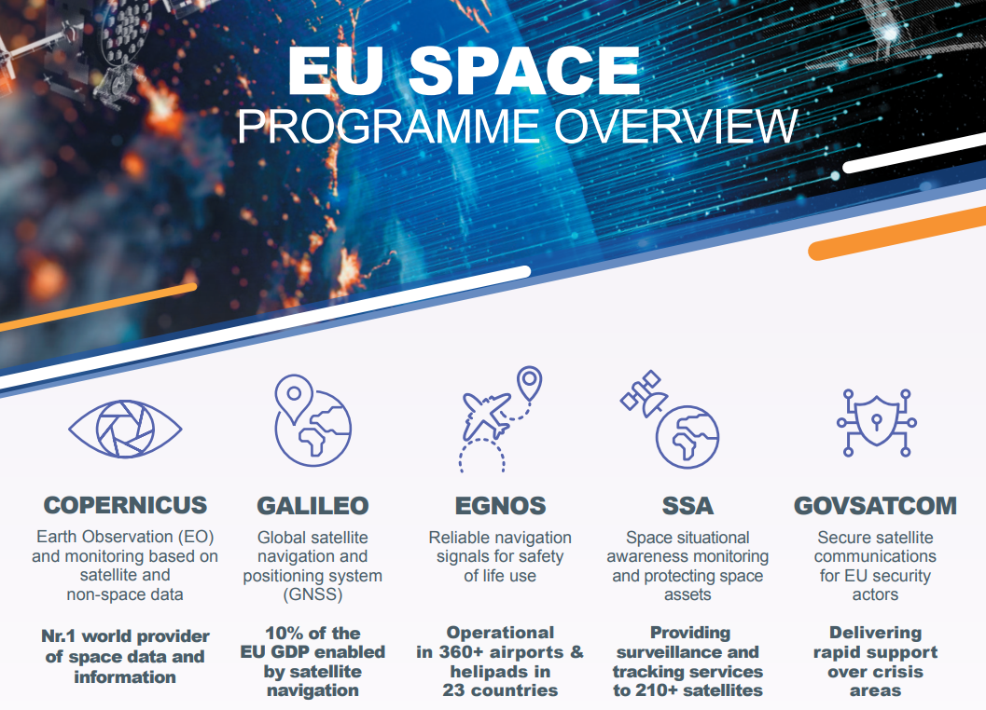

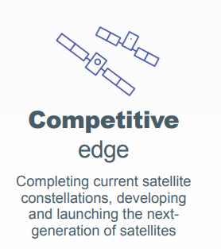
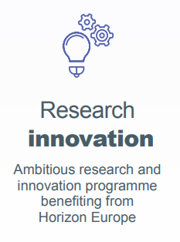
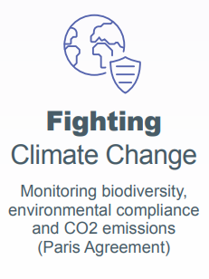
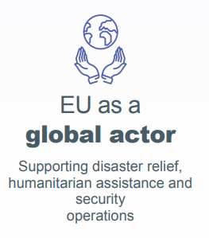
The EU Space Programme
Slide ‹#›

Slide 3
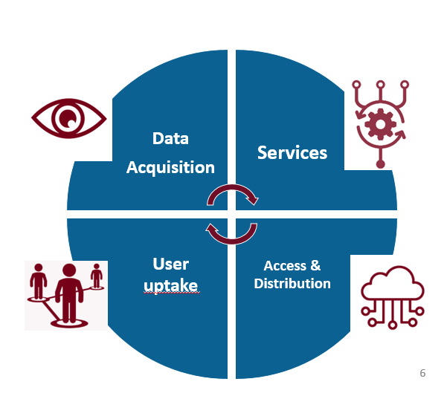
Four dimensions of Copernicus
4 families of satellite missions:
Optical
SAR/microwave
Altimetry
Spectroscopic/atmosphere
+ in-situ data
Two main types of services:
Environment
Emergency & security
Access & distribution:
Sentinels hubs
5 DIAS* platforms
15 TB distributed daily
Notes:
Copernicus was born as a tool for environment monitoring and as the EU’s contribution to global environment and climate change efforts (including international commitments such as COP21)

Slide 4





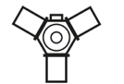

The Sentinels and their main uses
SENTINEL-1
SENTINEL-2
SENTINEL-3
SENTINEL-4
SENTINEL-5
SENTINEL-5P
SENTINEL-6
All-weather, day and night observations to support services for sea-ice monitoring, marine environment surveillance, ship detection, land-surface motion risks, mapping of forest, water and soils, humanitarian aid and crisis management
2 satellites in orbit
Next launch: 2023
Agriculture/vegetation monitoring, soil and water cover, forest management, border and maritime surveillance, emergency management: floods, fires
2 satellites in orbit
Next launch: 2024
Ocean forecast, climate change and operational oceanography: sea surface height, ocean color, oceanic carbon fluxes, monitoring river or lakes level
2 satellites in orbit
Next launch: 2024-25
Continuous monitoring of atmospheric composition focused on air quality over Europe, with main products Ozone (O3), Nitrogen Dioxide (NO2), Sulphur Dioxide (SO2), Formaldehyde (HCHO) and aerosol properties
1st launch: 2023 (onboard MTG-S1)
(Precursor of Sentinel-5) daily global monitoring of the main atmospheric pollutants (CH4 and O2 NO2 CO2 HCHO, SO2) and two major greenhouse gases (CH4 and tropospheric O3)
1st launch: 2023-24
(onboard MetOp-SG A1)
Daily global monitoring for climate, air quality and ozone/surface UV applications, with key parameters O3, NO2, SO2, HCHO, CHOCHO, Aerosols, CH4 and stratospheric Ozone
1 satellite in orbit
Ocean forecast, climate change and real time ocean topography: wave height, ocean surface, wind speed
1 satellite in orbit
Next launch: 2025
Sentinel-1, -2 & -5P: operated by ESA
Sentinel-4, -5 & -6: operated by EUMETSAT (with some support from ESA)
Sentinel-3: jointly operated by ESA & EUMETSAT

Slide 5
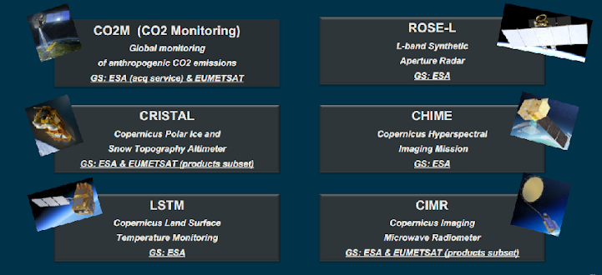
The Expansion missions

Slide 6
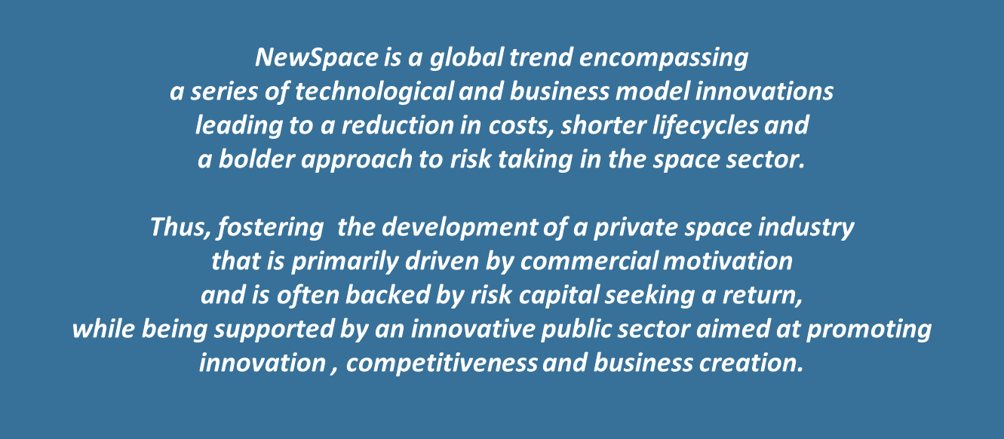
The Sentinels and their main uses
Source: : EU Space Economics in the global context study- SpaceTec Partners for DEFIS, 2021

Slide 7
NewSpace is gradually developing into new commercial fields beyond the traditional space
Traditional Space
New Space
Institutional
Space
Commercial
Space
New Business Services
with Commercialisation Potential
GNSS
LEO/MEO/GEO
Launcher
GeoInformation, Data and Services
Services: IoT, Media and Internet for All
Debris Mitigation
& Removal
Military
Space Activities
MSS/ FSS
COM Satellites
Components
and Subsystems
For SmallSats
SmallSat
Systems
On Orbit
Servicing (OOS)
Space Science
LEO COM Satellites
Evolved PNT
SmallSat/Mega
Constellations
Manufacturing in
Microgravity
and Space
Energy from Space
Traditional EO Satellites
New Launch Systems
Space Resource
Mining
Human Space
Exploration
ISS Servicing
Space Tourism
Space
Habitats
Humans
to Mars
Established
Emerging

Slide 8
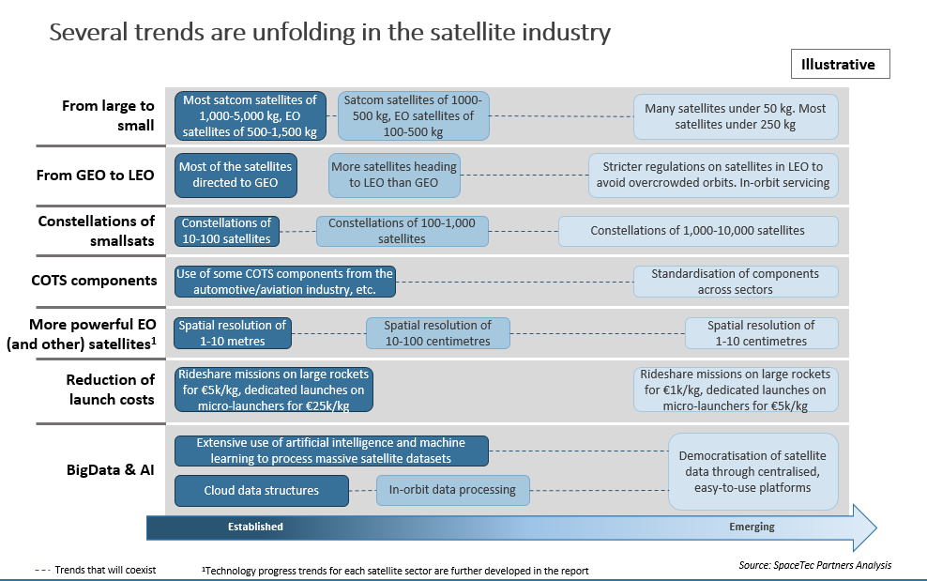
Trends

Slide 9
Interaction with NEW Space
The interaction can have several degrees of integration
Data Buy
Service buy
Co-design
Full procurement
Increasing involvement in architecture design
Increasing investment

Slide 10
Evolution
Copernicus Sentinels - REFERENCE
COPERNICUS
HYBRID
CONSTELLATION
New Space – AGILE
Expansions - GREEN

Slide 11
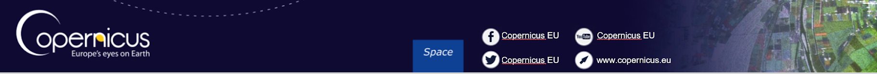
Thank you

