Slide 1
Biodiversity: CEOS Engagement with User Needs
CEOS SIT-37 (virtual)
29-31 March 2022
Gary Geller
NASA Jet Propulsion Laboratory
California Institute of Technology
(c) 2022 California Institute of Technology. Government sponsorship acknowledged.
Notes:
Provide Plenary action status
GEO BON will discuss user needs for biodiversity—continue to work closely with CBD (and other organizations)

Slide 2
Introduction
Biodiversity: The variety of life on Earth
Provides essential benefits and services to society and our planet
Key organizations: UN CBD, IPBES, UNEP-WCMC, GEO BON
CBD: Working to finalize Global Biodiversity Framework (GBF)
Developments at the 2021 CEOS Plenary
Interventions by CSA…AEM, CNES, CSIRO, ESA, ISRO
Action
Notes:
CSA intervened to suggest a meeting with CBD, other agencies followed

Slide 3
Action status
Introductory call with CBD Head of Monitoring, Review and Reporting (30 November)
Contacted agencies about forming a “Discussion Group”
AEM, CSIRO, ESA (POCs provided; thank you)
CNES, ISRO, (CSA) (still welcome biodiversity POCs)
Productive individual consultations with CSIRO & ESA POCs
CBD telecon with CEOS Discussion Group slated for a future date
Insufficient quorum
CBD bandwidth constraint
But: We are developing needs based on existing information
Notes:
NOTE: CEOS CEO provided help and guidance WRT POC identification—much appreciated
CSA is facilitating this activity though still looking for biodiversity POC

Slide 4
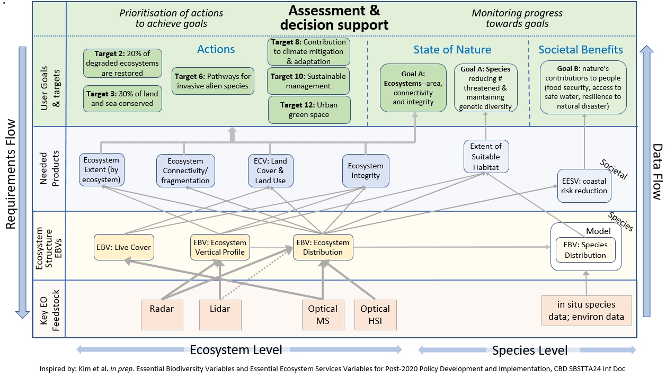
Action status
Notes:
Andy Gonzalez of GEO BON will explain this, but did want to say that GEO BON has been working with CBD and other organizations for a long time and has a pretty good sense of end user needs. This figure is based on existing knowledge and incorporates information from multiple sources of information including CBD.

Slide 5
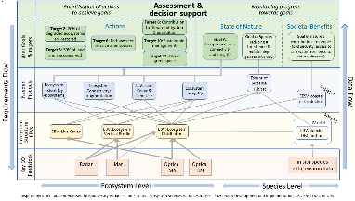
Plans
April: “touch base” call with CBD
Continue to solicit POCs for this CEOS effort
Continue refining EO role for CBD & Parties
Welcome additional agency participation in Discussion Group
2nd co-lead for the CEOS Biodiversity Activity is needed
Notes:
What can be accomplished depends on level of support available.
Sustaining this activity needs continued, and enhanced, CEOS agency involvement as well as collective recognition by CEOS

Slide 6
GEO BON and the UN CBD Global Biodiversity Framework
CEOS SIT-37 (virtual)
29-31 March 2022
Andrew Gonzalez
GEO BON co-chair
McGill University &
Quebec Centre for Biodiversity Science

Slide 7
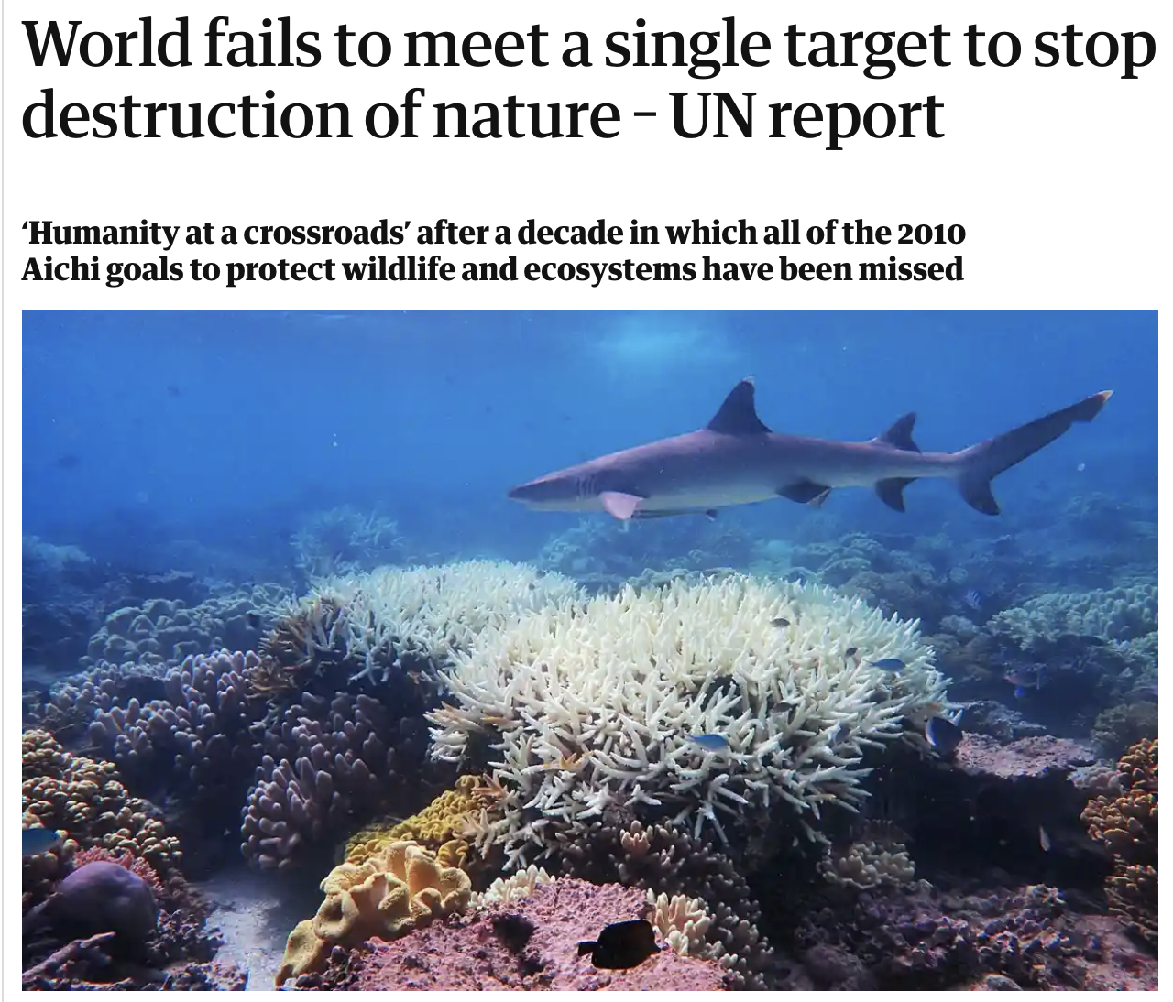
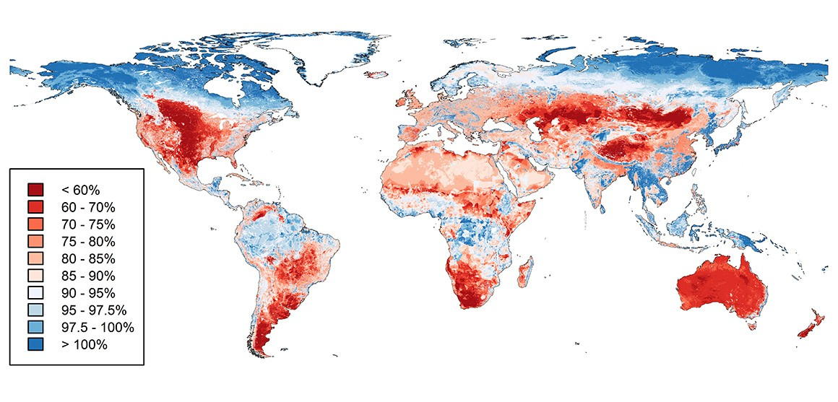
Global biodiversity crisis
Worldwide loss of biodiversity intactness
Across 65% of the terrestrial surface, land use and related pressures have caused biotic intactness to decline
Newbold et al. 2016 Nature

Slide 8
Biodiversity loss is a systemic risk
“more than half of global GDP (US$44-trillion) depends on biodiversity and healthy ecosystems and is therefore exposed to biodiversity loss.”
The Future of Nature and Business (World Economic Forum, 2020)

Slide 9
GEO Biodiversity Observation Network - Mission
Since 2016
A global network: 2164 members from 130 countries & 1344 institutions
Flagship
Transforming the acquisition, coordination and delivery of biodiversity observations and related services to users including decision makers and the scientific community
geobon.org

Slide 10
GEO BON & CBD
GEO BON has been working with the CBD for well over a decade
In the context of CBD’s new Global Biodiversity Framework GEO BON:
Develops and proposes indicators
Supports Parties to track and guide progress to national targets by providing:
Guidance so that Parties can easily identify appropriate indicators
Access to user-friendly indicator methodologies
Guidance for the sustained production, delivery and use of biodiversity data via Biodiversity Observation Networks (BONs)

Slide 11
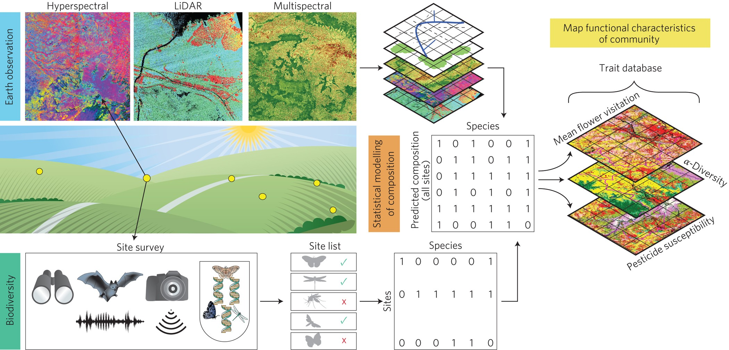
Revolution in our capacity to detect biodiversity
Bush et al. (2017) Nature Ecology & Evolution

Slide 12
Essential Biodiversity Variables
EBV Class
Set of variables capturing the major dimensions
of biodiversity and how it is changing
Genetic Composition
EO:
Important data source
Species Populations
Species Traits
Community Composition
EBVs are:
Biologically and policy relevant
Generalizable across realms
Scalable
EO:
Core data source
Ecosystem Structure
Ecosystem Functions
Notes:
There are six classes of EBVs each of which has several variables in it (not shown). Space-based EO is an important input for all of them (even Genetics, which is emerging) but is the key input for some of them. For example Ecosystem Extent, within the Ecosystem Structure class, is mostly a space-based EO-derived variable.
Ecosystem Structure class
Ecosystem Extent
Ecosystem Vertical Profile
Live cover fraction
Ecosystem Function class
Primary productivity
Ecosystem phenology
Ecosystem disturbance

Slide 13
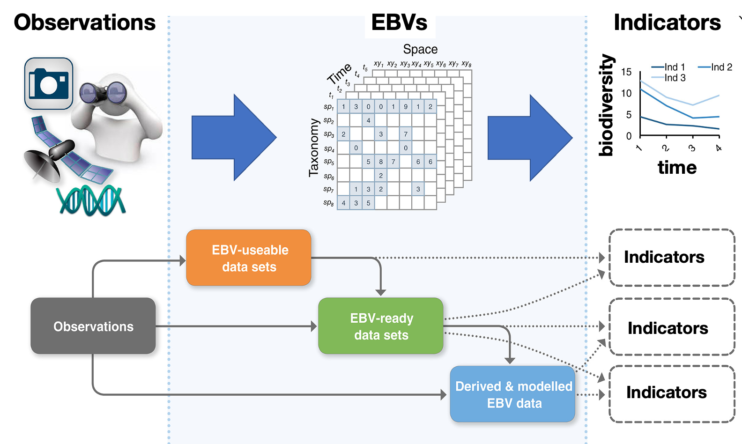
EBV to indicator workflow
Users
National Governments

Slide 14
CBD needs
Prioritisation of actions to achieve goals
Assessment &
decision support
Monitoring progress towards goals
Actions
Target 8: Contribution to climate mitigation & adaptation
State of Nature
Societal Benefits
Target 2: 20% of degraded ecosystems are restored
Target 6: Pathways for invasive alien species
Target 10: Sustainable management
Goal A: Ecosystems--area, connectivity
and integrity
Goal A: Species reducing # threatened & maintaining genetic diversity
Goal B: nature’s contributions to people (food security, access to safe water, resilience to natural disaster)
GBF Goals
& Targets
Target 3: 30% of land and sea conserved
Target 12: Urban green space
Extent of Suitable Habitat
Needed Products
Ecosystem Extent (by ecosystem)
Ecosystem Connectivity/ fragmentation
ECV: Land Cover & Land Use
Ecosystem Integrity
Societal
EESV: coastal risk reduction
Ecosystem Level
Species Level
Inspired by: Kim et al. In prep. Essential Biodiversity Variables and Essential Ecosystem Services Variables for Post-2020 Policy Development and Implementation, CBD SBSTTA24 Inf Doc
Notes:
The CBD GBF sets out specific top-level Goals as well as Targets.
These are addressed with a variety of products, many of which are indicators.
Specific indicators are not all shown and are still being negotiated.

Slide 15
CBD needs
Prioritisation of actions to achieve goals
Assessment &
decision support
Monitoring progress towards goals
Actions
Target 8: Contribution to climate mitigation & adaptation
State of Nature
Societal Benefits
Target 2: 20% of degraded ecosystems are restored
Target 6: Pathways for invasive alien species
Target 10: Sustainable management
Goal A: Ecosystems--area, connectivity
and integrity
Goal A: Species reducing # threatened & maintaining genetic diversity
Goal B: nature’s contributions to people (food security, access to safe water, resilience to natural disaster)
User Goals
& targets
Target 3: 30% of land and sea conserved
Target 12: Urban green space
Requirements Flow
Data Flow
Extent of Suitable Habitat
Needed Products
Ecosystem Extent (by ecosystem)
Ecosystem Connectivity/ fragmentation
ECV: Land Cover & Land Use
Ecosystem Integrity
Societal
EESV: coastal risk reduction
Species
l
Ecosystem Structure EBVs
Model
EBV: Live Cover
EBV: Ecosystem Vertical Profile
EBV: Ecosystem Distribution
EBV: Species Distribution
Ecosystem Level
Species Level
Inspired by: Kim et al. In prep. Essential Biodiversity Variables and Essential Ecosystem Services Variables for Post-2020 Policy Development and Implementation, CBD SBSTTA24 Inf Doc
Notes:
EBVs support the products, Goals, and Targets.
Not all connections are shown.

Slide 16
CBD’s new Global Biodiversity Framework
Prioritisation of actions to achieve goals
Assessment &
decision support
Monitoring progress towards goals
Actions
Target 8: Contribution to climate mitigation & adaptation
State of Nature
Societal Benefits
Target 2: 20% of degraded ecosystems are restored
Target 6: Pathways for invasive alien species
Target 10: Sustainable management
Goal A: Ecosystems--area, connectivity
and integrity
Goal A: Species reducing # threatened & maintaining genetic diversity
Goal B: nature’s contributions to people (food security, access to safe water, resilience to natural disaster)
User Goals
& targets
Target 3: 30% of land and sea conserved
Target 12: Urban green space
Requirements Flow
Data Flow
Extent of Suitable Habitat
Needed Products
Ecosystem Extent (by ecosystem)
Ecosystem Connectivity/ fragmentation
ECV: Land Cover & Land Use
Ecosystem Integrity
Societal
EESV: coastal risk reduction
Species
l
Ecosystem Structure EBVs
Model
EBV: Live Cover
EBV: Ecosystem Vertical Profile
EBV: Ecosystem Distribution
EBV: Species Distribution
Ecosystem Level
Species Level
Inspired by: Kim et al. In prep. Essential Biodiversity Variables and Essential Ecosystem Services Variables for Post-2020 Policy Development and Implementation, CBD SBSTTA24 Inf Doc
Notes:
Ecosystem Distribution is ubiquitous—needed everywhere (typically as Land Cover).

Slide 17
EO role in addressing CBD Needs
Prioritisation of actions to achieve goals
Assessment &
decision support
Monitoring progress towards goals
Actions
Target 8: Contribution to climate mitigation & adaptation
State of Nature
Societal Benefits
Target 2: 20% of degraded ecosystems are restored
Target 6: Pathways for invasive alien species
Target 10: Sustainable management
Goal A: Ecosystems--area, connectivity
and integrity
Goal A: Species reducing # threatened & maintaining genetic diversity
Goal B: nature’s contributions to people (food security, access to safe water, resilience to natural disaster)
User Goals
& targets
Target 3: 30% of land and sea conserved
Target 12: Urban green space
Extent of Suitable Habitat
Needed Products
Ecosystem Extent (by ecosystem)
Ecosystem Connectivity/ fragmentation
ECV: Land Cover & Land Use
Ecosystem Integrity
Societal
Data Flow
Requirements Flow
EESV: coastal risk reduction
Species
l
Ecosystem Structure EBVs
Model
EBV: Live Cover
EBV: Ecosystem Vertical Profile
EBV: Ecosystem Distribution
EBV: Species Distribution
Key EO Feedstock
Radar
Lidar
Optical MS
Optical HSI
in situ species data; environ data
Ecosystem Level
Species Level
Inspired by: Kim et al. In prep. Essential Biodiversity Variables and Essential Ecosystem Services Variables for Post-2020 Policy Development and Implementation, CBD SBSTTA24 Inf Doc
Notes:
Note that Ecosystem Distribution benefits from all types of EO sensors—not just optical
Key point 1: EO is essential for many key products needed by the CBD (e.g., Ecosystem Distribution, Species Distribution)
Key point 2:
EO must be transformed into higher-level products to address CBD needs
But many needed higher level products are not routinely produced by space agencies (eg: Ecosystem Integrity)

Slide 18
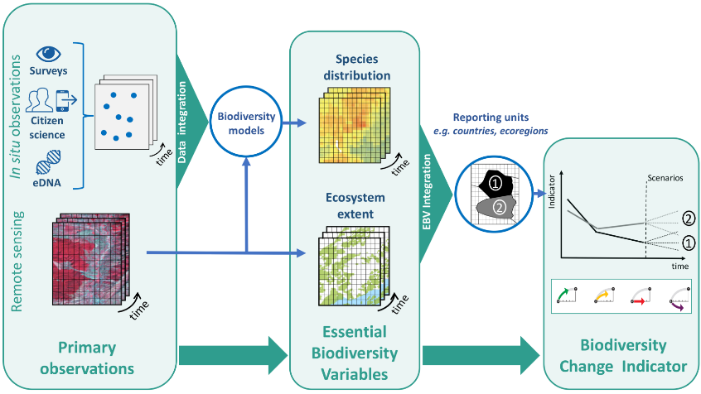
Linking observations, EBVs & indicators
Users
National Governments
Navarro et al. 2017 COES
Notes:
Role: Intermediary between primary observations and key products such as indicators
This is the horizontal version of the blue spherical figure…

Slide 19
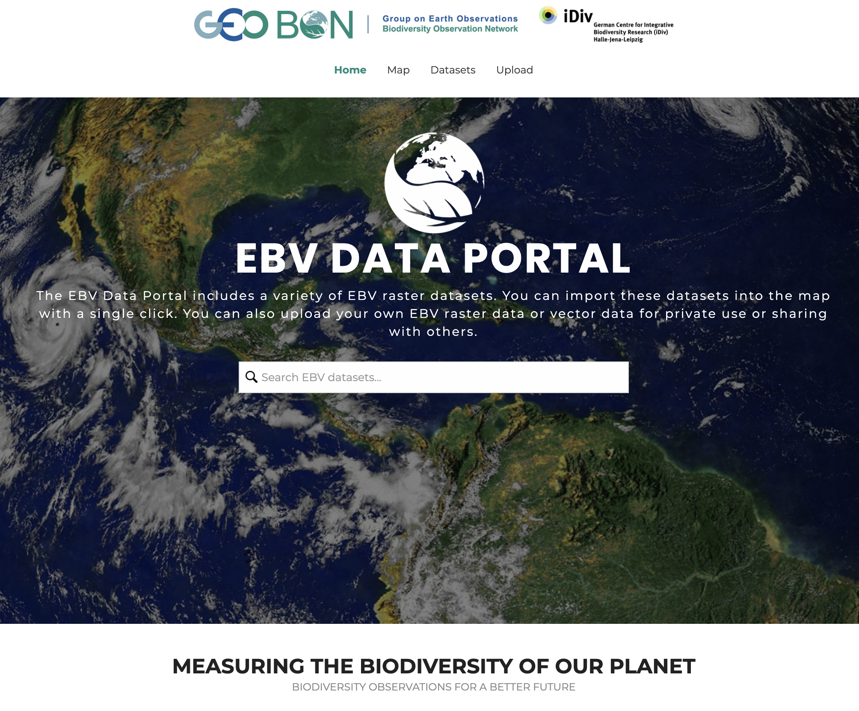
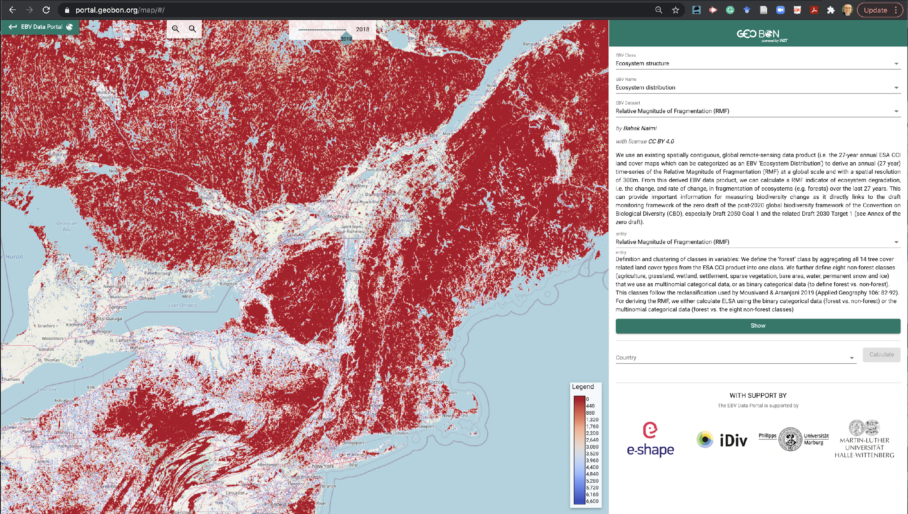
EBV dashboard
portal.geobon.org

Slide 20
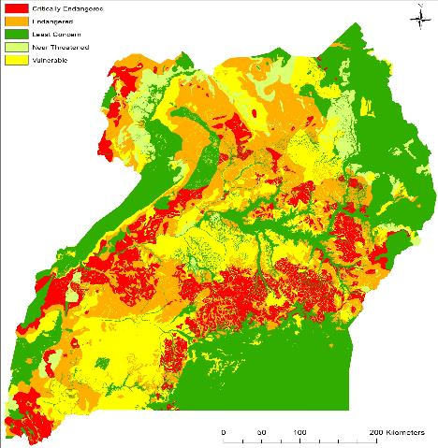
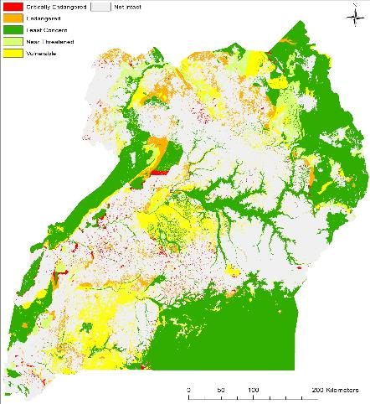
Example: Ecosystem assessment in Uganda
Original extent of ecosystems
Remaining extent of ecosystems
Monitoring & Assessing
Addresses:
CBD Goal A &
Targets 2, 3, others
Supports response by national governments
Uganda Spatial Biodiversity Assessment (Connect Africa: Stephen Holness, Nelson Mandela University)
Notes:
Example output for Uganda to assess what ecosystems in the country remain.
This is being used to inform Uganda’s National Development Plan and prioritize conservation efforts in the country.
Next slide shows how this product feeds into decision support
Slide content courtesy of Mike Gill, NatureServe.

Slide 21
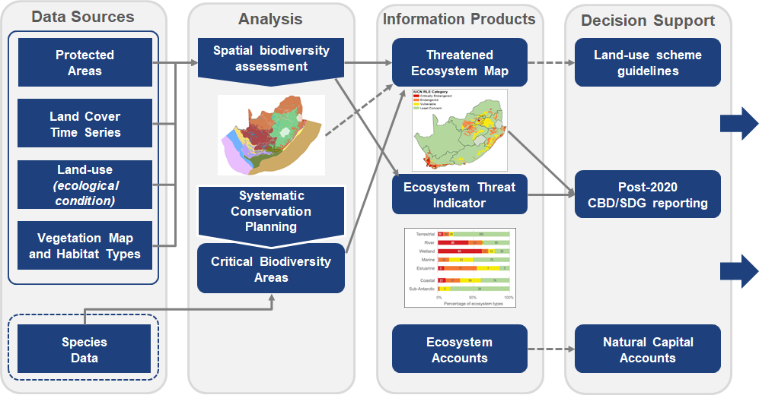
Feeding decision support
Transforming Data to Conservation Intelligence
Post-2020 Target Tracking
Goal A
Area, connectivity & integrity of natural ecosystems
Threatened species
Target 2
Well-connected and effective protected area system
Other area-based conservation measures
*Adapted from Matthew Child, South African National Biodiversity Institute, in collaboration with NatureServe
Notes:
Example: South Africa’s National Biodiversity Institute Spatial Biodiversity Assessments.
Key points
EO data are essential
But its their derived products that are actually needed
This South African example shows the overall flow that is needed
Take a very basic set of core ingredients like protected area coverage, landcover, and habitat condition
Produce policy-relevant outputs that support protected area planning and ecosystem restoration and conservation.
Slide content courtesy of Mike Gill, NatureServe

Slide 22
Summary: GEO BON and CBD
EO data is essential input to many key biodiversity products
Needed by CBD Parties to meet their obligations
Also needed by other key organizations
Ecosystem Distribution is particularly important
Usually manifested as land cover (human drivers)
Nearly ubiquitous for all biodiversity products
Biggest gap for EO utilization
Lack of derived, higher-level products (e.g. EBV layers)
Tools can help, e.g., to generate products to estimate and forecast variables and indicators
But product development requires technical skills often missing
Notes:
Main gap in space-based observations is global repeat lidar.
But biggest gap overall is in lack of higher level products.

Slide 23
Wrap up and discussion
(c) 2022 California Institute of Technology. Government sponsorship acknowledged.

Slide 24
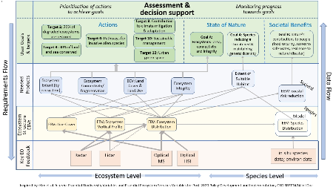
Wrap up
EO is essential for CBD and GBF
Gaps exist
Global repeat lidar
Higher level products
CEOS agencies are invited to
Identify POCs to join Discussion Group
Put forth a co-lead for the Biodiversity Activity
Join discussion at the Technical Workshop
Discussion Group will continue to explore where EO can help address biodiversity user needs
Notes:
Discussion group will refine the figure with more detail and prioritization

Slide 25
Backup
(c) 2022 California Institute of Technology. Government sponsorship acknowledged.

Slide 26
Proposed Path to the 2022 CEOS Plenary
2022
IF CEOS Agencies
Assemble the discussion group
VCs and WGs join the biodiversity cross-cutting discussion
Consider the results and decide on resourcing and next steps
Then Discussion Group will:
Perform user needs analysis for space information in support of biodiversity in collaboration with UN Convention on Biological Diversity (CBD) and other partners
Identify activities to propose for consideration by the CEOS Plenary
Develop way forward to implement resourced activities
Propose a governance for CEOS biodiversity activities
March
SIT
September
SIT TW
November
Plenary

