Slide 1
SIT-37 WG DISASTERS
Hélène de Boissezon - CNES
WG Disasters co-lead
Agenda Item 3.2
SIT-37 Virtual Meeting, 29-31 March 2022

Slide 2
Content
“The path to sustainability - Use cases for the operational uptake of satellite EO at the local scale”
WGD#17 held on 15-17 March
Recap of current activities
Sustainability planning
New initiatives
Recovery Observatory (RO) Demonstrator
Progress
Recognition of RO Demo activity in the UN General Assembly declaration on Space 2030 Agenda
Wildfire Pilot
Progress
Plans

Slide 3
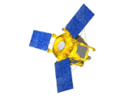
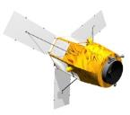
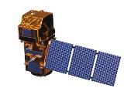
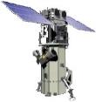
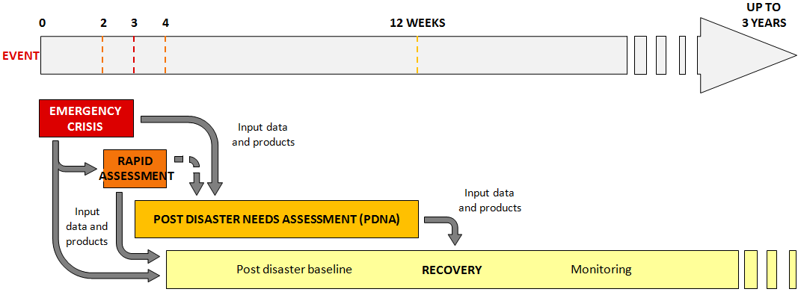
Recovery Observatory (RO) Demonstrator
Satellites have become critical for Response to disasters…
… but what about Recovery?
National Recovery Plan
Planning
‹#›
“Recovery Observatory” :
Process allowing operational use of EO for Rapid Assessments, PDNA, Recovery planning & Recovery M&E

Slide 4
Recovery Observatory (RO) Demonstrator

Slide 5
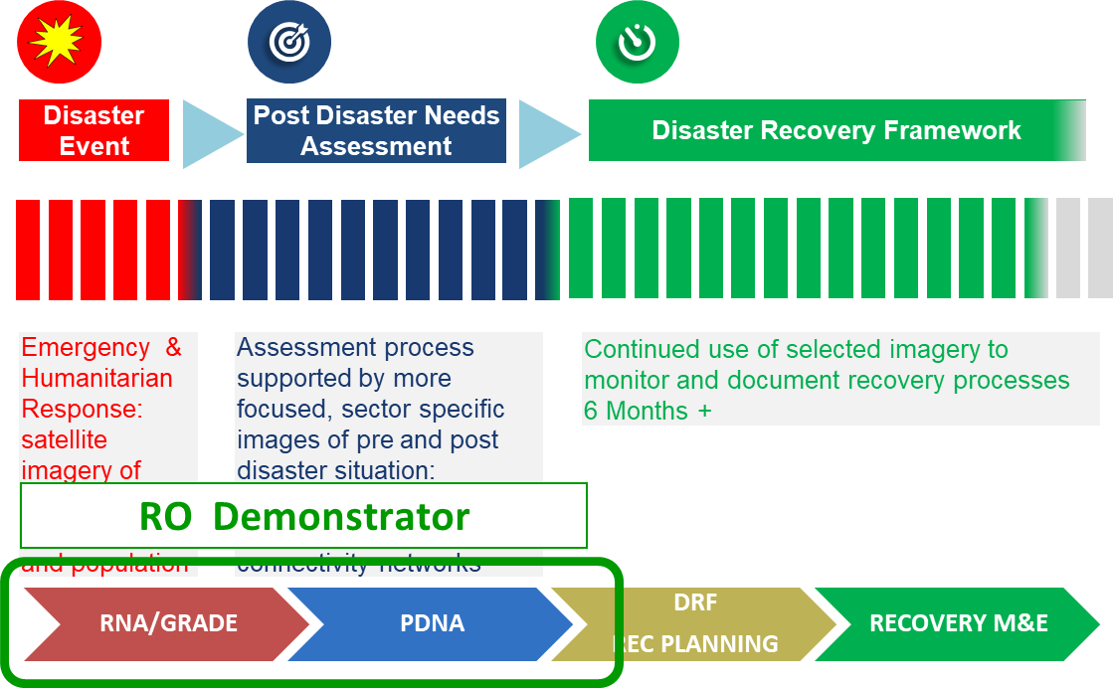
Recovery Observatory (RO) Demonstrator

Slide 6
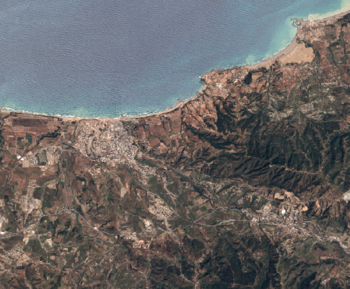
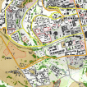
Recovery Observatory (RO) Demonstrator
Collection of satellite images and maps at several scales
during 6 months after a major disaster
Overview area
Mid-scale products from Sentinel data at 10m resolution
Change in landcover, open spaces
Vegetation loss or re-growth
Agriculture
Update frequency:
every 10 days to 6 months
Iterative links with PDNA partners and government: decision makers and technical awareness, capacity building needs assessment, ….
Overview
AOI
Urban
zoom 1
Hot Spot
zoom 2
Hot spot zooms
Large scale products from very high resolution data
Urban areas, housing, ….
Transport infrastructure, coastal areas, …
IDP camps, …
Specific areas of interest
Update frequency: every 1 to 2 months
Ancillary data remain indispensable: terrain validation data, aerial and drone data, statistics, cartography, ….

Slide 7
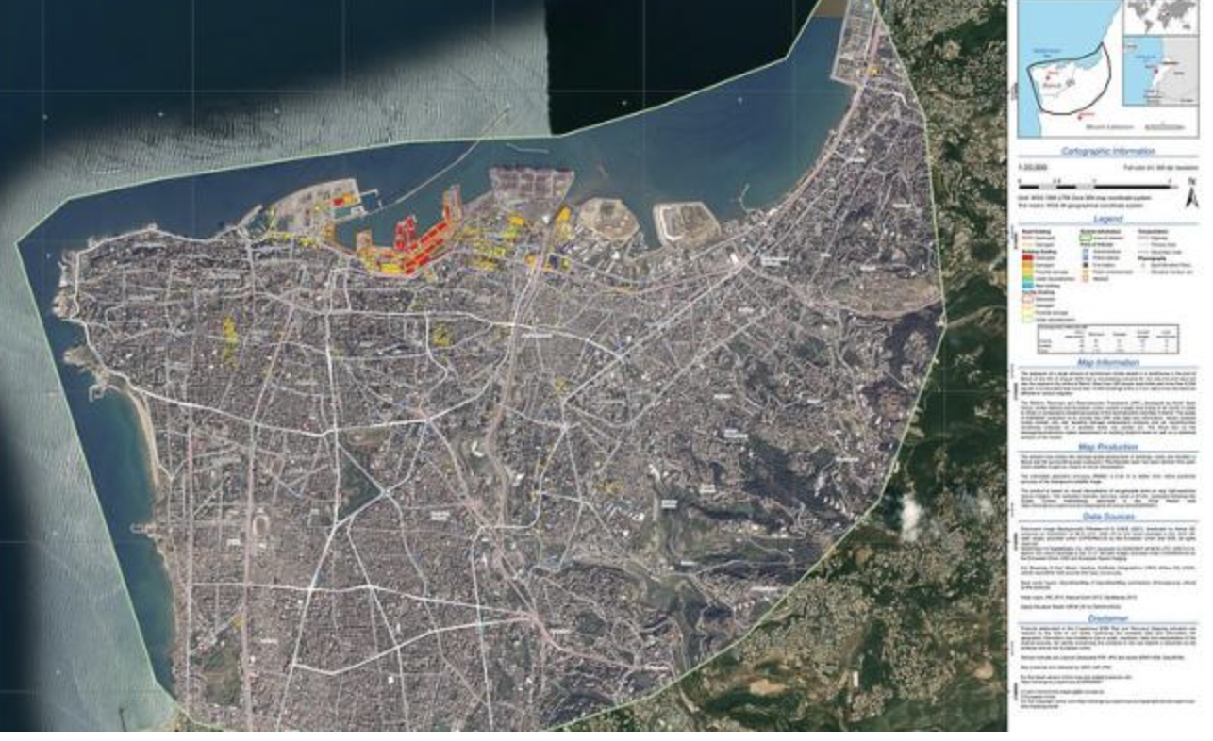
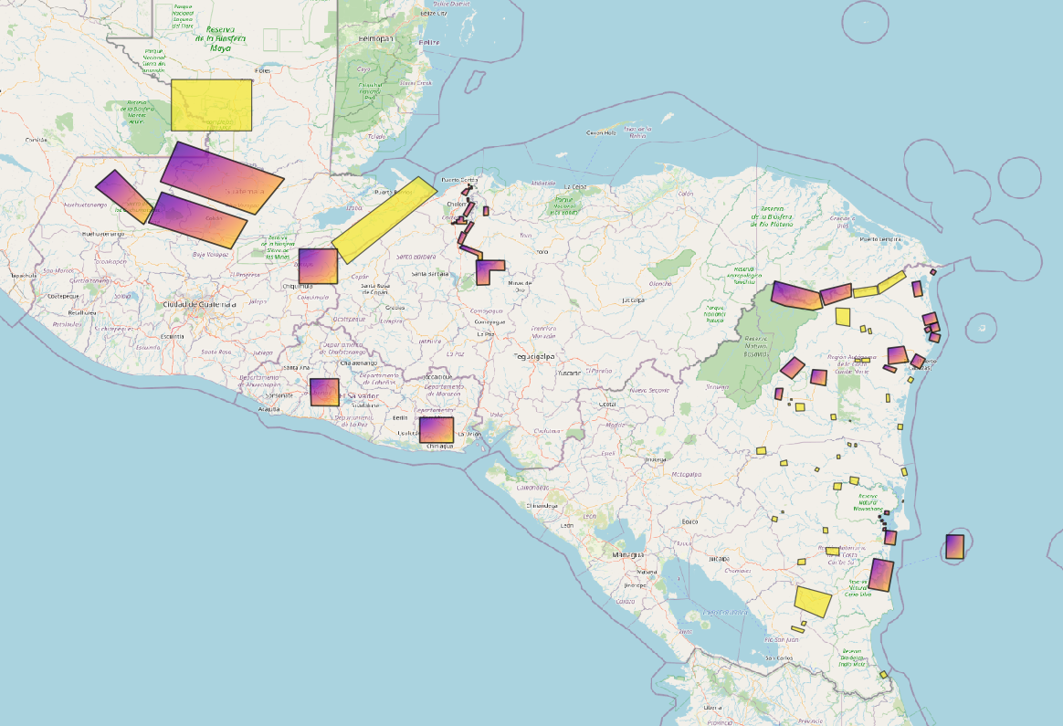
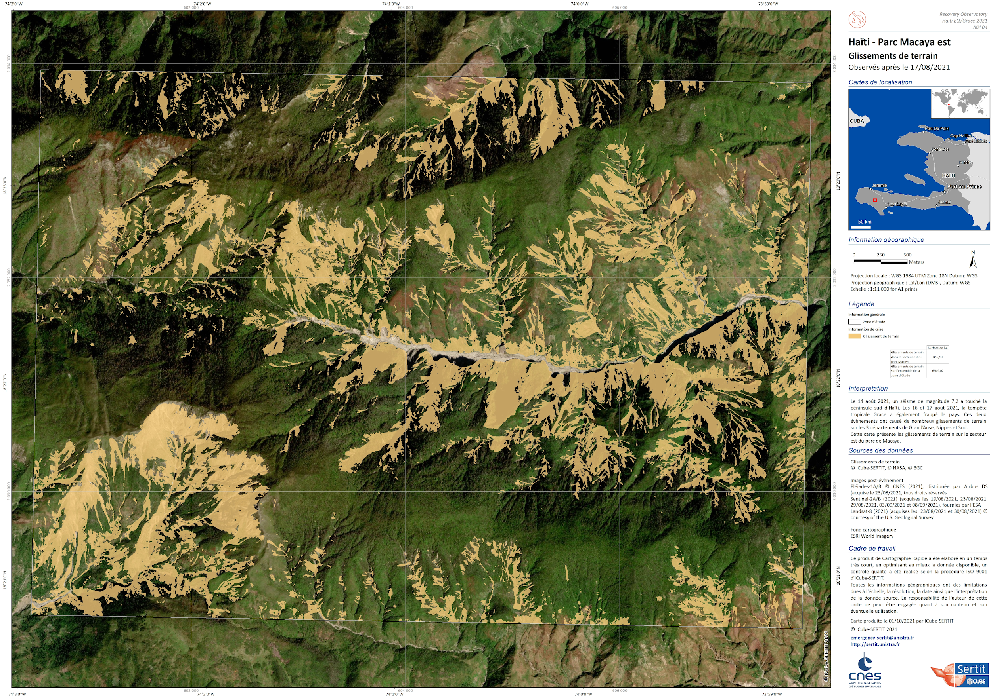
RO Demonstrator activity since SIT#35
Work with World Bank/GFDRR, EU and UNDP, to include satellite-derived information products in PDNAs and other rapid assessments (GRADE).
In kind contributions from stakeholders and CEOS partners (data & value-adding resources)
RO demonstrators to extend Charter observations to complete damage assessment and support Recovery framework
1st RO demonstrator test late 2020; 3 to 5 demonstrations over 2021-2023 (~ 3 years)
Report to CEOS Plenary (2023) and to other partners and make recommendations for sustainable on-going use of satellites
Beirut blaze, August 2020
Eta/Iota hurricanes, March 2021
Haiti earthquake, August 2021

Slide 8
Recognition of RO Demo activity in the UN General Assembly
RO Sustainability : our main objective now
Recognition from UN General Assembly in Space 2030 Agenda (Nov 2021) provides context for planning sustainable RO activities.
Inside RO Demo Team, specific sub-group in charge of sustainability reflection and propositions, that will :
Document :
requirements of a ‘basic RO’ : what do you need to do and what do you get for 50k (for ex.)
related benefits and current limitations
Explore with PDNA partners sustainable financing options :
Approach a range of potential donors including trust funds
Explore not for profits actors active in recovery
Explore linkages with existing space sector initiatives (e.g. Copernicus EMS, ESA’s GDA, UN-Spider, …) for sustainable organisation and processes
Report back by December 2022
Synergies with GEO :
Participation to GEO DRR WG (Disaster Risk Reduction)
RO documented in the EO Risk Tool Kit

Slide 9
Content
“The path to sustainability - Use cases for the operational uptake of satellite EO at the local scale”
WGD#17 held on 15-17 March
Recap of current activities
Sustainability planning “
New initiatives
Recovery Observatory (RO) Demonstrator
Progress
Recognition of RO Demo activity in the UN General Assembly declaration on Space 2030 Agenda
Wildfire Pilot
Objectives
Progress

Slide 10
Plans for wildfire pilot - WildFire Pilot Scope
Aim: to provide a comprehensive gap analysis for active-fire earth observation
Four specific Objectives:
Conduct a detailed inventory and gap analysis of existing and proposed EO systems suitable for global active-fire monitoring;
Considering climate change driven fire regime changes and projected mission life spans
Conduct a detailed analysis of global stakeholders and end-users of near-real-time active-fire EO data;
Define targeted user requirements for active-fire remote sensing systems for the disaster mitigation applications;
Propose a way forward in coordinating global wildfire monitoring activities.

Slide 11
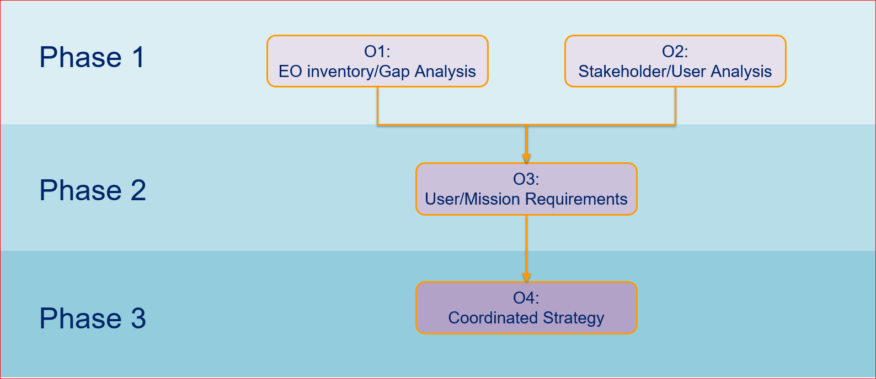
Plans for wildfire pilot - Implementation Overview
2022
2021-2022
next
next

Slide 12
Plans for wildfire pilot – Phase 1 / objective 1
Objective 1: Conduct a detailed inventory and gap analysis of existing and proposed EO systems suitable for global active-fire monitoring
Objective 1-a: “Assemble datasets to form a spatial and temporal global fire regime dataset with climate change projections over the 2020-50 period”
Objective 1-b: “Identify existing and future active fire EO capabilities and coverage areas”

Slide 13
Plans for wildfire pilot – Phase 1 / objective 2
Objective 2: Conduct a detailed analysis of global stakeholders and end-users of near-real-time active-fire EO data
Fire management stakeholder mapping has been undertaken and is ongoing.
Method – the consultation will use focus groups and key informants to access in-depth information on the attitudes and behaviors of informants.
Scheduling for consultations in preparation.

Slide 14
Thank you for your attention

